Slide 1

RESULTS National Webinar May 2, 2026

Slide 2
Our Values
At RESULTS we pledge to create space for all voices, including those of us who are currently experiencing poverty. We will address oppressive behavior in our interactions, families, communities, work, and world. Our strength is rooted in our diversity of experiences, not in our assumptions.
With unearned privilege comes the responsibility to act so the burden to educate and change doesn’t fall solely on those experiencing oppression. When we miss the mark on our values, we will acknowledge our mistake, seek forgiveness, learn, and work together as a community to pursue equity.
Read our full anti-oppression values statement here at results.org/values.
Notes:
Updated AO slide (2/22)

Slide 3
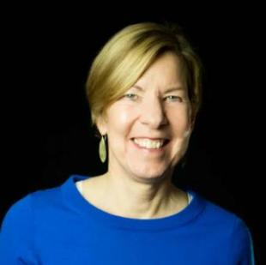
Welcome!
Joanne Carter Executive Director

Slide 4
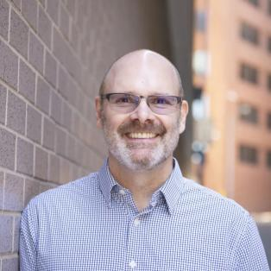
Jos Linn
Director
Grassroots Impact
Jlinn@results.org

Slide 5
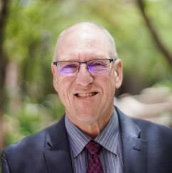
Guest Speaker
Guest speaker: Jay Evensen
Opinion Editor, Deseret News (UT)
Cameron Duncan Media Award Recipient

Slide 6
Global Poverty Campaigns Update

Slide 7
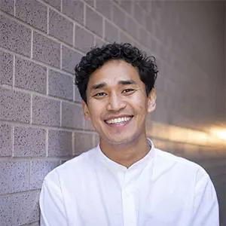
Tenzin Kunor
Senior Associate, Global Policy tkunor@results.org

Slide 8
FY27 Senate Dear Colleague Letters
Global Fund:
8 signers
4 Republicans (+4)
Tuberculosis:
35 signers
Tied record high
Maternal & Child Health, Gavi, Nutrition:
33 signers
+5 signers from FY26
Basic Education, GPE:
31 signers
+1 signer from FY26

Slide 9
FY27 House National Security, Department of State, and Related Programs (NSRP) Bill
The bill provides:
$8.88 billion for global health (~$532 million decrease) and humanitarian assistance reduced (~$400 million)
However, our funding for our priority issue areas were protected and maintained
Important wins:
Prevented deeper cuts
Strengthened accountability and reporting
E.g. required tracking of TB and child health outcomes

Slide 10
What are the key actions?
Push Appropriations Forward. Still more work to do.
Urge Senators to engage Appropriations Committee with a focus on:
Strong funding levels
Ensuring funds are delivered and implemented
Media Action. Use your voice and write a Letter to the Editor.
Choose an issue:
Maternal and Child Health, TB, Nutrition, Education, Global Poverty
Share:
Why it matters to you
Why your Member of Congress should lead

Slide 11
U.S. Poverty Campaigns Update

Slide 12
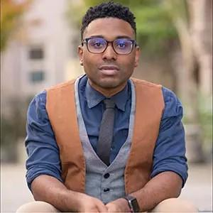
TaShon Thomas
Interim VP, Campaigns and Advocacy tthomas@results.org

Slide 13
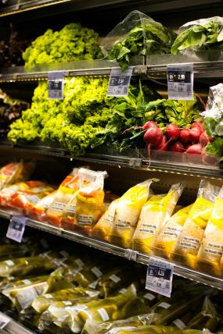
Farm Bill Update
House Passed Farm Bill 224-200
Does NOT address the catastrophic cuts made to SNAP last year
Farm Bill now goes to the Senate
Unclear if Senate will act at all
Much harder for Farm Bill to pass the Senate due to 60-vote threshold
Photo by Eduardo Soares on Unsplash

Slide 14
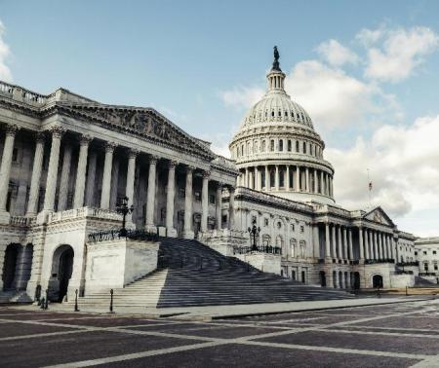
Reconciliation 2.0…..and 3.0?
Budget Resolution has passed both House and Senate - now they can write the bill
Focus is on ICE and CBP funding
Lack of ICE accountability biggest threat in first reconciliation bill
Follow up reconciliation bill or other “anti-fraud” legislation a major threat to poverty programs
Could cut EITC, Medicaid, SNAP or further restrict CTC
Key message: NO MORE CUTS and reverse cuts from last year’s reconciliation bill
Photo by Tim Mossholder on Unsplash

Slide 15
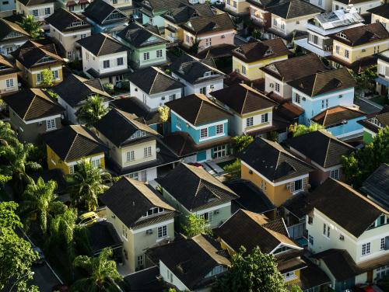
Housing Choice Vouchers
Senate Dear Colleague letter had 42 signers!
Great job! That’s more than last year
Only 25 percent of eligible families receive voucher support
Expecting T-HUD appropriations markup in early June
Photo by Breno Assis on Unsplash

Slide 16

Amplify Your Voice
Write and submit letters about:
Support for Housing Choice Vouchers
No Farm Bill without SNAP cost-share delay
Stronger Start for Working Families Act and/or tax fairness
No cuts to WIC Fruit and Vegetable Program in Appropriations

Slide 17
Grassroots Board Nominations

Slide 18
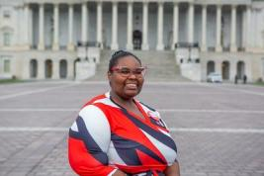
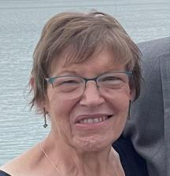
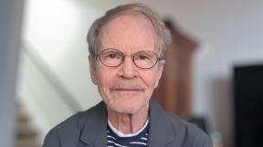
Meet the Candidates
Tiffany Tagbo
RESULTS Oklahoma
Allison Gallaher
RESULTS Ohio
John Hornby
RESULTS Gig Harbor, WA
Notes:
B

Slide 19

Voting is now open!
All active RESULTS volunteers are eligible to vote in this election. If you accidentally vote more than once, your last vote will be counted.
Read the candidates’ written and video statements at https://results.org/blog/results-2026-grassroots-board-elections
Attend the Candidates’ Forum on May 7 at 8:30 pm ET.
https://results.zoom.us/j/94679759298
Then cast your ballot and encourage your RESULTS partners
to raise their voices too!
https://www.surveymonkey.com/r/GRDC2026
Notes:
B

Slide 20
Election timeline
May 7@ 9:30 ET: Candidates forum on Zoom
June 15 @midnight: Online voting closes
June 19-27: REF Board elects the slate nominated by the volunteers
July 1: Successful candidate takes office
More information at https://results.org/blog/results-2026-grassroots-board-elections
Notes:
B

Slide 21
Grassroots Inspiration & Action

Slide 22
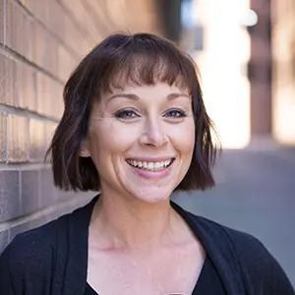
Amanda Beals
Associate Director,
Grassroots Expansion
abeals@results.org

Slide 23


Slide 24
Media Matters!
Your voice will help shape the conversation
Every Action Counts
Written & Submitted?
Let us know! (sleone@results.org)
Published?
Report it here: https://results.org/report-media
24

Slide 25
Amplify Your Media Advocacy
Mobilize More Voices
Build a Bigger Network
Share media actions with friends & family
Strengthen RESULTS Leadership
Coach a new advocate to submit their first LTE
Host an LTE writing party or coffee meet up
New to RESULTS? Take your first action! Reach out for support.
Collaborate with local partners on media
Activate your action networks (formal & informal)
Notes:
Sarah

Slide 26
Simple Steps to Build Power
Step 1: Lead by Example
Step 2: Map Your Network
Step 3: Take One Action
Submit your own letter → If published, share it with others.
Choose one person → Where are you already connected?
Text/email I Meet up I Zoom party I Meet with partner org
26

Slide 27
Tools to Amplify Media Power
RESULTS Mapping Tool
LTE Action Meeting Agenda
Monthly Action Sheet
Action Network Media Tips
LTE Writing Worksheet
New Advocate Mentor Media Tips

Slide 28
Get Inspired, Together
Amplify Every Voice: Power Building Hour
Tuesday, May 12, 1pm ET
RESULTS Power Building Gathering
Thursday, June 4, 8pm ET

Slide 29
Tips for Success
Make it fun & low pressure
Focus on relationships, not numbers
Start close to home

Slide 30
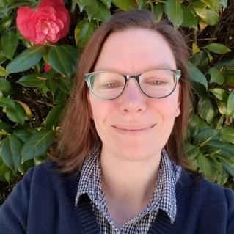
Grassroots Share
Jennie Vano
RESULTS Tacoma

Slide 31

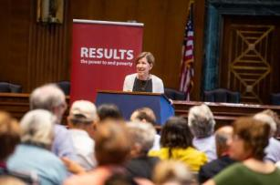
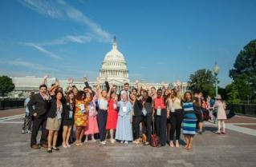
July 12-14, Washington, DC
Register today!
www.results.org/conference

Slide 32
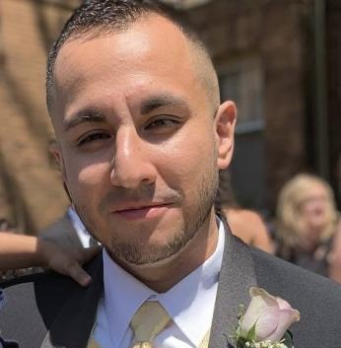
Grassroots Share
Luiggi Francalanci
RESULTS Fellow
Milwaukee, WI

Slide 33
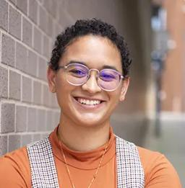
Lakeisha McVey
Senior Manager, Lived Experience Engagement
lmcvey@results.org

Slide 34
National Conference Hill Day
Tuesday, July 14, 2026
Lobby Day Kickoff on Senate side.
We recommend scheduling your Senate meetings in the morning and House meetings in the afternoon.
As you schedule your July 14 lobby meetings, please report them here!
Congressional reception from 4:30-6:00pm.
Full conference agenda is on our website: https://results.org/conference.

Slide 35
Help us help you attend the National Conference!
Active, U.S-based volunteers who need help with registration and/or travel costs are encouraged to apply to our Conference Equity Fund.
https://tinyurl.com/RESULTSEquityFund

Slide 36
Announcements

Slide 37
Thank you for joining us!
Who is joining you in the room today?
Please complete the Zoom poll by indicating the number of people in the room with you today
(including yourself).

Slide 38
Friends & Family Fundraising
Some of your fellow advocates are starting spring Friends & Family fundraisers to support RESULTS' trainings, resources, and campaigns.
If you'd like to learn more about creating your own, please contact Beth Wilson at bethwilson1950@gmail.com.
Or support your fellow volunteers by making a donation to their fundraisers.
https://results.org/donate/fundraise

Slide 39
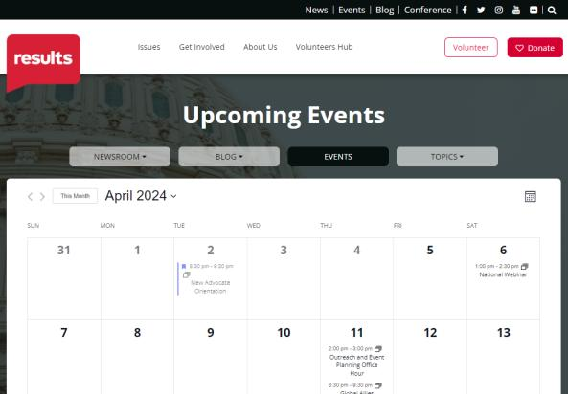
Find RESULTS events
www.results.org/events

Slide 40
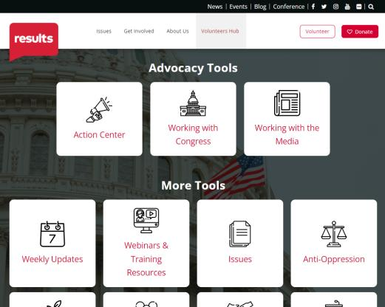
Find webinar slides and recording
www.results.org/volunteers/national-webinars

Slide 41
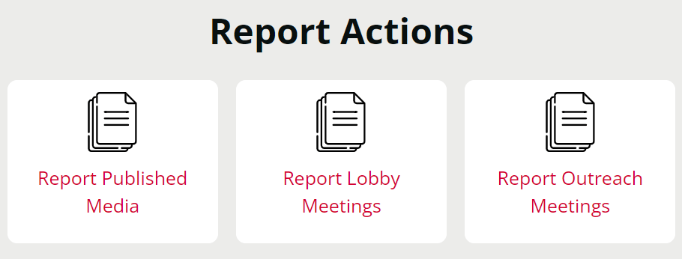
Let us know the amazing things you are doing!
https://results.org/volunteers/reporting-your-advocacy-actions

Slide 42
Join us June 6 for the next National Webinar!
Let's get ready for the 2026 National Conference!!
Registration is always open
for the 2026 National Webinars!
www.tinyurl.com/RESULTS2026

