Slide 1

RESULTS National Webinar April 11, 2026

Slide 2
Our Values
At RESULTS we pledge to create space for all voices, including those of us who are currently experiencing poverty. We will address oppressive behavior in our interactions, families, communities, work, and world. Our strength is rooted in our diversity of experiences, not in our assumptions.
With unearned privilege comes the responsibility to act so the burden to educate and change doesn’t fall solely on those experiencing oppression. When we miss the mark on our values, we will acknowledge our mistake, seek forgiveness, learn, and work together as a community to pursue equity.
Read our full anti-oppression values statement here at results.org/values.
Notes:
Updated AO slide (2/22)

Slide 3
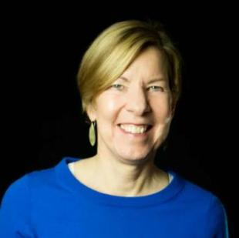
Welcome!
Joanne Carter Executive Director

Slide 4
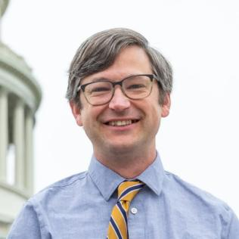
David Plasterer
Senior Associate,
U.S. Poverty Policy
dplasterer@results.org

Slide 5
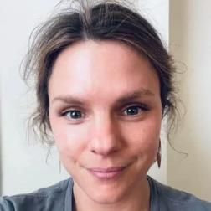
Guest Speaker
Margot Crandall-Hollick
Principal Research Associate Urban Institute and Brookings Institution Tax Policy Center www.taxpolicycenter.org

Slide 6

Child Tax Credit What it is, why it’s important, and how it can better serve low-income families
Margot Crandall-Hollick, Principal Research Associate at the Urban-Brookings Tax Policy Center
RESULTS NATIONAL WEBINAR April 11, 2026

Slide 7
IT’S TAX TIME!! LET’S TALK ABOUT TAX CREDITS
Introduction
Brief Overview of Why We Are Talking About Tax Benefits and the Child Tax Credit
How the Child Tax Credit (CTC) Works
To Better Serve Low-Income Families Focus on the Phase In → Stronger Start for Working Families Act
Discussion

Slide 8
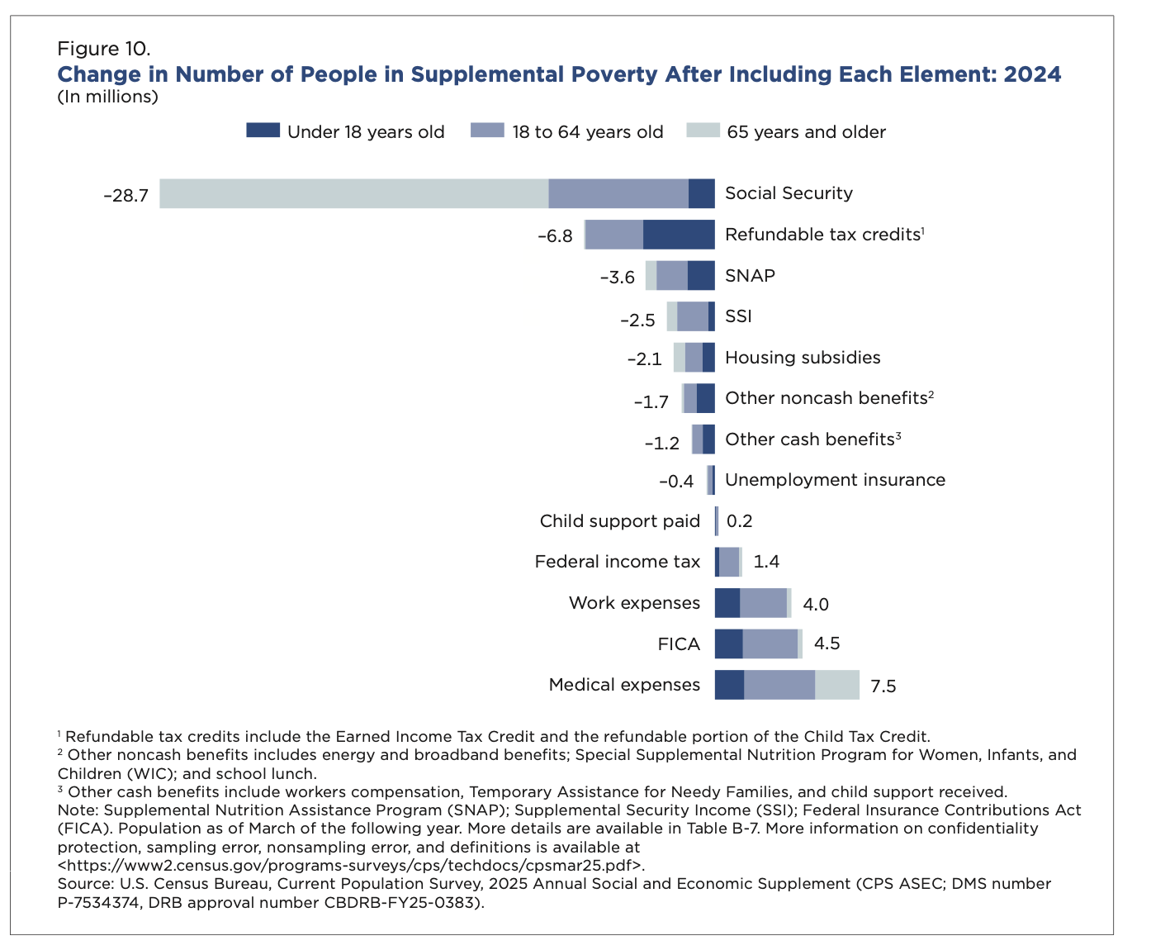
BRIEF OVERVIEW The Earned Income Tax Credit (EITC) and the Refundable Portion of the Child Tax Credit (CTC) reduce child poverty more than any other federal program
→
Source: Census Bureau 2025 https://www.census.gov/library/publications/2025/demo/p60-287.html

Slide 9
HOW CTC WORKS

Slide 10
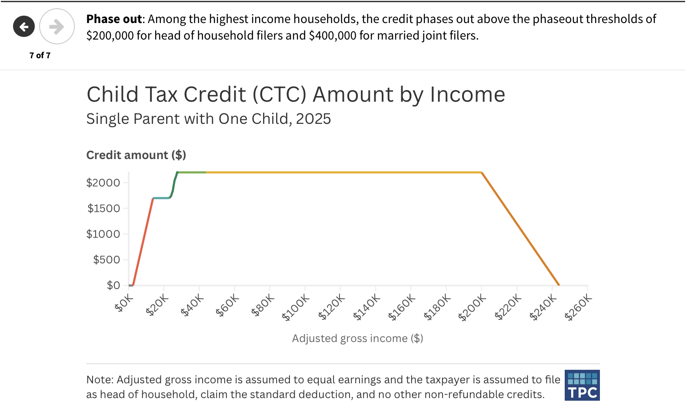

Slide 11
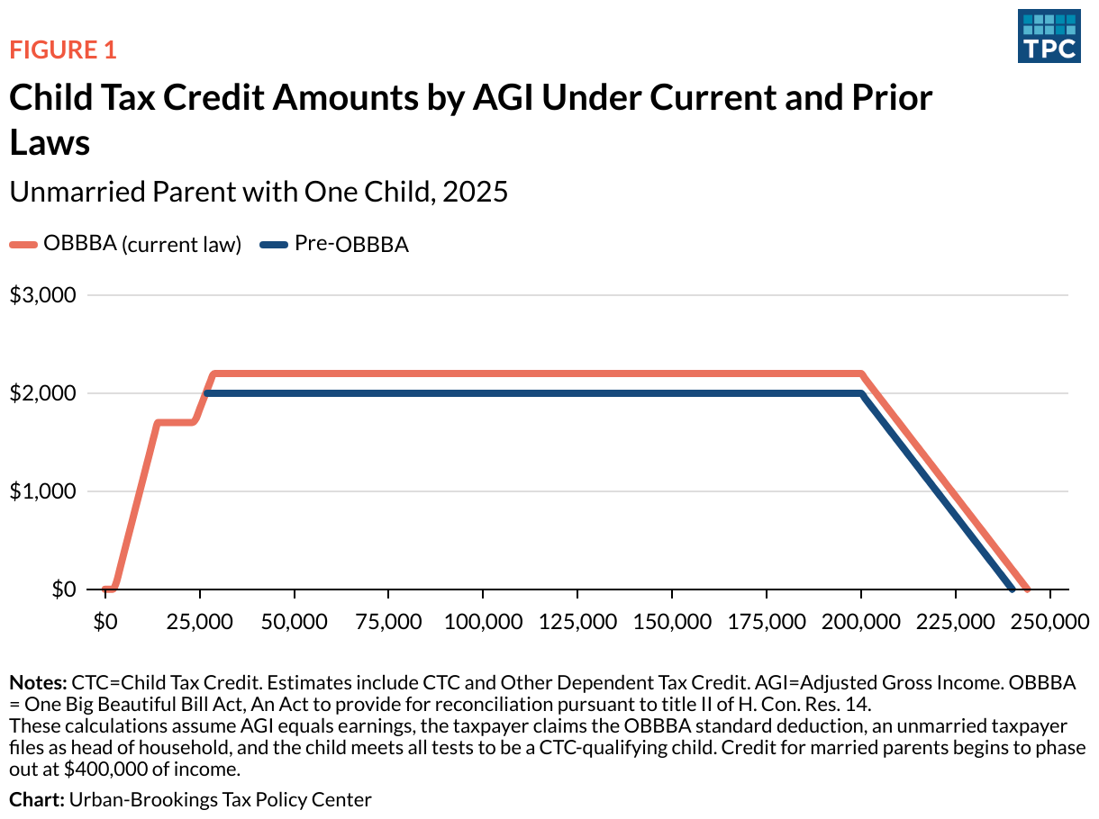
HOW THE CTC WORKS How did OBBBA change the CTC?
Need more income to access larger (nonrefundable) credit of $2,200
Source: Maag 2025 https://taxpolicycenter.org/taxvox/child-tax-credit-changes-boost-and-stabilize-benefits-some-still-exclude-lowest-incomel

Slide 12
DISCUSSION

Slide 13
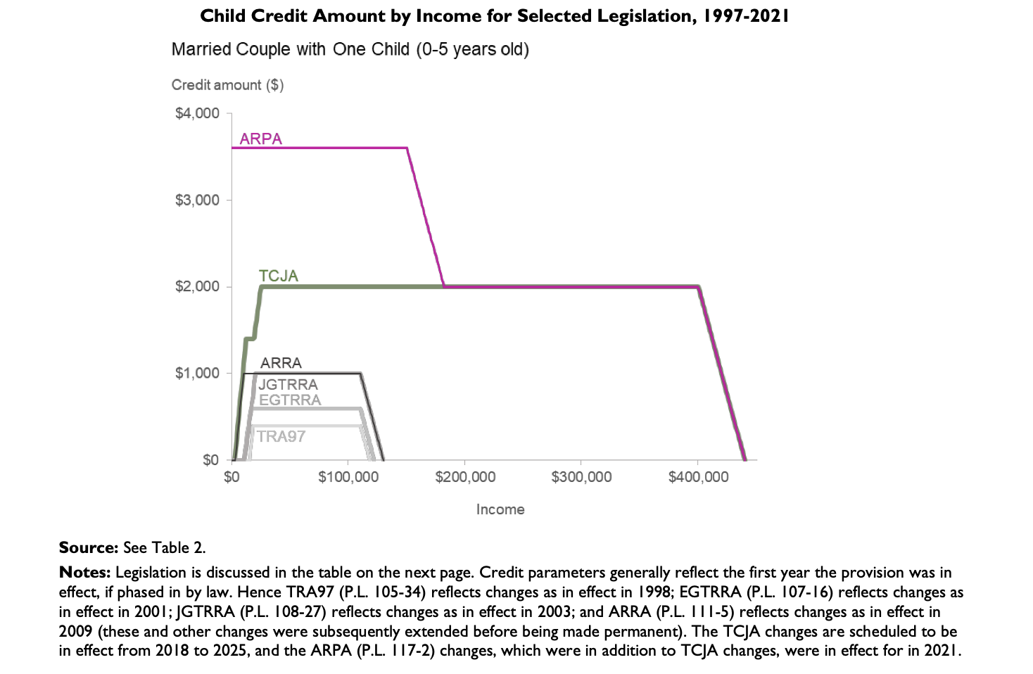
CTC has expanded over time 1997-2024 (excludes OBBBA)
Source: CRS Report R45124 https://www.congress.gov/crs_external_products/R/PDF/R45124/R45124.9.pdf

Slide 14
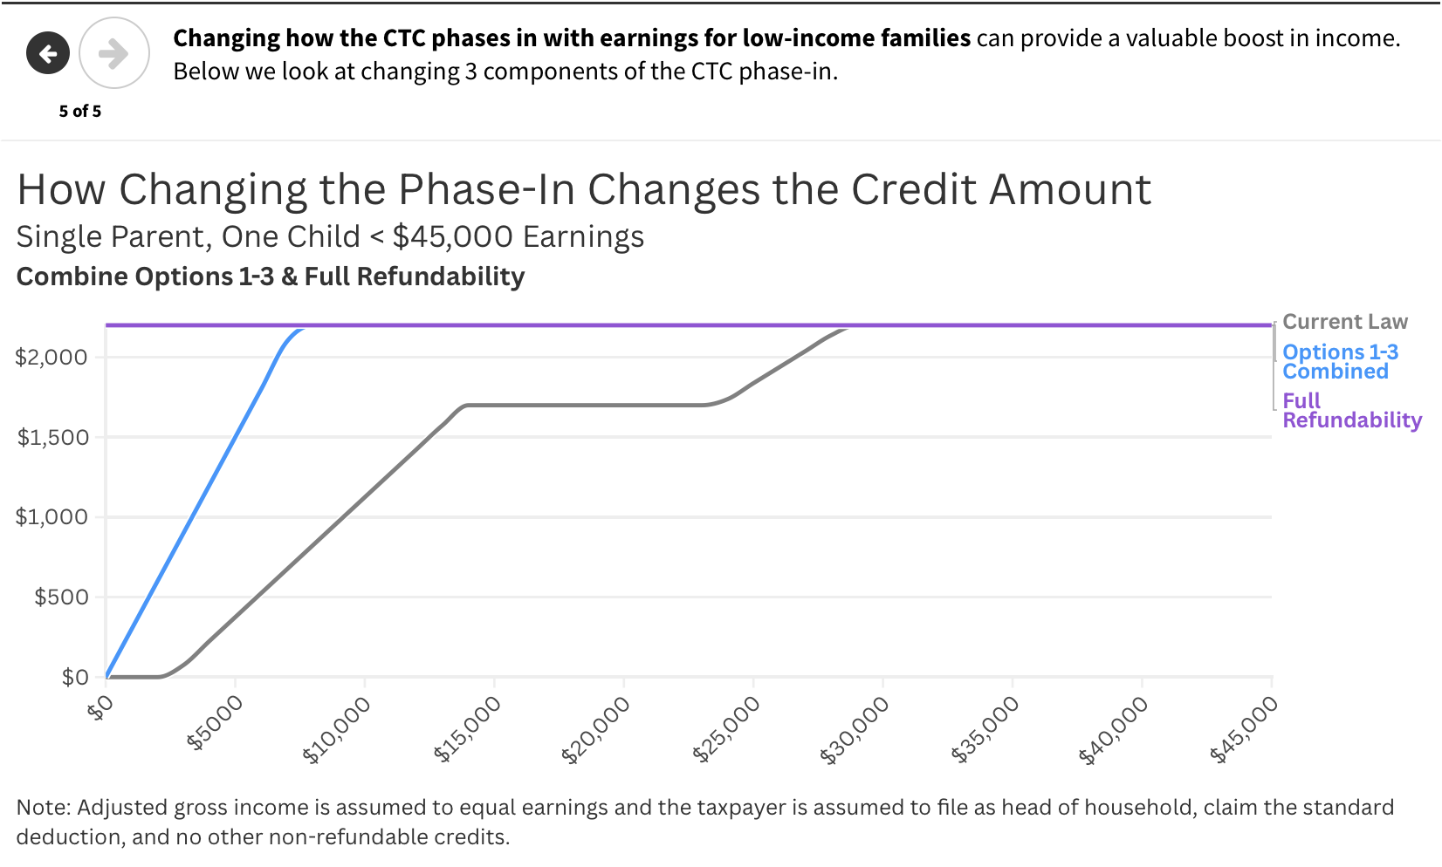

Slide 15
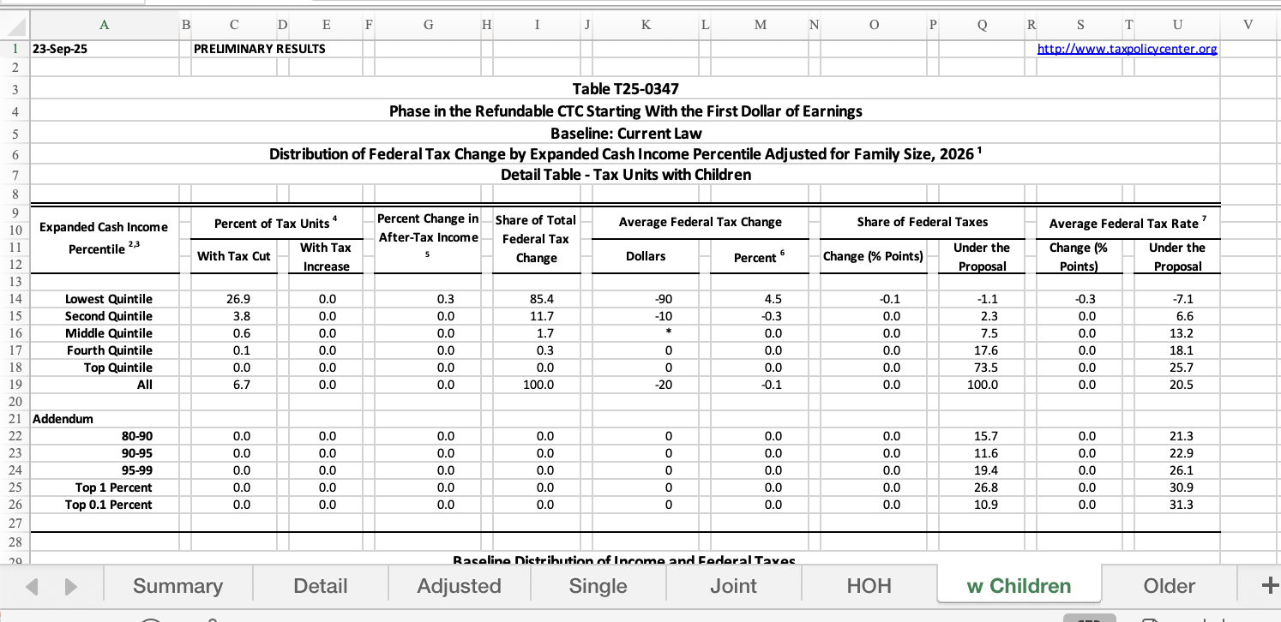
More than 1 in 4 families with children at the bottom of the income distribution are eligible for a tax cut=after-tax income rises.
Almost 90% of benefit from SSWF goes to families with children with the lowest incomes
Among 26.9% who benefit, average CTC increase is about $340 (most see a $375 increase, some with income less $2,500 see less).
**Note TPC tables average benefits reflect average over ALL families with children including the over 70% who see no change
Source: Maag 2025
Source: Maag 2025 https://taxpolicycenter.org/tax-model-analysis/options-expand-child-tax-credit-ctc-updated-september-2025
Notes:
Among 27% who benefit, average CTC increases by $330

Slide 16
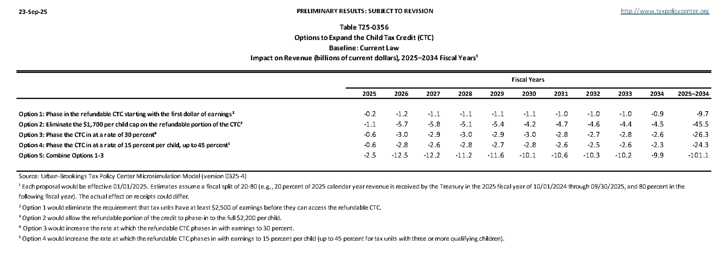
SSWF has a budgetary cost of $1 billion per year.
Source: Maag 2025
Source: Maag 2025 https://taxpolicycenter.org/taxvox/child-tax-credit-changes-boost-and-stabilize-benefits-some-still-exclude-lowest-incomel

Slide 17
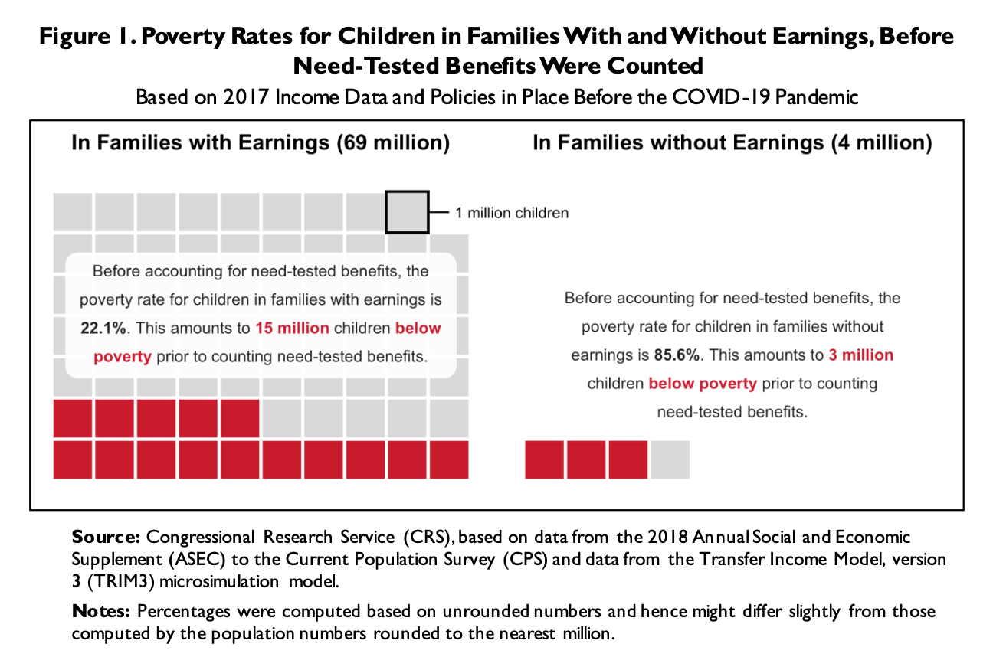
Child Poverty & Work Most Children in Poverty Live with at Least One Person Who Works
Source: CRS Report R46922 https://www.congress.gov/crs-product/R46922

Slide 18
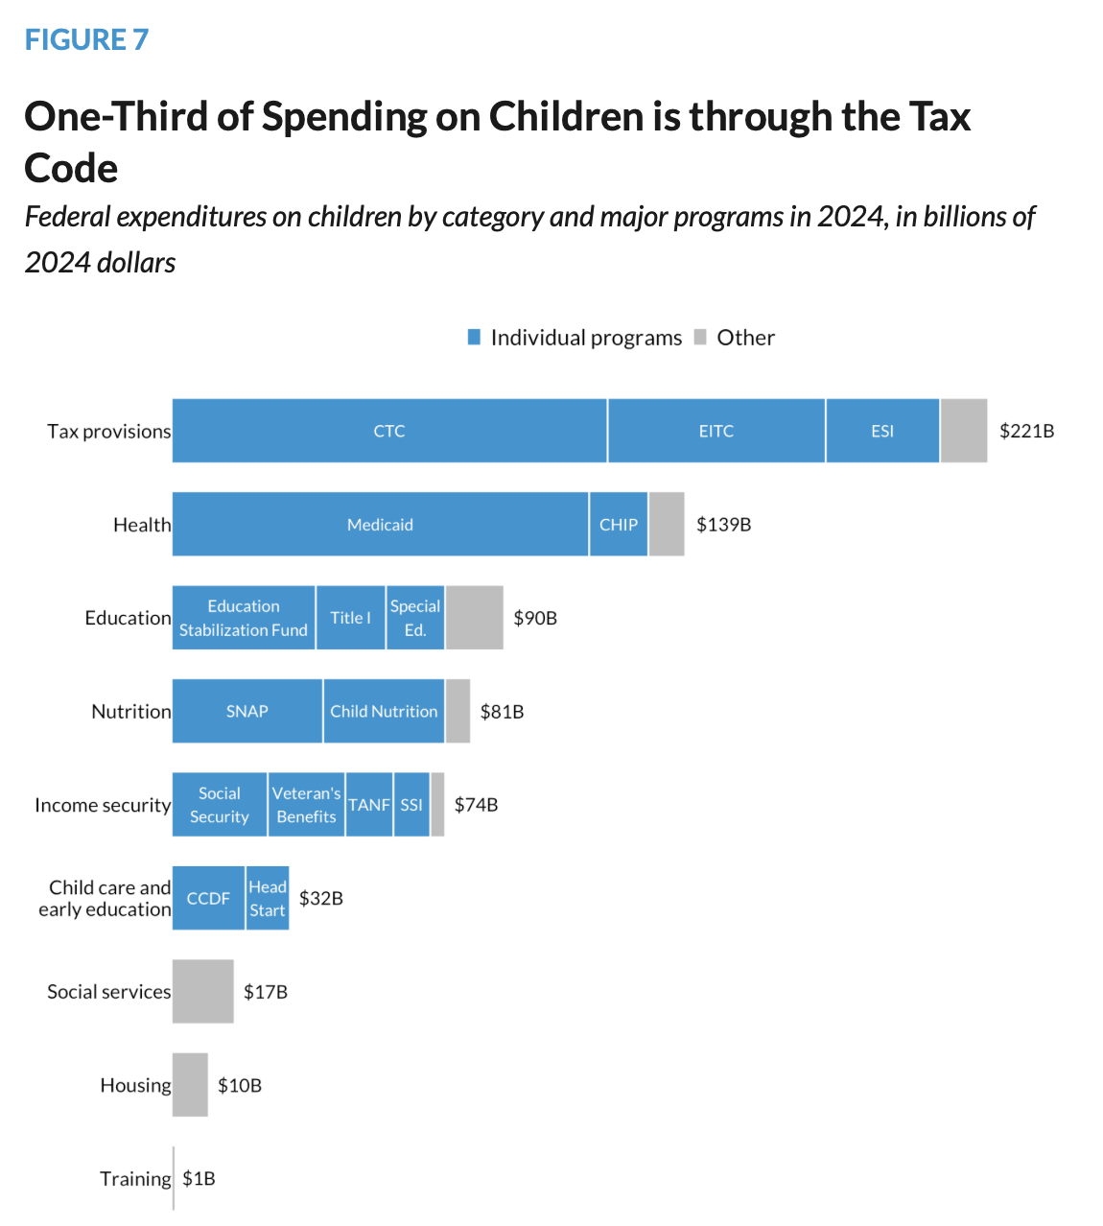
BRIEF OVERVIEW The Income Tax System is One of the Major Tools the Federal Government Uses to Invest in Children
→
Source: Kids’ Share 2025; Tentative Release Date April 27! (Please check it out)

Slide 19
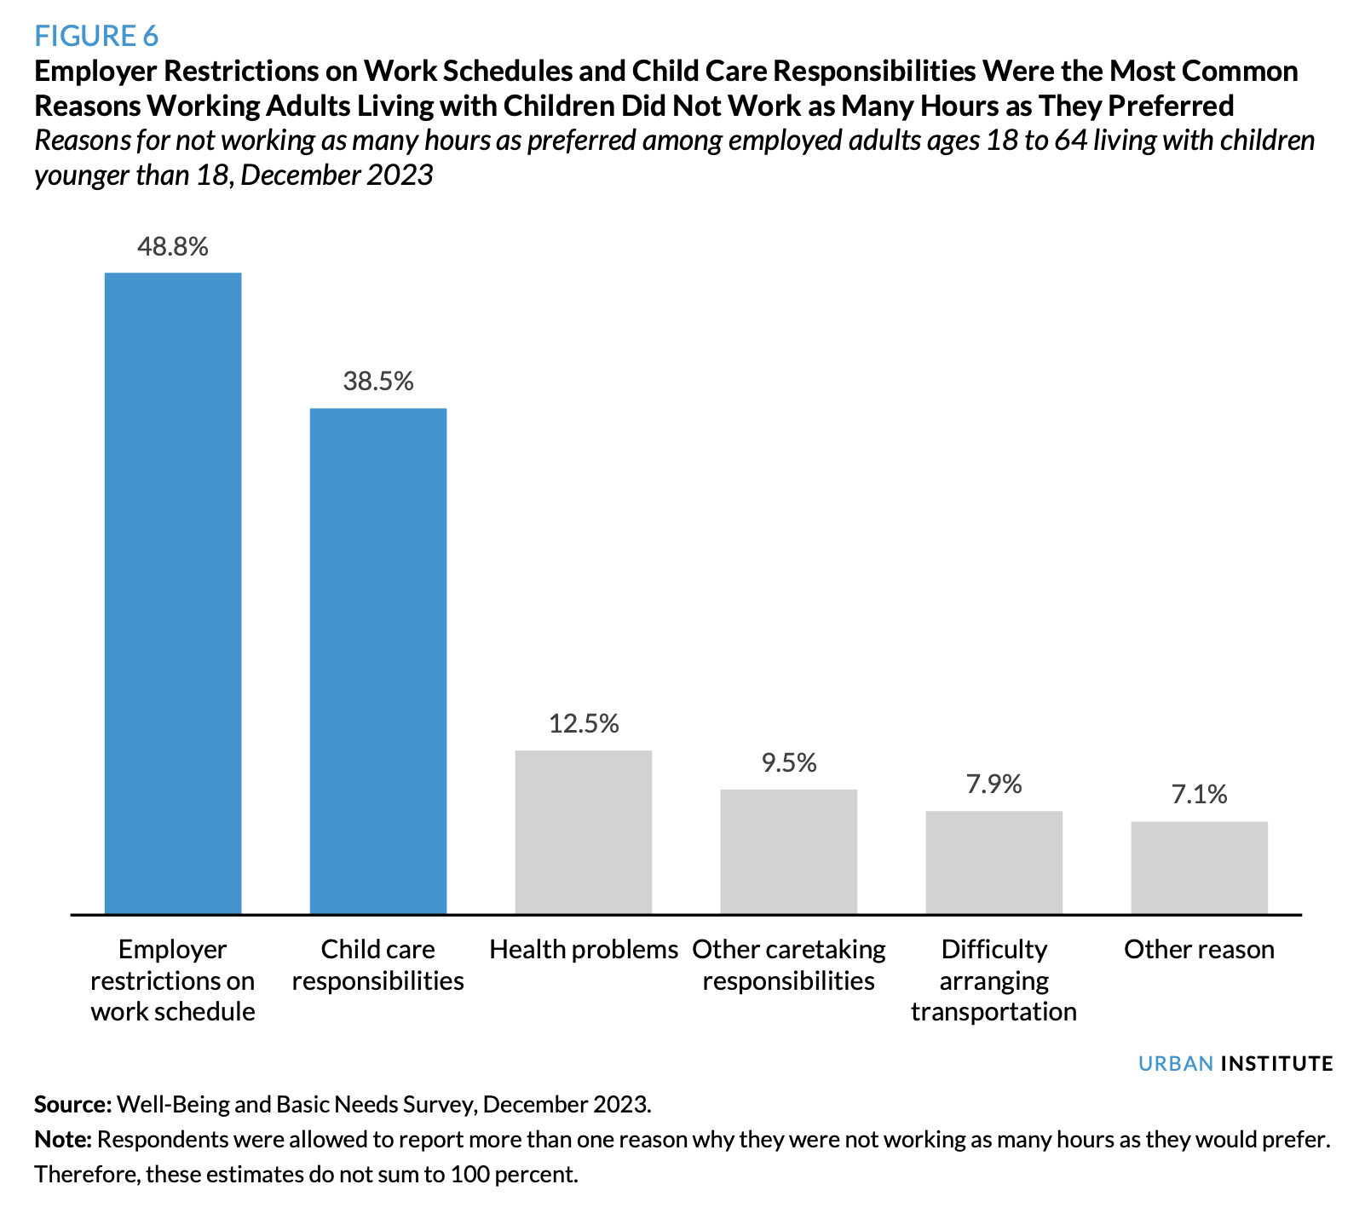
Child Poverty & Work Many workers with low-incomes want to work more but struggle to do so.
Source: Tax Policy Center 2024 https://taxpolicycenter.org/sites/default/files/2024-12/An_Expanded_Child_Tax_Credit_Could_Help_Low-Income_Families_Facing_Material_Hardships.pdf

Slide 20
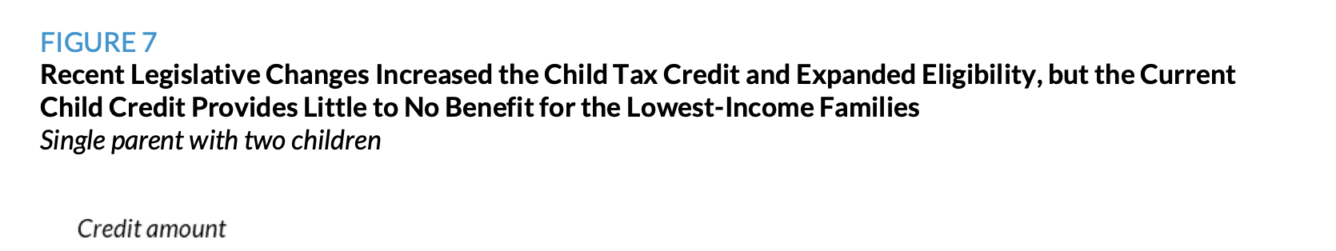
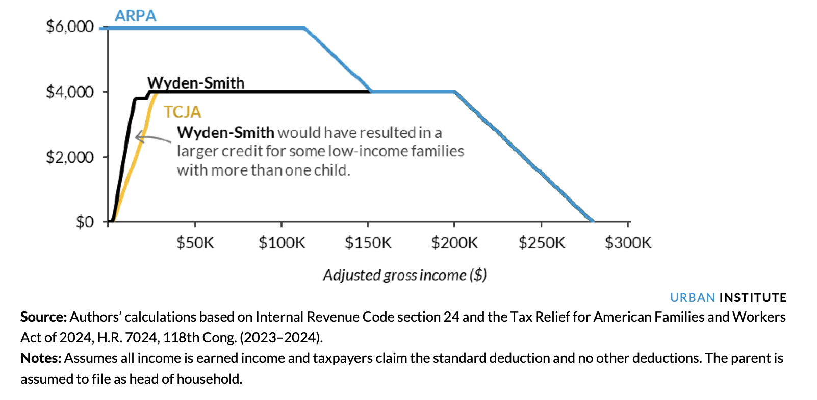
Phasing in the credit faster helps larger low-income families Phasing in on a per-child basis helps low-income families with more than one child
Source: Tax Policy Center 2024 https://taxpolicycenter.org/sites/default/files/2024-12/An_Expanded_Child_Tax_Credit_Could_Help_Low-Income_Families_Facing_Material_Hardships.pdf

Slide 21
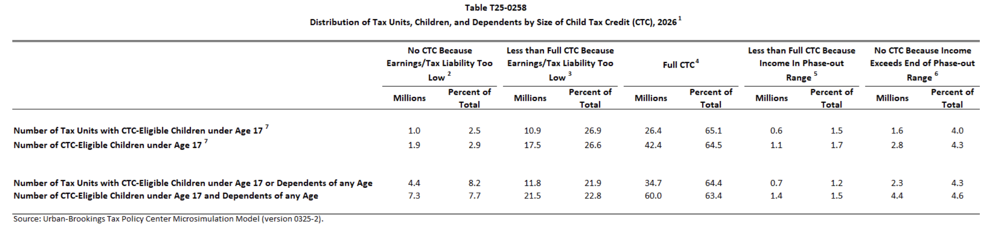
CTC & Work 17 million children left out of full CTC due to low earnings; 2 million because earnings < $2,500

Slide 22
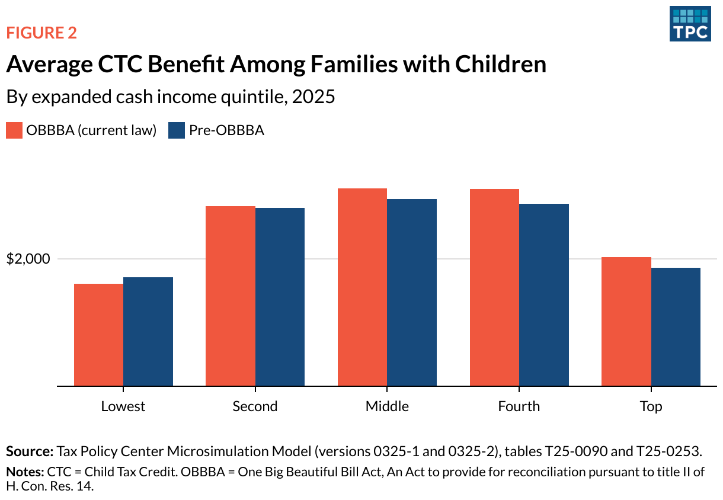
HOW THE CTC WORKS Low-Income Families on Average Slightly Worse Off After OBBBA
Need more income to access larger (nonrefundable) credit of $2,200
Source: Maag 2025 https://taxpolicycenter.org/taxvox/child-tax-credit-changes-boost-and-stabilize-benefits-some-still-exclude-lowest-incomel

Slide 23
U.S. Poverty Campaigns Update

Slide 24
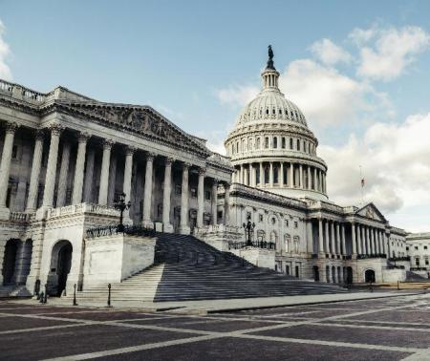
Reconciliation 2.0
Expected Reconciliation bill to cover DHS funding potentially done by May
Lack of ICE accountability biggest threat in first reconciliation bill
Follow up reconciliation bill or other “anti-fraud” legislation a major threat to anti poverty programs
Could cut EITC, Medicaid, SNAP or further restrict CTC
Key message: NO MORE CUTS and reverse cuts from last year’s reconciliation bill
Photo by Tim Mossholder on Unsplash

Slide 25
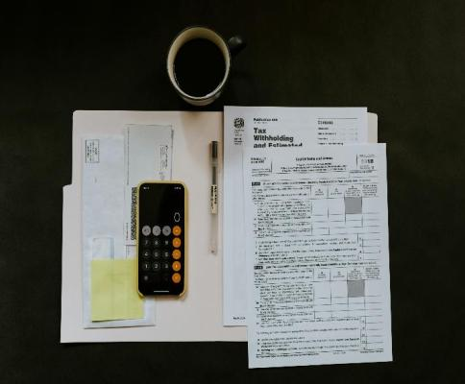
Tax Day Media and Meetings
Use Tax Day as a media hook
Stronger Start for Working Families Act and/or tax fairness
Targeted Senate work on Stronger Start for Working Families Act
Likely to see a House companion bill and opportunity to talk to your representatives about co-sponsorship
Key message: the tax code should prioritize families
Photo by Kelly Sikkema on Unsplash

Slide 26
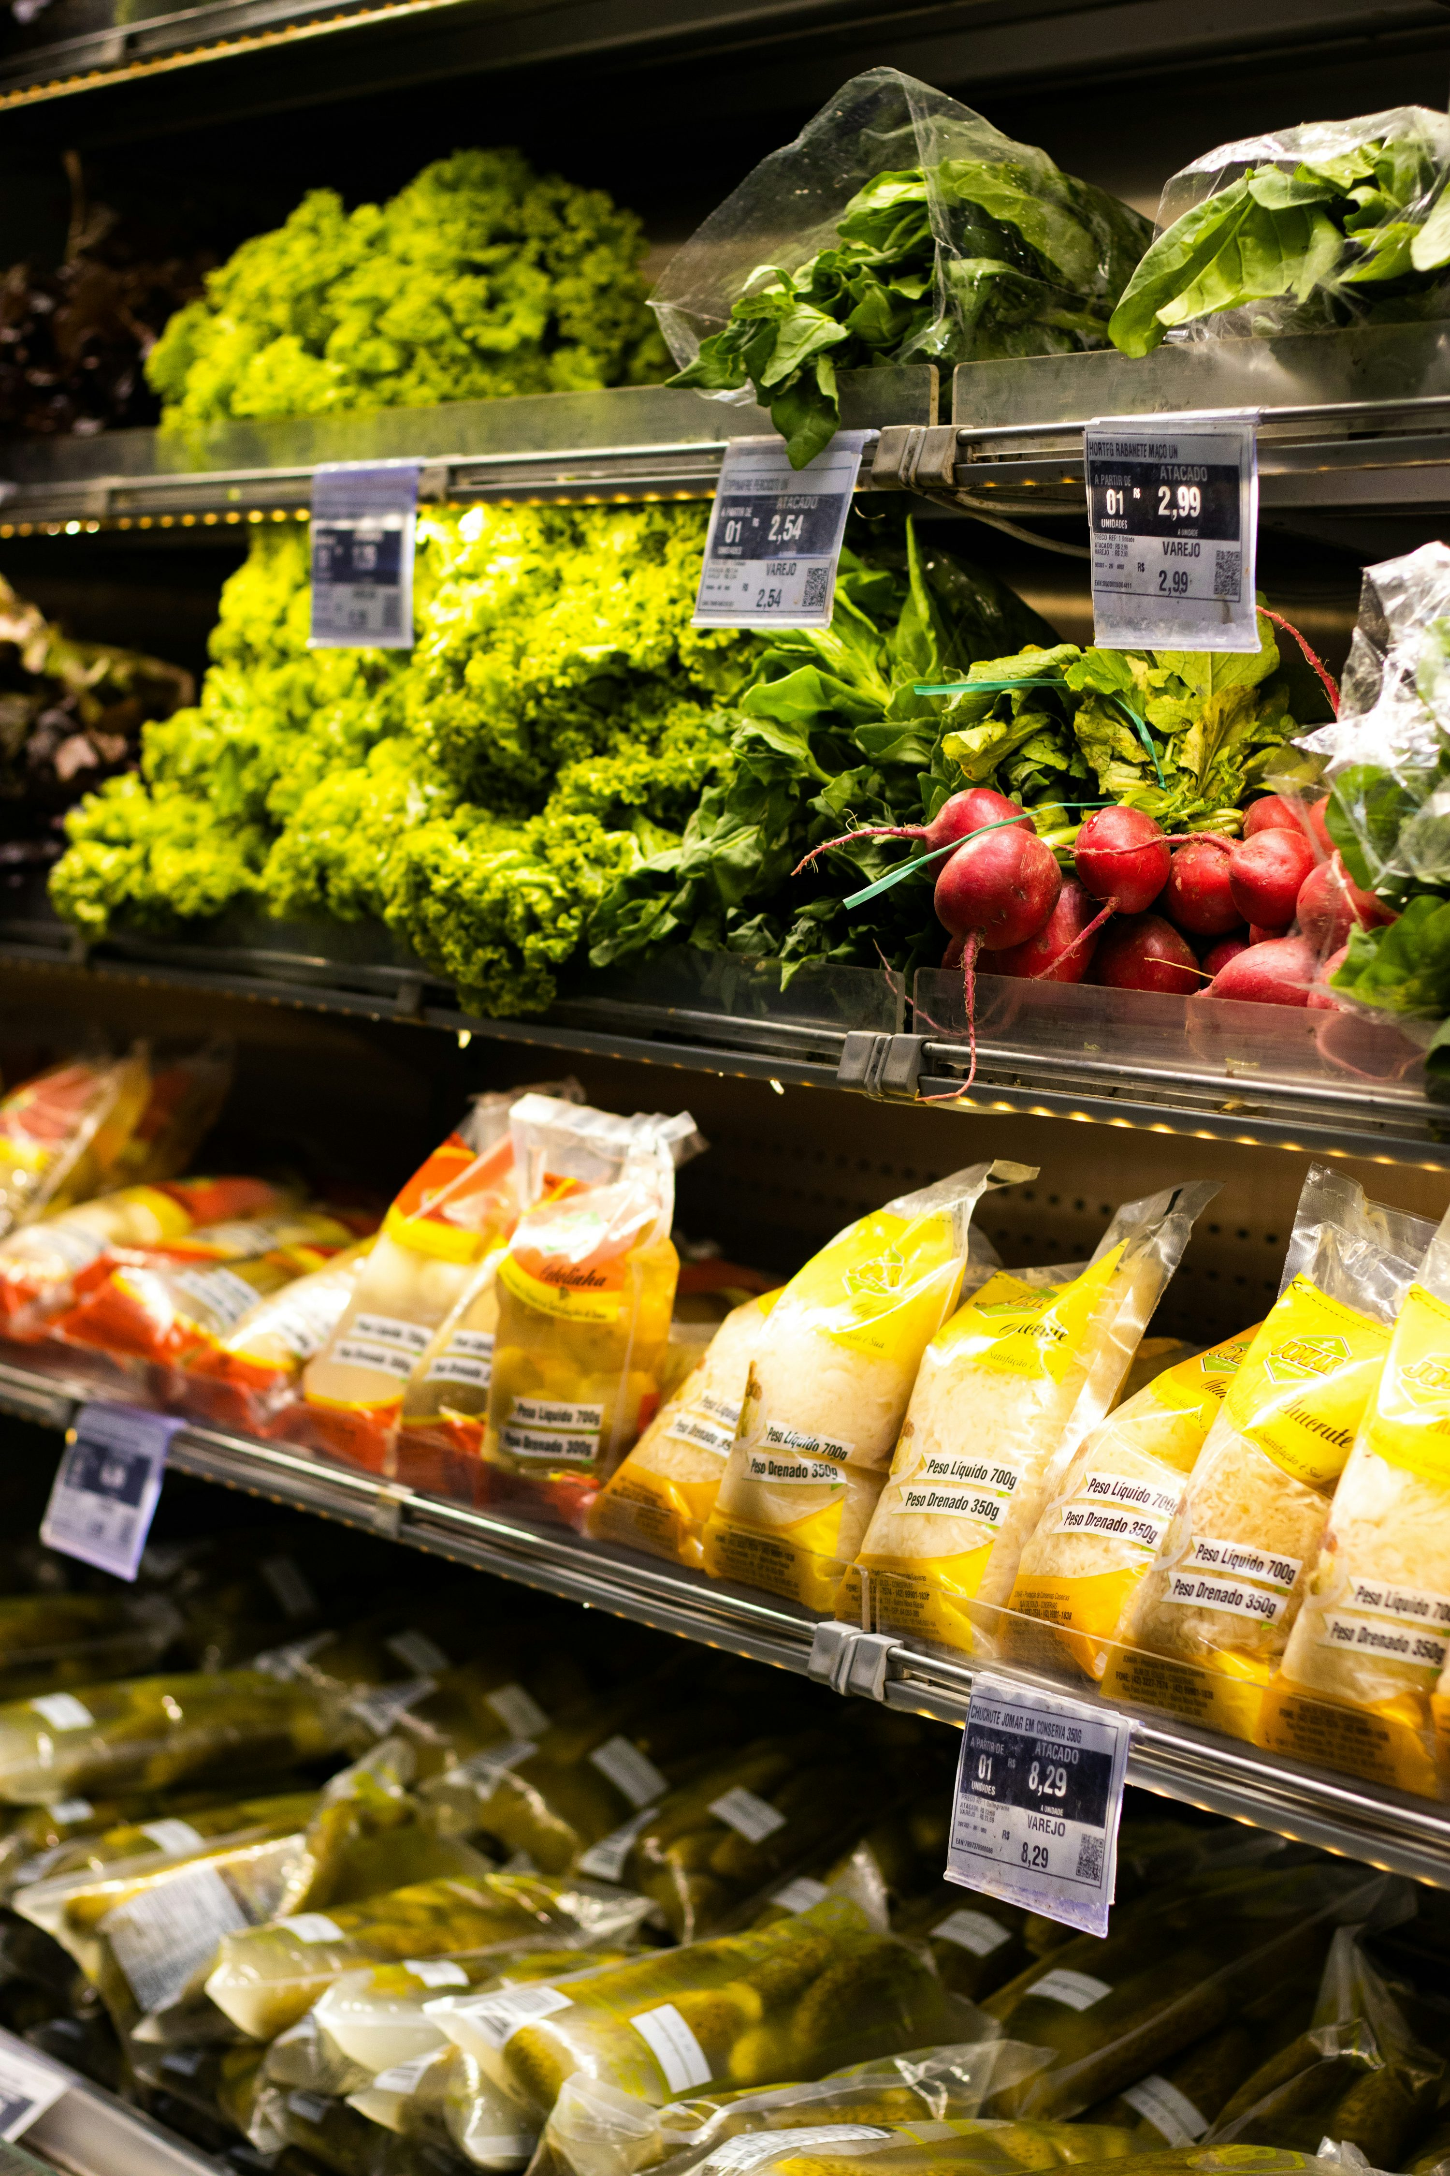
SNAP Update
House Ag Committee passed a slim Farm Bill
Full House and Senate action unclear
Does not address the catastrophic cuts made to SNAP last year
Potential for a farmer “bailout” bill likely to be best opportunity
Key message: any farm/nutrition related bill before congress MUST delay the state cost sharing policy
Photo by Eduardo Soares on Unsplash

Slide 27
Global Poverty Campaigns Update

Slide 28
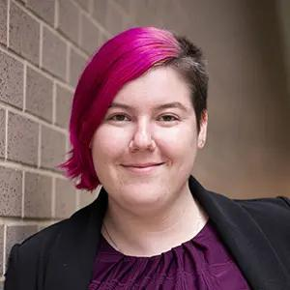
Katie Fleischer
Senior Associate, Advocacy kfleischer@results.org

Slide 29
Account | FY25 Enacted | FY26 House | FY26 Senate | FY26 Enacted | FY27 Requests
Housing Choice Vouchers | $32.15 billion | $32.15 billion | $33.97 billion | $34.96 billion | Fully renew + add 250,000 new vouchers
Global Fund to Fight AIDS, TB and Malaria | $1.65 billion | $1.5 billion | ------ | $1.25 billion | $1.53 billion
Global Tuberculosis | $394.5 million | $394.5 million | ------ | $378.7 million | $1 billion
Global Maternal and Child Health | $915 million | $915 million | ------ | $915 million | $1.15 billion
Of which, Gavi, the Vaccine Alliance | $300 million | $300 million | ------ | $300 million | $340 million
Global Nutrition | $165 million | $172.5 million | ------ | $165 million | $300 million
Global Basic Education | $922 million | $737.6 million | ------ | $691.5 million | $970 million
Of which, GPE | $121.6 million | $121.6 million | ------ | $121.6 million | $150 million

Slide 30
FY27 House Dear Colleague Letters
Global Fund:
171 signers
9 Republicans (+2)
Tuberculosis:
133 signers
7 Republicans (-1)
MCH, Gavi, Nutrition:
118 signers
9 Republicans (+3)
Basic Education, GPE:
110 signers
4 Republicans (+3)
Housing Choice Vouchers:
109 signers
0 Republicans (+0)

Slide 31
What are the key actions?
Submit official Senate appropriations request forms. This urges offices to include our asks in their submissions to Appropriations subcommittees.
Deadlines for Senators to submit: April 20 (T-HUD), April 30 (SFOPS)
Send Senate offices "Dear Colleague" letters.
The more bipartisan signers, the stronger the message.

Slide 32
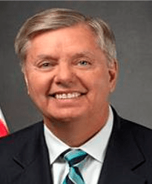
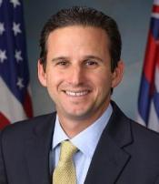
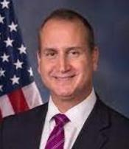
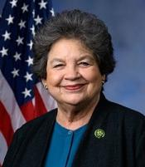
Leadership of the State, Foreign Operations, and Related Programs Subcommittee of Appropriations (SFOPS)
U.S. Senate
U.S. House
Lindsey Graham (R-SC)
Chairman
Brian Schatz (D-HI)
Ranking Member
Mario Diaz-Balart (R-FL)
Chairman
Lois Frankel (D-FL)
Ranking Member
Photos via Wikimedia Commons

Slide 33
Senate Dear Colleague Letters
FY27 Senate Tuberculosis Dear Colleague
Bipartisan letter led by Sens. Todd Young (R-IN) and Jacky Rosen (D-NV)
Asks appropriators for increased funding for bilateral TB programs
Deadline: TBD
Coming soon:
FY27 Senate Global Fund to Fight AIDS, TB and Malaria
FY27 Senate Maternal and Child Health, Gavi, and Nutrition
FY27 Senate Basic Education and GPE
FY27 Senate Housing Choice Vouchers

Slide 34
Humanitarian Funding
New FY27 request: $6.5 billion for International Humanitarian Assistance
Can be included in your Senate Member forms and any follow up with congressional offices on FY27 appropriations
Cheat sheet and leave-behind now available: https://results.org/resources/fy27-appropriations-memos

Slide 35
FY27 Campaign Resources
FY27 Appropriations form cheat sheets and leave behinds: https://results.org/resources/fy27-appropriations-memos
FY27 Dear Colleague letters: https://results.org/blog/fy27-appropriations-tell-congress-to-fund-the-fight-against-global-poverty
Build a Better Future campaign page: https://results.org/2026-campaign
Find links to lobby meeting requests, laser talks, and more!
Understanding Appropriations: https://results.org/resources/understanding-appropriations

Slide 36
Grassroots Inspiration & Action

Slide 37
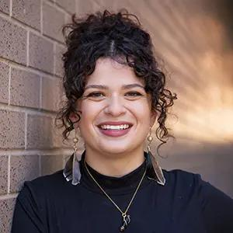
Sarah Leone
Senior Associate,
Grassroots Impact sleone@results.org

Slide 38
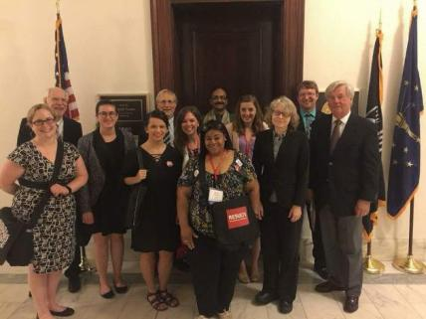
RESULTS National Conference
Sarah lobbying as a volunteer with RESULTS Indiana at her first RESULTS Conference in 2016. This was taken after her first lobby meeting.

Slide 39
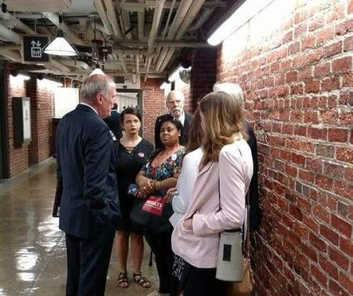
RESULTS National Conference
RESULTS Indiana speaking with former IN Senator Dan Coats in the tunnels underneath Capitol Hill.

Slide 40
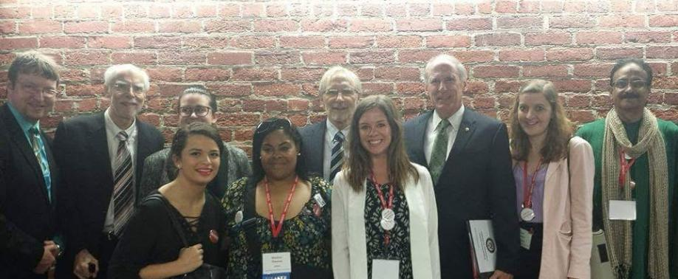
RESULTS National Conference

Slide 41

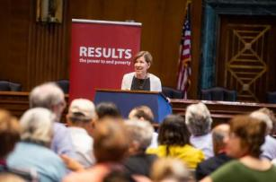
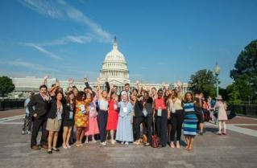
July 12-14, Washington, DC
Register today!
www.results.org/conference

Slide 42
2026 RESULTS National Conference
July 12-14, 2026
American University Law School in Washington, DC
Join us this summer for our biggest event of the year. Join hundreds of your fellow advocates as we meet, learn, and lobby together!
New! Conference agenda is now on our website.
Use our hotel discount to book your room at the
Embassy Suites Chevy Chase Pavilion.
Learn more and register at www.results.org/conference
(Deadline to register and book a discounted room is June 12)

Slide 43
Help us help you attend!
Active, U.S-based volunteers who need help with registration and/or travel costs are encouraged to apply to our conference equity fund.
https://tinyurl.com/RESULTSEquityFund

Slide 44
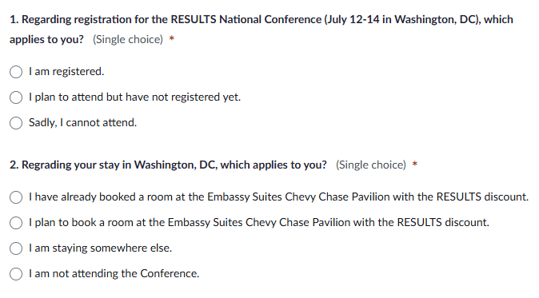
Conference attendance poll

Slide 45
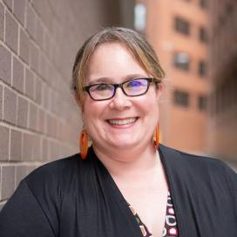
Lisa Marchal
Senior Manager, Grassroots Impact
lmarchal@results.org

Slide 46
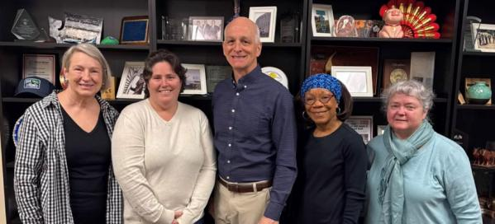

Your First 2026 Lobby Push!
RESULTS Seattle with Rep. Adam Smith (WA-9)
Photo by Luke Thornton on Unsplash

Slide 47
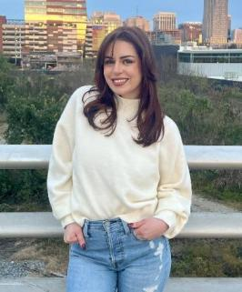
Grassroots Share
Angelica Torres
RESULTS Raleigh

Slide 48
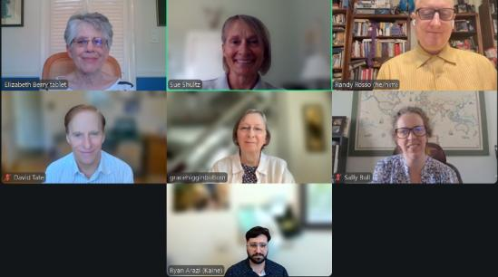
Building champions . . . Building power . . .
Your advocacy
at work!
RESULTS Virginia with Sen. Kaine’s office

Slide 49
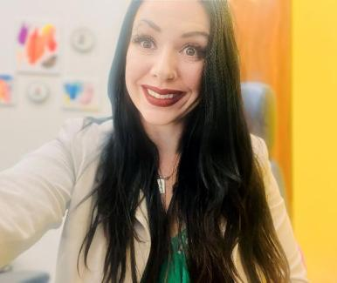
Experts on Poverty focus
Kali Daugherty
RESULTS Expert on Poverty and
Executive Director, Walker's Point Youth & Family Center

Slide 50
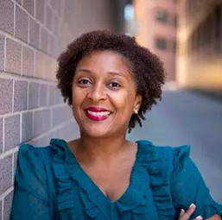
Karyne Bury
Manager, Grassroots Impact kbury@results.org

Slide 51
The Advocacy Trifecta
Media
Congress
Community

Slide 52


Slide 53
Why Media?
Cut through the noise!
Grabs attention of the community (fellow constituents!)
Thank or call out your member of Congress.
Leverage published media during lobby meetings.

Slide 54
Amplify Every Voice Media Campaign
Every volunteer submits at least one media piece (LTE, Op Ed) between now and July.
Every group invites others to submit media: new volunteers, action network members, and local partners.

Slide 55
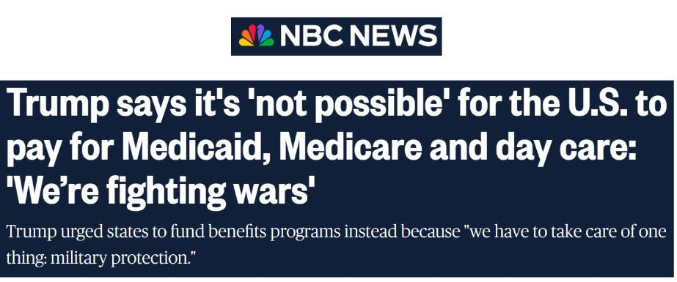
Getting Started: Find a hook

Slide 56
Getting started: Find a hook
Mark important dates and observances:
April 7: World Health Day
April 11-17: Black Maternal Health Week
April 15: Tax Day
April 24-30: World Immunization Week

Slide 57

Tips for writing LTEs
Keep it short, 150 to 200 words.
Personalize it – why is this issue important to you? Your district? Your state?
Mention your members of Congress by name in your letter.
Photo by Glenn Carstens-Peters at Unsplash.com

Slide 58
EPIC Format makes an epic LTE
Use the EPIC format structure
Engage (Hook)
Problem
Inform on Solution
Call to action for the reader or your members of Congress

Slide 59
Media resources
Working with Media page
Find LTE templates on our Action Center:
Congress must prioritize TB funding!
Delay the deep cuts to SNAP
Help more families afford rent
Expand the CTC to help more families
Media & Democracy Project: Journalism Directory
LTEs & Op Eds published by RESULTS Volunteers

Slide 60
Media Office Hour
Wednesday, April 22, 2-3 p.m. ET
Grassroots media is a powerful tool to influence lawmakers and strengthen democracy. If you need help brainstorming, writing, editing, or submitting a media piece, RESULTS staff welcomes you to bring your questions to this open office hour.
Join via Zoom at https://results.zoom.us/j/91601524175
or dial (312) 626-6799, meeting ID 916 0152 4175.

Slide 61
Build Power through Media
Amplify Every Voice, Amplify Your Advocacy
Mobilize More Voices
Build a Bigger Network
Build relationships with organizations & partners for collaborative action
Strengthen RESULTS Group
Help new advocates find their place & grow in confidence
Table in the community with letter writing actions
Share letter writing & media actions with friends, family, & broader networks
Table at community events to invite people to become advocates
Host in-person action meetings to build relationships with current & new advocates

Slide 62
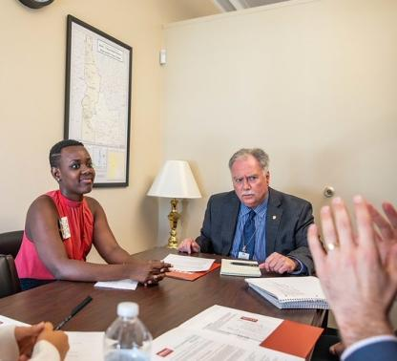
One Lobby Meeting = Many Voices
Bring letters & media to your meetings on the Hill! That is how power and influence is built!

Slide 63
Grassroots Board Nominations

Slide 64
Nominations open for Grassroots Director seats on the RESULTS Board!
Responsibilities of the Board
Set vision and goals and evaluate progress
Assure our financial solvency and integrity
Be an ambassador for the organization
Responsibilities of Grassroots Directors
Advocate for the interests of the grassroots on the Board and its committees
Educate volunteers about the activities of the Board
Ensure that open Grassroots Director seats are filled in a timely way
Notes:
B

Slide 65

Do you know a great leader?
Nomination Criteria:
Have at least one year of active experience as a RESULTS volunteer in the United States
Be a current volunteer
Be committed to the mission of RESULTS and our anti-oppression values
Be ready and willing to meet the responsibilities of Grassroots Directors
More information at:
https://results.org/blog/2026-grassroots-director-nominations-are-open
Notes:
B

Slide 66
Election timeline
By April 23: Submit nominations
By April 25: Nominees submit documentation
May 2: Candidates speak on the May national webinar, online voting opens
May 7@ 8:30 ET: Candidates forum on Zoom
June 15 @midnight ET: Online voting closes
June 19-27: REF Board elects the slate nominated by the volunteers
July 1: Successful candidate takes office
More information at:
https://results.org/blog/2026-grassroots-director-nominations-are-open
Notes:
B

Slide 67
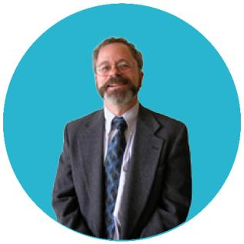
Ernest Loevinsohn
Current RESULTS Board of Directors Member and Former Chair
Notes:
B

Slide 68
Announcements

Slide 69
Thank you for joining us!
Who is joining you in the room today?
Please complete the Zoom poll by indicating the number of people in the room with you today
(including yourself).

Slide 70
Anti-Oppression (AO) Learning Community
Friday, April 17, 12-1:30 p.m. ET
Our next AO Learning Community session will explore what it means to view RESULTS’ policy issues through a human rights lens: examining what defines a human right, whose voices are valued in a democracy, and how power and lived experience shape whose needs are prioritized.
Register here

Slide 71
July 12-14, Washington, DC
Register today!
www.results.org/conference

Slide 72
Appropriations Forms Office Hour
Let us help you meet those looming appropriations deadlines!
Check out our requests and cheat sheets and drop in to office hours. Senior Associate Katie Fleischer will be available to answer questions and guide you through the process.
Friday, April 17, 12-1 p.m. ET
Wednesday, April 22, 1-2 p.m. ET
Wednesday, April 29, 1-2 p.m. ET
Join via https://results.zoom.us/j/93961093308 (Meeting ID 939 6109 3308).
You can also contact Katie Fleischer (kfleischer@results.org) with your questions.

Slide 73
U.S. Poverty Free Agents
Tuesday, April 21, 1-2 p.m. ET
If you are a solo advocate in your area and want support in taking action on our U.S. poverty campaigns, come on along!
Join via Zoom at https://results.zoom.us/j/98076262565 or dial (929) 436-2866, meeting ID 980 7626 2565.

Slide 74
Media Office Hour
Wednesday, April 22, 2-3 p.m. ET
Grassroots media is a powerful tool to influence lawmakers and strengthen democracy. If you need help brainstorming, writing, editing, or submitting a media piece, RESULTS staff welcomes you to bring your questions to this open office hour.
Join via Zoom at https://results.zoom.us/j/91601524175
or dial (312) 626-6799, meeting ID 916 0152 4175.

Slide 75
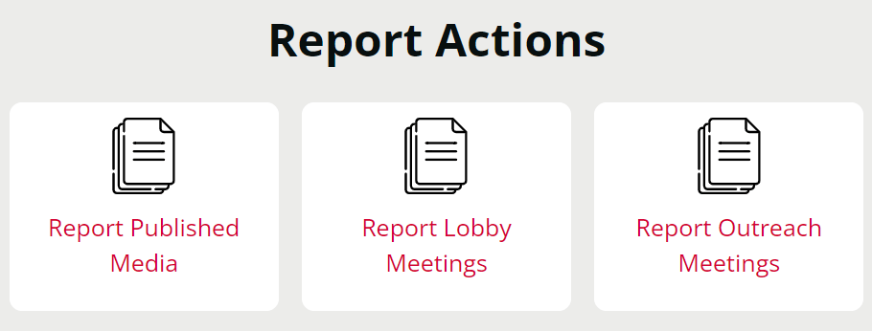
Let us know the amazing things you are doing!
https://results.org/volunteers/reporting-your-advocacy-actions

Slide 76
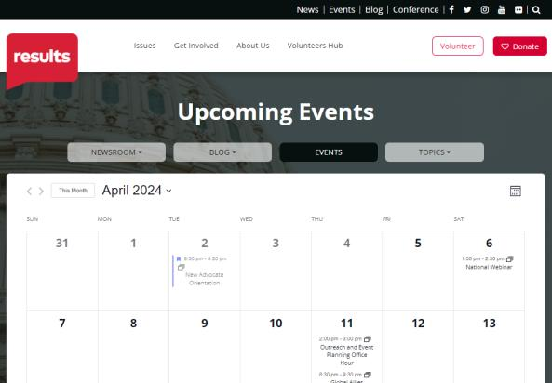
Find events
www.results.org/events

Slide 77
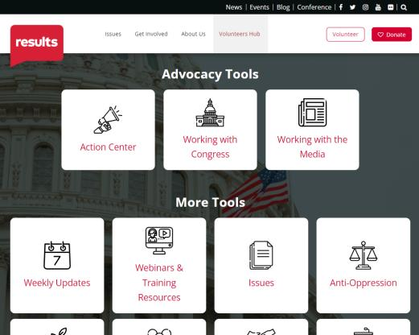
Find today’s slides
www.results.org/volunteers/national-webinars

Slide 78
April office closures
Friday, April 24
Staff Wellness Day

Slide 79
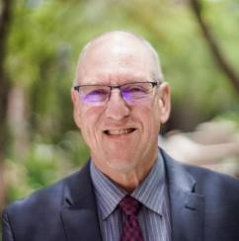
Join us May 2 for the next National Webinar!
Registration is always open
for the 2026 National Webinars!
www.tinyurl.com/RESULTS2026
Guest speaker: Jay Evensen
Opinion Editor, Deseret News (UT)
Cameron Duncan Media Award Recipient

