Slide 1

RESULTS National Webinar February 7, 2026

Slide 2
Our Values
At RESULTS we pledge to create space for all voices, including those of us who are currently experiencing poverty. We will address oppressive behavior in our interactions, families, communities, work, and world. Our strength is rooted in our diversity of experiences, not in our assumptions.
With unearned privilege comes the responsibility to act so the burden to educate and change doesn’t fall solely on those experiencing oppression. When we miss the mark on our values, we will acknowledge our mistake, seek forgiveness, learn, and work together as a community to pursue equity.
Read our full anti-oppression values statement here at results.org/values.
Notes:
Updated AO slide (2/22)

Slide 3
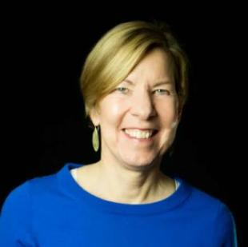
Welcome!
Joanne Carter Executive Director

Slide 4
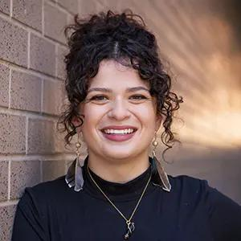
Sarah Leone
Senior Associate, Grassroots Impact sleone@results.org

Slide 5
Why does our "Building a Better Future" campaign matter?

Slide 6
Appropriations 101

Slide 7
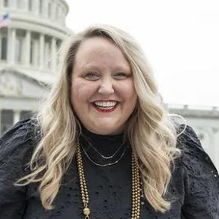
Crickett Nicovich
Director, Policy and Government Affairs
cnicovich@results.org

Slide 8
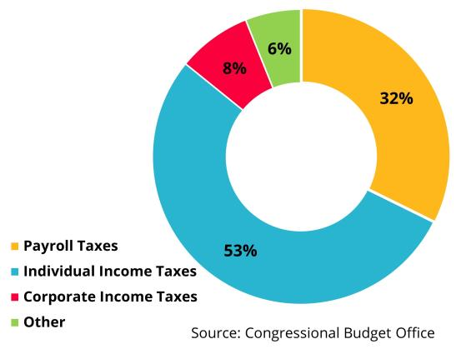
FY23 Federal Revenue
Funds collected from the public that arise from the government’s exercise of its sovereign powers

Slide 9
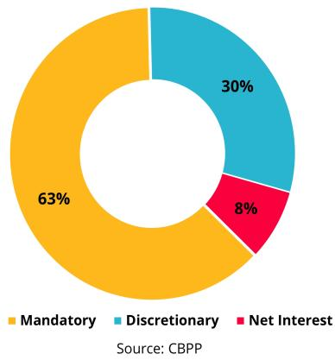
Components of federal spending, FY23

Slide 10
Where RESULTS advocacy fits into the budget
Discretionary spending
Optional spending
Typically done for one year at a time
Two main categories
Defense (DOD): funding for military operations
Non-Defense Discretionary (NDD): funding for everything else, such as education, scientific research, infrastructure, national parks, environmental protection, etc, including foreign assistance, housing programs, and WIC.
10

Slide 11
Where RESULTS advocacy fits into the budget
Mandatory spending
Spending that does not have to be approved every year and is required by law.
Includes Medicare, Medicaid, and Social Security, SNAP and a few other programs.
Accounts for the biggest chunk of the budget.
11

Slide 12
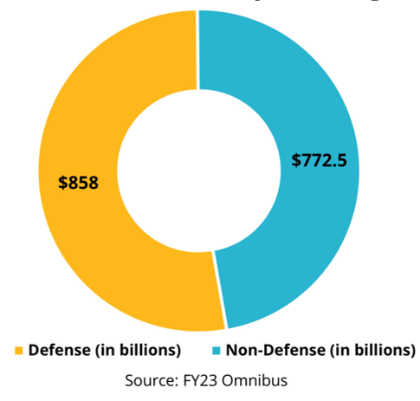
FY23 discretionary funding

Slide 13
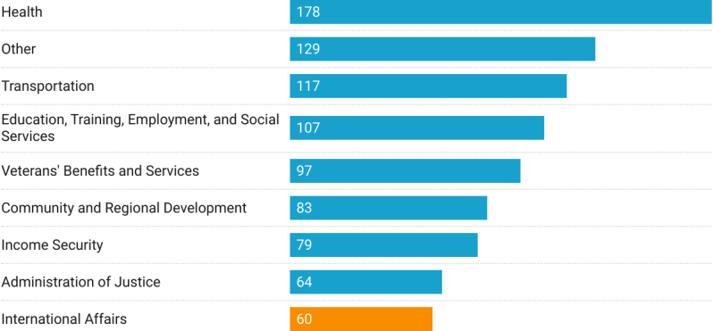
Nondefense discretionary spending, FY20 in billions of dollars
REMINDER: The IA budget funds the State Department, foreign service, embassy security, etc...
Less than 1% of our $4 Trillion budget supports global anti-poverty programs!
Source: Office of Management and Budget

Slide 14
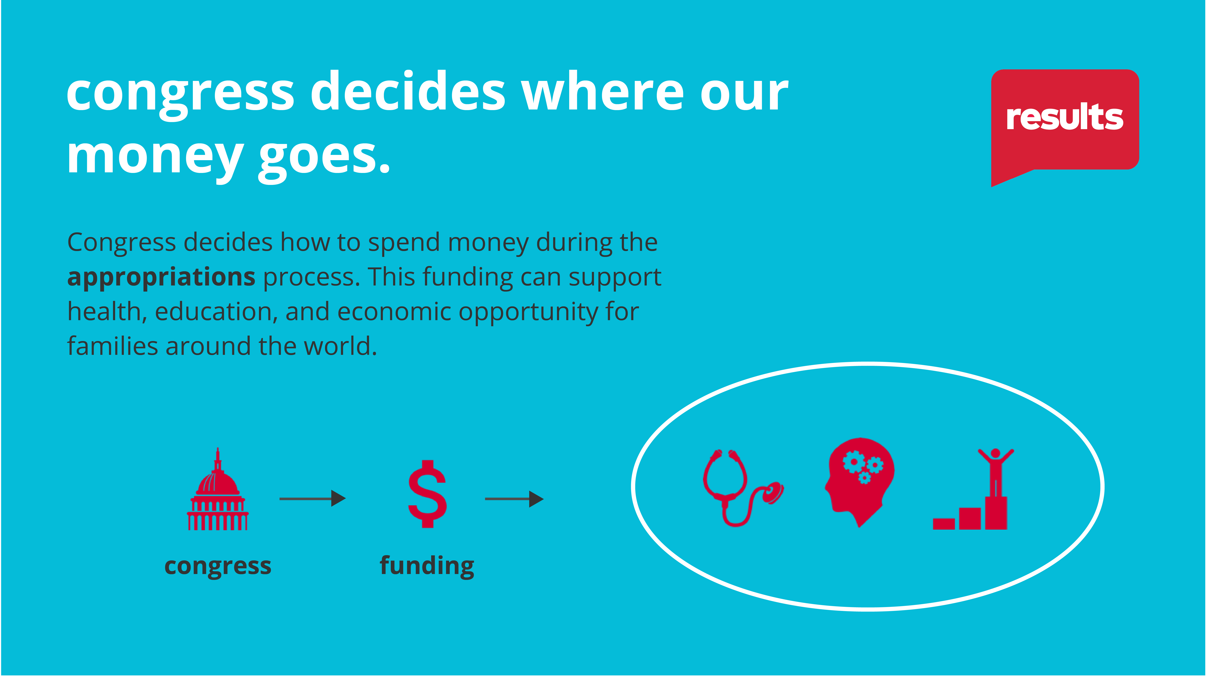

Slide 15





President's Budget Request (PBR)
The Office of Management and Budget and White House officials begin shaping up to 18 months prior to the start of the Fiscal Year.
A policy document, part of the administration’s vision.
Only a proposal. Congress does not have to follow it. Can often be seen as “dead on arrival”, even by many in their own party.
New policies are often previewed in the State of the Union address
OMB begins working on future budgets early
After the State of the Union, the President sends their budget request to Congress

Slide 16
What is supposed to happen...
Twelve appropriations subcommittees in the House and Senate hold public hearings and prepare appropriations bills. Discretionary spending limits are set by the budget resolution (if Congress does one), which can also include changes to taxes and mandatory programs.
The full Appropriations Committees in the House and Senate vote on the 12 bills approved in subcommittee.
The full House and full Senate vote on each appropriations bill.
The 12 bills go to the White House and are signed into law.

Slide 17
the budget process (simplified)
President’s budget request
APPROPRIATIONS COMMITTEES
BUDGET COMMITTEES
OTHER COMMITTEES
House & Senate hold hearings
House & Senate draft and mark up budget resolution
Submit “views and estimates to House & Senate budget committees
House & Senate make suballocations to subcommittees 302(b)
House & Senate hold hearings, set 302(a)
Subcommittees draft and report bills
House & Senate must complete by Oct 1
Source: Congressional Research Service
Notes:
https://sgp.fas.org/crs/misc/R46468.pdf

Slide 18
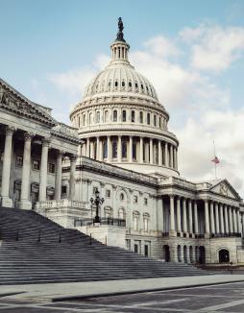
But in reality...
The PBR is often delayed due to urgent political realities and delays from previous years' spending bills
The House and Senate are supposed to pass a final budget resolution that sets the funding allocations for all 12 sub-committees by mid-April, however…
Unless one party controls both the House and Senate, we rarely see budget resolutions anymore.
The bills MUST pass by the end of the fiscal year – September 30th – or the government goes unfunded (a “shutdown”).
“Laws are like sausages, it is better not to see them being made.”
Photo via Unsplash

Slide 19
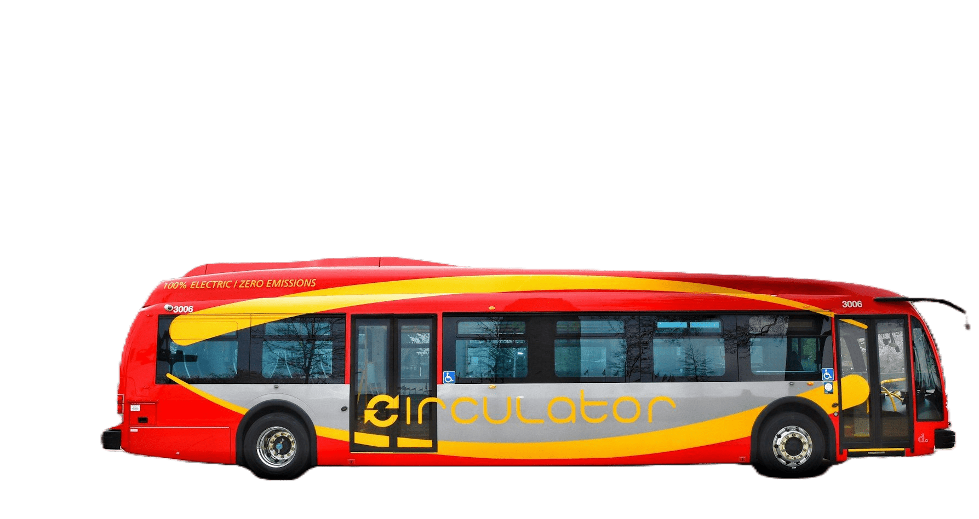
All aboard the omnibus
The current budget process has been in effect almost 50 years, but Congress has only managed to pass all its required measures four times (fiscal years 1977, 1989, 1995, 1997)
Source: Pew Research Center
Photo via Unsplash

Slide 20
So where are we now?
The U.S. fiscal year is the accounting period that runs Oct. 1 – Sept. 30 of the following year. We are currently in Fiscal Year 2026, which started on October 1, 2025.
Congress finally passed its FY26 appropriations bills this week – four months after the start of the fiscal year!
Now, preparations for FY27 appropriations are beginning.

Slide 21




Your advocacy made a difference
 | President’s budget | FY26 enacted level
Housing Choice Vouchers | 43% cut | Increased
Maternal and Child Health | 90% cut | Maintained
Gavi, the Vaccine Alliance | $0 | Maintained
Nutrition | $0 | Maintained
Tuberculosis | 50% cut | 4% cut
Global Fund to Fight AIDS, TB & Malaria | 50% cut | Pledge upheld
Global Basic Education | $0 | 25% cut
Global Partnership for Education | $0 | Maintained

Slide 22



power of the purse
"No money shall be drawn from the Treasury, but in Consequence of Appropriations made by Law…”
Photos via Unsplash, Design: Dorothy Monza
Notes:
Article I, section 9, clause 7 of the U.S. Constitution states that "No money shall be drawn from the Treasury, but in Consequence of Appropriations made by Law..." This is what gives Congress the power to make these appropriations. The President, however, still has the power to veto appropriations bills.^{[2]} However, the President does not have line-item veto authority so that he must either sign the entire bill into law or veto it.

Slide 23
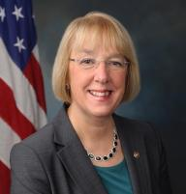
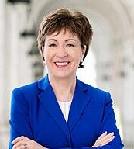
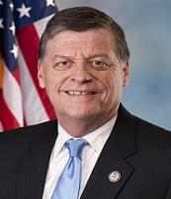
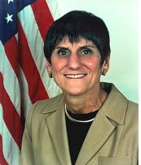
Appropriations Committee Leadership
Chairwoman Susan Collins (R-ME)
Ranking Member Patty Murray (D-WA)
Chairman Tom Cole (R-OK)
Ranking Member Rosa DeLauro (D-CT)
See the full list of appropriations committee members at
www.appropriations.senate.gov and www.appropriations.house.gov
Photos via Wikimedia Commons

Slide 24
How do we influence Congress to increase spending on our priority issues?

Slide 25
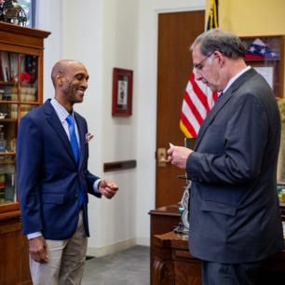
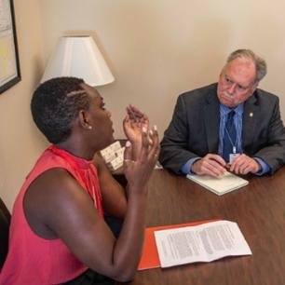
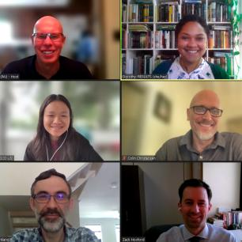
…meeting with members of Congress and their staff (at home & in DC) to create champions on our issues and to sway the “swayables” in the middle
We influence appropriations by…

Slide 26


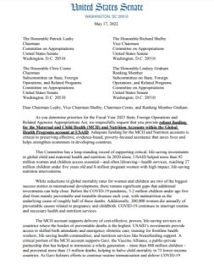
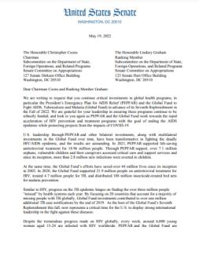
…requesting signatures on annual “Dear Colleague” letters. A champion requests a specific funding amount in a public letter – and asks their colleagues to join them in public support.
We influence appropriations by…

Slide 27
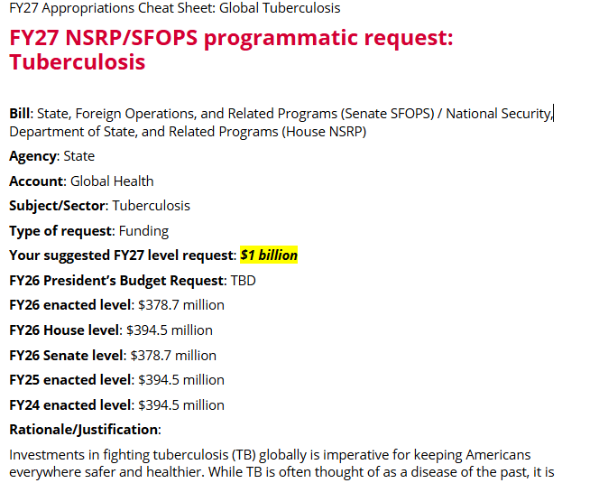
…asking members to submit our funding levels in their personal requests to the subcommittees, by filling out forms for each member.
We influence appropriations by…

Slide 28

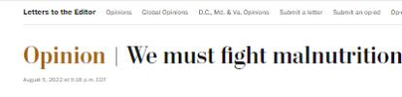
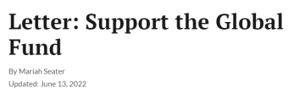

…generating relevant local media.
We influence appropriations by…
Photo via Unsplash

Slide 29
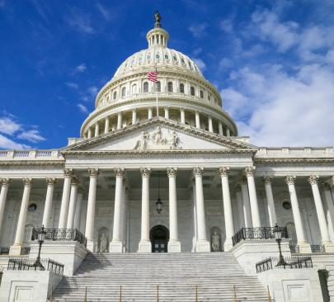
Timing? Well...
There’s a lot we still don’t know... But here’s what we do know:
President Trump will give his State of the Union Address on February 24
The Administration will likely send their budget request to Congress in early March
Dear Colleague letters are being written now and will likely come out in late March/early April
Photo via Unsplash

Slide 30
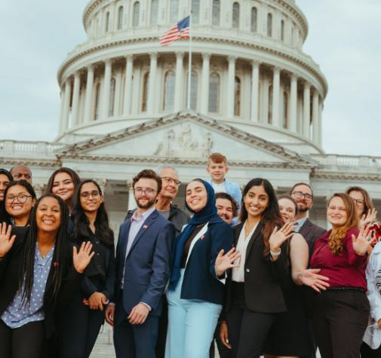
Approps Mantras
Early and Often!
If you want to go fast, go alone. If you want to go far, go together.

Slide 31
FY27 Campaign Resources
Build a Better Future campaign page: https://results.org/2026-campaign
Find links to lobby meeting requests, laser talks, and more!
Understanding Appropriations: https://results.org/resources/understanding-appropriations
FY27 Appropriations memos: https://results.org/resources/fy27-appropriations-memos
Coming soon! RESULTS blog post with Dear Colleague letters (https://results.org/blog)

Slide 32
Domestic Appropriations Ask: Housing

Slide 33
Homelessness is a Policy Choice
Evidence shows that we can solve homelessness if we address its primary driver: the gap between incomes and rent.
Rental assistance is effective but federal funding annually leaves behind a majority of the families that need it.
About 8.5 million households with very low incomes who received no housing assistance pay more than half their income on rent.
Insufficient annual funding for rental assistance means too often low-income families are forced to choose between paying rent or meeting other basic needs.

Slide 34
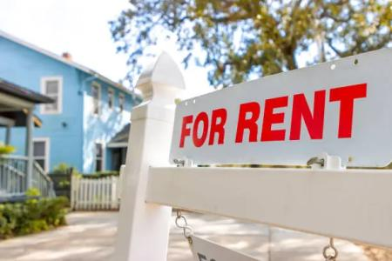
Housing Choice Vouchers
Annually funded by Congress through the T-HUD Bill.
Serves 2.3 million low-income families that earn less than the federal poverty line, which includes over 2 million children.
Vouchers sharply reduce homelessness and lift more than a million people above the poverty line.
Only 1 in 4 families who qualify for rental assistance are able to get it.

Slide 35
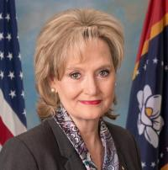
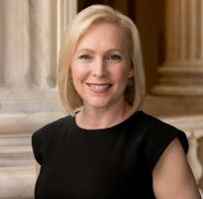
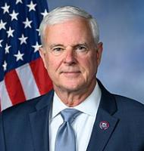
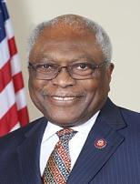
Leadership of the Transportation, Housing, and Urban Development Subcommittee of Appropriations (T-HUD)
Chairwoman Cindy Hyde-Smith (R-MS)
Ranking Member Kirsten Gillibrand (D-NY)
Chairman Steve Womack (R-AR)
Ranking Member Jim Clyburn (D-SC)
Photos via Wikimedia Commons

Slide 36
Account | FY25 Enacted | FY26 House | FY26 Senate | FY26 Enacted | FY27 Requests
Housing Choice Vouchers | $32.15 billion | $32.15 billion | $33.97 billion | $34.96 billion | INCREASE to fully fund current vouchers and support 250,000 more vouchers
Global Fund to Fight AIDS, TB and Malaria | $1.65 billion | $1.5 billion | ------ | $1.25 billion | $1.5 billion
Global Tuberculosis | $394.5 million | $394.5 million | ------ | $378.7 million | $1 billion
Global Maternal and Child Health | $915 million | $915 million | ------ | $915 million | $1.15 billion
Of which, Gavi, the Vaccine Alliance | $300 million | $300 million | ------ | $300 million | $340 million
Global Nutrition | $165 million | $172.5 million | ------ | $165 million | $300 million
Global Basic Education | $922 million | $922 million | ------ | $691.5 million | $970 million
Of which, GPE | $121.6 million | $121.6 million | ------ | $121.6 million | $150 million

Slide 37
EPIC Laser Talk: Speaking Powerfully on Housing

Slide 38
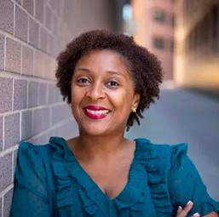
Karyne Bury
Manager, Grassroots Impact kbury@results.org

Slide 39
What is an EPIC laser talk?
RESULTS uses an easy format for our volunteers to create powerful “laser talks.”
EPIC Laser Talks are short and compelling talks, less than 2 minutes long, that are the backbone of our advocacy work.
It is a simple acronym to help you remember the basics.

Slide 40
EPIC stands for:
Engage
State the Problem
Inform about the solution
Give the Call to action

Slide 41
Your EPIC worksheet
How to use your worksheet:
Follow along each part of EPIC laser talk
Jot down how you will personalize, in short bullet points
Continue to refine your talk, practice and edit

Slide 42
Housing EPIC Laser Talk: Engage
Engage:
Housing affordability and homelessness are urgent challenges. Working families across the country are doing everything right and still can’t afford a place to live.

Slide 43
Personalize your Engage Statement
Personal connection to the housing issue
Member of Congress’ connection to the issue
Your story
Intersectional issues

Slide 44
Housing EPIC Laser Talk: Problem
Problem:
Nearly half of all renters are rent-burdened, spending over 30 percent of their income on housing. Rising costs for food, health care, and other essentials are pushing too many families toward housing instability and homelessness.

Slide 45
Personalize your Problem Statement
Are there statistics that resonate with you?
Or are that specific to your state or district?
Research data from community partners who work on housing and/or homelessness to illustrate the problem.

Slide 46
Housing EPIC Laser Talk: Inform
Inform:
This crisis is solvable. Housing Choice Vouchers (HCVs) and other special purpose vouchers currently help 2.4 million households stay stably housed and move toward economic security. The program provides flexible supports like rental assistance, landlord incentives, and help with move-in costs. However, chronic underfunding means only one in four eligible households receives assistance.

Slide 47
Personalize your Inform Statement
Which parts of the solution stand out to you, and why?
Add any additional context to the presented solutions that will address the problem.

Slide 48
Housing EPIC Laser Talk: Call to Action
Call to Action:
Congress can strengthen housing stability nationwide. Will you urge appropriators to increase funding for Housing Choice Vouchers to fully renew current vouchers and add 250,000 in new vouchers in Fiscal Year 2027 (FY27)?

Slide 49
Personalize your Call to Action
What is the bold action you are demanding your member of Congress to take?
Do they have a relationship with any colleagues or appropriators you can name?
Be as specific as you can be with what you want them to do.

Slide 50
Thanks everyone! Your next steps
Review your EPIC laser talk
Continue to personalize it, make it yours!
Practice, practice, practice!

Slide 51
Global Appropriations Asks: Health and Education

Slide 52
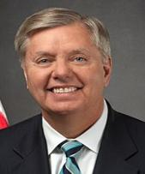
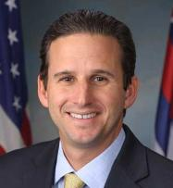
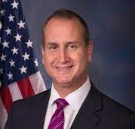
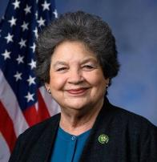
SFOPS/NSRP Subcommittee Leadership
Chairman Lindsey Graham (R-SC)
Ranking Member Brian Schatz (D-HI)
Chairman Mario Diaz-Balart (R-FL) Ranking Member Lois Frankel (D-FL)
Photos via Wikimedia Commons

Slide 53
Account | FY25 Enacted | FY26 House | FY26 Senate | FY26 Enacted | FY27 Requests
Housing Choice Vouchers | $32.15 billion | $32.15 billion | $33.97 billion | $34.96 billion | Fully renew + add 250,000 new vouchers
Global Fund to Fight AIDS, TB and Malaria | $1.65 billion | $1.5 billion | ------ | $1.25 billion | $1.5 billion
Global Tuberculosis | $394.5 million | $394.5 million | ------ | $378.7 million | $1 billion
Global Maternal and Child Health | $915 million | $915 million | ------ | $915 million | $1.15 billion
Of which, Gavi, the Vaccine Alliance | $300 million | $300 million | ------ | $300 million | $340 million
Global Nutrition | $165 million | $172.5 million | ------ | $165 million | $300 million
Global Basic Education | $922 million | $922 million | ------ | $691.5 million | $970 million
Of which, GPE | $121.6 million | $121.6 million | ------ | $121.6 million | $150 million

Slide 54
EPIC Laser Talk: Speaking Powerfully on TB

Slide 55
Sarah Leone
Senior Associate, Grassroots Impact sleone@results.org

Slide 56
How do I create the EPIC Laser Talk?
E = Engage: Get the listener’s attention with a dramatic fact or short value statement.
P = State the Problem: Share the problem you want to listener to solve.
I = Inform about Solutions: Inform the listener about a solution to the problem.
C = Call to action: Tell the listener as specific as possible what you want them to do.
Ideally, phrase your Call to Action in the form of a yes or no question.

Slide 57
2026 EPIC Laser Talk: Tuberculosis
Engage:
While tuberculosis (TB) is often thought of as a disease of the past, it is the world’s leading infectious killer. Many cases are curable, but access to treatment often comes too late.

Slide 58
2026 EPIC Laser Talk: Tuberculosis
Personalize your Engage statement:
How do you relate to this issue?
What resonates with you?
Do you have a personal story about TB you want to share?

Slide 59
2026 EPIC Laser Talk: Tuberculosis
Problem:
We’ve known how to prevent, treat, and cure TB for decades yet an estimated 10.7 million people fell ill and 1.23 million died in 2024. Every year, 2.7 million go undiagnosed. Treatment and diagnosis disruptions last year may lead to more drug resistance and millions of additional cases and deaths.

Slide 60
2026 EPIC Laser Talk: Tuberculosis
Personalize your Problem statement:
Although TB has not gone to pandemic levels in the U.S., it is a global disease and does exist in our country.
Do you know the stats in your state/district?
Diseases know no borders, TB is airborne, so it can impact anyone, anywhere.

Slide 61
2026 EPIC Laser Talk: Tuberculosis
Inform:
Congress can play a key role by continuing U.S. support for bilateral global TB programs. In 2023 alone, the U.S. supported the treatment of 113,000 cases of drug-resistant TB, diagnosis of 6.4 million patients, and prevention for 2.4 million people at the highest risk. Crucial research and new innovations have dramatically shortened TB treatment, reduced side effects, and saved more lives.

Slide 62
2026 EPIC Laser Talk: Tuberculosis
Personalize your Inform statement:
Which parts of the solution stand out to you, and why?
Add any additional context to the presented solutions that will address the problem.

Slide 63
2026 EPIC Laser Talk: Tuberculosis
Call to Action:
Congress can support countries to prevent, find, and treat all forms of TB. Will you urge appropriators to include $1 billion for bilateral global Tuberculosis in Fiscal Year 2027 (FY27)?

Slide 64
2026 EPIC Laser Talk: Tuberculosis
Personalize your Call to Action:
What is the bold action you are demanding for your member of Congress?
Be as specific as you can be with what you want them to do.

Slide 65
FY27 Campaign Resources
Build a Better Future campaign page: https://results.org/2026-campaign
Find links to lobby meeting requests, laser talks, and more!
Understanding Appropriations: https://results.org/resources/understanding-appropriations
FY27 Appropriations memos: https://results.org/resources/fy27-global-appropriations-memos
Coming soon! RESULTS blog post with Dear Colleague letters (https://results.org/blog)

Slide 66
Thank you for learning with us today about one of RESULTS’ most grassroots-energized, people-powered advocacy trainings.

Slide 67
Announcements

Slide 68
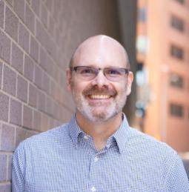
Jos Linn
Director of Grassroots Advocacy
jlinn@results.org

Slide 69
Thank you for joining us!
Who is joining you in the room today?
Please complete the Zoom poll by indicating the number of people in the room with you today
(including yourself).

Slide 70

2026 RESULTS National Conference

Slide 71

2026 RESULTS National Conference
https://tinyurl.com/RESULTSEquityFund

Slide 72

Sunday, February 8, 4:00-5:30 p.m. ET
Join us for some connection and inspiration with advocates from across the globe!
Register today!

Slide 73
Let's Meet the Moment: A Call to Advocate for Women and Girls
Wednesday, February 18, 2 p.m. ET Special Guest Speaker: Zsuzsanna Lippai, CEO, The Fuller Project
All are welcome to join the Together Women Rise Advocacy Chapter, in partnership with RESULTS, for this conversation. At a time when gender equity and global development are increasingly under threat, advocacy is more important than ever.

Slide 74
U.S. Poverty Free Agents
Tuesday, February 17, 1-2 p.m. ET
If you are a solo advocate in your area and want support in taking action on our U.S. poverty campaigns, come on along!
Join via Zoom at https://results.zoom.us/j/98076262565 or dial (929) 436-2866, meeting ID 980 7626 2565.

Slide 75
Media Office Hour
Wednesday, February 18, 2-3 p.m. ET
Grassroots media is a powerful tool to influence lawmakers and strengthen democracy. If you need help brainstorming, writing, editing, or submitting a media piece, RESULTS staff welcomes you to bring your questions to this open office hour.
Join via Zoom at https://results.zoom.us/j/91601524175
or dial (312) 626-6799, meeting ID 916 0152 4175.

Slide 76
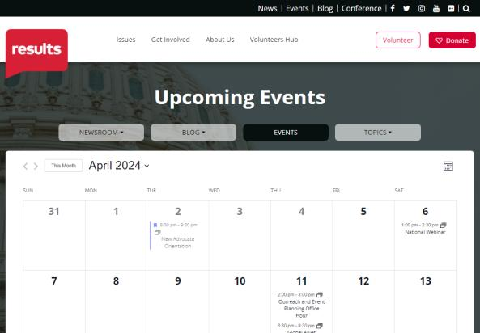
Find events
www.results.org/events

Slide 77
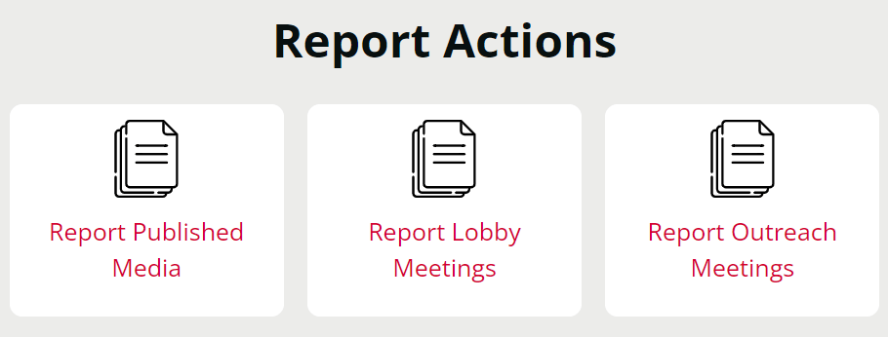
Let us know the amazing things you are doing!
https://results.org/volunteers/reporting-your-advocacy-actions

Slide 78
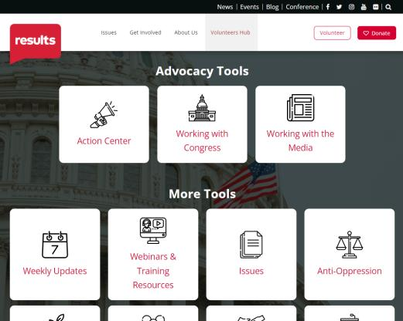
Find today’s slides
www.results.org/volunteers/national-webinars

Slide 79
February Office Closures
Monday, February 16
President’s Day
Friday, February 27
Staff Wellness Day

Slide 80
Join us on March 7 for the next National Webinar!
Registration is always open
for the 2026 National Webinars!
Your 2025 registrations do not carry over,
but one registration takes care of the whole year.
www.tinyurl.com/RESULTS2026

