Slide 1

RESULTS U.S. Policy Forum
October 23, 2025
Welcome!

Slide 2
Our Values
At RESULTS we pledge to create space for all voices, including those of us who are currently experiencing poverty. We will address oppressive behavior in our interactions, families, communities, work, and world. Our strength is rooted in our diversity of experiences, not in our assumptions.
With unearned privilege comes the responsibility to act so the burden to educate and change doesn’t fall solely on those experiencing oppression. When we miss the mark on our values, we will acknowledge our mistake, seek forgiveness, learn, and work together as a community to pursue equity.
Read our full anti-oppression values statement here at results.org/values.
Notes:
Updated AO slide (2/22)

Slide 3

TaShon Thomas
Interim VP, Campaigns and Advocacy
tthomas@results.org

Slide 4

Crickett Nicovich
Director, Government Affairs and Policy
cnicovich@results.org

Slide 5
Update on Shutdown

Slide 6
Current Status
Federal government shutdown continues, the House remains on recess
Medicaid and Medicare will remain funded
WIC received $300 million from the Administration keeping the programming running until middle of November

Slide 7
SNAP Payments Update
SNAP payments for October have already been sent out to recipients
States have begun to issue notices to recipients about the potential for delays or even non-issuances
Department of Agriculture has a contingency fund ($6B) to support the program; but there are nearly $8B needed to fully support

Slide 8
Current actions
Our asks remain the same:
  Tell Congress: Pass an FY26 budget that reduces poverty and includes guardrails to ensure the money is spent as directed
  Tell the media: Shutdown highlights deep flaws in OBBBA, it's time to stand up for our democracy
Take Action:
https://results.org/volunteers/action-center/action-alerts

Slide 9
2026 Campaign

Slide 10



2026 Domestic Priorities
Extend the Child Tax Credit and Earned Income Tax Credit for low wage parents and workers
Protect vital housing and nutrition programs funding through the appropriations process
Continue to hold Congress accountable for impacts of reconciliation bill, especially cuts to SNAP and Medicaid

Slide 11
Tax Policy Work
OBBBA increased the CTC from $2,000 per child to $2,200
  19 million kids from the lowest income families will not receive any additional credit from this change and remain woefully unsupported by the CTC
RESULTS remains committed to providing the full CTC benefit to these families
  Even if that comes over time. Look at how far we’ve come already!

Slide 12
Tax Policy Work
Building on our success
  Current efforts are primarily staff led alongside targeted grassroots groups
  Continue to build support among Republican offices
  Leveraging past bipartisan support that you helped to build
  Advocating for specific changes targeted at the 19 million kids left out under current law
Preparing for the next big moment or opportunity
  Staff is monitoring and building support for some type of policy change
  When that moment comes, we will be ready, and you will be the first to know!

Slide 13
Reconciliation Accountability
Continue to showcase the harms of the reconciliation bill
  Hospital closures
  Loss of nutrition assistance and healthcare
  Growing affordability crisis
Protect Congressional oversight and funds are spent as appropriated
Continue narrative change of "deservedness" of receiving benefits (ie work requirements, etc.)

Slide 14
Domestic Appropriations
Housing: Increase funding and provide more resources for housing and homelessness programs in FY27, and reject any proposed funding reductions or structural changes from the President’s Budget.
Nutrition: Protect, strengthen and fully fund federal food and nutrition programs in the FY27 Appropriations process.

Slide 15
Introduction to Appropriations

Slide 16
Federal Spending
Mandatory spending:
  Required by law, does not need to be approved every year
  Ex. Medicare, Medicaid, SNAP, Social Security
Discretionary spending:
  Incudes Defense (DOD) and Non-Defense (NDD)
  NDD: Housing choice vouchers, WIC, education, scientific research, infrastructure, national parks, environmental protection, foreign assistance...

Slide 17
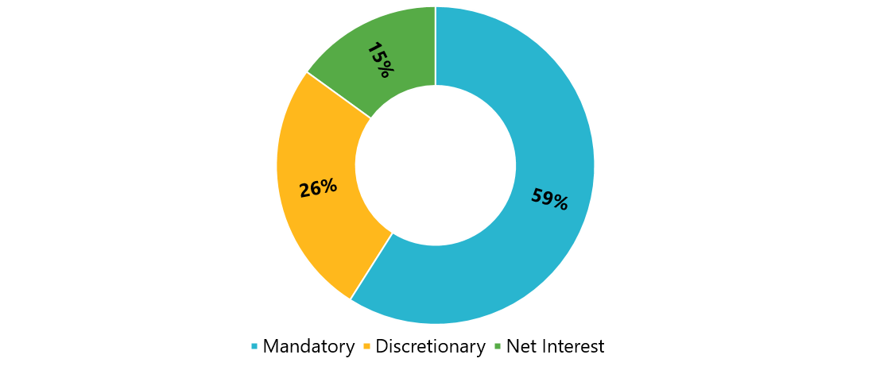
FY25 Federal Spending
Source: CBO

Slide 18
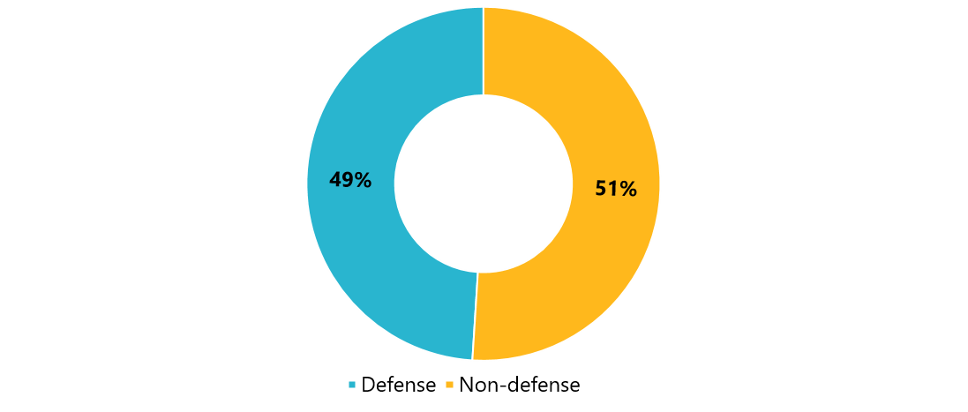
FY25 Discretionary Funding
Source: CBO

Slide 19
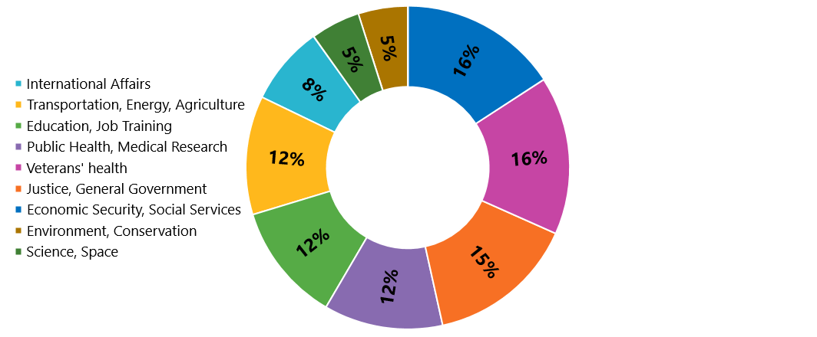
FY24 Non-defense Discretionary
Source: CBPP, data from OMB

Slide 20



power of the purse
"No money shall be drawn from the Treasury, but in Consequence of Appropriations made by Law…”
Photos via Unsplash, Design: Dorothy Monza
Notes:
Article I, section 9, clause 7 of the U.S. Constitution states that "No money shall be drawn from the Treasury, but in Consequence of Appropriations made by Law..." This is what gives Congress the power to make these appropriations. The President, however, still has the power to veto appropriations bills.^{[2]} However, the President does not have line-item veto authority so that he must either sign the entire bill into law or veto it.

Slide 21
Congress decides where our money goes
Legally, it is Congress who decides how to spend money during the appropriations process
12 Appropriations subcommittees in each Chamber
  Each is responsible for one appropriations bill
Our focus:
  Global: State and Foreign Operations (SFOPS)
  HCV: Transportation, Housing, and Urban Development (THUD)
  WIC: Agriculture, Rural Development, FDA

Slide 22
President’s Budget Request
A policy document, laying out the administration’s proposed vision
Can be “dead on arrival” even within the same party
The Office of Management and Budget (OMB) begins working on it up to 18 months before the start of the fiscal year

Slide 23
What’s supposed to happen
February: PBR sent to Congress
March: Budget resolutions
April: Suballocations set, subcommittees draft bills
May: Bills advanced to Appropriations committee and full House/Senate
Sep 30: Final deadline for all 12 bills to avoid a government shutdown

Slide 24
What’s supposed to happen
President’s budget request
APPROPRIATIONS COMMITTEES
BUDGET COMMITTEES
OTHER COMMITTEES
Hold hearings
Draft and mark up budget resolution
Submit views and estimates to budget committees
Set suballocations to subcommittees: 302(b)
Hold hearings, set topline discretionary spending limit: 302(a)
Subcommittees draft and report bills
Full committees vote on bills and send to floor
Source: Congressional Research Service
Notes:
https://sgp.fas.org/crs/misc/R46468.pdf

Slide 25

What actually happens
PBR is often delayed
Congress may not pass a budget resolution
In 50 years, Congress has only managed to pass all 12 bills four times
Continuing resolutions (CR) are common
All aboard the omnibus!
Source: Unsplash

Slide 26
Possible FY27 Timeline
February: Process begins, President's Budget released
March: Advocacy on Dear Colleague letters and individual Member forms
April: Dear Colleague letters close, subcommittees draft bills
May: Full committees pass bills
Sep 30: Deadline for a CR or FY27 bills

Slide 27
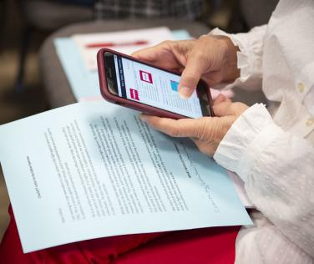
We influence appropriations by…

Slide 28
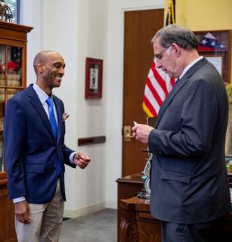
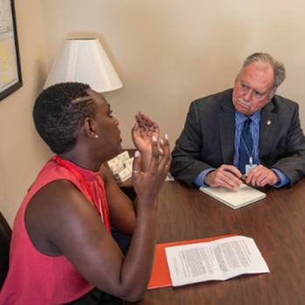
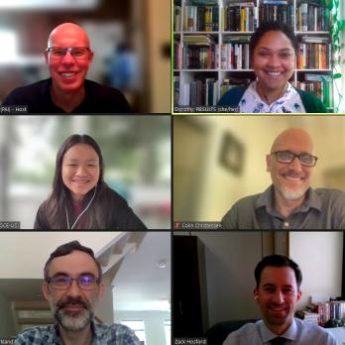
Meeting with MoCs and their staff
In DC, at home, and virtually

Slide 29


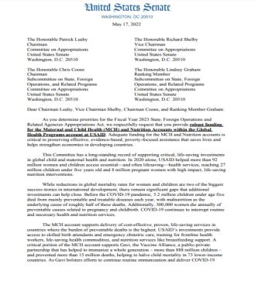
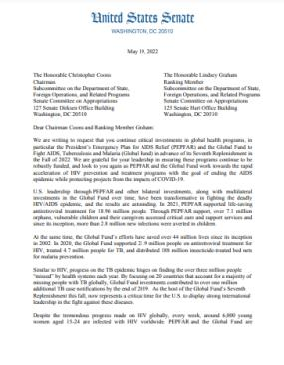
Requesting signatures on “Dear Colleague” letters

Slide 30
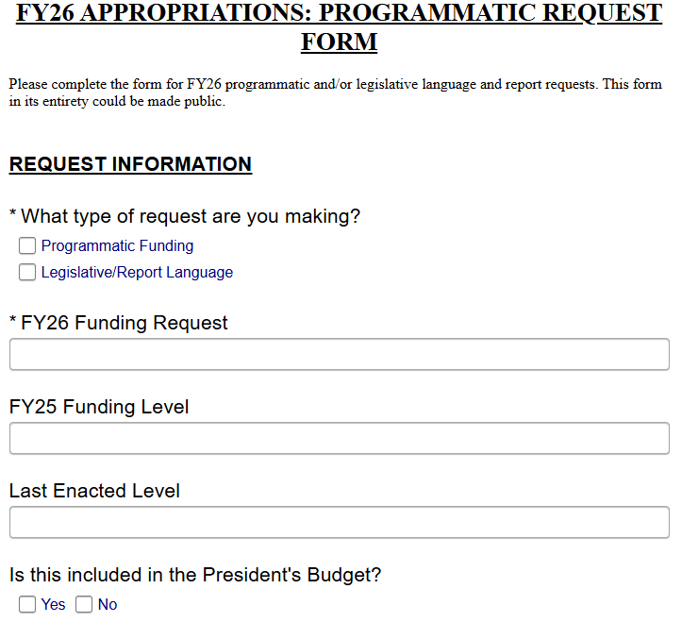
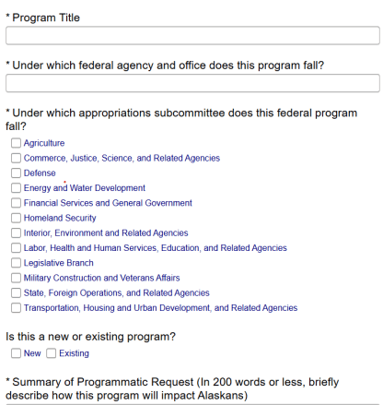
Asking MoCs to submit our funding levels in their personal requests

Slide 31

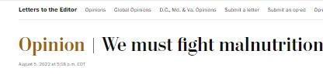
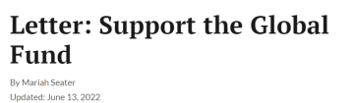
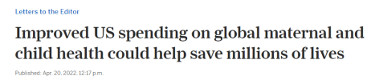
Generating local media
Source: Unsplash

Slide 32
Next Steps

Slide 33
Next Steps
Continue to advocate for funding of vital anti-poverty programs during the current budget fight
Re-engage different policy advocacy committees with grassroots (ie Tax Justice League, etc.)
Grassroots campaigns will likely occur on a quarterly basis due to current political environment

Slide 34
RESULTS website and social media

Slide 35
RESOURCES

Slide 36
In-Depth Information on Priorities

Slide 37
Housing Choice Vouchers
Helps with rent affordability: provides rental assistance to low-income families, the elderly, and individuals with disabilities
Public-Private Partnership: Participants can rent housing in the private market w/o paying more than 30 percent of their income
Special purpose vouchers: Some vouchers target specific populations like foster youth, people with disabilities, veterans, survivors of domestic violence and sexual assault or have additional services like mobility vouchers
Emergency Housing Vouchers: Narrower eligibility for people experiencing homelessness, created under American Rescue Plan Act
US Department of Housing and Urban Development: implements HCV, in partnership with local Public Housing Agencies

Slide 38
Special Supplemental Nutrition Program for Women, Infants, and Children (WIC)
Provides health and nutrition support to low-income pregnant women, breastfeeding women, and children under five
Includes breastfeeding support, nutrition education, healthcare referrals
Allows participants to buy fresh, frozen, or canned fruits and vegetables at authorized WIC vendors.
Positive health impacts = healthcare cost savings
US Department of Agriculture: runs WIC through Food and Nutrition Service

Slide 39
Looming threats on Housing
Trump Administration Budget Proposals to Congress
  Reduce funding, consolidate, and block grant rental assistance + 2-year time-limit
  Eliminate housing and homelessness programs
  Slash funding for HUD by 44 percent
State and Local Governments Wasting Taxpayer Dollars
  Increase in criminalization across communities
  Shift public resources from addressing root causes of homelessness & poverty to policing, courts, and incarceration
  Federal budget shortfalls = more cuts on state

Slide 40
Looming threats on nutrition
Cuts to Special Supplemental Nutrition Program for Women, Infants, and Children (WIC) + Meals on Wheels
  Congress might cut WIC by $100M
  Cuts to HUD programs = less support for Meals on Wheels programs to deliver meals and provide other services to seniors.
State and Local Governments
  Federal budget shortfalls = more cuts on food assistance
  More households losing SNAP benefits = more would qualify for WIC

Slide 41
Appropriations History
Appropriations Account | FY22 | FY23 | FY24 | FY25 | FY26 House | FY26 Senate
Topline: Tenant-Based Rental Assistance | $27.37 billion | $30.25 billion | $32.43 billion | $36.04 billion | $35.27 billion | $37.36 billion
Of which, Section 8 Voucher renewals | $24.1 billion | $26.4 billion | $28.49 billion | $32.15 billion | $32.15 billion | $33.97 billion
Of which, Tenant Protection Vouchers | $100 million | $337 million | $337 million | $337 million | $375 million | $430 million
Of which, Mainstream Vouchers | $459 million | $607 million | $743 million | $743 million | $743 million | $810 million
Of which, Foster Youth Vouchers | $30 million | $30 million | $30 million | $30 million | $30 million | $30 million
WIC | $6 billion | $6 billion | $7.03 billion | $7.6 billion | $7.6 billion | $8.2 billion

Slide 42
New Congressional Targets

Slide 43
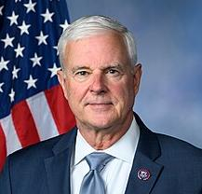
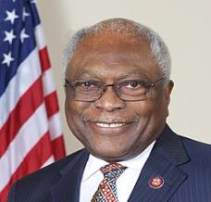
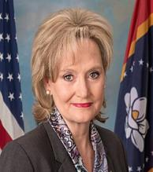
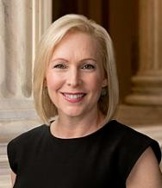
Transportation Housing and Urban Development (THUD) Approps Subcommittee Leadership
Chair Steve Womack (R-AR)
Ranking Member James Clyburn (D-SC)
Chair Cindy Hyde-Smith (R-MS)
Ranking Member Kirsten Gillibrand (D-NY)

Slide 44
Full THUD Membership
House Majority
Steve Womack (R-AR)
Stephanie Bice (R-OK)
Hal Rogers (R-KY)
John Rutherford (R-FL)
Tony Gonzales (R-TX)
Ryan Zinke (R-MT)
Juan Ciscomani (R-AZ)
Dave Joyce (R-OH)
Dale Strong (R-AL)
House Minority
James Clyburn (D-SC)
Mike Quigley (D-IL)
Bonnie Watson Coleman (D-NJ)
Norma Torres (D-CA)
Pete Aguilar (D-CA)
Adriano Espaillat (D-NY)

Slide 45
Full THUD Membership
Senate Majority
Cindy Hyde-Smith (R-MS)
Susan Collins (R-ME)
John Boozman (R-AR)
Shelley Moore Capito (R-WV)
Lindsey Graham (R-SC)
John Hoeven (R-ND)
John Kennedy (R-LA)
Jerry Moran (R-KS)
Katie Britt (R-Al)
Senate Minority
Kirsten Gillibrand (D-NY)
Patty Murray (D-WA)
Dick Durbin (D-IL)
Jack Reed (D-RI)
Chris Coons (D-DE)
Brian Schatz (D-HI)
Chris Murphy (D-CT)
Chris Van Hollen (D-MD)

Slide 46
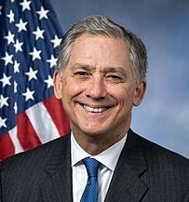
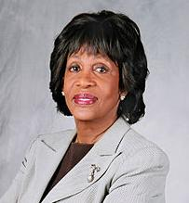
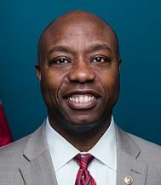
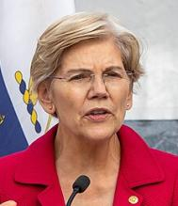
Housing Committee Leadership
Senate Banking, Housing, and Urban Affairs
House Financial Services
Chair French Hill (R-AR)
Ranking Member Maxine Waters (D-CA)
Chair Tim Scott (R-SC)
Ranking Member Elizabeth Warren (D-MA)

Slide 47
Full House Financial Services Membership
Majority
French Hill (R-AR)
Frank Lucas (R-OK)
Pete Sessions (R-TX)
Bill Huizenga (R-MI)
Ann Wagner (R-MO)
Andy Barr (R-KY)
Roger Williams (R-TX)
Tom Emmer (R-MN)
Barry Loudermilk (R-GA)
Warren Davidson (R-OH)
John Rose (R-TN)
Bryan Steil (R-WI)
William Timmons (R-SC)
Marlin Stutzman (R-IN)
Ralph Norman (R-SC)
Dan Meuser (R-PA)
Young Kim (R-CA)
Byron Donalds (R-FL)
Andrew Garbarino (R-NY)
Scott Fitzgerald (R-WI)
Mike Flood (R-NE)
Mike Lawler (R-NY)
Monica De La Cruz (R-TX)
Andy Ogles (R-TN)
Zach Nunn (R-IA)
Isa McClain (R-MI)
Maria Salazar (R-FL)
Troy Downing (R-MT)
Mike Haridopolos (R-Fl)
Tim Moore (R-NC)

Slide 48
Full House Financial Services Membership
Minority
Maxine Waters (D-CA)
Brad Sherman (D-CA)
David Scott (D-GA)
Al Green (D-TX)
Jim Himes (D-CT)
Joyce Beatty (D-OH)
Josh Gottheimer (D-NJ)
Sean Casten (D-IL)
Rashida Tlaib (D-MI)
Sylvia Gracia (D-TX)
Brittany Pettersen (D-CO)
Janelle Bynum (D-OR)
Nydia Velázquez (D-NY)
Gregory Meeks (D-NY)
Stephen Lynch (D-MA)
Emmanuel Cleaver (D-MO)
Bill Foster (D-IL)
Juan Vargas (D-CA)
Vicente Gonzalez (D-TX)
Ayanna Pressley (D-MA)
Ritchie Torres (D-NY)
Nikema Williams (D-GA)
Cleo Fields (D-LA)
Sam Liccardo (D-CA)

Slide 49
Full Senate Banking + Housing Membership
Majority
Minority
Tim Scott (R-SC)
Mike Crapo (R-ID)
Mike Rounds (R-SD)
Thom Tillis (R-NC)
John Kennedy (R-LA)
Bill Hagerty (R-TN)
Cynthia Lummis (R-WY)
Katie Britt (R-AL)
Pete Ricketts (R-NE)
Jim Banks (R-IN)
Kevin Cramer (R-ND)
Bernie Moreno (R-OH)
Dave McCormick (R-PA)
Elizabeth Warren (D-MA)
Jack Reed (D-RI)
Mark Warner (D-VA)
Chris Van Hollen (D-MD)
Catherine Cortez Masto (D-NV)
Tina Smith (D-MN)
Raphael Warnock (D-GA)
Andy Kim (D-NJ)
Ruben Gallego (D-AZ)
Lisa Blunt Rochester (D-DE)
Angela Alsobrooks (D-MD)

Slide 50
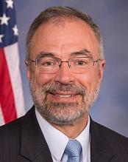
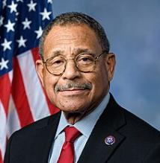
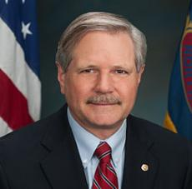
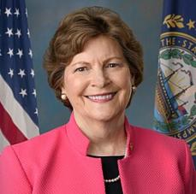
Ag, Rural Development, FDA Approps Subcommittee Leadership
Chair Andy Harris (R-MD)
Ranking Member Sanford Bishop Jr. (D-GA)
Chair John Hoeven (R-ND)
Ranking Member Jeanne Shaheen (D-NH)

Slide 51
Full Ag, Rural Development, FDA Membership
House Majority
House Minority
Andy Harris (R-MD)
Scott Franklin (R-FL)
Robert Aderholt (R-AL)
David Valadao (R-CA)
John Moolenaar (R-MI)
Dan Newhouse (R-WA)
Julia Letlow (R-LA)
Ben Cline (R-VA)
Ashley Hinson (R-IA)
Sanford Bishop Jr. (D-GA)
Chellie Pingree (D-ME)
Lauren Underwood (D-IL)
Marie Gluesenkamp Perez (D-WA)
Marcy Kaptur (D-OH)
Debbie Wasserman Schultz (D-FL)

Slide 52
Full Ag, Rural Development, FDA Membership
Senate Majority
Senate Minority
John Hoeven (R-ND)
Mitch McConnell (R-KY)
Susan Collins (R-ME)
Jerry Moran (R-KS)
Cindy Hyde-Smith (R-MS)
Deb Fischer (R-NE)
Markwayne Mullin (R-OK)
Mike Rounds (R-SD)
Jeanne Shaheen (D-NH)
Jeff Merkley (D-OR)
Tammy Baldwin (D-WI)
Martin Heinrich (D-NM)
Gary Peters (D-MI)
Kirsten Gillibrand (D-NY)
Jon Ossoff (D-GA)

Slide 53
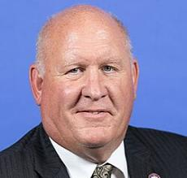
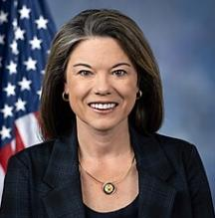
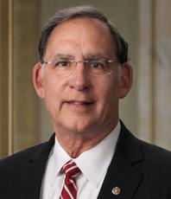
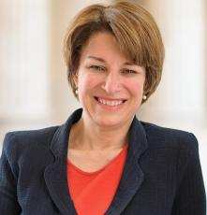
Agriculture Committee Leadership
Chair Glenn "GT" Thompson (R-PA)
Ranking Member Angie Craig (D-MN)
Chair John Boozman (R-AR)
Ranking Member Amy Klobuchar (D-MN)

Slide 54
Full House Ag Membership
Majority
Glenn Thompson (R-PA)
Frank Lucas (R-OK)
Austin Scott (R-GA)
Rick Crawford (R-AR)
Scott Desjarlais (R-TN)
Doug Lamalfa (R-CA)
David Rouzer (R-NC)
Trent Kelly (R-MS)
Don Bacon (R-NE)
Mike Bost (R-IL)
Dusty Johnson (R-SD)
Jim Baird (R-IN)
Tracey Mann (R-KS)
Randy Feenstra (R-IA)
Mary Miller (R-IL)
Barry Moore (R-Al)
Kat Cammack (R-FL)
Brad Finstad (R-MN)
John Rose (R-TN)
Ronny Jackson (R-TX)
Monica De La Cruz (R-TX)
Zach Nunn (R-IA)
Derrick Van Orden (R-WI)
Dan Newhouse (R-WA)
Tony Wied (R-WI)
Rob Bresnahan (R-PA)
Mark Messmer (R-IN)
Mark Harris (R-NC)
Dave Taylor (R-OH)

Slide 55
Full House Ag Membership
Minority
Angie Craig (D-MN)
Shontel Brown (D-OH)
David Scott (D-GA)
Jim Costa (D-CA)
Jim McGovern (D-MA)
Alma Adams (D-NC)
Jahana Hayes (D-CT)
Sharice Davids (D-KS)
Andrea Salinas (D-OR)
Don Davis (D-NC)
Jill Tokuda (D-HI)
Nikki Budzinski (D-IL)
Eric Sorensen (D-IL)
Gabe Vasquez (D-NM)
Jonathan Jackson (D-IL)
Shri Thanedar (D-MI)
Adam Gray (D-CA)
Kristen McDonald Rivet (D-MI)
Shomari Figures (D-Al)
Eugene Vindman (D-VA)
Josh Riley (D-NY)
John Mannion (D-NY)
April McClain Delaney (D-MD)
Chellie Pingree (D-ME)
Salud Carbajal (D-CA)

Slide 56
Full Senate Ag Membership
Majority
Minority
John Boozman (R-AR)
Mitch McConnell (R-KY)
John Hoeven (R-ND)
Joni Ernst (R-IA)
Cindy Hyde-Smith (R-MS)
Roger Marshall (R-KS)
Tommy Tuberville (R-AL)
Jim Justice (R-WV)
Chuck Grassley (R-IA)
John Thune (R-SD)
Deb Fischer (R-NE)
Jerry Moran (R-KS)
Amy Klobuchar (D-MN)
Michael Bennet (D-CO)
Tina Smith (D-MN)
Dick Durbin (D-IL)
Cory Booker (D-NJ)
Ben Ray Luján (D-NM)
Raphael Warnock (D-GA)
Peter Welch (D-VT)
John Fetterman (D-PA)
Adam Schiff (D-CA)
Elissa Slotkin (D-MI)

Slide 57
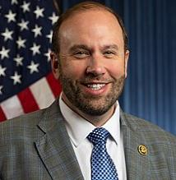
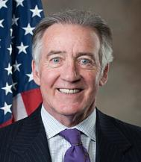
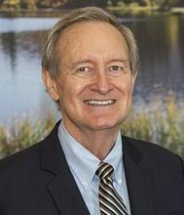
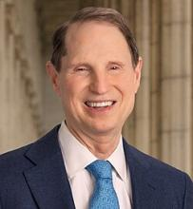
Tax Committees Leadership
House Ways & Means
Senate Finance
Chair Jason Smith (R-MO)
Ranking Member Richard Neal (D-MA)
Chair Mike Crapo (R-ID)
Ranking Member Ron Wyden (D-OR)

Slide 58
Full House Ways & Means Membership
Majority
Jason Smith (R-MO)
Vern Buchanan (R-FL)
Adrian Smith (R-NE)
Mike Kelly (R-PA)
David Schweikert (R-AZ)
Darin LaHood (R-IL)
Jodey Arrington (R-TX)
Ron Estes (R-KS)
Lloyd Smucker (R-PA)
Kevin Hern (R-OK)
Carol Miller (R-WV)
Greg Murphy (R-NC)
David Kustoff (R-TN)
Brian Fitzpatrick (R-PA)
Greg Steube (R-FL)
Claudia Tenney (R-NY)
Michelle Fischbach (R-MN)
Blake Moore (R-UT)
Beth Van Duyne (R-TX)
Randy Feenstra (R-IA)
Nicole Malliotakis (R-NY)
Mike Carey (R-OH)
Rudy Yakym (R-IN)
Max Miller (R-OH)
Aaron Bean (R-FL)
Nathaniel Moran (R-TX)

Slide 59
Full House Ways & Means Membership
Minority
Richard Neal (D-MA)
Lloyd Doggett (D-TX)
Mike Thompson (D-CA)
John Larson (D-CT)
Danny Davis (D-IL)
Linda Sanchez (D-CA)
Terri Sewell (D-AL)
Suzan Delbene (D-WA)
Judy Chu (D-CA)
Gwen Moore (D-WI)
Brendan Boyle (D-PA)
Don Beyer (D-VA)
Dwight Evans (D-PA)
Brad Schneider (D-IL)
Jimmy Panetta (D-CA)
Jimmy Gomez (D-CA)
Steven Horsford (D-NV)
Stacey Plaskett (D-VI)
Thomas Suozzi (D-NY)

Slide 60
Full Senate Finance Membership
Majority
Minority
Mike Crapo (R-ID)
Chuck Grassley (R-IA)
John Cornyn (R-TX)
John Thune (R-SD)
Tim Scott (R-SC)
Bill Cassidy (R-LA)
James Lankford (R-OK)
Steve Daines (R-MT)
Todd Young (R-IN)
John Barrasso (R-WY)
Ron Johnson (R-WI)
Thom Tillis (R-NC)
Marsha Blackburn (R-TN)
Roger Marshall (R-KS)
Ron Wyden (D-OR)
Maria Cantwell (D-WA)
Michael Bennet (D-CO)
Mark Warner (D-VA)
Sheldon Whitehouse (D-RI)
Maggie Hassan (D-NH)
Catherine Cortez Masto (D-NV)
Elizabeth Warren (D-MA)
Bernie Sanders (I-VT)
Tina Smith (D-MN)
Ben Ray Luján (D-NM)
Raphael Warnock (D-GA)
Peter Welch (D-VT)

Slide 62
RESULTS website and social media

