Slide 1

RESULTS National Webinar October 4, 2025 Welcome!

Slide 2
Our Values
At RESULTS we pledge to create space for all voices, including those of us who are currently experiencing poverty. We will address oppressive behavior in our interactions, families, communities, work, and world. Our strength is rooted in our diversity of experiences, not in our assumptions.
With unearned privilege comes the responsibility to act so the burden to educate and change doesn’t fall solely on those experiencing oppression. When we miss the mark on our values, we will acknowledge our mistake, seek forgiveness, learn, and work together as a community to pursue equity.
Read our full anti-oppression values statement here at results.org/values.
Notes:
Updated AO slide (2/22)

Slide 3
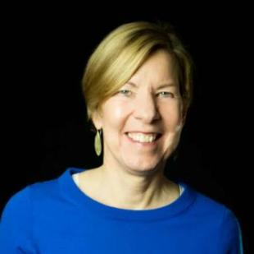
Welcome!
Joanne Carter Executive Director

Slide 4
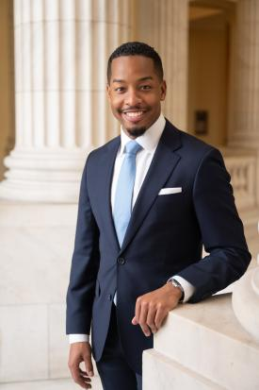
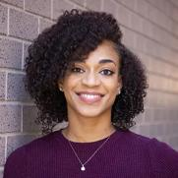
Guest Speaker
Freedom Richardson
Former RESULTS Fellow
Congressional Staffer
In conversation with
Errolyn Gray
Senior Associate
New Advocate
Engagement Team

Slide 5
U.S. Poverty Campaigns

Slide 6
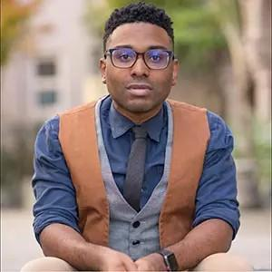
TaShon Thomas
Interim VP, Campaigns and Advocacy tthomas@results.org

Slide 7
Government shutdown showdown
Earlier this year, Congress passed a continuing resolution (CR) to fund the government until September 30th
The Senate has not been able to pass legislation to fund the government; while the House has been on recess
Based on the most recent vote, Senate Republicans need at least 5 more Democratic Senators’ support

Slide 8
What each side wants
Republican Demands
Democratic Demands
"Clean" Continuing Resolution to fund government at current levels
Opposed to any funding extensions requiring Administration to spend already appropriated funds
Any vote on Affordable Care Act subsidies would be a separate vote at some point in the future
Any funding agreement must address healthcare concerns
Undo OBBBA cuts to Medicaid and extend premium tax credits for the Affordable Care Act
Ensure guardrails are placed on funding bills requiring Administration to spend the funding

Slide 9
Shutdown impacts
WIC has a $150 million contingency, which is estimated to run out sometime this week
Funds for October's SNAP benefits will continue as normal; however, it is unclear how much is in the reserve funding for an extended shutdown
Some states have supplemental funding to ensure SNAP and WIC recipients continue, but many will be forced to turn participants away
Federal employees supporting Medicare, Medicaid and other mandatory health payments keep working unabated
Housing choice vouchers will continue until further notice

Slide 10
Tell Congress to protect anti-poverty programs
Use media to draw attention to our issues
During the shutdown, media is your best advocacy tool to get lawmakers’ attention
Tell them to pass a FY26 budget that prioritizes ending poverty and protects constitutional delegation of powers (Congress’ power of the purse)
Contact members of Congress about the FY26 federal budget
Email/call aides urging their bosses to fund WIC and Housing Choice Vouchers at levels that meet current need (with the shutdown, they may be slow to respond)
Budget must include language ensuring funding will be spent as directed
Specific ask for Democrats: Urge them to co-sponsor the Restoring Food Security for American Families and Farmers Act of 2025 (repeals OBBBA’s SNAP cuts) – bill to be introduced soon!

Slide 11
Global Poverty Campaigns

Slide 12


Gavi has helped immunize over 72 million in 2024 alone.
Every 5 minutes, 6 people's lives will have been saved by Gavi-supported vaccines.
Gavi impact
Notes:
Extraordinary success in the past from both Gavi and GF – we are advocating for things that work and that are making an impact

Slide 13

Global Fund impact:
In 2024 alone…
7.4 million people treated for TB
25.6 million people on HIV/AIDS treatment

Slide 14
Our focus remains the same
Fund high-impact global health and education programs, with an urgent focus on Global Fund
Hold administration accountable on outcomes for global health and poverty

Slide 15
Global congressional actions
Senate: Finalize FY26 bill with strong investments
Both Chambers: Hold the White House accountable to spend the money it already has for the fight against global poverty.
Champions for the Global Fund: Standing up for the U.S. 1:2 match, and making sure the U.S. does its part to help save 23 million lives.

Slide 16
Grassroots Inspiration and Action

Slide 17
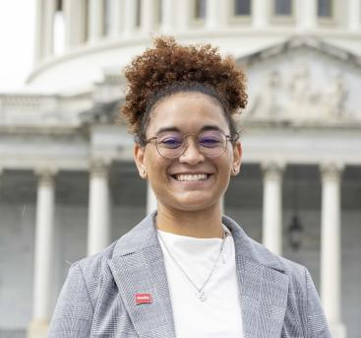
Lakeisha McVey
Senior Manager
Lived Experience Engagement
lmcvey@results.org

Slide 18
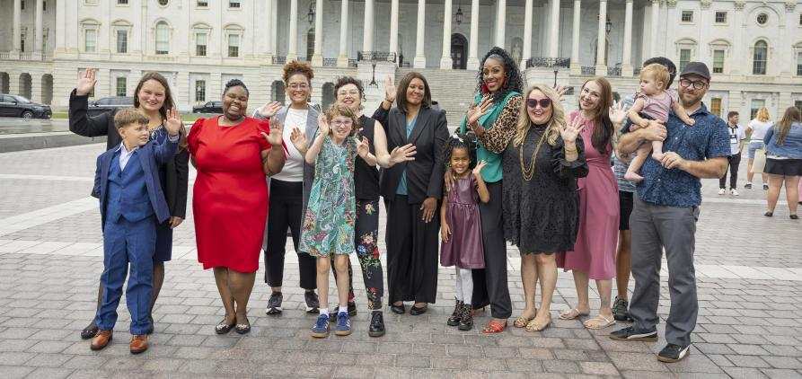
Celebrating the Experts on Poverty Summit

Slide 19
Impact of the EOP Summit
On Capitol Hill
20 lobby meetings: 13 Republican and 7 Democratic offices
Including with these 4 key Members of Congress/Committees:
House Democratic Minority Leader Hakeem Jeffries
House Ways and Means Committee
Senate Democratic Steering and Policy Committee
Senate Agriculture Committee
In the Media
Features in CBS News & Washington Post
Laying the foundation for lasting connections with key reporters

Slide 20
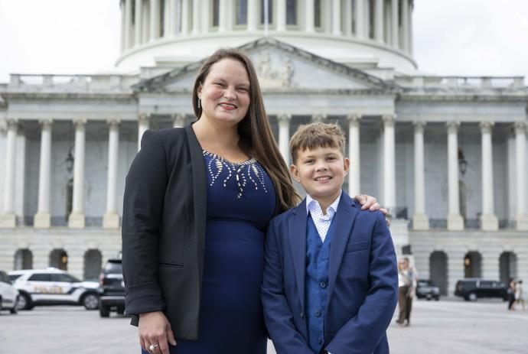
Expert on Poverty Maureen Bowling

Slide 21
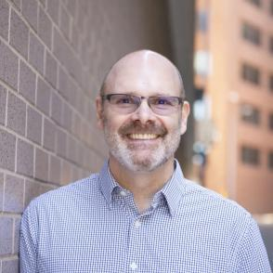
Grassroots Actions
Jos Linn
Director of Grassroots Advocacy
jlinn@results.org

Slide 22


Slide 23
600 Voices Media Campaign
600 media pieces by the end of 2025
Letters to the editor, op-eds, and other media
You currently have 391!
Push our policy priorities forward
Hold political leaders accountable
Strengthen our democracy

Slide 24
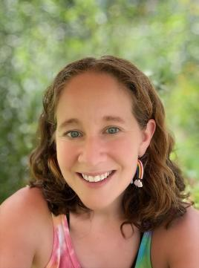
Media Share
Sarah Miller
RESULTS St. Louis
Former RESULTS Fellow

Slide 25
“600 Voices” Media Resources
RESULTS Action Center has letter to the editor templates
https://results.org/volunteers/action-center/
RESULTS Media Tools and How-to’s on the RESULTS website
https://results.org/volunteers/media-tools
Media and Democracy Project local journalism directory:
https://www.mediaanddemocracyproject.org/journalism-directory/#Directory
Report your published media: https://results.org/report-media
Contact Jos Linn for assistance: jlinn@results.org

Slide 26
“600 Voices” Media Resources
Media Office Hours
Wednesday, October 8, 9:00-10:00 p.m. ET
Wednesday, October 22, 2:00-3:00 p.m. ET
Monday, November 3, 8:00-9:00 p.m. ET
Wednesday, November 19, 2:00-3:00 p.m. ET
Monday, December 8, 8:00-9:00 p.m. ET
Wednesday, December 17, 2:00-3:00 p.m. ET
Join at https://results.zoom.us/j/93668005494
or call (312) 626-6799, meeting ID 936 6800 5494.
No registration required.

Slide 28
Announcements

Slide 29
Thank you for joining us!
Who is joining you in the room today?
Please complete the Zoom poll by indicating the number of people in the room with you today
(including yourself).

Slide 30
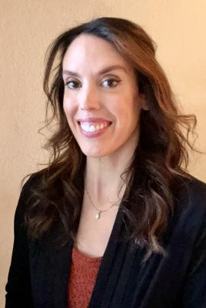
Andrea Balderrama
RESULTS Phoenix
RESULTS Fellow

Slide 31
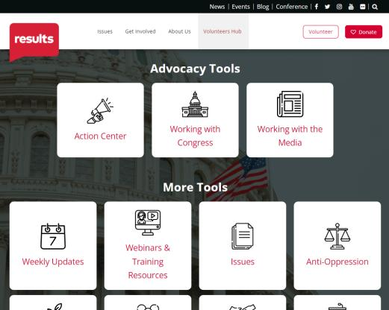
Find today’s slides
results.org/volunteers/national-webinars

Slide 32
U.S. Poverty Policy Forum
Thursday, October 23, 8 p.m. ET
This policy forum will provide insight into RESULTS’ U.S. poverty campaign priorities for the remainder of 2025.
Learn how we are preparing for final FY26 budget negotiations, with a focus on ensuring that housing and nutrition programs are protected and funded.
Please join us!
Register today

Slide 33

Register at:
https://results.zoom.us/meeting/register/0BOYsJ_FQNa9hNdj0YDnGg#/registration

Slide 34
RESULTS Organizational Partners
Global Allies (Returned Peace Corps Volunteers)
Thursday, October 9, 8:30 p.m. ET
Register today.
Together Women Rise Advocacy Chapter
with RESULTS
Tuesday, October 21, 8:30 p.m. ET
Learn more.

Slide 35
Monthly Support Calls
U.S. Poverty Free Agents
Tuesday, October 21, 1:00 p.m. ET
Contact Jos Linn at jlinn@results.org for information.
Global Poverty Free Agents
Contact Lisa Marchal (lmarchal@results.org) for support.

Slide 36
Monthly Support Calls
Media Office Hour
Wednesday, October 8, 9:00-10:00 p.m. ET
Wednesday, October 22, 2:00-3:00 p.m. ET
Join at https://results.zoom.us/j/93668005494
or call (312) 626-6799, meeting ID 936 6800 5494.
Action Network Power Hour
Thursday, October 16 (choose 12:30 p.m. ET or 8:00 p.m. ET)
Join via https://results.zoom.us/j/97263551612
or call (312) 626-6799, meeting ID 972 6355 1612.

Slide 37
October Office Closures
Monday, October 13: Indigenous Peoples’ Day
Friday, October 24: Staff Wellness Day

Slide 38
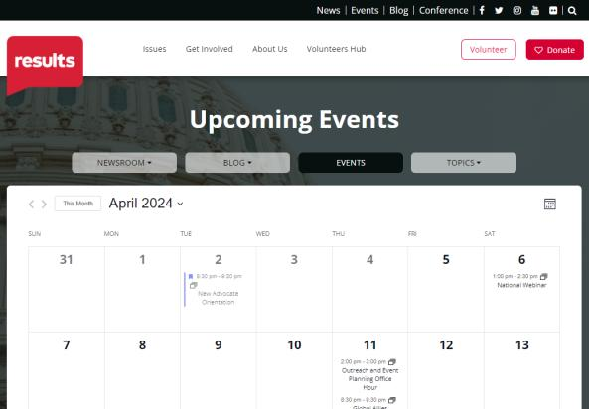
Find events
results.org/events

Slide 39
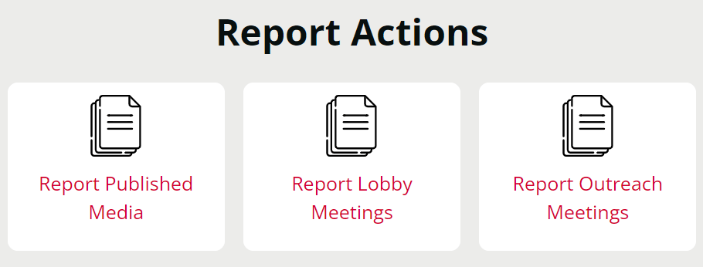
Let us know the amazing things you are doing!
https://results.org/volunteers/reporting-your-advocacy-actions

Slide 40
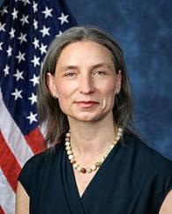
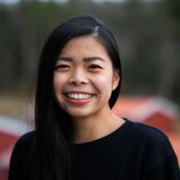
Join us for the November 2025 National Webinar
Sachiko Osawa
Community of Practice Coordinator
Leading Change Network
Rep. Maxine Dexter
(D-OR-3)
Saturday, November 1, 1:00 p.m. ET
Register: www.tinyurl.com/RESULTS2025

Slide 42
RESULTS website and social media

