Slide 1
RESULTS National Webinar April 5, 2025 Welcome!

Slide 2
Our Values
At RESULTS we pledge to create space for all voices, including those of us who are currently experiencing poverty. We will address oppressive behavior in our interactions, families, communities, work, and world. Our strength is rooted in our diversity of experiences, not in our assumptions.
With unearned privilege comes the responsibility to act so the burden to educate and change doesn’t fall solely on those experiencing oppression. When we miss the mark on our values, we will acknowledge our mistake, seek forgiveness, learn, and work together as a community to pursue equity.
Read our full anti-oppression values statement here at results.org/values.
Notes:
Updated AO slide (2/22)

Slide 3
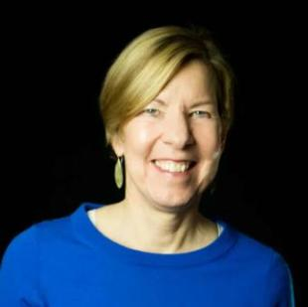
Welcome!
Joanne Carter Executive Director

Slide 4
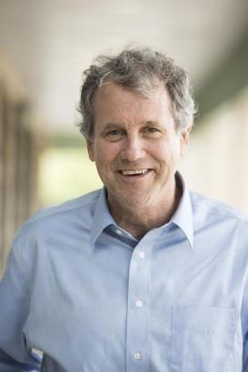
Guest Speaker
Former Senator Sherrod Brown
(D-OH)

Slide 5
Global Poverty Campaigns

Slide 6
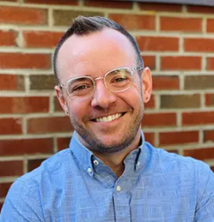
Global Campaigns Update
Colin Smith
Director of Global Policy
csmith@results.org

Slide 7
Demand the State Department restart terminated work. Decisions are only “final” if Congress lets them be. Reassert congressional authority over foreign aid. Congress has the power of the purse: they need to use it!
What should Congress do?

Slide 8
Congress & restarting programs
All this, and much more, is in grave danger:
Gavi, the Vaccine Alliance, supporting half the world’s kids
Tuberculosis programs in 20+ countries
Basic education programs for over 40 million kids
Access to basic nutrition across Asia, Africa, and Latin America
Neonatal care in at least 5 countries
8

Slide 9
Congress & the power of the purse
What can Congress do?
Submit official appropriations requests
Join congressional “sign on” letters
Speak personally to subcommittee leaders
9

Slide 10
U.S. Poverty Campaigns

Slide 11
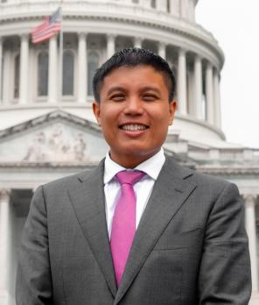
U.S. Campaigns Update
Michael Santos
Associate Director US Poverty / Policy msantos@results.org

Slide 12
Budget Resolutions
Congress passed CR for budget FY2025
Congress now focused on passing budget reconciliation before Memorial Day recess to advance their tax, border, and energy bill.
Both House + Senate need to compromise and realign their respective Budget Resolutions

Slide 13
House Proposed Cuts
Committee |  | Increase or decrease (-) in deficits, 2025-2034
Decreases in Mandatory Spending |  | -$2,002T
 | Agriculture (SNAP is here) | -$230B
 | Education and Workforce (WIC, TANF, and Head Start are here) | -$330B
 | Energy and Commerce (Medicaid is here) | -$880B
 | Financial Services (most housing programs are here) | -$1B
 | Natural Resources | -$1B
 | Oversight and Government Reform | -$50B
 | Transportation and Infrastructure | -$10B
 | Unspecified committee | -$500B

Slide 14
Medicaid and SNAP in Reconciliation
Supplemental Nutrition Assistance Program (SNAP) provides food assistance for nearly 40 million
Medicaid provides health coverage for nearly 80 million Americans
Both programs are vital to communities around the country, particularly rural communities, keeping people housed, fed, and healthy

Slide 15
What you can do
Tell lawmakers in lobby meetings, emails, and calls to not cut vital health and nutrition programs like SNAP and Medicaid.
Attend town hall meetings (only if comfortable) and urge lawmakers to oppose cuts.
Submit a letter to the editor combatting waste, fraud and abuse motive to cut benefits.
On CTC/EITC/Housing...
Unsplash

Slide 16
Action and Allies Campaign: Grassroots Inspiration and Action

Slide 17
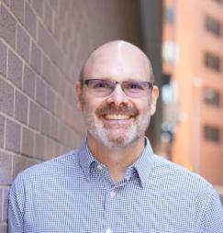
First 100 Days Lobbying Campaign
Jos Linn
Interim Director of Grassroots Advocacy
jlinn@results.org

Slide 18
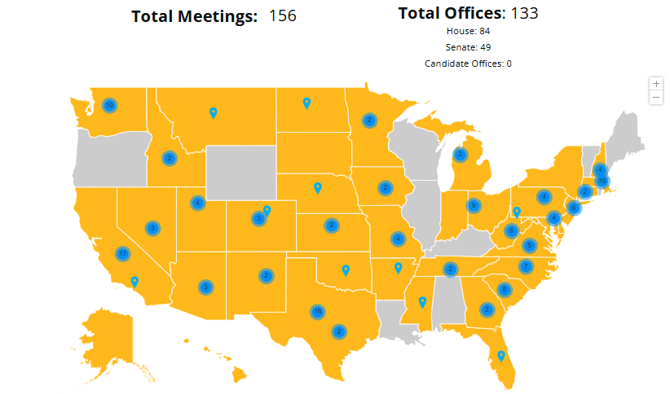
First 100 Days Lobbying Campaign
39 states
so far!
(AK, AZ, AR, CA, CO, CT, DE, FL, GA, HI, ID, IN, IA, KS, MD, MA, MI, MN, MI, MO, MY, NE, NV, NH, NM, NY, NC, ND, OH, OK, PA, SC, SD, TN, TX, UT, VA, WA, WV)
Report meetings at:
https://results.org/report-lobby-meetings
Updated as of 4/4

Slide 19
Lobby Meeting Resources
Action and Allies campaign page:
https://results.org/action-and-allies
119th Congressional Scorecard:
https://tinyurl.com/119CongSC Request lobby prep with staff: kfleischer@results.org
Other general lobbying resources:
https://results.org/volunteers/lobbying
Report your lobby meetings:
https://results.org/report-lobby-meetings
Congress will be on recess April 12-27.
Request face-to-face meetings and attend public events to talk to them.

Slide 20
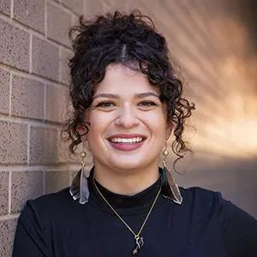
Grassroots Inspiration and Action
Sarah Leone
Senior Associate, ​ Grassroots Team​
sleone@results.org ​

Slide 21
Grassroots Inspiration and Action
Thank you for all your advocacy!

Slide 22
Grassroots Inspiration and Action
Who here has attended a lobby meeting so far this year?

Slide 23
Grassroots Inspiration and Action
Do we have any new advocates attend their first lobby meeting on the call today?

Slide 24
Grassroots Inspiration and Action
How many of you heard “waste, fraud, and abuse” rhetoric in your meetings and what was your response?

Slide 25
Grassroots Inspiration and Action
So what happens when the conversation in your meetings does not go as planned? How do you respond?

Slide 26
Grassroots Inspiration and Action
Do you feel more confident now that you can better handle challenging situations in a lobby meeting?

Slide 27
Announcements

Slide 28
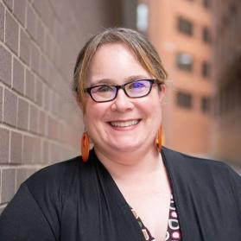
Closing Announcements
Lisa Marchal
Senior Manager, Grassroots Impact
lmarchal@results.org

Slide 29
Thank you for joining us!
Who is joining you in the room today?
Please complete the Zoom poll by indicating the number of people in the room with you today
(including yourself).

Slide 30
Need help filling out FY26 appropriations forms?
Join our Appropriations Forms Office Hour,
Fridays in April, 1:00 p.m. ET
Senior Associate Katie Fleischer will be available each Friday in April to answer questions and guide you through the process.
Join via https://results.zoom.us/j/98776436629 or call (312) 626-6799, meeting ID 987 7643 6629.
Be sure to also review our requests and cheat sheets.

Slide 31
Motivational Interviewing
Knowledge Network
RESCHEDULED
Come practice your new MI skills.
Register today!
To get caught up in previous MI sessions, go to: https://results.org/resources/getting-unstuck-with-your-members-of-congress-using-motivational-interviewing-techniques

Slide 32
Anti-Oppression Learning Community
Friday, April 25, 12:00 p.m. ET
This gathering offers a safe and brave space for volunteers to discuss topics of systemic oppression as they intersect with the issues RESULTS advocates on. It’s a space to foster learning and growth by asking questions, sharing thoughts and opinions, and building community.
Register today

Slide 33
New Advocate Orientations
Wednesday, April 9, 8:00 ET
In this 60-minute orientation, you will learn about our advocacy model, current campaigns, and opportunities to be a volunteer with RESULTS.
Register today!
Please reach out to Alicia Stromberg with any questions astromberg@results.org.

Slide 34
Partnership Calls
Global Allies (Returned Peace Corps Volunteers) Webinar
Thursday, April 10, 8:30 p.m. ET
Click for more details.
Together Women Rise Partnership Webinar
Tuesday, April 15, 8:30 p.m. ET
Click to learn more.

Slide 35
Monthly Support Calls
U.S. Poverty Free Agents
Tuesday, April 15, 1:00 p.m. ET
Contact Jos Linn at jlinn@results.org for information.
Global Poverty Free Agents
Contact Lisa Marchal (lmarchal@results.org) for more support.

Slide 36
Monthly Support Calls
Media Office Hour
Wednesday, April 16, 2:00-3:00 p.m. ET
Join at https://results.zoom.us/j/93668005494 or call (312) 626-6799, meeting ID 936 6800 5494.
Action Network Power Hour
Thursday, April 24 (choose 12:30 p.m. ET or 8:00 p.m. ET)
Join via https://results.zoom.us/j/97263551612
or call (312) 626-6799, meeting ID 972 6355 1612.

Slide 37
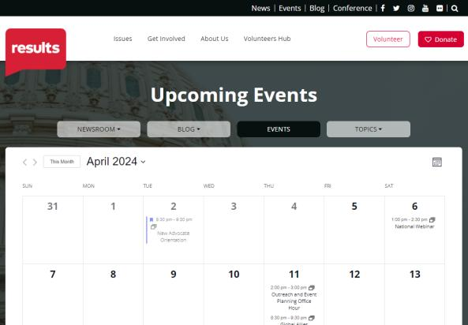
Find events
results.org/events

Slide 38
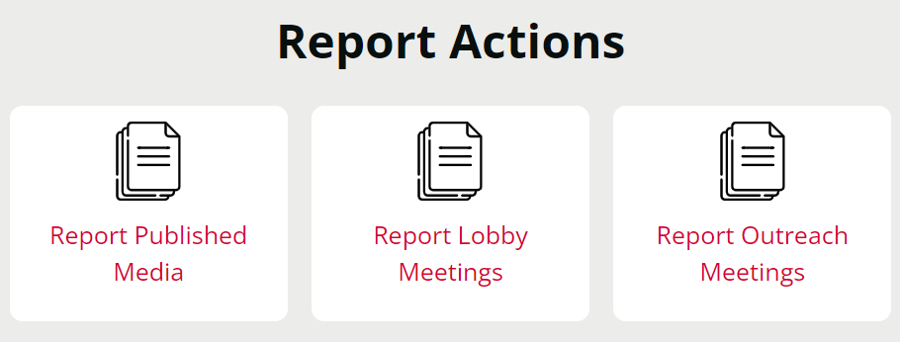
Let us know the amazing things you are doing!
https://results.org/volunteers/reporting-your-advocacy-actions

Slide 39
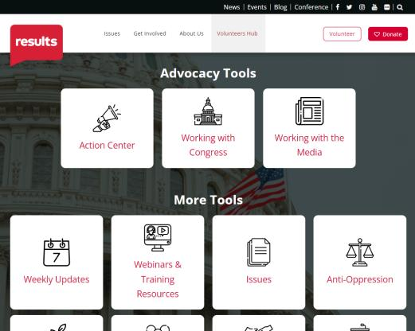
Find today’s slides
results.org/volunteers/national-webinars

Slide 40
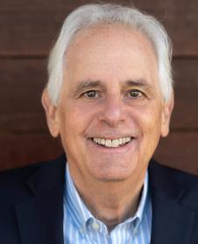
Join us for the May 2025 National Webinar
Special Guest:
RESULTS Founder Sam Daley-Harris
Saturday, May 3, 1:00 p.m. ET
Register: www.tinyurl.com/RESULTS2025

Slide 42
RESULTS website and social media

