Slide 1
RESULTS National Webinar March 1, 2025 Welcome!

Slide 2
Our Values
At RESULTS we pledge to create space for all voices, including those of us who are currently experiencing poverty. We will address oppressive behavior in our interactions, families, communities, work, and world. Our strength is rooted in our diversity of experiences, not in our assumptions.
With unearned privilege comes the responsibility to act so the burden to educate and change doesn’t fall solely on those experiencing oppression. When we miss the mark on our values, we will acknowledge our mistake, seek forgiveness, learn, and work together as a community to pursue equity.
Read our full anti-oppression values statement here at results.org/values.
Notes:
Updated AO slide (2/22)

Slide 3
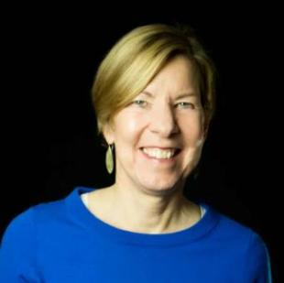
Welcome!
Joanne Carter Executive Director

Slide 4
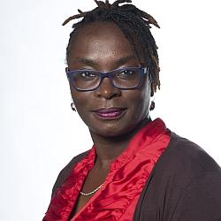
Guest Speaker
Maurine Murenga

Slide 5
Global Poverty Campaigns

Slide 6
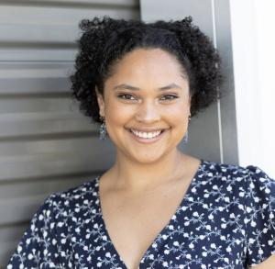
Global Campaigns Update
Dorothy Monza
Global Nutrition and Child Health Policy Manager
dmonza@results.org

Slide 7
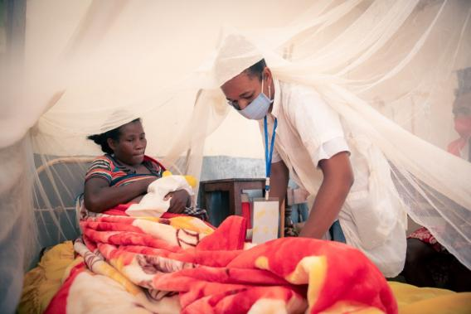
We must speak up for critical health and anti-poverty programs and call on Congress to do the same
Photo by Samy Rakotoniaina, February 2021
7

Slide 8
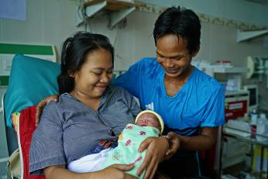
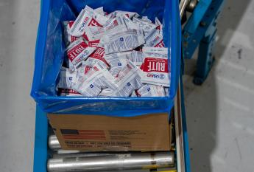
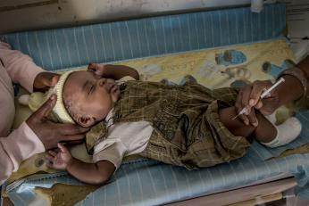
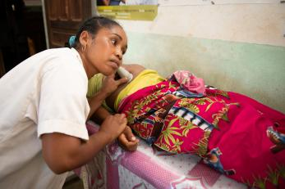
Terminations affect all our global health issues
Photo credits (left to right); Syanne Luntungan/ USAID EMAS; USAID; Karen Kasmauski/ MCSP and Jhpiego; Samy Rakotoniaina/MSH

Slide 9
We must speak up for critical health and anti-poverty programs and call on Congress to do the same
Maternal & Child Health
HIV/AIDS, Tuberculosis, & Malaria
Basic Education
Basic Education

Slide 10
U.S. Poverty Campaigns

Slide 11
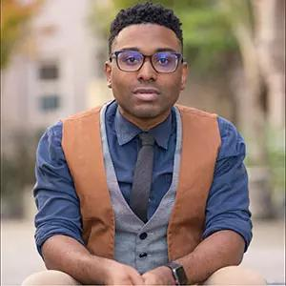
U.S. Campaigns Update
TaShon Thomas
Interim VP, Campaigns & Advocacy tthomas@results.org

Slide 12
Budget Resolutions Passed
Both Chambers passed vastly different versions of FY25 Budget Resolutions
Senate is focusing on a "skinny" approach prioritizing border and defense spending, energy production and unspecified budget cuts
House's "one big, beautiful bill approach" proposes $4.5 trillion in tax cuts, while also providing over $2 trillion in cuts to budget spending

Slide 13
House Proposed Cuts
Committee |  | Increase or decrease (-) in deficits, 2025-2034
Decreases in Mandatory Spending |  | -2,002T
 | Agriculture (SNAP is here) | -230B
 | Education and Workforce (WIC, TANF, and Head Start are here) | -330B
 | Energy and Commerce (Medicaid is here) | -880B
 | Financial Services | -1B
 | Natural Resources | -1B
 | Oversight and Government Reform | -50B
 | Transportation and Infrastructure | -10B
 | Unspecified committee | -500B

Slide 14
Medicaid and SNAP in Reconciliation
Supplemental Nutrition Assistance Program (SNAP) provides food assistance for nearly 40 million
Medicaid provides health coverage for nearly 80 million Americans
Both programs are vital to communities around the country, particularly rural communities, keeping people fed and healthy

Slide 15
Next Steps
To avoid a government shutdown, either a Continuing Resolution or full budget must be passed by March 14th
For reconciliation to work, both Chambers must pass the same version of a budget resolution for the Senate to pass without the filibuster

Slide 16
What you can do
Tell your senators in lobby meetings, emails, and calls to reject the House budget resolution and protect SNAP and Medicaid from drastic cuts
Attend town hall meetings (only if comfortable) and urge lawmakers to oppose cuts
Submit a letter to the editor combatting waste, fraud and abuse motive to cut benefits
Unsplash

Slide 17
Action and Allies Campaign: Grassroots Inspiration and Action

Slide 18
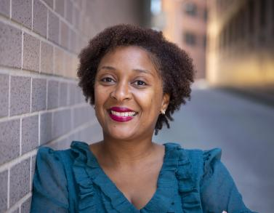
First 100 Days Lobbying Campaign
Karyne Bury
Manager, Grassroots Team
kbury@results.org

Slide 19
First 100 Days Lobbying Campaign
Our Goal
Meet with all 100 Senators and key House committee members by April 30.

Slide 20
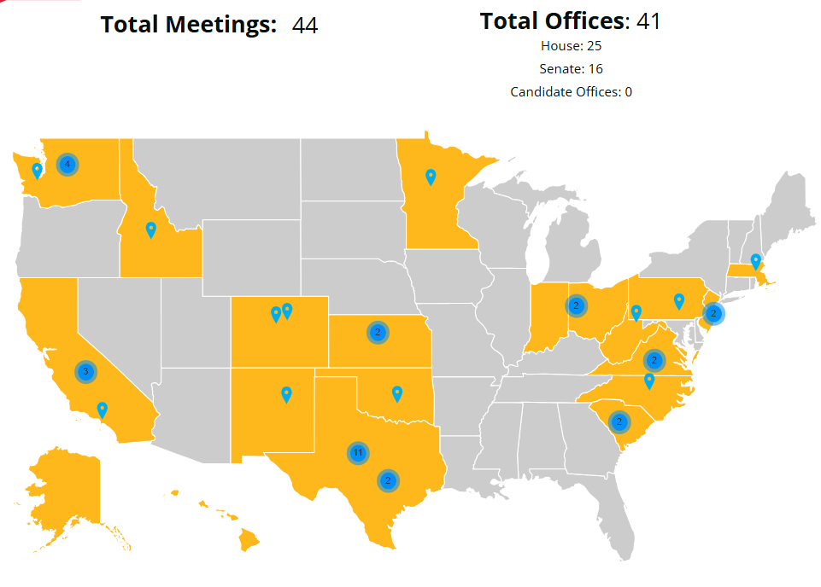
First 100 Days Lobbying Campaign
as of 3/1/2025

Slide 21
First 100 Days Media
91 reported pieces of media!
77 LTE’s
8 op-ed’s
1 editorial
3 podcasts
1 blog Feature
1 news article
See all our grassroots media at:
https://airtable.com/appfAPsIcTTu2lXMX/shrO8VvkjjXxlhbOU
Unsplash

Slide 22
First 100 Days Outreach
9 reported outreach activities and events
Houston, TX
St. Louis, MO
Beaumont, CA (3)
Shephardstown, WV
Ollala, WA
Corvallis, OR
Ft. Worth, TX

Slide 23
For Lobbying Success . . .
Lobbying resources for 2025:
https://results.org/action-and-allies
119th Congressional Scorecard:
https://tinyurl.com/119CongSC For lobby prep with staff: kfleischer@results.org
Other general lobbying resources:
https://results.org/volunteers/lobbying
Request
Prepare
Assess
Report
Celebrate

Slide 24
First 100 Days Lobby Meetings
Grassroots Volunteer Shares
Heide Craig, RESULTS South Carolina
Jenna Fliesen, RESULTS Spokane
Craig Roshaven, RESULTS Ft. Worth

Slide 25
Grassroots Board Nominations

Slide 26
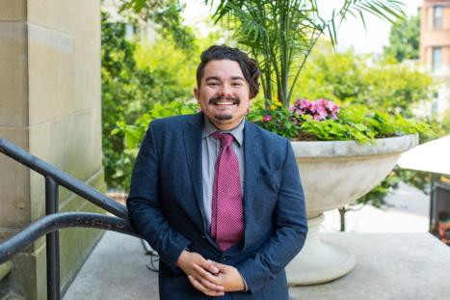
Aaron Carrillo
Grassroots Board Member

Slide 27
Nominations open for Grassroots Director seat on the RESULTS Board!
Responsibilities of the Board
Set vision and goals and evaluate progress
Assure our financial solvency and integrity
Be an ambassador for the organization
Responsibilities of Grassroots Directors
Advocate for the interests of the grassroots on the Board and its committees
Educate volunteers about the activities of the Board
Ensure that open Grassroots Director seats are filled in a timely way
Notes:
B

Slide 28
News from the Board: 2025 Strategic Priorities
Fully drive what we can disproportionately impact
US policy: Child Tax Credit
Global policy: Global Fund leadership
Take actions to avert harm
US policy: SNAP, appropriations
Global policy: Foreign Aid
Balance responding to threats with ensuring our influence
Notes:
B

Slide 29
News from the Board: Building Grassroots Power
Action as antidote
Find and bring in those motivated to engage
Key coverage
Community a key theme for 2025
Caring for ourselves and for each other
Tackling resignation and burnout
Notes:
B

Slide 30
News from the Board: Growing Resources and Capacity
In a shrinking and increasingly competitive philanthropic environment, we are focusing on:
maintaining relationships and delivering value in existing partnerships, such as with the Gates Foundation and the Rockefeller Foundation
Establishing the most active engagement with a pool of substantial new prospects in our history
Notes:
B

Slide 31
Do you know a great leader?
Nomination Criteria:
Have at least one year of active experience as a RESULTS volunteer in the United States
Be a current volunteer
Be committed to the mission of RESULTS and our anti-oppression values
Be ready and willing to meet the responsibilities of Grassroots Directors
More information at: https://results.org/blog/2025-grassroots-director-nominations-are-open
Notes:
B

Slide 32
Election timeline
March 1-April 15 – Submit nominations
By May 9 – Nominees submit documentation
May 15, 9 p.m. ET – Candidates forum on Zoom, online voting opens
June 7 – Candidates speak on the June national webinar
June 22, Midnight ET – Online voting closes
June 23–27 – REF Board elects the slate nominated by the volunteers
July 1 – Successful candidate takes office
Read more including how to nominate someone at: https://results.org/blog/2025-grassroots-director-nominations-are-open
Notes:
B

Slide 33
Announcements

Slide 34
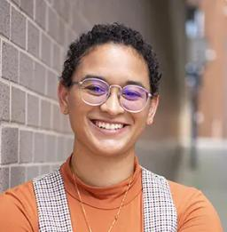
Closing Announcements
Lakeisha McVey
Senior Manager, Lived Experience Engagement
lmcvey@results.org

Slide 35
Thank you for joining us!
Who is joining you in the room today?
Please complete the Zoom poll by indicating the number of people in the room with you today
(including yourself).

Slide 36
Policy Forum: Reconciliation 101
Thursday, March 6, 8:30 p.m. ET
Join us to learn about the reconciliation bill working its way through Congress and what it means for our advocacy. You'll hear what reconciliation is, how it works, and what the best opportunities are to improve the tax code and protect programs like SNAP, Social Security, Medicare/Medicaid, WIC and the Earned Income Tax Credit.
Register today

Slide 37
Need help filling out FY26 appropriations forms?
Join our Appropriations Forms Office Hour,
Fridays in March, 1:00 p.m. ET
Senior Associate Katie Fleischer will be available each Friday in March to answer questions and guide you through the process.
Join via https://results.zoom.us/j/98776436629 or call (312) 626-6799, meeting ID 987 7643 6629.
Be sure to also review our requests and cheat sheets.

Slide 38
Motivational Interviewing
Final session
March 12, 8:00 p.m. ET
Join us for a conversation on what to do if you run into roadblocks using your new MI skills.
Register today!
To get caught up in previous MI sessions, go to: https://results.org/resources/getting-unstuck-with-your-members-of-congress-using-motivational-interviewing-techniques

Slide 39
AO Learning Community
Friday, March 21, 12:00 p.m. ET
In honor of Women's History Month and World Tuberculosis (TB) Day on March 24, we'll discuss the intersection of gender equity and TB and why gender-responsive care is essential to end the global TB epidemic.
Register today

Slide 40
New Advocate Orientations
Tuesday, March 4, 1:00 ET
Wednesday, March 12, 8:00 ET
In this 60-minute orientation, you will learn about our advocacy model, current campaigns, and opportunities to be a volunteer with RESULTS.
Register today!
Please reach out to Alicia Stromberg with any questions astromberg@results.org.

Slide 41
Partnership Calls
Global Allies (Returned Peace Corps Volunteers) Webinar
Thursday, March 13, 8:30 p.m. ET
Click for more details.
Together Women Rise Partnership Webinar
Tuesday, March 18, 8:30 p.m. ET
Click to learn more.

Slide 42
Monthly Support Calls
U.S. Poverty Free Agents
Tuesday, March 18, 1:00 p.m. ET
Contact Jos Linn at jlinn@results.org for information.
Global Poverty Free Agents
Meeting TBD
Contact Lisa Marchal (lmarchal@results.org) for more information.

Slide 43
Monthly Support Calls
Media Office Hour
Wednesday, March 19, 2:00-3:00 p.m. ET
Join at https://results.zoom.us/j/93668005494 or call (312) 626-6799, meeting ID 936 6800 5494.
Action Network Power Hour
Thursday, March 27, 12:30 p.m. ET or 8:00 p.m. ET (choose one)
Join via https://results.zoom.us/j/97263551612
or call (312) 626-6799, meeting ID 972 6355 1612

Slide 44
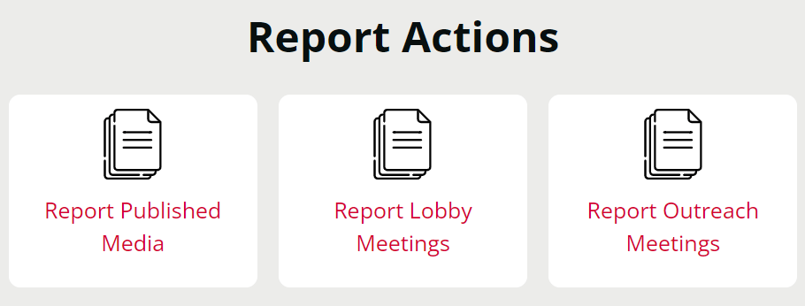
Let us know the amazing things you are doing!
https://results.org/volunteers/reporting-your-advocacy-actions

Slide 45
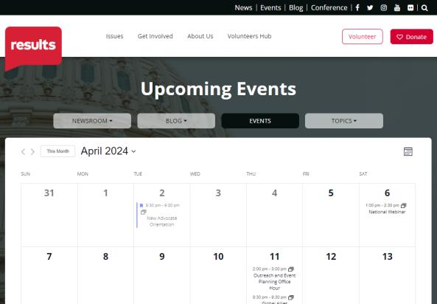
Find events
results.org/events

Slide 46
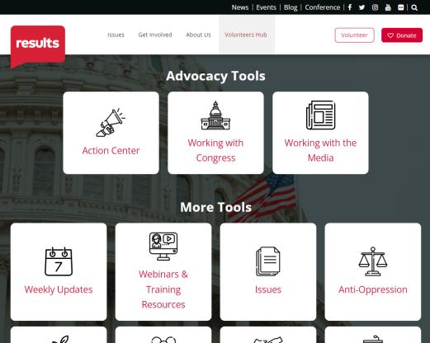
Find today’s slides
results.org/volunteers/national-webinars

Slide 47
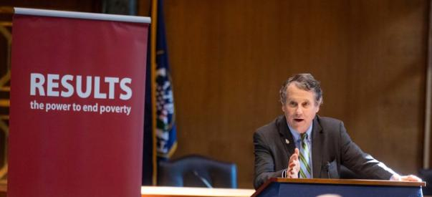
Join us for the April 2025 National Webinar
Special Guest:
Former Sen. Sherrod Brown (D-OH)
Saturday, April 5, 1:00 p.m. ET
Register: www.tinyurl.com/RESULTS2025

Slide 49
RESULTS website and social media

