Slide 1
RESULTS National Webinar February 1, 2025 Welcome!

Slide 2
Our Values
At RESULTS we pledge to create space for all voices, including those of us who are currently experiencing poverty. We will address oppressive behavior in our interactions, families, communities, work, and world. Our strength is rooted in our diversity of experiences, not in our assumptions.
With unearned privilege comes the responsibility to act so the burden to educate and change doesn’t fall solely on those experiencing oppression. When we miss the mark on our values, we will acknowledge our mistake, seek forgiveness, learn, and work together as a community to pursue equity.
Read our full anti-oppression values statement here at results.org/values.
Notes:
Updated AO slide (2/22)

Slide 3
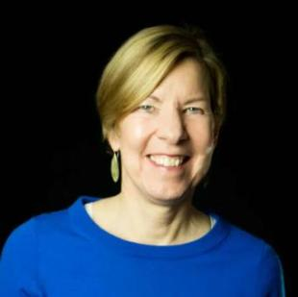
Welcome!
Joanne Carter Executive Director

Slide 4
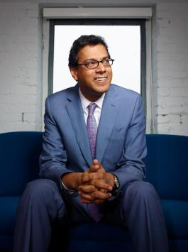
Guest Speaker
Dr. Atul Gawande Assistant Administrator for Global Health at USAID

Slide 5
Global Poverty Campaigns

Slide 6
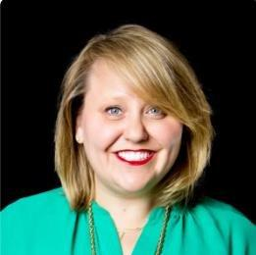
Campaign Updates
Crickett Nicovich Director, Policy and Government Affairs
cnicovich@results.org

Slide 7
Foreign Aid Stop-Work Order
Jan. 24 – Administration froze almost all foreign assistance for 90 days, and sent "stop-work" orders to State and USAID
Catastrophic effects: life-saving programs unable to provide medicine and nutrition, education programs shut down, health workers lost jobs

Slide 8
Foreign Aid Stop-Work Order
Goes against Congress, who appropriated funding for these programs
Jan. 28 – Waiver for "life-saving humanitarian assistance"
Unclear if this covers all global health programs

Slide 9
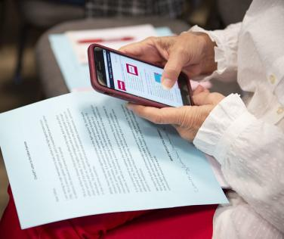
What you can do
Tell your members of Congress to publicly oppose the stop-work order
Submit a letter to the editor urging Congress to oppose the stop-work order

Slide 10
Our Priorities
Get meetings – First 100 Days
Keep juggling!
Appropriations is a "dam" to shore up support behind our issue areas
If we aren't talking about our issues— nobody is!
Unsplash

Slide 11
Appropriations
FY25:
Continuing resolution (CR) until March 14
FY26:
Should start soon, but may be delayed
Committee members will begin work on FY26 before finalizing FY25
Leave-behind memos: results.org/resources/fy26-global-appropriations-memos

Slide 12
FY26 Appropriations
Account | FY24 Enacted | FY25 House | FY25 Senate | FY26 RESULTS Ask
Global Fund | $1.65 billion | $1.25 billion | $1.2 billion | $2 billion
Tuberculosis | $394.5 million | $394.5 million | $394.5 million | $1 billion
Maternal and Child Health | $915 million | $915 million | $940 million | $1.15 billion
Of which, Gavi | $300 million | $300 million | $300 million | $340 million
Nutrition | $165 million | $172.5 million | $165.5 million | $300 million
Basic Education | $922 million | $922 million | $640.55 million | $1.15 billion
Of which, GPE | $121.6 million | $121.6 million | $85 million | $200 million

Slide 13
U.S. Poverty Campaigns

Slide 14
Federal Funding Freeze
Jan. 27 – Administration froze almost all federal grants and funding for domestic programs
Later announced "direct benefits" would not be affected, including SNAP and Medicaid
However, Trump's anti-DEI order means homelessness programs, Meals on Wheels, and others were still at risk

Slide 15
Federal Funding Freeze
Goes against Congress, who appropriated funding for these programs
After a lawsuit filed by multiple nonprofits, a federal judge temporarily blocked the freeze
Jan. 29 – Administration rescinded the memo for now

Slide 16
What you can do
Tell your members of Congress to publicly condemn the freeze
Submit a letter to the editor urging Congress to condemn the freeze
Unsplash

Slide 17
Reconciliation
A process to quickly move budget legislation
Republican Congressional leadership plans to use it to pass a large tax package
Expected timeline:
Negotiations starting: February
House vote: April/ May
Senate vote: May/ June

Slide 18
First 100 Days
Key Committees: House Ways & Means and Senate Finance
Democrats are preparing to introduce a CTC bill this month
Opportunity to push for cosponsors!
Our main goal: Encourage committee Republicans to protect and expand the CTC

Slide 19
Action and Allies Campaign: Bold Motivational Interviewing in 2025

Slide 20
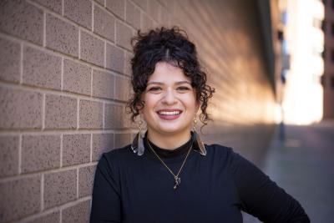
What is Motivational Interviewing?
Sarah Leone
Senior Associate, Grassroots Impact
Sleone@results.org

Slide 21
Let's be bold and impactful in 2025!

Slide 22
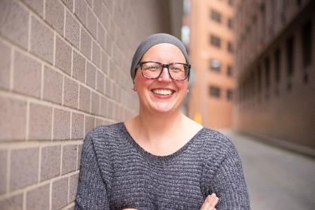
MI Skill Building and Role Plays
Joanna DiStefano
Senior Associate for Grassroots Impact jdistefano@results.org

Slide 23
Affirmations
Acknowledgement of shared values
Strengths, efforts, values, intentions
Usually offered as a statement
Sets a tone of mutual respect
Great conversation starter and a demonstration of active listening later

Slide 24
Affirmations
Research
RESULTS 119th Congressional Scorecard
MOC websites, newsletters, news, social media
Lobby reports
Researching your Members of Congress training
Compliment, recognition and appreciation given with sincerity

Slide 25
Open Questions
Requires an answer that is not Yes or No
Who, What, When, Where, How
Use Why questions with caution.
Emphasizes an attitude of openness and acceptance that everyone has their own perspective
Demonstrates curiosity and compassion
Utilized easily throughout the EPIC framework, which will still culminate in a Call to Action

Slide 26
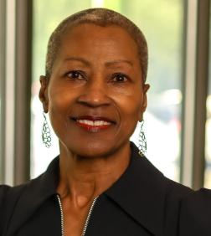
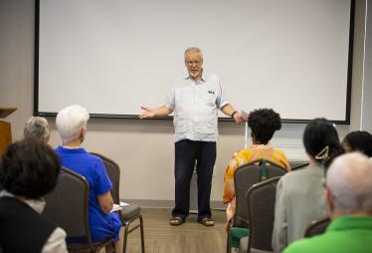
Open Questions
Craig Roshaven
RESULTS Ft. Worth (TX)
Ruth Thurmond Scott
RESULTS Triangle (NC)

Slide 27
First 100 Days Lobbying Campaign
Our Goal
Meet with all 100 Senators and Key House Committee Members by the end of April

Slide 28
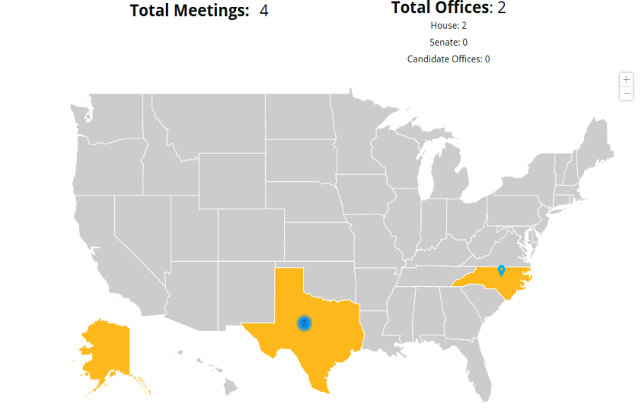

Slide 29
For Lobbying Success . . .
For lobby prep with staff: kfleischer@results.org
118th Congressional Scorecard:
https://tinyurl.com/118CongSC
Lobbying resources for 2025:
https://results.org/action-and-allies
Other general lobbying resources:
https://results.org/volunteers/lobbying
Request
Prepare
Assess
Report
Celebrate

Slide 30
Motivational Interviewing resources
Go to the RESULTS website for numerous MI resources: https://results.org/resources/getting-unstuck-with-your-members-of-congress-using-motivational-interviewing-techniques
Join the next MI training session on Wednesday, February 12 at 8:00 p.m. ET. Register today! (watch the previous sessions here)

Slide 31
Why does this work matter?
"Our belief in the promise of social change through connections with one another is why we keep trying after feeling disappointment, why we keep returning after grieving, why we keep fighting after resting. It's why we keep building after systems fail, why we keep on loving even when we are experiencing heartbreak. It's why we take actions that embody solidarity, resistance, and hope.
It’s why we infuse our efforts with joy, passion, affirmation, and healing. We intuitively know that something better is blooming, growing, emerging, and we want to be part of that momentum, that stream, that journey."
- Author, Activist, and Social Scientist Deepa Iyer

Slide 32
Announcements

Slide 33
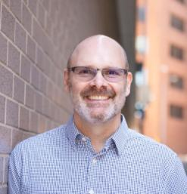
Closing Announcements
Jos Linn
Interim Director, Grassroots Impact
jlinn@results.org

Slide 34
Thank you for joining us!
Who is joining you in the room today?
In the poll, please respond with the number of people in the room with you (including yourself).

Slide 35
Policy Forum: Global Fund 101
Thursday, February 6, 8:00 p.m. ET
In the coming year, country governments will be asked to reinvest in the Global Fund to Fight AIDS, Tuberculosis and Malaria. In this webinar we’ll look at what makes the Global Fund unique, what’s possible in the years ahead, and how our advocacy can help get the U.S. government to recommit.
Register today

Slide 36
New Advocate Orientations Resume!
Tuesday, February 4, 1:00-2:00 p.m. ET
Wednesday, February 12, 8:00-9:00 p.m. ET
In this 60-minute orientation, you will learn about our advocacy model, current campaigns, and opportunities to be a volunteer with RESULTS.
Please reach out to Alicia Stromberg with any questions astromberg@results.org.
Register today!

Slide 37
Join the next session of Motivational Interviewing Series
Wednesday, February 12, 8:00-9:00 p.m. ET
Want to build bridges with lawmakers? Want to effectively talk to people who disagree with you? This is the series for you!
With only 2 more live sessions, don’t miss this opportunity to gain skills by using MI for effective dialogue with lawmakers you struggle to move into action.
Register today!
(watch the previous trainings here)

Slide 38
Leadership Community Calls
Action Network Power Hour
Thursday, February 27
Two options: 12:30–1:30 p.m. ET or 8:00–9:00 p.m. ET
Join via https://results.zoom.us/j/97263551612 or call (312) 626-6799, meeting ID 972 6355 1612.
Advocate Mentor Roundtable
Wednesday, February 5
Click for more details

Slide 39
Partnership Calls
Global Allies (Returned Peace Corps Volunteers) Webinar
Thursday, February 13, 8:30 p.m. ET
Click for more details.
Together Women Rise Partnership Webinar
Tuesday, February 18, 8:30 p.m. ET
Click to learn more.

Slide 40
Monthly Support Calls
U.S. Poverty Free Agents
Tuesday, February 18, 1:00 p.m. and 8:00 p.m. ET
Contact Jos Linn at jlinn@results.org for information.
Media Office Hour
Wednesday, February 19, 2:00-3:00 p.m. ET
Join at https://results.zoom.us/j/93668005494 or call (312) 626-6799, meeting ID 936 6800 5494.
Global Poverty Free Agents
Monday, February 24, 7:00 p.m. ET
Contact Lisa Marchal at lmarchal@results.org for information.

Slide 41
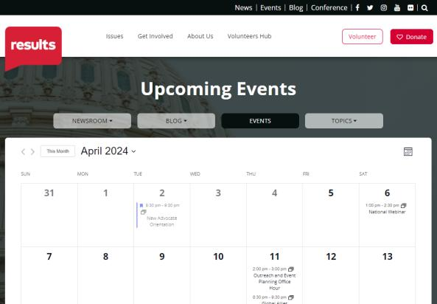
Find events
results.org/events

Slide 42
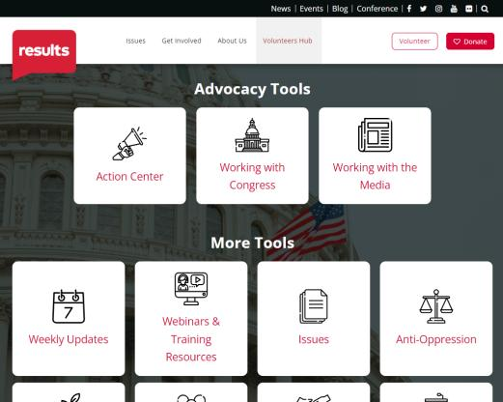
Find today’s slides
results.org/volunteers/national-webinars

Slide 43
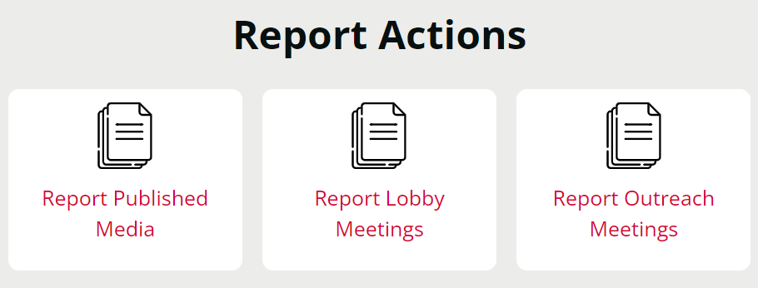
Let us know the amazing things you are doing!
https://results.org/volunteers/reporting-your-advocacy-actions

Slide 44
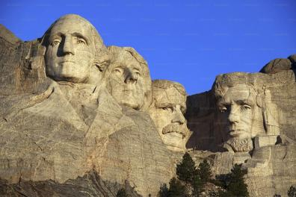
RESULTS Office Closure
President's Day
Monday, February 17
Unsplash

Slide 45
Join us for the March 2025 National Webinar
Saturday, March 1,
1:00 p.m. ET
Register: www.tinyurl.com/RESULTS2025

Slide 47
RESULTS website and social media

