Slide 1
RESULTS National Webinar December 7, 2024 Welcome!

Slide 2
Our Values
At RESULTS we pledge to create space for all voices, including those of us who are currently experiencing poverty. We will address oppressive behavior in our interactions, families, communities, work, and world. Our strength is rooted in our diversity of experiences, not in our assumptions.
With unearned privilege comes the responsibility to act so the burden to educate and change doesn’t fall solely on those experiencing oppression. When we miss the mark on our values, we will acknowledge our mistake, seek forgiveness, learn, and work together as a community to pursue equity.
Read our full anti-oppression values statement here at results.org/values.
Notes:
Updated AO slide (2/22)

Slide 3
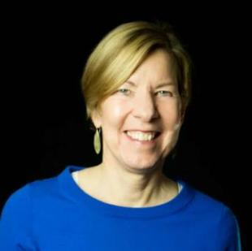
Welcome!
Joanne Carter Executive Director

Slide 4
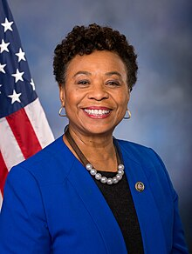
Rep. Barbara Lee (D-CA-12)
Guest Speaker

Slide 5
Global Poverty Campaigns

Slide 6
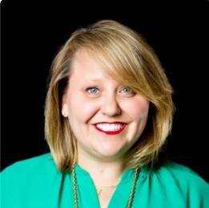
Global Campaign Updates
Crickett Nicovich Director, Policy and Government Affairs
cnicovich@results.org

Slide 7
End TB Now Act
S.288 introduced
by Sens. Young (R-IN) and Menendez (D-NJ)
Passed Senate Foreign Relations Committee
5 total cosponsors
Passed full Senate
by unanimous consent
H.R.1776 introduced
by Reps. Bera (D-CA) and Salazar (R-FL)
Passed House Foreign Affairs Committee
96 total cosponsors
Goal:
Attach to a Continuing Resolution (CR)

Slide 8
READ Act
S.41 introduced
by Sens. Durbin (D-IL) and Rubio (R-FL)
Passed Senate Foreign Relations Committee
7 total cosponsors
Passed full Senate
by unanimous consent
H.R.681 introduced
by Reps. Smith (R-NJ) and Meng (S-NY)
Passed House Foreign Affairs Committee
80 total cosponsors
Goal:
Pass full House on suspension calendar

Slide 9
Celebrating FY25 Appropriations
Highest ever signers on House TB DC, increased House Global Fund signers
Protected FY24 funding levels for Gavi, TB, and education
Increases included for maternal and child health and nutrition
Included requested language on maternal and child health, Gavi, nutrition and TB

Slide 10
Celebrating Global Health Wins
Gavi, the Vaccine Alliance
Almost 50 members signed on to bipartisan resolutions supporting increased U.S. investment
The Biden Administration announced a bold, early pledge of at least $1.58 billion over 5 years
Global Nutrition
106 bipartisan MoCs signed on to a letter supporting Nutrition for Growth

Slide 11
Getting Congress on the record
This year, 207 Representatives and 48 Senators took at least one of our global policy actions!

Slide 12
U.S. Poverty Campaigns

Slide 13
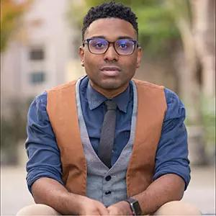
U.S. Campaign Updates
TaShon Thomas Interim VP, Campaigns & Advocacy tthomas@results.org

Slide 14
Celebrating Housing Wins
Laid groundwork for the re-introduction of the Renter Tax Credit
Began education lawmakers and grassroots on the impacts of recent Supreme Court case (Grants Pass v. Johnson)
Placed several op-eds in local and national papers about housing affordability

Slide 15
Celebrating Nutrition Wins
Stopped harmful cuts to the Supplemental Nutrition Assistance Program (SNAP)
Ensured the Special Supplemental Nutrition Program for Women, Infants and Children (WIC) saw increased funding and eliminated the $1B deficit for the program
Created bi-partisan support for the removal of the federal felony ban on receiving food assistance

Slide 16
Celebrating Tax Wins
Educated lawmakers on the Child Tax Credit; passed it out of the House with an overwhelming super majority; created a new baseline for negotiations during the next Congress
Participated in the development of the Direct File software currently in use by the IRS
Worked with coalition partners to submit letters of support for funding for extension of Direct File

Slide 17
Opportunities this month
Continue to advocate for the Farm Bill and the one year extension
Prepare for the incoming Administration and 119th Session of Congress

Slide 18
Grassroots Café: Group Planning

Slide 19
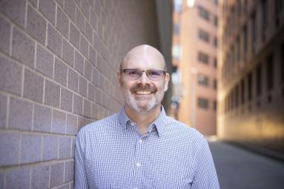
Double/50 Media Campaign
Jos Linn
Interim Director for Grassroots Impact jlinn@results.org

Slide 20
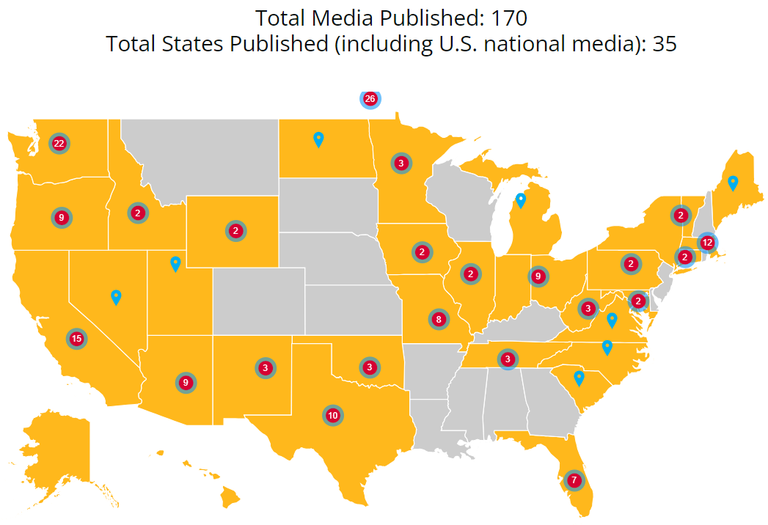
Double/50 Media Campaign
Here is where we are today!

Slide 21
Double/50 Media Campaign
Goal: Using media to make poverty a priority for the new Congress by getting 300 new media pieces across all 50 states by the end of December
Can you commit to sending in one letter or op-ed each week in December?
Here are the states where we still need media: Alabama, Arkansas, Colorado, Delaware, Georgia, Kansas, Kentucky, Louisiana, Mississippi, Montana, Nebraska, New Hampshire, New Jersey, Rhode Island, South Dakota, and Wisconsin.

Slide 22
Use our Hooks Tracker
Our Double/50 media hooks tracker has lots of hooks!
Find hooks: https://tinyurl.com/RESULTSMediaHooks
The list is updated weekly with hooks on various issues
Find media templates in the hooks spreadsheet (tab at bottom) and in our Action Center
For media coaching, contact Jos Linn at jlinn@results.org.

Slide 23
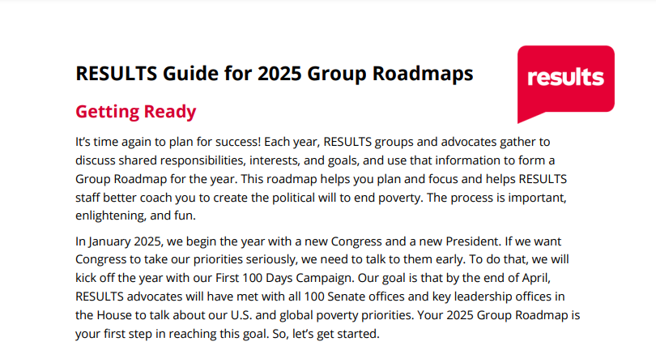
2025 Group Planning
https://results.org/volunteers/working-with-your-group

Slide 24
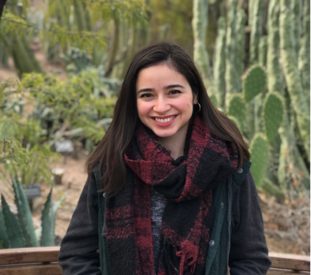
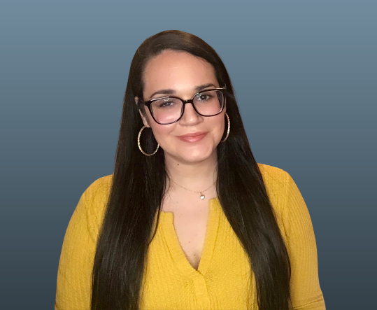
Grassroots Shares
Rayna Castillo
Co-Leader
RESULTS Phoenix (AZ) Domestic
Angela Rodriguez
Leader
RESULTS North Florida

Slide 25
Group Planning helps everyone!
Your planning helps RESULTS:
Know the size of our network
Know how many members of Congress we cover
Target our actions for maximum impact
Tailor our support to help you reach your individual and group goals

Slide 26
Group Planning helps everyone!
Your planning helps you:
Shape how you want to create the political will to end poverty
Focus on the actions you enjoy and will have the biggest impact
Identify how each person can share their gifts and contribute to a common cause
Try new things in your advocacy

Slide 27
Schedule your planning meeting!
Schedule your Group Planning meeting for December or early January.
Please complete your Group Roadmaps and updated Rosters by January 15
Roadmaps have been sent to Group Leaders.
For questions, contact Jos Linn at jlinn@results.org.

Slide 28
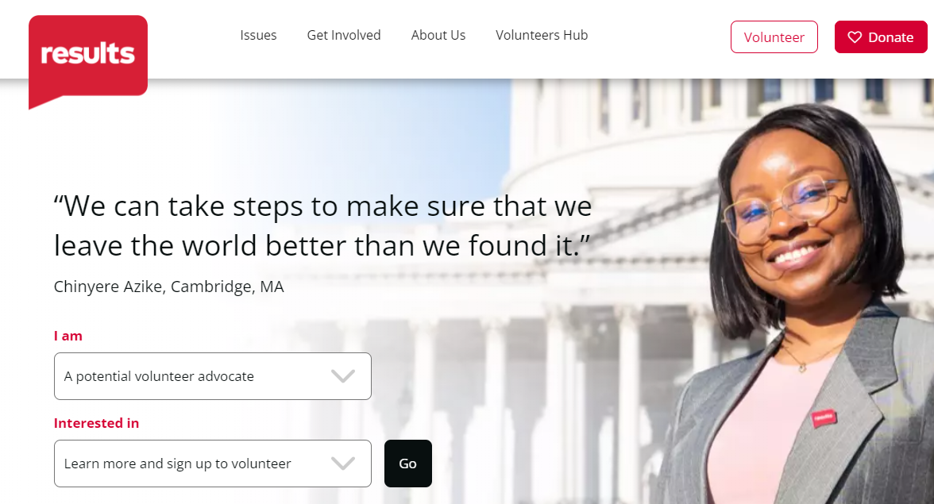
Find Planning Resources online

Slide 29
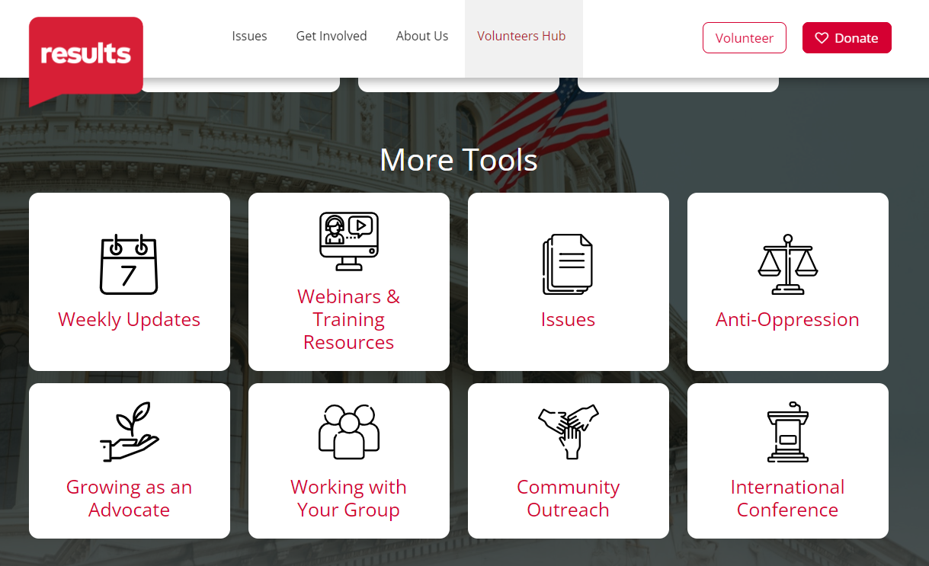
Find Planning Resources online

Slide 30
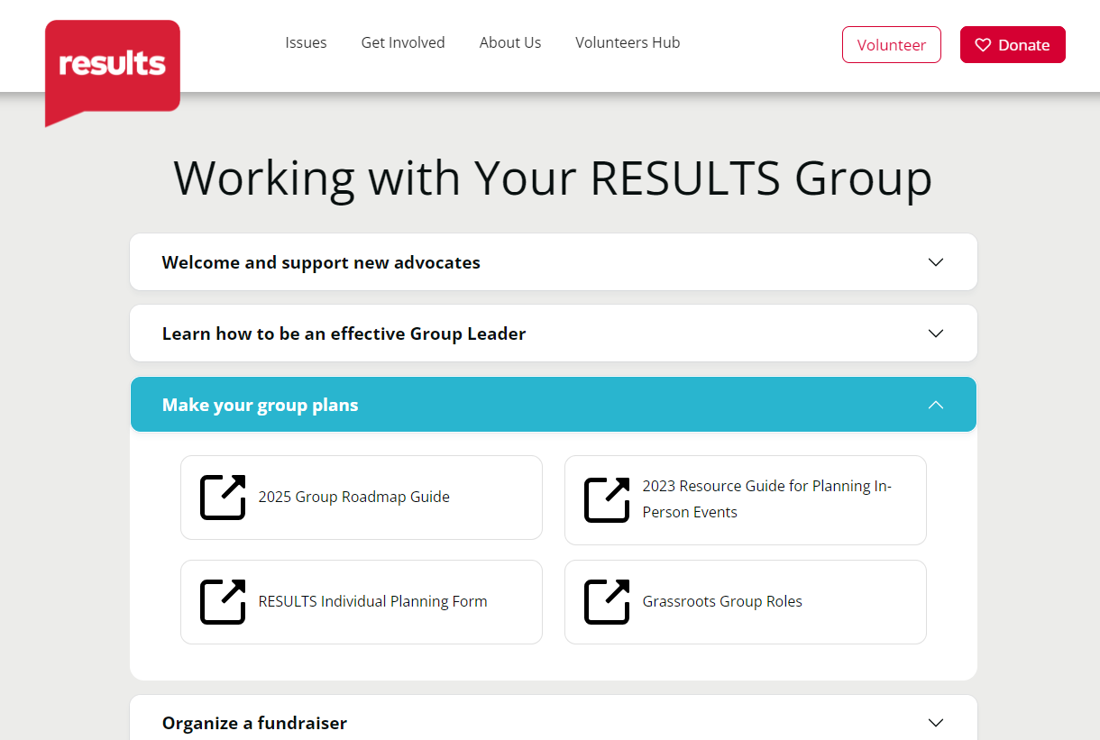
Find Planning Resources online
https://results.org/volunteers/working-with-your-group

Slide 31
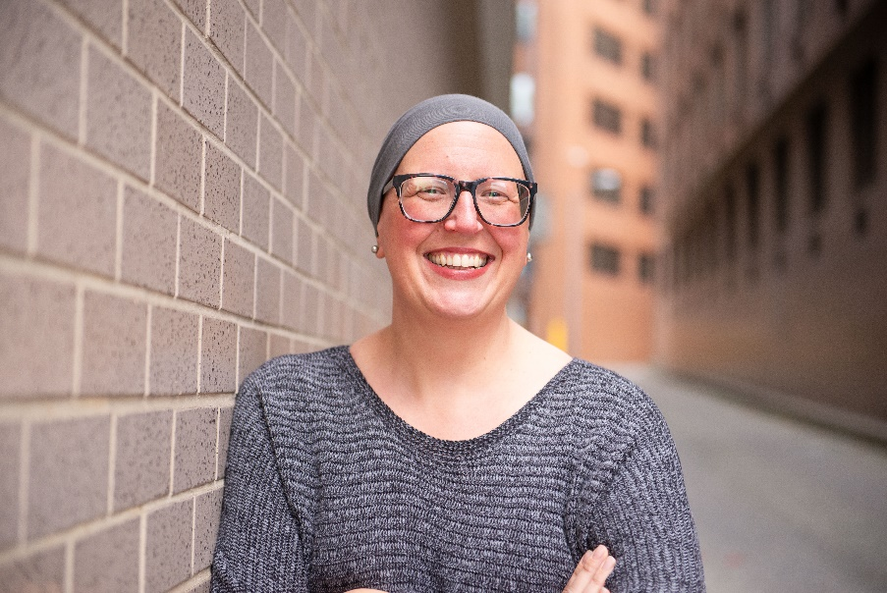
2024 Celebrations & Appreciation
Joanna DiStefano
Senior Associate for Grassroots Impact jdistefano@results.org

Slide 32
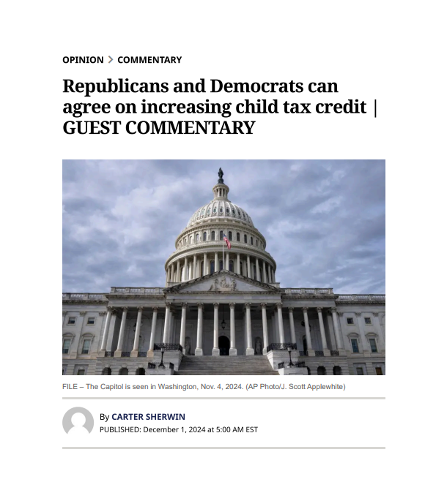
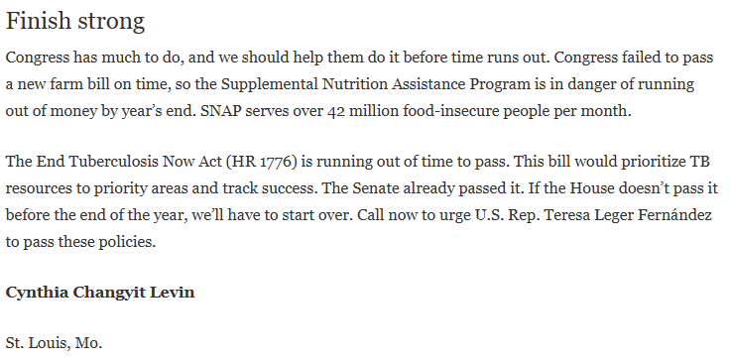
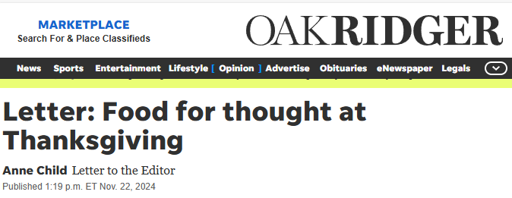
Media Successes

Slide 33
Media Successes
Total Publications = 522
LTEs: 279
Op-eds: 212
Editorials: 2
Articles: 9
Other: 20

Slide 34
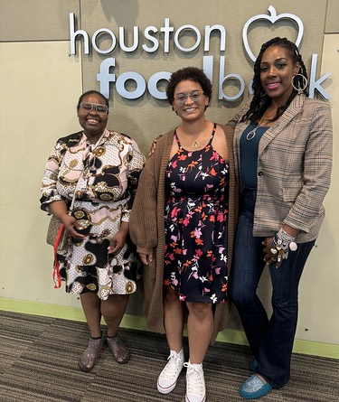
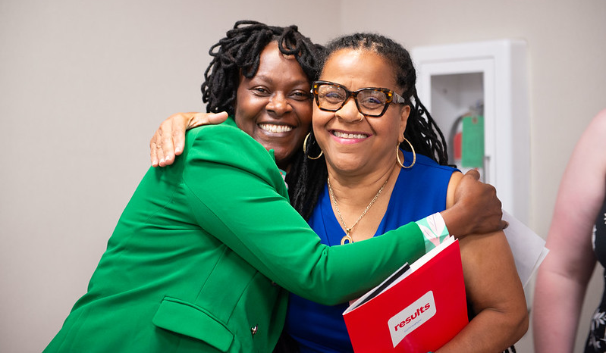
Experts on Poverty

Slide 35
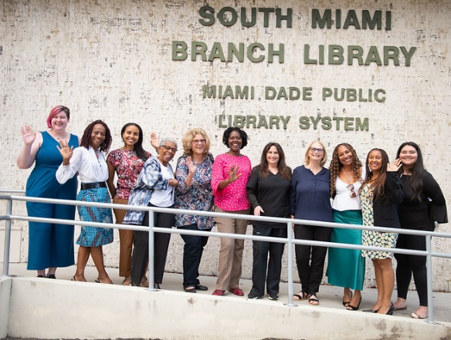
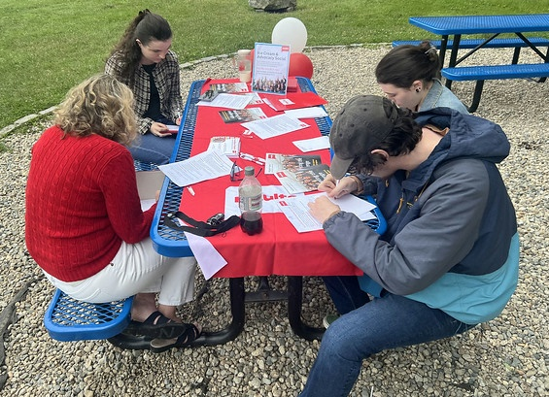
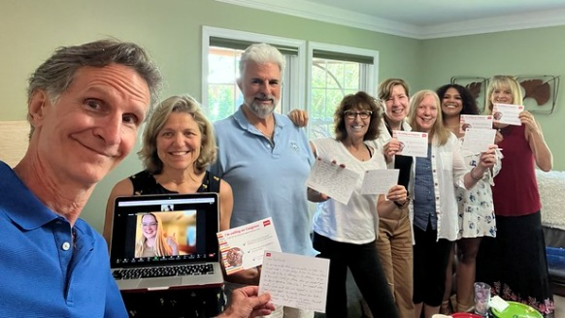
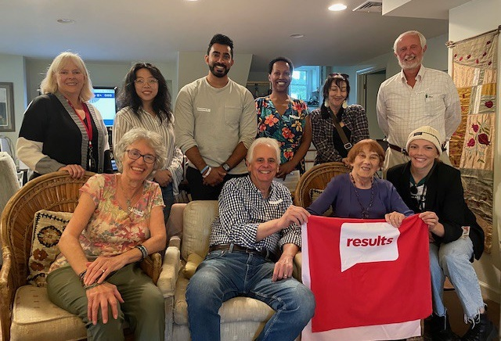
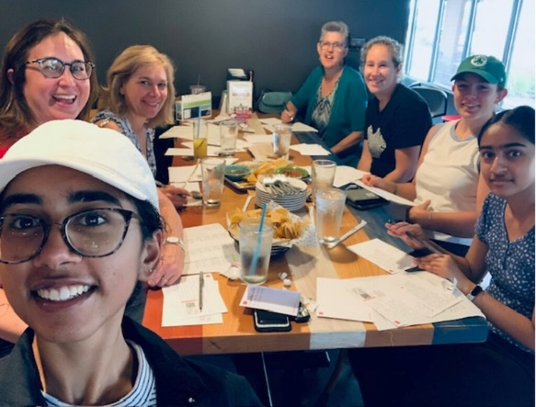
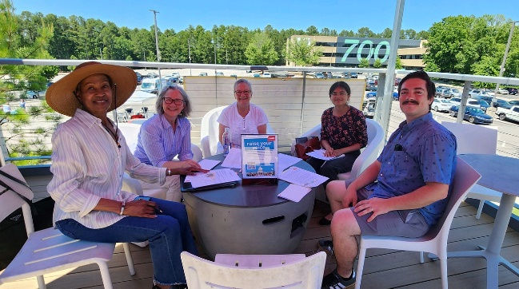
In-Person Events

Slide 36
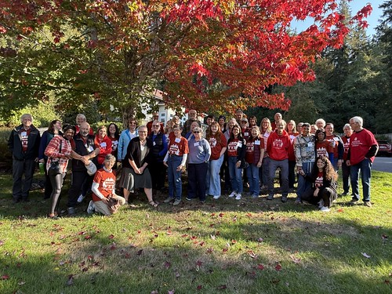
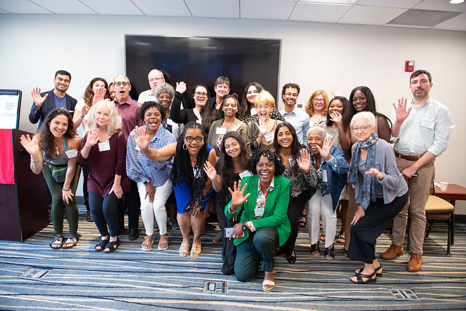
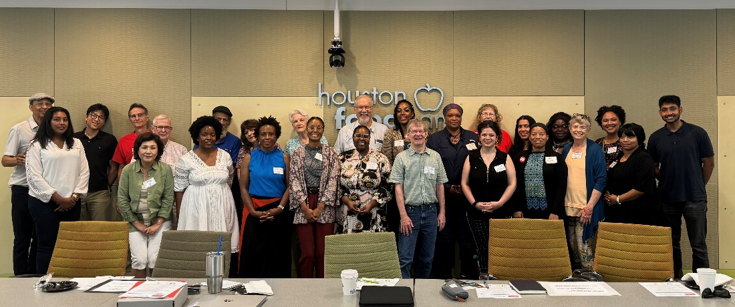
Regional Conferences

Slide 37
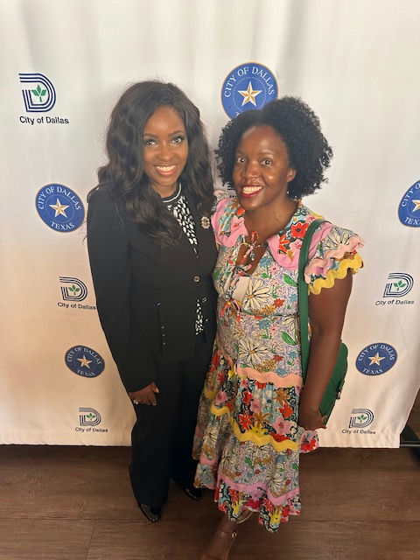
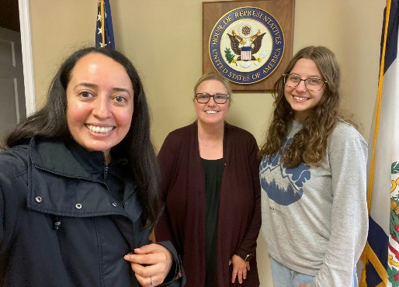
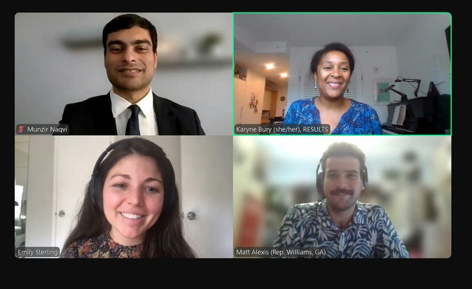
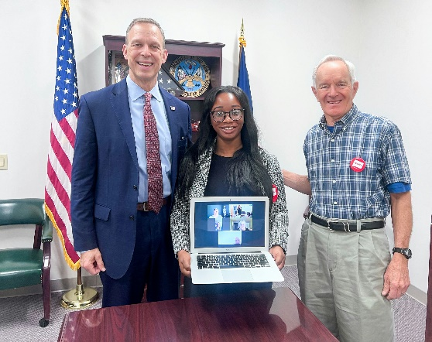
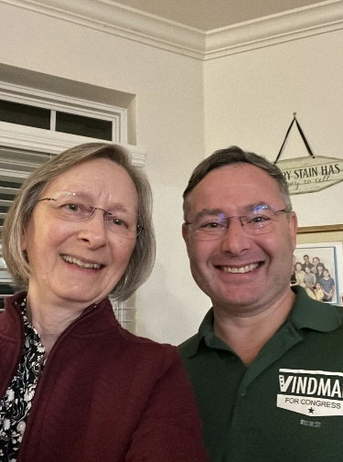
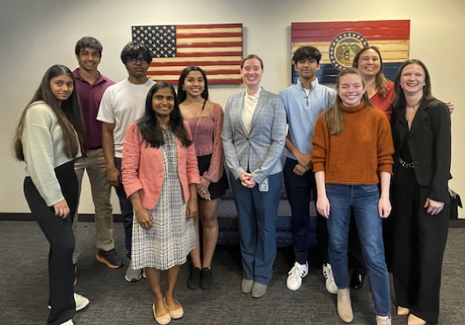
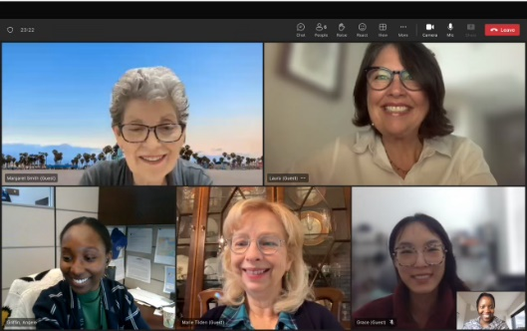
Lobbying

Slide 38
Congressional Meeting Successes
Year to date meetings = 307
Senate: 115
House: 175
Candidates: 17 (14H + 3S)
Face-to-Face: 63
Staff: 244
Meetings with New Advocate: 64
States: 43 states held at least 1 meeting

Slide 40
Congressional Coverage Successes
Senator & Representative | Coverage Amount 2024 | Met with in 2024!
House offices covered (435): | 279 | 126
Senate offices covered (100): | 94 | 66
Candidate offices covered | ------ | 17
Total number of Offices covered: | 373 out of 535 members of Congress | 209 Offices Met With

Slide 41
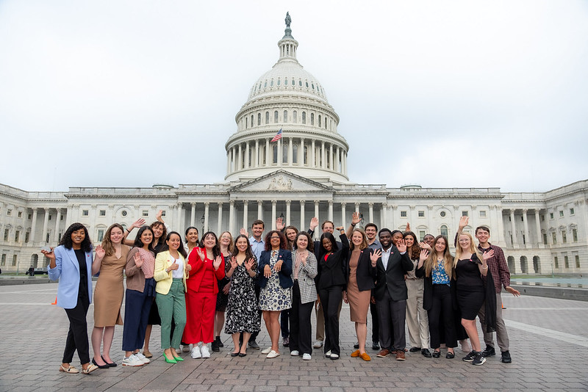
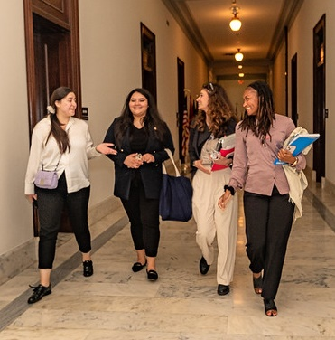
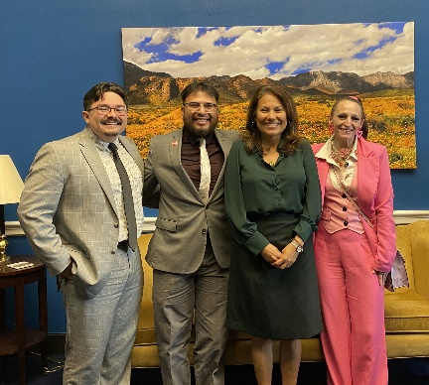
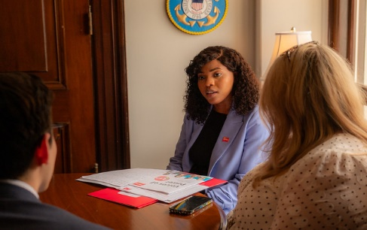
RESULTS Fellows

Slide 42
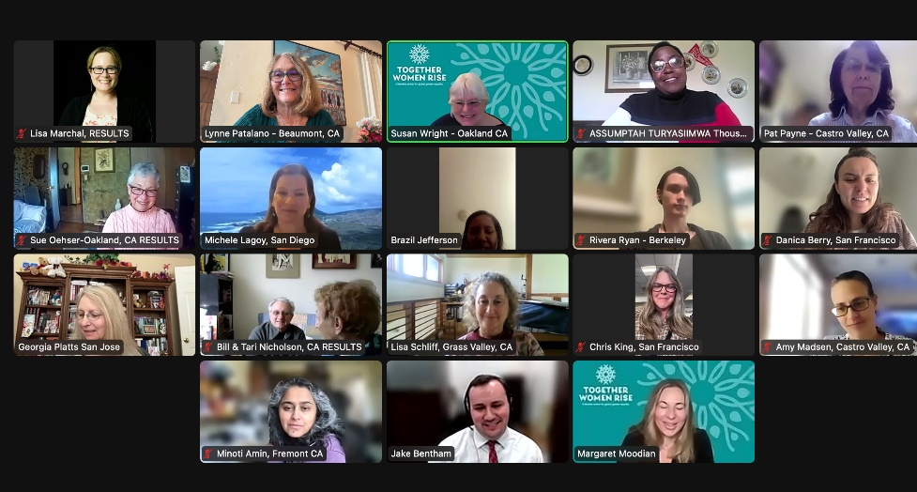
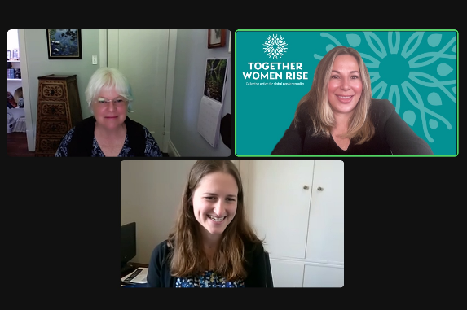
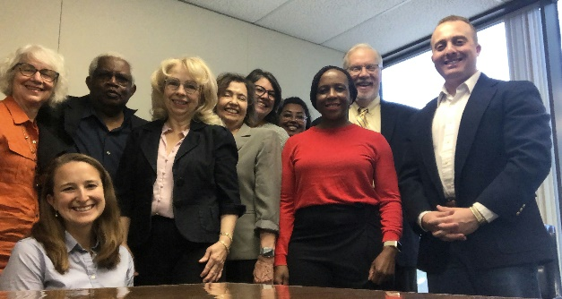
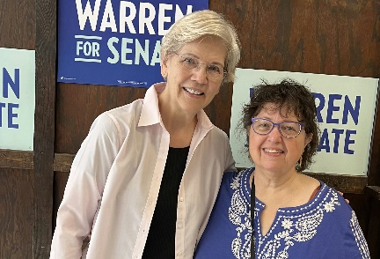
Organizational Partners

Slide 43
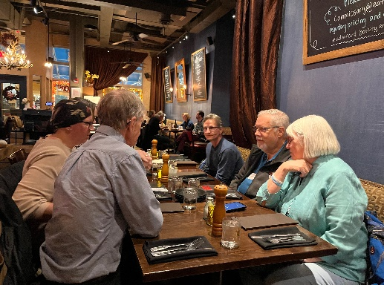
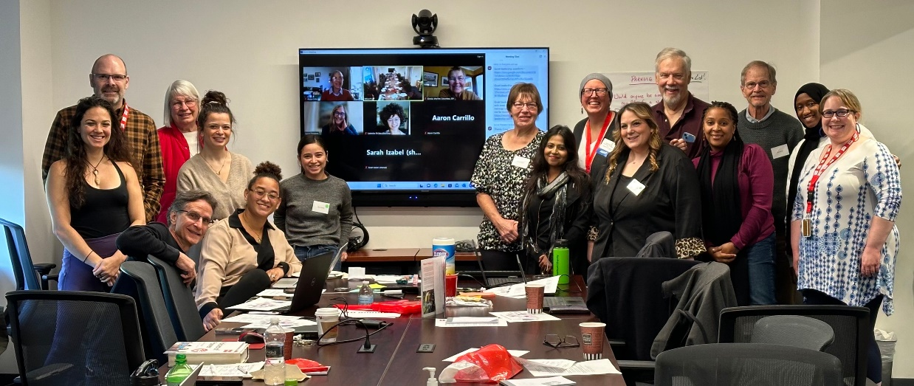
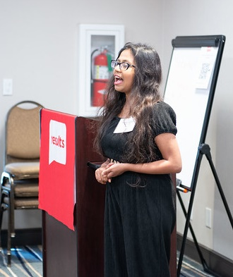
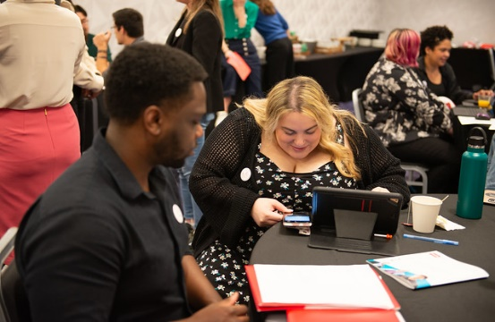
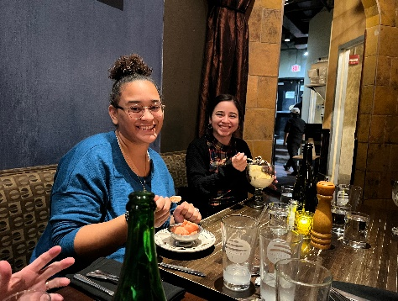
Regional Coordinators

Slide 44
Regional Coordinators
Aaron Carrillo, Upper Midwest
Allison Gallaher, Great Lakes
Beth Wilson, Intermountain West
Breanne Olwan, Mid-Atlantic
Craig Roshaven, Texas-Oklahoma
Danielle Bautista, California State
Ginnie Vogts, Great Lakes
John Hornby, Washington State​
Lynne Patalano, Western States​
Mabintou Darboe, Northeast​
Rayna Castillo, Intermountain West​
Tanha Rahman, Gulf South​
Pritika Vemulapalli, South Central​
Anne Child, Texas-Oklahoma​

Slide 45
Leadership Awards

Slide 46
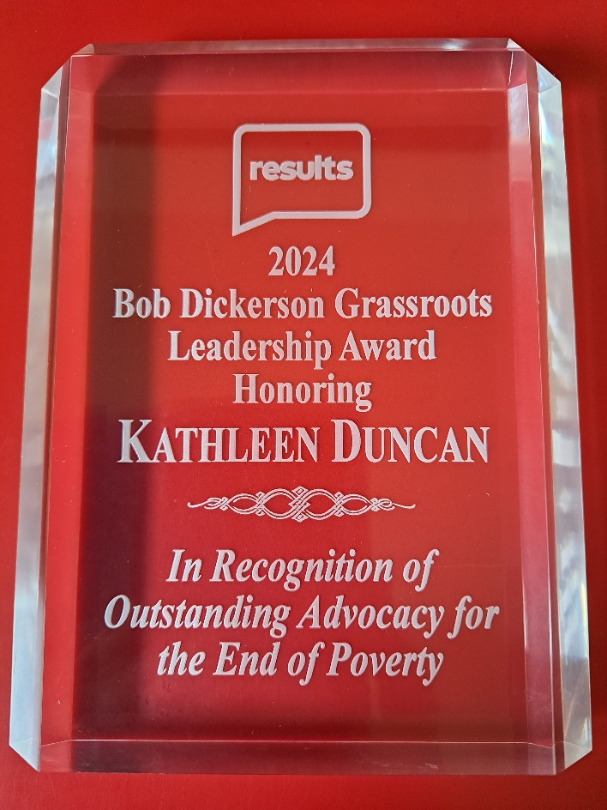
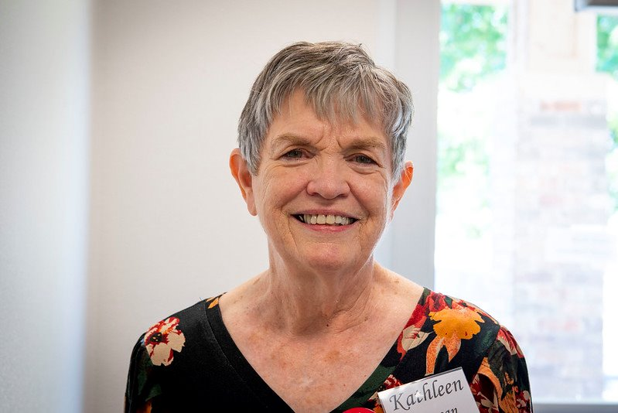
Bob Dickerson Leadership Award

Slide 47
Bob Dickerson Leadership Award
2024 Nominees
Rayna Castillo, Phoenix Domestic co-leader
Anne Child, East TN Joint leader
Mary Minor, Snohomish co-leader & action network manager
Margaret Smith, Dallas Global leader

Slide 48
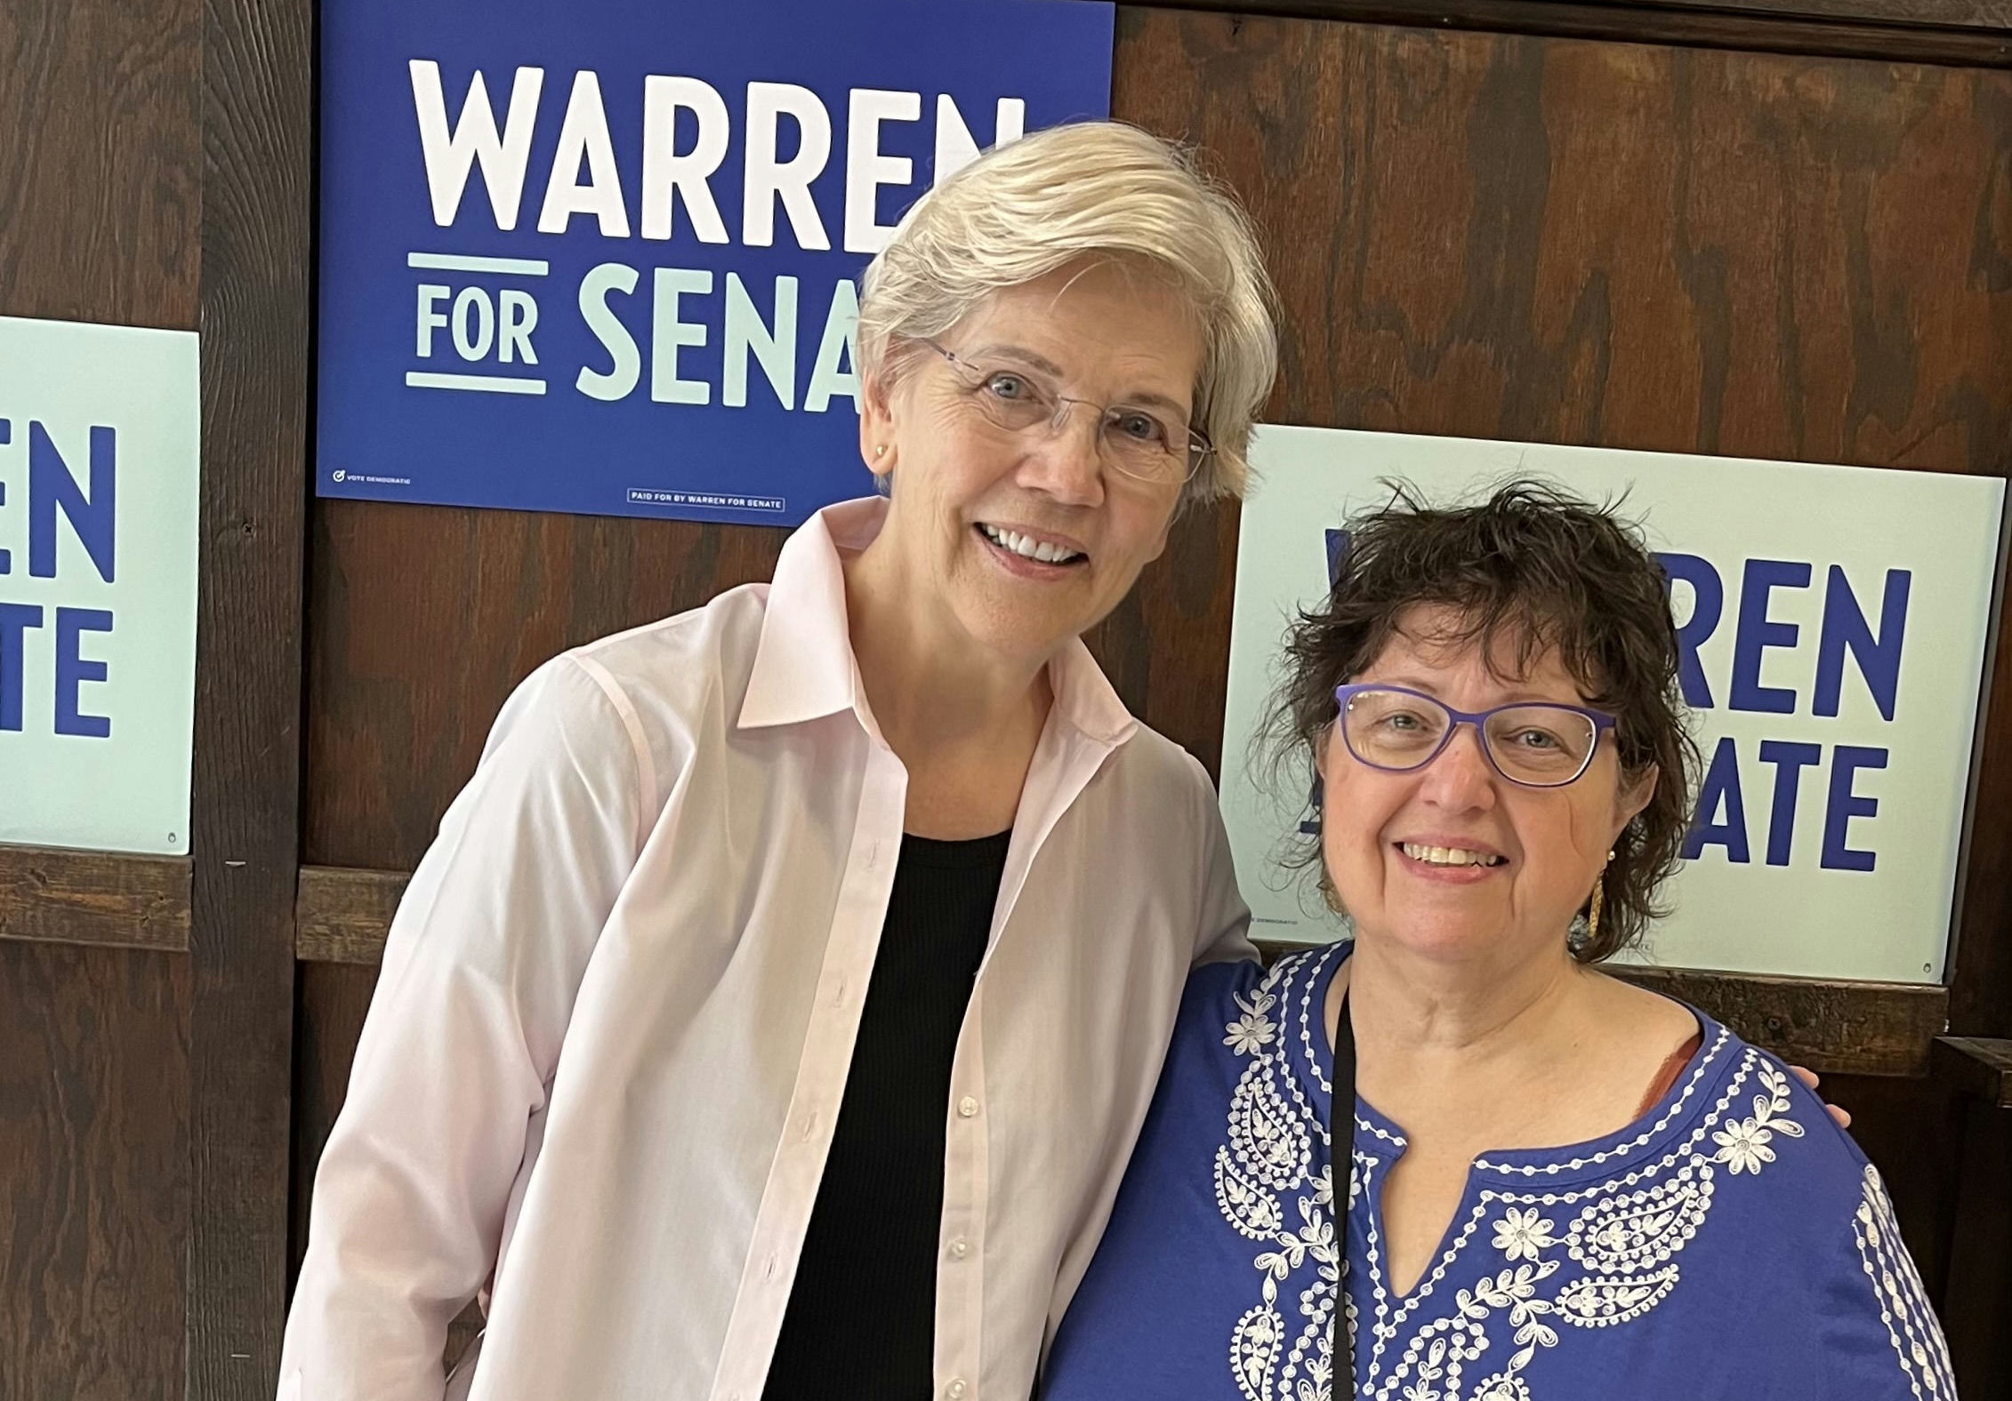
Cameron Duncan Media Award

Slide 49
Cameron Duncan Media Award
2024 Nominees
John Bauer, Editor, Everett (WA) Herald
Tiffany Tagbo, RESULTS Oklahoma co-leader & Expert on Poverty

Slide 50
Announcements

Slide 51
Closing Announcements
Lakeisha McVey Senior Manager,
Lived Experience Engagement
lmcvey@results.org

Slide 52
Thank you for joining us!
Who is joining you in the room today?
In the poll, please respond with the number of people in the room with you (including yourself).

Slide 53
Motivational Interviewing series continues
Wednesday, December 11, 8:00-9:00 p.m. ET
Want to build bridges with lawmakers? Want to effectively talk to people who disagree with you? This is the series for you!
We are thrilled to welcome back Dr. Dave Christian, Ph.D., P.C., who has trained in Motivational Interviewing (MI) for years. In six monthly sessions, you will gain skills using MI for effective dialogue with lawmakers you struggle to move into action. We're join us for this third session!
Register today!

Slide 54
Regional Coordinator Open House
Regional Coordinators support our vibrant network of volunteers in creative and crucial ways. Curious about what volunteer Regional Coordinators do within the RESULTS network?
Come on along to this open house to meet many of our volunteer Regional Coordinators and hear more about this unique leadership opportunity within RESULTS.
Monday, December 9, 9:00 p.m. ET
Registration today!

Slide 55
Office Hours
Outreach and Event Planning Office Hour
Thursday, December 12, 2:00 p.m. - 3:00 p.m. ET
Join via https://results.zoom.us/j/94004748060
or call (312) 626-6799, meeting ID 940 0474 8060.
Media Office Hour
Wednesday, December 18, 2:00-3:00 p.m. ET
Join at https://results.zoom.us/j/93668005494
or call (312) 626-6799, meeting ID 936 6800 5494.

Slide 56
Partnership Calls
Global Allies (Returned Peace Corps Volunteers) Webinar
Thursday, December 12, 8:30 p.m. ET
Click for more details.
Together Women Rise Partnership Webinar
Tuesday, December 17, 8:30 p.m. ET
Click to learn more.

Slide 57
Monthly Support Calls
U.S. Poverty Free Agents
Tuesday, December 17, 1:00 p.m. and 8:00 p.m. ET
Contact Jos Linn at jlinn@results.org for information.
Global Poverty Free Agents
Monday, December 9, 7:00 p.m. ET
Contact Lisa Marchal at lmarchal@results.org for information.

Slide 58
Let us know the amazing things you are doing?
https://results.org/volunteers/reporting-your-advocacy-actions

Slide 59
Find events
results.org/events

Slide 60
Find today’s slides
results.org/volunteers/national-webinars

Slide 61
Join us for the January 2025 National Webinar
Saturday, January 11 at 1:00 p.m. ET
We have a new Zoom meeting and registration link for our 2025 webinars. EVERYONE must register to join the January webinar. Please register today!
Register at: www.tinyurl.com/RESULTS2025

Slide 62
RESULTS Winter Break
The RESULTS office will be closed December 25-January 1
Happy holidays!

Slide 63
RESULTS website and social media

