Slide 1
RESULTS National Webinar November 2, 2024 Welcome!

Slide 2
Our Values
At RESULTS we pledge to create space for all voices, including those of us who are currently experiencing poverty. We will address oppressive behavior in our interactions, families, communities, work, and world. Our strength is rooted in our diversity of experiences, not in our assumptions.
With unearned privilege comes the responsibility to act so the burden to educate and change doesn’t fall solely on those experiencing oppression. When we miss the mark on our values, we will acknowledge our mistake, seek forgiveness, learn, and work together as a community to pursue equity.
Read our full anti-oppression values statement here at results.org/values.
Notes:
Updated AO slide (2/22)

Slide 3
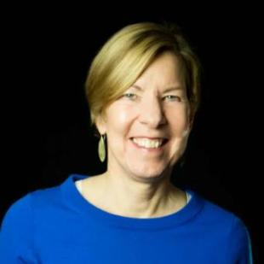
Welcome!
Joanne Carter Executive Director

Slide 4
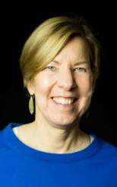
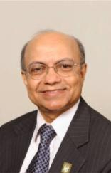
Where does our work go from here? A conversation
Joanne Carter Executive Director of RESULTS
Kul Gautam Chair of the RESULTS Board, Former Deputy Executive Director of UNICEF and

Slide 5
Global and U.S. Poverty Campaigns

Slide 6
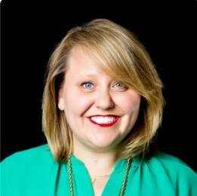
Campaign Updates
Crickett Nicovich Director, Policy and Government Affairs
cnicovich@results.org

Slide 7
End TB Now Act
S.288 introduced
by Sens. Young (R-IN) and Menendez (D-NJ)
Passed Senate Foreign Relations Committee
5 total cosponsors
Passed full Senate
by unanimous consent
H.R.1776 introduced
by Reps. Bera (D-CA) and Salazar (R-FL)
Passed House Foreign Affairs Committee
92 total cosponsors
Goal:
pass full House

Slide 8
READ Act
S.41 introduced
by Sens. Durbin (D-IL) and Rubio (R-FL)
Passed Senate Foreign Relations Committee
7 total cosponsors
Passed full Senate
by unanimous consent
H.R.681 introduced
by Reps. Smith (R-NJ) and Meng (S-NY)
Passed House Foreign Affairs Committee
76 total cosponsors
Goal:
pass full House

Slide 9
FY25 Appropriations
A full FY25 omnibus is possible, but increasingly unlikely
The current priority is supplemental FEMA funding for hurricane relief
More likely: some FY25 bills pass, others get a continuing resolution (CR) until next spring
Goal: Encourage Congress to finish FY25 appropriations before January with the highest possible funding levels for our issues

Slide 10
Global Appropriations
Account | FY24 Enacted | FY25 House | FY25 Senate | FY25 RESULTS Ask
USAID Maternal and Child Health | $915 million | $915 million | $940 million | $1.15 billion
Of which, Gavi, the Vaccine Alliance | $300 million | $300 million | $300 million | $340 million
USAID Nutrition | $165 million | $172.5 million | $165.5 million | $300 million
USAID Tuberculosis | $394.5 million | $394.5 million | $394.5 million | $1 billion
Global Fund to Fight AIDS, TB and Malaria | $1.65 billion | $1.25 billion | $1.2 billion | $1.65 billion
USAID Basic Education | $922 million | $922 million | $640.55 million | $1.15 billion
Of which, Global Partnership for Education | $121.6 million | $121.6 million | $85 million | $200 million

Slide 11
Farm Bill
The 2018 Farm bill officially expired on Sep 30
Programs like SNAP will have funding and are expected to continue until the end of the year
Possibilities: 1-year or some other short term extension
Goal: ensure Congressional champions are ready to protect /expand SNAP when the Farm bill moves

Slide 12
Tax Justice
Child Tax Credit
While unlikely to pass in the lame duck, we will follow the Wyden/Smith bill that expands the CTC
Goal: Continue to set the stage for expectations on CTC expansion in the 2025 bill using the Wyden/Smith bill as new baseline
Renters Tax Credit
We are working with congressional champions and coalition partners to finalize language for a new RTC bill to be introduced early next Congress
Designed to support rent-burdened people paying more than 30% of their income for rent
Goal: Build congressional support for the RTC in the 2025 tax bill

Slide 13
First 100 Days
Global Policy goals:
Increase FY26 Appropriations funding levels for Global Fund, bilateral TB, MCH, Gavi, Nutrition, and Global Education
Bold U.S. pledge for the Global Fund to Fight AIDS, TB, and Malaria
Follow up on Gavi replenishment and Nutrition for Growth
U.S. Policy goals:
Protect SNAP in the Farm bill
Introduce a new Renters Tax Credit bill
Ensure continued support for an expanded Child Tax Credit

Slide 14
Grassroots Café: Election Engagement

Slide 15
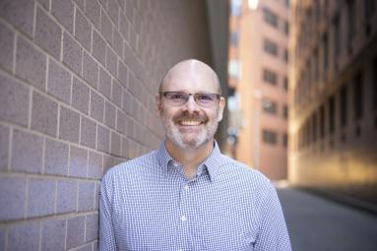
Double/50 Media Campaign
Jos Linn
Interim Director for Grassroots Impact jlinn@results.org

Slide 16
Double/50 Media Campaign
Goal: Using media to make poverty an election issue and a priority for the new Congress.
From September 1 – December 31, we will:
DOUBLE our 2024 media count for the year – 300 new media pieces!
Get at least one piece published in all 50 states

Slide 17
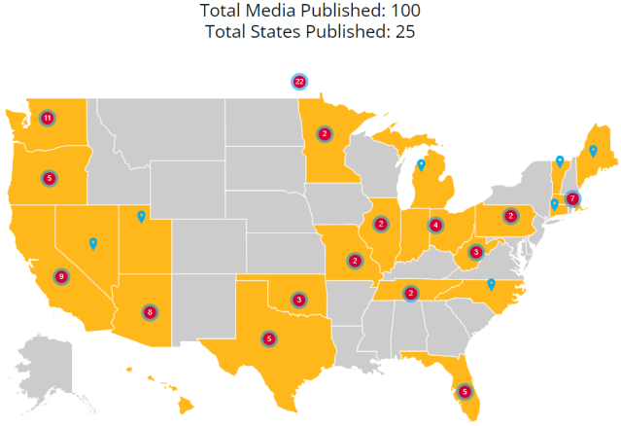
Double/50 Media Campaign
Here is where we are today!

Slide 18
Grassroots Share
Brazil Jefferson
RESULTS Riverside/San Bernadino (CA)

Slide 19
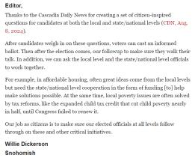
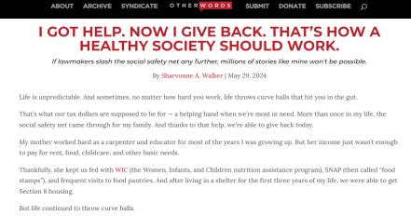
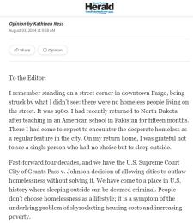
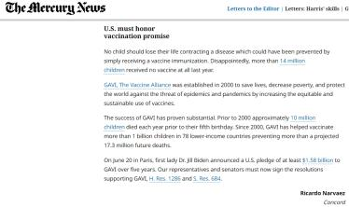
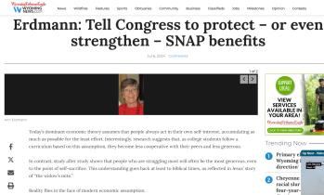
Your media matters!

Slide 20
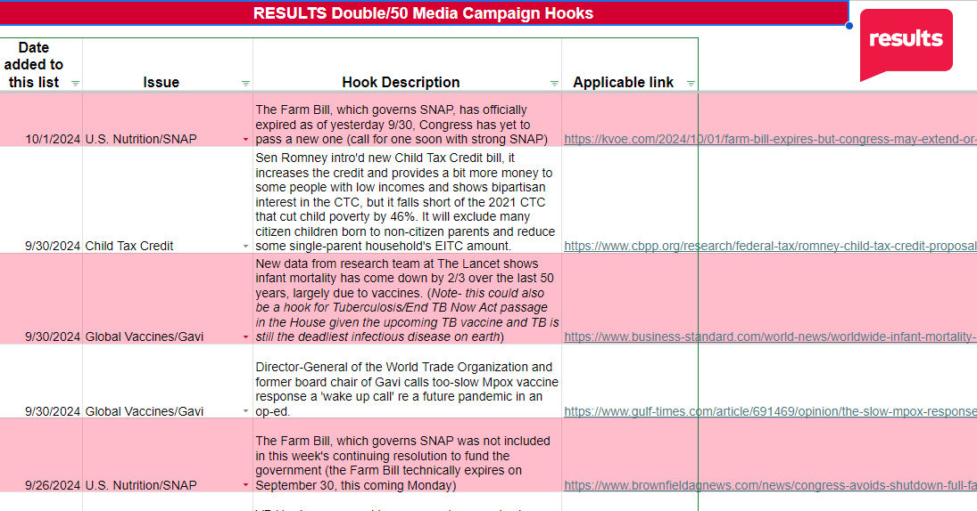
Check out our new “hooks” resource!

Slide 21
Check out our new “hooks” resource!
Our Double/50 media hooks tracker has lots of hooks!
Find hooks: https://tinyurl.com/RESULTSMediaHooks
The list is updated weekly with hooks on various issues
Find media templates in the hooks spreadsheet (tab at bottom) and in our Action Center
For media coaching, contact Jos Linn at jlinn@results.org.

Slide 22
Help us fill up this map!

Slide 23
RESULTS Post-Election Webinar: Organizing for the Future
Join us for a special webinar about our way forward after the elections. No matter what happens, we are going to raise our voices against poverty, together.
Thursday, November 14 at 8:30 p.m. ET
Learn more and register here.

Slide 24
Friends & Family Fundraising Campaign

Slide 25
Fall Friends and Family fundraising campaign
Visit www.results.org/donate/fundraise
to access our fundraising guide and build your own fundraising page
Questions to ask yourself:
Are you or your group able to hold a fundraiser this fall?
What is your goal, e.g., number of donations, amount raised, etc.
Could you create a match or other incentive to inspire giving?
How long would you like to hold your fundraiser?
Do you need any fundraising support? Please reach out to the Development team at development@results.org

Slide 26
Announcements

Slide 27
Thank you for joining us!
Who is joining you in the room today?
In the poll, please respond with the number of people in the room with you (including yourself).

Slide 28
Building Resiliency
As the election winds down, take time to recharge as a volunteer advocate with these
resources to practice self-care and self-compassion.

Slide 29
Motivational Interviewing series continues
Wednesday, November 6, 8:00-9:00 p.m. ET
Want to build bridges with lawmakers? Want to effectively talk to people who disagree with you? This is the series for you!
We are thrilled to welcome back Dr. Dave Christian, Ph.D., P.C., who has trained in Motivational Interviewing (MI) for years. In six monthly sessions, you will gain skills using MI for effective dialogue with lawmakers you struggle to move into action. We're join us for this third session!
Register today!

Slide 30
Grassroots Leadership Awards
Submit nominations by Friday, November 8
Bob Dickerson Leadership Award: recognizes a grassroots volunteer who shows extraordinary leadership and commitment to the mission of RESULTS
Cameron Duncan Media Award: given to a journalist, editor, or grassroots volunteer for outstanding work on issues related to poverty in the media

Slide 31
AO Learning Community Post-Election Gathering: “Repair”
No matter the outcome on election day, how do we repair the rifts in our communities and the impact those who have been marginalized? Join the discussion on
Friday, November 8, 12:00-1:30 p.m. ET
The AO Learning Community gathering is open to all volunteers! Register here.
For questions, please contact Lakeisha McVey at lmcvey@results.org.

Slide 32
RESULTS Post-Election Webinar: Organizing for the Future
Join us for a special webinar about our way forward after the elections. No matter what happens, we are going to raise our voices against poverty, together.
Thursday, November 14 at 8:30p.m. ET
Learn more and register here.

Slide 33
Regional Coordinator Open House
Regional Coordinators support our vibrant network of volunteers in creative and crucial ways. Curious about what volunteer Regional Coordinators do within the RESULTS network?
Come on along to this open house to meet many of our volunteer Regional Coordinators and hear more about this unique leadership opportunity within RESULTS.
Monday, December 9, 9:00 p.m. ET
Registration is open!

Slide 34
Office Hours
Outreach and Event Planning Office Hour
Thursday, November 14, 2:00 p.m. - 3:00 p.m. ET
Join via https://results.zoom.us/j/94004748060
or call (312) 626-6799, meeting ID 940 0474 8060.
Media Office Hour
Wednesday, November 20, 2:00-3:00 p.m. ET
Join at https://results.zoom.us/j/93668005494
or call (312) 626-6799, meeting ID 936 6800 5494.

Slide 35
Partnership Calls
Together Women Rise Partnership Webinar
Tuesday, November 19, 8:30 p.m. ET
Click to learn more.

Slide 36
Monthly Support Calls
U.S. Poverty Free Agents
Tuesday, November 19, 1:00 p.m. and 8:00 p.m. ET
Contact Jos Linn at jlinn@results.org for information.
Action Network Managers
Wednesday, November 20, 12:30 p.m. ET and 8:00 p.m. ET
Join via https://results.zoom.us/j/95416781155
or call (312) 626-6799, meeting ID 954 1678 1155).
Global Poverty Free Agents
Monday, November 25, 7:00 p.m. ET
Contact Lisa Marchal at lmarchal@results.org for information.

Slide 37
New Advocate Orientation
Learn more about RESULTS, our work, and how you can join the movement to end poverty.
Wednesday, November 20, 1:00 p.m. ET
Registration is open!

Slide 38
RESULTS Office Closed
November 11: Veterans Day
November 28-29: Autumn Break

Slide 39
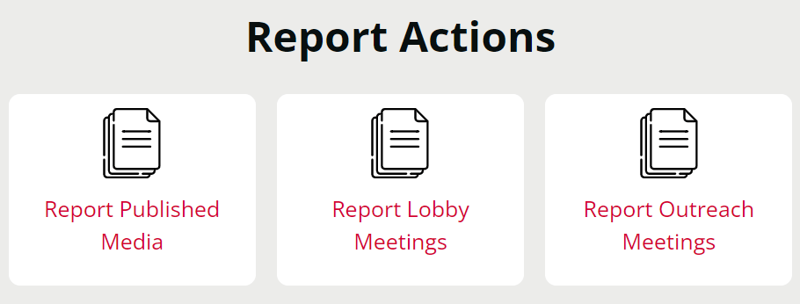
Let us know the amazing things you are doing?
https://results.org/volunteers/reporting-your-advocacy-actions

Slide 40
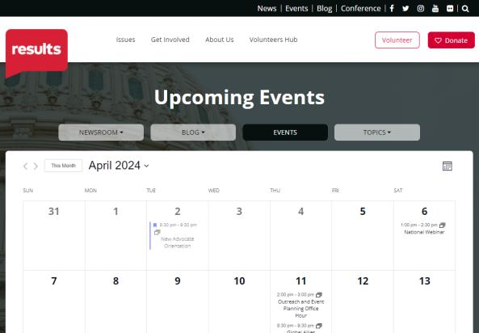
Find events
results.org/events

Slide 41
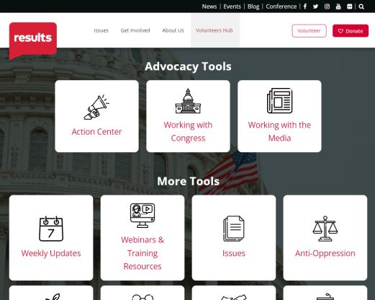
Find today’s slides
results.org/volunteers/national-webinars

Slide 42
Join us for the December National Webinar
December 7 at 1:00 p.m. ET Register at: tinyurl.com/RESULTS2024

Slide 44
RESULTS website and social media

