Slide 1
RESULTS National Webinar October 5, 2024 Welcome!

Slide 2
Our Values
At RESULTS we pledge to create space for all voices, including those of us who are currently experiencing poverty. We will address oppressive behavior in our interactions, families, communities, work, and world. Our strength is rooted in our diversity of experiences, not in our assumptions.
With unearned privilege comes the responsibility to act so the burden to educate and change doesn’t fall solely on those experiencing oppression. When we miss the mark on our values, we will acknowledge our mistake, seek forgiveness, learn, and work together as a community to pursue equity.
Read our full anti-oppression values statement here at results.org/values.
Notes:
Updated AO slide (2/22)

Slide 3
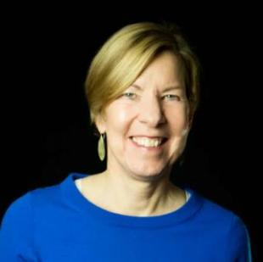
Welcome!
Joanne Carter Executive Director

Slide 4
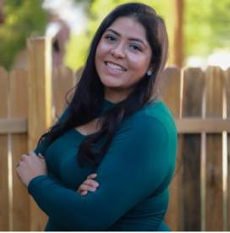
Guest Speaker
Grecia Lima National Political Director
Community Change Action

Slide 5
Global and U.S. Poverty Campaigns

Slide 6
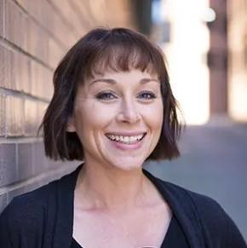
Campaign Updates
Amanda Beals Associate Director, Grassroots Expansion
abeals@results.org

Slide 7
Global Poverty Campaigns
Nutrition for Growth (N4G)
A global pledging moment to tackle malnutrition and ensure everyone, everywhere can reach their full potential.
Every four years alongside the Olympics.
2021
Tokyo
2025
Paris
2028
Los Angeles

Slide 8
What can the U.S. government do?
Make a specific, bold, new financial pledge
Send a powerful public signal to the world, encouraging others to be bold
Show our leadership ahead of the 2028 Los Angeles Summit

Slide 9
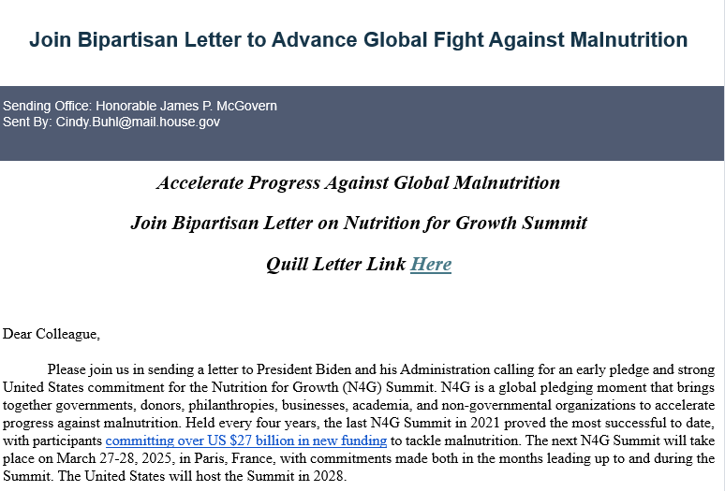
Getting Congress on the record
106 Members of Congress signed onto the bipartisan N4G letter!

Slide 10
End TB Now Act
S.288 introduced
by Sens. Young (R-IN) and Menendez (D-NJ)
Passed Senate Foreign Relations Committee
5 cosponsors
Passed full Senate
by unanimous consent
H.R.1776 introduced
by Reps. Bera (D-CA) and Salazar (R-FL)
Passed House Foreign Affairs Committee
91 cosponsors
Goal:
pass full House

Slide 11
U.S. Poverty Campaigns
2023 U.S. Census poverty data released in September
Supplemental Poverty Measure (SPM) increased from 12.4 percent to 12.9 percent in 2023
Housing costs are a key driver of poverty
SNAP helped 3.4 million people stay above the poverty line
Child poverty rose from 12.4 percent to 13.7 percent
The CTC lifted 2.4 million people above the poverty line in 2023, less than half of the 2021 expanded CTC

Slide 12
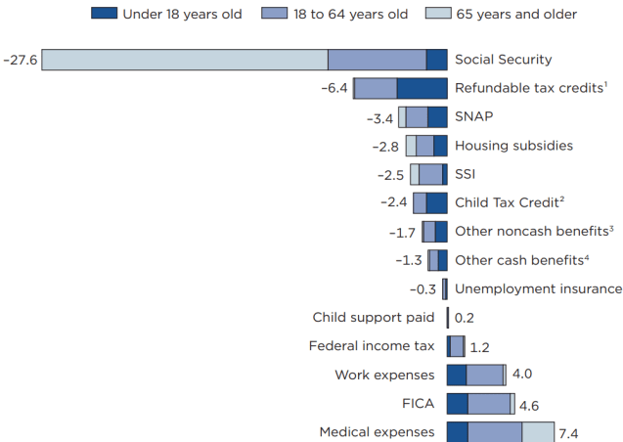
Anti-poverty programs work!
Learn more from the 2023 Census Poverty data and explore state and local data in the American Community Survey
# of fewer people (millions) below the poverty line in 2023 due to these programs
# of additional people (millions) below the poverty line in 2023 due to these factors
Source: U.S. Census Bureau

Slide 13
Farm Bill
The 2018 Farm bill officially expired on Sep 30
Programs like SNAP will have funding until the end of the year
But some members of Congress still want to cut billions from SNAP over the next decade and add burdensome restrictions

Slide 14
Appropriations
Congress passed a bipartisan continuing resolution (CR) that maintains current funding levels through December 20
The CR was "clean," with no partisan policy riders

Slide 15
Grassroots Café: Election Engagement

Slide 16
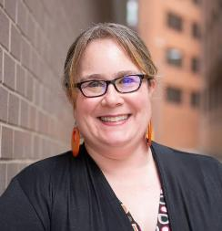
Election Engagement Campaign
Lisa Marchal
Manager, Grassroots Impact lmarchal@results.org

Slide 17
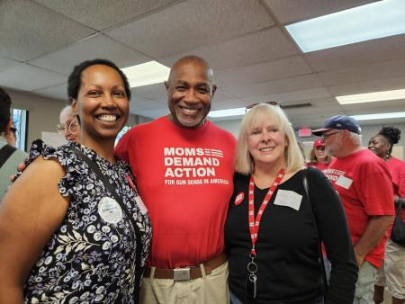
Grassroots Share
Jocelyn Dorgan (right)
RESULTS New Jersey

Slide 18
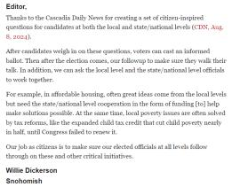
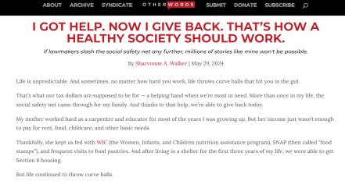
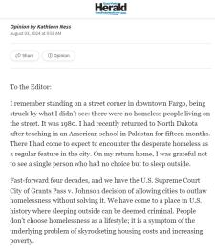
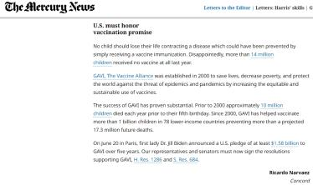
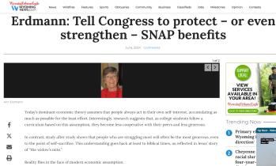
Your media matters!

Slide 19
Double/50 Media Campaign
Goal: Using media to make poverty an election issue and a priority for the new Congress.
From September 1 – December 31, we will:
DOUBLE our 2024 media count for the year – 300 new media pieces!
Get at least one piece published in all 50 states

Slide 20
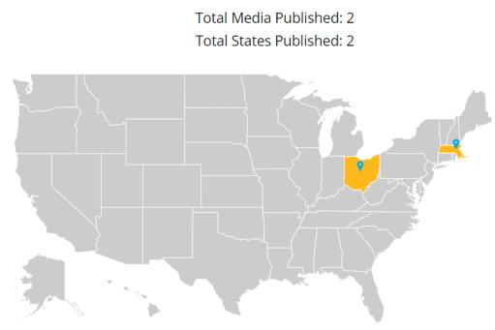
Double/50 Media Campaign
Here is where we were on the September webinar

Slide 21
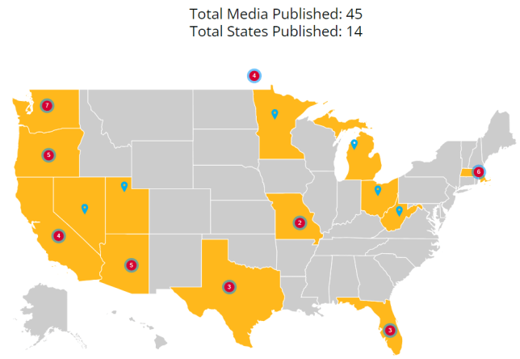
Double/50 Media Campaign
Here is where we are today!

Slide 22
22
Structure of LTEs
(works for Op-eds too)
3 components
Timely & relatable hook
Why it matters
Call to action

Slide 23
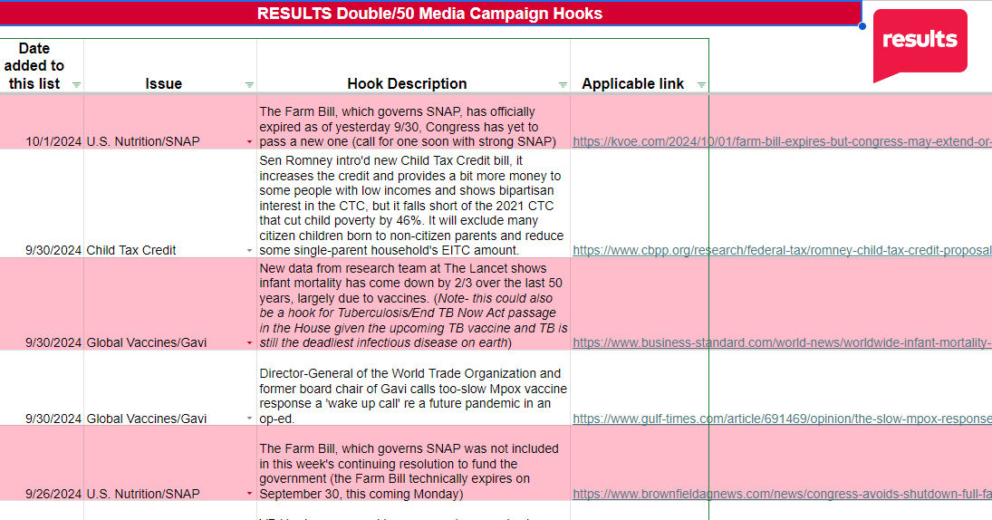
Check out our new “hooks” resource!

Slide 24
Example hooks for your letters!
U.S. Nutrition/SNAP: On 10/3, new work requirements for older adults for SNAP go into effect. The paperwork is prohibitive and harmful, leaving more people hungry. Call for a strong SNAP in a new Farm Bill. https://www.marketplace.org/2024/10/03/new-snap-work-requirements-for-older-adults-go-into-effect/
Child Tax Credit: In the televised vice presidential debate, both VP candidates acknowledged the lack of support for new parents and for child care. Candidates didn't say this directly, but you can call for a better CTC to help with this. https://www.youtube.com/watch?v=jXtCrMkiOvA
Global Vaccines/Gavi: New data from research team at The Lancet shows infant mortality has come down by 2/3 over the last 50 years, largely due to vaccines. (this could also be a hook for passing the End TB Now Act in the House given the upcoming TB vaccine and TB is still the deadliest infectious disease on earth). https://www.business-standard.com/world-news/worldwide-infant-mortality-rate-drops-by-two-third-over-50-years-report-124092800173_1.html.
Find more hooks at: https://tinyurl.com/RESULTSMediaHooks

Slide 25
Check out our new “hooks” resource!
Our Double/50 media hooks tracker has lots of hooks!
Find hooks: https://tinyurl.com/RESULTSMediaHooks
The list is updated weekly with hooks on various issues
Find media templates in the hooks spreadsheet (tab at bottom) and in our Action Center
For media coaching, contact Jos Linn at jlinn@results.org.

Slide 26
We still need you…
…to fill up this map!

Slide 27
Friends & Family Fundraising Campaign

Slide 28
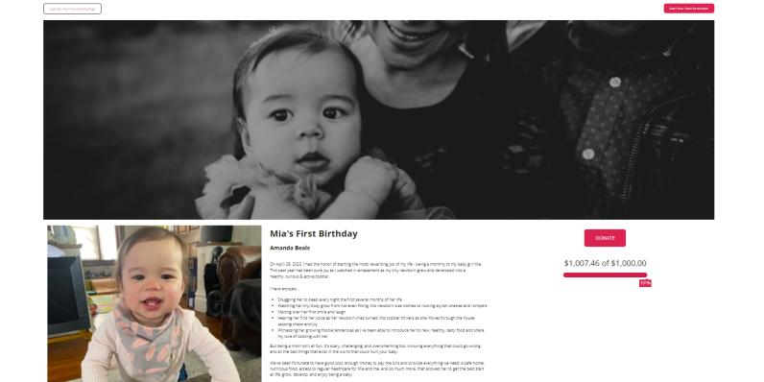
Fall Friends and Family fundraising campaign Visit www.results.org/donate/fundraise to access our fundraising guide and build your online fundraising page

Slide 29
Fall Friends and Family fundraising campaign
Visit www.results.org/donate/fundraise to access our fundraising guide and build your online fundraising page
Questions to ask yourself:
Are you or your group able to hold a fundraiser this fall?
What is your goal, e.g., number of donations, amount raised, etc.
Could you create a match or other incentive to inspire giving?
How long would you like to hold your fundraiser?
Please reach out to the Development team at development@results.org for support

Slide 30
Announcements

Slide 31
Thank you for joining us!
Who is joining you in the room today?
In the poll, please respond with the number of people in the room with you (including yourself).

Slide 32
Motivational Interviewing series continues!
Wednesday, October 9, 8:00-9 p.m. ET
Want to build bridges with lawmakers? Want to effectively talk to people who disagree with you? This is the series for you!
We are thrilled to welcome back Dr. Dave Christian, Ph.D., P.C., who has trained in Motivational Interviewing (MI) for years. In six monthly sessions, you will gain skills using MI for effective dialogue with lawmakers you struggle to move into action.
Register today!

Slide 33
Motivational Interviewing is catching on!
People from 20 states attended the September Motivational Interviewing session!

Slide 34
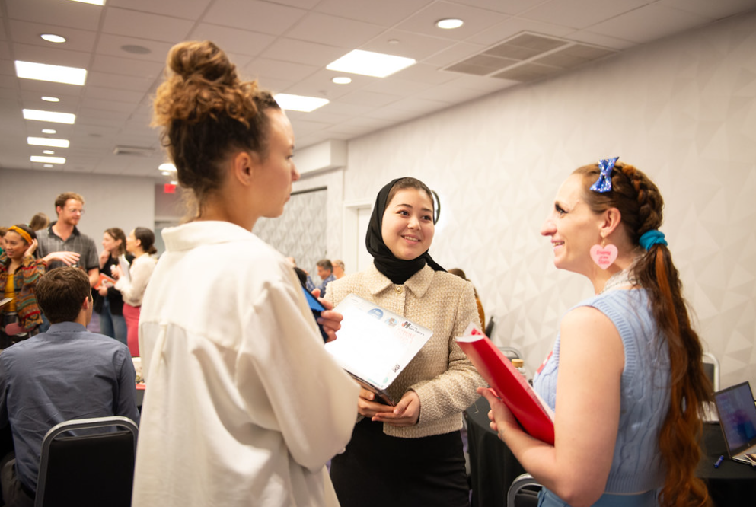
RESULTS Fellowship
Recruitment is now underway for the
2025 RESULTS Fellowship!
But time is running out . . . apply by November 1!
Learn more and apply at: https://results.org/fellowship

Slide 35
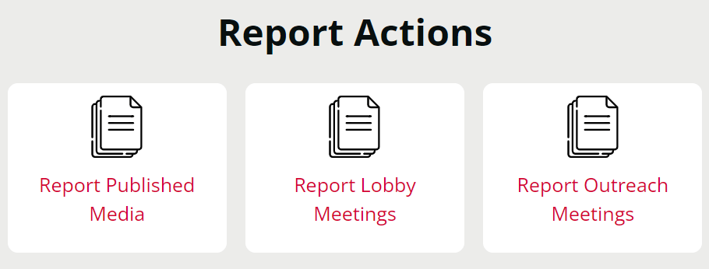
Let us know the amazing things you are doing?
https://results.org/volunteers/reporting-your-advocacy-actions

Slide 36
Office Hours
Outreach and Event Planning Office Hour
Thursday, October 10, 2:00 p.m. - 3:00 p.m. ET
Join via https://results.zoom.us/j/94004748060
or call (312) 626-6799, meeting ID 940 0474 8060.
Media Office Hour
Wednesday, October 16, 2:00-3:00 p.m. ET
Join at https://results.zoom.us/j/93668005494
or call (312) 626-6799, meeting ID 936 6800 5494.

Slide 37
Partnership Calls
Global Allies Program
(Returned Peace Corps Volunteers)
Thursday, October 10, 8:30 p.m. ET
Register today!
Together Women Rise Partnership Webinar
Tuesday, October 22, 8:30 p.m. ET
Click to learn more.

Slide 38
Monthly Support Calls
U.S. Poverty Free Agents
Tuesday, October 15, 1:00 p.m. and 8:00 p.m. ET
Contact Jos Linn at jlinn@results.org for information.
Action Network Managers
Wednesday, October 16, 12:30 p.m. ET and 8:00 p.m. ET
Join via https://results.zoom.us/j/95416781155
or call (312) 626-6799, meeting ID 954 1678 1155).
Global Poverty Free Agents
Monday, October 28, 7:00 p.m. ET
Contact Lisa Marchal at lmarchal@results.org for information.

Slide 39
New Advocate Orientations
Learn more about RESULTS, our work, and how you can join the movement to end poverty.
Thursday, October 17, 1:00 p.m. ET
Tuesday, October 29, 8:30 p.m. ET
Registration is open!

Slide 40
New Advocate Mentor Community Call
Are you interested in helping support new volunteers in your group? Learn more about being a New Advocate Mentor!
Wednesday, October 30, 8:00 p.m. ET
Register today!

Slide 41
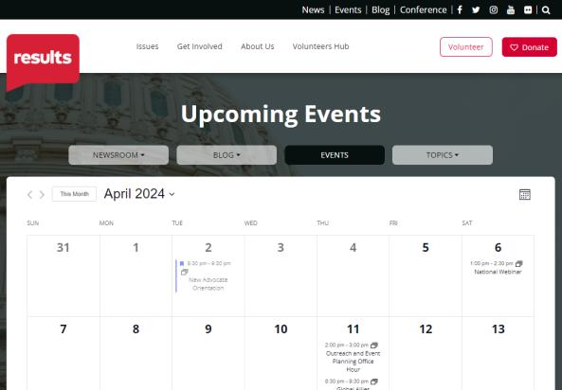
Find events
results.org/events

Slide 42
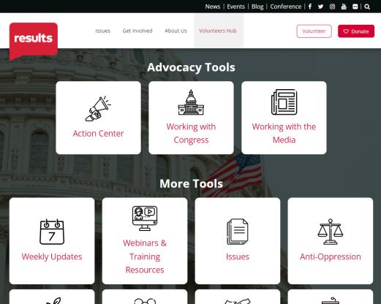
Find today’s slides
results.org/volunteers/national-webinars

Slide 43
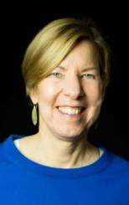
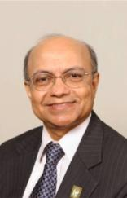
Join us for the November National Webinar
A conversation with…
Kul Gautam Former Deputy Executive Director of UNICEF and Chair of the RESULTS Board
Joanne Carter Executive Director of RESULTS
November 2 at 1:00 p.m. ET Register at: tinyurl.com/RESULTS2024

Slide 44
Are you registered to vote?
Voter registration deadlines are fast approaching. Visit www.vote.org to register or confirm you’re already registered.
When voting opens in your state, please vote!
Picture source: Allison Saeng via Unsplash

Slide 45
RESULTS website and social media

