Slide 1
ACTION Global Health Advocacy Partnership
September 12, 2024

Slide 2
Vision
A world where all people have equitable access to health.
Mission
To influence policy and mobilize resources to fight diseases of poverty and achieve equitable access to health.
Notes:
This is the ACTION Partnership’s vision and mission

Slide 3
2024 is ACTION’s 20 Year Anniversary
Notes:
2024 is ACTION 20th anniversary

Slide 4
From to
Coordinated TB Advocacy
Vaccines added, Australia, EU, Zambia, AIDES (France) added
2014-2016 Phase 4
2008-2012 Gates Phase 2
2013 Phase 3 + CIFF
Child Health, Nutrition added
Global Fund, TB, Child health (incl. vaccines + polio), Nutrition
2011 Strategic Plan
2012 Rebranding
2004-2007 Gates Phase 1
Global Health Advocacy
2017-2021 Strategic Framework
End the Epidemics, Healthy Start, Equitable & Sustainable Systems
2020-2024
New Gates Foundation grant
CEPI and COVID advocacy
20th anniversary
New Strategic Framework
2004
2011
2017
2024
Notes:
ACTION was founded in 2004 by a group of people working in the TB advocacy space who got together to discuss how they could get more attention focused on TB. They established “Advocacy to Control TB Internationally” (the first ACTION logo), and it was led by RESULTS in the U.S. and colleagues and current Partners in India and France. In 2011, ACTION broadened the scope of its work to “Global Health Advocacy,” and now, our advocacy includes the Global Fund, TB, R&D, child health (incl. routine childhood immunization and polio), nutrition, and pandemic preparedness and response.

Slide 5
Secretariat Structure
&
RESULTS (U.S.) is a founding partner of ACTION
RESULTS hosts the ACTION Secretariat; ACTION Secretariat team members are employees of RESULTS
RESULTS is represented on the ACTION Leadership Group

Slide 6
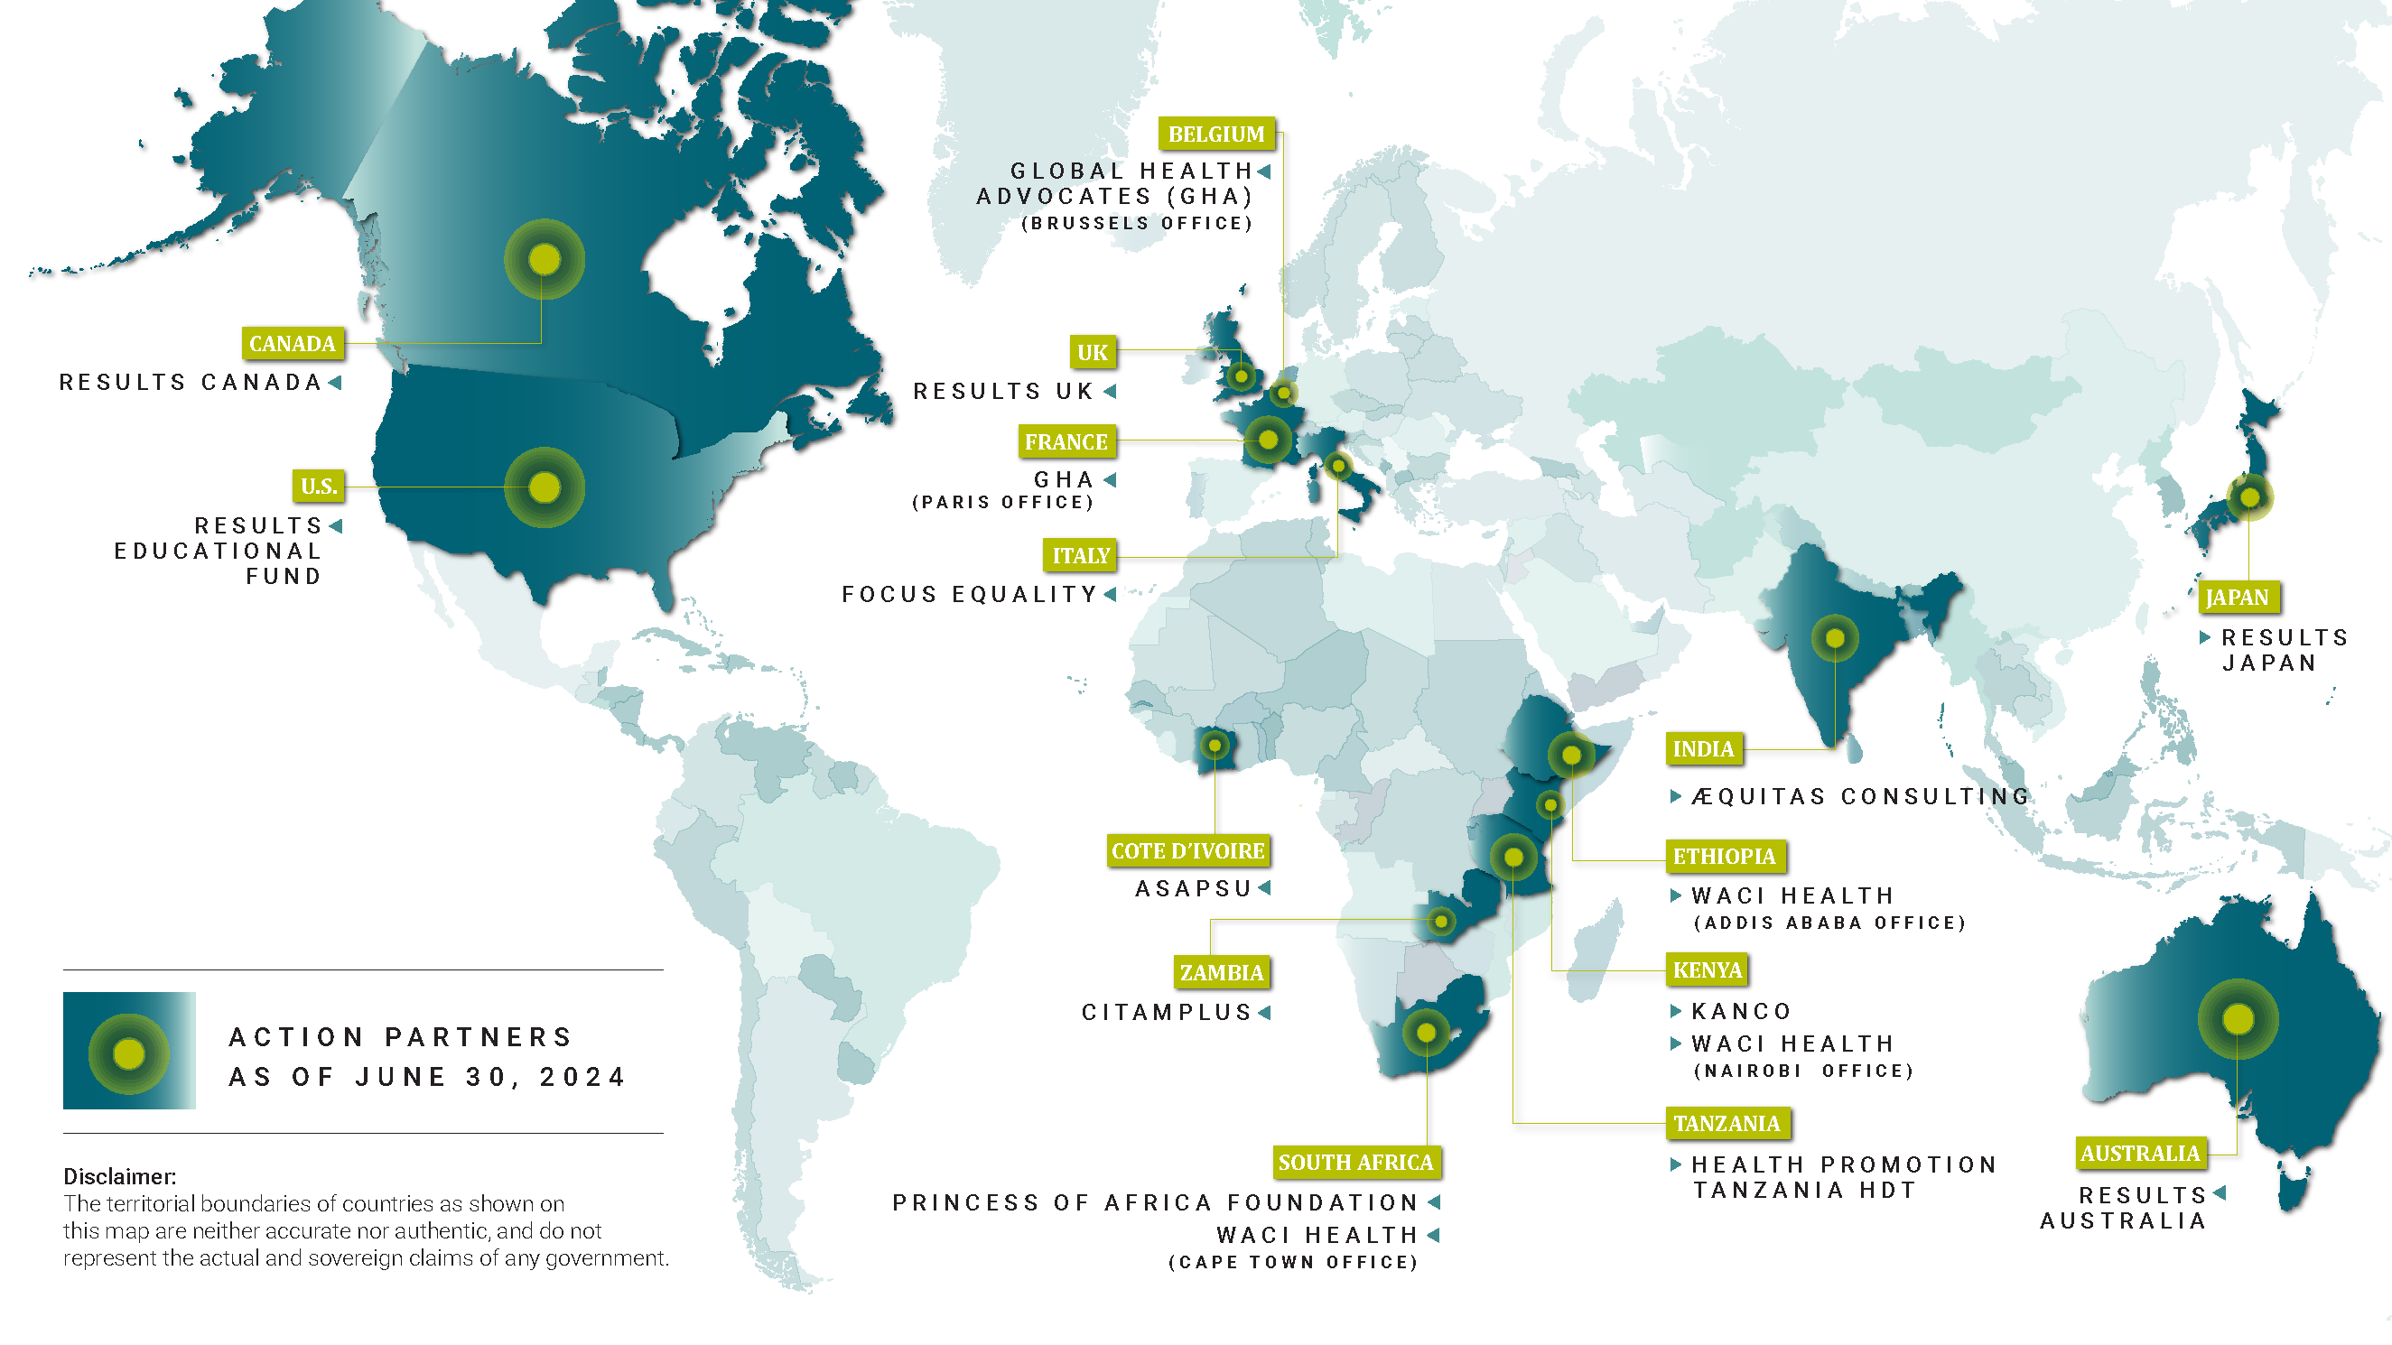
Our Global Reach
Notes:
14 Partners advocating in 13 countries plus the European Union and African Union

Slide 7
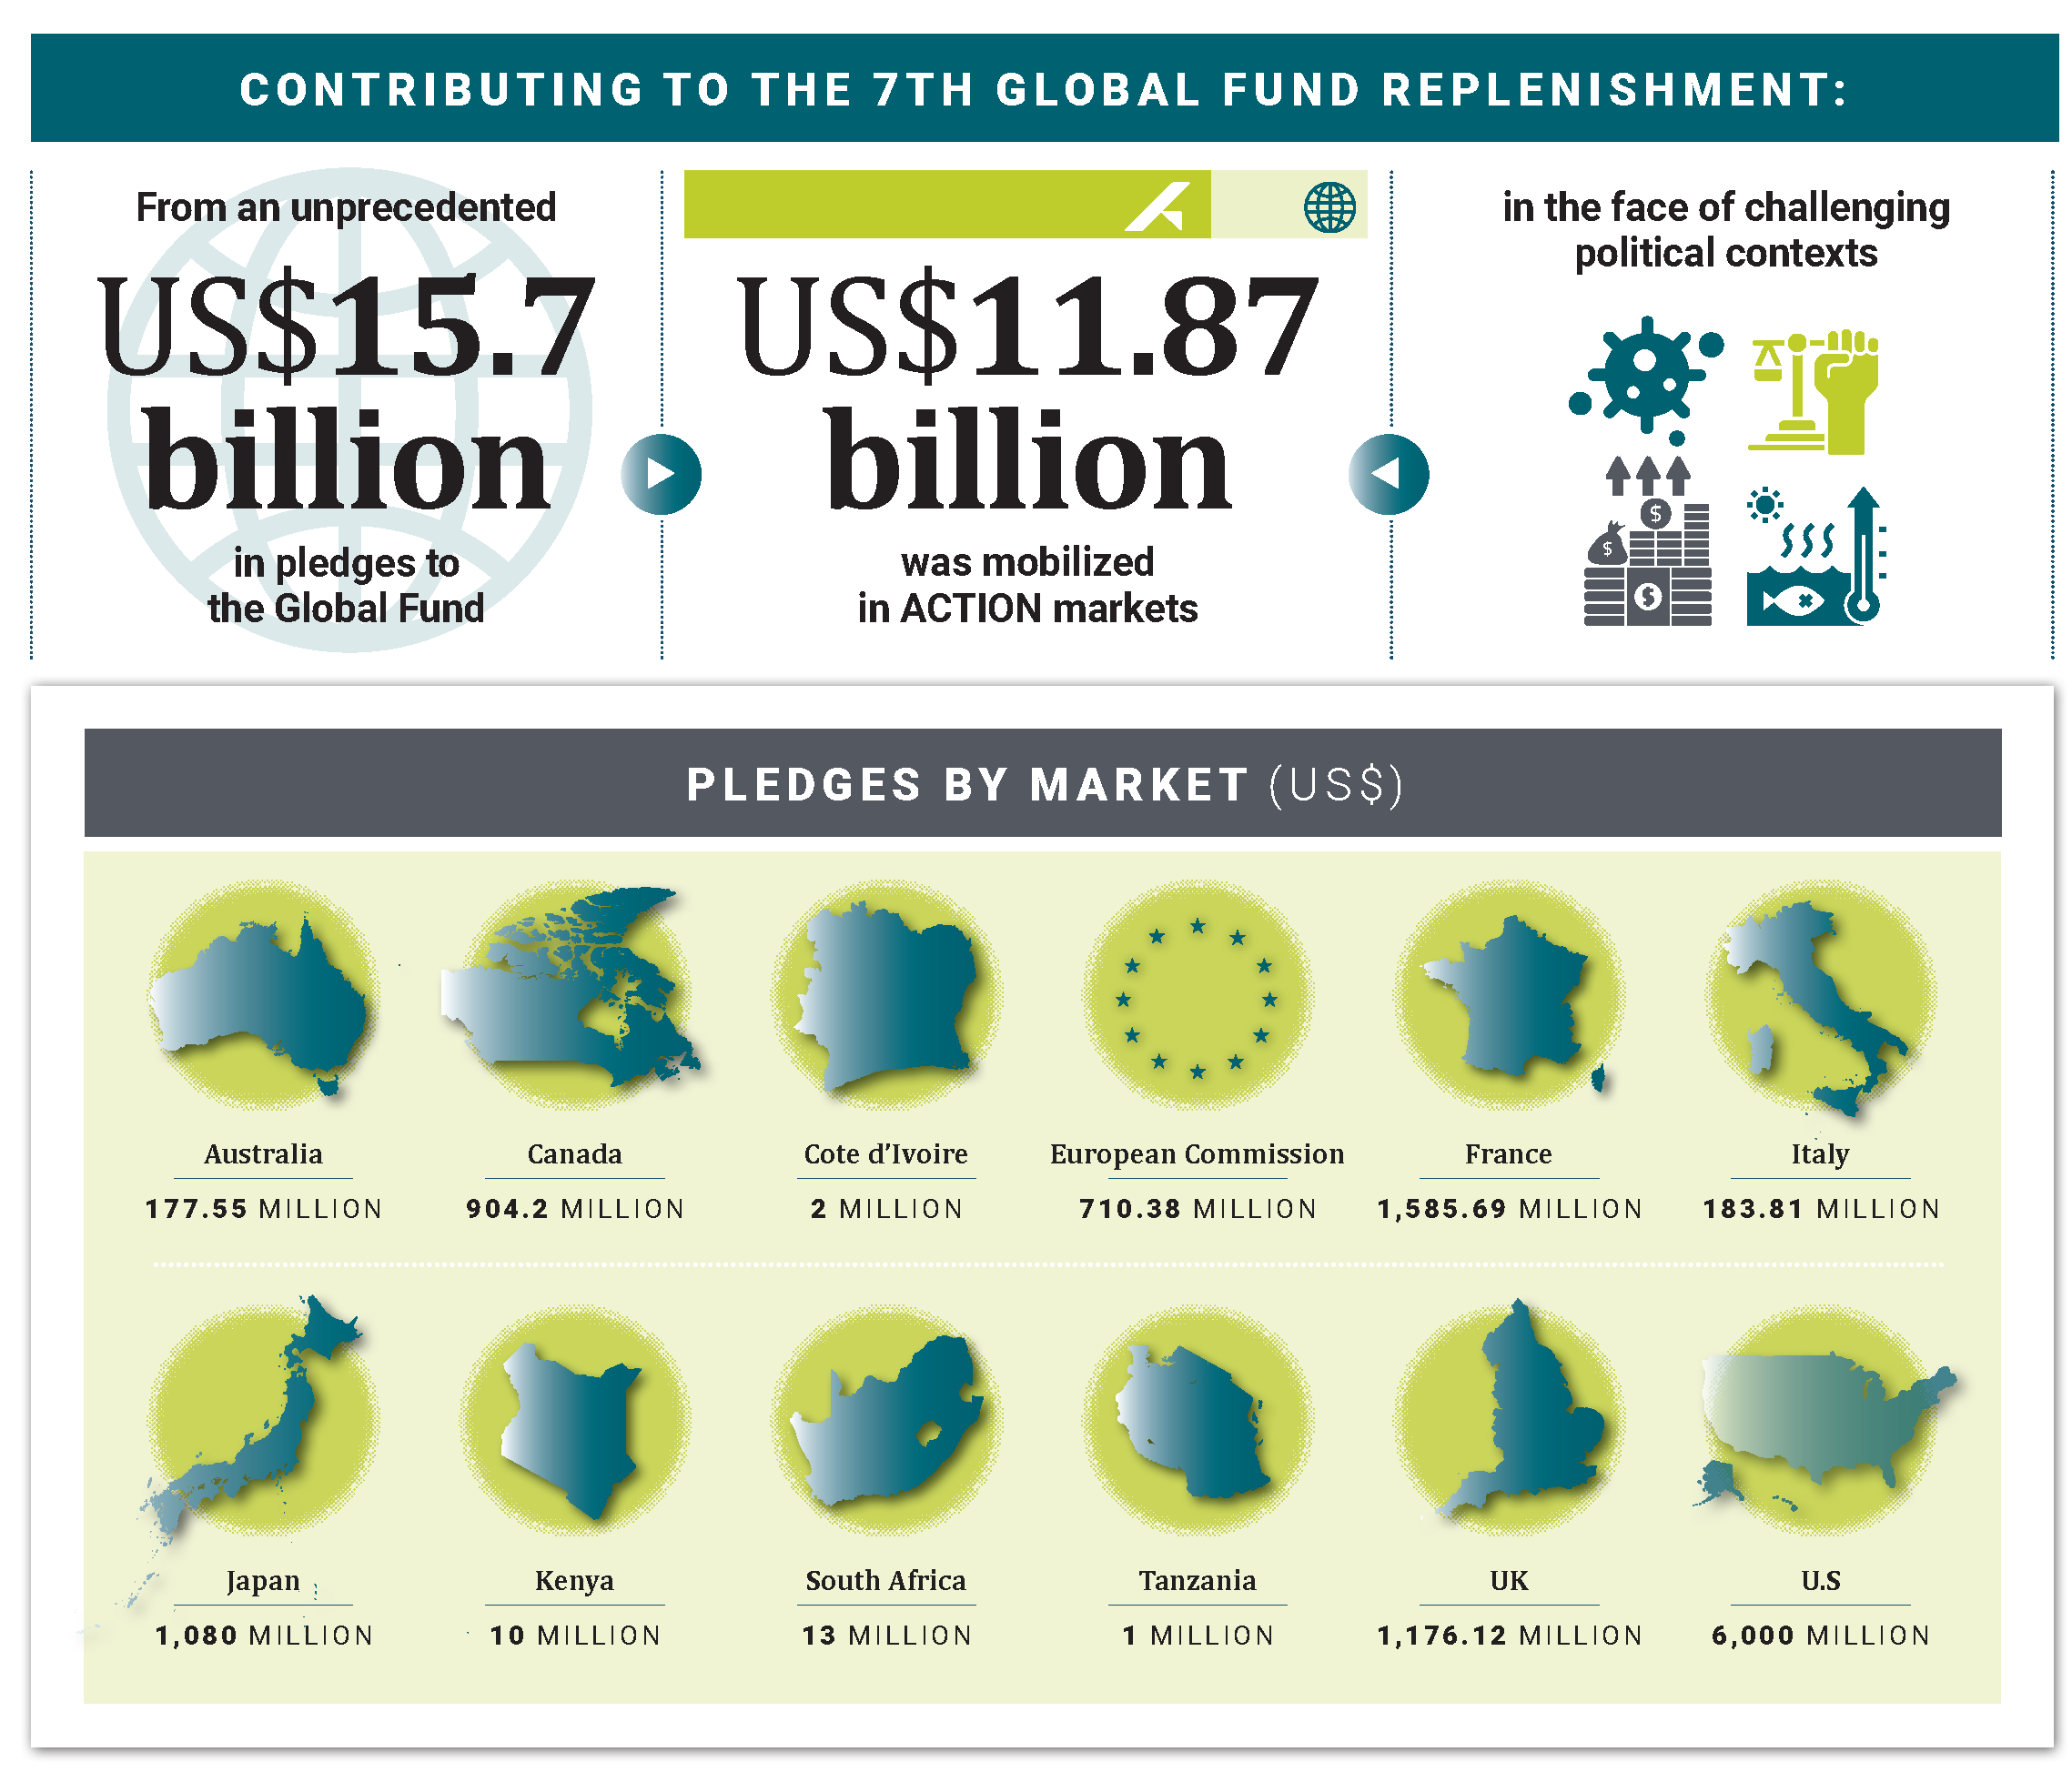
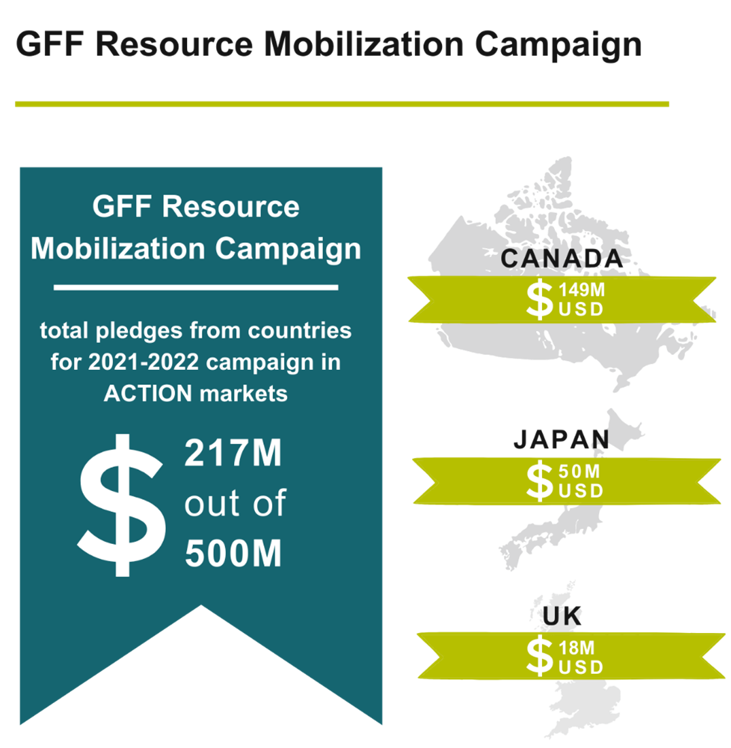
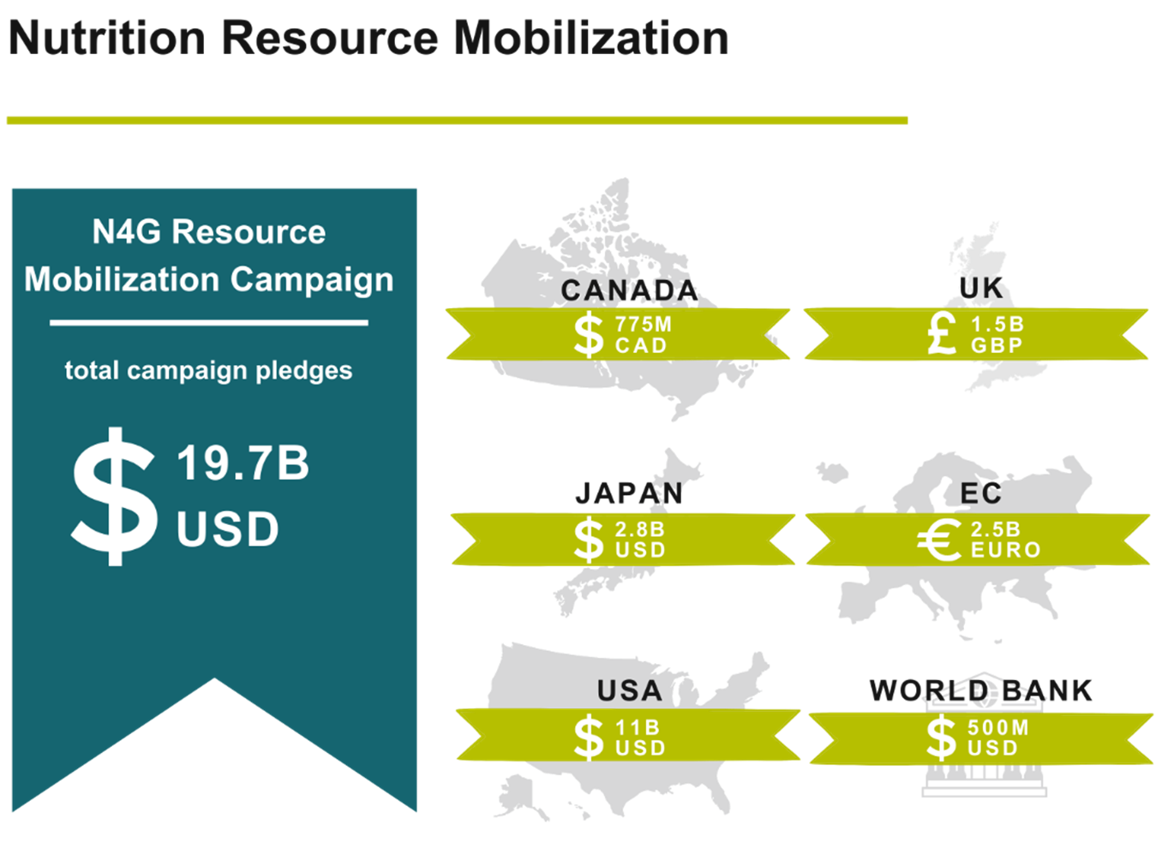
Resource mobilization in ACTION markets
2005: $288.40 million for TB (bilateral and multilateral resources, including GFATM)
2006: $324.29 million for TB
2007: $423.92 million for TB
2008: $456.86 million for TB, including $68 million to the GFATFM
2008–2011: $1.8 billion for GFATM
2011: $2.5 billion for Gavi
2013: $3 billion for Nutrition for Growth (nutrition-specific only)
2015: $4.52 billion for Gavi
2016: $9.9 billion for GFATM
2017–2020: $869.21 million for the GPEI
2019: $10.3 billion for GFATM
2020: $5.18 billion for Gavi
2020–2021: $11.25 billion for ACT-A, including $8.1 billion for COVAX
2021: $258 million for the GFF
2021: $17.1 billion for N4G (both nutrition-specific and nutrition-sensitive)
2022: $11.87 billion for GFATM
2022: $784 million for CEPI
2022: $92.35 million for the GPEI
Notes:
A lot of our advocacy revolves around mobilizing resources for global health programs. We started mobilizing millions of dollars — now billions of dollars — each year for various issues and mechanism. Here's a quick snapshot of numbers across the years. We have helped to raise tens of billions of dollars for AIDS, TB, malaria, routine immunization, polio, nutrition, RMNCAH, R&D, the COVID response, and more!

Slide 8
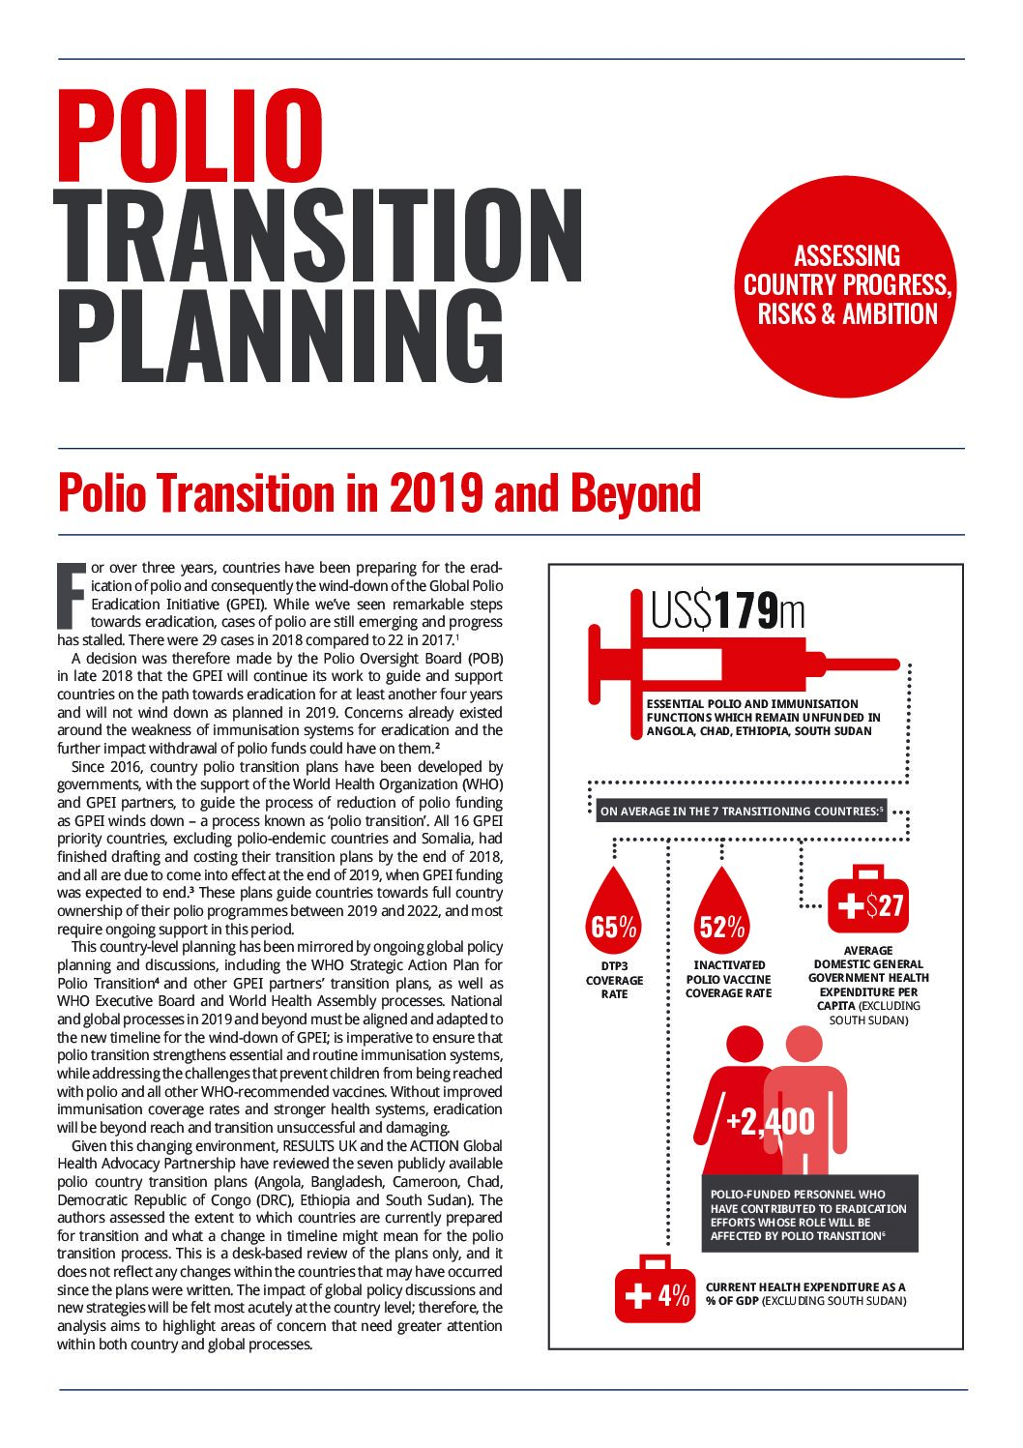
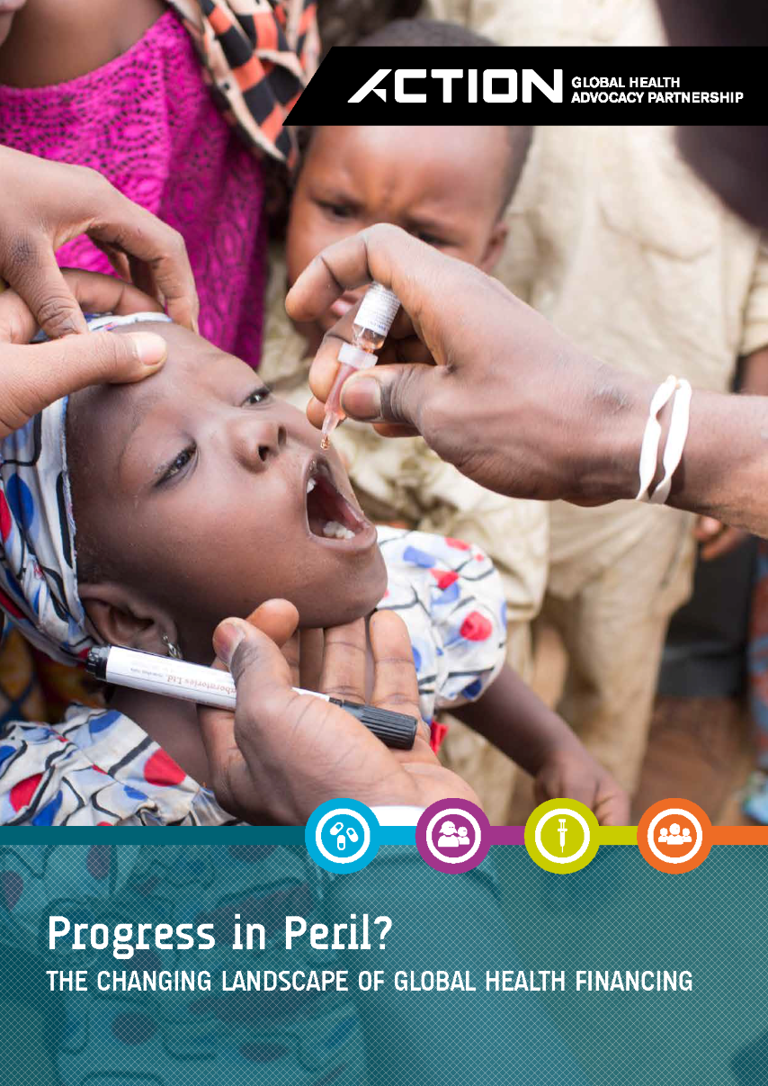
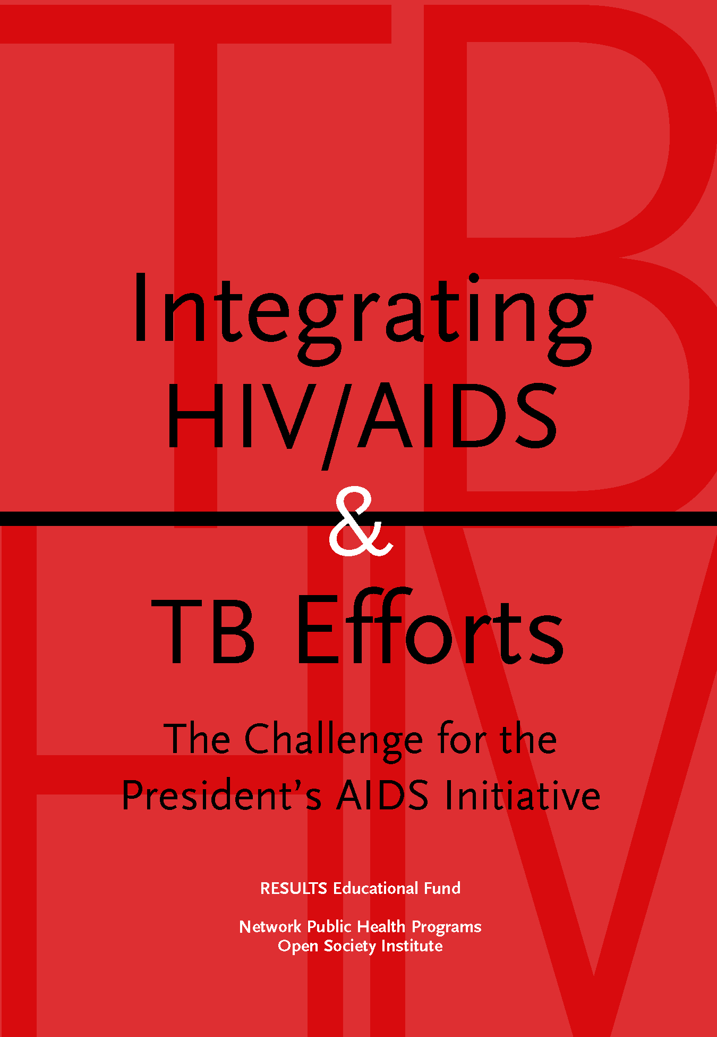
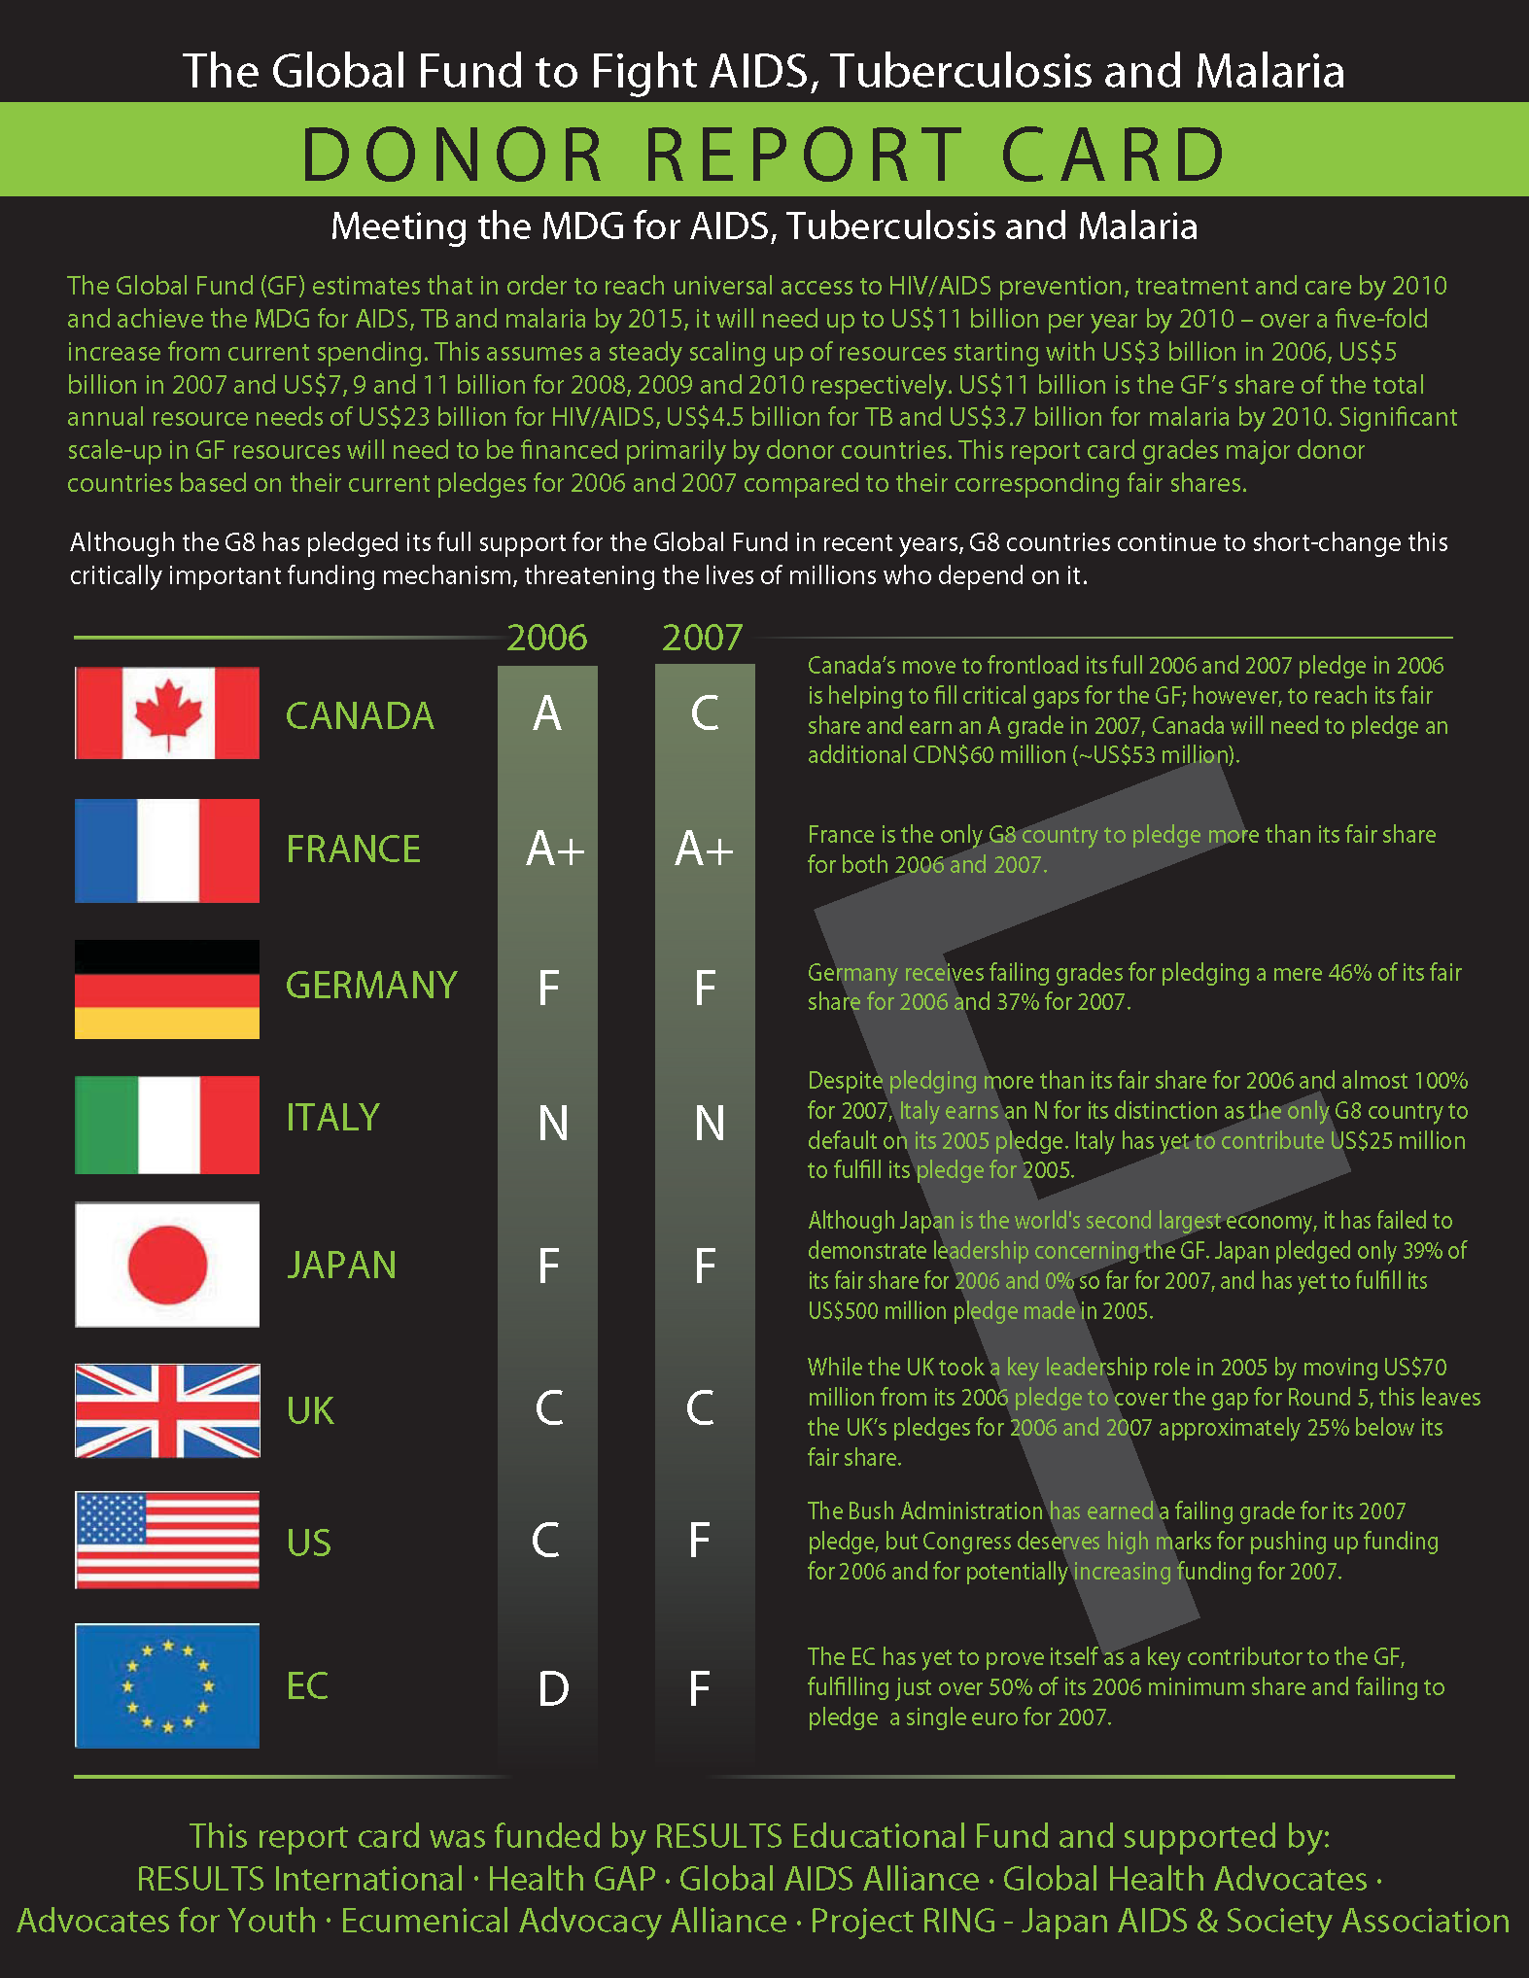
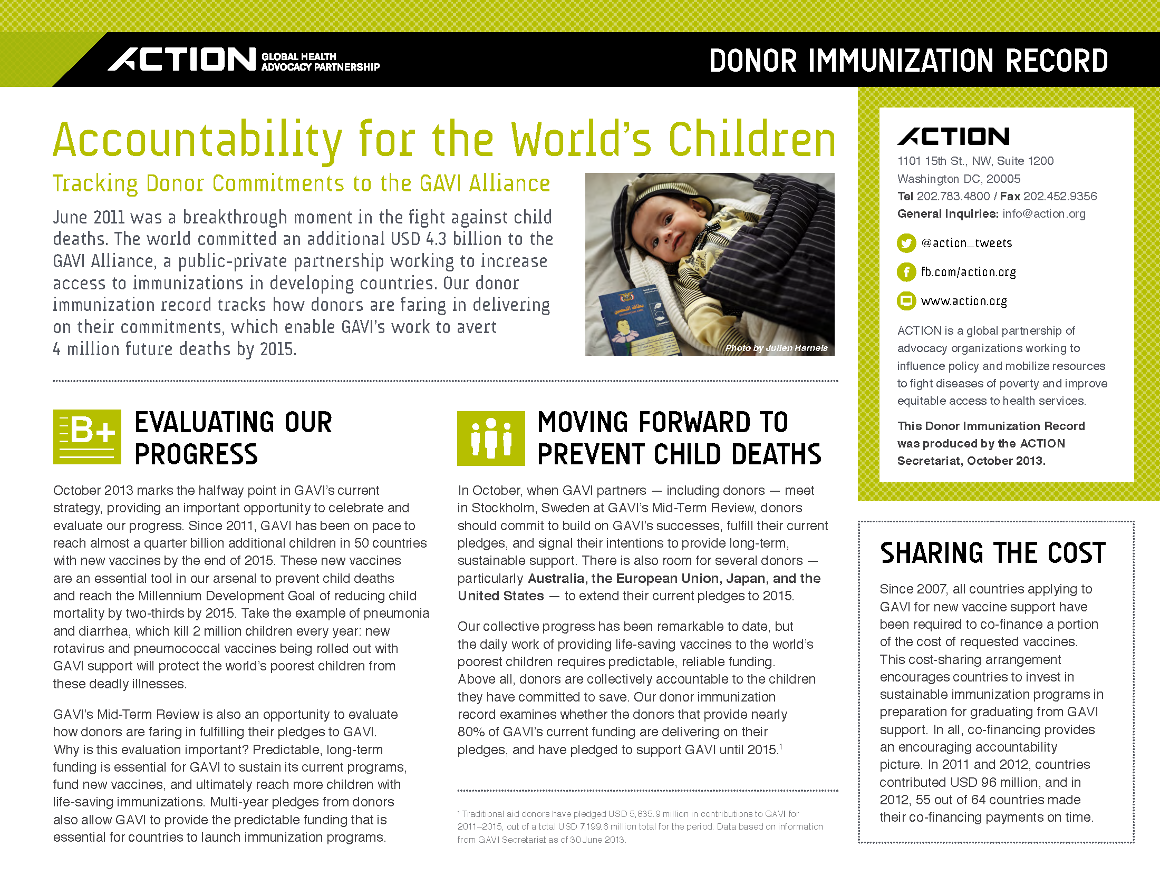
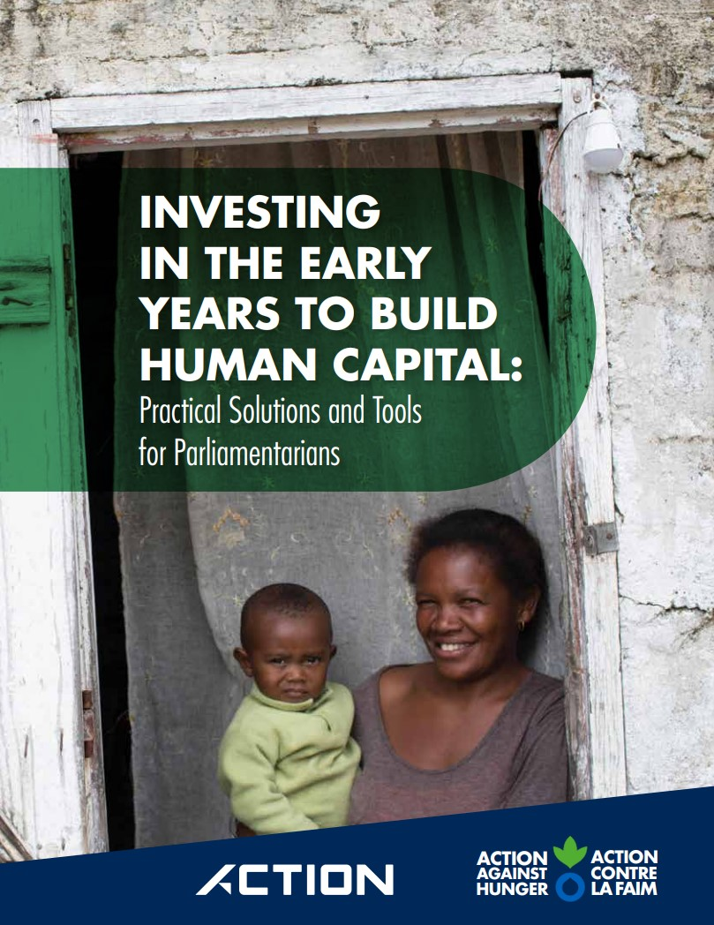
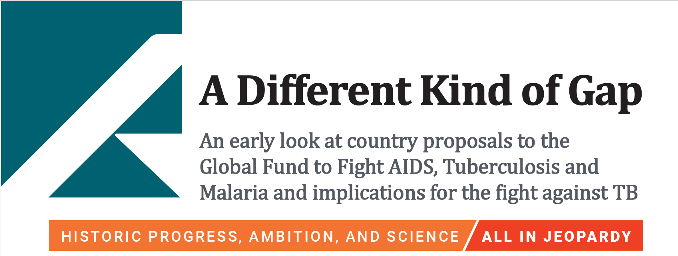
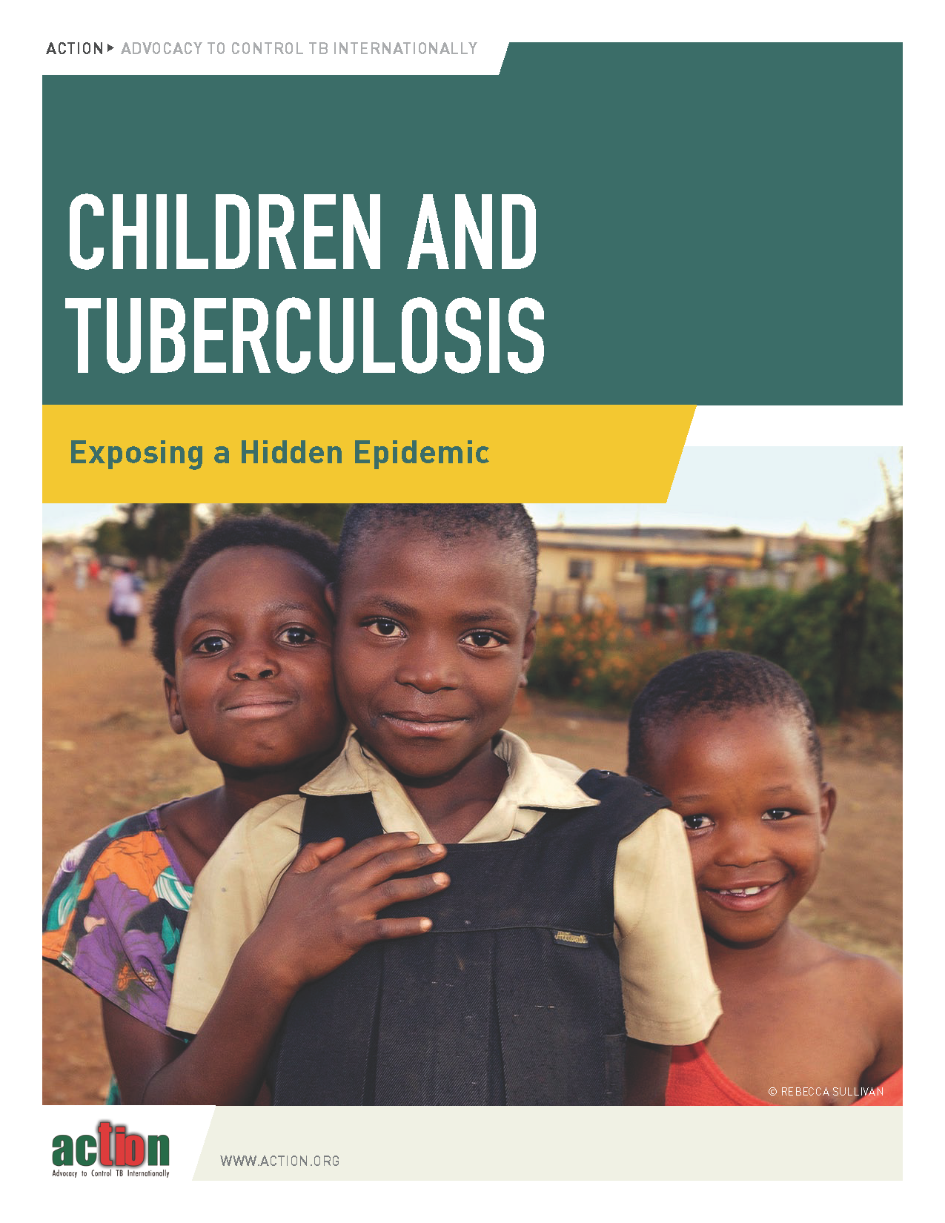
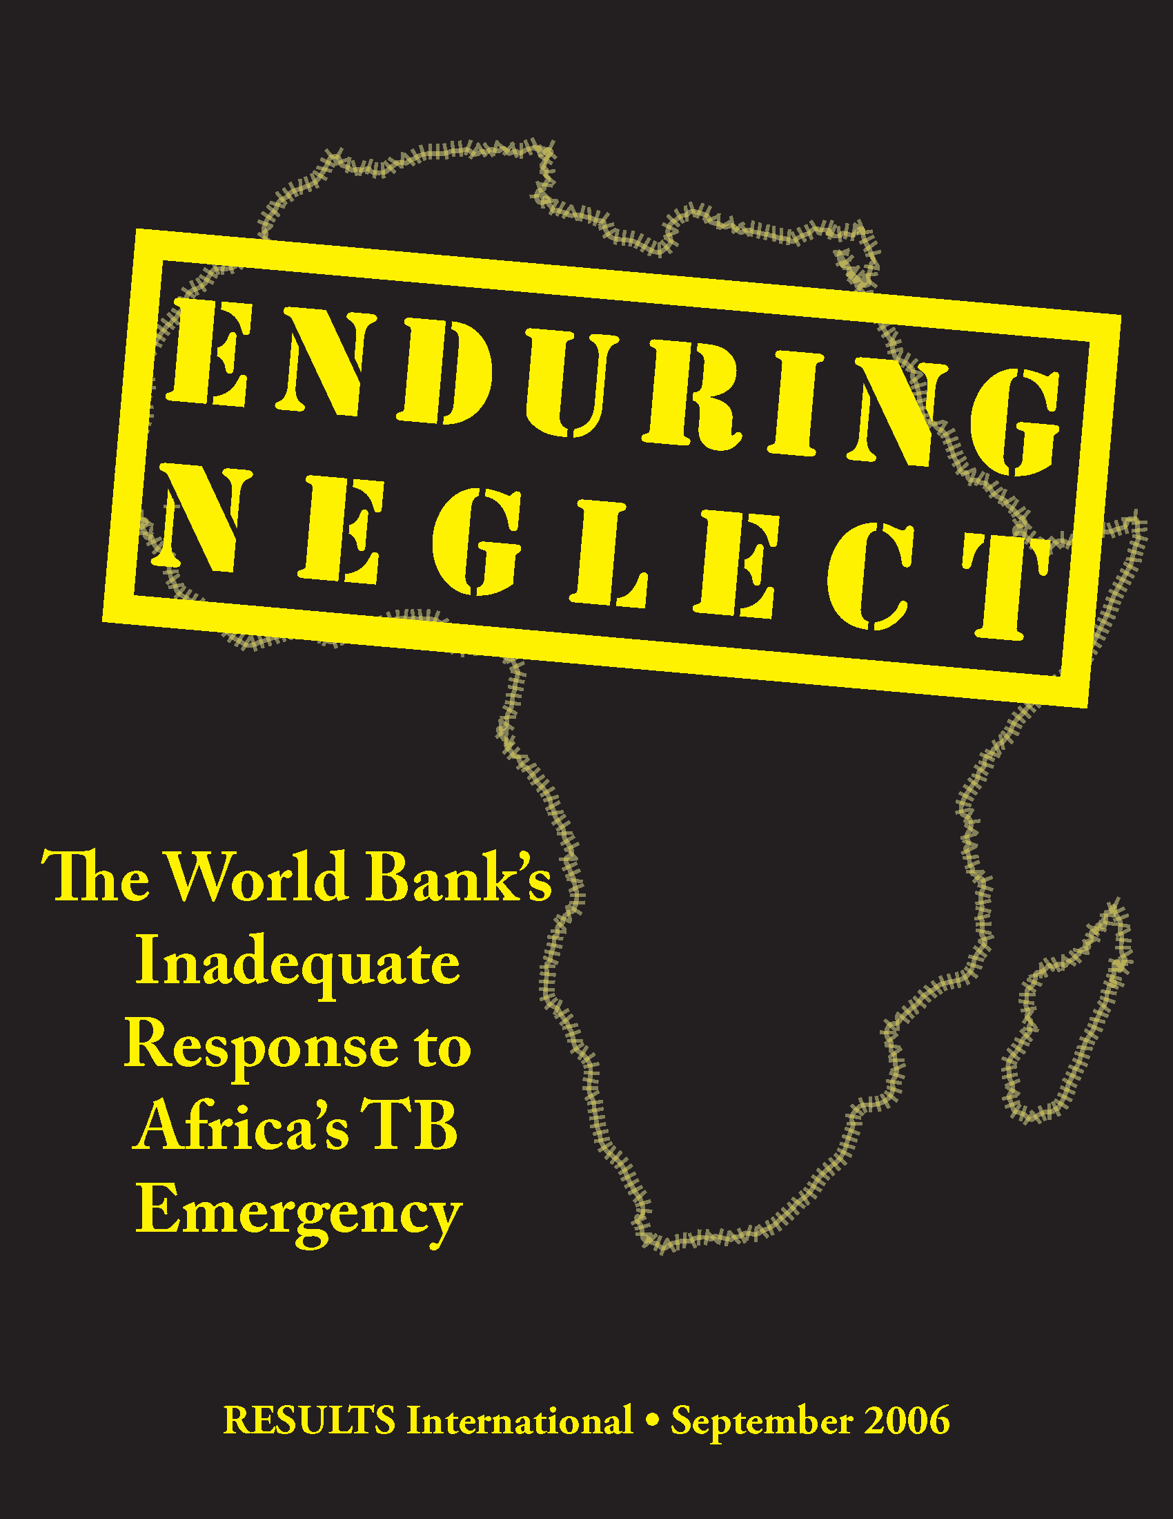
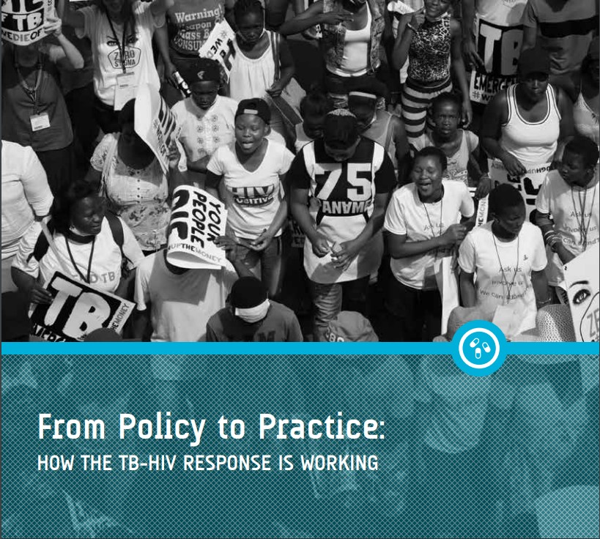
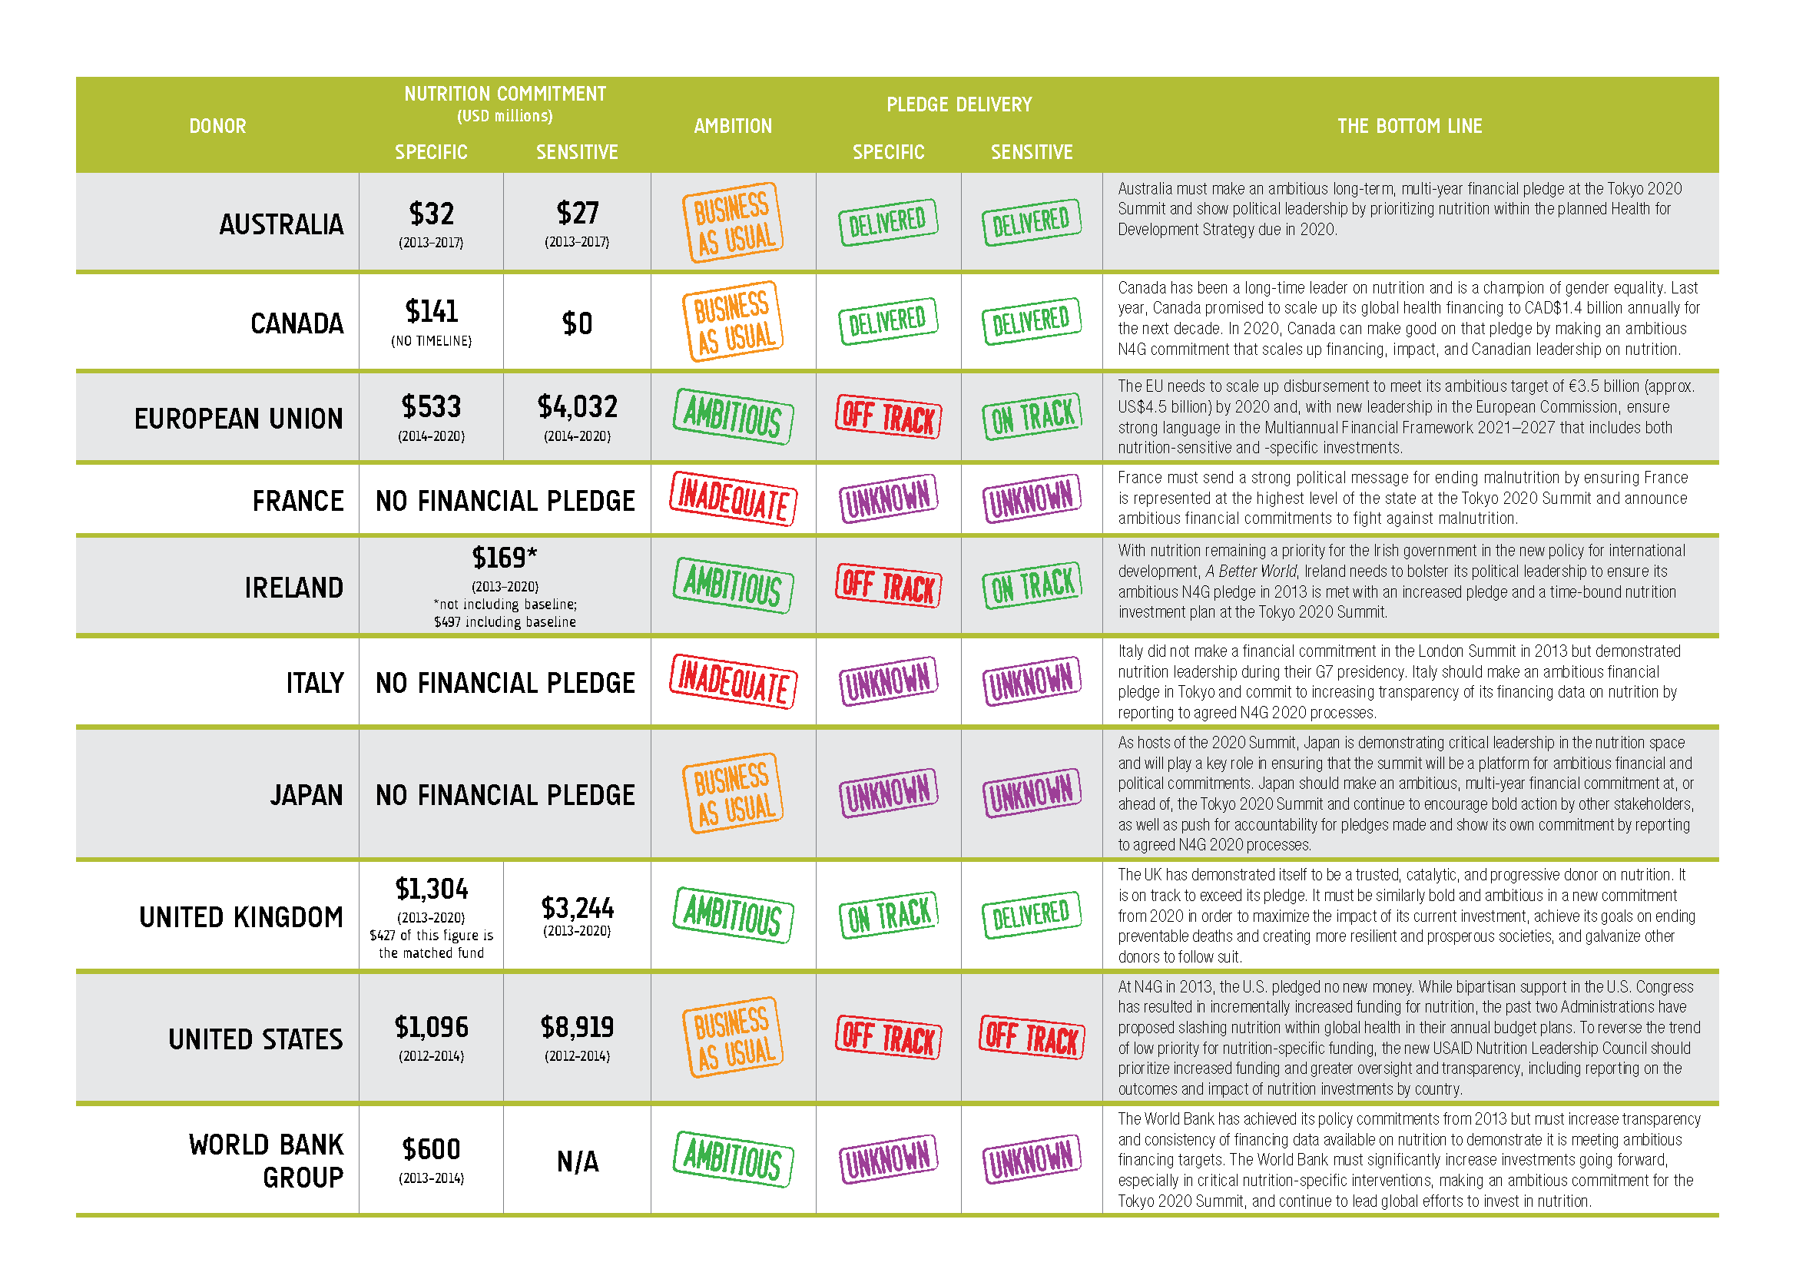
Policy and Accountability
Notes:
In terms of policy and accountability, we've worked to push more for equitable policies from the country level through the global level and in institutions like the Global Fund and the World Bank and developed accountability tools like fair share analysis and donor scorecards to ensure that these resources are delivered and have their intended impact.

Slide 9
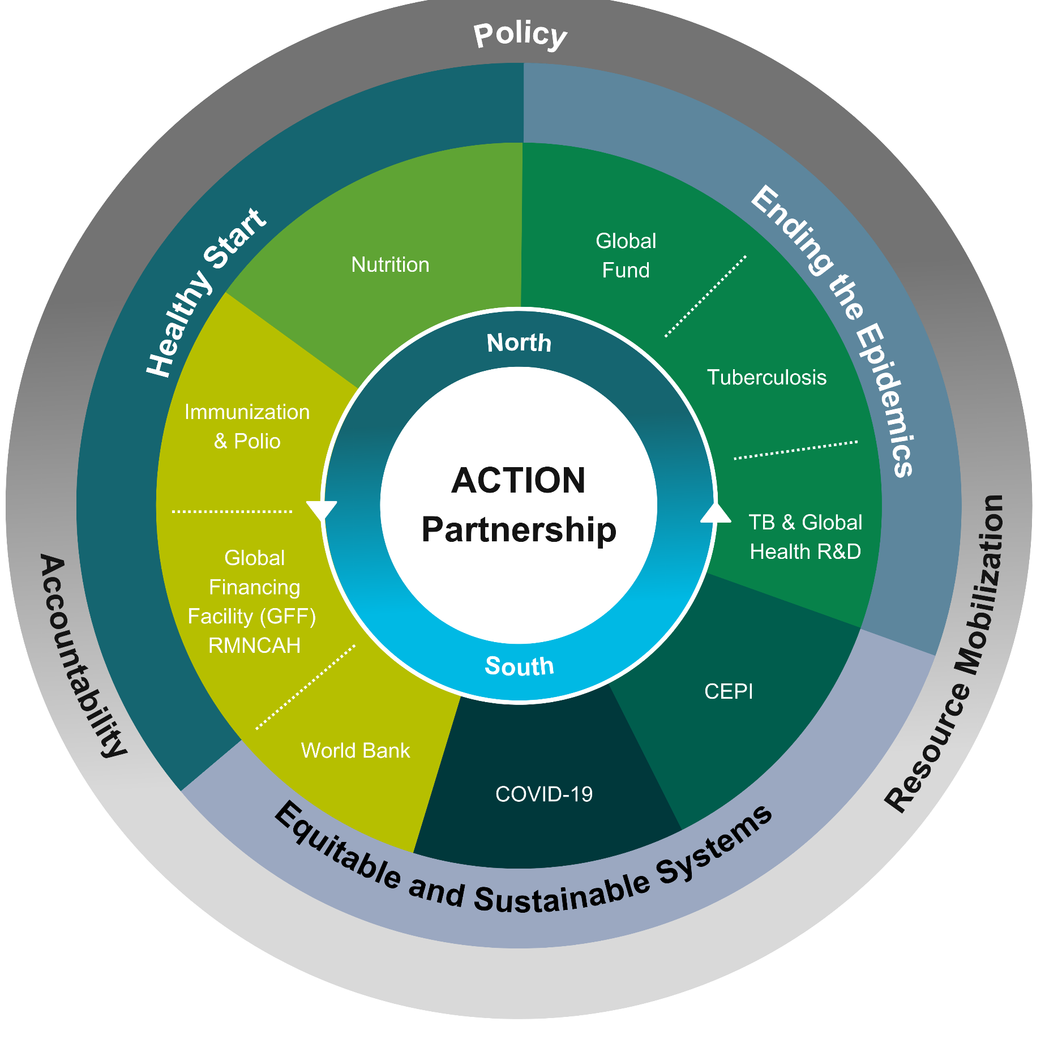
ACTION's Pillars
Ending the Epidemics
Healthy Start
Equitable and Sustainable Systems
PPPR
11
Notes:
ACTION’s advocacy is organized under 3 pillars:
Ending the Epidemics includes the Global Fund, tuberculosis (TB), and global health R&D.
Healthy Start includes child health and immunization (including the fight to eradicate polio), nutrition, and MNCH (maternal, newborn, and child health).
Equitable and Sustainable Systems includes human capital, health financing (in particular, work with the World Bank), and health systems, as well as PPPR (meaning pandemic preparedness, prevention, and response).

Slide 10
Global Health Campaigns
World Bank IDA21 replenishment
Gavi replenishment
Nutrition for Growth (N4G) Summit

Slide 11
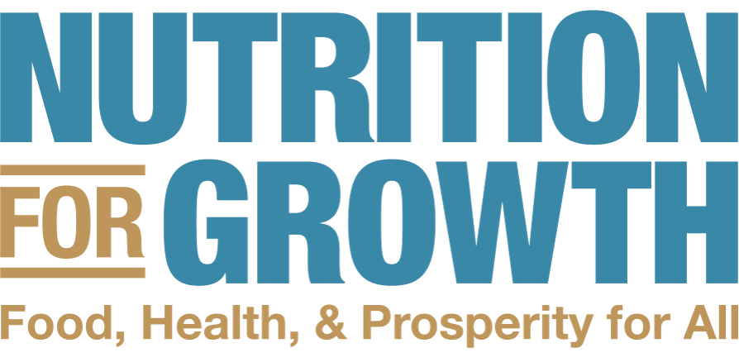
Rolling campaign
EU
European
Parliament
election
Gavi Replenishment
Global Fund Replenishment
US
Presidential election
SUN Global Gathering
UK
Parliamentary
election
Australia
General
election
UN General Assembly
Jul
Sep
Oct
Nov
Dec
Mar
Oct
World Bank Annual Meetings
Canada
Federal election
Paris N4G Summit
2024
IDA21 Replenishment
2025
Notes:
Here you can see how much resource mobilization across the different issues that ACTION Partners are working on, as well as a few key moments we plan to leverage and political elections in ACTION markets that have already had a big impact and will continue to do so.

Slide 12
World Bank’s IDA21 Replenishment
Important to know
Latest update
Concessional financing for poorest countries (low interest or grants)
Last IDA replenishment garnered $93 billion
New corporate scorecard
Strengthen policy commitment, as well as new proposed PC on UHC target
Include indicators in nutrition and MNCH
Increased funding of the CRW+
Upcoming IDA Meetings: WB Annual Meetings (Oct) and IDA 21 Replenishment Pledging Conference (Dec)
Notes:
Important to know
The International Development Association, or IDA, is largest source of external concessional financing for low-income and vulnerable countries
IDA replenishment happens every 3 years
As part of the new corporate scorecard, changes to the previous IDA policy framework are being developed which means that human capital is not a priority as a standalone, but now under "People" focus. This is how the IDA framework is organized by focus areas that identify priorities for IDA.
Latest update
Latest iteration of the policy framework still has policy commitments that could be stronger in their detail and ambition- we're there for pushing for those policy commitments to be refined, expanding access to more IDA countries and proposing a new policy commitment linked to the World Bank's UHC target set at the Spring meetings.
We're also continuing to push for added indicators especially in nutrition and maternal child health
We've also called for increased funding of the CRW+ crisis response window which is a special financing window to help countries respond to crisis, and have seen it used in response to the food security and nutrition crisis. This is looking positive and have heard that the number will depend on the final replenishment $.
Last push ahead of October where it will be the last IDA Deputies meeting (essentially by then this is all mostly negotiated) before pledging conference in December hosted by Korea

Slide 13
Gavi replenishment (likely Q1 2025)
Important to know
ACTION priorities
Last replenishment before 2030 (SDGs)
$9 billion target
$2.4 billion secured
The “Big Catch-Up,” polio, and the mpox response
Push donors to be ambitious while being cognizant of challenges
Inclusion/centering of implementing governments and country voices
Policies: zero-dose kids, HPV, polio, and malaria
Notes:
Important to know
This will be the last replenishment before 2030, the year by which the sustainable development goals (SDGs) are to be achieved.
Gavi has set a $9 billion target, with $2.4 billion secured at the June launch of Gavi’s investment opportunity, including at least $1.58 billion from the U.S. which was announced by First Lady Dr. Jill Biden.
The “Big Catch-Up” was launched during World Immunization Week in 2023 by Gavi and global health partners to reverse the decline in childhood vaccination recorded during the COVID-19 pandemic, due to overburdened health services and closed clinics, as well as disrupted imports and exports of vials, syringes, and other medical supplies.
Polio:
By 2019, all Gavi-supported countries had introduced the first dose of inactivated polio vaccine (IPV1) into their routine immunization schedules, reaching a coverage rate of 81% in 2022. Since December 2023, countries eligible for Gavi support have been able to apply to switch to a whole-cell pertussis (wP) hexavalent vaccine (hexavalent) – a six-in-one vaccine that combines the pentavalent vaccine (diphtheria, tetanus, whole-cell pertussis [DTwP], hepatitis B, and Haemophilus influenzae type b) with IPV. Countries that have not yet introduced IPV2 are encouraged to introduce hexavalent or IPV2 as a matter of urgency.
The mpox response
Gavi’s 1st shipment of mpox vaccines (15k doses) to the DRC arrived on Tuesday to support the global and regional effort to contain the outbreak. They add to the 215,000 vaccine doses that the European Union donated to the country last week. According to the Africa Centres for Disease Control and Prevention (Africa CDC), the outbreak had resulted in 5,265 confirmed cases, 18,737 suspected cases and 617 deaths from 1 January –31 August 2024. In DRC alone, there have been 4,799 confirmed cases, 17,801 suspected cases and 610 deaths. Under Gavi’s Fragility, Emergencies and Displaced Populations (FED) Policy, US$ 2.9 million from existing support has been made available to support DRC’s vaccination effort. This is an example of the role Gavi plays in the global health and pandemic response ecosystem. Gavi PR: https://www.gavi.org/news/media-room/15000-mpox-vaccine-doses-arrive-democratic-republic-congo
ACTION priorities
Push donors to be ambitious while being cognizant of challenges
Inclusion/centering of implementing governments and country voices
Policies: zero-dose kids, HPV, polio, and malaria
Rollout of the malaria vaccine: There are now 2 malaria vaccines, R21/Matrix-M and RTS,S, and there is now enough supply to meet the current demand. In July and August, Cote d’Ivoire, South Sudan, Mozambique, and Central African Republic introduced the R21 vaccine into their routine immunization programs. They join 8 others on the continent that have already introduced RTS,S malaria vaccines (Kenya, Ghana, Malawi, Cameroon, Burkina Faso, Sierra Leone, Benin, Liberia). In total, 15 African countries are expected to introduce malaria vaccines with Gavi support in 2024. Current plans show that countries plan to reach around 6.6 million children with the malaria vaccine in 2024 and 2025.

Slide 14
Nutrition for Growth (March 2025)
Important to know
ACTION priorities
2025 summit hosted by France
Governance is inclusive of CSOs, LMICs, and other stakeholders
N4G is a platform, not a financing mechanism
$10.8 billion per year financing gap for key nutrition-specific interventions
High-level attendance of heads of state and mobilization of other governments
Early pledges, commensurate with current needs
Prioritization of nutrition in all development policies, programs, and budgets
Notes:
Important to know
France is the host for the 2025 N4G Summit, which will be held in Paris in March. The governance structure of the Paris N4G summit is inclusive of CSOs, LMICs, and other stakeholders, and our French Partners are closely involved with the team that is organizing the event.
Unlike other resource mobilization campaigns, this is not a replenishment and there is not an official investment case. N4G is more of a platform for convening heads of states and other industry leaders to pledge resources for nutrition programming, which we break into “specific” and “sensitive” interventions. Nutrition-specific interventions target immediate causes of malnutrition, such as micronutrient and protein supplementation, promoting good health and hygiene, complementary foods, whereas nutrition-sensitive interventions focus on underlying factors, such as staple food fortification and pro-breastfeeding policies.
The latest estimates show that there is an annual financing gap of $10.8 billion per year for key nutrition-specific interventions.
ACTION priorities
We’re seeking to secure high-level attendance at the Paris summit by heads of state and to get their support in mobilizing other governments – both to attend the summit and to make bold, ambitious financial and policy commitments.
We are also calling for pledges to be made early – before March – and to be commensurate with current needs. In other words, flat funding of nutrition programs is not enough. In the U.S., advocates are asking for at least $13.3 billion in funding attributable to nutrition-related activities over FY 2025 to FY 2028, including at least $2 billion for nutrition-specific activities. And, this would only keep pace with inflation.
We also call on governments to prioritize nutrition in all development policies, programs, and budgets.

Slide 15
Thank you! Questions?

