Slide 1
RESULTS National Webinar September 7, 2024 Welcome!

Slide 2
Our Values
At RESULTS we pledge to create space for all voices, including those of us who are currently experiencing poverty. We will address oppressive behavior in our interactions, families, communities, work, and world. Our strength is rooted in our diversity of experiences, not in our assumptions.
With unearned privilege comes the responsibility to act so the burden to educate and change doesn’t fall solely on those experiencing oppression. When we miss the mark on our values, we will acknowledge our mistake, seek forgiveness, learn, and work together as a community to pursue equity.
Read our full anti-oppression values statement here at results.org/values.
Notes:
Updated AO slide (2/22)

Slide 3
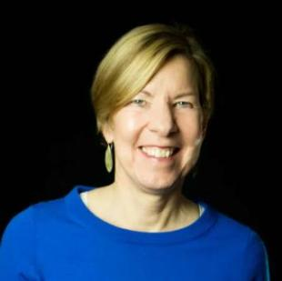
Welcome!
Joanne Carter Executive Director

Slide 4
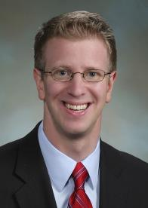
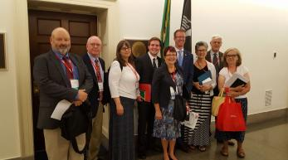
Guest Speaker
Rep. Derek Kilmer (D-WA-8)
Facilitated by RESULTS Gig Harbor (WA) volunteer Andy Clarke (far left)

Slide 5
Global Poverty Campaigns

Slide 6
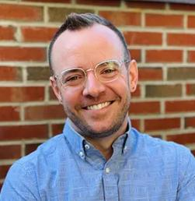
U.S. Poverty Campaigns
Colin Smith Director of Global Policy csmith@results.org

Slide 7
In a world of intractable problems, malnutrition is one we already know how to end.

Slide 8
Nutrition for Growth
A global pledging moment to tackle malnutrition and ensure everyone, everywhere can reach their full potential. Every four years alongside the Olympics.
2021
Tokyo
2025
Paris
2028
Los Angeles

Slide 9
What can the U.S. government do?
Make a specific, bold, new financial pledge
Send a powerful public signal to the world, encouraging others to be bold
Members of Congress are writing to President Biden!
Ask your representative to join the list

Slide 10
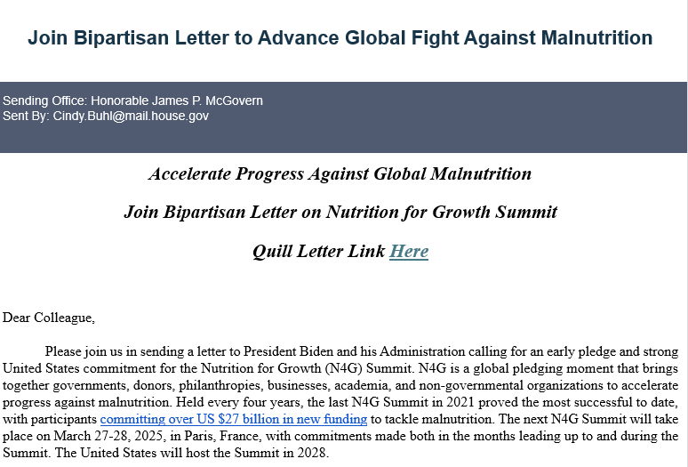
Get Congress on the record
Bipartisan congressional letter calls for an early pledge and new policies

Slide 11
Deadline:
September 12
48 signers and counting!

Slide 12
U.S. Poverty Campaigns

Slide 13
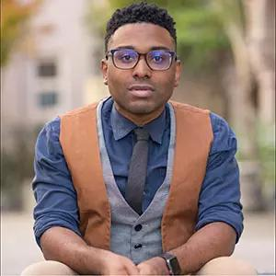
U.S. Poverty Campaigns
TaShon Thomas Interim VP, Campaigns & Advocacy tthomas@results.org

Slide 14
U.S. Poverty Campaigns Update
Food Insecurity Report Released
Food insecurity increased to 13.5% of households compared to 12.8% in 2022
Prices increased for everyone with households with children spiked to the highest levels in nearly a decade
Food insecurity among Black and Hispanic Americans was more than twice as high as White Americans
No significant difference between cities (15.9%) and rural areas (15.4%); but still significantly less than the nation's suburbs (11.7%)
Southern states saw the most food insecurity than any other region (14.7%)

Slide 15
U.S. Poverty Campaigns Update
SNAP
No vote is likely until after the federal appropriations packages are passed
Farm Bill programs, including SNAP, have funding until at least December
Some leaders in the House and Senate continue to call for cuts to SNAP and restrictions on foods people may purchase
House Ag Chair Thompson's SNAP Choice amendment will NOT be included in FY25 Appropriations

Slide 16
U.S. Poverty Campaigns Update
Appropriations
Closely watching how this appropriations process plays out
Speaker Johnson could introduce the SAVE Act
$7.7 billion to support nearly seven million individuals expected to participate in the Special Supplemental Nutrition Program for Women, Infants, and Children (WIC)

Slide 17
17
Take action on key
U.S. poverty priorities
SNAP / Farm Bill action:
Continue to talk to your members of Congress about protect SNAP from reckless cuts and policies in Farm Bill discussions.

Slide 18
Supporting RESULTS through Planned Giving

Slide 19
Planned Giving: A Legacy of RESULTS
The 45 in 45 campaign
We're celebrating 45 years of RESULTS in 2025!
We're launching the 45 in 45 campaign to secure 45 new bequests and support a thriving future for RESULTS
All new and existing members of RESULTS' Legacy Society will receive a special custom RESULTS notebook! Please contact me to claim your gift at mstrobel@results.org or (202) 783-4800 x 221

Slide 20
Planned Giving: A Legacy of RESULTS
"If you're going to live, leave behind a legacy. Make an impact on the world that can never be erased."
-Maya Angelou
What is Planned Giving?
Your commitment to ending poverty can extend beyond your lifetime with a planned gift to RESULTS Educational Fund, our 501(c)(3) tax-deductible arm.
Naming RESULTS Educational Fund in your will or trust, or as a beneficiary of a life insurance policy or retirement account, is a powerful way to magnify your impact, as our advocacy leverages your gift many times.
These gifts can offer personal and financial advantages to you while providing RESULTS with an invaluable source of support.

Slide 21
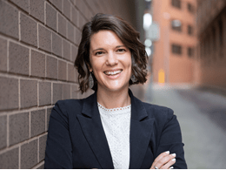
Planned Giving: A Legacy of RESULTS
Do you want to leave a legacy of RESULTS? Want to learn more about planned giving or our Legacy Society?
Have you included RESULTS in your estate plans or as a beneficiary of assets such as a retirement plan?
I'd love to talk with you! Or visit www.results.org/planned-giving
Melissa M. Strobel
Director of Development
mstrobel@results.org
(202) 783-4800 x 221

Slide 22
Grassroots Café

Slide 23
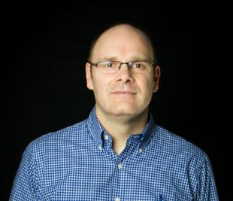
Election Engagement Media
Jos Linn
Interim Director, Grassroots Impact jlinn@results.org

Slide 24
Election Engagement Campaign
August Perspectives on Democracy & In-District Meetings
September Importance of Candidate Engagement & Media Training
October Using Data to Combat Toxic Poverty Narratives
November Keeping Congress Accountable During End of Lame Duck Year
October

Slide 25
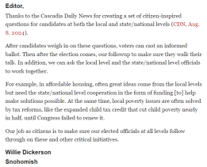
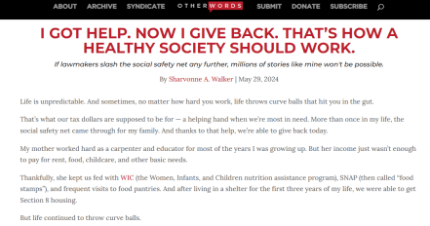
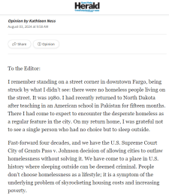
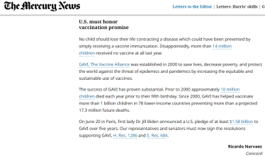
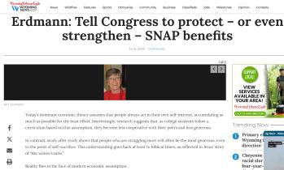
Your media matters!

Slide 26
Join the Double 50 campaign!
Goal: Using media to make poverty an election issue and a priority for the new Congress.
From September 1 – December 31, we will:
DOUBLE our 2024 media count for the year – 300 new media pieces!
Get at least one piece published in all 50 states

Slide 27
Join the Double 50 campaign!
RESULTS commits to supporting you to reach our goal with:
New media templates on the website each week (www.results.org/volunteers/action-center/)
Regular media hooks to use for letters
Weekly updates on our progress and where to target your media
Monthly media office hours and special trainings

Slide 28
Join the Double 50 campaign!
Speaking of hooks:
The 2023 U.S. Census poverty data will be released on September 10
One of the few times each year the media covers poverty issues
The new data is a great hook for letters and op-eds!
Watch for more info in Tuesday’s Weekly Update

Slide 29
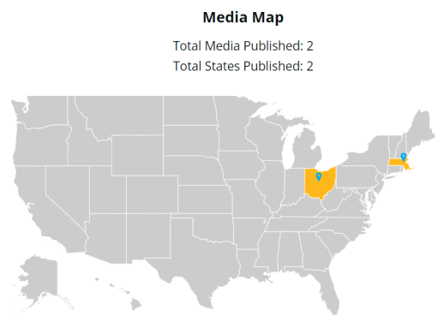
We need you…
…to fill up this map!

Slide 30
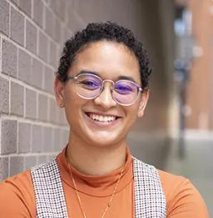
Welcome!
Lakeisha McVey Senior Manager,
Lived Experience Engagement
lmcvey@results.org

Slide 31
Lived Experience Op-ed Project
Developed through a partnership with the Institute for Policy Studies (IPS)
Amplify the experiences and expertise of RESULTS volunteers with lived experiences of poverty in the U.S.
Op-eds are ghost-written & published on OtherWords.org
IPS compensates $200 for time and expertise

Slide 32
Benefits/Impact
Opportunity to share your experiences and tell your story the way you want it to be told
IPS will pitch your op-ed to other papers
In 2024 alone, 9 op-eds have been published
Republished over 120 times
66 unique national and local outlets
23 states

Slide 33
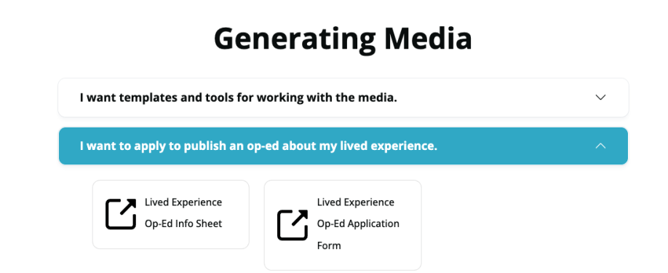
Find more information & apply
results.org/volunteers/media-tools

Slide 34
Centering Lived Poverty Experience in the Media
Thursday, September 12, 8:00-9:00 p.m. ET
Do you have lived experience of poverty and want to publish an op-ed? Would you like to help get op-eds published in your local media from writers with lived experience?
Hear about RESULTS’ partnership with the Institute for Policy Studies (IPS) to publish op-eds from advocates with lived experience of poverty.
Please register to attend the webinar. For any questions, please contact Lakeisha McVey at lmcvey@results.org.

Slide 35
Questions? Contact me!
Lakeisha McVey lmcvey@results.org

Slide 36
Announcements

Slide 37
Thank you for joining us!
Who is joining you in the room today?
In the poll, please respond with the number of people in the room with you (including yourself).

Slide 38
Motivational Interviewing series begins!
Wednesday, September 11, 8:00 – 9 p.m. ET
Want to build bridges with lawmakers? Want to effectively talk to people who disagree with you?
We are thrilled to welcome back Dr. Dave Christian, Ph.D., P.C., who has trained in Motivational Interviewing (MI) for years. In six monthly sessions, you will gain skills using MI for effective dialogue with lawmakers you struggle to move into action.
Register today!

Slide 39
Election Support Office Hours
Drop in to discuss your questions relating to election engagement beginning on September 10 at 1:00 p.m. ET!
Additional Opportunities:
Thursday, September 12 at 8:00 p.m. ET
Monday, September 16 at 8:00 p.m. ET
Thursday, September 19 at 2:00 p.m. ET
Tuesday, September 24 at 8:00 p.m. ET
Join via https://results.zoom.us/j/97873811515
or call 312-626-6799 (Meeting ID: 978 7381 1515).

Slide 40
Building Resilience as Advocates from a Trauma Informed Care Approach
Wednesday, September 25 at 8:00 – 10:00 p.m. ET Facilitated by: Dr. Khalila Fordham and Dr. Paolo Laraño (The Greenhouse Foundation)
As dedicated advocates, we often need to harness the skills to navigate stress, anxiety, and frustration. This dynamic, engaging, and interactive workshop invites you to further develop resilience while facing the difficulties of advocacy work from a trauma-informed perspective.
RSVP: https://tinyurl.com/RESULTSBuildingResilience

Slide 41
September U.S. Poverty Policy Forum “The United States of Hunger”
Thursday, September 19, 1:00 p.m. ET
In this special forum, leaders will discuss the persistent issue of food insecurity. They will discuss our current government dietary guidelines compared with economic reality, as well as connect housing affordability and food insecurity. Attendees will get also insights into how food insecurity affects public health.
Register today!

Slide 42
RESULTS Fellowship
Recruitment is now underway for the
2025 RESULTS Fellowship!
Learn more and apply at: https://results.org/fellowship
Also, join us for a Fellowship info session on
Wednesday, September 18, 6:00 p.m. ET.
Register today!

Slide 43
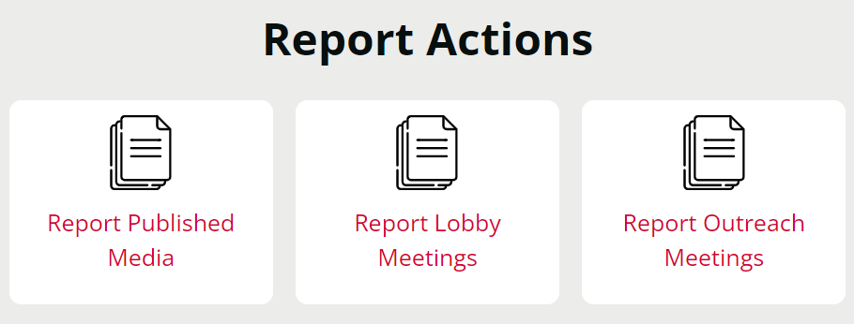
Let us know the amazing things you are doing?
https://results.org/volunteers/reporting-your-advocacy-actions

Slide 44
Centering Lived Poverty Experience in the Media
Thursday, September 12, 8:00-9:00 p.m. ET
Do you have lived experience of poverty and want to publish an op-ed? Would you like to help get op-eds published in your local media from writers with lived experience?
Hear about RESULTS’ partnership with the Institute for Policy Studies (IPS) to publish op-eds from advocates with lived experience of poverty.
Please register to attend the webinar. For any questions, please contact Lakeisha McVey at lmcvey@results.org.

Slide 45
Office Hours
Outreach and Event Planning Office Hour
Thursday, September 12, 2:00 p.m. - 3:00 p.m. ET
Join via https://results.zoom.us/j/94004748060
or call (312) 626-6799, meeting ID 940 0474 8060.
Media Office Hour
Wednesday, September 18, 2:00-3:00 p.m. ET
Join at https://results.zoom.us/j/93668005494
or call (312) 626-6799, meeting ID 936 6800 5494.

Slide 46
Partnership Calls
Global Allies Program
(Returned Peace Corps Volunteers)
Thursday, September 12, 8:30 p.m. ET
Register today!
Together Women Rise Partnership Webinar
Tuesday, September 24, 8:30 p.m. ET
Click to learn more.

Slide 47
Free Agents
U.S. Poverty Free Agents
Tuesday, September 17, 1:00 p.m. and 8:00 p.m. ET
Contact Jos Linn at jlinn@results.org for information.
Global Poverty Free Agents
Monday, September 23, 7:00 p.m. ET
Contact Lisa Marchal at lmarchal@results.org for information.

Slide 48
New Advocate Orientations
Wednesday, September 18, 8:30 p.m. ET
Tuesday, September 24, 1:00 p.m. ET
Registration is open!

Slide 49
Action Network Manager Calls
Wednesday, September 18,
12:30 p.m. ET and 8:00 p.m. ET
Join via https://results.zoom.us/j/95416781155
or call (312) 626-6799, meeting ID 954 1678 1155).

Slide 50
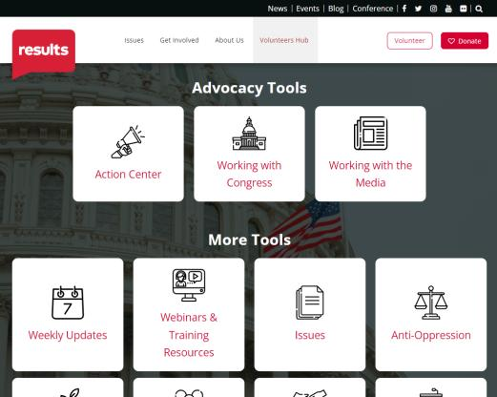
Find today’s slides
results.org/volunteers/national-webinars

Slide 51
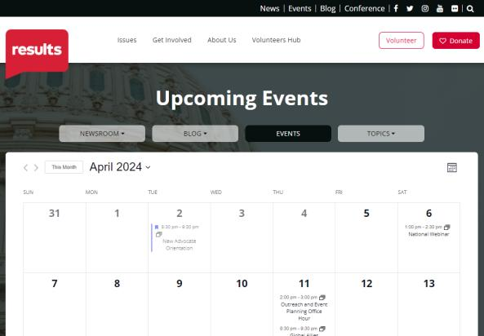
Find events
results.org/events

Slide 52
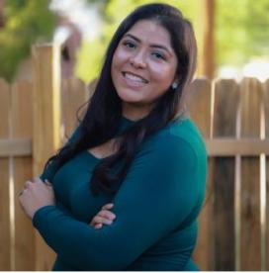
Join us for the October National Webinar
Guest speaker:
Grecia Lima
National Political Director at Community Change Action
October 5 at 1:00 p.m. ET Register at: tinyurl.com/RESULTS2024

Slide 53
RESULTS website and social media

