Slide 1
RESULTS National Webinar August 3, 2024 Welcome!

Slide 2
Our Values
At RESULTS we pledge to create space for all voices, including those of us who are currently experiencing poverty. We will address oppressive behavior in our interactions, families, communities, work, and world. Our strength is rooted in our diversity of experiences, not in our assumptions.
With unearned privilege comes the responsibility to act so the burden to educate and change doesn’t fall solely on those experiencing oppression. When we miss the mark on our values, we will acknowledge our mistake, seek forgiveness, learn, and work together as a community to pursue equity.
Read our full anti-oppression values statement here at results.org/values.
Notes:
Updated AO slide (2/22)

Slide 3
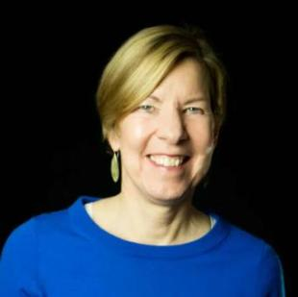
Welcome!
Joanne Carter Executive Director

Slide 4
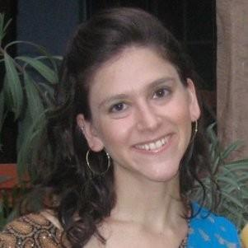
Guest Speaker
Melanie Vant
Director, Democracy Delivers Initiative
U.S. Agency for International Development (USAID)

Slide 5
Global Poverty Campaigns

Slide 6
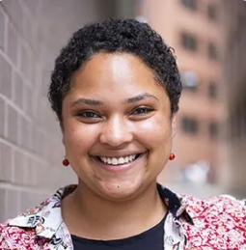
Election Engagement Campaign
Dorothy Monza
Global Nutrition and Child Health Policy Manager
dmonza@results.org

Slide 7
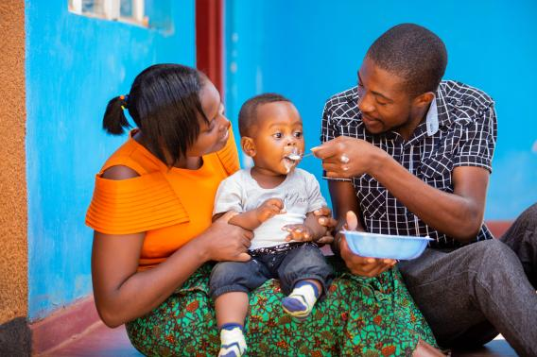
Nutrition is fundamental
Credit: USAID Malawi

Slide 8
1,000 Days

Slide 9
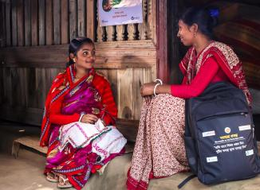
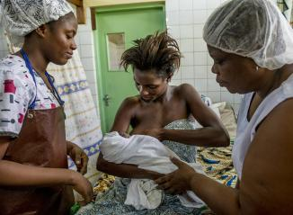
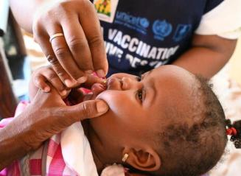
We can prevent malnutrition
© UNICEF/UN0668289/Dejongh
PHOTO CREDITS - 1. Mehzabin Rupa/World Vision / 2. Karen Kasmauski/MCSP / 3. © UNICEF/UN0668289/Dejongh
Notes:
https://www.flickr.com/photos/usaid_images/51952948100/in/photostream/
https://www.flickr.com/photos/mcspglobal/15294988248/

Slide 10
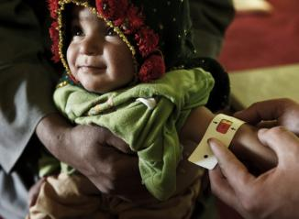
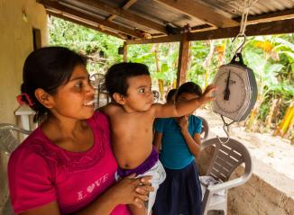
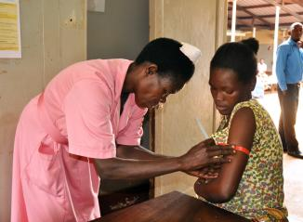
We can detect malnutrition early
PHOTO CREDITS - 1. ACF/Christina Tchad / 2. USAID-ACCESO/Fintrac Inc. / 3. Kate Consavage/USAID
Notes:
https://www.flickr.com/photos/usaidafrica/32390294158/
https://www.flickr.com/photos/usaid_images/14720125257/
https://www.flickr.com/photos/usaidafrica/41809766381/

Slide 11
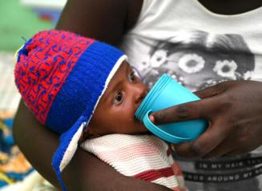
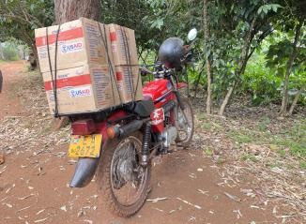
We can treat malnutrition
PHOTO CREDITS - 1. © UNICEF/UN0668307/Dejongh / 2 & 3. Kate Consavage/USAID
Notes:
https://www.flickr.com/photos/198231745@N02/52942498880/
https://www.flickr.com/photos/usaidafrica/41809739091/

Slide 12
Our big global moment
This Photo by Unknown Author is licensed under CC BY-SA

Slide 13
We want the US Government to
Make a specific, bold, new financial pledge
Make a powerful public signal to the world, encouraging others to be bold
Congressional sign-on letter coming soon!
Stay tuned for ways you can take action

Slide 14
Global Poverty Policy Forum
Focus: Malnutrition Nutrition is one of the most important factors to a strong start in life. Unfortunately, nearly half of all preventable child deaths have malnutrition as an underlying cause. We can and must do better.
Thursday, August 15, 9:00 p.m. ET
Register now!

Slide 15
U.S. Poverty Campaigns

Slide 16
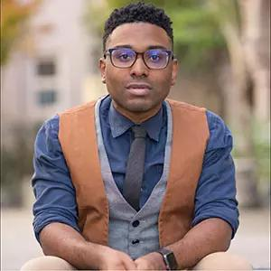
U.S. Poverty Campaigns
TaShon Thomas Director, U.S. Poverty Policy tthomas@results.org

Slide 17
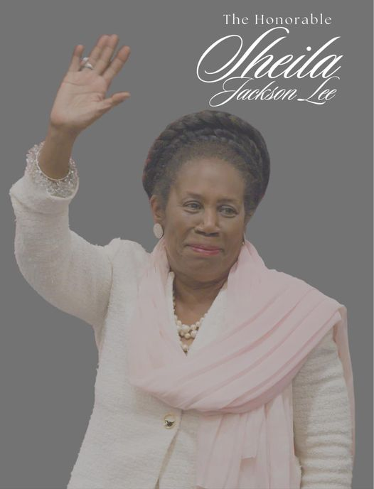
Moment of Silence
Congressmember Sheila Jackson Lee (D), TX-18 1950-2024
Co-sponsored several RESULTS backed legislation

Slide 18
U.S. Poverty Campaigns Update
Child Tax Credit
Sadly, the bipartisan bill expanding the Child Tax Credit failed to pass the Senate by a 48-44 vote
This was a failure of election year politics, not your advocacy
You helped build important policy agreement even in an extremely polarized time in our politics
That policy agreement builds a strong foundation for our advocacy in 2025 when major tax policy decisions will be made

Slide 19
U.S. Poverty Campaigns Update
SNAP
No movement on the Farm Bill and likely not until after the election
Some leaders in the House and Senate continue to call for cuts to SNAP and restrictions on foods people may purchase
Housing
We continue to see fallout from the US Supreme Court’s Grants Pass decision
CA governor recently ordered all homelessness encampments in the state cleared

Slide 20
20
Take action on key
U.S. poverty priorities
CTC action: Email your senator or publish a letter to the editor expressing your disappointment with the Senate vote.
SNAP / Farm Bill action: Continue to talk to your members of Congress about protect SNAP from reckless cuts and policies in Farm Bill discussions.
Housing action: In light of the SCOTUS decision allowing the criminalization of homelessness, please submit a letter to the editor urging Congress to act now.

Slide 21
Grassroots Café

Slide 22
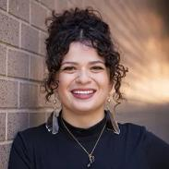
August Recess
Sarah Leone
Senior Associate, Grassroots Impact sleone@results.org

Slide 23
August Recess
Recess runs from now until September 9
Members travel back to home states and districts
Members, and candidates, want to hear what’s important to constituents
Opportunity to meet with Representatives, Senators, and/or key staff members face-to-face

Slide 24
August Recess
Goals
Introduce your RESULTS group as resource, proof that the community cares
Educate the office on issues, and gather intel
Get a commitment from the office to take action

Slide 25
August Recess
Why we do it?
Build more relationships with the office.
Leverage connection within district office.
Demonstrate “people power” and uplift new voices in our community
Chance to meet your Rep or Senator in person

Slide 26
Best Practices for In District Lobbying
Focus on building relationships
Invite your community to attend
Be persistent
Find your MOC at a community event
Any other tips? Share your thoughts in the chat!

Slide 27
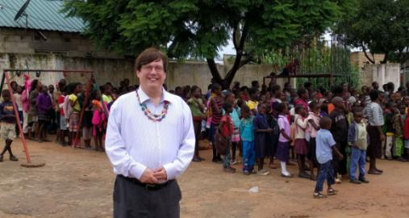
Let’s hear from an advocate!
David Burns
RESULTS Central NJ Global

Slide 28
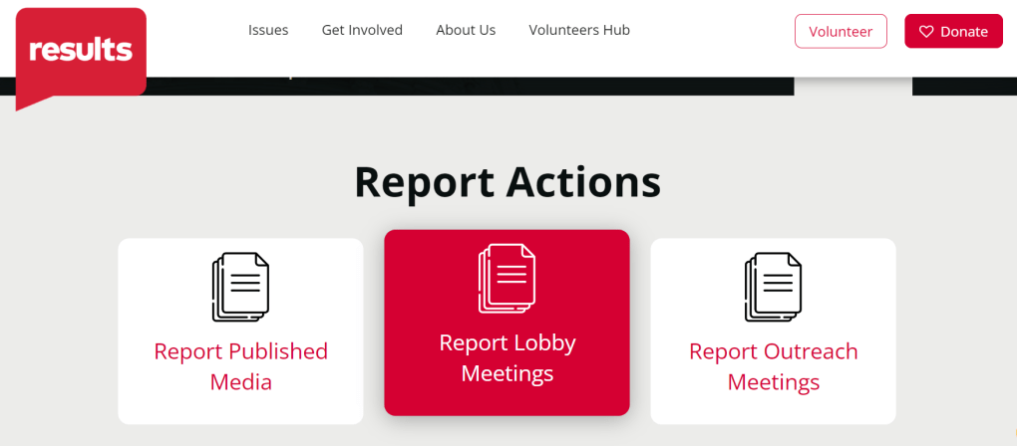
Please remember to report candidate engagement on the lobby report form!

Slide 29
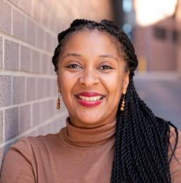
Election Engagement Campaign
Karyne Bury
Manager of Grassroots Impact
kbury@results.org

Slide 30
Election Engagement Campaign
Goals:
Interaction with candidates and incumbents
Continue getting them on the record on U.S. and Global poverty issues
Elevate poverty issues among the public discourse
Continue community base-building efforts launched this summer

Slide 31
Election Engagement Campaign
Key Activities:
Direct Advocacy (August Recess)
Generating media
More community outreach

Slide 32
Election Engagement Campaign
Amplify your actions with media!
Build public awareness of poverty issues
Prompt concern and desire for action
Make a strong case for leadership to support solutions
Require candidates to take a position!
Join our September webinar on how to generate media during election season!

Slide 33
Election Engagement Campaign
August Perspectives on Democracy & In-District Meetings
September Importance of Candidate Engagement & Media Training
October Using Data to Combat Toxic Poverty Narratives
November Keeping Congress Accountable During End of Lame Duck Year
October

Slide 34
Election Engagement Campaign
Resources:
Community of Change website: “Make Elections About Poverty”
Check in with Group Leaders, Regional Coordinators, and RESULTS Elections Team
RESULTS Elections Team Office Hours

Slide 35
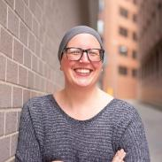
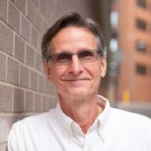
August Recess Election Engagement Campaign
RESULTS Elections Team Drop In Office Hours (all times Eastern Time)
Joanna DiStefano Wednesday, 8/7
5:00-7:00 p.m. ET
Sarah Leone Wednesday, 8/14
12:00-2:00 p.m. ET
Karyne Bury
Wednesday, 8/21
12:00-2:00 p.m. ET
Ken Patterson Monday, 8/26
5:00-7:00 p.m. ET
Join at: https://results.zoom.us/j/97873811515

Slide 36
Anti Oppression Resources
https://results.org/volunteers/anti-oppression

Slide 37
Anti Oppression Resources
https://results.org/volunteers/anti-oppression

Slide 38
Announcements

Slide 39
Thank you for joining us!
Who is joining you in the room today?
In the poll, please respond with the number of people in the room with you (including yourself).

Slide 40
Other Office Hours
Outreach and Event Planning Office Hour
Thursday, August 8, 2:00 p.m. - 3:00 p.m. ET
Join via https://results.zoom.us/j/94004748060
or call (312) 626-6799, meeting ID 940 0474 8060.
Media Office Hour
Wednesday, August 21, 2:00-3:00 p.m. ET
Join at https://results.zoom.us/j/93668005494
or call (312) 626-6799, meeting ID 936 6800 5494.

Slide 41
Partnership Calls
Global Allies Program
(Returned Peace Corps Volunteers)
Thursday, August 8, 8:30 p.m. ET
Register today!
Together Women Rise Partnership Webinar
Tuesday, August 20, 8:30 p.m. ET
Click to learn more.

Slide 42
Anti-Oppression Learning
Friday, August 16, 12:00-1:30 p.m. ET
The Anti-Oppression (AO) Learning Community offers a brave space where no matter where you are in your understanding of
anti-oppression topics, you are welcome.
This community is open to any RESULTS volunteer.
Register for the AO Learning Community meeting.
For questions, please contact Lakeisha McVey at lmcvey@results.org.

Slide 43
RESULTS Fellowship
Come along to an upcoming info session on the next Fellowship cohort!
Register for the August 14, 6:00 p.m. ET. session
Another session will happen in September.

Slide 44
Free Agents
U.S. Poverty Free Agents
Tuesday, August 20, 1:00 p.m. and 8:00 p.m. ET
Contact Jos Linn at jlinn@results.org for information.
Global Poverty Free Agents
Monday, August 26, 7:00 p.m. ET
Contact Lisa Marchal at lmarchal@results.org for information.

Slide 45
Action Network Manager Calls
Wednesday, August 21,
12:30 p.m. ET and 8:00 p.m. ET
Join via https://results.zoom.us/j/95416781155
or call (312) 626-6799, meeting ID 954 1678 1155).

Slide 46
Anti-Oppression Resources
Find these resources and more at results.org/volunteers/anti-oppression:
Resource Guides from our Diversity & Inclusion trainings, including:
Interrupting Microaggressions
Creating Space for Critical Conversations
Information on how RESULTS responds to oppressive incidents
Notes:
Updated AO slide (2/22)

Slide 47
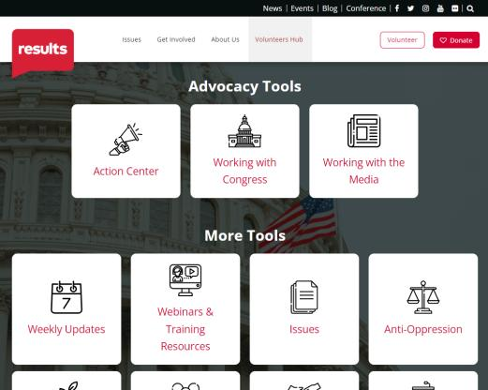
Find today’s slides
results.org/volunteers/national-webinars

Slide 48
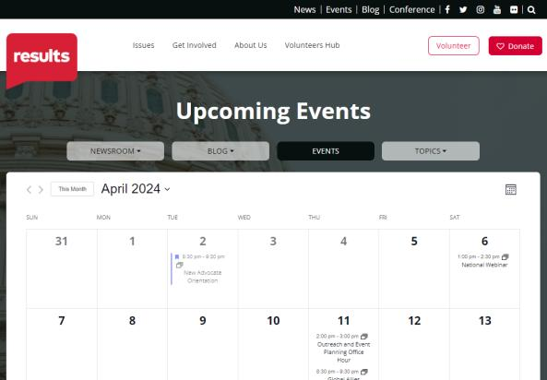
Find events
results.org/events

Slide 49
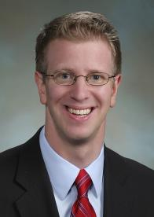
Join us for the September National Webinar
Special guest:
Rep. Derek Kilmer
(D-WA-6)
September 7 at 1:00 p.m. ET Register at: tinyurl.com/RESULTS2024

Slide 50
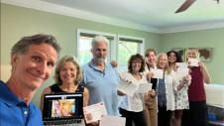
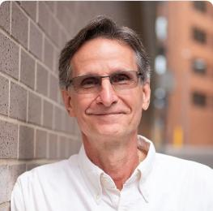
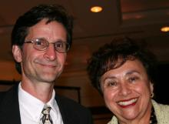
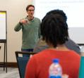
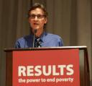
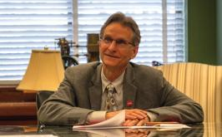
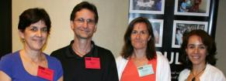
Farewell, Ken!
Ken Patterson
Director of Grassroots Impact

Slide 51
RESULTS website and social media

