Slide 1
RESULTS National Webinar June 1, 2024 Welcome!

Slide 2
Our Values
At RESULTS we pledge to create space for all voices, including those of us who are currently experiencing poverty. We will address oppressive behavior in our interactions, families, communities, work, and world. Our strength is rooted in our diversity of experiences, not in our assumptions.
With unearned privilege comes the responsibility to act so the burden to educate and change doesn’t fall solely on those experiencing oppression. When we miss the mark on our values, we will acknowledge our mistake, seek forgiveness, learn, and work together as a community to pursue equity.
Read our full anti-oppression values statement here at results.org/values.
Notes:
Updated AO slide (2/22)

Slide 3
Resources
Find these resources and more at results.org/volunteers/anti-oppression:
Resource Guides from our Diversity & Inclusion trainings, including:
Interrupting Microaggressions
Creating Space for Critical Conversations
Information on how RESULTS responds to oppressive incidents
Notes:
Updated AO slide (2/22)

Slide 4
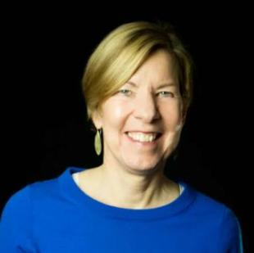
Welcome!
Joanne Carter Executive Director

Slide 5
U.S. Poverty Campaigns

Slide 6
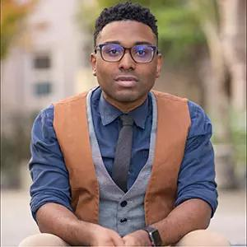
U.S. Poverty Campaigns
TaShon Thomas Director, U.S. Poverty Policy tthomas@results.org

Slide 7
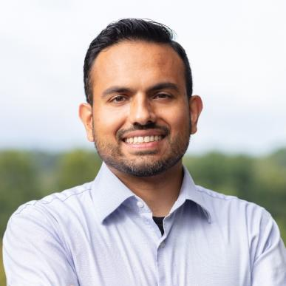
Guest Speaker
Salaam Bhatti
SNAP Director
Food Research and Action Center (www.frac.org)

Slide 8
U.S. Poverty Campaigns Update
Child Tax Credit Still awaiting on Senate Leadership to put legislation on the floor
Housing Expect to hear Grants Pass decision within the next couple of weeks.

Slide 9
9
Take action on key
U.S. poverty priorities
SNAP / Farm Bill Continue to talk to Senate Agriculture Committee leaders and members of Congress to protect SNAP from reckless cuts and policies in Farm Bill discussions.
Notes:
Substantive Policy & Review of Asks (3 min) - highlight different approaches between CTC vs. RTC – CTC is already a federal law, and we’re looking at ways to improve/expand it. There’s no federal RTC – we're working on it!
CTC (one slide for key take aways) - Tell your member to urge colleagues and leadership to expand the Child Tax Credit (CTC) with monthly payments and full refundability for all low-income families
RESULTS urges you to enact an extension of an expanded CTC to strengthen families and fight child poverty. It’s critical that you prioritize the needs of families with the lowest or no incomes in any tax package this year, and communicate that this is a top priority with leadership and colleagues on the Senate Finance Committee/House Ways and Means Committee.
RTC (one slide for key take aways)
RESULTS urges you and your staff to research renter tax credit policies that use the tax code to help lower-income renters, and meet directly with constituents struggling with rent costs to discuss policy solutions.
Important to remember that it’s not the policy detail you’re selling or asking members, but the general idea itself – so strategize accordingly.
Resources here: https://results.org/set-the-agenda

Slide 10
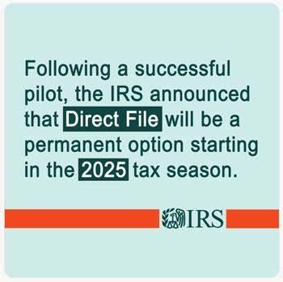
10
Thank you to EOPs and
advocates on the win!
Notes:
Substantive Policy & Review of Asks (3 min) - highlight different approaches between CTC vs. RTC – CTC is already a federal law, and we’re looking at ways to improve/expand it. There’s no federal RTC – we're working on it!
CTC (one slide for key take aways) - Tell your member to urge colleagues and leadership to expand the Child Tax Credit (CTC) with monthly payments and full refundability for all low-income families
RESULTS urges you to enact an extension of an expanded CTC to strengthen families and fight child poverty. It’s critical that you prioritize the needs of families with the lowest or no incomes in any tax package this year, and communicate that this is a top priority with leadership and colleagues on the Senate Finance Committee/House Ways and Means Committee.
RTC (one slide for key take aways)
RESULTS urges you and your staff to research renter tax credit policies that use the tax code to help lower-income renters, and meet directly with constituents struggling with rent costs to discuss policy solutions.
Important to remember that it’s not the policy detail you’re selling or asking members, but the general idea itself – so strategize accordingly.
Resources here: https://results.org/set-the-agenda

Slide 11
Global Poverty Campaigns

Slide 12
Taking action on access to lifesaving vaccines globally
12

Slide 14
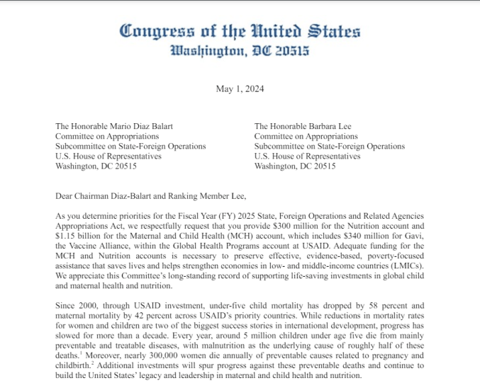
Rallying Congress for Gavi
Step 1:

Slide 15
Will the U.S. government make an early, bold pledge to Gavi?
JUNE
20

Slide 16
Rallying Congress for a U.S. pledge
Will you…
Add your name to the resolution?
Reach out to your colleagues?
Write to the White House?

Slide 17
Rallying Congress for a U.S. pledge
together
Will you…
Add your name to the resolution?
Reach out to your colleagues?
Write to the White House?

Slide 18
Grassroots Café

Slide 19
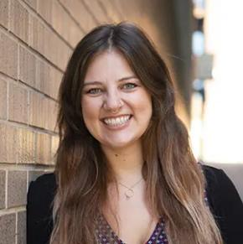
The Power of Community in Advocacy
Alicia Stromberg
Manager
Grassroots Expansion
astromberg@results.org

Slide 20
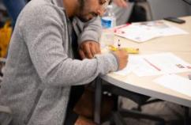
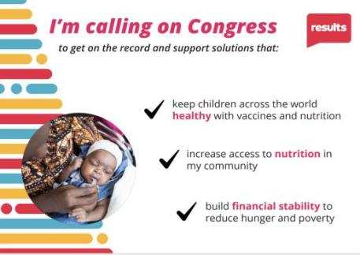
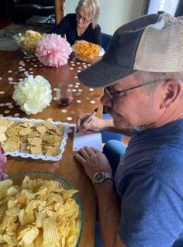
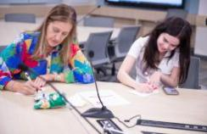
“On the Record” Community Action
results.org/community-of-change

Slide 21
Upcoming actions & ideas
New Hampshire Ice Cream Social
Washington Birthday BBQ
Nevada Friends & Family Lunch & Games
Colorado Potluck
Farmer's Markets
Church Groups
Tabling
Social gatherings
Where are you already showing up with your community?

Slide 22
Who to invite
New online supporters
800 people inquired with RESULTS in 2024
Ask your RC for your list
People in your Action Network
Community Partners
Friends & family

Slide 23
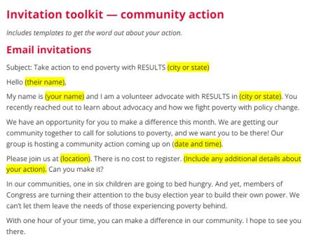
How to invite
results.org/community-of-change

Slide 24
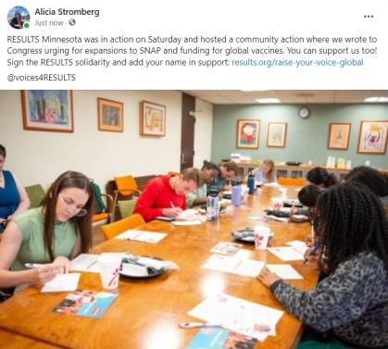
Social Media
Promote your action
Take pictures during your meeting
Share with your community after
Tag @voices4RESULTS!
Use the Social Media guide

Slide 25
Group Coaching
Join the Expansion team & fellow advocates for support to plan your action & invite your community
4 sessions - Week of June 3
RSVP for a session
Questions? Reach out to Alicia Stromberg at astromberg@results.org

Slide 26
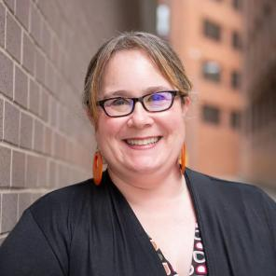
Celebrating Success!
Community of Change Campaign
(https://results.org/community-of-change)
Our springtime lobby
and outreach push
Lisa Marchal
Senior Manager
Grassroots Impact
lmarchal@results.org

Slide 27
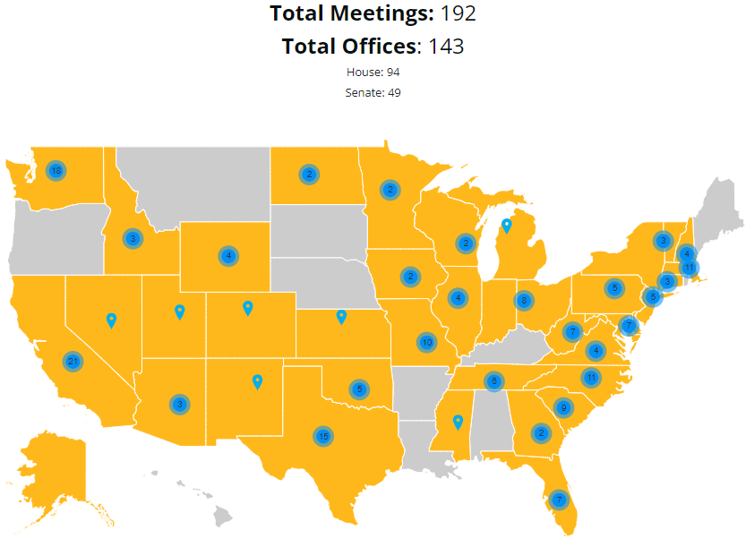

Slide 28
Speaker Tour with Dr. Theopista Masenge

Slide 29
Dr. Theopista Masenge and the power of vaccines

Slide 30
Thank you, Dr. Theo!

Slide 31
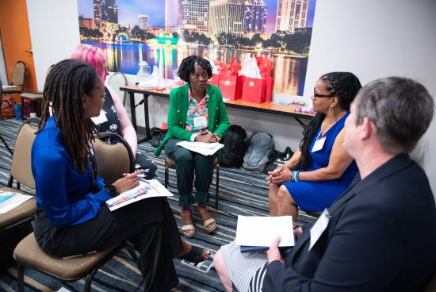
Gulf South Regional Conference

Slide 32
More of the Gulf South Regional Conference

Slide 33
Fellowship Leadership Conference

Slide 34
Fellowship Conference – Advocacy Prep

Slide 35
Fellowship Advocacy Meetings

Slide 36
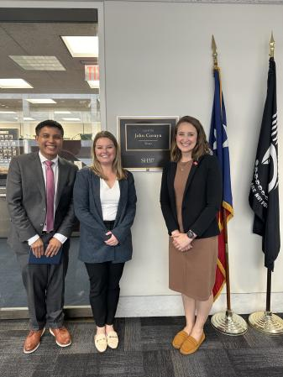
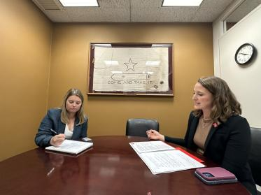
Sharing a powerful advocacy experience
Kristin Klade
RESULTS Fort Worth
2024 Fellow

Slide 37
Coastal CT Lobby Meeting

Slide 38
Virginia Lobby Meeting

Slide 39
Will you share your lobby experience with us today?

Slide 40
Congratulations!
Let’s keep going!
Keep lobbying
and keep inviting others to join in
as we build our collective strength.

Slide 41
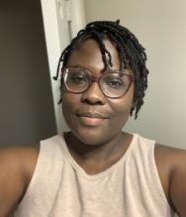
2024 Grassroots Director Elections
Elizabeth Brown
Kasapo Chibwe
Voting closes on Saturday, June 22 at 11:59pm ET
Learn more about the candidates and how to vote at: https://results.org/blog/results-2024-grassroots-board-elections

Slide 42
Announcements

Slide 43
Thank you for joining us!
Who is joining you in the room today?
In the poll, please respond with the number of people in the room with you (including yourself).

Slide 44
An opportunity to TRIPLE your support!
RESULTS is still working to raise $350,000 to amplify our work on behalf of the estimated 350 million children worldwide who face undernutrition.
Thanks to a generous challenge match from volunteers Alan and Ellen Newberg, your donation to RESULTS will be TRIPLED until we reach our goal!
Every donation matters. Gifts from Friends and Family fundraisers count, too! Donate at: results.org/donate
(Thanks to everyone who has made a gift!)

Slide 45
Anti-Oppression (AO) Workshop
Disrupting Biases on Poverty and Classism
Facilitated by RESULTS Experts on Poverty Friday, June 7, 12:00-1:30 p.m. ET
Ending poverty is not possible without addressing oppression and centering the voices of those with lived experiences of poverty. The tools provided in this session will help you build more transformational relationships and create inclusive, welcoming environments in your groups with trauma-informed advocacy in mind.
For more information and to register: https://tinyurl.com/DistruptingBias

Slide 46
Anti-Oppression (AO) Workshop
Restorative Justice & Global Conflict
Facilitated by DC Peace Team
June 17 | 8 PM ET to 10 PM ET
This session will be held as a space for you to openly share how global conflict is impacting how you show up as an advocate. This space will NOT be an exchange for political or religious ideology, but rather a safe place for expression and how war in other areas of the world is affecting us. The space will also allow for reflection on how we can utilize restorative processes to move toward personal and global healing.
For more information and to register: https://tinyurl.com/RestorativeJusticeDCPeace

Slide 47
Motivational Interviewing 101
How to have a values-based discussion with your member of Congress!
Wednesday, June 12, 8:00 pm ET
Register today.

Slide 48
Partnership Calls
Global Allies (Returned Peace Corps Volunteers) Webinar
Thursday, June 6, 8:00 p.m. ET
Learn more.
Together Women Rise Partnership Webinar
Tuesday, June 18, 8:30 p.m. ET
Click to learn more.

Slide 49
June Community Action Coaching
Drop-in Coaching to help you
create your event/action
RSVP
4 sessions to chose from the week of June 4

Slide 50
Office Hours
Event Planning and Outreach Office Hour
Thursday, June 13, 2 p.m. ET
Join at https://results.zoom.us/j/98524229370
or call (312) 626-6799, meeting ID 985 2422 9370.
Media Office Hour
Wednesday, June 20, 2 p.m. ET
Join at https://results.zoom.us/j/93668005494
or call (312) 626-6799, meeting ID 936 6800 5494.

Slide 51
Support Calls
U.S. Poverty Free Agents
Tuesday, June 18, 1:00 p.m. and 8:00 p.m. ET
Contact Jos Linn at jlinn@results.org for information.
Action Network Manager Calls
Wednesday, June 26, 12:30 p.m. ET and 8:00 p.m. ET
https://results.zoom.us/j/95416781155
or call 312-626-6799, meeting ID 954 1678 1155
No registration required.
Global Poverty Free Agents
Monday, June 24, 7:00 p.m. ET
Contact Lisa Marchal at lmarchal@results.org for information.

Slide 52
RESULTS office closed Wednesday, June 19 in observance of the Juneteenth holiday

Slide 53
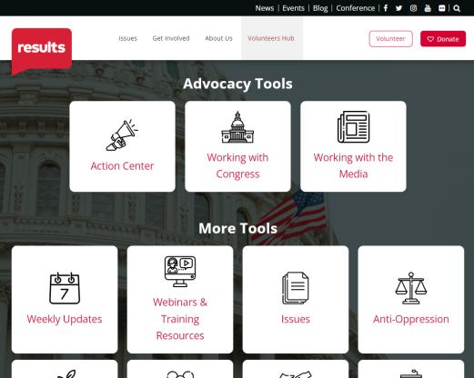
Find today’s slides
results.org/volunteers/national-webinars

Slide 54
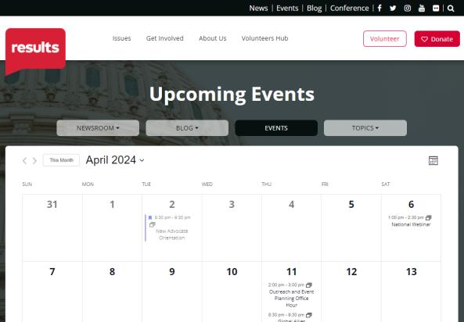
Find events
results.org/events

Slide 55
Join us for the July National Webinar July 13 at 1:00 p.m. ET SPECIAL DATE due to Independence Day holiday Register at: tinyurl.com/RESULTS2024
Focus:
Gearing up for election season

Slide 56
RESULTS website and social media

