Slide 1
RESULTS National Webinar May 4, 2024 Welcome!

Slide 2
Our Values
At RESULTS we pledge to create space for all voices, including those of us who are currently experiencing poverty. We will address oppressive behavior in our interactions, families, communities, work, and world. Our strength is rooted in our diversity of experiences, not in our assumptions.
With unearned privilege comes the responsibility to act so the burden to educate and change doesn’t fall solely on those experiencing oppression. When we miss the mark on our values, we will acknowledge our mistake, seek forgiveness, learn, and work together as a community to pursue equity.
Read our full anti-oppression values statement here at results.org/values.
Notes:
Updated AO slide (2/22)

Slide 3
Resources
Find these resources and more at results.org/volunteers/anti-oppression:
Resource Guides from our Diversity & Inclusion trainings, including:
Interrupting Microaggressions
Creating Space for Critical Conversations
Information on how RESULTS responds to oppressive incidents
Notes:
Updated AO slide (2/22)

Slide 4
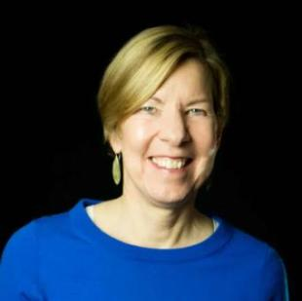
Welcome!
Joanne Carter Executive Director

Slide 5
Child well-being: vaccines and more

Slide 6
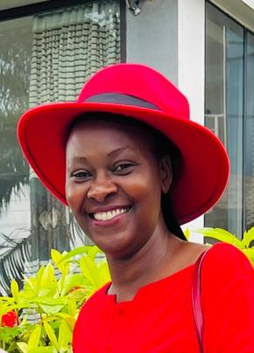
Guest Speaker Dr. Theopista Jacob Masenge
Pediatrician and
child health specialist
from Tanzania
Vice President of the Pediatric Association of Tanzania and Chairperson of the national Pediatric and Adolescent Technical Working Group

Slide 7
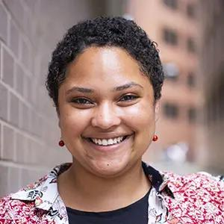
Moderator
Dorothy Monza Manager,
Global Nutrition and Child Health Policy
dmonza@results.org

Slide 8
Virtual Press Call with Dr. Theo
Tuesday, May 7, 3:00 pm ET
This call will give local editors and journalists insights on global child survival, including vaccinations and malnutrition, and encourage them to write on this topic. Registration is required.
Contact Joanna DiStefano (jdistefano@results.org)
for more information.

Slide 9
Campaigns Updates

Slide 10
Global Poverty Campaigns Update FY25 Appropriations
Account | FY24 Enacted | FY25 PBR | FY25 RESULTS Ask
USAID Maternal and Child Health | $915 million | $940 million | $1.15 billion
Of which, Gavi, the Vaccine Alliance | $300 million | $300 million | $340 million
USAID Nutrition | $165 million | $160 million | $300 million
USAID Tuberculosis | $394.5 million | $394.5 million | $1 billion
Global Fund to Fight AIDS, TB and Malaria | $1.65 billion | $1.19 billion | $1.65 billion
USAID Basic Education | $922 million | N/A | $1.15 billion
Of which, GPE | $121.6 million | N/A | $200 million

Slide 11
FY25 House Appropriations
Tuberculosis Dear Colleague
Led by Reps. Bera (D-CA) and Wagner (R-MO)
Asks for $1 billion for USAID TB
Global Fund Dear Colleague
Led by Reps. Houlahan (D-PA), Bera (D-CA), González-Colón (R-PR) and Salazar (R-FL)
Asks for strong support for the Global Fund

Slide 12
FY25 House Appropriations
FY25 House Basic Education and GPE Dear Colleague Letter
Led by Reps. Mike Quigley (D-IL) and Brian Fitzpatrick (R-PA)
Asks appropriators for increased funding for International Basic Education, including the Global Partnership for Education (GPE)
Maternal and Child Health, Gavi, and Nutrition Dear Colleague
Led by Reps. Brian Fitzpatrick (R-PA), Jacobs (D-CA), Salazar (R-FL), and McGovern (D-MA)
Asks for $300 million for USAID Nutrition and $1.15 billion for USAID Maternal and Child Health, which includes $340 million for Gavi, the Vaccine Alliance

Slide 13
FY25 Senate Appropriations
Maternal and Child Health Dear Colleague
Led by Sens. Shaheen (D-NH) and Marshall (R-KS)
Asks for robust funding for USAID MCH, Gavi, and Nutrition
Tuberculosis Dear Colleague
Led by Sens. Brown (D-OH) and Young (R-IN)
Asks for increased funding for USAID TB
COMING SOON! Global HIV/AIDS and Global Basic Education letters!
Learn more: https://results.org/blog/fy25-appropriations-tell-congress-to-fund-the-fight-against-poverty

Slide 14
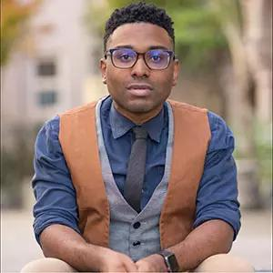
U.S. Poverty Campaigns Update
TaShon Thomas Director, U.S. Poverty Policy tthomas@results.org

Slide 15
U.S. Poverty Campaigns Update
Child Tax Credit We need your help getting this to the finish line!
SNAP / Farm Bill House and Senate Ag Committees have released framework for Farm Bill. Will continue to oppose harmful cuts to SNAP and other assistance programs.
Housing Fair Housing Month – stay tuned for series of blog posts and webinar programming featuring some of our RESULTS volunteers!

Slide 16
Child Tax Credit If you have a Democratic Senator, please contact their offices and ask them to urge Sen. Schumer to put the tax bill on the floor next week. If you have a Republican Senator, urge them to support the bill when/if it is brought to the floor for a vote.
16
Take action on key
U.S. poverty priorities
SNAP / Farm Bill Tell Agriculture Committee leaders and members of Congress to protect SNAP from reckless cuts and policies in Farm Bill discussions.
Notes:
Substantive Policy & Review of Asks (3 min) - highlight different approaches between CTC vs. RTC – CTC is already a federal law, and we’re looking at ways to improve/expand it. There’s no federal RTC – we're working on it!
CTC (one slide for key take aways) - Tell your member to urge colleagues and leadership to expand the Child Tax Credit (CTC) with monthly payments and full refundability for all low-income families
RESULTS urges you to enact an extension of an expanded CTC to strengthen families and fight child poverty. It’s critical that you prioritize the needs of families with the lowest or no incomes in any tax package this year, and communicate that this is a top priority with leadership and colleagues on the Senate Finance Committee/House Ways and Means Committee.
RTC (one slide for key take aways)
RESULTS urges you and your staff to research renter tax credit policies that use the tax code to help lower-income renters, and meet directly with constituents struggling with rent costs to discuss policy solutions.
Important to remember that it’s not the policy detail you’re selling or asking members, but the general idea itself – so strategize accordingly.
Resources here: https://results.org/set-the-agenda

Slide 17
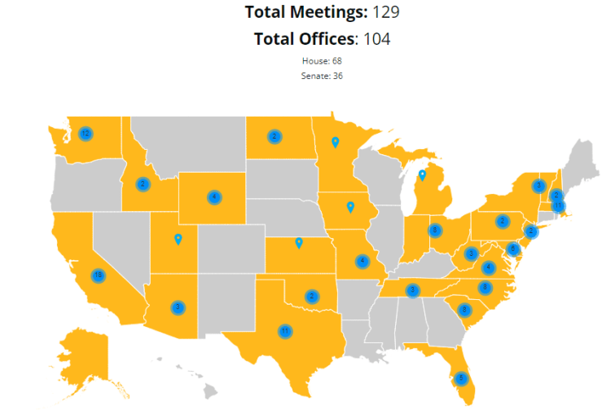
Amazing! Keep up the great work!

Slide 18
Call to Action: Meet with your members of Congress
Meet with 100 percent of the offices we cover
Meet in-person with as many senators and representatives as we can
Total meeting goal: 350
Resources: https://results.org/volunteers/lobbying
Request lobby prep with Katie Fleischer (kfleischer@results.org)
Please remember to report your lobby meetings: https://results.org/report-lobby-meetings
Notes:
Link to resources: https://results.org/volunteers/lobbying

Slide 19
Grassroots Café

Slide 20
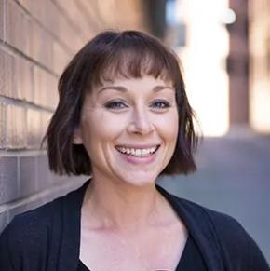
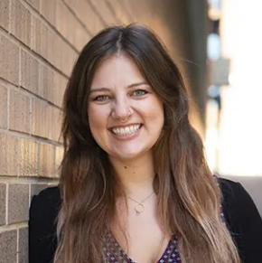
Why Community Matters in Advocacy
Amanda Beals
Associate Director
Grassroots Expansion
abeals@results.org
Alicia Stromberg
Manager
Grassroots Expansion
astromberg@results.org

Slide 21
Build the Base
CREATE A FOLLOWING
Build community connection & awareness.
Mobilize for Action
ENGAGE YOUR FOLLOWING
Support community to act.
Organize for Power
BUILD POWER
Connect community for long-term advocacy.
Nurture new relationships. Enlist new advocates. Develop new leaders.
21

Slide 22
Stronger Community = Advocacy Success
Jan–May
Goal: Build Influence in Congress
Action: Lobbying
June-July
Goal: Grow Grassroots Power
Action: Community Action Meetings
Aug–Nov
Goal: Final Push with this Congress
Action: August Recess Meetings + Election Events
2025
Goal: High-Impact in New Congress
Action: First 100 Days Lobbying

Slide 23
Goals of Coming Together
Strengthen & build new relationships
Demonstrate community power
Combat cynicism and encourage action

Slide 24
RESULTS Spring Recruitment
720+ people reached out with interest in volunteering since January 2024
People from all 50 states
110 people attended an introductory webinar in 2024
People looking for connection and meaningful action

Slide 25
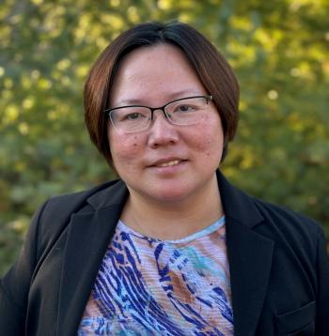
Volunteer Share
Qiaozhi (Chelsea) Li
RESULTS Kentucky
Advocate
Joined January 2024

Slide 26
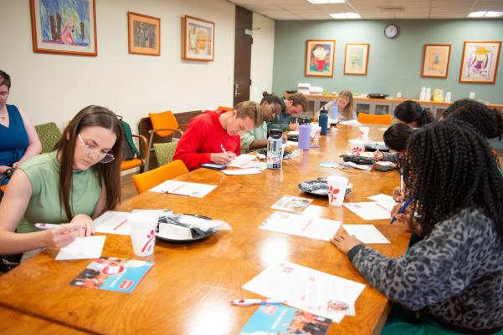
"On the Record" Community Action Meetings

Slide 27
Summer of Community Action
Get together as a team
Invite new people to join you
take action where you'll already be

Slide 28
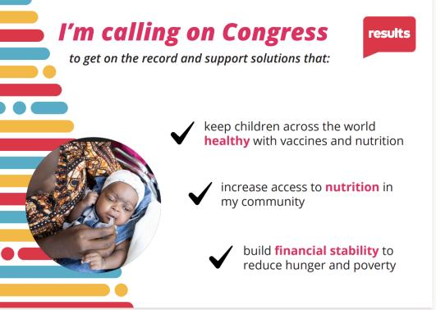
“On the Record” Mobilizing Action

Slide 29
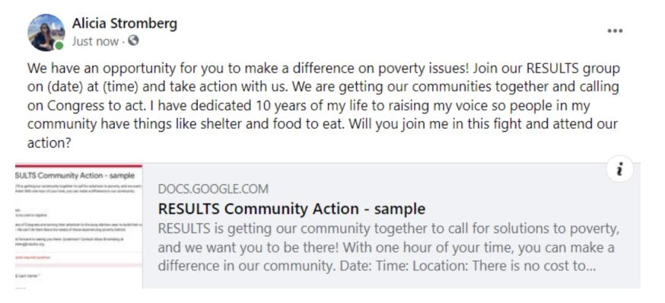
On the Record: Social Media Action

Slide 30
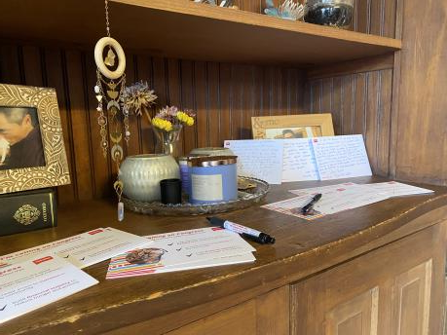
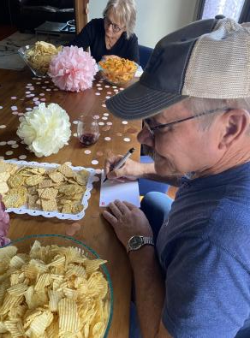
Join the Wave of Community Action: Friends & Family

Slide 31
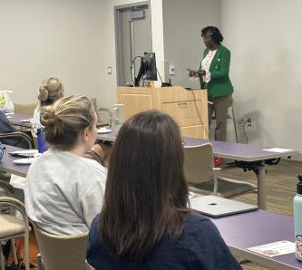
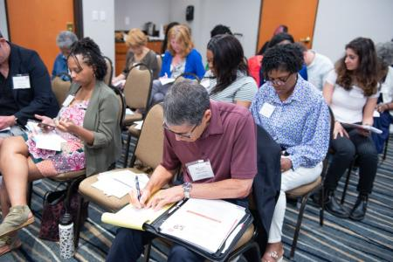
Join the Wave of Community Action
Gulf South Regional Conference
New Orleans Medical School

Slide 32
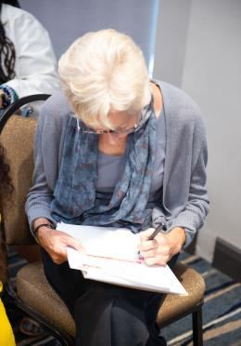
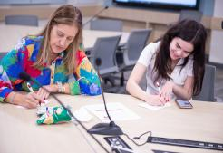
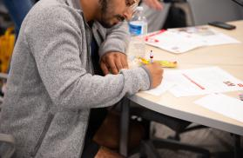
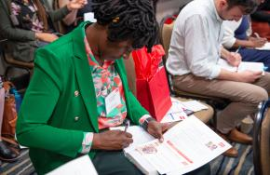
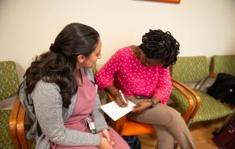
Join the Wave of Community Action

Slide 33
Timeline
May
Plan your “On the Record” Action
June-July
Host Community Action Meeting + Activities
August-November
Leverage power at August Recess Meetings + Election Events
Invite new action takers to join you

Slide 34
How will you get your community “On the Record” to call for solutions to poverty?
Let’s brainstorm!

Slide 35
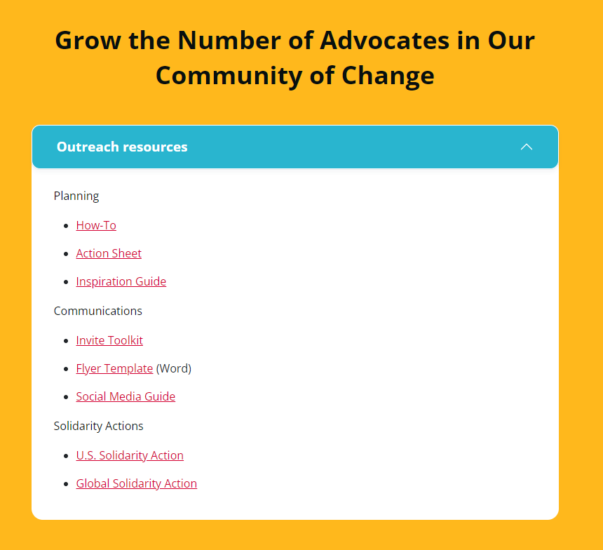
Resources on our website
results.org/community-of-change

Slide 36
Support to do this
Drop-in Coaching – RSVP
4 sessions week of May 20
Community Partnership Training - RSVP
May 7 @ 8pm ET
Outreach Planning Meeting (OPCs) – RSVP
May 8 @ 7pm ET
Group Leaders: Look for postcards in your mailbox
Questions? Reach out to Alicia astromberg@results.org

Slide 37
Announcements

Slide 38
Thank you for joining us!
Who is joining you in the room today?
In the poll, please respond with the number of people in the room with you (including yourself).

Slide 39
Grassroots Board Candidates’ Forum
Thursday, May 9, 9:00 pm ET
Current Grassroots Directors will host a town hall meeting to introduce you to the candidates and provide information on when voting will begin.
No registration required, Zoom link:
results.zoom.us/j/9909684715?omn=94654504812

Slide 40
An opportunity to TRIPLE your support!
RESULTS is urgently working to raise $350,000 to amplify our work on behalf of the estimated 350 million children worldwide who face undernutrition.
Thanks to a generous challenge match from Alan and Ellen Newberg of Washington state, your donation to RESULTS will be TRIPLED until we reach our goal!
These 350 million children deserve not just to survive, but to be healthy and thriving, reaching for their dreams and contributing to our aspirations for a better world. Will you step up in support of children — and triple your impact — by making a special tax-deductible gift to RESULTS today?
www.results.org/donate

Slide 41
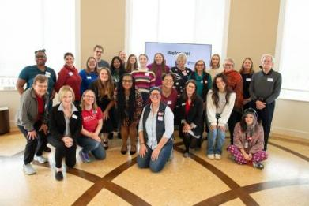
Building Community Partnerships to End Poverty
Tuesday, May 7 | 8:00–9:15 p.m. ET
Community partnerships are essential to our advocacy and greater mission to end poverty.
Learn how to find local partners and connect with them.
Explore opportunities to work together to advocate for the end of poverty.
https://tinyurl.com/RESULTSPartnerships

Slide 42
May Global Poverty Policy Forum
Wednesday, May 15, 2:00-2:45 p.m. ET
Gavi, the Vaccine Alliance is an innovative global partnership that’s immunized more than 1 billion children – preventing more than 17 million future deaths. Now, Gavi is developing a bold plan to recover lost progress and reach kids who were missed during COVID-19, as well as adding game changing new vaccines—like those against malaria—into their coverage.
Register at: https://tinyurl.com/GaviPolicyForum

Slide 43
Partnership Calls
Global Allies (Returned Peace Corps Volunteers) Webinar
Wednesday, May 8, 8:00 p.m. ET
Special event with RESULTS Founder Sam Daley-Harris
Learn more.
Together Women Rise Partnership Webinar
Tuesday, May 21, 8:30 p.m. ET
Click to learn more.

Slide 44
Anti-Oppression (AO) Events
Anti-oppression Applied Learning Simulation
Friday, May 17, 12:00 p.m. ET
Register online.

Slide 45
Office Hours
Event Planning and Outreach Office Hour
Thursday, May 16, 2 p.m. ET
Join at https://results.zoom.us/j/98524229370
or call (312) 626-6799, meeting ID: 985 2422 9370.
Media Office Hour
Wednesday, May 22, 2 p.m. ET
Join at https://results.zoom.us/j/93668005494
or call (312) 626-6799, meeting ID 936 6800 5494.

Slide 46
Support Calls
U.S. Poverty Free Agents
Tuesday, May 21, 1:00 p.m. and 8:00 p.m. ET
Contact Jos Linn at jlinn@results.org for information.
Action Network Manager Calls
Wednesday, May 15, 12:30 p.m. ET and 8:00 p.m. ET
https://results.zoom.us/j/95416781155
or call 312-626-6799, meeting ID 954 1678 1155
No registration required.
Global Poverty Free Agents
Monday, May 13, 7:00 p.m. ET
Contact Lisa Marchal at lmarchal@results.org for information.

Slide 47
New Advocate Orientation
Invite interested friends and colleagues to learn more about RESULTS!
Tuesday, May 21, 1:00 pm ET
Register today.

Slide 48
RESULTS office closed Monday, May 27
In observance of Memorial Day

Slide 49
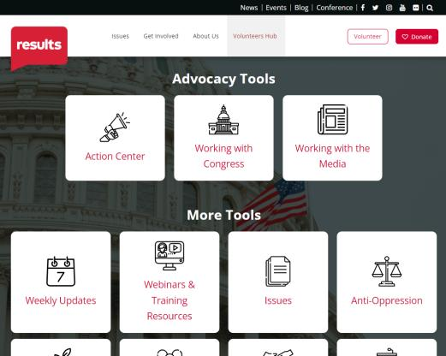
Find today’s slides
results.org/volunteers/national-webinars

Slide 50
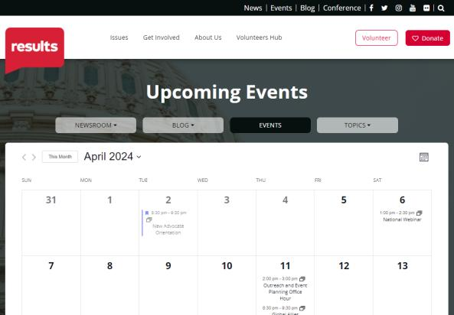
Find events
results.org/events

Slide 51
Join us for the June National Webinar
Focus:
Protecting SNAP in the Farm Bill
June 1, 1:00 p.m. ET | Register: tinyurl.com/RESULTS2024

Slide 53
RESULTS website and social media

