Slide 1
RESULTS National Webinar April 6, 2024 Welcome!

Slide 2
Our Values
At RESULTS we pledge to create space for all voices, including those of us who are currently experiencing poverty. We will address oppressive behavior in our interactions, families, communities, work, and world. Our strength is rooted in our diversity of experiences, not in our assumptions.
With unearned privilege comes the responsibility to act so the burden to educate and change doesn’t fall solely on those experiencing oppression. When we miss the mark on our values, we will acknowledge our mistake, seek forgiveness, learn, and work together as a community to pursue equity.
Read our full anti-oppression values statement here at results.org/values.
Notes:
Updated AO slide (2/22)

Slide 3
Resources
Find these resources and more at results.org/volunteers/anti-oppression:
Resource Guides from our Diversity & Inclusion trainings, including:
Interrupting Microaggressions
Creating Space for Critical Conversations
Information on how RESULTS responds to oppressive incidents
Notes:
Updated AO slide (2/22)

Slide 4
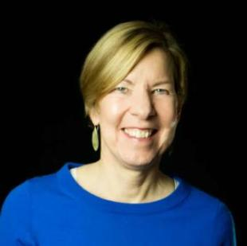
Welcome!
Joanne Carter Executive Director

Slide 5
Reclaiming Our Democracy: a discussion with Sam Daley-Harris

Slide 6
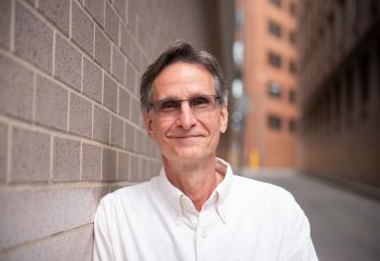
Moderator
Ken Patterson Director,
Grassroots Impact
kpatterson@results.org

Slide 7
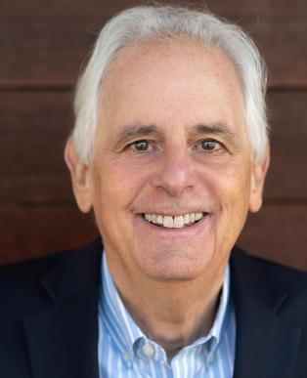
Sam Daley-Harris Founder of RESULTS

Slide 8
Campaigns Updates

Slide 9
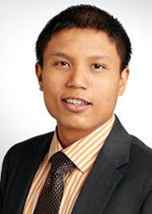
U.S. Poverty Campaigns Update
Michael Santos Associate Director U.S. Poverty Policy msantos@results.org

Slide 10
U.S. Poverty Campaigns Update
Child Tax Credit We need your help getting this to the finish line!
SNAP / Farm Bill Oppose any harmful policies and urge Congress to invest more to reduce hunger in the U.S.
Housing Fair Housing Month – stay tuned for series of blog posts and webinar programming featuring some of our RESULTS volunteers!

Slide 11
Child Tax Credit If you have a Democratic Senator, please contact their offices and ask them to urge Sen. Schumer to put the tax bill on the floor next week. If you have a Republican Senator, urge them to support the bill when/if it is brought to the floor for a vote.
11
Take action on key
U.S. poverty priorities
SNAP / Farm Bill Tell Agriculture Committee leaders and members of Congress to protect SNAP from reckless cuts and policies in Farm Bill negotiations.
Notes:
Substantive Policy & Review of Asks (3 min) - highlight different approaches between CTC vs. RTC – CTC is already a federal law, and we’re looking at ways to improve/expand it. There’s no federal RTC – we're working on it!
CTC (one slide for key take aways) - Tell your member to urge colleagues and leadership to expand the Child Tax Credit (CTC) with monthly payments and full refundability for all low-income families
RESULTS urges you to enact an extension of an expanded CTC to strengthen families and fight child poverty. It’s critical that you prioritize the needs of families with the lowest or no incomes in any tax package this year, and communicate that this is a top priority with leadership and colleagues on the Senate Finance Committee/House Ways and Means Committee.
RTC (one slide for key take aways)
RESULTS urges you and your staff to research renter tax credit policies that use the tax code to help lower-income renters, and meet directly with constituents struggling with rent costs to discuss policy solutions.
Important to remember that it’s not the policy detail you’re selling or asking members, but the general idea itself – so strategize accordingly.
Resources here: https://results.org/set-the-agenda

Slide 12
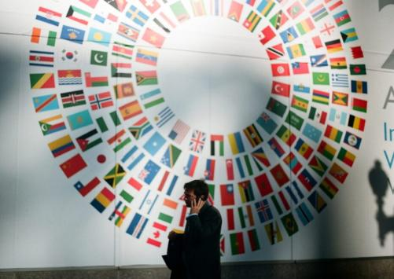
Pushing the World Bank to prioritize people and poverty
The International Development Association (IDA) is the part of the World Bank that helps the world’s poorest countries.
IDA aims to reduce poverty by providing zero to low-interest loans and grants for programs that boost economic growth, reduce inequalities, and improve people’s living conditions in 75 of the lowest income countries.

Slide 13
The most recent replenishment of IDA's resources resulted in a historic $93 billion financing package for IDA countries for fiscal years 2022-2025.
This fall – the World Bank will be asking for an increase in resources! And Congress should be weighing in on how that funding should impact poverty.

Slide 14
Global Poverty Campaigns Update
Senate World Bank Dear Colleague
Led by Sen. Booker (D-NJ)
Urges the new World Bank president to:
increase public reporting and accountability
increase support for communities in the lowest-income countries
set bold goals to reach more people with health, nutrition, and education funding.
Deadline: Tuesday April 9
Learn more: https://results.org/blog/pushing-the-world-bank-to-prioritize-people-and-poverty

Slide 15
FY25 Appropriations
Account | FY24 Enacted | FY25 PBR | FY25 RESULTS Ask
USAID Maternal and Child Health | $915 million | $940 million | $1.15 billion
Of which, Gavi, the Vaccine Alliance | $300 million | $300 million | $340 million
USAID Nutrition | $165 million | $160 million | $300 million
USAID Tuberculosis | $394.5 million | $394.5 million | $1 billion
Global Fund to Fight AIDS, TB and Malaria | $1.65 billion | $1.19 billion | $1.65 billion
USAID Basic Education | $922 million | N/A | $1.15 billion
Of which, GPE | $121.6 million | N/A | $200 million

Slide 16
FY25 House Appropriations
Tuberculosis Dear Colleague
Led by Reps. Bera (D-CA) and Wagner (R-MO)
Asks for $1 billion for USAID TB
Global Fund Dear Colleague
Led by Reps. Houlahan (D-PA), Bera (D-CA), González-Colón (R-PR) and Salazar (R-FL)
Asks for strong support for the Global Fund
Education Dear Colleague
Led by Reps. Quigley (D-IL) and Fitzpatrick (R-PA)
Asks for increased funding for USAID International Basic Ed
COMING SOON – Maternal and Child Health, Gavi, and Nutrition letter!

Slide 17
FY25 Senate Appropriations
Maternal and Child Health Dear Colleague
Led by Sens. Shaheen (D-NH) and Marshall (R-KS)
Asks for robust funding for USAID MCH, Gavi, and Nutrition
Tuberculosis Dear Colleague
Led by Sens. Brown (D-OH) and Young (R-IN)
Asks for increased funding for USAID TB
COMING SOON! Global HIV/AIDS and Global Basic Education letters!
Learn more: https://results.org/blog/fy25-appropriations-tell-congress-to-fund-the-fight-against-poverty

Slide 18
Grassroots Café

Slide 19
Thank you for joining us!
Who is joining you in the room today?
In the poll, please respond with the number of people in the room with you (including yourself).

Slide 20
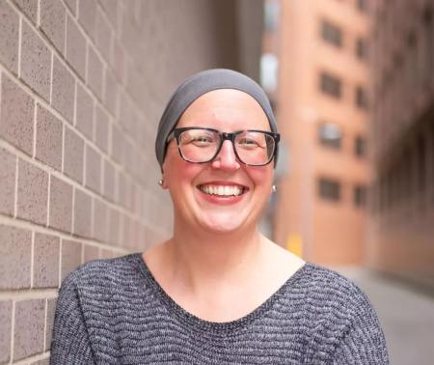
Shaping government that reflects our values
Joanna DiStefano
Senior Associate
Grassroots Impact
jdistefano@results.org

Slide 21
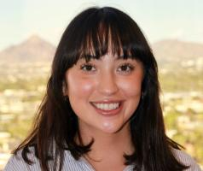
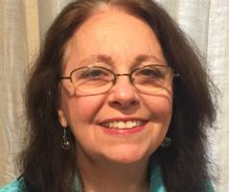
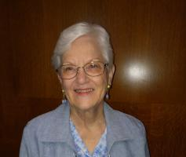
Grassroots shares
Karina Garavito
RESULTS Phoenix and a RESULTS Fellow
Pat Payne
RESULTS Oakland
Eloise Sutherland
RESULTS Austin

Slide 22
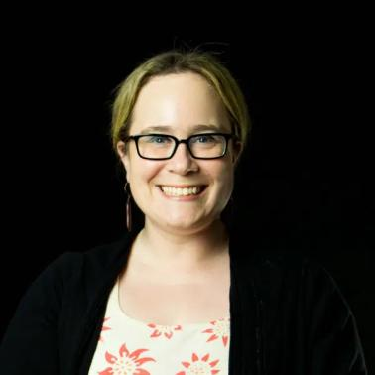
Call to Action!
Lisa Marchal
Manager
Grassroots Impact
lmarchal@results.org

Slide 23
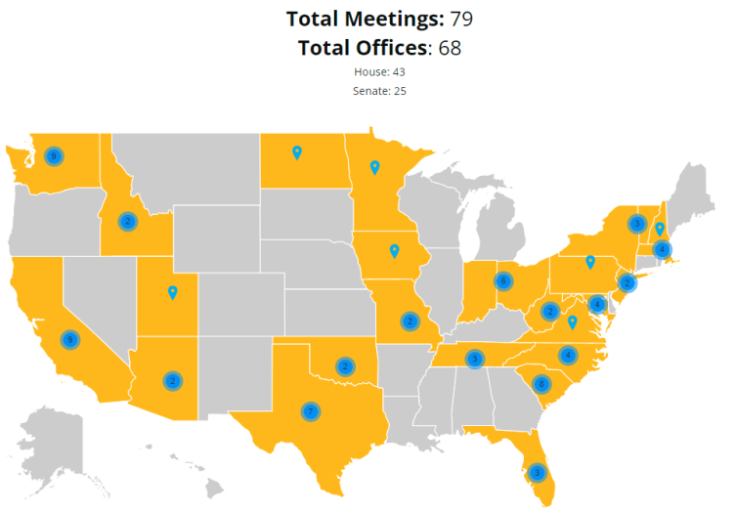
Amazing! Keep up the great work!

Slide 24
Call to Action: Meet with your members of Congress
Meet with 100 percent of the offices we cover
Meet in-person with as many senators and representatives as we can
Total meeting goal: 350
Resources: https://results.org/volunteers/lobbying
Request lobby prep with Katie Fleischer (kfleischer@results.org)
Please remember to report your lobby meetings: https://results.org/report-lobby-meetings
Notes:
Link to resources: https://results.org/volunteers/lobbying

Slide 25
Announcements

Slide 26
RESULTS Grassroots Board Nominations
Nominate yourself or an advocate you admire to be the next RESULTS/REF Grassroots Board Member
Eligibility requirements:
One-year of advocacy with RESULTS
committed to the mission of RESULTS and our anti-oppression values
ready and willing to meet the responsibilities of Grassroots Directors
Learn more here: https://results.org/blog/2024-grassroots-director-nominations-are-open
Nominations are due Wednesday, April 24
Questions? Please contact Allison Gallaher, algallaher@gmail.com.

Slide 27
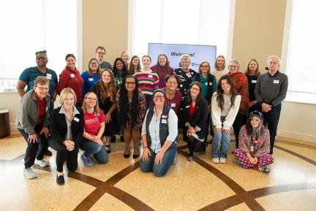
Building Community Partnerships to End Poverty
Tuesday, May 7 | 8:00–9:15 p.m. ET
Community partnerships are essential to our advocacy and the greater mission to end poverty.
Learn how to find local partners and connect with them.
Explore opportunities to work together to advocate for the end of poverty.
https://tinyurl.com/RESULTSPartnerships

Slide 28
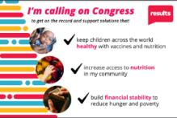
June Convening
We want to get our communities on the record for the end of poverty.
Plan to hold in-person, community meetings to take action on nutrition and child health.
Stay tuned for more details!

Slide 29
Partnership Calls
Global Allies (Returned Peace Corps Volunteers) Webinar
Thursday, April 11, 8:30 p.m. ET
Learn more.
Together Women Rise Partnership Webinar
Tuesday, April 16, 8:30 p.m. ET
Click to learn more.

Slide 30
Anti-Oppression (AO) Events
AO 301: Oppression – The Missing Perspectives
Friday, April 19, 2:00 p.m. ET
Register online

Slide 31
Maximizing Outreach to Your Online Network
Wednesday, April 24, 8 p.m. ET​
Register today
In April, we are opening the New Advocate Mentor call to the entire network. Please join us for a discussion on how to maximize invitations to "warm leads" and increase engagement from new volunteers at your community actions & lobby meetings.
We hope to see you there!

Slide 32
Office Hours
Event Planning and Outreach Office Hour
Thursday, April 11, 2 p.m. ET
Join at https://results.zoom.us/j/98524229370
or call (312) 626-6799, meeting ID: 985 2422 9370.
Media Office Hour
Wednesday, April 17, 2 p.m. ET
Join at https://results.zoom.us/j/93668005494
or call (312) 626-6799, meeting ID 936 6800 5494.

Slide 33
Support Calls
U.S. Poverty Free Agents
Tuesday, April 16, 1:00 p.m. and 8:00 p.m. ET
Contact Jos Linn at jlinn@results.org for information.
Action Network Manager Calls
Wednesday, April 17, 12:30 p.m. ET and 8:00 p.m. ET
New Zoom link coming (check Weekly Update)
No registration required.
Global Poverty Free Agents
Monday, April 22, 7:00 p.m. ET
Contact Lisa Marchal at lmarchal@results.org for information.

Slide 34
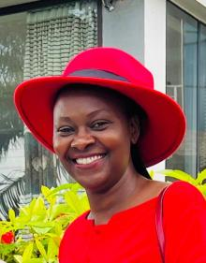
Join us for the May National Webinar
Dr. Theopista Jacob Masenge
Vice President of the Pediatric Association of Tanzania
Focus: the importance of vaccines and nutrition in child health
May 4, 1:00 p.m. ET | Register: tinyurl.com/RESULTS2024

Slide 35
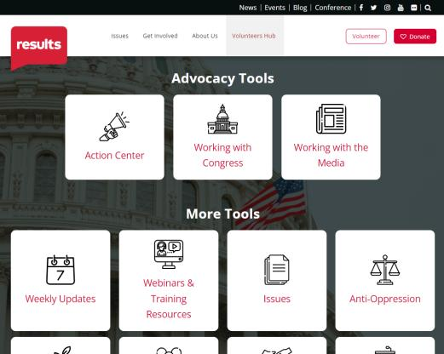
Find today’s slides
results.org/volunteers/national-webinars

Slide 36
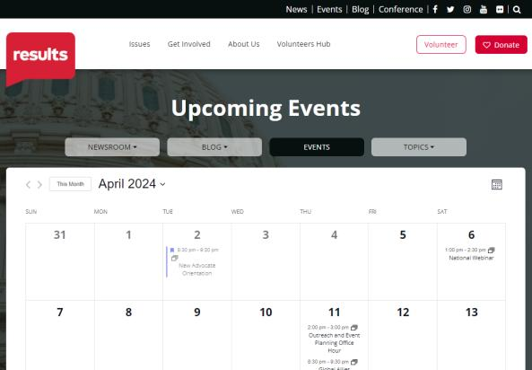
Find events
results.org/events

Slide 37
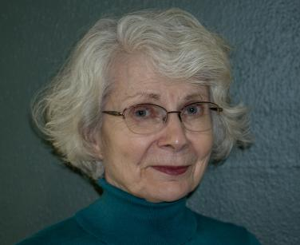
Raise Your Voices, Children
by Kathleen Ness (RESULTS North Dakota)

Slide 38
RESULTS website and social media

