Slide 1
RESULTS National Webinar March 2, 2024 Welcome!

Slide 2
Our Values
At RESULTS we pledge to create space for all voices, including those of us who are currently experiencing poverty. We will address oppressive behavior in our interactions, families, communities, work, and world. Our strength is rooted in our diversity of experiences, not in our assumptions.
With unearned privilege comes the responsibility to act so the burden to educate and change doesn’t fall solely on those experiencing oppression. When we miss the mark on our values, we will acknowledge our mistake, seek forgiveness, learn, and work together as a community to pursue equity.
Read our full anti-oppression values statement here at results.org/values.
Notes:
Updated AO slide (2/22)

Slide 3
Resources
Find these resources and more at results.org/volunteers/anti-oppression:
Resource Guides from our Diversity & Inclusion trainings, including:
Interrupting Microaggressions
Creating Space for Critical Conversations
Information on how RESULTS responds to oppressive incidents
Notes:
Updated AO slide (2/22)

Slide 4
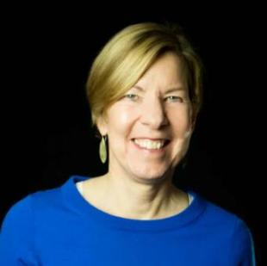
Welcome!
Joanne Carter Executive Director

Slide 5
Delivering Change for Women and Children Around the Globe Panel Discussion

Slide 6
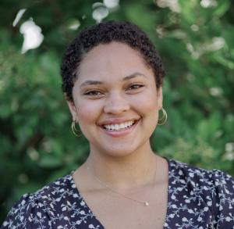
Moderator
Dorothy Monza Global Nutrition and Child Health Policy Manager
dmonza@results.org

Slide 7
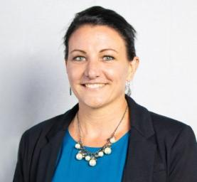
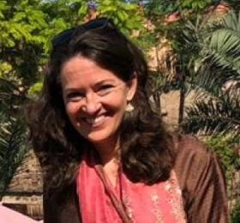
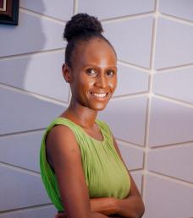
Panelists
Anne Kraemer
CEO
Wuqu' Kawoq,
Maya Health Alliance
Dr. Deborah Ash
Senior Nutrition Advisor, Global Nutrition
Family Health International Solutions
Hilda Kwezi
Advocacy Officer
Health Promotion Tanzania

Slide 8
Grassroots Café

Slide 9
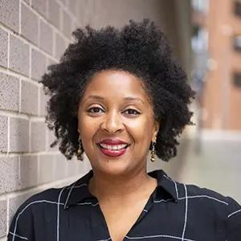
Mobilizing Grassroots
Karyne Bury Manager, Grassroots Impact
kbury@results.org

Slide 10
Thank you for joining us!
Who is joining you in the room today?
In the poll, please respond with the number of people in the room with you (including yourself).

Slide 11
Call to Action
Take action with us on International Women’s Day
Friday, March 8 #InspireInclusion
Photos courtesy of internationalwomensday.com

Slide 12
Call to Action: FY25 Appropriations
RESULTS Action Alert: Take action in support of Women and Children on International Women’s Day and beyond!
Request that your member of Congress support bold funding for FY25 Appropriations
$1.15 Billion for Maternal & Child Health
$340 million for Gavi and $300 Million for Nutrition
Notes:
Link to action: https://results.org/volunteers/action-center/action-alerts?vvsrc=%2fcampaigns%2f112489%2frespond https://results.org/volunteers/action-center/action-alerts?vvsrc=%2fcampaigns%2f112489%2frespond

Slide 13
Call to Action: Meet with your members of Congress
Meet with 100% of the offices we cover
Meet in-person with as many senators and representatives as we can
Total meeting goal: 350
Resources: https://results.org/volunteers/lobbying
Request lobby prep with Katie Fleischer (kfleischer@results.org)
Please remember to report your lobby meetings: https://results.org/report-lobby-meetings
Notes:
Link to resources: https://results.org/volunteers/lobbying

Slide 14
Call to Action: Make official FY25 Appropriations Requests
Contact your member and ask about deadlines and procedures to submit an official FY25 appropriations request
Find FY25 Appropriations memos and resources to complete these forms at: https://results.org/resources/fy25-global-appropriations-memos
Contact Katie Fleischer for support in completing FY25 Appropriations requests! (kfleischer@results.org)
Notes:
Link to report meetings: https://results.org/report-lobby-meetings

Slide 15
Thanks for taking action!
© UNICEF/UN0846229/
© UNICEF/UN0678997/Oo
© UNICEF/UN0519271/Zhanibekov
© UNICEF/UN0663897/Schermbrucker

Slide 16
U.S. Poverty Campaigns

Slide 17
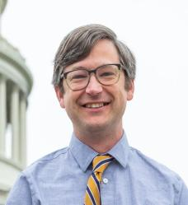
U.S. Poverty Campaigns Update
David Plasterer Senior Associate
U.S. Poverty Policy dplasterer@results.org

Slide 18
Update on Tax Package
Tax Relief for American Families and Workers Act – H.R. 7024
Passed the House 357-70 on January 31
The legislation is now under consideration in the Senate
At least seven Republicans have publicly voiced support
Many more have voiced quiet support in meetings with advocates
Sen. Crapo (R-ID) statement
Continued opposition to the "lookback" provision
Our advocacy is working – he is hearing from colleagues

Slide 19
Update on Tax Package
Possible paths for passage in the Senate
Attach to funding bill due to be passed by March 28
Stand-alone bill
If attached to funding bill
May require committee markup/chance for CTC to be weakened
Need agreement from the “Four Corners”
If passed standalone
Would require at least 10 Republicans to vote for bill despite opposition from leadership

Slide 20
Update on Tax Package
ACTION #1: Call and e-mail senators telling them to pass the Tax Relief for American Families and Workers Act
Use our online CTC action to e-mail senators today
Call you senators this Tuesday, March 5 – national CTC day of action
Look for action alert from RESULTS you can forward to your networks
ACTION #2: Submit letters to the editor telling your senators by name to pass the bill – families need relief now, before tax filing season is over
Use our online CTC media action to submit letters today

Slide 21
Announcements

Slide 22
RESULTS Grassroots Board Town Hall
Thursday, March 14, 9:00 p.m. ET. Join the Zoom call here.
No registration required.
With great opportunities for outreach this year, join the webinar to:
Get trained on creating your Story of Self
Hear examples of stories
Write and practice your story
Find resources available to you for on-going support
Learn how you can run for the open Grassroots position on the RESULTS/RESULTS Ed Fund Board
Come create your RESULTS story and help grow our movement!

Slide 23
Anti-Oppression (AO) Events
AO Learning Community
Friday, March 15, 12:00 p.m. ET
Register online.
AO 201: Structural Racism
Friday, March 22, 12:00 p.m. ET
Register online.

Slide 24
New Training
Pulling Off Effective Congressional Meetings
Monday March 11, 9:00 p.m. ET
Bring your experiences, questions, challenges.
Register for the webinar today.

Slide 25
Skills Trainings
Motivational Interviewing 101
Wednesday, March 13, 8:00 p.m. ET
Register online.
2-part Quiet Leadership Training
Starting Wednesday, March 20, 9:00 p.m. ET
Register online.

Slide 26
Other Trainings
New Advocate Orientation
Tuesday, March 6, 12:00 pm ET.
Register today.
Four-part Group Leader Training Series Continues
March 6 & March 13, 8:00 pm ET
Registration is open.

Slide 27
Partnership Calls
Global Allies (Returned Peace Corps Volunteers) Webinar
Thursday, March 14, 8:30 p.m. ET
Learn more.
Together Women Rise Partnership Webinar
Tuesday, March 19, 8:30 p.m. ET
Click to learn more.

Slide 28
Office Hours
Event Planning and Outreach Office Hour
Thursday, March 14, 2:00 p.m. ET
Join at https://results.zoom.us/j/98524229370
or call (312) 626-6799, meeting ID: 985 2422 9370.
Media Office Hour
Wednesday, March 20, 2:00 p.m. ET
Join at https://results.zoom.us/j/93668005494
or call (312) 626-6799, meeting ID 936 6800 5494.

Slide 29
Support Calls
U.S. Poverty Free Agents
Tuesday, March 19, 1:00 p.m. and 8:00 p.m. ET
Contact Jos Linn at jlinn@results.org for information.
Action Network Manager Calls
Wednesday, March 20, 12:30 p.m. ET and 8:00 p.m. ET
New Zoom link coming (check Weekly Update)
No registration required.
Global Poverty Free Agents
Monday, March 25, 7:00 p.m. ET
Contact Lisa Marchal at lmarchal@results.org for information.

Slide 30
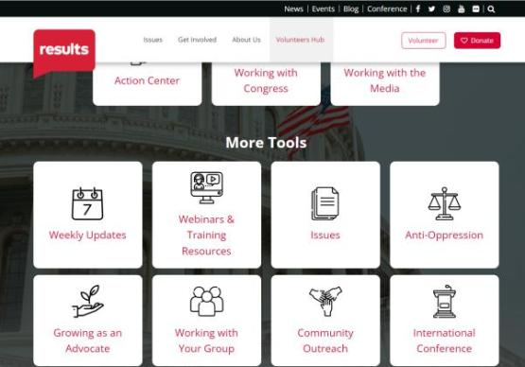
Find today’s slides
results.org/volunteers/national-webinars

Slide 31
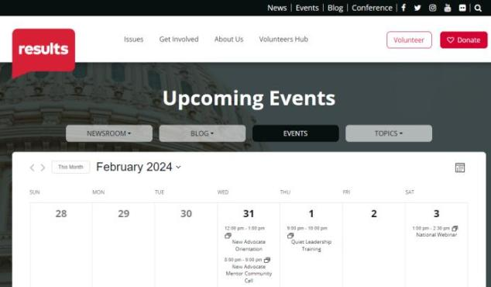
Find events
results.org/events

Slide 32
Looking ahead to the April National Webinar
Sam Daley-Harris
Founder of RESULTS
Reclaiming Our Democracy
April 6, 1:00 p.m. ET | Register: tinyurl.com/RESULTS2024

Slide 33
RESULTS website and social media

