Slide 1
RESULTS National Webinar
February 3, 2024
Welcome!

Slide 2
Our Values & Resources
2
​At RESULTS we pledge to create space for all voices, including those of us who are currently experiencing poverty. We will address oppressive behavior in our interactions, families, communities, work, and world. Our strength is rooted in our diversity of experiences, not in our assumptions.
With unearned privilege comes the responsibility to act so the burden to educate and change doesn’t fall solely on those experiencing oppression. When we miss the mark on our values, we will acknowledge our mistake, seek forgiveness, learn, and work together as a community to pursue equity.
Read our full anti-oppression values statement here at results.org/values.
Find these resources and more at results.org/volunteers/anti-oppression:
Resource Guides from our Diversity & Inclusion trainings, including:
Interrupting Microaggressions
Creating Space for Critical Conversations
Information on how RESULTS responds to oppressive incidents
Notes:
Updated AO slide (2/22)

Slide 3
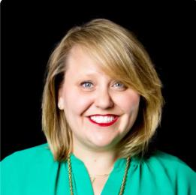
Welcome!
Crickett Nicovich Director of Policy and Government Affairs cnicovich@results.org

Slide 4
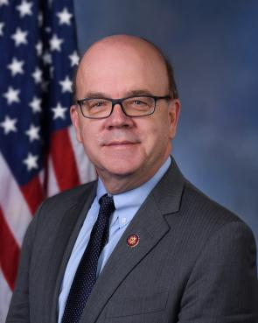
Rep. Jim McGovern (D-MA-2)
Guest Speaker

Slide 5
US Policy Updates

Slide 6
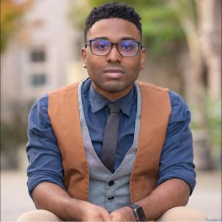
U.S. Poverty Campaigns Update
TaShon Thomas Director of U.S. Policy tthomas@results.org

Slide 7
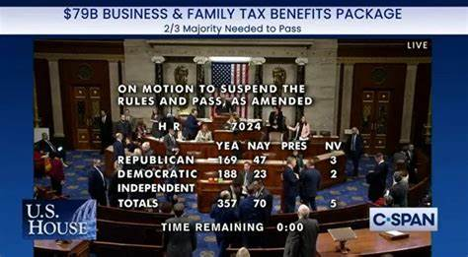
Let’s Take A Moment To Celebrate!
Notes:
Thanks in part to the hard work of our grassroots advocates and coalition partners, we are now one step closer to providing more financial stability for some working families. While this package falls short of helping all families of the 19 million children living in poverty, its overwhelmingly bi-partisan passage shows Congress can work together to unlock more resources which lifts children out of poverty. Let’s celebrate overcoming this hurdle today, but we have more work to do tomorrow.

Slide 8
Take action!
Here is your message to senators:
Will you support H.R. 7024, the Tax Relief for American Families and Workers Act which expands the CTC for 16 million children in families with low income? Also, will you urge Senate leaders to bring the bill to a vote NOW?
Call using our online action alert: https://results.org/volunteers/action-center/action-alerts?vvsrc=%2fCampaigns%2f72571%2fRespond
Notes:
Now that the House has passed the tax package, including a CTC expansion, we must now work against the clock as the Senate is set to go on a two week recess starting next Sunday. Call and email your Senators and urge them to take up the tax package before they go to recess. It is important the CTC is included in this year’s filing season which is already under way. The Senate must act now to ensure more families are made financially stable and more children are lifted out of poverty.

Slide 9
2024 US Policy Campaigns
Notes:
Now that the CTC is off to the Senate and we are hopeful for swift passage, we will now turn our attention to other policies we can educate and support our grassroots on. Over the last couple of weeks, our team has heard from many of you on potential items we can focus on in the coming months. Today I am excited to reveal how we are planning on moving forward.

Slide 10
2024 Policy Priorities
Tax Equity
Housing Justice
Healthy Start
Child Tax Credit
Renter Tax Credit
SNAP/WIC Reauthorization and Funding
Notes:
First, we have rearranged our policy priorities to fit within one of three areas. These areas are as follows:
Tax equity: The primary goal of this policy bucket is to use the US tax code to create more equitable financial assistance to low-income individuals and families. This includes continuing to work on the Child Tax Credit in preparation for 2025 expirations.
Housing Justice: The goal of this area is to create policies which create more opportunities to increase affordable housing and remove past barriers to housing. This includes advocating for a federal renter tax credit to provide more financial stability as rents continue to rise.
Healthy Start: This final policy area will work to create legislation providing more supports to families as they provide a solid foundation for children to develop. In 2024, this means ensure nutrition assistance programs, such as WIC and SNAP are reauthorized and fully funded.

Slide 11
2024 Grassroots Timeline
January/February
March-May
June-October
Action: Child Tax Credit
Action: SNAP/WIC
Election Action/Education: Renter Tax Credit
Education: SNAP/WIC
Education: Renter Tax Credit
November/December
Action: Lame Duck Session
Education: 2025 First 100 Days
NOTE: Timeline may change based on progression of Farm Bill and Appropriations.
Notes:
As we continue through the year, our major focus will be on the Renter’s Tax Credit and SNAP/WIC. This is dependent upon the progression of the Farm Bill, which is set to expire in September. Our goal for 2024 is provide both opportunities of education on our priorities, as well as, grassroots actions. Once again we thank Rep. McGovern talking with us today about nutrition assistance updates. This was our first education opportunity for the grassroots. Look out for an invitation for a Policy forum later this month or early March to provide a deeper dive into federal nutrition assistance programs and opportunities to create grassroots action.
This spring we will also provide education opportunities on the Renter Tax Credit being proposed through the HOME ACT sponsored by Senator Cory Booker of New Jersey. We expect Sen. Booker to re-introduce the HOME Act in March or April. From there, our election education and action efforts will focus on passage of the HOME Act and the need for more financial assistance for renters.
Then this winter, we will focus on tying up any last minute items during the lame duck session and turn our focus to the first 100 days of the next Congress and Presidential administration.

Slide 12
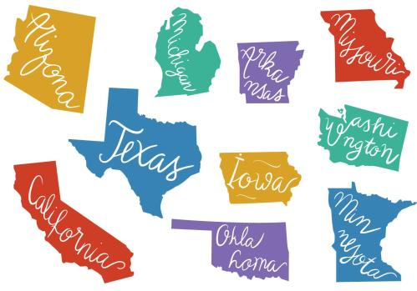
MORE TO COME!
Notes:
We have also heard some grassroots would like to be active in state policy work. We are exploring opportunities of what that would look like for us in the future, including starting in no more than five pilot states and ensuring we have staff capacity to help those efforts. We will provide more information closer to the fall of this year. If you have any questions, please do not hesitate to reach out.

Slide 13
RESULTS Global Policy Work

Slide 14
Our Goal
Congress demanding equity and impact in the fight against global poverty

Slide 15
Appropriations
FY24 Appropriations:
Continuing Resolution maintains FY23 funding levels until March 1 and 8
SFOPS bill (our issues) on March 8
Asking for both READ Act Reauthorization and End TB Now Act to be included on an omnibus
FY25 Appropriations:
Coming soon! Mid-February approps memos will be ready!

Slide 16
World Bank Advocacy
Congressional letter to the World Bank, led by Senator Booker – still working on securing a Republican lead!
Key asks:
Accountability at the WB to prioritize resources for the lowest-income places to have the biggest impact on poverty
Human needs at the center – urging increased investment in "Human Capital", i.e. health, nutrition, and education
Transparency & accountability
A key role in debt relief
For more information: July 2023 Global Policy Forum

Slide 17
Grassroots Café

Slide 18
Thank you for joining us!
Who is joining you in the room today?
In the poll, please respond with the number of people in the room with you (including yourself).

Slide 19
We have a bold agenda!
Let’s look at our 2024 Action Timeline
https://results.org/2024-actions-timeline

Slide 20
Goals for Feb. - April
Meet with 100% of offices we cover
Meet in-person with as many senators and representatives as we can
Total meeting goal: 345

Slide 21
Meeting with Congress
Relationship building is everything
Congressional meetings build relationships
Two meeting moments in 2024:
February – April
August - October

Slide 22
Resources
Sample meeting request letter: Volunteer Hub/Working with Congress
Legislator Look-Up: Volunteer Hub/Working with Congress (see icon toward top of page)
Lobby prep. support: Contact Katie Fleischer (kfleischer@results.org)

Slide 23
Let’s Hear from You
What are your best practices for getting meetings?
What are your best practices for preparing your state/group for meetings?

Slide 24
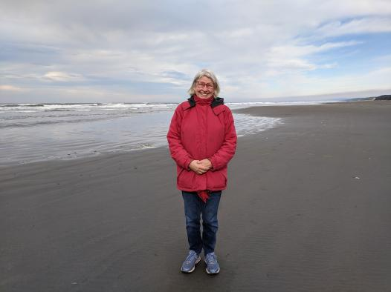
WA state advocate Beth Wilson

Slide 25
Resources and Preparing for Lobby Meetings

Slide 26
What helpful resources are available to you?
Being a Congressional Point Person - February 6 at 8:30 pm ET
The Congressional Point Person is an important role to play for RESULTS.
But what does the Congressional Point Person do? How can we make the most of the role to build congressional relationships, engage others, and increase our impact?
Register for the “Being a Congressional Point Person” webinar to learn and share your insights.
Researching Your members of Congress – February 15 at 8:30 pm ET
To have effective lobby meetings, you need to know a bit about your member(s) of Congress.
In this 90-minute webinar, RESULTS Regional Coordinator Allison Gallaher shares tips and tools on how to research your legislators.
Learn how to find what they care about, how they plan to lead, and how to connect with them on our issues.
Join us for the Researching Your Member(s) of Congress webinar!

Slide 27
Preparing for lobby meetings

Slide 28
What is Motivational Interviewing?

Slide 29
How can Motivational Interviewing help you in your advocacy journey?

Slide 30
How many of you have heard of Motivational Interviewing before? Feel free to post your response in the chat or use the raise your hand function!

Slide 31
OARS Technique
We have a very simple and easy-to-remember acronym to help anchor us in the MI approach when it comes to our Congressional meetings, and that is OARS, O-A-R-S.
And that stands for
Open Questions
Affirmations
Reflections
Summaries.

Slide 32
Have any of you ever used Motivational Interviewing when speaking with a congressional office? Feel free to post your response in the chat or use the raise your hand function!

Slide 33
Where can you access Motivational Interviewing resources?

Slide 34
www.results.org
Go to the Volunteer Hub
Working with Congress
I want to prepare for a lobby meeting

Slide 35
www.results.org
Go to the Volunteer Hub
Webinars and Training Resources (menu right)
Training Resources (at the top)

Slide 36
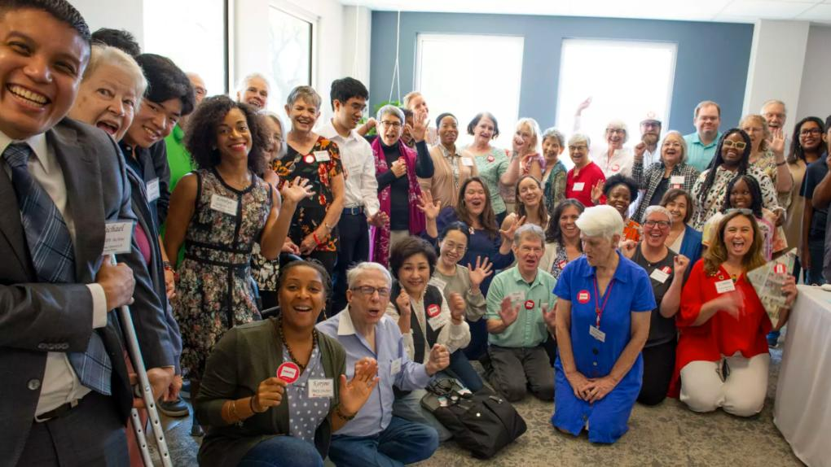
Community of Change

Slide 37
RESULTS Ladder of Engagement
Group member
Attend lobby meeting
Attend Orientation
Added to Action Network
Action Alerts
Takes Solidarity Action
Goal = Engage new supporters across all levels

Slide 38
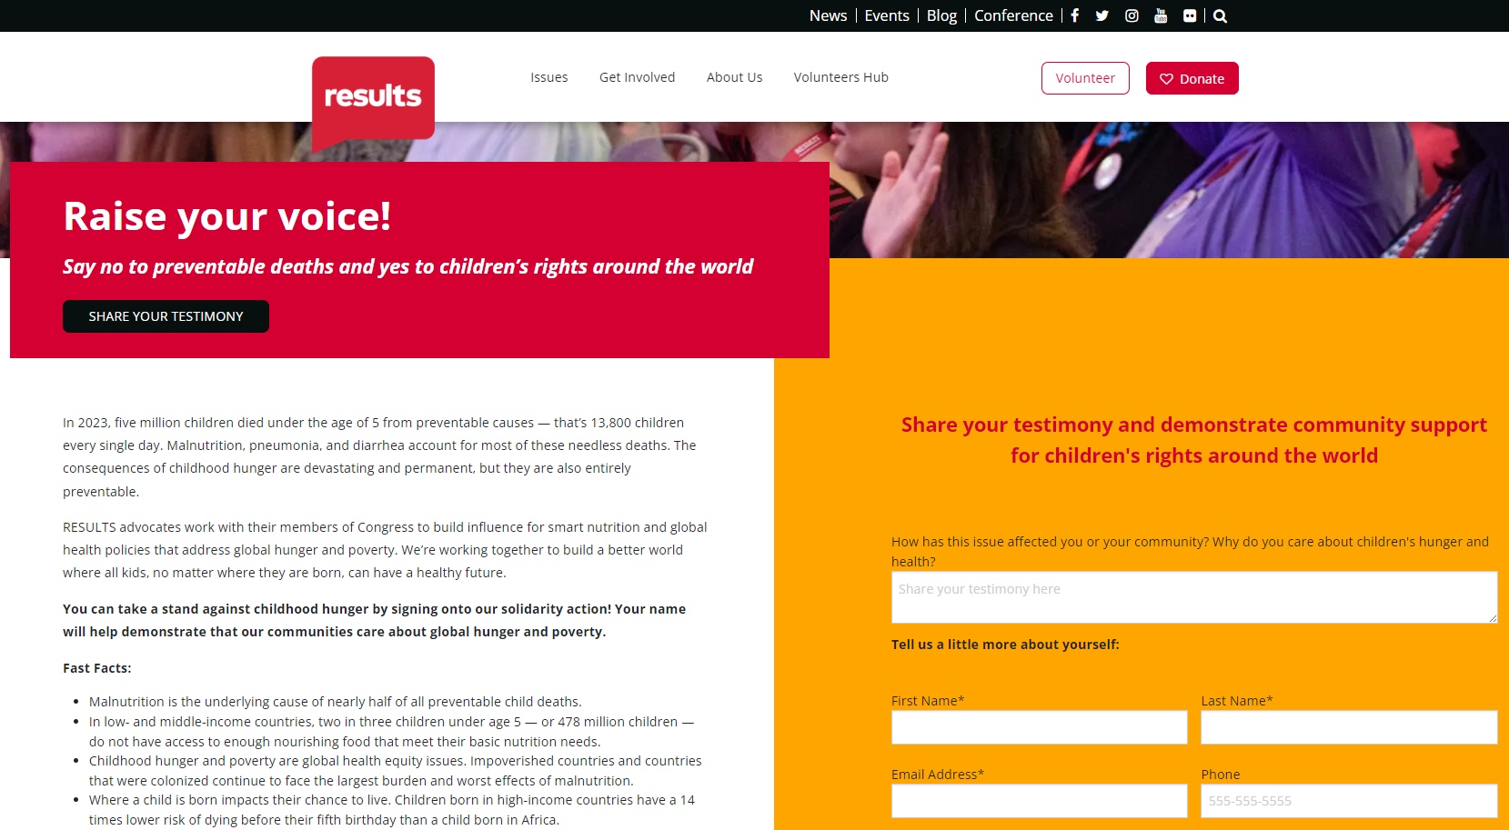
Global Solidarity Action is live
https://results.org/raise-your-voice-global

Slide 39
Share the solidarity action on social media & invite your network to support our lobby meetings
US Action
results.org/raise-your-voice-us
Global Action
results.org/raise-your-voice-global
Sample caption
"I am meeting with my Senators and Representatives this spring to push for bold funding increases in child health and nutrition, vaccines, and global education. Want to support me? Sign our solidarity action! We will share the number of signers and your testimony with our members of Congress during our lobby meetings to demonstrate broad community support for these issues."
RESULTS Educational Fund
@voices4RESULTS

Slide 40
Announcements

Slide 41
2023 lobbying totals
Total lobby meetings: 376 meetings (83 face-to-face)
113 Senate meetings, including 12 face-to-face (74 different offices)
261 House meetings including 71 face-to-face (161 different offices)
2 candidate meetings

Slide 42
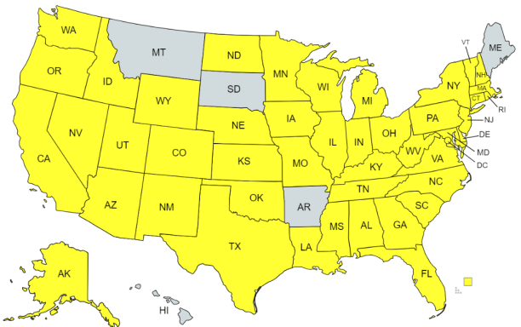
What states held meetings in 2023?
You held at least ONE lobby meeting in 45 states in 2023!

Slide 43
2023 congressional coverage
Added 15 additional House districts!
Current coverage:
86 Senate offices
260 House offices

Slide 44
2023 Media Totals
Total media: 589 pieces (2022 total: 477)
327 discuss the Child Tax Credit
153 discuss Renter Tax Credit or housing
94 discuss global tuberculosis
44 discuss global education
States published: 45 plus national publications
Groups published: 60 groups published plus Free Agents and Action Network members
72 percent of all 2023 media came during our Apr-Jun and Sep-Dec media campaigns

Slide 45
Build the Buy-in media campaign
Time frame:
September 1 – December 31, 2023
Goals:
250 published pieces
Published in all 50 states
Every RESULTS group gets published once
results.org/build-the-buy-in

Slide 46
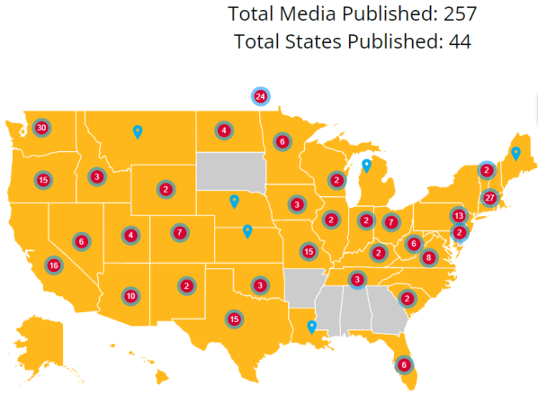
Look at what you did!
Only 6 states where we
didn’t get published:
AL, AR, DE, GA, MS, SD

Slide 47
52 of 81 Groups with BTBI media
AK: RESULTS Anchorage
AZ: RESULTS Phoenix
CA: RESULTS Contra Costa
RESULTS Oakland
RESULTS San Diego (US)
RESULTS Silicon Valley
CO: RESULTS Colorado
CT: RESULTS Coastal CT
DC/MD: RESULTS DC/MD
FL: RESULTS Miami
RESULTS North Florida
ID: RESULTS Boise
IA: RESULTS Iowa
IN: RESULTS Indiana
KY: RESULTS Lexington
MA: RESULTS Massachusetts
MN: RESULTS Minnesota
MO: RESULTS Kansas City
RESULTS St. Louis (US)
RESULTS St. Louis (Global)
NC: RESULTS Triangle
RESULTS Western NC
NH: RESULTS New Hampshire
NJ: RESULTS Delaware Valley
NM: RESULTS Albuquerque
RESULTS Santa Fe
NV: RESULTS Las Vegas
NY: RESULTS Buffalo
OH: RESULTS Cleveland
RESULTS Columbus
OK: RESULTS Oklahoma
OR: RESULTS Greater Oregon
PA: RESULTS Philadelphia
RESULTS South Central PA
SC: RESULTS Greenville/Spartanburg
TN: RESULTS East Tennessee
TX: RESULTS Austin (Global)
RESULTS Austin (US)
RESULTS Dallas
UT: RESULTS Salt Lake City (US)
VA: RESULTS Virginia
VT: RESULTS Vermont
WA: RESULTS Bremerton
RESULTS Seattle
RESULTS Snohomish
RESULTS South Kitsap
RESULTS SW Washington
RESULTS Tacoma
RESULTS Tri-Cities
WI: RESULTS Wisconsin
WV: RESULTS West Virginia
WY: RESULTS Cheyenne

Slide 48
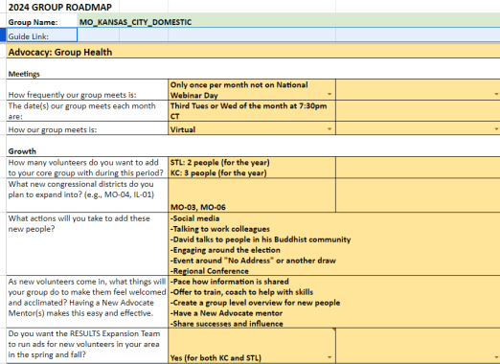
2024 Group Roadmaps
Thank you to everyone who has worked on or completed your 2024 Group Roadmaps (and updated your Group Rosters).
Benefits to you: focus, shared responsibility, inspiration
Benefits to RESULTS: inspiration, coverage, support
Benefits to the world: the sky’s the limit!

Slide 49
2024 Group Roadmaps
If you have not completed your Roadmaps (including updating your Group Roster with roles), please complete them by Thursday, February 15.
If you need more time, just let RESULTS staff know.
Thank you and we look forward to helping your reach your 2024 goals!

Slide 50
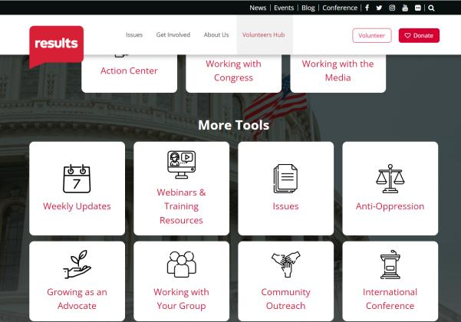
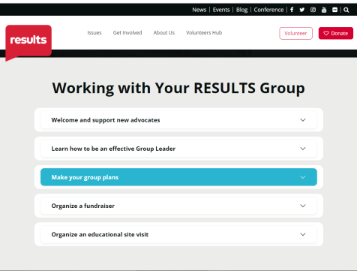
2024 Group Roadmaps
Questions? Contact RESULTS staff at grassroots@results.org.

Slide 51
Support Calls
Being a Congressional Point Person
Tuesday, February 6, 8:30 pm ET
Register online
Researching Your Member(s) of Congress
Thursday, February 15, 8:30 pm ET
Register online

Slide 52
Other Support Calls
Global Allies (Returned Peace Corps Volunteers) Webinar
Thursday, February 8, 8:30 pm ET
Learn more.
Together Women Rise Partnership Webinar
Tuesday, February 20, 8:30 pm ET
Click to learn more.
Media Office Hour
Wednesday, February 21, 2:00 pm ET
Join via Zoom at https://results.zoom.us/j/93668005494 or (312) 626-6799, meeting ID 936 6800 5494. No registration required.

Slide 53
Other Support Calls
Event Planning and Outreach Office Hours
Thursday, February 8, 2:00 pm ET
Join via Zoom at https://results.zoom.us/j/98524229370 or call (312) 626-6799, Meeting ID: 985 2422 9370. No registration required.
Action Network Manager Call
Wednesday, February 21, 12:30 pm ET and 8:00 pm ET
Click for the 12:30 session; Click for the 8:00 session
No registration required.

Slide 54
Other Support Calls
New Advocate Orientation
Tuesday, February 13, 12:00 pm ET.
Register today.
Four-part Group Leader Training Series
Starting Wednesday, February 21, 8:00 pm ET
Registration is open.

Slide 55
Free Agents Webinars
U.S. Poverty Free Agents
Tuesday, February 20, 1:00 pm and 8:00 pm ET
Contact Jos Linn at jlinn@results.org for information.
Global Poverty Free Agents
Monday, February 26, 7:00 pm ET
Contact Lisa Marchal at lmarchal@results.org for information.

Slide 56
The RESULTS office will be closed Monday, February 19 in observance of Presidents’ Day

Slide 57
Don't forget to submit your lobby, media, and outreach reports! https://results.org/volunteers/reporting-your-advocacy-actions

Slide 58
Find today’s slides
https://results.org/volunteers/national-webinars

Slide 59
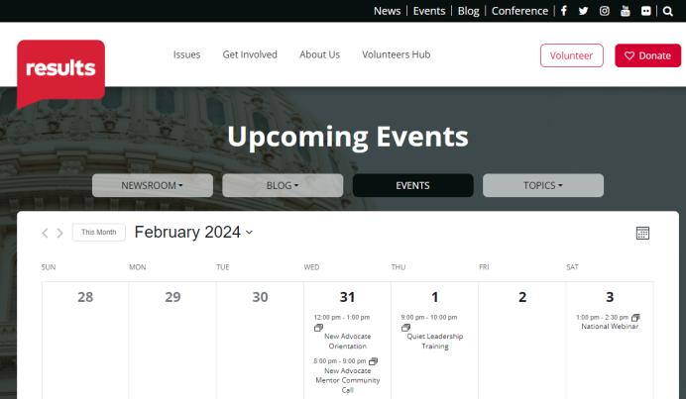
Find events
https://results.org/events

Slide 60
Looking ahead to the March National Webinar...
Delivering Change for Women and Children Around the Globe
Learn about health equity, child survival, and gender equity programs and policies, and get inspired to act on International Women’s Day (Friday, March 8) and advocate to Congress throughout 2024.
March 2, 1pm ET | REGISTER: tinyurl.com/RESULTS2024

Slide 61
By Richard Burlton (Unsplash)
By Cristina Matos-Albers (Unsplash)

