Slide 1
The RESULTS Global Policy Forum
February 16, 2023
Welcome!

Slide 2
Our Anti-Oppression Values
2
​RESULTS is a movement of passionate, committed everyday people. Together we use our voices to influence political decisions that will bring an end to poverty. Poverty cannot end as long as oppression exists. We commit to opposing all forms of oppression, including ableism, ageism, biphobia, classism, colonialism, homophobia, racism, religious discrimination, sexism, transphobia, white saviorism, and xenophobia.
At RESULTS we pledge to create space for all voices, including those of us who are currently experiencing poverty. We will address oppressive behavior in our interactions, families, communities, work, and world. Our strength is rooted in our diversity of experiences, not in our assumptions.
With unearned privilege comes the responsibility to act so the burden to educate and change doesn’t fall solely on those experiencing oppression. When we miss the mark on our values, we will acknowledge our mistake, seek forgiveness, learn, and work together as a community to pursue equity.
There are no saviors — only partners, advocates, and allies. We agree to help make the RESULTS movement a respectful, inclusive space.
Find all our anti-oppression resources at https://results.org/volunteers/anti-oppression/

Slide 3
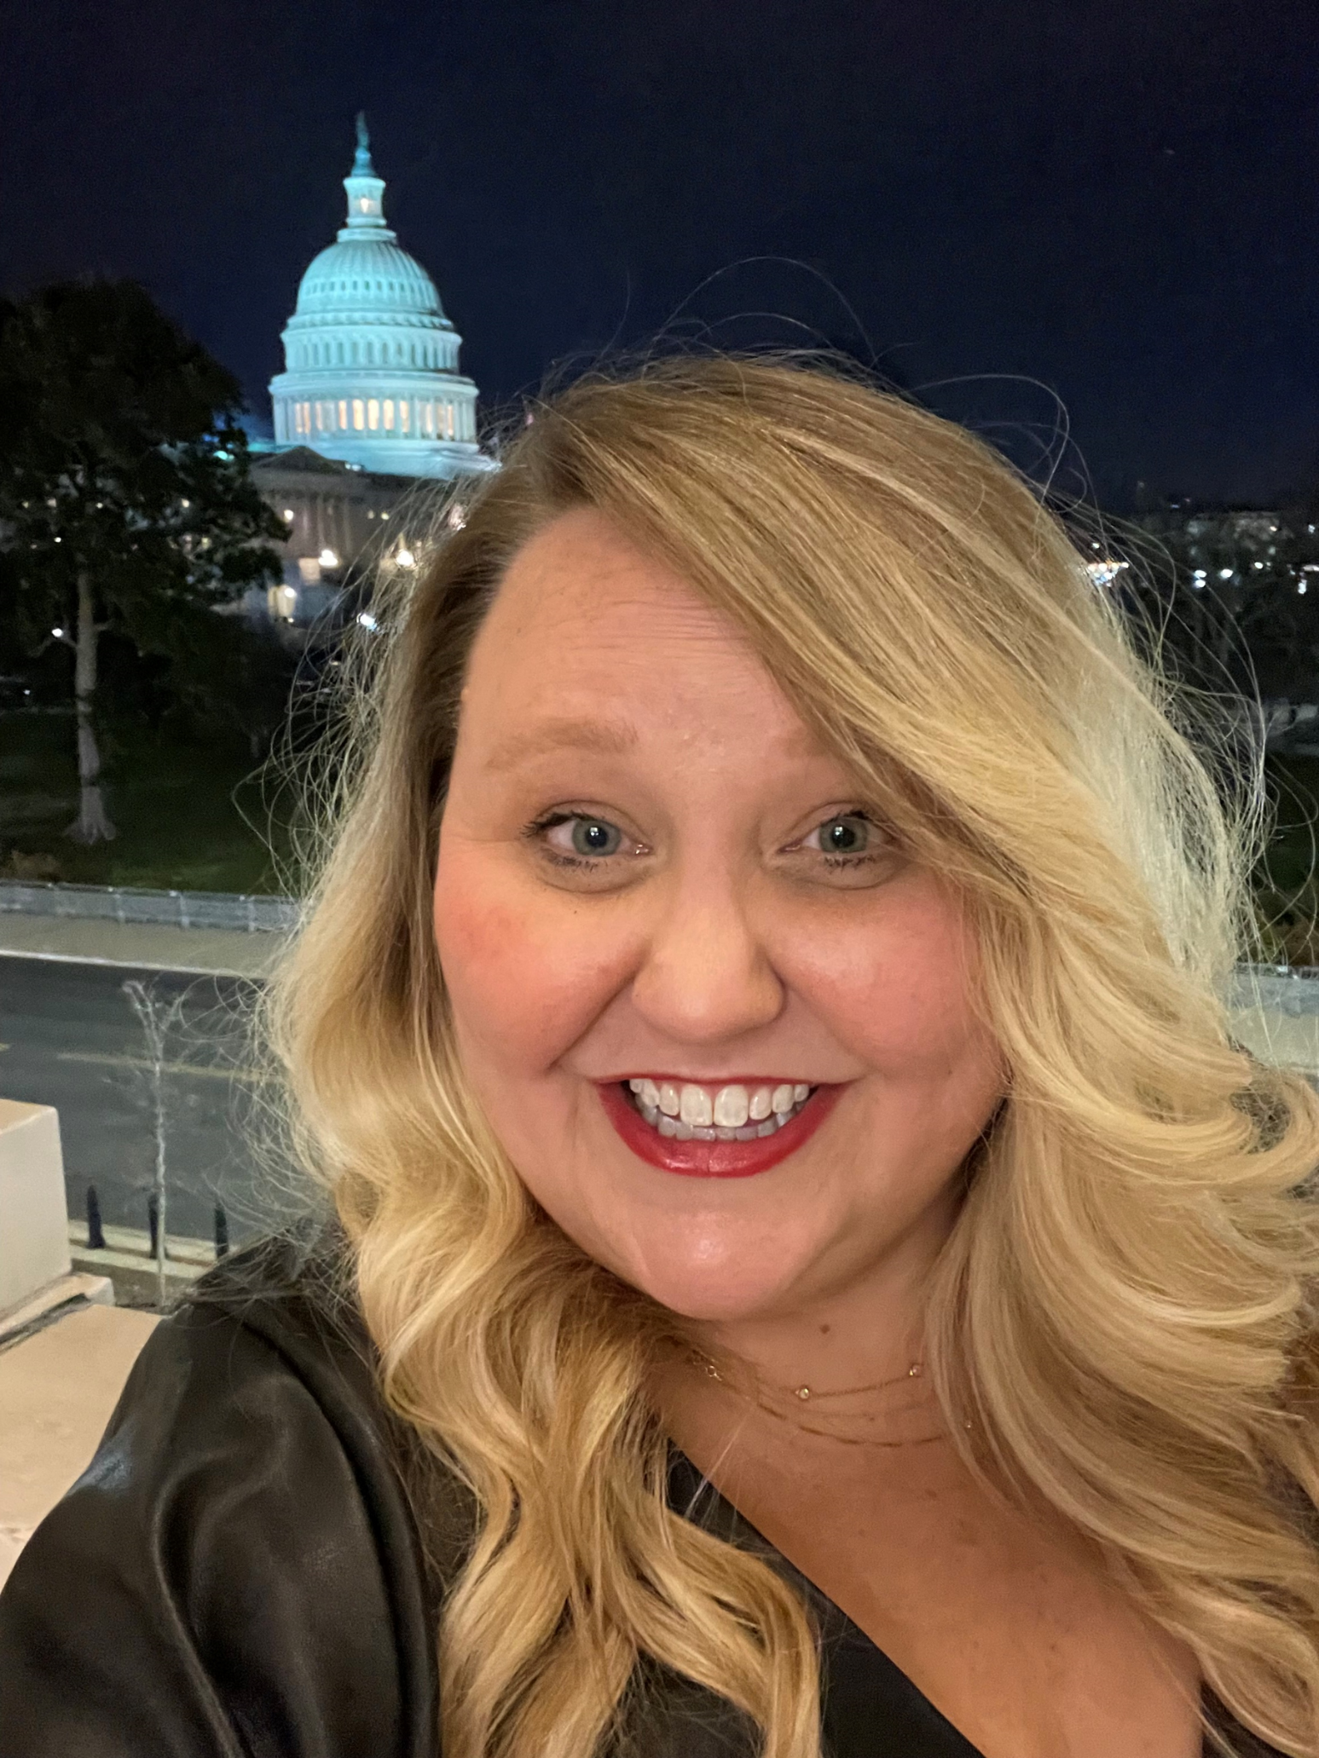
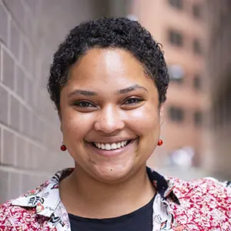
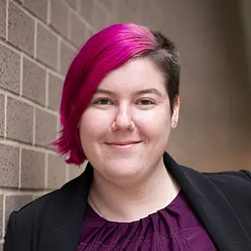
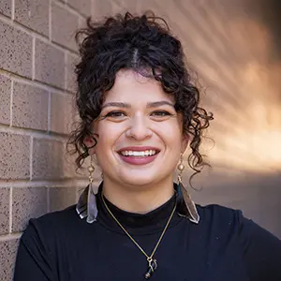
Crickett Nicovich Associate Director, Policy and Government Affairs Dorothy Monza Senior Policy Associate, Child Health and Nutrition Katie Fleischer Advocacy Associate Sarah Leone Grassroots Impact Associate

Slide 4
Budget & Appropriations 201

Slide 5
Congress decides where our money goes

Slide 6
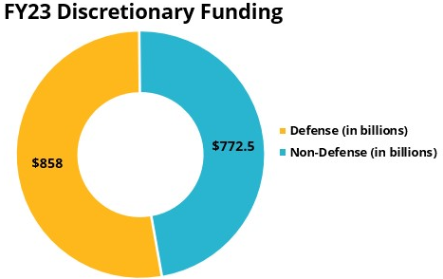
Understanding the Jargon
https://results.org/blog/government-funding-cheat-sheet
Notes:
https://www.cbpp.org/research/federal-budget/introduction-to-the-federal-budget-process
Another good backgrounder
https://crsreports.congress.gov/product/pdf/R/R46240 the wonkiest - a deep dive on how the processes work

Slide 7
Appropriations Subcommittees
Annually - Twelve appropriations subcommittees in the House and twelve appropriations subcommittees in the Senate hold public hearings and prepare appropriations bills.
Appropriations Committees in the House and Senate vote on the 12 bills approved in subcommittee. Then full House and full Senate vote on each appropriations bill.
The bill or bills MUST pass by the end of the fiscal year – September 30th – or the government goes unfunded.
Notes:
Explain committee process and opportunities to take action
The House and Senate Budget Committees create resolutions that allocate a certain amount of money to each of the 12 appropriations subcommittees on each side of Congress. Once each budget resolution passes their chamber, they’re reconciled in a bicameral budget conference, setting the maximum amount of money available to each subcommittee.
Then, the 12 subcommittees each hold hearings and prepare bills that specify funding levels for each individual program. Once the subcommittee passes their bill, the full Appropriations committee votes on it, and then the entire chamber.
If the House and Senate bills don’t match, it’ll take even more negotiation to reconcile the bills. Finally, when Congress agrees on the 12 appropriations bills, they go to the President to be signed.
The goal is to get the bills signed by October 1, when the new fiscal year begins. Unfortunately, it doesn’t always work this way. Congress rarely passes each appropriations bill separately, instead bundling them together in a larger omnibus package. This can slow down the process with lengthy negotiations, forcing Congress to pass a continuing resolution (CR) to keep the government funded and avoid a government shutdown. CRs extend the current level of funding, meaning that we can only get funding increases for the programs we advocate for when Congress finally passes their appropriations bills.

Slide 8
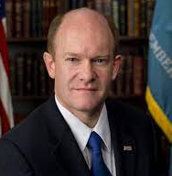
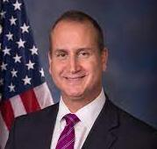
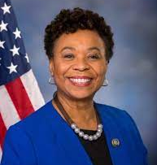
Our Focus – Senate and House State and Foreign Operations Sub-Committee Leadership
Chairman Chris Coons (D-DE)
Ranking Member Lindsay Graham (R-SC)
Chairman Mario Diaz-Balart (R-FL-26) Ranking Member Barbara Lee (D-CA-12)
The full appropriations committee members are available at
www.appropriations.senate.gov and
www.appropriations.house.gov
Notes:
Explain SFOPS, mention Approps posse?

Slide 9
NEW House and Senate SFOPS members for the 118th
SENATE Chair Christopher Coons (D-DE), Ranking Member Lindsey Graham (R-SC)
Majority members: Senators Coons (chair), Durbin, Shaheen, Merkley, Murphy, Van Hollen, Schatz (HI);
Minority members: Graham (ranking member), McConnell, Boozman, Moran, Rubio, and Hagerty
HOUSE
Chair Mario Diaz-Balart (R-FL), Ranking Member Barbara Lee (D-CA)
Majority members: Diaz-Balart (chair), Hal Rogers (KY), Chris Stewart (UT), Guy Reschenthaler (PA), Chuck Fleischmann (TN), Jake LaTurner (KS), Jerry Carl (AL)
Minority members: Lee (Ranking Member), Grace Meng (NY), Lois Frankel (FL), Norma Torres (CA)

Slide 10
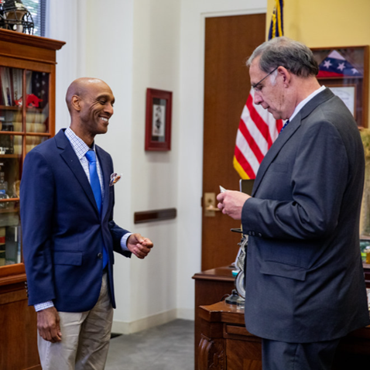
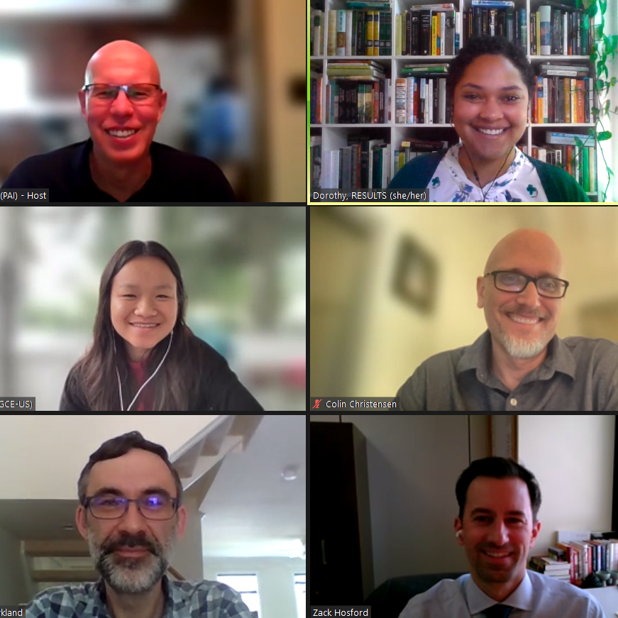
meeting with members of Congress and their staff (at home & in DC)
we influence appropriations by…
Notes:
Mention lobby prep, Set the Agenda resources
Most Americans don’t follow the Appropriations process, meaning members of Congress don’t always feel pressure from their constituents to fight for specific programs. But you can get our issues on their radar by sending an email, calling their offices, and asking for a meeting with their Foreign Policy staffers. Your goal is to introduce our appropriations asks, share why those issues matter to you, and ask your senator or representative to speak to members of SFOPs about our requests.

Slide 11
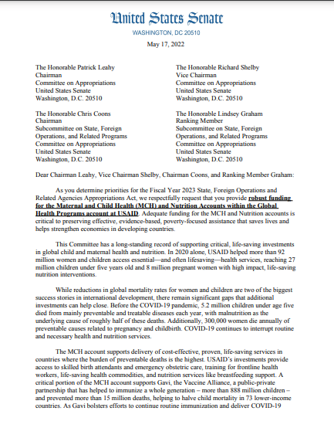
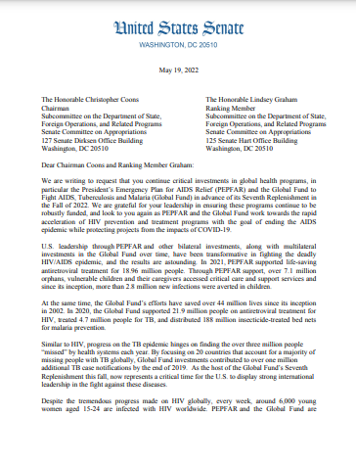
requesting signatures on annual “dear colleague” letters
we influence appropriations by…
Notes:
DCs- one for each issue
During the appropriations process, members of Congress can make their priorities known by signing on to “Dear Colleague” letters for issues that they care about. Each letter is circulated by champions in Congress asking other members to join them, like a petition. Then, the letters are sent to the leaders of the SFOPs subcommittee, which writes the foreign aid spending bill. These letters can have a lot of sway, and a large number of bipartisan signers shows the committee that there is strong support for that issue.
Our job is to ask members of Congress to sign the letters we’re endorsing. Typically, we prioritize Dear Colleague letters on global Tuberculosis, Maternal and Child Health and Nutrition, the PEPFAR/ Global Fund to Fight AIDS, Tuberculosis, and Malaria, and global education.

Slide 12
The Impact of Dear Colleague Letters
Account | FY17 Signers | FY17 Funding | FY20 Signers | FY20 Funding | FY23 Signers | FY23 Funding
USAID Maternal and Child Health | 146 House 27 Senate | $814.5 million | 146 House 37 Senate | $851 million | 178 House 35 Senate | $910 million
USAID Tuberculosis | 71 House 16 Senate | $241 million | 77 House 29 Senate | $310 million | 120 House 30 Senate | $394.5 million
Notes:
Increased number of signers-- higher priority for SFOPS-- greater funding

Slide 13
Your impact
In FY23, we worked on 3 House and Senate DCs, out of 12 House and 6 Senate global health letters.
Our House letters:
Republican co-lead, 6 to 14 Republican signers
Three of the top four most popular, average of 149 signers
Our Senate letters:
Republican co-lead, at least one other Republican signer
Average of 33 signers
Other House letters:
Five had no Republican signers, the rest had four or fewer
Average of 51 signers
Other Senate letters:
Average of one Republican signer
Average of 30 signers
Notes:
We know that your appropriations work every spring has a huge impact. Your emails, forms, calls, articles, and meetings let your members of Congress know what they should prioritize in their requests to appropriations committees. And RESULTS is a key factor in making sure our issues become priorities.

Slide 14
How Members can influence SFOPS
Non-committee Members
Approps or SFOPS Members
Dear Colleague letters
Individual requests to SFOPS leadership
Weigh in personally – floor conversations – additional letters
Testifying at SFOPS "Members' Day"
Dear Colleague Letters (they can sign/but many won't)
Individual requests to the Chair and/or RM
Weigh in personally – floor conversations – additional letters
Questions on our issues during SFOPS hearings
Notes:
RESULTS volunteers are an integral part of the appropriations process, and there are many ways to get involved. Members that aren’t on the Appropriations committee still have a key role. They have an opportunity to submit input on each of the 12 bills, and we can influence which issues they prioritize in their submissions to the State and Foreign Operations and Related Programs (SFOPs) subcommittee, which manages foreign policy appropriations.

Slide 15
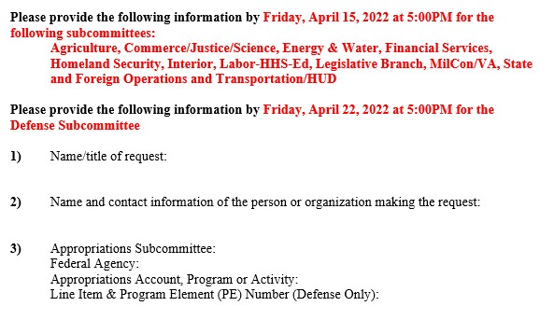
submitting Member-specific forms
we influence appropriations by…
Notes:
Members can also personally speak or write to subcommittee leadership, asking them to include specific funding levels in their bill. By reaching out to your member’s office and filling out their appropriations form, we can let them know that their constituents want them to submit requests for increased global health and education funding. RESULTS staff can help you fill out the forms, which can often require a lot of specific policy information.

Slide 16
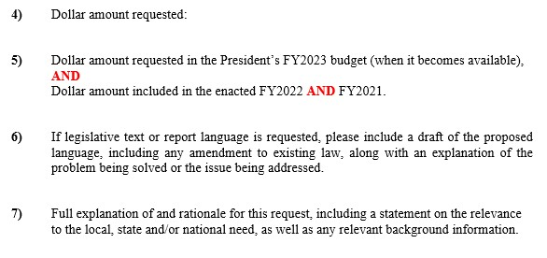
submitting Member-specific forms
we influence appropriations by…

Slide 17
submitting Member-specific forms
we influence appropriations by…
FY24 Online Form Example: Sen Chris Coons
https://www.coons.senate.gov/services/appropriations-requests/programmatic-funding

Slide 18
Cheat Sheets for Forms! (to come!) https://results.org/resources/fy24-global-appropriations-memos

Slide 19
FY24 Appropriations Requests
Account | FY21 | FY22 | FY23 | RESULTS’ FY24 Request
USAID Tuberculosis | $319 million | $371 million | $394.5 million | $1 billion
USAID Maternal and Child Health | $855 million | $890 million | $910 million | $1.15 billion
Of which, Gavi | $290 million | $290 million | $290 million | $340 million
USAID Nutrition | $150 million | $155 million | $160 million | $300 million
USAID International Basic Education | $950 million | $950 million | $970 million | $1.2 billion
Of which, Global partnership for Education | $125 million | $125 million | $130 million | $200 million
Global Fund to Fight AIDS, TB, and Malaria | $1.56 billion | $1.56 billion | $2 billion | $2 billion

Slide 20
Often the forms ask… How does this help our district?
Moral stance
Economic stance
Security stance
https://www.usglc.org/in-your-state/

Slide 21
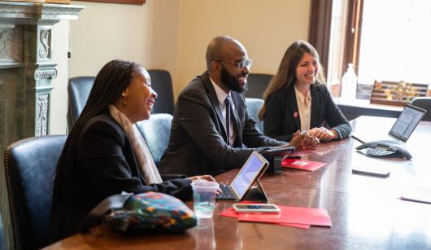
Policy Info and Leave Behinds
results.org/set-the-agenda

Slide 22
Making the Case for Appropriation Asks Using Motivational Interviewing (MI) techniques

Slide 23
What the heck is Motivational Interviewing?

Slide 24
The Backfire Effect:
Well-reasoned arguments can cause pushback.

Slide 25
Don’t Personalize the Problem
They are the problem.
Us
Do Externalize the Problem
The Issue is the Problem
Us

Slide 26
What common values do you share?
Avoiding radical changes
Eliminating subsidies
American ingenuity
Improving infrastructure
Privatization
Reduced regulations
Sustainability
Supporting families
Protect taxpayers
Revenue neutrality
Conservative leadership
Avoid big spending
Smaller government
Individual liberty
Economic security
Business/Job growth
National Security
Market-based solutions
Individual responsibility
Fairness based on effort
Treating people equally
Respect for innocent life
Patriotism
Nationalism
Deference to tradition
Reducing spending

Slide 28
What does that look like in the context of Appropriation asks?

Slide 29
Challenge Yourself!
Notes:
When prepping for your lobby meetings this month and next month, craft some sentences using MI techniques to help open up a dialogue with your member(s) of Congress!

