Slide 1
RESULTS National Webinar
December 2, 2023
Welcome!

Slide 2
Our Values & Resources
2
​At RESULTS we pledge to create space for all voices, including those of us who are currently experiencing poverty. We will address oppressive behavior in our interactions, families, communities, work, and world. Our strength is rooted in our diversity of experiences, not in our assumptions.
With unearned privilege comes the responsibility to act so the burden to educate and change doesn’t fall solely on those experiencing oppression. When we miss the mark on our values, we will acknowledge our mistake, seek forgiveness, learn, and work together as a community to pursue equity.
Read our full anti-oppression values statement here at results.org/values.
Find these resources and more at results.org/volunteers/anti-oppression:
Resource Guides from our Diversity & Inclusion trainings, including:
Interrupting Microaggressions
Creating Space for Critical Conversations
Information on how RESULTS responds to oppressive incidents
Notes:
Updated AO slide (2/22)

Slide 3
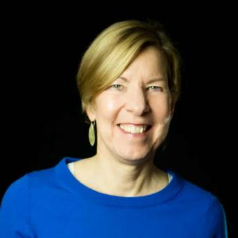
Joanne Carter RESULTS Executive Director
Welcome!

Slide 4
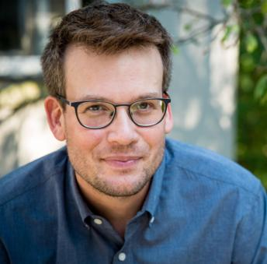
Guest Speaker
John Green
Best-selling author (“The Fault in Our Stars”)
and tuberculosis advocate
https://www.johngreenbooks.com

Slide 5
RESULTS Global Policy Work

Slide 6
Global Poverty Campaigns Update
Your breakthrough work this year on TB
… and what's next!

Slide 7
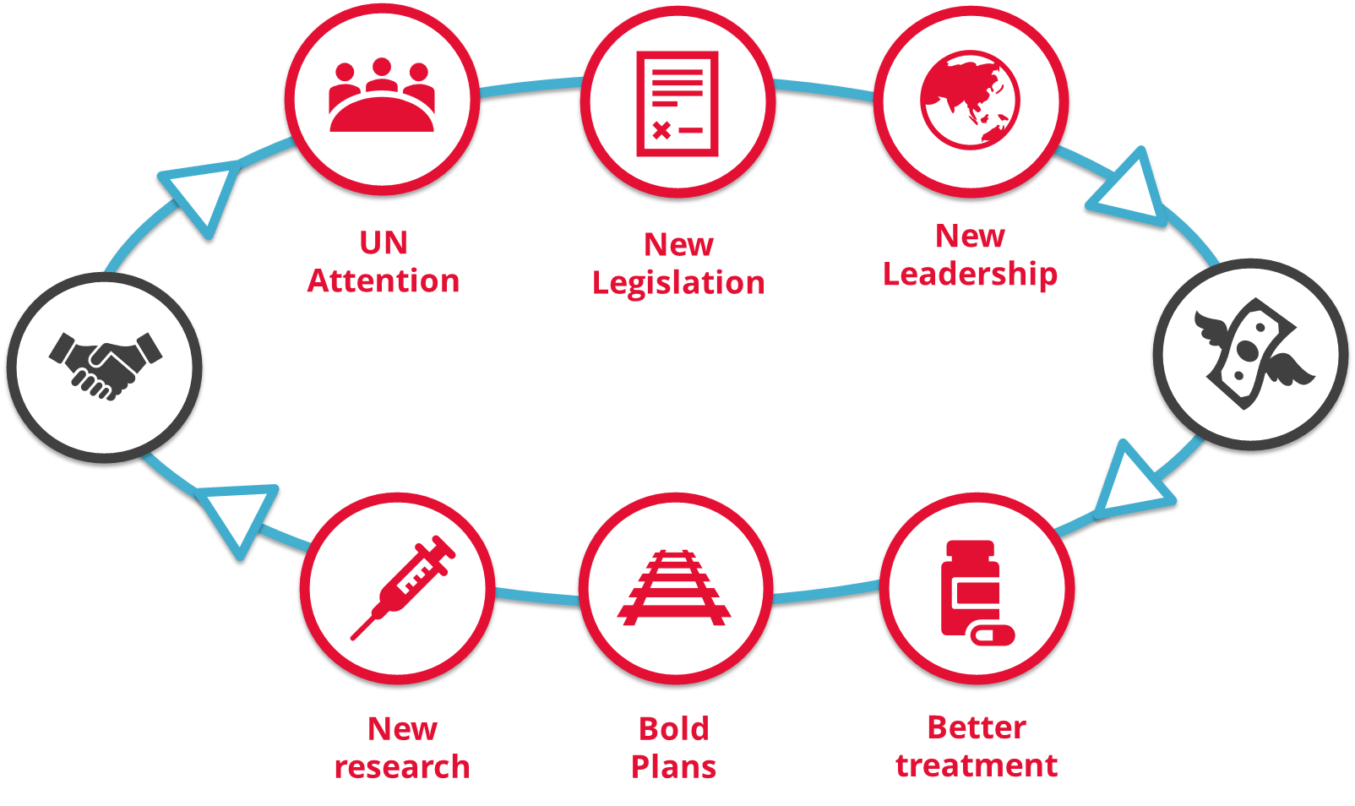

Slide 8
Actions for Congress on TB
The End Tuberculosis Now Act
Cosponsor & ask congressional leadership to pass the bill!

Slide 9
Actions for Congress on education
The READ Act
House: Cosponsor & ask Foreign Affairs leadership to move the bill out of committee.
Senate: Done!!!

Slide 10
RESULTS U.S. Policy Work

Slide 11
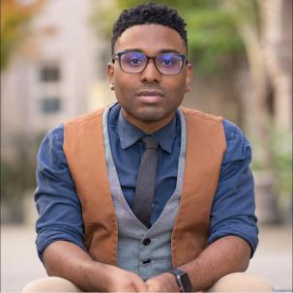
U.S. Poverty Campaigns Update
TaShon Thomas Director of U.S. Policy tthomas@results.org

Slide 12
CTC Updates
Ongoing conversations with potential to move by end of year or January funding bill
Almost 150 Republican Members sent a letter to Speaker Johnson requesting a tax package by the end of the year
Members are aware CTC must be included in any tax package

Slide 13
Take action!
Ask your members of Congress to:
Will you urge your colleagues on the House Ways and Means Committee or Senate Finance Committee to expand the full benefit of the Child Tax Credit (CTC) to as many families as possible, prioritizing those with low incomes?
See our CTC leave-behind at: https://results.org/wp-content/uploads/2023-CTC-Request-Summer-and-Fall-MEGA-RESOURCE.pdf

Slide 14
Take action!
Keep submitting letters to the editor and op-eds with the message:
Any tax bill this year must significantly reduce child poverty by expanding the Child Tax Credit.
Use our updated CTC media alert to send your letters today. Remember, things could happen quickly so the more letters you get now, the more pressure it puts on Congress to expand the CTC.

Slide 15
Build the Buy-in update

Slide 16
results.org/build-the-buy-in

Slide 17
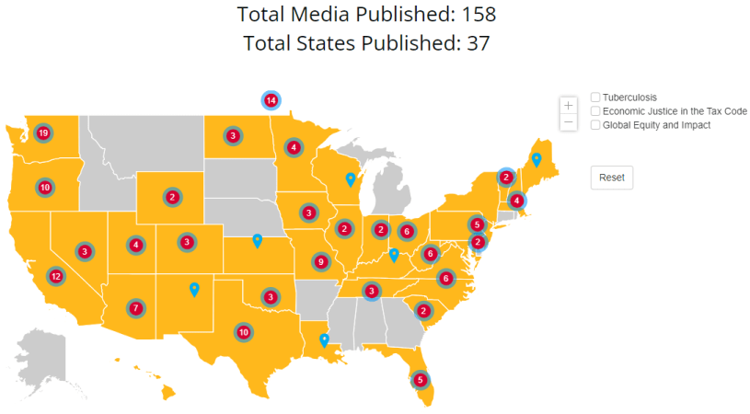
Media Map: December 2
States where we still need media:
AL, AK, AR, CT, DE, GA,
ID, MI, MS, MT, NE, RI, SD

Slide 18
44 of 81 Groups with BTBI media (so far)
AZ: RESULTS Phoenix
CA: RESULTS Contra Costa
RESULTS Oakland
RESULTS San Diego (US)
RESULTS Silicon Valley
CO: RESULTS Colorado
DC/MD: RESULTS DC/MD
FL: RESULTS Miami
RESULTS North Florida
IA: RESULTS Iowa
IN: RESULTS Indiana
KY: RESULTS Lexington
MA: RESULTS Massachusetts
MO: RESULTS Kansas City
RESULTS St. Louis (US)
RESULTS St. Louis (Global)
NC: RESULTS Triangle
RESULTS Western NC
NH: RESULTS New Hampshire
NJ: RESULTS Delaware Valley
NM: RESULTS Albuquerque
NV: RESULTS Las Vegas
OH: RESULTS Cleveland
RESULTS Columbus
OK: RESULTS Oklahoma
OR: RESULTS Greater Oregon
PA: RESULTS Philadelphia
SC: RESULTS Greenville/Spartanburg
TN: RESULTS East Tennessee
TX: RESULTS Austin (Global)
RESULTS Austin (US)
RESULTS Dallas
UT: RESULTS Salt Lake City (US)
VA: RESULTS Virginia
VT: RESULTS Vermont
WA: RESULTS Bremerton
RESULTS Seattle
RESULTS Snohomish
RESULTS South Kitsap
RESULTS SW Washington
RESULTS Tri-Cities
WI: RESULTS Wisconsin
WV: RESULTS West Virginia
WY: RESULTS Cheyenne

Slide 19
Build the Buy-In Campaign
STRONG MEDIA PUSH from Sep. 1 through Dec. 31
250 media pieces
At least 1 media piece published in all 50 states
At least 1 media piece published by each RESULTS group and Free Agent

Slide 20
Build the Buy-In Campaign
We have 29 days left!
If every volunteer submits one piece each week, we’ll hit our goals
Look to different newspapers in your state (or papers in other states)
Don’t hesitate to ask for help

Slide 21
Build the Buy-In Campaign
Ideas for LTE hooks…
Rise in respiratory illnesses in the U.S. → End TB Now Act
Winter temps mean increased utility costs for families → CTC expansion
Kids leave for winter break this month, but millions of kids around the world have no school to leave → READ Act
Holiday season is a good time think about how best to help those in need → CTC, TB, or READ
Find media actions at: https://results.org/volunteers/action-center/action-alerts

Slide 22
Build the Buy-In Campaign
MEDIA RESOURCES
Build the Buy-in page: https://results.org/build-the-buy-in
Media actions: https://results.org/volunteers/action-center/action-alerts
Working with the media: https://results.org/volunteers/media-tools
2023 Grassroots Media Packets: https://results.org/resources/2023-grassroots-media-packets
Report published media: https://results.org/report-media
Need help with your media work? Contact Jos Linn at jlinn@results.org.

Slide 23
Grassroots Café

Slide 24
Thank you for joining us!
Who is joining you in the room today?
In the poll, please respond with the number of people in the room with you (including yourself).

Slide 25
Thank you!
To everyone who joined RESULTS and helped build our movement
Chat box: Share the name of new volunteers who joined your group or took action this year

Slide 26
Thank you!
Elsa le Blanc
Dover, New Hampshire
Joined March 2023

Slide 27
Thank you!
Malachi Gillespie
Fort Collins, Colorado
Joined January 2023

Slide 28
Thank you!
Daiana Surkova
Tallahassee, Florida
Joined October 2023

Slide 29
Thank you New Advocate Mentors!
Cat Schoessler
Bill Whitmire
Lynne Patalano
Dilani Logan
John Tupper
Georgia Platts
Karen Rose
Lisa Eckert
Andy Clarke
Tory Stephens
Jo Anne Deshon
Emily Kauffman
Kathy Shearer
Josiane Apollon
Alonna Williams
Claire McDonald
Marcelina Ceniceros
Brendan Bow
Kazmyn Ramos
Steve Arnold
Marta Richenburg
Sylvia Lewis
Katy Czaia
Carri Drake
Cindy Changyit Levin
Shruti Panda
Lindsay Saunders
Ruth Thurmond Scott
Emily Bird
Gina Gylys
Marc Tolo
Sara Keeney
Kitty Sherlock
Darla Swanson
Sarah Bargnesi
Joanne DiDato
Allison Gallaher
Gail Lowe
Janet Brumbaugh
Peter Stoel
David Ehrenkrantz
Shweta Gudapati
Bruce Kessler
Anne Child
Sarah Yanes
Yaseer Khanani
Connie Vecellio
Craig Roshaven
Kathleen Duncan
Rhea Rhonda Belt
David Costello
Bernadine Williams
Elizabeth Berry
Jake West
Grace West
Maureen Schnell
Melessa Rogers
Zelda Foxall
Willie Dickerson
Leslie Boyer
Mike Boyer
Nancy Curtiss
Jennie Vano
Barb Puigh
Mary Kate O'Leary
Judy Eicher

Slide 30
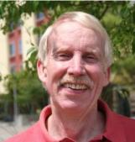
Bob Dickerson Leadership Award
30
And the recipient is…

Slide 31
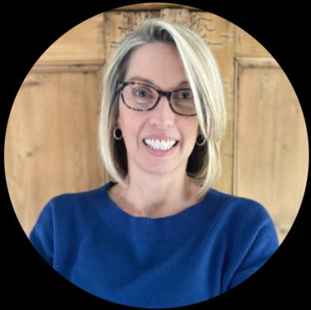
Bob Dickerson Leadership Award
31
Christina Gunther RESULTS Coastal Connecticut
Congratulations, Christina!

Slide 32
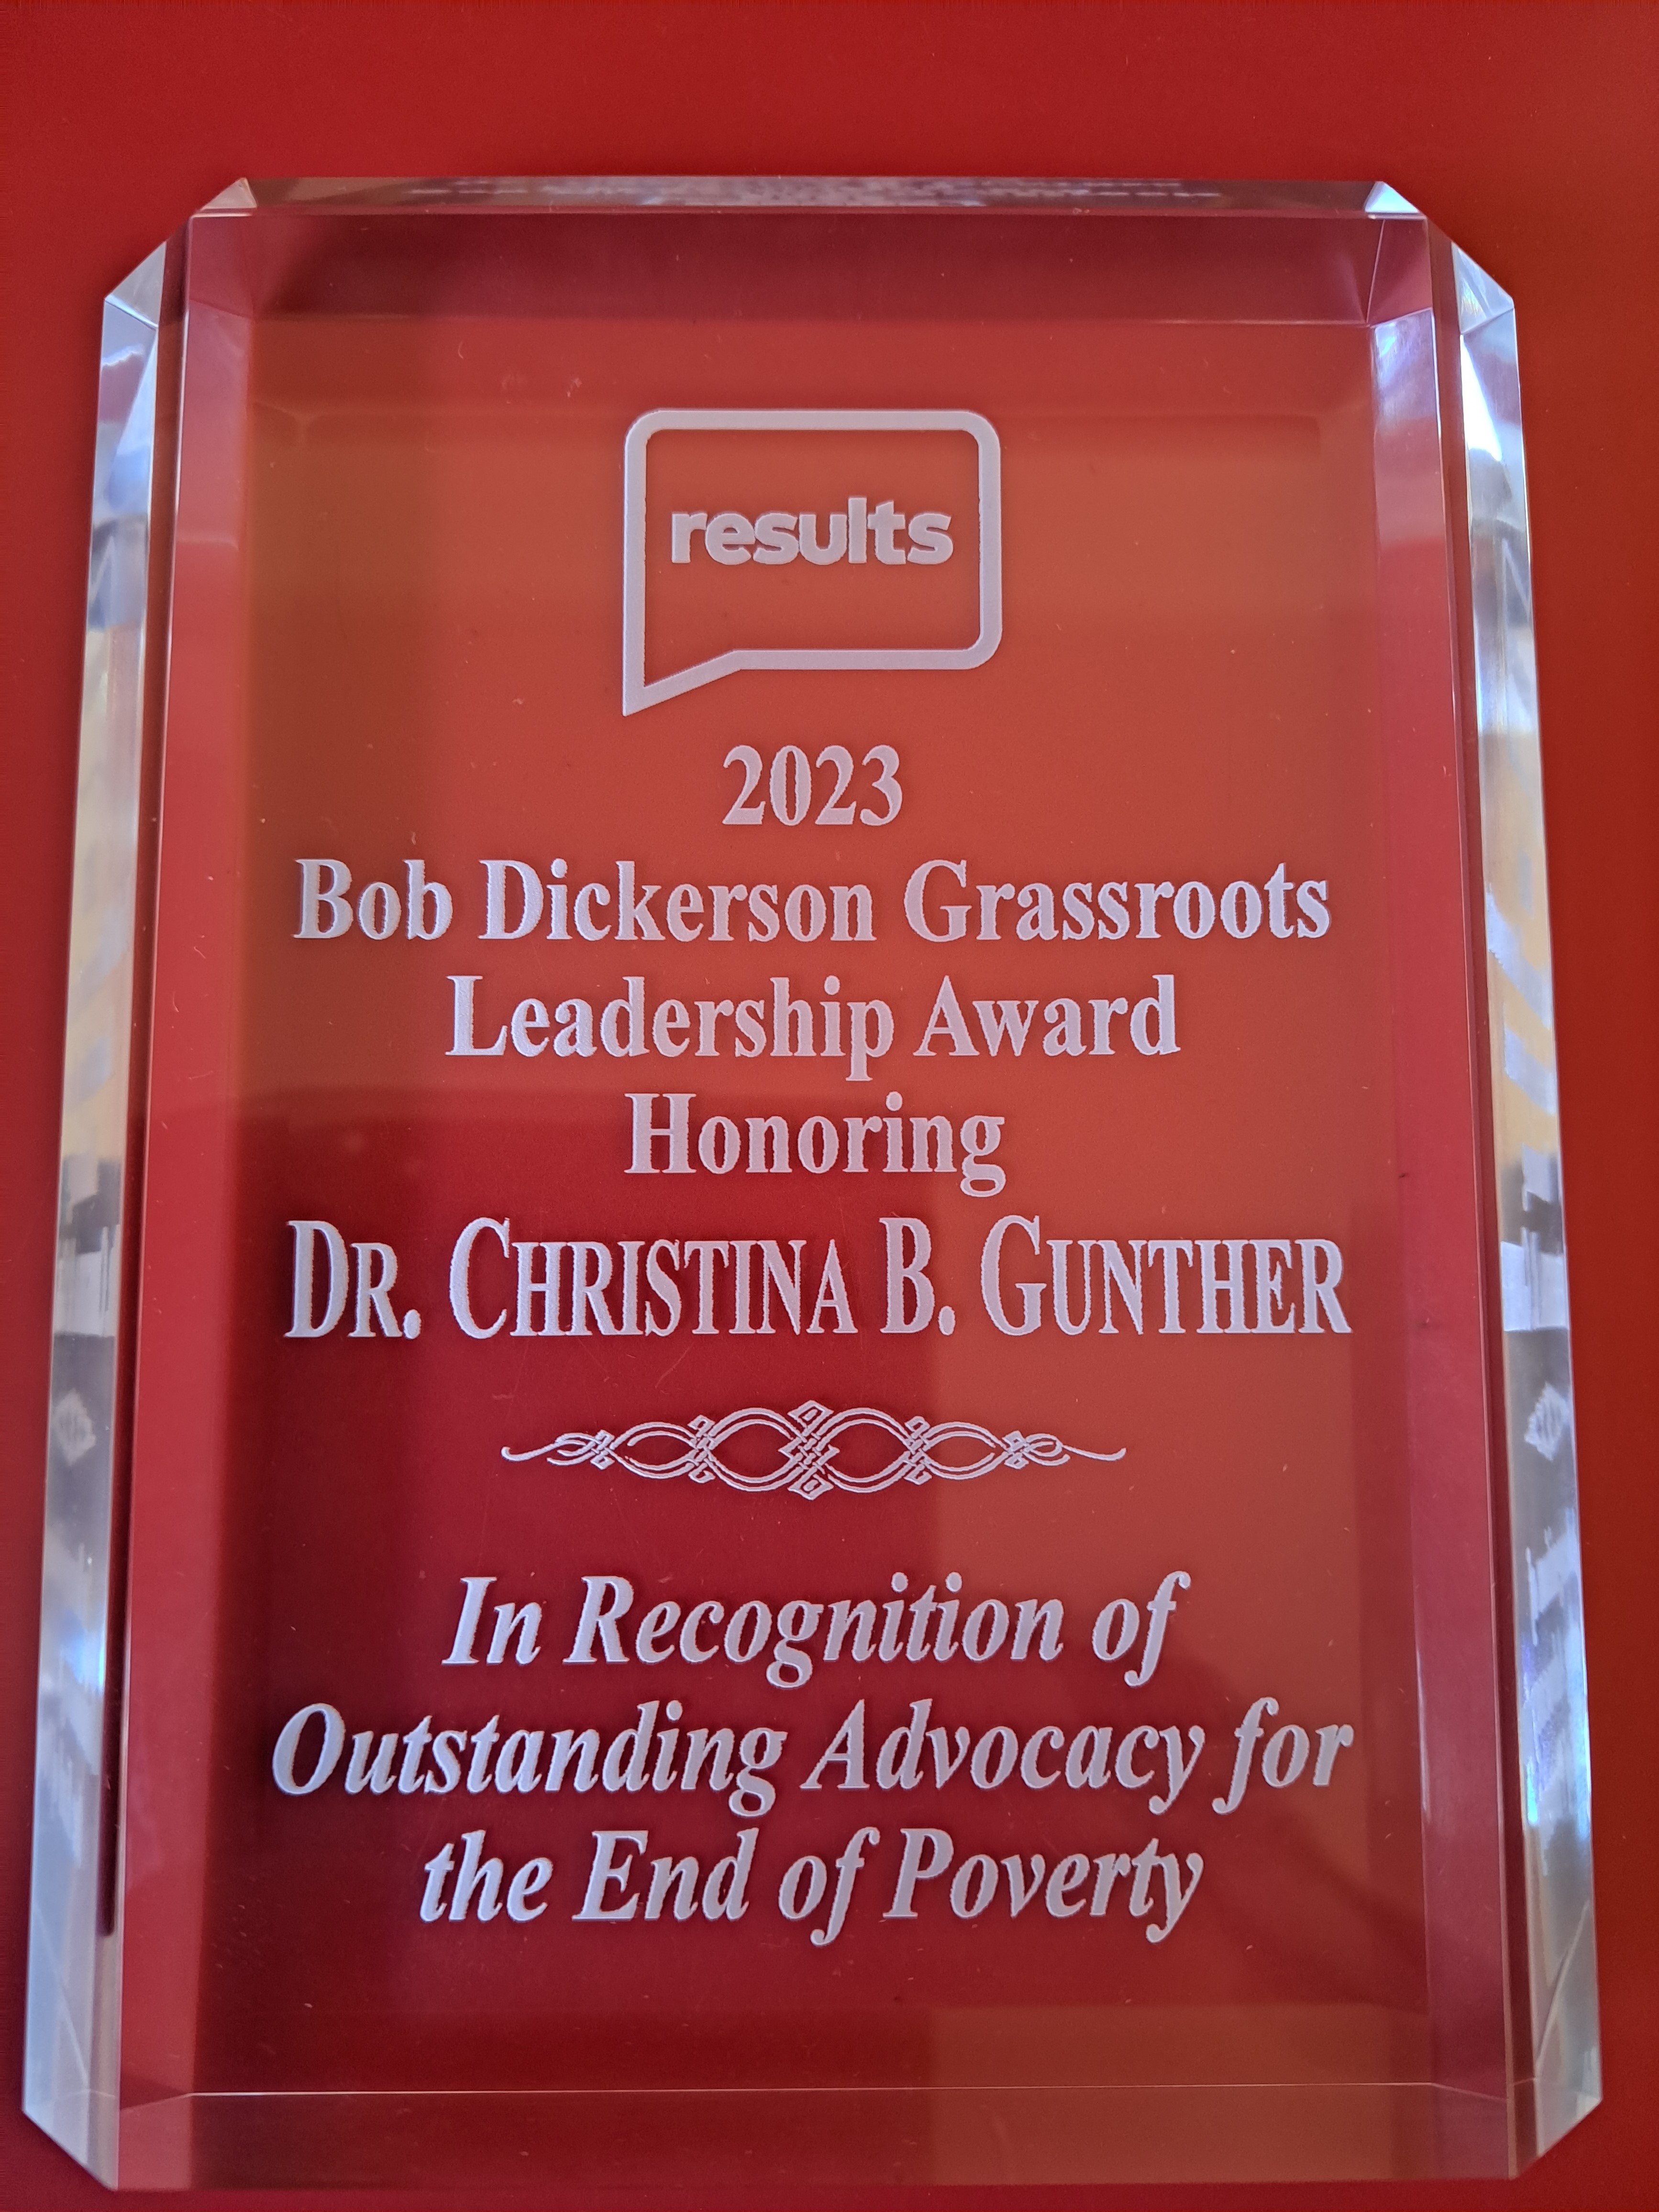
Bob Dickerson Leadership Award
32

Slide 33
Cameron Duncan Media Award
33
And the recipient is…

Slide 34
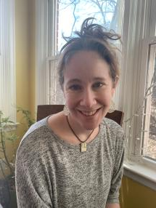
Cameron Duncan Media Award
34
Sarah Miller
RESULTS St. Louis (US Poverty)
Congratulations, Sarah!

Slide 35
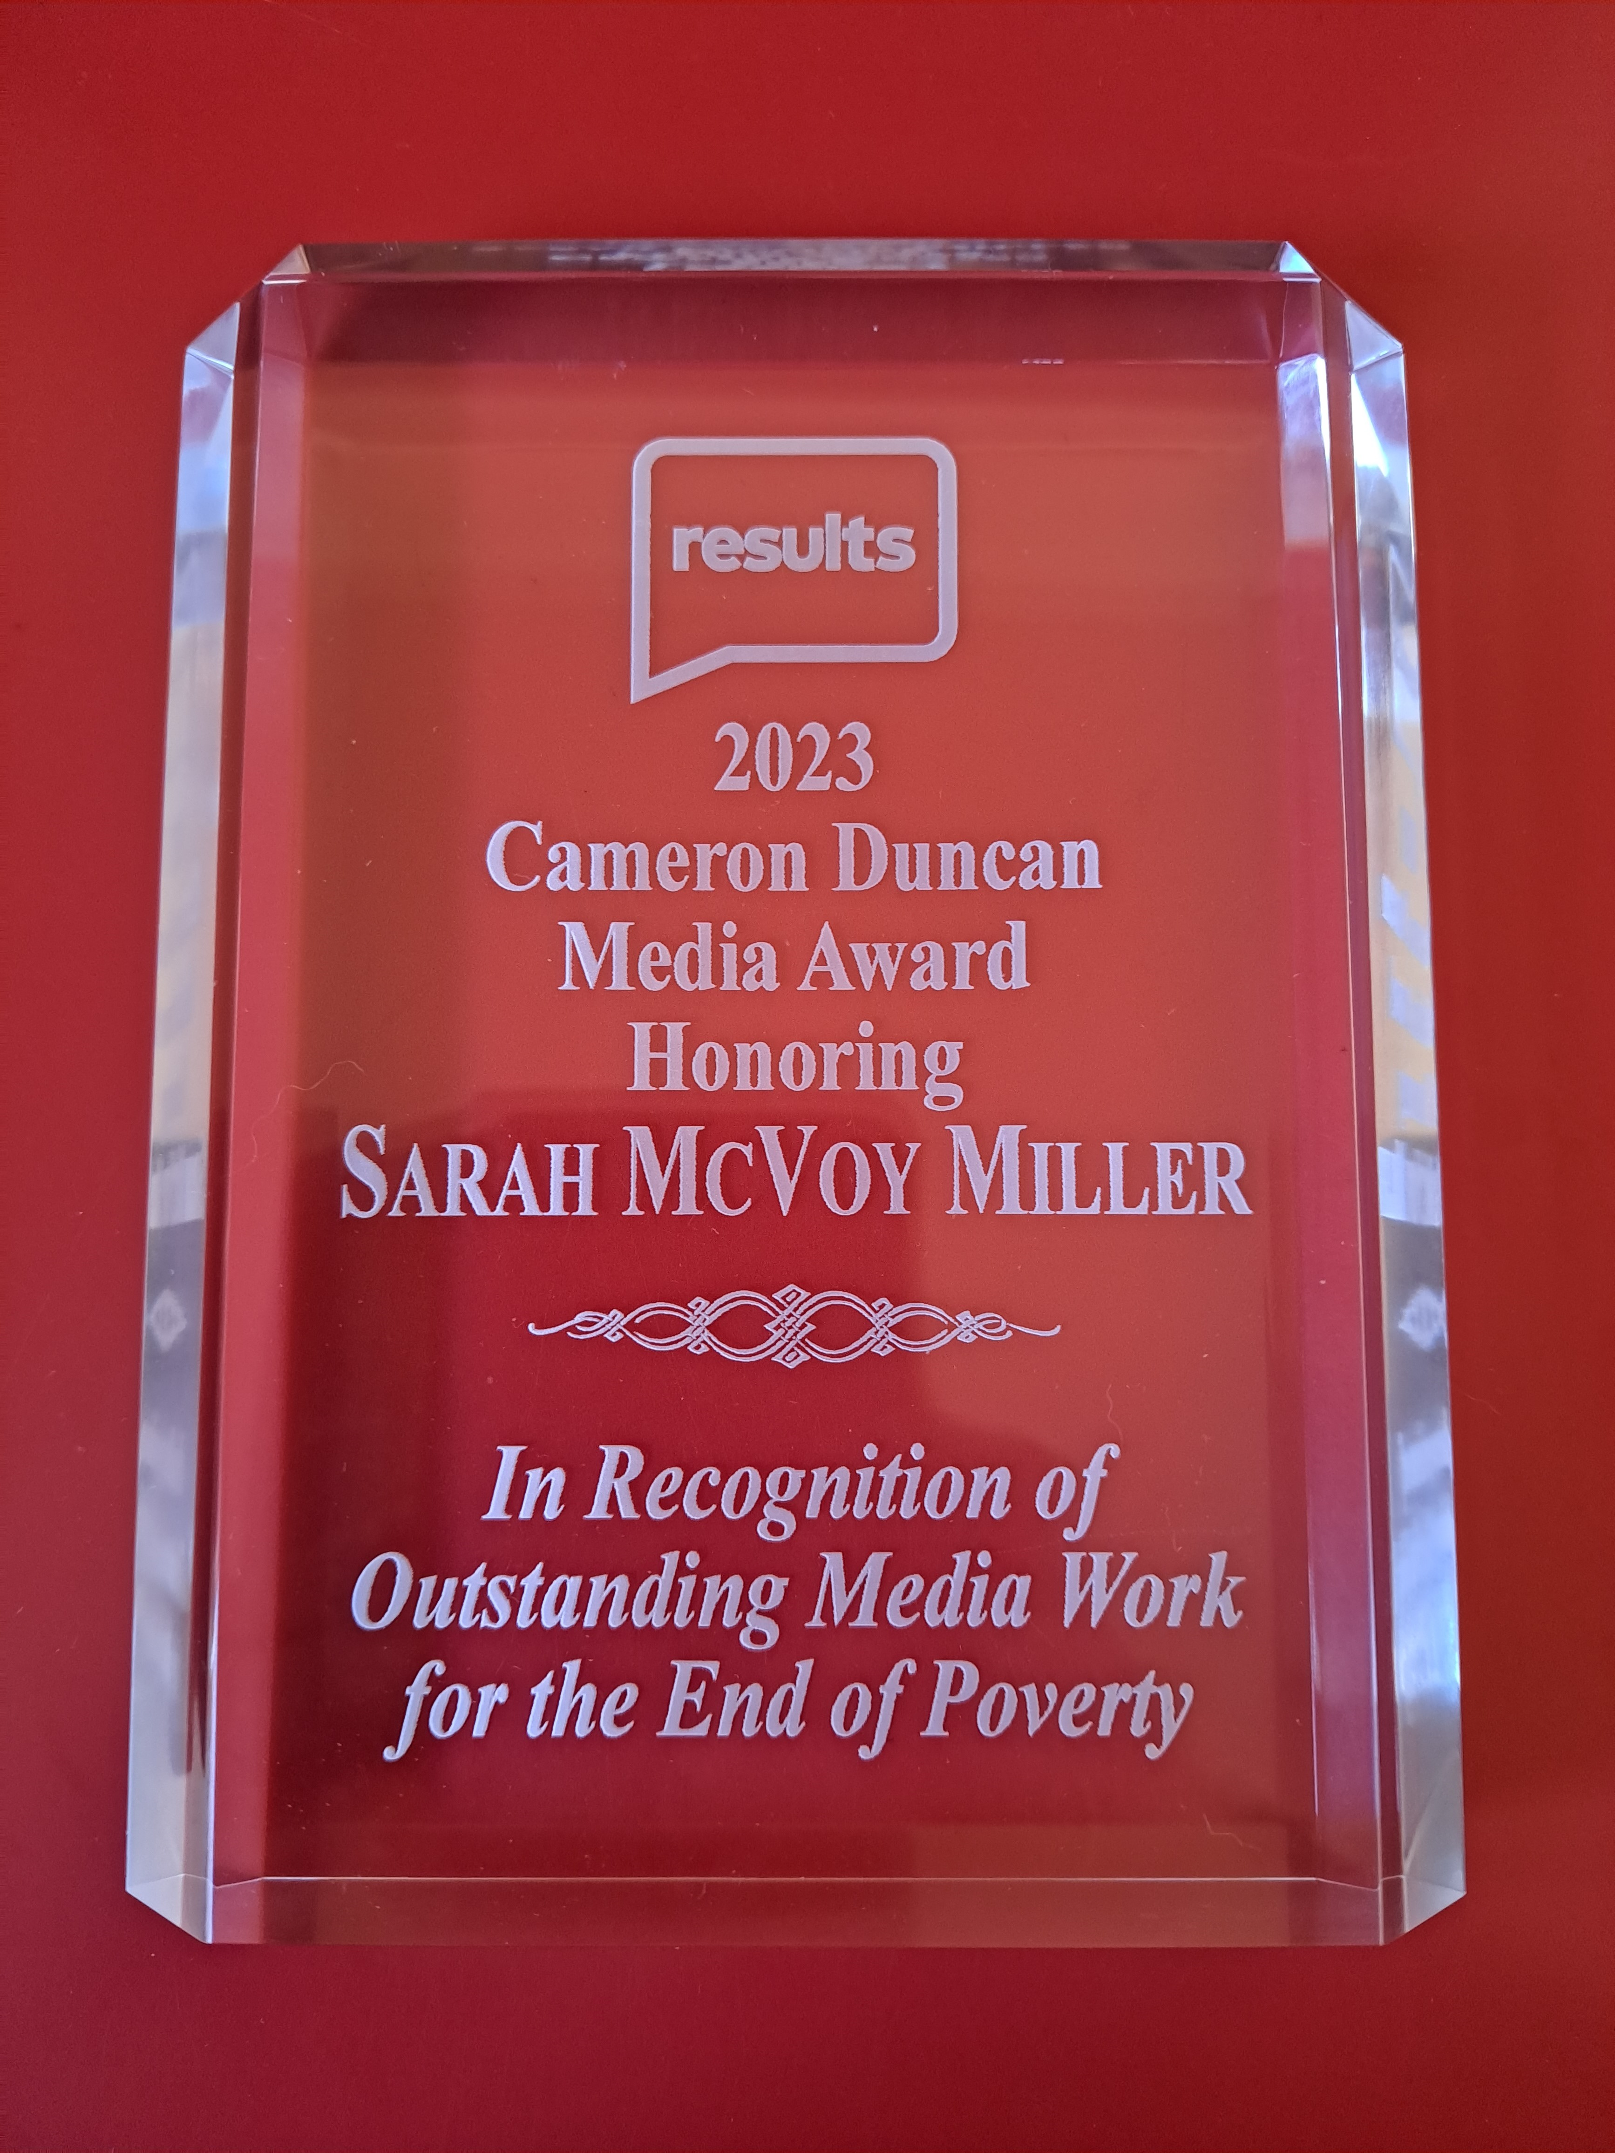
Cameron Duncan Media Award
35

Slide 36
Announcements

Slide 37
Group Planning materials coming!
37
Group Planning will be a major focus in January. 2024 is a huge opportunity for you to engage new people in our advocacy work.
Materials will be available by December 22.
Look for more info about planning in the Weekly Update and on January 2024 National Webinar.

Slide 38
Grassroots Townhall
We invite all volunteers to a Grassroots Town Hall event for a discussion of your year in RESULTS, your celebrations of successes, and acknowledgement of disappointments as we face the year ahead. Come share with us:
One thing that you are the most proud of or excited about involving your RESULTS work this year
Your biggest disappointment or regret from this year
The funniest moment from your RESULTS work this year
Thursday, December 7, 9:00 pm ET
Join directly by clicking this link.

Slide 39
December Policy Forum
Join us for an update on our U.S. and Global Policy campaigns.
Thursday, December 14 at 8:30 pm ET.
Register today!
Beginning in 2024, policy forums will be held on an as-needed basis. They will no longer take place monthly.

Slide 40
Share Your Story!
Complete the form at: https://airtable.com/appfAPsIcTTu2lXMX/shrZN4c5r8IsgVwpH

Slide 41
Celebrate new advocates!
We are delighted to have so many new advocates in our midst who are taking powerful action and making positive waves. If you want to celebrate the actions of a new volunteer, please share about the experience.
Complete the form at:
https://form.jotform.com/RESULTSvolunteer/celebrate

Slide 42
Anti-oppression Applied Learning Simulation
Upon completing all three anti-oppression workshops: Diversity & Inclusion 101, Systemic Racism, and Oppression: The Missing Perspectives, we will deepen the application of our learning through applied learning. Join us for the Tribunal on Residential Segregation and Environmental Racism. Participants will play various roles in analyzing the transformation of legal Jim-Crow segregation into the geographic segregation of affluent white suburbs and impoverished inner-city segregated areas, including the evidence of continuing racial disparities demonstrating that inequality is perpetuated today.
Friday, December 8, 12:00-1:30 pm ET
Register here!

Slide 43
Other Support Calls
Together Women Rise Partnership Webinar
Tuesday, December 12, 8:30 pm ET
Click to learn more.
Media Office Hour
Wednesday, December 13, 2:00 pm ET
Join via Zoom at https://results.zoom.us/j/93668005494 or (312) 626-6799, meeting ID 936 6800 5494. No registration required.
New Advocate Orientation
Wednesday, December 13, 8:30 pm ET
Register today: https://tinyurl.com/NAOSEPT23

Slide 44
Other Support Calls
End-of-Year Action Network Managers Webinars
Wednesday, December 6
Click for the 12:30 session; Click for the 8:00 session
No registration required.
Event Planning and Outreach Office Hours
Thursday, December 14, 2:00 pm ET
Join via Zoom at https://results.zoom.us/j/98524229370 or call (312) 626-6799, Meeting ID: 985 2422 9370. No registration required.

Slide 45
Free Agents Webinars
Global Poverty Free Agents
Monday, December 11, 7:00 pm ET
Contact Lisa Marchal at lmarchal@results.org for information.
U.S. Poverty Free Agents
Tuesday, December 12, 1:00 pm and 8:00 pm ET
Contact Jos Linn at jlinn@results.org for information.

Slide 46
Don't forget to submit your lobby, media, and outreach reports! https://results.org/volunteers/reporting-your-advocacy-actions

Slide 47
January National Webinar Saturday, January 6 at 1:00 pm ET https://tinyurl.com/RESULTS2024 Happy holidays!
See you in the new year!

