Slide 1
RESULTS National Webinar
Who Deserves to Be Poor? Work and Income Requirements as Tools of Oppression
October 14, 2023

Slide 2
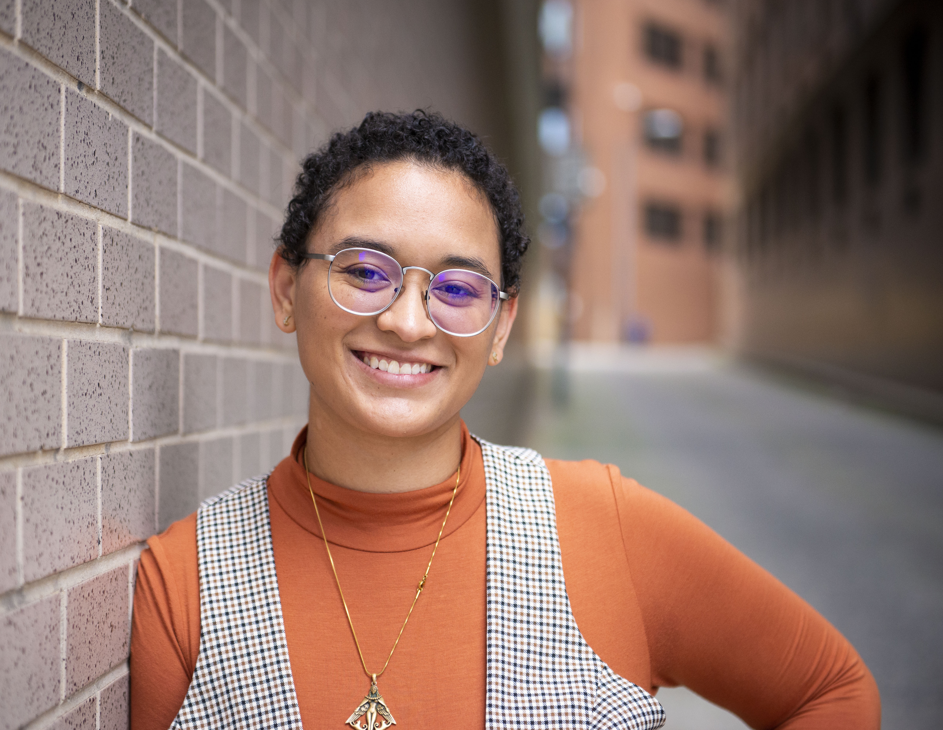
Lakeisha McVey Senior Associate, Experts on Poverty RESULTS Des Moines, IA
Welcome!

Slide 3
Our Values & Resources
3
​At RESULTS we pledge to create space for all voices, including those of us who are currently experiencing poverty. We will address oppressive behavior in our interactions, families, communities, work, and world. Our strength is rooted in our diversity of experiences, not in our assumptions.
With unearned privilege comes the responsibility to act so the burden to educate and change doesn’t fall solely on those experiencing oppression. When we miss the mark on our values, we will acknowledge our mistake, seek forgiveness, learn, and work together as a community to pursue equity.
Read our full anti-oppression values statement here at results.org/values.
Check out the 2023 Fall Anti-Oppression Workshop Schedule for training opportunities.
Find these resources and more at results.org/volunteers/anti-oppression:
Resource Guides from our Diversity & Inclusion trainings, including:
Interrupting Microaggressions
Creating Space for Critical Conversations
Information on how RESULTS responds to oppressive incidents
Notes:
Updated AO slide (2/22)

Slide 4
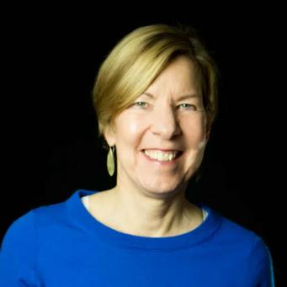
Joanne Carter RESULTS Executive Director
Welcome!

Slide 5
Music Break!

Slide 6
Laser Talk Training Using the E.P.I.C. Format

Slide 7
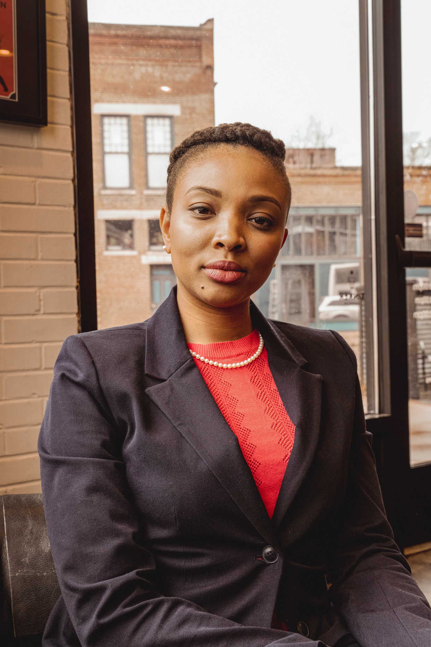
Kazmyn Ramos Expert on Poverty
Indianapolis, IN

Slide 8
Overview
What is a laser talk?
How do you prepare to create one?
Step 1: Know Yourself
Step 2: Know Your Audience
Step 3: Know the Message/Ask
Bringing a laser talk together using the E.P.I.C. format
Q&A

Slide 9
What is a laser talk?
A laser talk is a short, compelling pitch you can use as a starting point to influence someone to take action on an issue.
How/where can you use a laser talk?
Lobby Meetings
Townhalls
To write a letter to the editor (LTE)

Slide 10
How do you prepare for a laser talk?

Slide 11
Step 1: Know Yourself
What is your story?
Why do you volunteer with RESULTS?
Why are you passionate about the issues RESULTS advocates on?

Slide 12
Step 2: Know Your Audience
Who is your member of Congress?
What do you know about them and their values?
What connections exist between you, the issue, and your member?

Slide 13
Step 3: Know Your Message
What issue do you want addressed?
Why is this issue important? Why does it matter?
What are you asking your member of Congress to do about it?

Slide 14
The E.P.I.C. Format
E is for Engage the audience
P is for state the Problem
I is for Inform on the solution
C is for Call to Action

Slide 15
E – Engage
What fact or personal statement will grab your member of Congress's attention?
Example:
The recently released Census Bureau data showed the poverty rate in 2022 was 12.4%, an increase of 4.6% from 2021. This is the first increase in the overall poverty rate since 2010.
Source: Sept 12 Census Bureau Press Release

Slide 16
P – Problem
What is the problem? Why does it matter? How does it impact you or your community?
Example:
Under current income requirements, 19 million children live in homes that do not receive the full benefit of the Child Tax Credit (CTC). Seventeen million of these children have parents with jobs, and they disproportionately come from rural areas.

Slide 17
I – Inform
What is the policy solution?
Example:
When the CTC is paid monthly and the reaches more families, especially those earning the lowest incomes, it helps provide economic stability.

Slide 18
C – Call to Action
Ask a yes or no question. What do you want your member of Congress to do?
Example:
Will you speak to your colleagues on the Ways and Means Committee or Senate Finance Committee about expanding the CTC so that more working families with low incomes receive the full benefit?

Slide 19
Final Laser Talk using the E.P.I.C format
The recently released Census Bureau data showed the poverty rate in 2022 was 12.4%, an increase of 4.6% from 2021. This is the first increase in the overall poverty rate since 2010.
Under current income requirements, 19 million children live in homes that do not receive the full benefit of the Child Tax Credit (CTC). Seventeen million of these children have parents with jobs, and they disproportionately come from rural areas.
When the CTC is paid monthly and the reaches more families, especially those earning the lowest incomes, it helps provide economic stability.
Will you speak to your colleagues on the Ways and Means Committee or Senate Finance Committee about expanding the CTC so that more working families with low incomes receive the full benefit?

Slide 20
Questions?

Slide 21
Resources
Crafting an EPIC Laser Talk Worksheet
Researching your member of Congress
Child Tax Credit (CTC) Leave Behind
Example CTC EPIC Laser Talk
1-Minute Video: How to Create an EPIC Laser Talk

Slide 22
Breakout Rooms
Start drafting your EPIC Laser Talk based on what you heard today and your own experience
Notes:
Worksheet: https://results.org/wp-content/uploads/Crafting-a-Laser-Talk-using-the-EPIC-format.pdf

Slide 23
Let’s hear your EPIC Laser Talks! Any last questions?
Notes:
2 shares, 2 mins each

Slide 24
Next Steps & Announcements

Slide 25
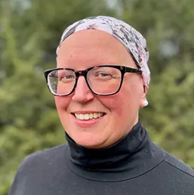
Joanna DiStefano Senior Associate Grassroots Impact

Slide 26
Bringing it all together
How will I use what I've learned today?

Slide 27
Build the Buy In Campaign
250 media pieces from Sept. 1 through the end of the year
At least 1 media piece published in all 50 states
At least 1 media piece published by each RESULTS group and Free Agent

Slide 28
Build the Buy In Campaign cont.
Total media - 70
States with published media - 27
Groups published - 26

Slide 29
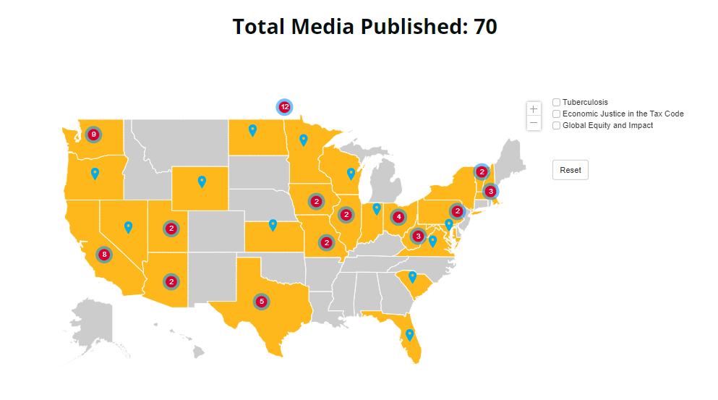
Let’s fill this map!
Notes:
Note: update the map

Slide 30
Build the Buy-In Campaign
RESOURCES
Build the Buy-in page: https://results.org/build-the-buy-in
Media actions: https://results.org/volunteers/action-center/action-alerts
Working with the media: https://results.org/volunteers/media-tools
2023 Grassroots Media Packets: https://results.org/resources/2023-grassroots-media-packets
Report published media: https://results.org/report-media

Slide 31
Living our AO Values
Acknowledge responsibility to act
Commit to being there
Seek out more perspectives and skills
Notes:
Note: update the map

Slide 32
32
Apply for the 2023
Experts on Poverty Cohort
results.org/experts-on-poverty
Deadline is November 30

Slide 33
Experts on Poverty Program Information Session
Hear from program lead, Lakeisha McVey, and a current Expert on Poverty about what the program is all entails and to ask questions.
Tuesday, October 24, 12:00 pm ET
Registration: https://tinyurl.com/oct24infosession
Tuesday, November 7, 8:00 pm ET
Registration: https://tinyurl.com/nov7infosession

Slide 34
RESULTS Grassroots AO Learning Community
Join the AO Learning Community – a discussion group to advance RESULTS’ anti-oppression learning.
Join our next meeting
Friday, October 20, 12:00 PM ET
Register: https://tinyurl.com/AOlearningcommunity

Slide 35
Thank you for joining us!
Who is joining you in the room today?
In the poll, please respond with the number of people in the room with you (including yourself).

Slide 36
Join the next
RESULTS National Webinar
Saturday, November 4 at 1:00 pm ET

Slide 38
Upcoming In-Person Events
Oct 21 – Capital Regional Conference – Winchester, VA
Contact Joanna DiStefano – jdistefano@results.org
Oct 21 – Midwest Regional Conference – St. Louis, MO
Contact Jos Linn – jlinn@results.org
Oct 21 – Western North Carolina Fall Advocacy Social – Hickory, NC
Contact Emily Bird - movewithemily@gmail.com
Dec 2 – Northern California – Oakland, CA
Contact Sarah Izabel - izabelss@alumni.vcu.edu or Sue Oehser - soehser@earthlink.com

Slide 39
In-Person Events Support
Event Planning and Outreach Office Hours
Thursday, November 9, 2:00 pm ET
Thursday, December 14, 2:00 pm ET
Join via Zoom at https://results.zoom.us/j/98524229370 or call (312) 626-6799, Meeting ID: 985 2422 9370. No registration required.
Or message Joanna DiStefano (jdistefano@results.org) to set up a time to talk through your plans.

Slide 40
Free Agents Webinars
U.S. Poverty Free Agents
Tuesday, October 17, 1:00 pm ET and 8:00 pm ET (your choice)
Contact Jos Linn at jlinn@results.org for information.
Global Poverty Free Agents
Monday, October 23, 7:00 pm ET
Contact Lisa Marchal at lmarchal@results.org for information.

Slide 41
Partner Organization Webinars
Together Women Rise partnership webinar
Tuesday, October 17, 8:30 pm ET
Join at https://tinyurl.com/TWRRP
Global Allies Program: Partners Ending Poverty
with Returned Peace Corps Volunteers
Thursday, November 9, 8:30 pm ET
Register at https://tinyurl.com/GAPSummer23

Slide 42
Other Support Calls
Action Network Managers Webinar
Wednesday, October 18, 12:30 pm and 8:00 pm ET
Click for the 12:30 session; Click for the 8:00 session
No registration required.

Slide 43
Group Leader Training Series
Are you a current (or even aspiring) RESULTS Group Leader? You are welcome to this four-part learning series to be held on four successive weeks starting October 18, from 8:00-10:00 pm ET.
Based on a series of trainings held 2015-2018, these interactive sessions will get you in touch with fellow Group Leaders, offer encouraging information about leadership itself, give you practical tools for leading your RESULTS group, and provide some fun.
Register today! Questions? Contact Lisa Marchal.

Slide 44
October Policy Forums
Thursday, October 19
U.S. Policy Forum, 8:00 pm ET
Focus:
Register: https://tinyurl.com/USPFSEPT23
Global Policy Forum, 9:00 pm ET
Focus:
Register: https://tinyurl.com/GPFSEPT23

Slide 45
RESULTS Merchandise Shop
RESULTS Merchandise Shop linked at the bottom of every page
results.threadless.com
Reach out to communications@results.org with any questions

