Slide 1
The RESULTS Global Policy Forum
October 19, 2023
Welcome!

Slide 2
Our Values & Resources
2
​At RESULTS we pledge to create space for all voices, including those of us who are currently experiencing poverty. We will address oppressive behavior in our interactions, families, communities, work, and world. Our strength is rooted in our diversity of experiences, not in our assumptions.
With unearned privilege comes the responsibility to act so the burden to educate and change doesn’t fall solely on those experiencing oppression. When we miss the mark on our values, we will acknowledge our mistake, seek forgiveness, learn, and work together as a community to pursue equity.
Read our full anti-oppression values statement here at results.org/values.
Check out the 2023 Fall Anti-Oppression Workshop Schedule for training opportunities.
Find these resources and more at results.org/volunteers/anti-oppression:
Resource Guides from our Diversity & Inclusion trainings, including:
Interrupting Microaggressions
Creating Space for Critical Conversations
Information on how RESULTS responds to oppressive incidents

Slide 3
Global Legislation Overview

Slide 4
Legislation Status- End of 2022
Bill | Cosponsors (House) | Committee (House) | Passed (House) | Cosponsors (Senate) | Committee (Senate) | Passed (Senate) | Signed into law
TB | 46 | X |  | 7 | X
Education | 55 | X | X | 10 | X
Nutrition | 103 | X | X | 20 | X | X | X

Slide 5
RESULTS appropriations advocacy issues
OUR ISSUES
Ending the tuberculosis epidemic
Ending preventable maternal and child deaths
Ensuring access to quality education for
all children

Slide 6
Legislation Status- Current
Bill | Cosponsors (House) | Committee (House) | Passed (House) | Cosponsors (Senate) | Committee (Senate) | Passed (Senate) | Signed into law
TB | 64 | X |  | 4 | X
Education | 41 |  |  | 7 | X

Slide 7
7
Equity & Impact in Global Anti-Poverty Programs
Goal: All bills, signed into law, requiring equity & impact in the fight against global poverty
Nutrition
Education
Tuberculosis
APPROPRIATIONS ???

Slide 8
Global Education

Slide 9
Access to education suffered in COVID
School closures continue to disrupt the education of more than 616 million students.
The longer vulnerable children are out of school, the less likely they are to return, and the World Bank estimates that this generation of students will lose $17 trillion in lifetime earnings.

Slide 10
Why Education?
Education can end cycles of poverty by increasing future wages, preventing child marriages, and reducing infant mortality.
COVID has severely disrupted children's access to quality education around the world.
Girls, low-income children, and children with disabilities face the greatest barriers to education.

Slide 11
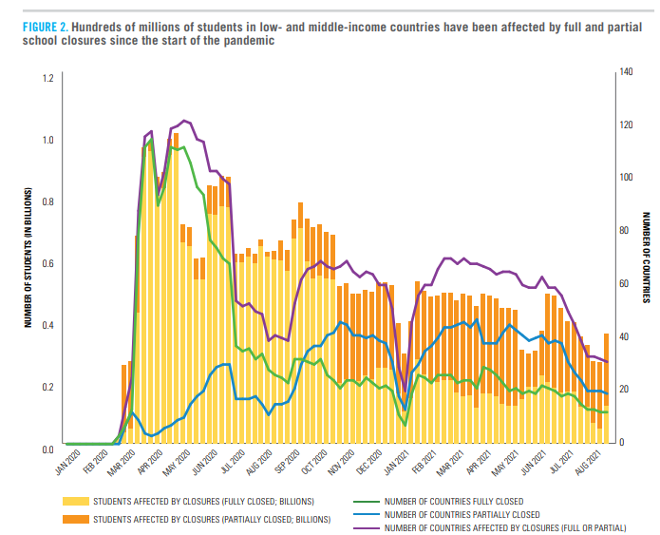
Global Impact
11
In low- and middle-income countries, up to 70% of 10-year-olds are unable to read a simple text.
Around 200 million youth ages 12-17 are out of school, and 80% of children in low-income countries lack access to preschool.
Source: "The State of the Global Education Crisis" by UNESCO, UNICEF, and the World Bank
Notes:
Key for conversations: make it real, share how you have used the CTC, how your family or community has been impacted, and share some of the important data on the impact of the CTC.
Talking points:
1. The CTC is so effective helping families make ends meet – and we have studies show how families use their CTC – which includes housing. This CBPP analysis of U.S. Census Bureau’s Household Pulse Survey collected between July and September 2021 focuses specifically on how lower-income families used the CTC -- families used the CTC for housing, food, clothing, and utilities — and education.
https://www.cbpp.org/blog/rising-food-and-energy-prices-underscore-the-urgency-of-acting-on-the-child-tax-credit
Related: A new study from the Brookings Institution shows that the CTC monthly payments dramatically reduced child poverty, fostered healthier eating, and allowed parents to invest in their children’s education. Also, a steady supplement to their monthly income helped families avoid high-interest payday loans for financial help. As the study confirms, families spent their CTC payments on rent, food, and clothes for their kids.
2. At a time when federal rental assistance is not universally available to all those who need it and instead only reaches one in four eligible households, the CTC played a role for some families as another form of rental assistance – and this is a big deal to help families weather high costs due to inflation.
3. This loss of monthly CTC payments and full refundability comes at the worst possible time – when families are facing higher costs from inflation. Moody’s Analytics says the average household is spending an extra $327 per month due to inflation, with a steep rise in rents fueling it. The 2021 CTC monthly payments averaged $444 per month per household. The math is simple; if you want to help families with higher costs, extend the CTC.
4. Meanwhile it is important to note that the CTC does not cause inflation – and is a key tool for families feeling the pressure of rising costs. In April, more than 130 economists wrote that, “the expanded Child Tax Credit is one of the easiest, most effective, and direct tools currently at our disposal to help families deal with the impact of inflation on family budgets.” There is no evidence that the increased CTC in 2021 contributed to rising costs. As noted by CBPP, the expanded CTC would contribute “little or no inflationary pressure”, and two former Treasury Secretaries made a similar point in a May 2 New York Times op-ed. When a politician says that inflation is hurting families, the response should be, “Then why haven’t you extended the Child Tax Credit payments?”
5. Finally, we know that many of you have heard from policymakers that they would like an earnings requirement linked to the CTC. We urge you to share why you think investing in dramatic reductions in child poverty should be the goal, and that you are focused on reducing hardship for children regardless of their parents’ work history. You could share that 1.4 million CTC households have left their jobs since the payments stopped, primarily because they can no longer afford childcare. Now, as inflation bears down, families are facing greater obstacles to making ends meet.
INTERACTIVE: what is something you’ve shared about why you think the CTC is important in your media, outreach, or advocacy meetings? Or, what is something you plan to emphasize in your Advocacy Month meetings?

Slide 12
READ Act Reauthorization Act (H.R.681/S.41)
Reauthorizes the 2017 READ Act for an additional 5 years.
Continues and updates our comprehensive strategy to promote basic education and support students, especially girls.
Ensures education for children affected by conflict and other emergencies.
Improves coordination between U.S. agencies, partner countries, and civil society organizations like the Global Partnership for Education.
Requires rigorous monitoring and evaluations and a yearly report to Congress.

Slide 13
Global Tuberculosis

Slide 14
Why TB?
Tuberculosis sickens over 10 million people every year, and the highest burden disproportionately impacts low-income countries and communities.
Too often, TB hits family bread-winners, knocking them out of the workforce in the prime of their lives, pushing vulnerable populations into further poverty.
During the COVID pandemic the fight against TB lost progress and resources. Reallocating resources for the COVID pandemic led to an estimated 1 million fewer people receiving TB diagnoses and treatment.
Failing to act now will lead to an additional 43 million cases and 6.6 million deaths by 2030, according to the Stop TB Partnership.

Slide 15
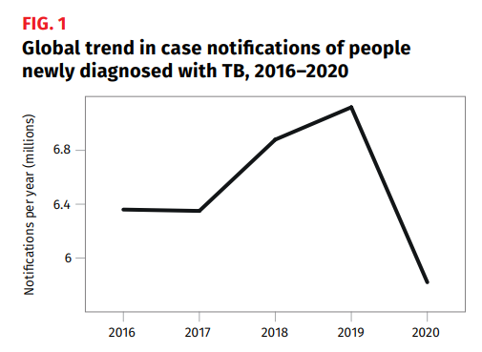
Tuberculosis in 2020
WHO confirmed the first increase in TB deaths in over a decade.
Over 10 million people fell ill and 1.5 million people lost their lives.
Source: World Health Organization 2021 Global Tuberculosis Report

Slide 16
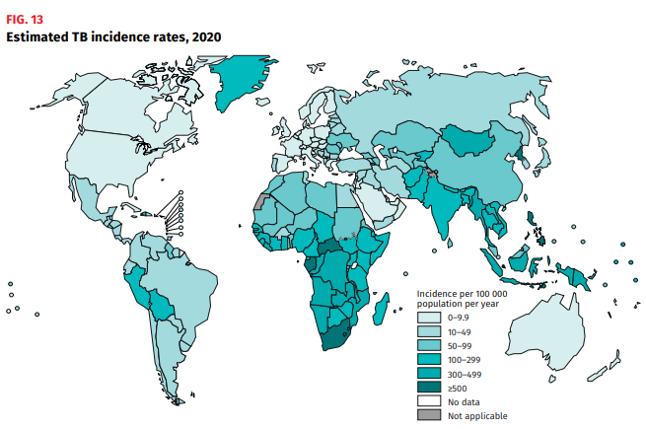
Global Impact
16
In many low- and middle-income countries, TB is still the leading infectious disease killer.
Over 95 percent of TB cases and deaths are in low-income countries.
Source: World Health Organization 2021 Global Tuberculosis Report
Notes:
Key for conversations: make it real, share how you have used the CTC, how your family or community has been impacted, and share some of the important data on the impact of the CTC.
Talking points:
1. The CTC is so effective helping families make ends meet – and we have studies show how families use their CTC – which includes housing. This CBPP analysis of U.S. Census Bureau’s Household Pulse Survey collected between July and September 2021 focuses specifically on how lower-income families used the CTC -- families used the CTC for housing, food, clothing, and utilities — and education.
https://www.cbpp.org/blog/rising-food-and-energy-prices-underscore-the-urgency-of-acting-on-the-child-tax-credit
Related: A new study from the Brookings Institution shows that the CTC monthly payments dramatically reduced child poverty, fostered healthier eating, and allowed parents to invest in their children’s education. Also, a steady supplement to their monthly income helped families avoid high-interest payday loans for financial help. As the study confirms, families spent their CTC payments on rent, food, and clothes for their kids.
2. At a time when federal rental assistance is not universally available to all those who need it and instead only reaches one in four eligible households, the CTC played a role for some families as another form of rental assistance – and this is a big deal to help families weather high costs due to inflation.
3. This loss of monthly CTC payments and full refundability comes at the worst possible time – when families are facing higher costs from inflation. Moody’s Analytics says the average household is spending an extra $327 per month due to inflation, with a steep rise in rents fueling it. The 2021 CTC monthly payments averaged $444 per month per household. The math is simple; if you want to help families with higher costs, extend the CTC.
4. Meanwhile it is important to note that the CTC does not cause inflation – and is a key tool for families feeling the pressure of rising costs. In April, more than 130 economists wrote that, “the expanded Child Tax Credit is one of the easiest, most effective, and direct tools currently at our disposal to help families deal with the impact of inflation on family budgets.” There is no evidence that the increased CTC in 2021 contributed to rising costs. As noted by CBPP, the expanded CTC would contribute “little or no inflationary pressure”, and two former Treasury Secretaries made a similar point in a May 2 New York Times op-ed. When a politician says that inflation is hurting families, the response should be, “Then why haven’t you extended the Child Tax Credit payments?”
5. Finally, we know that many of you have heard from policymakers that they would like an earnings requirement linked to the CTC. We urge you to share why you think investing in dramatic reductions in child poverty should be the goal, and that you are focused on reducing hardship for children regardless of their parents’ work history. You could share that 1.4 million CTC households have left their jobs since the payments stopped, primarily because they can no longer afford childcare. Now, as inflation bears down, families are facing greater obstacles to making ends meet.
INTERACTIVE: what is something you’ve shared about why you think the CTC is important in your media, outreach, or advocacy meetings? Or, what is something you plan to emphasize in your Advocacy Month meetings?

Slide 17
End TB Now Act (H.R.1776/S.288)
Directs USAID to set bold targets to reach vulnerable populations and detect, cure, and prevent TB.
Improves coordination with global organizations, including the Global Fund, to develop and implement a global TB response.
Catalyzes support for research and development of new tools to prevent, diagnose, and treat TB, including drug-resistant strains.
Requires annual reporting to Congress that evaluates the effectiveness and impact of TB programs.

Slide 19
Looking Ahead
Overall goals: Improve the effectiveness, equity, and impact of U.S. programs for global health and education.
PASS THESE BILLS!
Tuberculosis: Pass full House and Senate
Education: Pass House committee and full Senate

