Slide 1
RESULTS National Webinar
September 9, 2023
Welcome!

Slide 2
Our Values & Resources
2
​At RESULTS we pledge to create space for all voices, including those of us who are currently experiencing poverty. We will address oppressive behavior in our interactions, families, communities, work, and world. Our strength is rooted in our diversity of experiences, not in our assumptions.
With unearned privilege comes the responsibility to act so the burden to educate and change doesn’t fall solely on those experiencing oppression. When we miss the mark on our values, we will acknowledge our mistake, seek forgiveness, learn, and work together as a community to pursue equity.
Read our full anti-oppression values statement here at results.org/values.
Find these resources and more at results.org/volunteers/anti-oppression:
Resource Guides from our Diversity & Inclusion trainings, including:
Interrupting Microaggressions
Creating Space for Critical Conversations
Information on how RESULTS responds to oppressive incidents
Notes:
Updated AO slide (2/22)

Slide 3
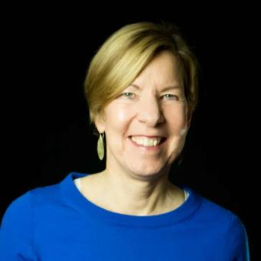
Joanne Carter RESULTS Executive Director
Welcome!

Slide 4
RESULTS U.S. Policy Work

Slide 5
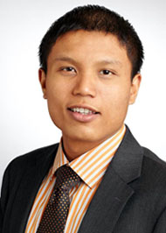
Michael Santos Associate Director, RESULTS U.S. Poverty Policy msantos@results.org

Slide 6
Background
Congress is back from recess!
Possible tax package in the horizon
CTC work = greater fairness on tax code
Work on economic justice continues
October National Webinar on work requirements

Slide 7
Background
Congress is back from recess!
Possible tax package in the horizon
CTC work = greater fairness on tax code
Work on economic justice continues
October National Webinar on work requirements

Slide 8
Background
Congress is back from recess!
Possible tax package in the horizon
CTC work = greater fairness on tax code
Work on economic justice continues
October National Webinar on work requirements

Slide 9
Background
Congress is back from recess!
Possible tax package in the horizon
CTC work = greater fairness on tax code
Work on economic justice continues
October National Webinar on work requirements

Slide 10
Background
Congress is back from recess!
Possible tax package in the horizon
CTC work = greater fairness on tax code
Work on economic justice continues
October National Webinar on work requirements

Slide 11
CTC Request
Ask your members of Congress to:
Will you urge your colleagues on the House Ways and Means Committee or Senate Finance Committee to expand the full benefit of the Child Tax Credit (CTC) to as many families as possible, prioritizing those with low incomes?
See our new CTC leave-behind at: https://results.org/wp-content/uploads/2023-CTC-Request-Summer-and-Fall-MEGA-RESOURCE.pdf

Slide 12
RESULTS Global Policy Work

Slide 13
Great Work!!
Over 50 meetings so far during congressional recess!
33 senators signed the TB sign-on letter to the Administration!
Signers: Brown, Young, Markey, Feinstein, Coons, Tillis, Klobuchar, Cantwell, Murray, Kaine, Booker, Padilla, Reed, Warren, Rosen, Duckworth, Cardin, Van Hollen, Casey, Capito, Hickenlooper, Manchin, Shaheen, Whitehouse, Lujan, Hirono, Merkley, Sanders, Warner, Menendez, Peters, Blumenthal, Murkowski.

Slide 14
Global policy
Our Fall Goal
Congress prioritizes equity and impact in the fight against global poverty

Slide 15
Equity & Impact
Who does it reach? Who gets left out?
Are we working in partnership?
How is funding delivered?
Are interventions based on evidence?

Slide 16
Part 1
How the U.S. government spends money and designs programs
Part 2
How the World Bank spends money and designs programs

Slide 17
Program Design
Malnutrition Prevention & Treatment Act
The End Tuberculosis Now Act
The READ Act

Slide 18
Asks on TB Right Now
Ask Reps and Senators to cosponsor the End TB Now Act and speak to House/Senate leadership about passing it ASAP.
Tip: Leverage your work on the House and Senate TB sign-on letters:
Share final letter and thank those who signed. Ask them to cosponsor End TB Now Act and speak to leadership.
Share final letter with those who didn't sign as well and let them know they can still make a difference on TB by cosponsoring the End TB Now Act.

Slide 19
Asks on READ Act Right Now
READ in the House: Ask Reps. to cosponsor the READ Act and speak to Foreign Affairs leadership (McCaul, Meeks) about moving the bill out of committee ASAP.
READ in the Senate: Ask Senators to cosponsor READ Act and speak to Senate leadership about passing it ASAP.
Global Education & READ Act Opportunity: Invite Reps., Senators, staff to International Literacy Day event on 9/13

Slide 20
Grassroots Café

Slide 21
Build the Buy-In Campaign
results.org/build-the-buy-in

Slide 22
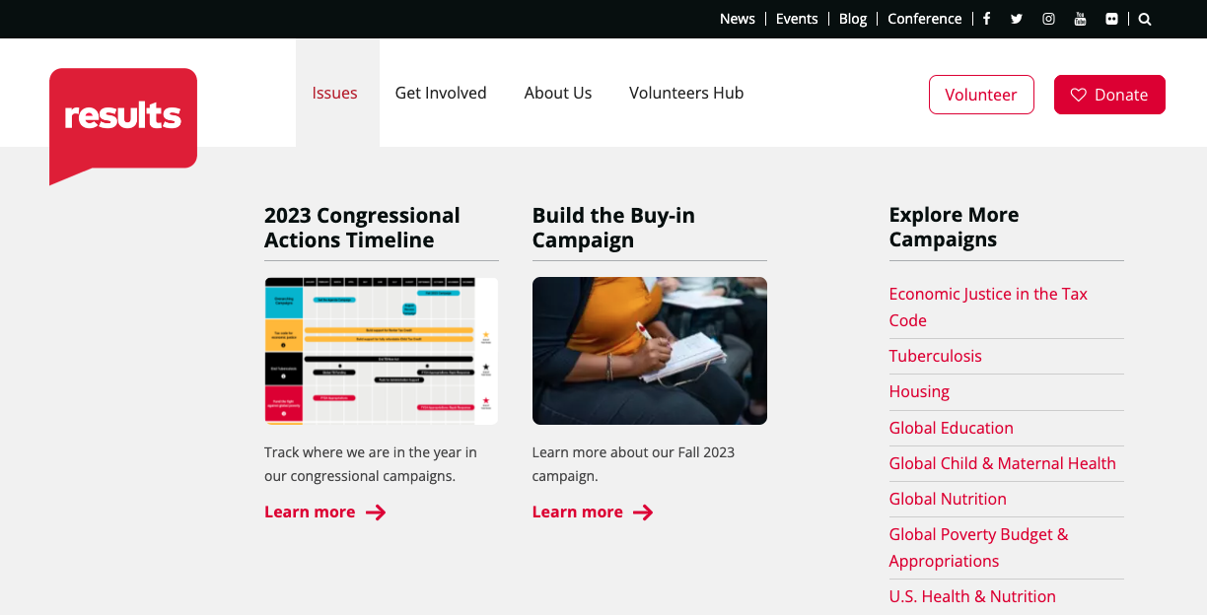
Build the Buy-In Campaign
results.org/build-the-buy-in

Slide 23
Build the Buy-In Campaign
STRONG MEDIA PUSH
250 media pieces by the end of the year (starting Sep. 1)
At least 1 media piece published in all 50 states
At least 1 media piece published by each RESULTS group and Free Agent

Slide 24
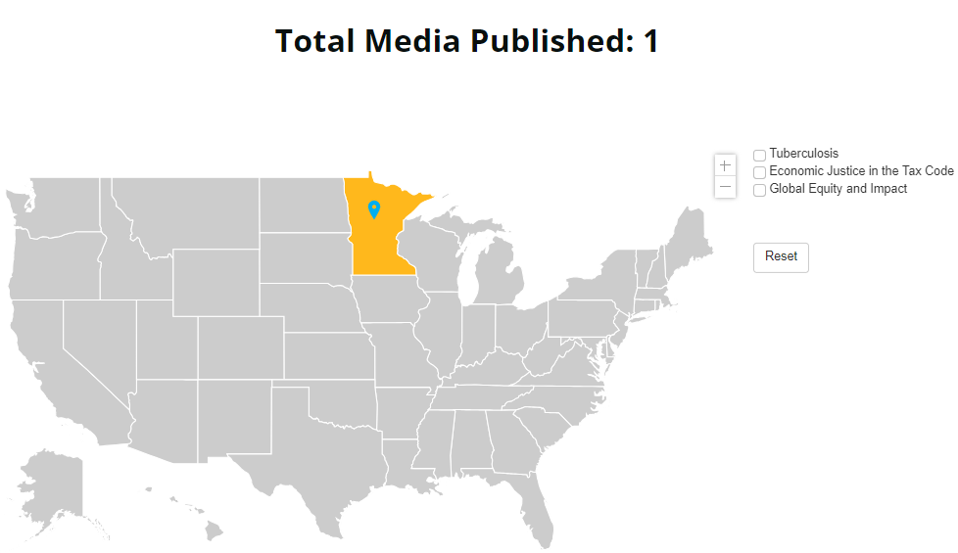
Let’s fill this map!

Slide 25
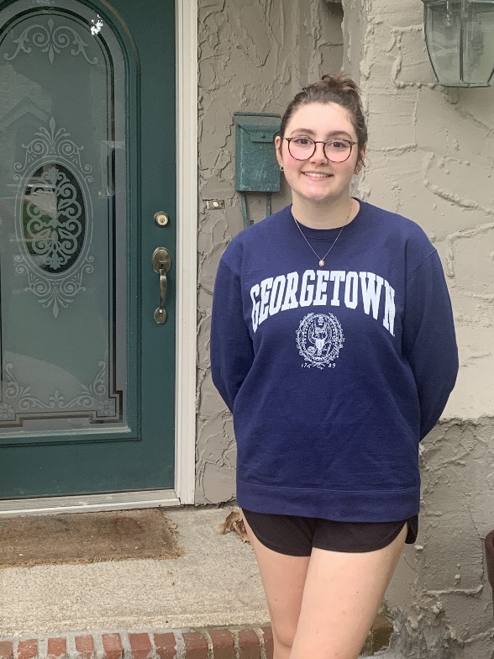
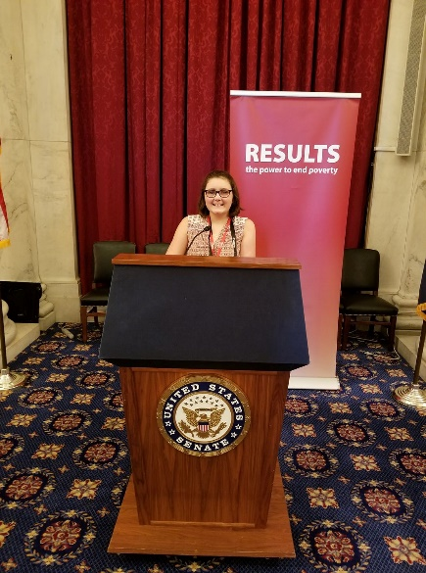
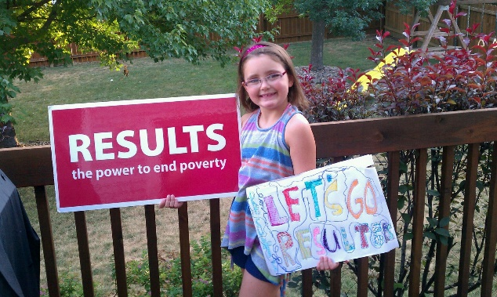
Grassroots Share
Stella Linn
RESULTS Kansas City

Slide 26
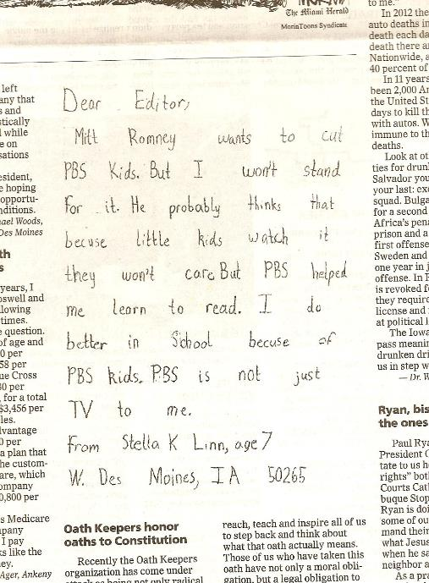
Grassroots Share
October 9, 2012
The Des Moines Register

Slide 27
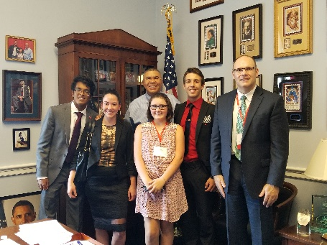
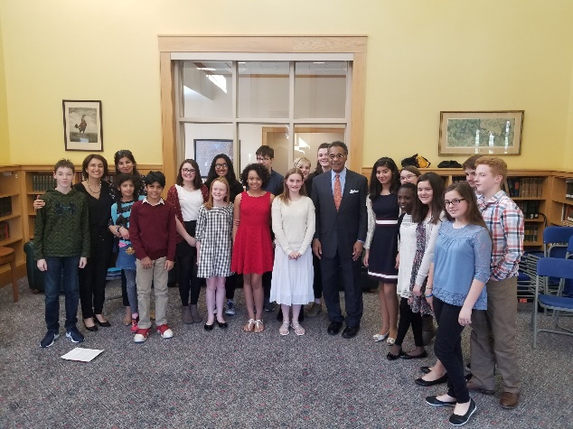
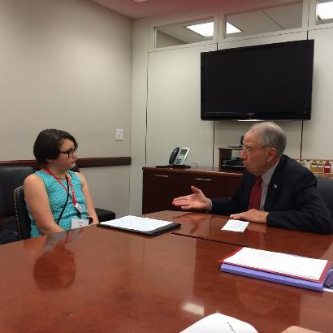
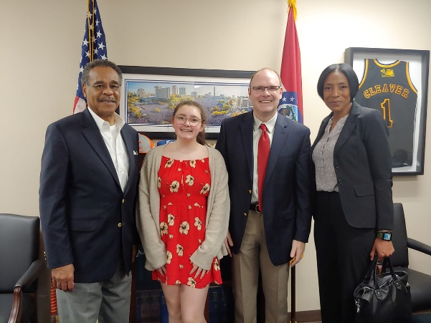
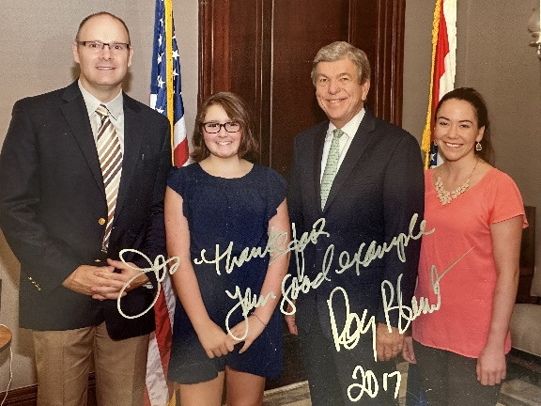
Grassroots Share

Slide 28
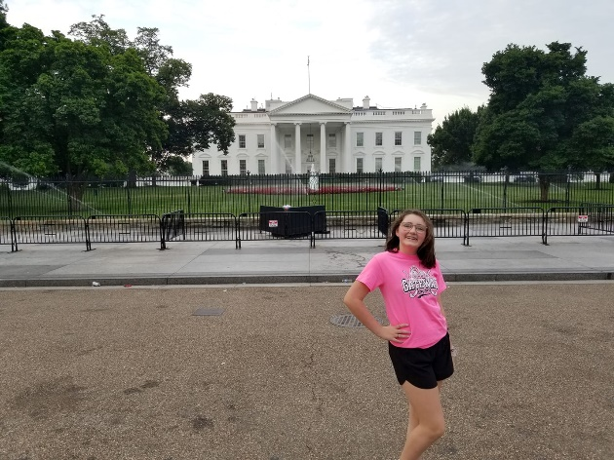
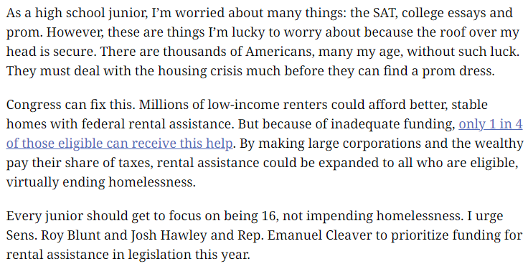
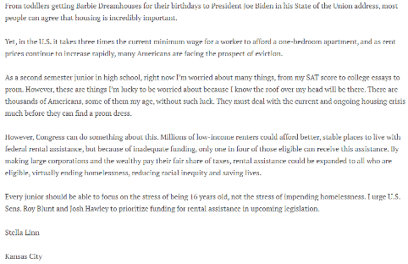
Grassroots Share

Slide 29
How we succeed!
250 media pieces by the end of the year (starting Sep. 1)
Submit media pieces regularly, not just one and done
At least 1 media piece published in all 50 states
Ask people to people in other states to submit media and help them do it
At least 1 media piece published by each RESULTS group
Each person in your group submits one or more pieces per month between now and the end of the year

Slide 30
Build the Buy-In Campaign
RESOURCES
Build the Buy-in page: https://results.org/build-the-buy-in
Media actions: https://results.org/volunteers/action-center/action-alerts
Working with the media: https://results.org/volunteers/media-tools
2023 Grassroots Media Packets: https://results.org/resources/2023-grassroots-media-packets
Report published media: https://results.org/report-media

Slide 31
Share Your Story!

Slide 32
We want to hear from YOU!
What is your story? What is your “why”?
We all have a reason why we are passionate about ending poverty, a reason why we joined RESULTS or an advocacy experience that we are proud of and keeps us motivated.
We want to hear what drives you to advocacy and what it feels like to take action. Your voice matters.
Your story matters.

Slide 33
Let's watch!

Slide 34
How to submit your story?
Visit Results.org/share-your-story to submit your story now!

Slide 35
Don't forget to turn in your lobby, media, and outreach reports!

Slide 36
Announcements

Slide 37
Fall Friends and Family fundraising campaign Visit results.org/donate/fundraise to access our fundraising guide and create your online fundraising page

Slide 38
Fall Friends and Family fundraising campaign Fundraising resources on our blog: results.org/blog
Nervous about fundraising? Tips from RESULTS volunteers
"Ask the people who know you well. My donors trust me and respect me because they know I work hard as a RESULTS volunteer. Reciprocal respect and love are the foundation of the way I raise money.
- Beth Wilson, RESULTS group leader, regional coordinator, former grassroots fundraising coordinator and former grassroots board member.
https://results.org/blog/nervous-about-fundraising-tips-from-results-volunteers
This fall, step out to support RESULTS
"I share my story because fundraising for RESULTS both brings in critical financial support and can be a great way to introduce people to our mission to end poverty. By showing up, telling our stories, and inviting friends, colleagues, and family to give, we are offering them the opportunity to join us in making a real impact in the world."
-Lesley Reed, Director of Donor Communications and RESULTS volunteer
https://results.org/blog/this-fall-step-out-to-support-results

Slide 39
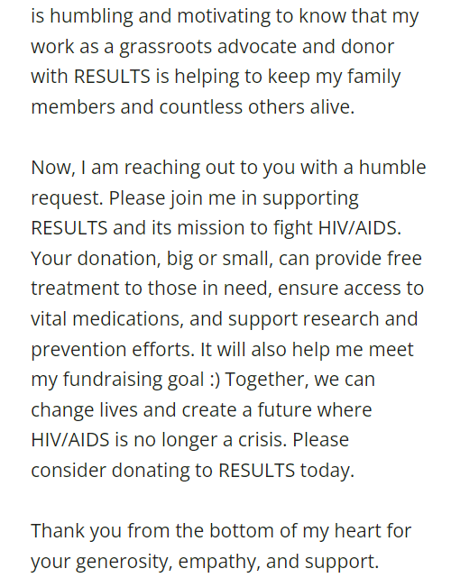
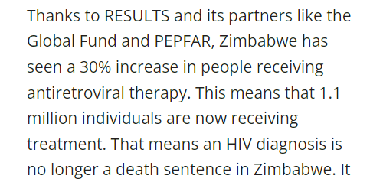
Fall Friends and Family fundraising campaign

Slide 40
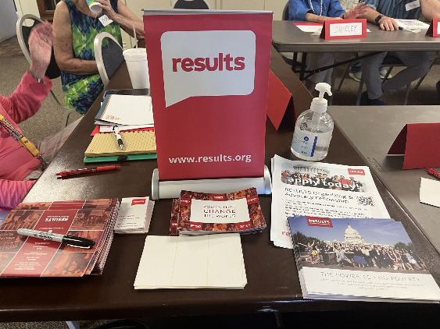
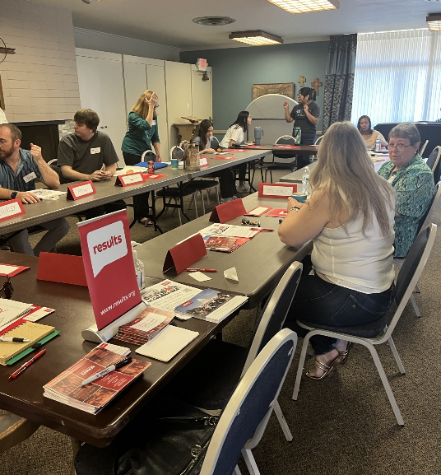
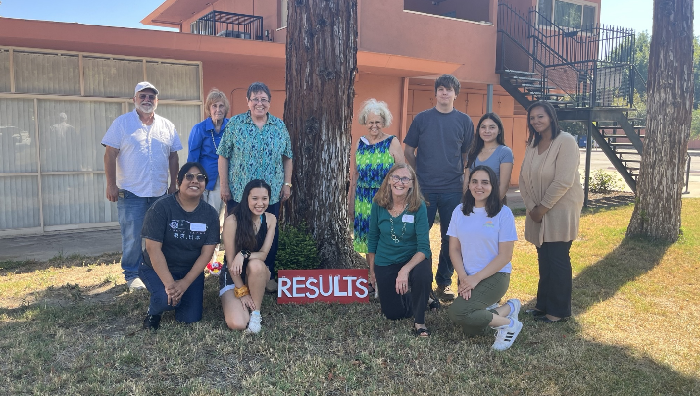
In-Person Events
Southern California
Regional Conference
August 12
San Bernardino, CA

Slide 41
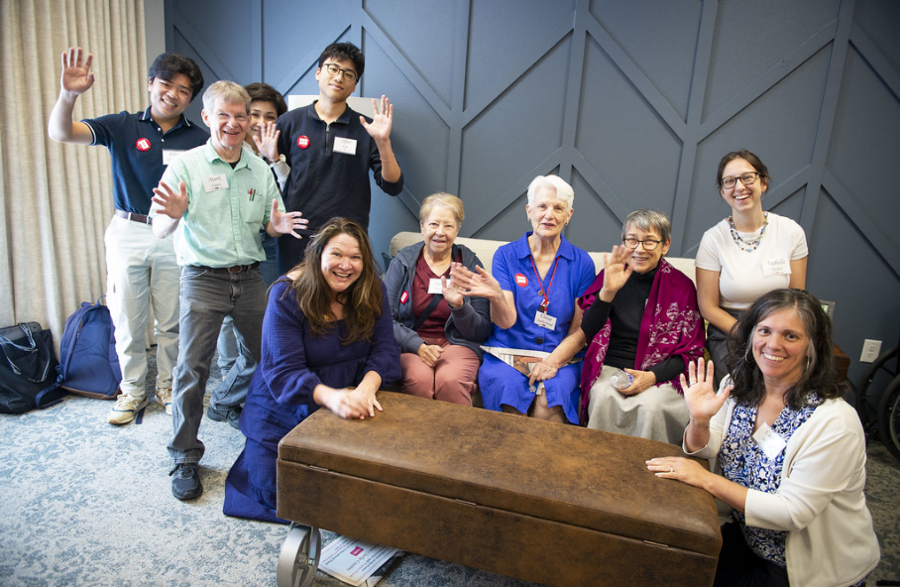
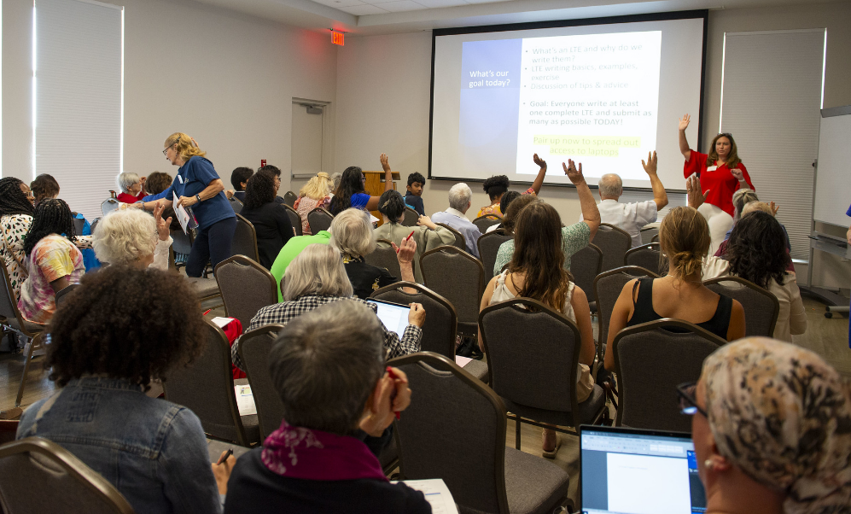
In-Person Events
Texas-Oklahoma
Regional Conference
August 19, Austin, TX

Slide 42
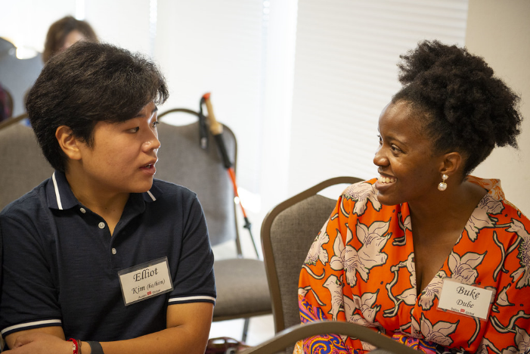
In-Person Events Grassroots Share
Buke Dube, RESULTS Dallas Global

Slide 43
Upcoming In-Person Events
Sept 30 – Indiana Statewide Conference – Indianapolis, IN
Contact Kazmyn Ramos - kjp0402@gmail.com
Oct 21 – Capital Regional Conference – Winchester, VA
Contact Joanna DiStefano – jdistefano@results.org
Oct 21 – Midwest Regional Conference – St. Louis, MO
Contact Jos Linn – jlinn@results.org
Oct 21 – Western North Carolina Fall Advocacy Social – Hickory, NC
Contact Emily Bird - movewithemily@gmail.com
Dec 2 – Northern California – Oakland, CA
Contact Sarah Izabel - izabelss@alumni.vcu.edu or Sue Oehser - soehser@earthlink.com

Slide 44
In-Person Events Support
Event Planning and Outreach Office Hours
Thursday, September 14, 2:00 pm ET
Thursday, October 12, 2:00 pm ET
Thursday, November 9, 2:00 pm ET
Thursday, December 14, 2:00 pm ET
Join via Zoom at https://results.zoom.us/j/98524229370 or call (312) 626-6799, Meeting ID: 985 2422 9370. No registration required.
Or message Joanna DiStefano (jdistefano@results.org) to set up a time to talk through your plans.

Slide 45
Join us for a special October National Webinar:
Who deserves to be poor?
Work & income requirements as tools of oppression
Saturday, October 14, 12:00-3:00 pm ET ​
Featured panel speakers, moderated by Michael Santos
Peggy Bailey, Center for Budget and Policy Priorities
Aaron Carrillo, RESULTS Grassroots Board
Elisa Minoff, Center for the Study of Social Policy
2. EPIC Laser Talk training on the Child Tax Credit
Facilitated by Kazmyn Ramos, RESULTS Expert on Poverty
Learn how to make the case for an expanded Child Tax Credit

Slide 46
Diversity and Inclusion 101
Learn about implicit bias and microaggressions and gain an understanding of systemic racism and oppression.
Friday, September 29, 12:00 pm ET
(90 minutes)
Registration: https://results.org/events/2023-09-29/

Slide 47
Group Leader Training Series
Are you a current (or even aspiring) RESULTS Group Leader? You are welcome to this four-part learning series to be held on four successive weeks starting October 18, from 8:00-10:00 pm ET.
Based on a series of trainings held 2015-2018, these interactive sessions will get you in touch with fellow Group Leaders, offer encouraging information about leadership itself, give you practical tools for leading your RESULTS group, and provide some fun.
Register today! Questions? Contact Lisa Marchal.

Slide 48
Partner Organization Webinars
Global Allies Program: Partners Ending Poverty
with Returned Peace Corps Volunteers
Thursday, September 14, 8:30 pm ET
Register at https://tinyurl.com/GAPSummer23
Together Women Rise partnership webinar
Tuesday, September 19, 8:30 pm ET
Join at https://tinyurl.com/TWRRP

Slide 49
September Policy Forums
Thursday, September 21
U.S. Policy Forum, 8:00 pm ET
Focus: 2022 U.S. Census Poverty Data review with Meredith Dodson of the Coalition on Human Needs
Register: https://tinyurl.com/USPFSEPT23
Global Policy Forum, 9:00 pm ET
Focus: News on the eve of the UN High-Level Meeting on tuberculosis
Register: https://tinyurl.com/GPFSEPT23

Slide 50
Free Agents Webinars
U.S. Poverty Free Agents
Tuesday, September 19, 1:00 pm ET and 8:00 pm ET (your choice)
Contact Jos Linn at jlinn@results.org for information.
Global Poverty Free Agents
Monday, September 25, 7:00 pm ET
Contact Lisa Marchal at lmarchal@results.org for information.

Slide 51
Other Support Calls
Event Planning and Outreach Office Hours
September 14th, 2:00 pm ET
Join via Zoom at https://results.zoom.us/j/98524229370 or call (312) 626-6799, Meeting ID: 985 2422 9370. No registration required.
Action Network Managers Webinar
Wednesday, September 20, 12:30 pm and 8:00 pm ET
Click for the 12:30 session; Click for the 8:00 session
No registration required.

Slide 52
Other Support Calls
Media Office Hour
Wednesday, September 20, 2:00 pm ET
Join via Zoom at https://results.zoom.us/j/93668005494 or (312) 626-6799, meeting ID 936 6800 5494. No registration required.
New Advocate Orientations
Thursday, September 14 (12:30 pm ET)
Or Wednesday, September 27 (8:30 pm ET)
Register today: https://tinyurl.com/NAOSEPT23

Slide 53
Thank you for joining us!
Who is joining you in the room today?
In the poll, please respond with the number of people in the room with you (including yourself).

