Slide 1
RESULTS Policy Forum – U.S. Poverty
September 21, 2023

Slide 2
Welcome!
2
David Plasterer Senior Policy Associate U.S. Poverty Policy dplasterer@results.org
Notes:
Housekeeping rules
Process vs. Substantive Policy
We will discuss the overall legislative advocacy process and how our U.S. poverty policy priorities (Child Tax Credit + Renter Tax Credit) fit within that process. The goal is to provide you with more context to aid in your upcoming meetings with members of Congress and to strategize on how you can work with your members throughout the year.
Hopefully the topics we cover this evening will help you understand how the Policy team thinks through the legislative strategy and the underlying substantive policy. The goal is to help you follow along why we do certain things, in certain ways, at certain times of the year.

Slide 3
Guest Speaker Meredith Dodson
3
Senior Director of Public Policy Coalition on Human Needs Mdodson@chn.org
Notes:
Housekeeping rules
Process vs. Substantive Policy
We will discuss the overall legislative advocacy process and how our U.S. poverty policy priorities (Child Tax Credit + Renter Tax Credit) fit within that process. The goal is to provide you with more context to aid in your upcoming meetings with members of Congress and to strategize on how you can work with your members throughout the year.
Hopefully the topics we cover this evening will help you understand how the Policy team thinks through the legislative strategy and the underlying substantive policy. The goal is to help you follow along why we do certain things, in certain ways, at certain times of the year.

Slide 4
How to Reduce Poverty:
4
Using New Data to Show that Poverty is a Policy Choice
September 21, 2023
Notes:
Topline: expiration of expanded CTC was devastating, 3 mil kids/poverty more than doubled (5 total) – this is a policy choice. And YOU all can make an impact – story to tell in your media, with policymakers.

Slide 5
Data on Poverty and Hardship
5
September 12: Census Current Population Survey: Income, Poverty, Health Insurance for 2022 – Official and Supplemental Poverty Measures
September 14: American Community Survey 1-year estimates for areas with populations over 65,000
Census Household Pulse Data – food, housing, other hardships, tracked from April 2020 – August 2023 so far (state and metro area data available) –new data released September 20. Upcoming release dates: October 11, and November 8, 2023.
USDA Household Food Security in the United States in 2022 will be released on October 25, 2023
Notes:
Big thing: ACS data doesn’t show impact of CTC and other policies – only the SPM

Slide 6
Official Poverty Measure thresholds for 2022:
6
Obviously, these levels do not adequately capture the true costs of meeting basic needs – especially in areas with high costs of living.
Size of Family Unit | Estimated Threshold
1 person (unrelated individual) | $14,891
Under 65 years | $15,225
65 years and over | $14,036
2 people | $18,932
Householder under 65 | $19,690
Householder 65 years and over | $17,712
3 people | $23,284
4 people | $29,960
5 people | $35,495
6 people | $40,135

Slide 7
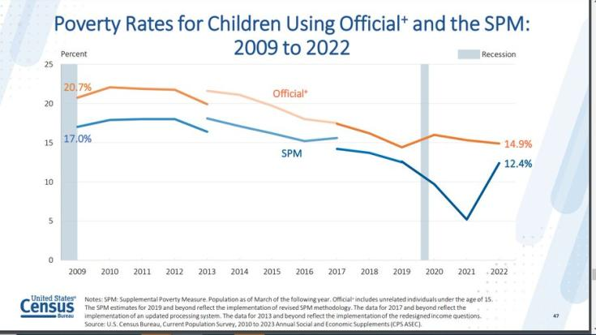
The Child Tax Credit, stimulus payments, UI, and other pandemic assistance caused child poverty to plummet in 2021. All of this ended in 2021 – and child poverty rose in 2022, using the SPM.
7

Slide 8
The SPM answers questions about how effective certain programs are in reducing poverty.
8
Without SS income, 28.9 mil more people would have been poor
Without refundable tax credits, 6.4 mil more people would have been poor
Without SNAP and school lunch, 5.1 mil more people would have been poor
Without the Child Tax Credit, 2.4 mil more people would have been poor (was 5.3 million in 2021)
Notes:
The EITC and CTC are still making an impact but about 3 mil would have been lifted out of poverty if the expanded CTC was still in place in 2022.

Slide 9
First Focus: Overall Takeaways
9
Child poverty more than doubled in 2022, largely due to the expiration of improvements to the Child Tax Credit
12.4% of children (nearly 9 million) were living in poverty in 2022 compared with 5.2% (nearly 4 million) in 2021
Children experienced a bigger increase in poverty than for other age groups
Evidence from 2021 confirms that we know what works to reduce child poverty when we have the political will to act, so it is critical that we extend improvements to the Child Tax Credit and take other actions to stop our backtracking on progress.
Notes:
5 mil children into poverty overall (stimulus, UI…) – 3 mil from CTC

Slide 10
Addressing Disparities
10
The racial poverty gap had narrowed for children in 2021 but disparities have widened once again
Black (18.3 percent), Hispanic (19.5 percent), American Indian and Alaskan Native (25.9 percent) and Asian (9.9 percent) compared to white children (7.2 percent)
In 2021, improvements to the Child Tax Credit alone prevented nearly 3 million children alone from falling below the poverty line, compared with 1.4 million in 2022

Slide 11
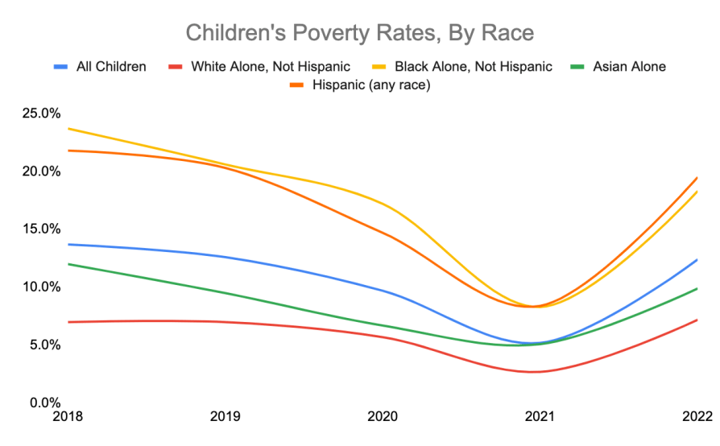
11

Slide 12
Telling a more current story.
12
Columbia U’s Center on Poverty and Social Policy, monthly poverty tracking: https://www.povertycenter.columbia.edu/forecasting-monthly-poverty-data (from Jan. 2020 through May 2023 so far)
Census Bureau’s Household Pulse surveys – started April 2020, ongoing through August 2023 with new data released 9/20, 10/11, and 11/8. https://www.census.gov/programs-surveys/household-pulse-survey.html
covers hardship, not poverty: having enough to eat, afford rent or other bills, employment, health, education, child care, Child Tax Credit
has state and metro area data as well as national

Slide 13
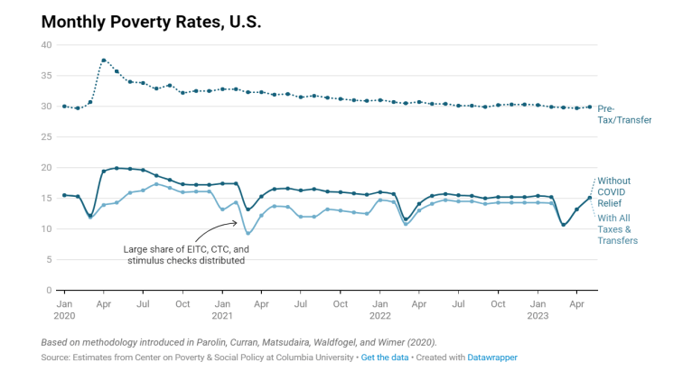
Columbia Center on Poverty and Social Policy Monthly Poverty Estimates
13

Slide 14
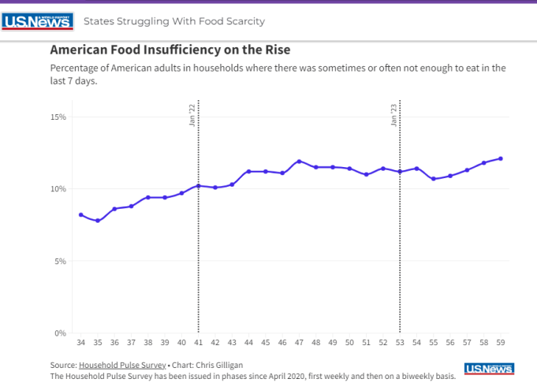
Food “Insufficiency” via the Census Household Pulse Survey, July 2021 to July 2023
14
Notes:
Food insufficiency via the Census Household Pulse Survey, July 2021 to July 2023. https://www.usnews.com/news/best-states/articles/states-with-the-highest-food-insufficiency-rates

Slide 15
Household Pulse: many more reported sometimes/often without enough to eat in past 7 days after loss of pandemic benefits, compared to 2 years ago, when CTC and other benefits (including higher SNAP aid) were still in place.
15
 | 7/21/21 – 8/16/21 averaged | 6/28/23 – 8/7/23 averaged
Total | 8.0% | 12.1%
Hispanic/Latino (of any race) | 12.5% | 16.5%
White alone, not Hispanic | 5.7% | 9.4%
Black alone, not Hispanic | 15.6% | 21.3%
Asian alone, not Hispanic | 3.8% | 6.2%
2 or more races/other, not Hispanic | 14.7% | 18.9%
Children in household | 9.9% | 15.0%
No children in household | 7.0% | 10.4%

Slide 16
Use the data to make your case.
16
Bring back the expanded Child Tax Credit!
The Supplemental Poverty Measure makes the case for reviving the CTC.
Your media – along with direct contact and follow up with policymakers and their staff – can ensure there is momentum to expand the CTC in any tax package that moves this year.
Conversations are happening NOW on what a potential year-end tax package looks like (so send off your media once published ASAP).
Notes:
MD wax poetically on how important RESULTS media work is. STOP Slides here, take questions.

Slide 17
Other ways to use the data – funding human needs.
17
UPDATE: What’s happening in Congress now.
Can tell Congress: support investments in programs like WIC, Head Start, child care, education, housing, etc. as Congress debates annual funding levels.
The American Community Survey has state and local data to illustrate need – such as households spending more than half their income on rent (needed: more rent subsidies!); many young children have all parents in the labor force (needed: more child care!).
Household Pulse has state and metro area findings about households w/children without enough to eat (needed: adequate WIC funding! Protect SNAP!)
Notes:
Proposed cuts (MD verbal)
What’s happening
Protect SNAP!
You can also use the SPM, Columbia monthly figures and Household Pulse’s data about too little food to argue that all proposals to cut or time-limit SNAP or reduce benefits must be rejected; instead, we need improvements like ending the ban on ex-felons and covering Puerto Rico in SNAP.

Slide 18
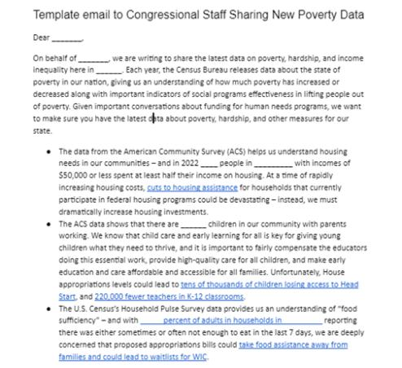
Resources for Action
18
Using the Data: Share with Congress
CHN’s budget toolkit for state and local groups includes a template email you can use to share the new data with Congressional staff – also includes CTC.
You can quickly plug in your local numbers and send.
More in CHN’s poverty resource library.
Notes:
Note: this template also
https://www.chn.org/resource_library/poverty-resource-library/

Slide 19
The data helps you craft a compelling message – but it means nothing without a persistent messenger.
19
Thank you for being some of the best messengers out there – decisionmakers need to hear from you!
chn.org

Slide 20
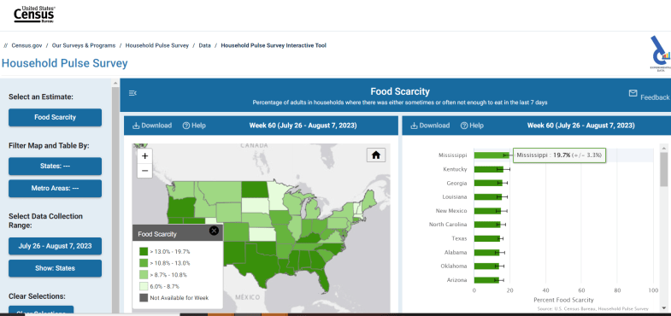
How to use Household Pulse
20
Data tools: https://www.census.gov/data-tools/demo/hhp/#/ (shows, for example, food scarcity (% of adults in households sometimes/often not having enough to eat in the previous week) by state or metro area)

Slide 21
American Community Survey: Sept. 14
21
A much bigger survey: the 1-year data for 2022 goes down to geographies with populations 65,000 or more
Provides detailed information for states, counties, congressional districts, “places” (cities), metro areas
Answers questions about income, earnings, employment, use of public benefits, health insurance, education, family structure, immigrant status, cost of housing, disabilities, etc., with breakdowns by age, gender, race/ethnicity – crosstabs such as poverty by educational attainment, health insurance by race…
The 2020 ACS could not achieve acceptable sampling because of the pandemic – they did not release 1-year results; only 5-year averaging

Slide 22
Problems with ACS data:
22
Uses official poverty definition – doesn’t take into account value of benefits
You won’t be able to compare to 2020, but you can compare to earlier years
It’s from 2021 – a lot has changed since then
Advantages of ACS data:
Allows you to show child poverty by race/ethnicity, as well as many other topics by state and smaller jurisdictions, such as congressional districts

Slide 23
How to get at ACS data: data.census.gov
23
Select “Advanced Search”
Use filters:
Geography – select state, and pick a state
Survey – select American Community Survey, 1 year estimates
Select “Comparison Profile”
Choose CP03 (Comparative Economic Characteristics)
Click on the double arrow to spread out the table
Click on “Excel” to download it, so you can save the table
Step-by-step to get handy comparisons over past 5 years
Shows whether differences over time are statistically significant
But does NOT show breakdowns by race

Slide 24
Getting Race/Ethnic breakdowns for host of topics
24
Data.census.gov
Advanced search
Filters:
Geography – pick state
Survey
American Community Survey, 1 year estimates
Selected Population Profiles
Topics
Race and Ethnicity
Select All Available Races
Click on double arrows, top right
Click on Excel to save the table
Lots of race categories – choose the ones you want – scroll way to the right to find White alone, not Hispanic

Slide 25
To calculate percentages in Household Pulse, you have to add up all the responses, and leave out “Did not report”. For Hispanic or Latino, below, the “CHN total” is 34,295,232; then we add “sometimes” and “often” who did not have enough to eat in the last 7 days. Here, 6,306,329. We divide “sometimes + often” by the CHN total, to get 18.4% of Hispanic/Latino adults reporting their households sometimes/often did not have enough to eat in the last 7 days. Note that the same tables are available for all states and many metro areas – see tabs at bottom.
25
17,420,976
21,898,751

