Slide 1
RESULTS National Webinar
August 5, 2023
Welcome!

Slide 2
RESULTS U.S. Policy Work

Slide 3
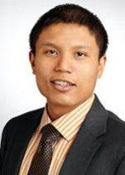
Michael Santos Associate Director RESULTS U.S. Poverty Policy msantos@results.org

Slide 4
Our Values & Resources
4
​At RESULTS we pledge to create space for all voices, including those of us who are currently experiencing poverty. We will address oppressive behavior in our interactions, families, communities, work, and world. Our strength is rooted in our diversity of experiences, not in our assumptions.
With unearned privilege comes the responsibility to act so the burden to educate and change doesn’t fall solely on those experiencing oppression. When we miss the mark on our values, we will acknowledge our mistake, seek forgiveness, learn, and work together as a community to pursue equity.
Read our full anti-oppression values statement here at results.org/values.
Check out the 2023 Spring Anti-Oppression Workshop Schedule for training opportunities.
Find these resources and more at results.org/volunteers/anti-oppression:
Resource Guides from our Diversity & Inclusion trainings, including:
Interrupting Microaggressions
Creating Space for Critical Conversations
Information on how RESULTS responds to oppressive incidents
Notes:
Updated AO slide (2/22)

Slide 5
Background
Congress is on recess!
Remember: working on economic justice
Need the CTC to be fair
Possible tax package in the horizon
CTC work = greater impact on tax code

Slide 6
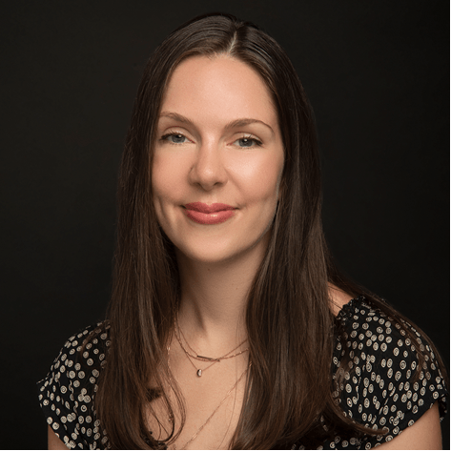
Sophie Collyer Research Director Center on Poverty and Social Policy at Columbia University
Guest Speaker

Slide 7
WHAT WE KNOW ABOUT THE Child Tax Credit
RESULTS National Webinar
August 5, 2023
Sophie Collyer

Slide 8
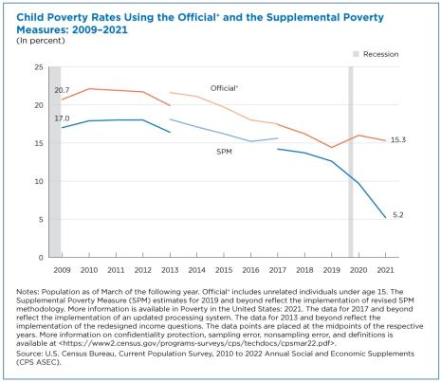
The 2021 Child Tax Credit Expansion and Child Poverty

Slide 9
The 2021 Child Tax Credit Expansion and Child Poverty
Poverty rates for 2022 will be released this coming September, and we’ll likely see a reversal of this downward trend with child poverty increasing given the expiration of the Child Tax Credit expansion.
We’ve already seen evidence of this from CPSP’s monthly poverty series.
Monthly CTC begins
Monthly CTC Ends
Link to brief: https://www.povertycenter.columbia.edu/publication/monthly-poverty-january-2022
Link to data: https://www.povertycenter.columbia.edu/forecasting-monthly-poverty-data

Slide 10
Why aren’t families receiving expanded CTC payments anymore?
The American Rescue Plan expansion to the CTC was temporary (and we’ll discuss the specifics of that temporary expansion in a bit).
The CTC on the books today actually follows the parameters outlined in the Tax Cuts and Jobs Act of 2017.
Under this structure:
Families need at least $2,500 in earnings to qualify at all for the credit
It then phases in with earnings so you need to earn a certain amount in order to qualify for the full credit
It begins to phase out for single filers (heads of household) with earnings above $200,000 and joint filers with earnings above $400,000.

Slide 11
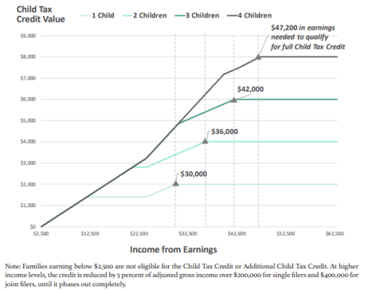
Why aren’t families receiving expanded CTC payments anymore?
Families need at least $2,500 in earnings to qualify at all for the credit
It then phases in with earnings so you need to earn a certain amount in order to qualify for the full credit
It begins to phase out for single filers (heads of household) with earnings above $200,000 and joint filers with earnings above $400,000
Link to brief: https://www.povertycenter.columbia.edu/s/Child-Tax-Credit-Larger-Families-CPSP-2020-8rsg.pdf
Note: We’ll soon be updating this to reflect the 2022 tax code and will share!

Slide 12
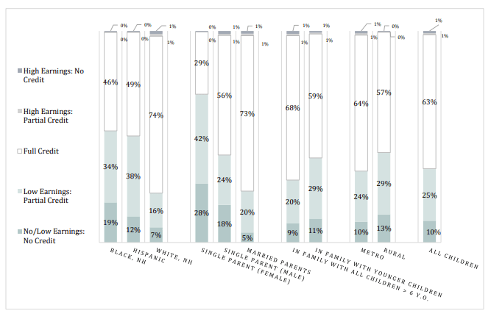
As a result of the current CTC structure, many children are left behind.
Pre-pandemic, roughly 1 in 3 children in the U.S. were ineligible for the full CTC because their family income was not high enough to qualify.
Groups with an even higher share of children left behind included:
Black Children (53%)
Latino Children (50%)
Children with single parents (70%, 42%)
Children in families with young children (40%)
Children in rural areas (43%)
Children in larger families (not shown)
Link to brief: https://www.povertycenter.columbia.edu/s/Who-Is-Left-Behind-in-the-Federal-CTC-CPSP-2019.pdf
Note: We’ll soon be updating these results with more recent data.

Slide 13
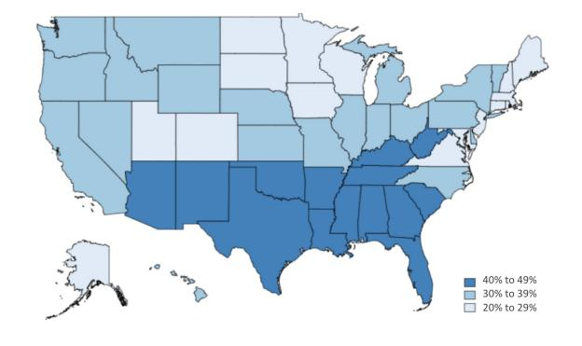
As a result of the current CTC structure, many children are left behind.
Share of children ineligible for full CTC
Link to brief: https://www.povertycenter.columbia.edu/s/Losing-Out-on-Child-Tax-Credit-CPSP-2019.pdf
Note: We’ll soon be updating these results with more recent data.

Slide 14
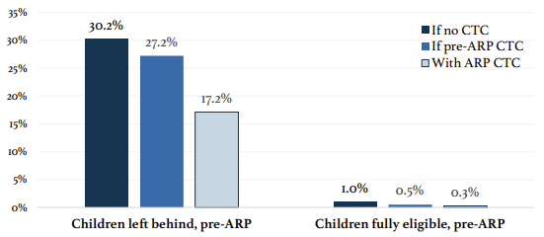
What happened when those left behind received the expanded CTC payments in 2021?
The American Rescue Plan:
(1) expanded eligibility,
(2) increased payment amounts, and
(3) allowed for monthly delivery of payments.
As discussed, child poverty fell to a historic low in 2021 as a result of these expansions, and much of this reduction stemmed from ensuring those left behind under current and pre-ARP law, had access to the expanded CTC.
Link to brief: https://www.povertycenter.columbia.edu/s/Expanded-CTC-and-Child-Poverty-in-2021-CPSP-hry6.pdf

Slide 15
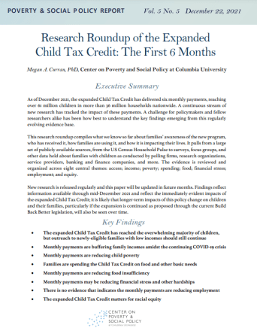
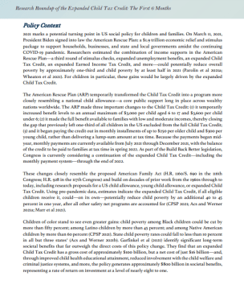
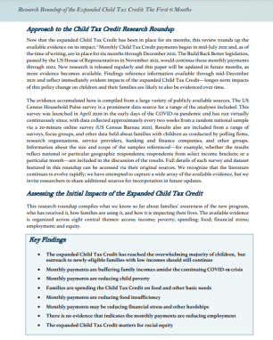
What else happened when families received the expanded CTC payments in 2021?
Link to roundup:
https://www.povertycenter.columbia.edu/publication/2022/child-tax-credit/research-roundup-one-year-on

Slide 16
What else happened when families received the expanded CTC payments in 2021?
ACCESS
INCOME
POVERTY
SPENDING
Reached over 61 million children, but outreach needed to newly-eligible children in low income families
Buffered family incomes amidst continuing pandemic & uncertain economy
Significantly reduced child poverty (by approx. 30%) during the six months it was in place
Families spent it on basic household needs – most common item: food
HUNGER
STRESS
EMPLOYMENT
EQUITY
Reduced food insecurity, particularly among families with lower incomes
Reduced financial stress and material hardship.
No evidence of reductions in parental work
Children of color stand to benefit the most

Slide 17
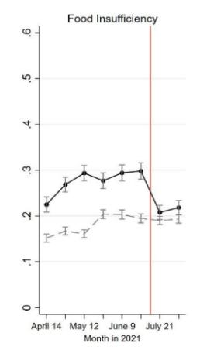
What else happened when families received the expanded CTC payments in 2021?
The initial Child Tax Credit payments reduced food insufficiency by 25%.
Food insufficiency here is defined as sometimes or often not having enough food to eat in the house in the previous seven days.
Link to paper: https://www.aeaweb.org/articles?id=10.1257/pandp.20231088
Households with children
Households without children

Slide 18
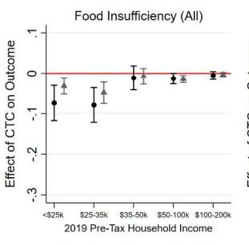
What else happened when families received the expanded CTC payments in 2021?
These substantial reductions in food insufficiency were concentrated among households with less than $35,000 in annual income.
Link to paper: https://www.aeaweb.org/articles?id=10.1257/pandp.20231088

Slide 19
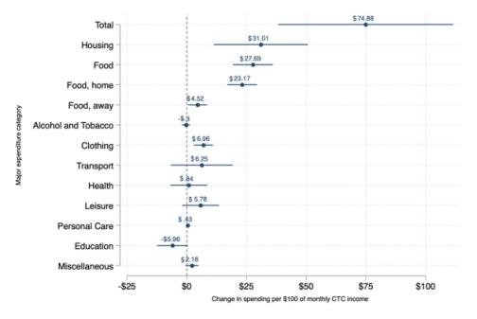
What else happened when families received the expanded CTC payments in 2021?
Recent analysis using the Consumer Expenditure Survey data finds that families spent the CTC payments on basic needs like food and housing, and on child-related goods and services.
Link to paper: https://www.nber.org/system/files/working_papers/w31412/w31412.pdf

Slide 20
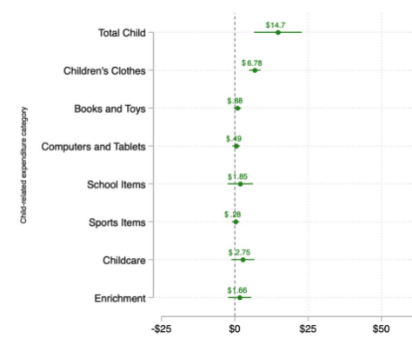
What else happened when families received the expanded CTC payments in 2021?
Recent analysis using the Consumer Expenditure Survey data finds that families spent the CTC payments on basic needs like food and housing, and on child-related goods and services.
Link to paper: https://www.nber.org/system/files/working_papers/w31412/w31412.pdf

Slide 21
Takeaways
The 2021 expansion to the Child Tax Credit led to a historic decline in child poverty, but we’ll likely see a reversal of this trend in September when Census releases the 2022 poverty rates.
Why? The temporary expansion is no longer in effect, and the CTC that families were eligible for in 2022 was tied to earnings, meaning children in the lowest income families were ineligible for the full credit. That is, it could not reach the families who would benefit from it the most.
What happened when families currently ineligible received the full credit and the credit value increased?:
Families used payments to meet their basic needs
Historic reductions in poverty
A sharp and immediate decline in food insecurity
Among many other improvements to wellbeing

Slide 22
Thank you
Email: sophie.collyer@columbia.edu
Web: povertycenter.columbia.edu
Twitter: @cpsppoverty

Slide 23
CTC Request
Ask your members of Congress to:
Will you urge your colleagues on the House Ways and Means Committee or Senate Finance Committee to expand the full benefit of the Child Tax Credit (CTC) to as many families as possible, prioritizing those with low incomes?
See our new CTC leave-behind at: https://results.org/wp-content/uploads/2023-CTC-Request-Summer-and-Fall-MEGA-RESOURCE.pdf

Slide 24
Grassroots Café

Slide 25
Lobby Meeting 101
Notes:
Tee up questions for share

Slide 26
Basics of in district lobbying

Slide 27
Grassroots Share: Liz Brown!

Slide 28
Best Practices for In District Lobbying
Focus on building relationships
Invite your community to attend
Be persistent
Find your MOC at a community event

Slide 29
Q&A: Now is the time to ask questions!

Slide 30
Announcements

Slide 31
Fall Friends and Family fundraising campaign Visit www.results.org/donate/fundraise to access our fundraising guide and create your online fundraising page

Slide 32
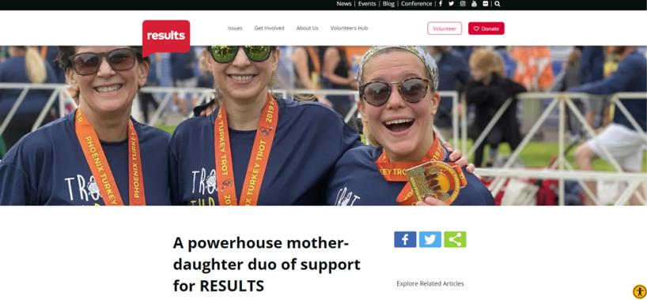
Grassroots Share: Nancy Gardiner
results.org/blog/a-powerhouse-mother-daughter-duo-of-support-for-results

Slide 33
Fall Friends and Family fundraising campaign Visit www.results.org/donate/fundraise to access RESULTS' fundraising guide and create your online fundraising page
Questions to consider:
Is your group (or individual volunteers) able to hold an online fundraiser this fall?
What is your goal, e.g., number of donations, amount raised?
Could you create a match or other incentive to inspire giving?
For how long would you like to hold your fundraiser?
Please reach out to the Development team at development@results.org for support!

Slide 34
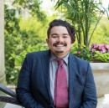
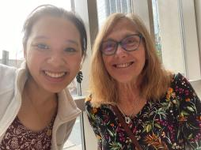
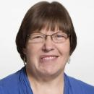
August Town Hall: All Are Welcome!
Questions? Email grboard@results.org
Get to know this year’s Grassroots Board Members!
Learn about the RESULTS Board of Directors and how we can be a resource to you!
Meet and mingle with other volunteers!
Lynne Patalano
Aaron Carrillo
Jennn M. Koo
Allison Gallaher
Thursday, August 10 at 8:30pm ET
Bring a friend and join us at tinyurl.com/resultstownhall

Slide 35
Thank you for joining us!
Who is joining you in the room today?
In the poll, please respond with the number of people in the room with you (including yourself).

Slide 36
Lobby Prep Office Hours
Tuesdays in August, 8:00-9:00 pm ET
To help you have powerful lobby meetings in August, join our Lobby Prep Office Hours to get coaching on congressional requests, insights into your members of Congress, etc. This is an easy way to make sure you are ready for your August lobby meetings.
Join at: https://results.zoom.us/j/98582131855
or dial (301) 715-8592, meeting ID: 985 8213 1855.
No registration required and join any time during the hour.
If you prefer more personalized coaching, please contact RESULTS staff to schedule a lobby prep call with your group (grassroots@results.org).

Slide 37
Join training on having meaningful conversations
Motivational Interviewing 101
Join this special edition workshop to help you have an effective dialogue with your members of Congress. By utilizing a few tips and tricks, you can begin to transcend the adversarial mindset and use values-based advocacy to make the case for change.
Wednesday, August 9, 8:00 pm ET
Register at: https://tinyurl.com/MI101August

Slide 38
Diversity and Inclusion 101
Learn about implicit bias and microaggressions and gain an understanding of systemic racism and oppression.
Friday, August 25, 12:00 pm ET (90 minutes)
Registration: https://tinyurl.com/DandIAug

Slide 39
Join the next
RESULTS National Webinar
Saturday, September 9 at 1:00 pm ET
(a week later than normal due to Labor Day)

Slide 40
Join us for a special October National Webinar
Who deserves to be poor? Work requirements as a tool of oppression
Saturday, October 14, 12:00-3:00 pm ET
Featured panel speakers, moderated by Michael Santos,
Peggy Bailey, Center for Budget and Policy Priorities
Aaron Carrillo, RESULTS Grassroots Board
Elisa Minoff, Center for the Study of Social Policy

Slide 41
Partner Organization Webinars
Global Allies Program: Partners Ending Poverty
with Returned Peace Corps Volunteers
Thursday, August 10, 8:30 pm ET
Register at https://tinyurl.com/GAPSummer23
Together Women Rise partnership webinar
Tuesday, August 15, 8:30 pm ET
Join at https://tinyurl.com/TWRRP

Slide 42
Free Agents Webinars
U.S. Poverty Free Agents
Tuesday, August 22, 1:00 pm ET and 8:00 pm ET (your choice)
Contact Jos Linn at jlinn@results.org for information.
Global Poverty Free Agents
Monday, August 28, 7:00 pm ET
Contact Lisa Marchal at lmarchal@results.org for information.

Slide 43
Other Support Calls
Event Planning and Outreach Office Hours
Thursdays in August, 2:00 pm ET
Join via Zoom at https://results.zoom.us/j/98524229370 or call (312) 626-6799, Meeting ID: 985 2422 9370. No registration required.
Action Network Managers Webinar
Wednesday, August 16, 12:30 pm and 8:00 pm ET
Click for the 12:30 session; Click for the 8:00 session
No registration required.

Slide 44
Other Support Calls
Media Office Hour
Wednesday, August 23, 2:00 pm ET
Join via Zoom at https://results.zoom.us/j/93668005494 or (312) 626-6799, meeting ID 936 6800 5494. No registration required.
New Advocate Mentor Connection Call
Thursday, August 24, 8:00 pm ET
Register at: https://tinyurl.com/NAMCCAug

Slide 45
RESULTS Merchandise Shop
RESULTS Merchandise Shop linked at the bottom of every page
results.threadless.com
Reach out to communications@results.org with any questions

Slide 46
RESULTS Global Policy Work

Slide 47
Our Fall Goal
Congress demanding equity and impact in the fight against global poverty

Slide 48
Extended! Senate TB letter – Closing Friday
Email your senator's foreign policy aide
Follow up with a phone call, and keep calling until you get a “yes” or “no”
ASK: Will you sign the letter to President Biden, asking for bold U.S. leadership on TB?

Slide 49
Equity & Impact
How is funding delivered?
Who does it reach? Who gets left out?
What are the priorities?

Slide 50
Part 1
How the U.S. government spends money and designs programs
Part 2
How the World Bank spends money and designs programs

Slide 51
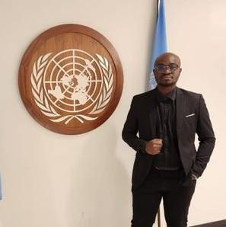
Kenneth Prudencio Head of Advocacy ASAPSU
Guest
Speaker

Slide 52
Malnutrition Prevention & Treatment Act
The End Tuberculosis Now Act
The READ Act

Slide 53
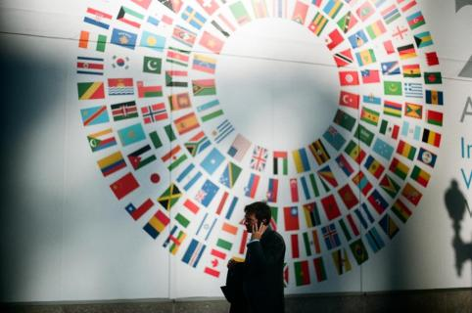
The World Bank
What is it?
Why focus on it?
What can we do?
Photo by Markus Krisetya on Unsplash

Slide 54
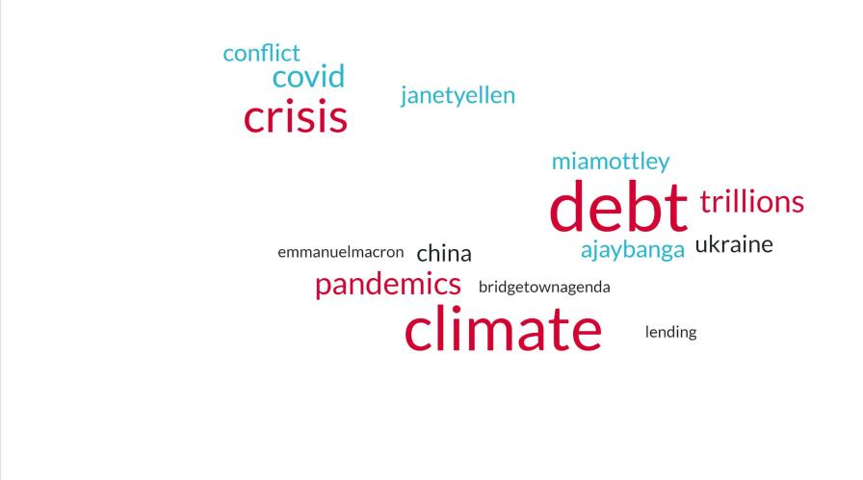
2023
What about poverty?

Slide 55
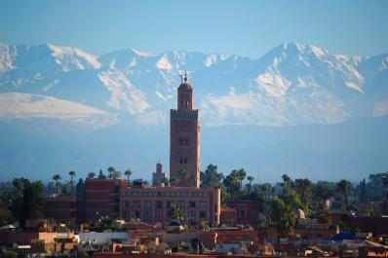
“By carving out a role for itself in shaping day-to-day Bank policy, Congress has cracked open a closed process”
Congress Underestimated: The Case of the World Bank American Journal of International Law
Photo by Jeremy Bishop on Unsplash

Slide 56
Equity & impact campaign Asks for Congress
Sponsor TB & education bills, and push to get them passed into law
Sign bipartisan letter to World Bank (soon!)

Slide 57
Join the next
RESULTS National Webinar
Saturday, September 9 at 1:00 pm ET
(remember, a week later than normal due to Labor Day)
See you next month!

