Slide 1
RESULTS National Webinar
July 8, 2023

Slide 2
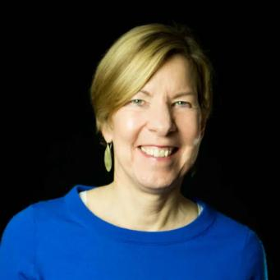
Joanne Carter RESULTS Executive Director
Welcome!

Slide 3
Our Values & Resources
3
​At RESULTS we pledge to create space for all voices, including those of us who are currently experiencing poverty. We will address oppressive behavior in our interactions, families, communities, work, and world. Our strength is rooted in our diversity of experiences, not in our assumptions.
With unearned privilege comes the responsibility to act so the burden to educate and change doesn’t fall solely on those experiencing oppression. When we miss the mark on our values, we will acknowledge our mistake, seek forgiveness, learn, and work together as a community to pursue equity.
Read our full anti-oppression values statement here at results.org/values.
Check out the 2023 Spring Anti-Oppression Workshop Schedule for training opportunities.
Find these resources and more at results.org/volunteers/anti-oppression:
Resource Guides from our Diversity & Inclusion trainings, including:
Interrupting Microaggressions
Creating Space for Critical Conversations
Information on how RESULTS responds to oppressive incidents
Notes:
Updated AO slide (2/22)

Slide 4
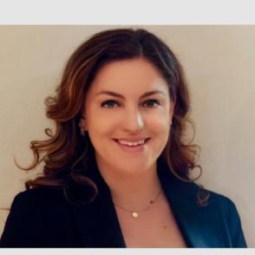
Neesha Suarez Deputy Chief of Staff Congressman Seth Moulton (D-MA-6)
Guest Speaker

Slide 5
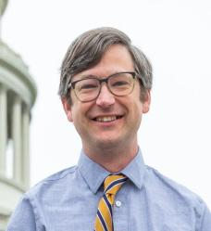
U.S. Poverty Campaigns
David Plasterer Senior Associate RESULTS U.S. Poverty Policy dplasterer@results.org

Slide 6
Child Tax Credit Update
American Family Act (AFA)
The AFA was introduced with 204 original co-sponsors!
Thanks to you and your advocacy!
Working Families Tax Relief Act (WFTRA)
The WFTRA was introduced with 41 original co-sponsors!
Thank you for your advocacy!

Slide 7
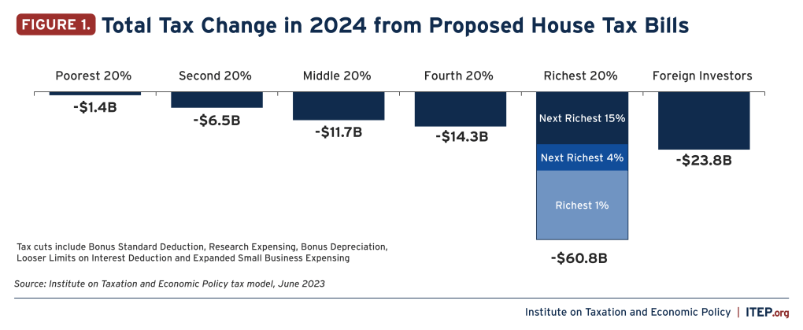
GOP Tax Proposal

Slide 8
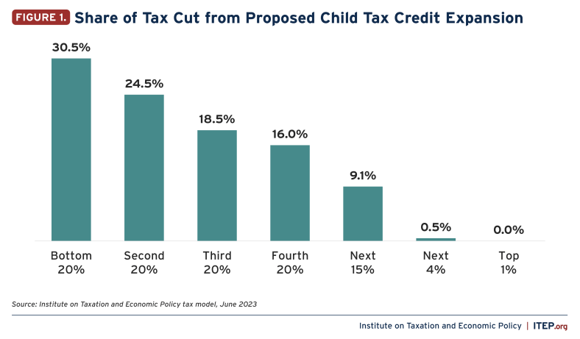
Contrast

Slide 9
CTC Request
Ask your members of Congress to:
Will you urge your colleagues on the House Ways and Means Committee or Senate Finance Committee to expand the full benefit of the Child Tax Credit (CTC) to as many families as possible, prioritizing those with low incomes?
See our new CTC leave-behind at: https://results.org/wp-content/uploads/2023-CTC-Request-Summer-and-Fall-MEGA-RESOURCE.pdf

Slide 10
RESULTS Global Policy Work

Slide 11
Preventable
Treatable
Curable
Notes:
But TB IS Preventable, Treatable AND Curable. We

Slide 12
10.6 million
people sick with TB
1.6 million
deaths
Notes:
10.6 million falling sick, 1.6 million lives lost to TB. Likely will retake COVID. Shameful spot at the top of the list.
I don’t want to paint an overly rosy picture of things before the pandemic –
But for twenty years, things were steadily moving in the right direction.
Every year, stronger systems, more people treated, fewer sick
But a million fewer people treated for TB in 2020 vs 2019
Last year’s data – worse by every measure. More people sick, fewer in treatment, more dying

Slide 13
40%
are missing from treatment
Notes:
40% of people sick left behind by health system.

Slide 14
2023 Plan to Accelerate TB
Increase funding for TB to $1 billion
Use funding to accelerate action on TB (Pass the End TB Now Act).
Ensure US leadership on TB at UN High-Level Meetings on TB in September

Slide 15
2023 Plan to Accelerate TB
Increase funding for TB to $1 billion
Use funding to accelerate action on TB (Pass the End TB Now Act).
Ensure US leadership on TB at UN High-Level Meetings on TB in September

Slide 16
3. Ensure U.S. Leadership
Bipartisan HOUSE letter to the President closes on Monday July 10!
Led by Reps. Ami Bera (D-CA), Maria Salazar (R-FL), Michael McCaul (R-TX), Gregory Meeks (D-NY)
Bipartisan SENATE letter is coming soon!
ASK: Will you sign the letter to President Biden, asking the Administration to demonstrate bold U.S. leadership at the UN High Level Meeting on TB?

Slide 17
Take Action on House TB Letter
Write to your Rep's foreign policy aide today!
Follow up with a phone call Monday morning.
Keep calling until you get a yes or no answer.
ASK: Will you sign the letter to President Biden, asking the Administration to demonstrate bold U.S. leadership at the UN High Level Meeting on TB?

Slide 18
We take action
to get Congress to take action
to get the U.S. to do its part

Slide 19
Grassroots Café

Slide 20
Let’s get ready for August Recess!
How did past lobby meeting requests go?
What were some successes?
What were some challenges, and how did you overcome them?
Notes:
Tee up questions for share

Slide 21
Let’s get ready for August Recess!
Here are some tips to prepare:
Meet with your group and determine your goals.
Make your request as soon as possible (today if you can!), a sample meeting request letter is available on our website.
Research your member of Congress, where are they on our issues?
Join lobby prep office hours held by staff or request a lobby prep meeting if you need one.

Slide 22
Let’s get ready for August Recess!
Here are some tips to prepare:
Review the issues, watch campaign videos, prepare your EPIC laser talks.
Prepare media, hand-written letters, and stories.
Reach out to warm leads, partners, and others in your community. Invite them to join your meetings!
Check out our August Recess Meetings Checklist for more!

Slide 23
Open Shares
Let's talk about August recess meetings
What’s a success you’ve had in booking/prepping for a lobby meeting – maybe even something that surprised you!
What’s a dilemma you’ve faced in booking or prepping for a lobby meeting and how did you overcome it?

Slide 24
Lobby Meeting Turnout
What is the goal? Mobilize people from our communities to attend lobby meetings with us during the August 2023 recess (Aug 8 - Sep 5)
Why? We can demonstrate people power with our members of Congress by uplifting voices from our community who are in support of our issues
Consider inviting: your Action Network, community partners, “warm leads” from expansion, family and friends

Slide 25
Resources for you
Sample phone, email, and text messages to use in your invitations
List of "warm leads" (people who inquired about volunteering with RESULTS)
Ask your RC for your list
August National Webinar = Lobbying 101
Invite new volunteers/partners for a primer
August Recess Turnout Toolkit has a recap of what we discussed today

Slide 26
Lobby Meeting Turnout
Make your invitation friendly & exciting - “This is an opportunity to connect with people and take action around your values!”
Have a direct ask - “Will you join a few lobby meetings with us during the month of August?”
Share that you are local - people are energized hearing from folks in their community
Have a concrete meeting date/time to invite them to as a next step

Slide 27
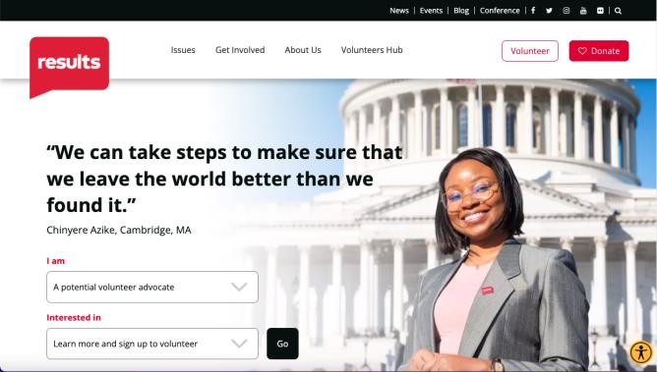
RESULTS has a new home page!
www.results.org
Try out the new menu:
- "I am...”
- “Interested in..."

Slide 28
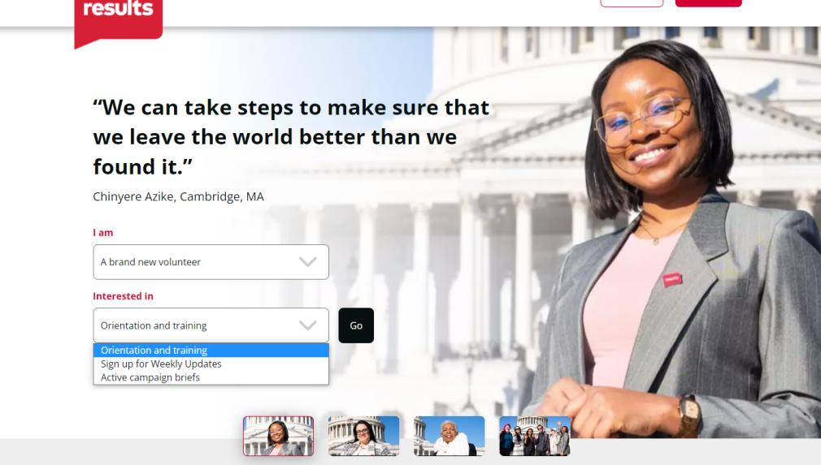

Slide 29
Home page tips
New look, same navigation
Volunteers Hub is unchanged
"Inequality & Tax Policy" issue title is now "Economic Justice in the Tax Code“
Donation info located at the bottom of our Home page

Slide 30
RESULTS Merchandise Shop
RESULTS Merchandise Shop linked at the bottom of every page
results.threadless.com
Reach out to communications@results.org with any questions

Slide 31
Announcements

Slide 32
Thank you for joining us!
Who is joining you in the room today?
In the poll, please respond with the number of people in the room with you (including yourself).

Slide 33
July Policy Forums
Thursday, July 20
8:00-8:45 pm ET: U.S. Poverty Policy Forum
Continuing the Conversation on the Renter Tax Credit &
What to Expect in this Congress
Register today.
9:00-9:45 pm: Global Poverty Policy Forum
Preview of Fall Equity & Impact Campaign
Register today.

Slide 34
Free Agents Webinars
U.S. Poverty Free Agents
Tuesday, July 18, 1:00 pm ET and 9:00 pm ET (your choice)
Contact Jos Linn at jlinn@results.org for information.
Global Poverty Free Agents
Monday, July 24, 7:00 pm ET
Contact Lisa Marchal at lmarchal@results.org for information.

Slide 35
Partner Organization Webinars
Global Allies Program: Partners Ending Poverty
with Returned Peace Corps Volunteers
Thursday, July 13, 8:30 pm ET
Register at https://tinyurl.com/GAPSummer23
Together Women Rise partnership webinar
Tuesday, July 18, 8:30 pm ET
Join at https://tinyurl.com/TWRRP

Slide 36
Other Support Calls
Media Office Hour
Wednesday, July 19, 2:00 pm ET
Join via Zoom at https://results.zoom.us/j/93668005494
or (312) 626-6799, meeting ID 936 6800 5494.
No registration required.
Action Network Managers Webinar
Wednesday, July 19, 12:30 pm and 8:00 pm ET
Click for the 12:30 session
Click for the 8:00 session
No registration required.

Slide 37
Other Support Calls
Event Planning and Outreach Office Hours
each Thursday at 1:00 pm ET this month:
Join via Zoom at https://results.zoom.us/j/98524229370
or call (312) 626-6799, Meeting ID: 985 2422 9370.
No registration required.
Anti-oppression Learning Community Meeting
Friday, July 28 at 12:00 pm ET.
Learn more about this 90-minute gathering and register.
Notes:
Dr. Christina Gunther (3 mins)

Slide 38
Join the next
RESULTS National Webinar
Saturday, August 5 at 1:00 pm ET
See you next month!

