Slide 1
Equity & Impact Fall 2023 Campaign Preview

Slide 2
Our Goal
Congress demanding equity and impact in the fight against global poverty

Slide 3
Equity & Impact
How is funding delivered?
Who does it reach? Who gets left out?
What are the priorities?

Slide 4
Part 1
How the U.S. government spends money and designs programs

Slide 5
Malnutrition Prevention & Treatment Act
The End Tuberculosis Now Act
The READ Act

Slide 6
Malnutrition Prevention & Treatment Act
The End Tuberculosis Now Act
The READ Act

Slide 7
3 bills to answer…
How is funding delivered?
Who does it reach? Who gets left out?
What are the priorities?

Slide 8
Part 2
How the World Bank spends money and designs programs

Slide 9
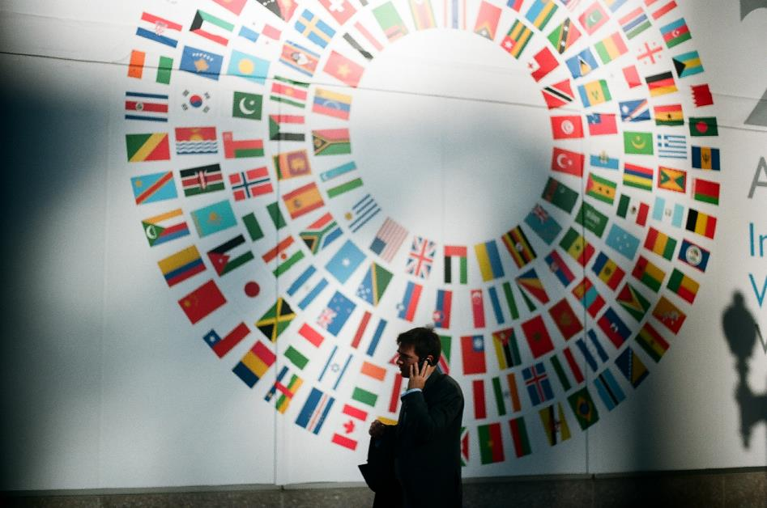
The World Bank
What is it?
Why focus on it?
What can we do?

Slide 10
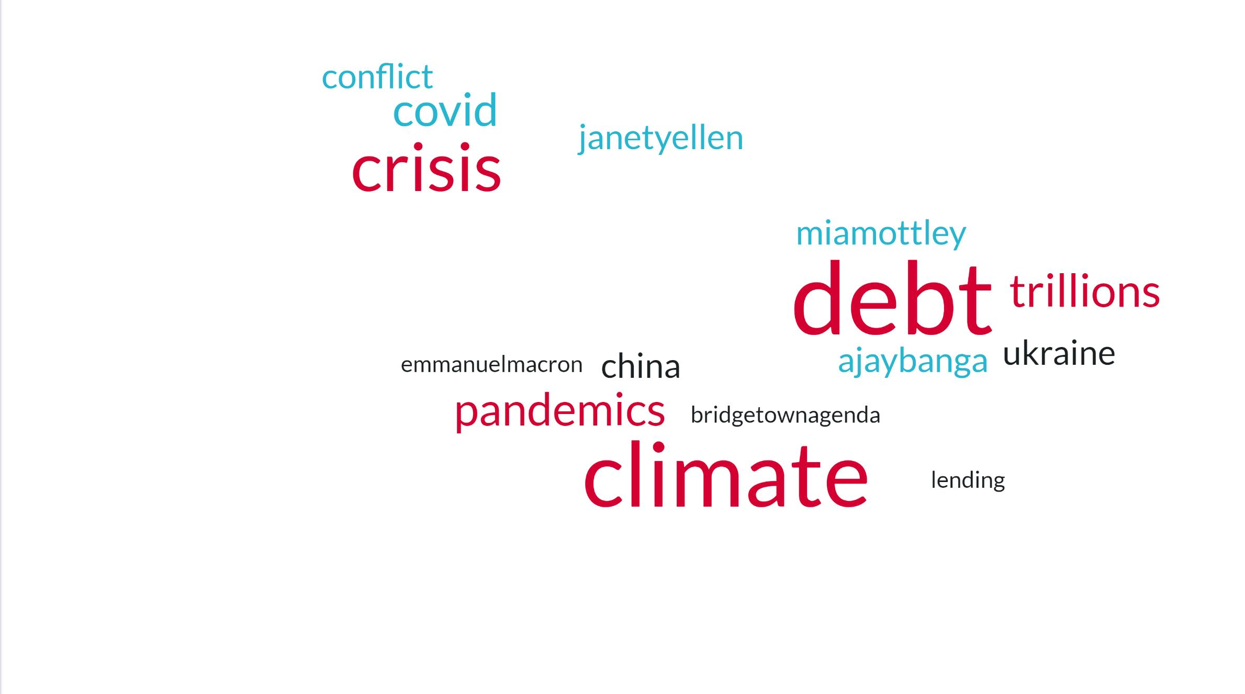
2023

Slide 11
What about poverty?

Slide 12
Equity & Impact
How is funding delivered?
Who does it reach? Who gets left out?
What are the priorities?

Slide 13
Our top asks this fall
Priority for the lowest-income places
Human needs at the center
Transparency & accountability
A key role in debt relief

Slide 14
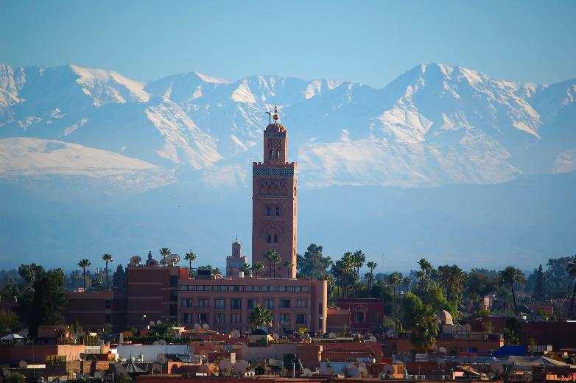
“By carving out a role for itself in shaping day-to-day Bank policy, Congress has cracked open a closed process”
Congress Underestimated: The Case of the World Bank American Journal of International Law

Slide 15
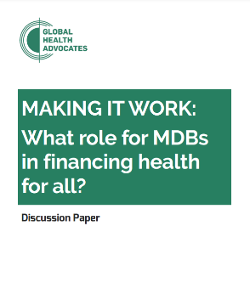
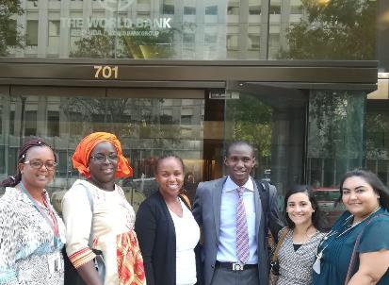
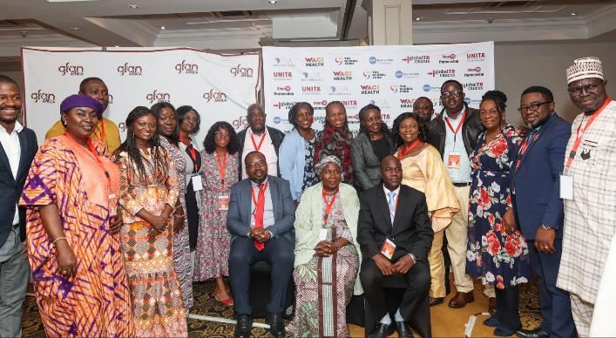
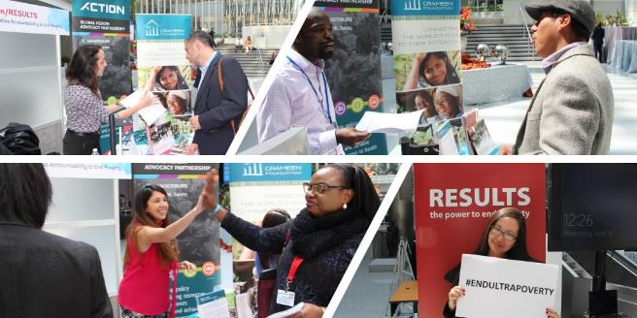
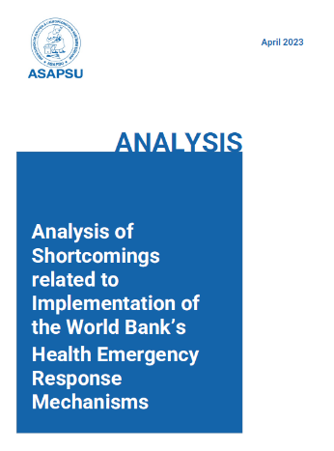

Slide 16
Congressional letter
Different message
Different politics
Different responsibilities

Slide 17
Our Goal
Congress demanding equity and impact in the fight against global poverty

Slide 18
Our actions
Goal: Congress demanding equity and impact in the fight against global poverty
Bipartisan letter to World Bank
TB & education bills signed into law
New champions in Congress

