Slide 1
Renter Tax Credit Basics – Part 2
U.S. Policy Forum
July 20, 2023

Slide 2
Michael Santos Associate Director RESULTS U.S. Poverty Policy msantos@results.org
2
Welcome!

Slide 3
Renter Tax Credit

Slide 4
Goals & Objectives
Basics of RTC + policy considerations
Compare ideal RTC to other viable RTCs
Federal RTC proposals + updates
Distinguishing RTC from other ongoing RESULTS work
Current state of play + Strategize + Key Takeaways

Slide 5
Calculating an RTC
credit amount = lesser of rent paid/SAFMR/FMR – 30% of monthly income
$200 = $500 – $300
SAFMR — Small Area Fair Market Rent
FMR — Fair Market Rent
Credit for rent-burdened households (Rent-burdened = paying >30% AGI)
Notes:
FMR is calculated by HUD to determine the reasonable market rate for a modest rental unit in a given area. It is typically based on the 40th percentile (or occasionally the 50th percentile) of rental rates among new leases. One drawback of FMR calculations is that rental rates can vary widely within a single area, and FMR treats entire metro areas homogenously.
To remedy this, HUD has begun phasing in Small Area Fair Market Rent calculations to localize this metric, making programs based on this calculation more equitable. SAFMRs allow localities to determine fair market rent for each zip code, and sometimes an even smaller area if a zip code is especially large and economically diverse.

Slide 6
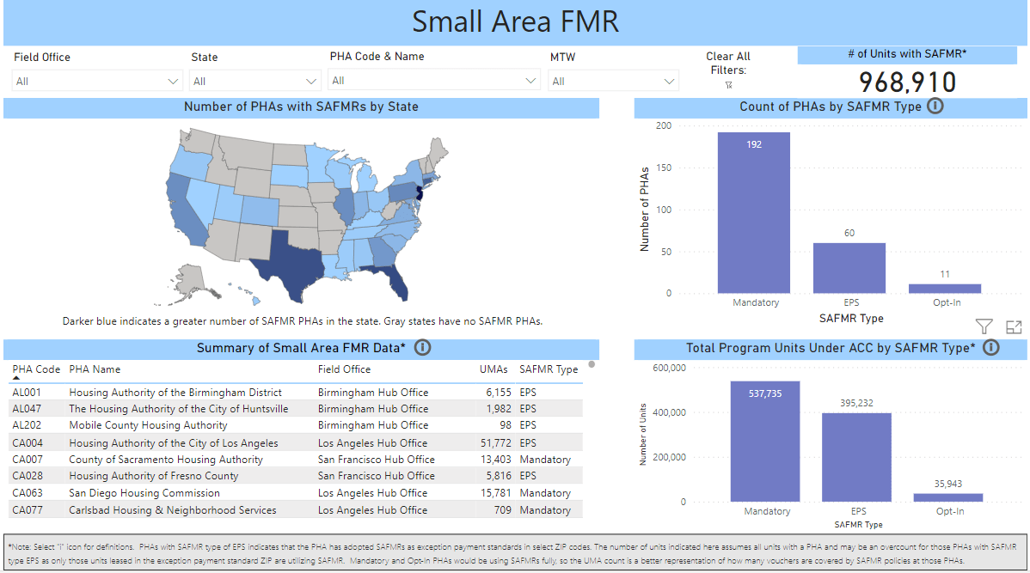
(Small Area) Fair Market Rents
Notes:
https://app.powerbigov.us/view?r=eyJrIjoiNWI3Nzc5NTctNGE4ZC00Zjk4LWIzYjktZDYzZWNjOWUzZGY2IiwidCI6IjYxNTUyNGM1LTIyZTktNGJjZC1hODkzLTExODBhNTNmYzdiMiJ9

Slide 7
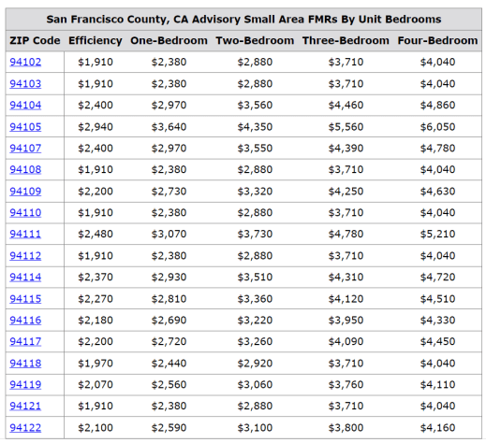
(Small Area) Fair Market Rents

Slide 8
Policy Considerations
Equity/Efficiency vs. Simplicity
Compliance burden tools + audits
Politics vs. Policy

Slide 9
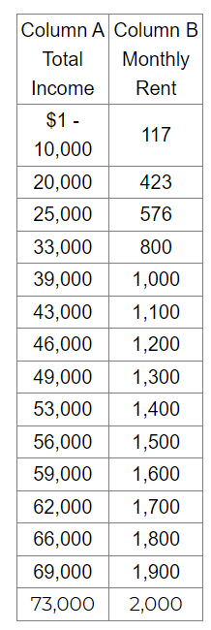
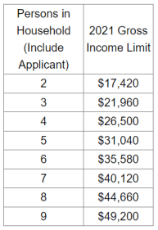
Other Ways to Calculate RTC
9
Notes:
https://dat.maryland.gov/realproperty/Pages/Renters%27-Tax-Credits.aspx
-tax limit (based on income) subtracted by 15% of total occupance rent for year -dwelling must be principal residence -different requirements for age 60 or over or 100% disabled -income restrictions based on household size
maximum of $1,000

Slide 10
Other Ways to Calculate RTC
10
Notes:
http://www.211iowa.org/search/?id=31065127#:~:text=Agency%3A%20Iowa%20Department%20of%20Revenue,forms%20mailed%2C%20must%20have%20documentation
-65 years of age or older or disabled -income restriction: $25,328
max credit: $1,000

Slide 11
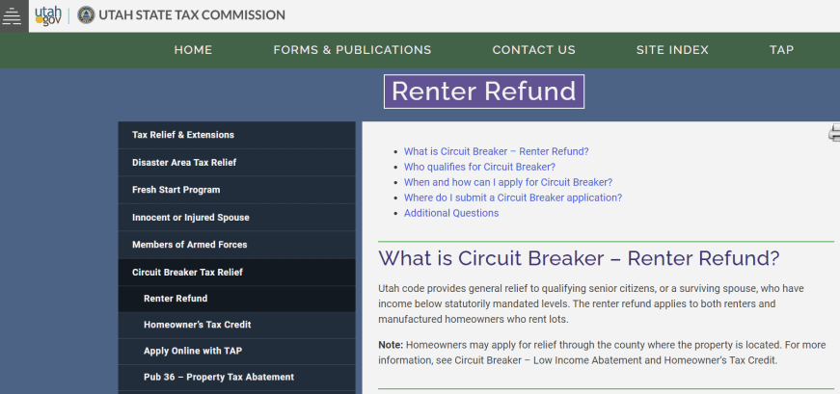
Other Ways to Calculate RTC
11
Notes:
https://tax.utah.gov/relief/circuitbreaker/renter-refund
presented as a "lifeline for seniors"; struggling with lack of outreach and knowledge; income caps adjust annually to keep pace with inflation
-66 years of age or older; widow or widower of any age -must have resided in Utah for entire calendar year -must show proof of rent paid -income restriction: $35,807
max credit: $1,110
As a reminder, we have a list of RTC states online: https://docs.google.com/spreadsheets/d/1R5RNB2CWh1NhVGJ8f-RdoJqrUxw2igxc/edit#gid=1629029837

Slide 12
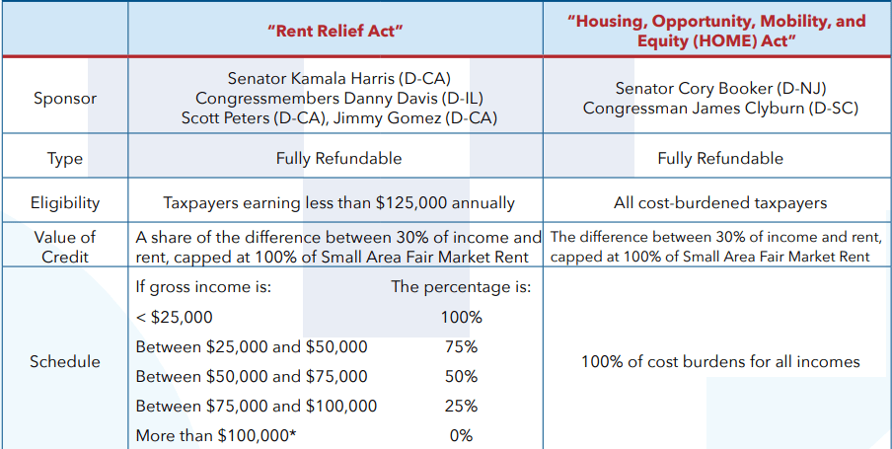
Review of Federal Proposals
Senator Raphael Warnock (D-GA)
Source: https://nlihc.org/sites/default/files/Factsheet_08022018.pdf

Slide 13
Word du jour: tabula rasa

Slide 14
Key Takeaways
Global vs. US (CTC) vs. US (RTC)
Calculus of Priorities for MoCs
Need to raise awareness + outreach
Navigating politics: state RTCs vs. federal proposals
Possible 2023 briefing
2024 strategy for MoCs, Coalitions, Taskforces, Caucuses

Slide 15
Questions?

Slide 16
Thank you!
Notes:
Another way to approach this engaging statement is that you can catch the attention of policymakers because it is unusual to have such powerful evidence that policies can make such an impact. The CTC is effective in lifting out children of poverty – in fact, Columbia University researchers found that after the monthly payments started in July 2021, nearly 4 million children were kept from poverty each month.
CTC and EITC have allowed more people to move out of poverty than any other program besides Social Security (5.3 million people in 2020)

