Slide 1
Renter Tax Credit Basics
U.S. Policy Forum
June 15, 2023

Slide 2
Michael Santos Associate Director RESULTS U.S. Poverty Policy msantos@results.org
2
Welcome!

Slide 3
Renter Tax Credit
Notes:
The question is how is the battle going?

Slide 4
Goals & Objectives
Understand the basics of RTC
Know the policy considerations informing the debate on RTC (landmines/pressure points)
Learn how to compare a universal RTC to other incremental or simpler bills

Slide 5
5
Notes:
https://youtu.be/7ulFrH0wpOI

Slide 6
Calculating an RTC
credit amount = lesser of rent paid/SAFMR/FMR – 30% of monthly income
$200 = $500 – $300
SAFMR — Small Area Fair Market Rent
FMR — Fair Market Rent
Credit for rent-burdened households (Rent-burdened = paying >30% AGI)
Notes:
FMR is calculated by HUD to determine the reasonable market rate for a modest rental unit in a given area. It is typically based on the 40th percentile (or occasionally the 50th percentile) of rental rates among new leases. One drawback of FMR calculations is that rental rates can vary widely within a single area, and FMR treats entire metro areas homogenously.
To remedy this, HUD has begun phasing in Small Area Fair Market Rent calculations to localize this metric, making programs based on this calculation more equitable. SAFMRs allow localities to determine fair market rent for each zip code, and sometimes an even smaller area if a zip code is especially large and economically diverse.

Slide 7
(Small Area) Fair Market Rents
Parks & Rec Metro Area
= $700
Pawnee
= $400
Eagleton = $1,000
Notes:
https://www.huduser.gov/portal/datasets/fmr/fmrs/FY2023_code/select_geography_sa.odn

Slide 8
(Small Area) Fair Market Rents
San Francisco Metro Area
NYC Metro Area
Notes:
https://www.huduser.gov/portal/datasets/fmr/fmrs/FY2023_code/select_geography_sa.odn

Slide 9
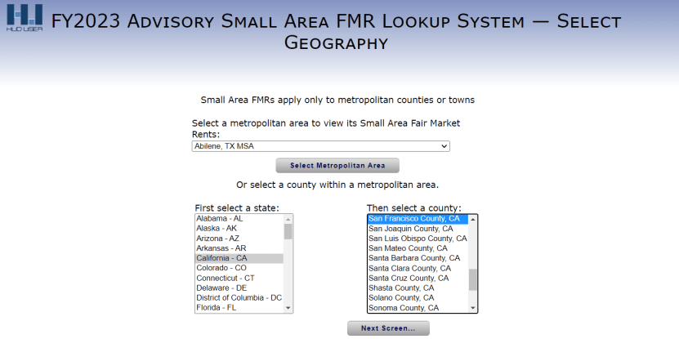
(Small Area) Fair Market Rents
Notes:
https://www.huduser.gov/portal/datasets/fmr/fmrs/FY2023_code/select_geography_sa.odn

Slide 10
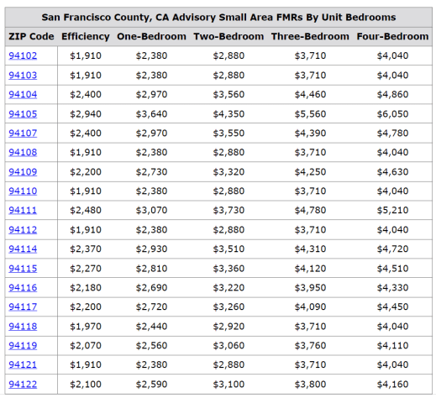
(Small Area) Fair Market Rents

Slide 11
RTC Example 1: Average Joe/Jill
credit amount = lesser of rent paid/SAFMR/FMR – 30% of monthly income
$700 = $1000 – $300
Michael has a monthly income of $1000.
SAFMR = $1000
Rent paid = $1000

Slide 12
RTC Example 2: The Cheapskate
credit amount = lesser of rent paid/SAFMR/FMR – 30% of monthly income
$0 = $1000 – $3000
Michael has a monthly income of $10000.
SAFMR = $1000
Rent paid = $1000

Slide 13
RTC Example 3: Keeping up with the Joneses
credit amount = lesser of rent paid/SAFMR/FMR – 30% of monthly income
$700 = $1000 – $300
Michael has a monthly income of $1000.
SAFMR = $1000
Rent paid = $2000

Slide 14
RTC Example 4: The Role of Low Supply of Affordable Housing
credit amount = greater of rent paid/SAFMR/FMR – 30% of monthly income
$1700 = $2000 – $300
Michael has a monthly income of $1000.
SAFMR = $1000
Rent paid = $2000

Slide 15
Questions?

Slide 16
Policy Considerations
Equity/Efficiency vs. Simplicity
Compliance burden tools + audits
Politics vs. Policy

Slide 17
Other Elements of RTC
How is the credit calculated?
How do you apply for the credit?
Who the credit goes to? LL/T
Who is eligible? Income limits?
How often can you get the credit?

Slide 18
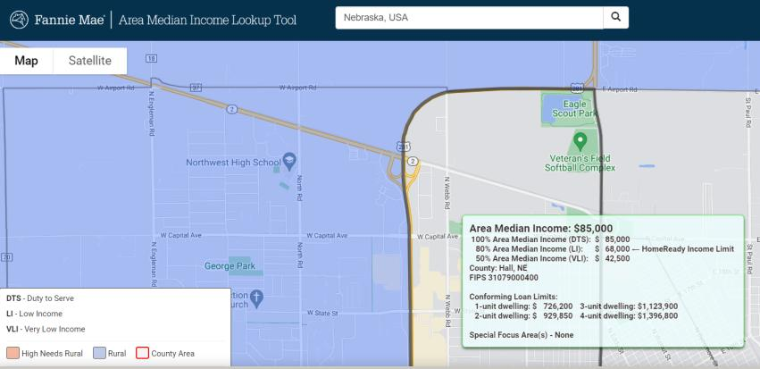

Slide 19
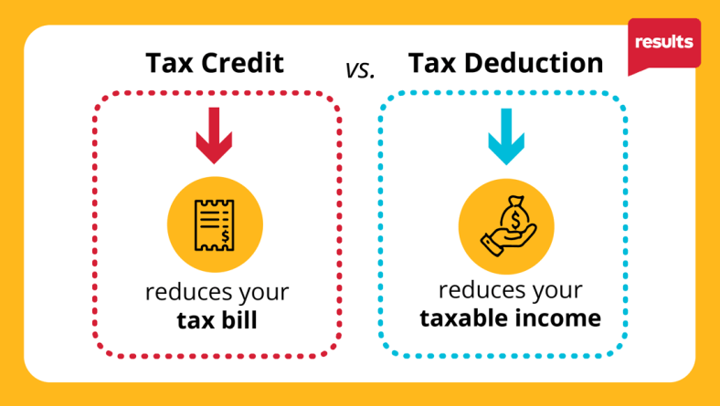
19

Slide 20
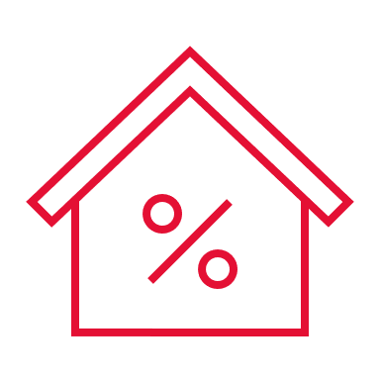
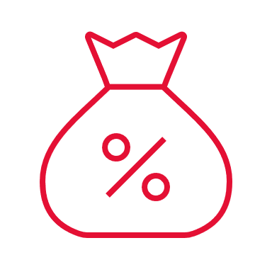
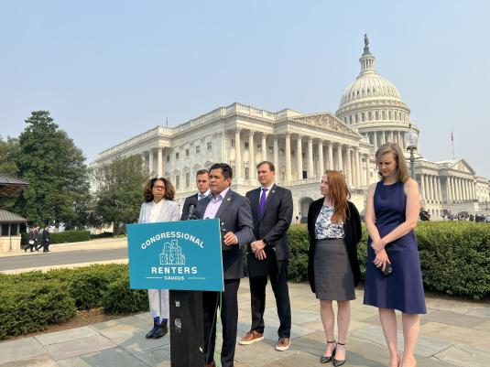
Congressional Renters Caucus
20
Chair:
Jimmy Gomez (D-CA)
Vice-Chairs:
Ritchie Torres (D-NY) +
Ayanna Pressley (D-MA)
Other members:
Dan Goldman (NY)
Rob Menendez (NJ)
Maxwell Alejandro Frost (FL)
Dwight Evans (PA)
Sydney Kamlager-Dove (CA)
Lloyd Doggett (TX)
Grace Meng (NY)
Delegate Eleanor Holmes Norton (DC)

Slide 21
Key Takeaway
We need a tax credit that helps rent-burdened low-income renters
The more rent-burdened you are, the greater the tax credit can help so you don’t have to pay more than your fair share

Slide 22
Questions?

Slide 23
Thank you!
Notes:
Another way to approach this engaging statement is that you can catch the attention of policymakers because it is unusual to have such powerful evidence that policies can make such an impact. The CTC is effective in lifting out children of poverty – in fact, Columbia University researchers found that after the monthly payments started in July 2021, nearly 4 million children were kept from poverty each month.
CTC and EITC have allowed more people to move out of poverty than any other program besides Social Security (5.3 million people in 2020)

