Slide 1
RESULTS National Webinar
May 6, 2023

Slide 2
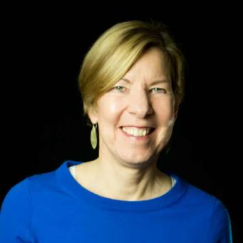
Joanne Carter RESULTS Executive Director
Welcome!

Slide 3
Our Values & Resources
3
​At RESULTS we pledge to create space for all voices, including those of us who are currently experiencing poverty. We will address oppressive behavior in our interactions, families, communities, work, and world. Our strength is rooted in our diversity of experiences, not in our assumptions.
With unearned privilege comes the responsibility to act so the burden to educate and change doesn’t fall solely on those experiencing oppression. When we miss the mark on our values, we will acknowledge our mistake, seek forgiveness, learn, and work together as a community to pursue equity.
Read our full anti-oppression values statement here at results.org/values.
Check out the 2023 Spring Anti-Oppression Workshop Schedule for training opportunities.
Find these resources and more at results.org/volunteers/anti-oppression:
Resource Guides from our Diversity & Inclusion trainings, including:
Interrupting Microaggressions
Creating Space for Critical Conversations
Information on how RESULTS responds to oppressive incidents
Notes:
Updated AO slide (2/22)

Slide 4
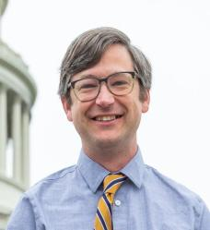
U.S. Poverty Campaigns
David Plasterer Senior Associate RESULTS U.S. Poverty Policy dplasterer@results.org

Slide 5
Hill Updates
Debt Ceiling Crisis
Looming threats on budget, cuts to social spending and critical anti-poverty programs, e.g. SNAP, Medicaid
Debt ceiling negotiations threaten U.S. and global economy and put anti-poverty programs at risk
President Biden and congressional Leaders to meet May 9
Annual government funding bill is best opportunity for CTC in 2023
This fall at the earliest – after debt ceiling debate completed
Notes:
https://results.org/blog/how-to-take-action-on-upcoming-house-legislation-that-includes-the-child-tax-credit

Slide 6
Targeted action on the CTC
Help get co-sponsors for the
American Families Act (AFA)
The AFA would restore the CTC to its 2021 levels, covering all families with low-incomes, regardless of earnings.
Goal is 175 original co-sponsors (107 so far) to show strong support for expanding the CTC this year. See if your Democratic House member has signed on as an original cosponsor.
Check this new blog for resources to ask your Democratic member to sign on.

Slide 7
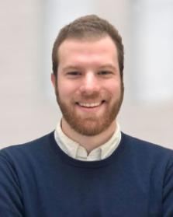
Alex Coccia, Ph.D. Senior Policy Analyst Center for the Study of Social Policy alex.coccia@cssp.org
Guest Speaker

Slide 8
RESULTS National Webinar Saturday, May 6
Alex Coccia
Senior Policy Analyst
Center for the Study of Social Policy
www.CSSP.org | info@CSSP.org | 202.371.1565

Slide 9
The ABC Coalition
The Automatic Benefit for Children (ABC) Coalition is a cross-cutting group of national, state, and grassroots organizations. Our mission is to create a child allowance, or a guaranteed minimum income for children, that provides regular, meaningful assistance to families, promotes racial equity and justice, enjoys broad public support, and serves as a foundation for a more equitable and inclusive social support system. We see the expansion of a fully inclusive Child Tax Credit as a step toward that goal.
Our Principles for a Child Allowance
Learn more about the ABC Coalition
Notes:
Principles: https://www.abccoalition.org/child-allowance-principles/
Learn more: https://www.abccoalition.org/

Slide 10
Key research on the Child Tax Credit
Child Tax Credit: Key Findings from July 2022 National Survey, CLASP
Research Roundup of the Expanded Child Tax Credit: One Year On, CPSP at Columbia University
The Differential Effects of Monthly & Lump-Sum Child Tax Credit Payments on Food & Housing Hardship, CPSP at Columbia University
The impacts of the 2021 expanded child tax credit on family employment, nutrition, and financial well-being, Brookings
The Impact of the 2021 Expanded Child Tax Credit (CTC) on Families Raising Children with Disabilities, Boston University, Washington University of St. Louis, Appalachian State University
Notes:
Report: Measuring the Child Tax Credit’s Economic and Community Impact, Niskanen Center (https://www.niskanencenter.org/report-measuring-the-child-tax-credits-economic-and-community-impact/)

Slide 11
CSSP Research: Advancing an Anti-Racist Child Allowance
The Child Tax Credit & Family Economic Security: Findings from the Center for the Study of Social Policy’s Survey of Families with Children
Where Do We Go From Here?: How Temporary Investments in the Child Tax Credit & Child Care Impacted North Carolina Families, and the Road Ahead
“We Don’t Have that in Mississippi”: How Temporary Expansions of the Child Tax Credit & Child Care Demonstrate the Importance of Federal Investments & Oversight
A ‘Godsend’: How Temporary Investments in the Child Tax Credit and Child Care Impacted Michigan Families
The American Rescue Plan’s Child Tax Credit: Advancing Equity and Laying the Foundation for a Child Allowance
Economic Security in Good Times and Bad: COVID-19 Demonstrates Why We Need a Child Allowance
Read about CSSP’s approach to research.

Slide 12
Grassroots Café

Slide 13
Thank you for joining us!
Who is joining you in the room today?
In the poll, please respond with the number of people in the room with you (including yourself).

Slide 14
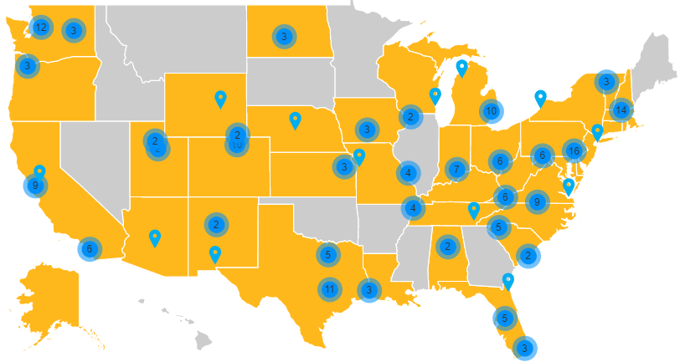
Set the Agenda Campaign
https://results.org/set-the-agenda

Slide 15
You have “Set the Agenda”!
Set the Agenda lobby meetings (Jan 1 through April 30):
191 reported (37 face-to-face with members of Congress!)
You’ve invited people to join you – new volunteers & organizational partners!
You’ve made bold asks on FY24 appropriations for global programs and engaged with your MOCs on equitable tax policies. Every action you take matters!
You’ve gained momentum – keep it going throughout 2023!
Notes:
Karyne

Slide 16
Grassroots Share: Set the Agenda
Natalia Loeb
RESULTS North Florida
Notes:
Dr. Christina Gunther (3 mins)

Slide 17
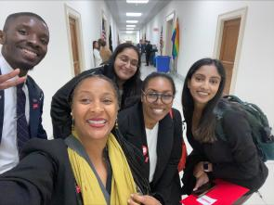
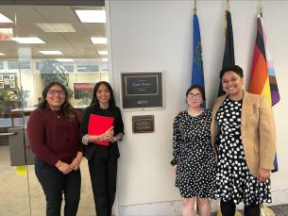
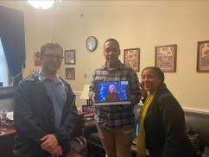
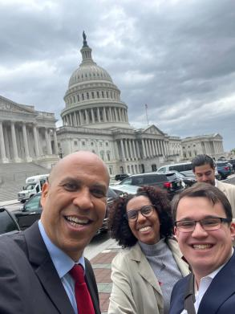
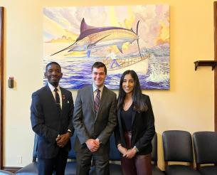
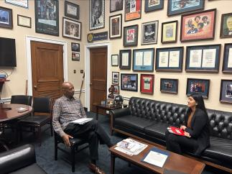
2023 RESULTS Fellowship Class
Notes:
Yolanda Pass to Jos

Slide 19
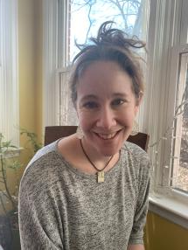
Grassroots Media Share
Generating letters to the editor
Sarah Miller
RESULTS St. Louis (US)

Slide 20
Media 150 campaign
Generate 150 media pieces between April1 and June 30
We are already 51 published pieces total toward our goal
Topics: budget cuts/debt ceiling, CTC, End TB Now Act
Try for more than one or all of them!

Slide 21
Media 150 Resources
Online media action: House budget/debt ceiling
Online media action: Child Tax Credit
Online media action: End TB Now Act
Brush up with our online media tools
See media from RESULTS volunteers in our 2023 Grassroots Media packets
Writing an op-ed training: May 17 at 2:00pm ET (see more in the announcements)
Contact Jos Linn (jlinn@results.org) for questions and coaching

Slide 22
Resource Guide for In-Person Events
https://results.org/wp-content/uploads/2023-Resource-Guide-for-Planning-In-Person-Events_Final.pdf

Slide 23
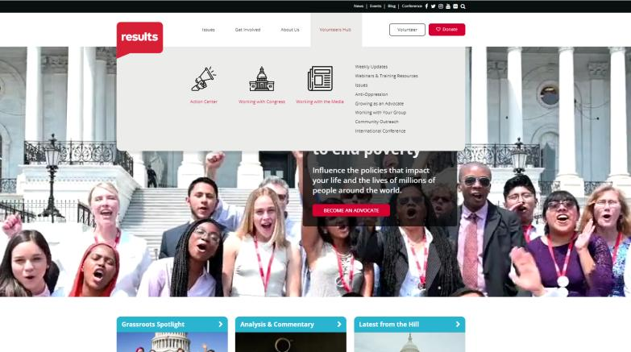
Resource Guide for In-Person Events

Slide 24
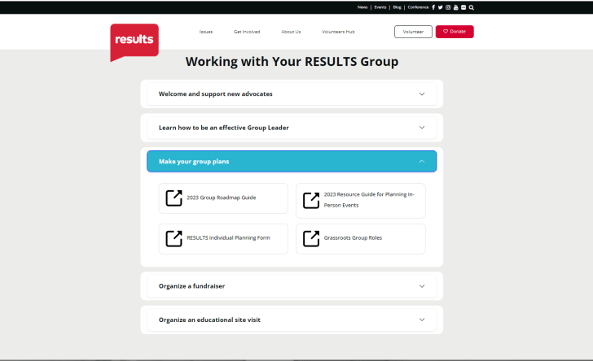
Resource Guide for In-Person Events

Slide 25
In-Person Events
Let us know what your plans are and if you're interested in applying for funding support!
CONTACT: Joanna DiStefano
Senior Associate for Grassroots Impact
(jdistefano@results.org)

Slide 26
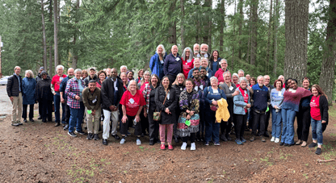
In-Person Events
2023 Pacific Northwest Regional Conference,
April 14-16
Event photo gallery:
https://drive.google.com/drive/folders/1Dpq2NCHS93pvFt5XZHBZe9HXhHuYXwSa

Slide 27
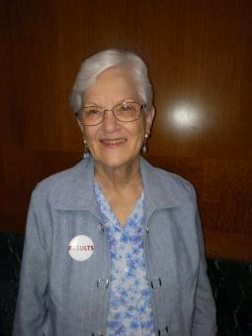
In-Person Events
Texas-Oklahoma Regional Conference
August 19
Eloise Sutherland
RESULTS Austin Global Group Leader

Slide 28
In-Person Events
Check in with your regional coordinator to talk through your ideas.
Stop by our Event Planning Office Hours each Friday at 12:00 pm ET this month: https://results.zoom.us/j/99349167795 or call (312) 626-6799, Meeting ID: 993 4916 7795.
Attend the In-Person Events Planning Webinar – Wednesday, June 7 at 8:00 pm ET. Register today.

Slide 29
Announcements

Slide 30
Grassroots Board Town Hall
Thursday, May 11, 8:30 pm ET
Current Grassroots Board members will host a town hall meeting to introduce you to the candidates, as well as information on when voting will begin.
Register to attend the town hall today!

Slide 31
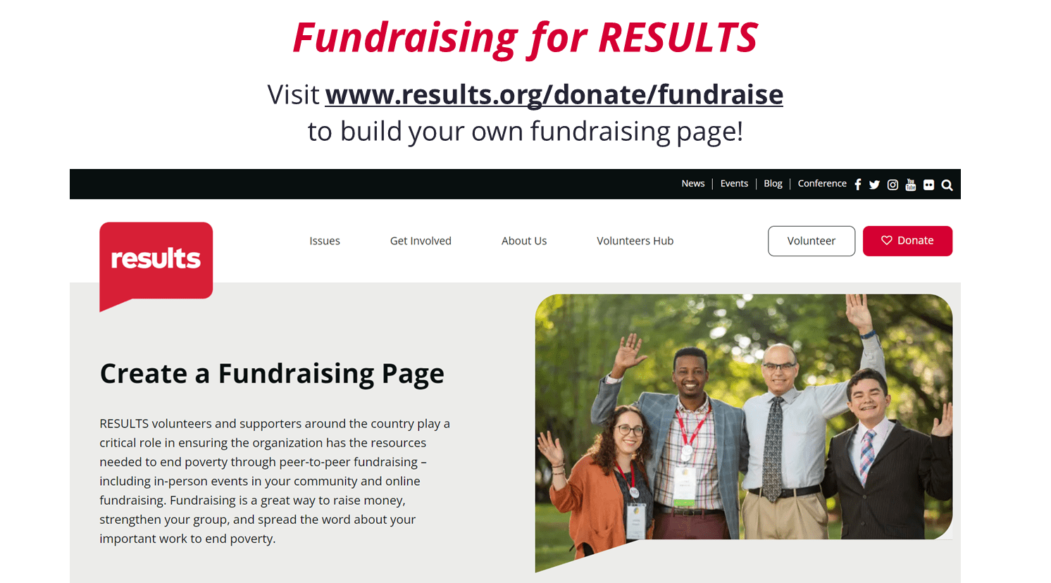

Slide 32
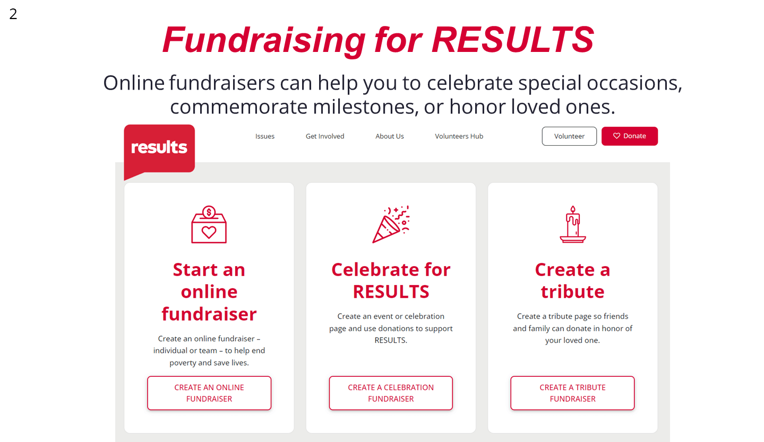

Slide 33
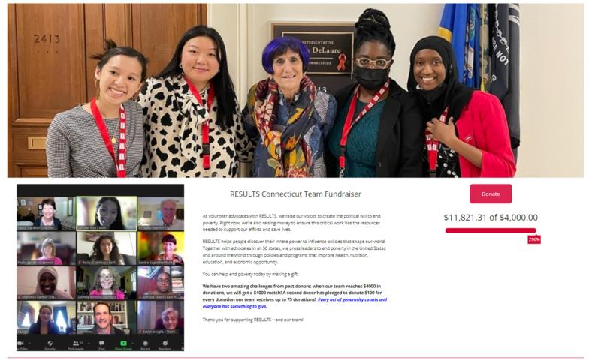

Slide 34
2023 Anti-Oppression Trainings
Disrupting Biases on Poverty & Classism – May 9, 8:00 pm ET facilitated by RESULTS Experts on Poverty. Register here.
Diversity & Inclusion 101 – May 23, 8:00 pm ET. Register here.
Applied Learning Simulation – June 30, 12:00 pm ET. Learn more.
Check out the details here:
2023 Spring Anti-Oppression Workshop Schedule
Notes:
Dr. Christina Gunther (3 mins)

Slide 35
Free Agents and New Advocate Orientations
Global Poverty Free Agents
May 8, 7:00 pm ET
Contact Lisa Marchal at lmarchal@results.org for information.
U.S. Poverty Free Agents
May 16, 1:00 pm ET and 9:00 pm ET (your choice)
Contact Jos Linn at jlinn@results.org for information.
2023 New Advocate Orientation sign-up page: https://tinyurl.com/NAdvOrientation23

Slide 36
Partner Organization Webinars
Global Allies Program: Partners Ending Poverty
with Returned Peace Corps Volunteers
May 11, 8:30 pm ET
Register at https://tinyurl.com/GlobalAllies223
Together Women Rise partnership webinar
May 16, 8:30 pm ET
Join at https://tinyurl.com/TWRPFeb

Slide 37
May Policy Forums
Thursday, May 18
8:00-8:45 pm ET: U.S. Poverty Policy Forum
Register today.
9:00-9:45 pm ET: Global Poverty Policy Forum
Register today.

Slide 38
Learning and Sharing Opportunities
Action Network Managers Webinar
May 17
Click for the 12:30 pm ET session
Click for the 8:00 pm ET session
No registration required.

Slide 39
Learning and Sharing Opportunities
Media Office Hour – Writing an op-ed training
May 17, 2:00 pm ET
Join via Zoom at https://results.zoom.us/j/93668005494
or (312) 626-6799, meeting ID 936 6800 5494.
No registration necessary.
Group Leader Office Hour
May 25, 7:30 pm ET
Join via Zoom at https://results.zoom.us/j/6602641580.
No registration necessary.

Slide 40
Learn with our Founder!
The RESULTS Champion Scale
with RESULTS Founder Sam Daley-Harris
Wednesday, May 31, 8:00 pm ET
Have you ever thought, “My member of Congress is opposed to our bills, what’s the point of meeting with them?” or “My member of Congress is good on our issues, there’s no reason to meet with them”? RESULTS founder Sam Daley-Harris will lead a workshop on “Moving Your Member of Congress Up the Champion Scale” from opposed
to neutral, to supporter, to advocate, to leader, and, eventually,
to champion. Join Sam for the fun.
Register today!

Slide 41
RESULTS Global Policy Work

Slide 42
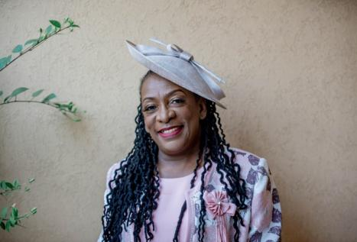
Carol Nawina Kachenga Executive Director of CITAMplus
Guest Speaker

Slide 43
2023 Plan to Accelerate TB
Increase TB funding
Use funding well to accelerate TB progress
Ensure US leadership on TB at UN High-Level Meetings on TB in September

Slide 44
1. Increase Funding
FY 24 House Appropriations Sign-On Letters
FINAL: Tuberculosis Dear Colleague Letter | FINAL: Global Maternal and Child Health and Nutrition Dear Colleague Letter | FINAL: International Basic Education Dear Colleague Letter | FINAL: Global Fund to Fight AIDS, TB, and Malaria Dear Colleague Letter
129 | 154 | 129 | 144

Slide 45
1. Increase Funding
FY 24 Senate Appropriations Sign-On Letters
FINAL: Tuberculosis Dear Colleague Letter | FINAL: Global Maternal and Child Health and Nutrition Dear Colleague Letter | FINAL: International Basic Education Dear Colleague Letter | FINAL: Global Fund to Fight AIDS, TB, and Malaria Dear Colleague Letter
33 | 42 | 36 | 38

Slide 46
2. Use Funding to Accelerate TB
End TB Now Act (S.288, H.R.1776)
Establish bold TB goals to reach most vulnerable
Strengthen coordination
Catalyze research and development
Improve country capacity to address TB
Accountability

Slide 47
2. Use Funding to Accelerate TB
End TB Now Act (S.288, H.R.1776)
May Ask for Congress: Please cosponsor the bipartisan End TB Now Act
Find bill fact sheet in "Set the Agenda"
Find online action to Congress, media action, laser talk in the Action Center of website

Slide 48
3. Ensure U.S. Leadership
Coming Soon: (Late May)
Bipartisan letter to the Biden Administration

Slide 49
49
Join the next
RESULTS National Webinar
Saturday, June 3 at 1:00 pm ET
See you next month!

