Slide 1
RESULTS National Webinar
March 4, 2023

Slide 2
Our Values & Resources
2
​At RESULTS we pledge to create space for all voices, including those of us who are currently experiencing poverty. We will address oppressive behavior in our interactions, families, communities, work, and world. Our strength is rooted in our diversity of experiences, not in our assumptions.
With unearned privilege comes the responsibility to act so the burden to educate and change doesn’t fall solely on those experiencing oppression. When we miss the mark on our values, we will acknowledge our mistake, seek forgiveness, learn, and work together as a community to pursue equity.
Read our full anti-oppression values statement here at results.org/values.
Check out the 2023 Spring Anti-Oppression Workshop Schedule for training opportunities.
Find these resources and more at results.org/volunteers/anti-oppression:
Resource Guides from our Diversity & Inclusion trainings, including:
Interrupting Microaggressions
Creating Space for Critical Conversations
Information on how RESULTS responds to oppressive incidents
Notes:
Updated AO slide (2/22)

Slide 3
Lakeisha McVey Senior Associate, Experts on Poverty Read more about the Experts on Poverty at https://results.org/experts-on-poverty
3
Welcome!

Slide 4
La’Shon Marshall (and her son Caleb) RESULTS volunteer (Detroit) and Expert on Poverty We encourage you to visit her tribute page and share remembrances of La’Shon (https://results.org/lashon)
4
Remembering La’Shon

Slide 5
Grassroots Café

Slide 6
Thank you for joining us!
Who is joining you in the room today?
In the poll, please respond with the number of people in the room with you (including yourself).

Slide 7
Welcome new RESULTS volunteers
Amanda Ortiz – Bronx, NY
Anissa Corralez - San Antonio, TX
Aubrey Molloy - New York, NY
Chloe Harris – Mesa, AZ
Degarland Mlo – Charlotte, NC
Denishea Williams - Cedar Hill, TX
Dorothy Venditto - Mount Kisco, NY
Elizabeth Brown – Nottingham, NC
Elizabeth Parent – Nottingham, MD
Faith Ayepola- West Haven, CT
Jonathan George – Indianapolis, IN
Julie McCrobie - New York, NY
Kate Crouthamel – Escondido, CA
Kelly Miller – Hueysville, KY
Lindsey Noyed – Minneapolis, MN
Lisa Huron – Leander, TX
Malachi Gillespie - Fort Collins, CO
Mary Ellen Koenn - Star City, WV
Rebecca Baker - San Antonio, TX
Valerie Gregorio – California, MD
Vanessa Yanez – Tucson, AZ

Slide 8
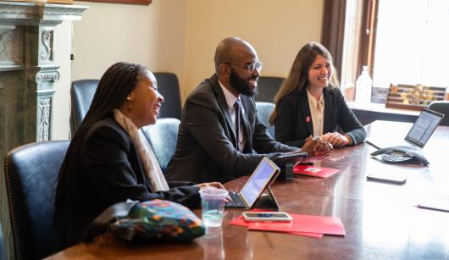
Set the Agenda!
results.org/set-the-agenda

Slide 9
Set the Agenda Campaign
https://results.org/set-the-agenda
Planning Goal: 100 percent of RESULTS groups complete their Group Roadmaps by January 31. 76 percent are complete.
If you have not updated your Group Roster and completed your Group Roadmap, please do so ASAP.
Contact Jos Linn with questions (jlinn@results.org).
Organizing Goal: Engage all new advocates in leadership by inviting them to attend and speak at congressional meetings. Most groups are reaching out to our 4,500 “warm leads” and getting some positive responses.
Use our Set the Agenda outreach guide (https://bit.ly/set-the-agenda).
If you have questions, contact Alicia Stromberg (astromberg@results.org).

Slide 10
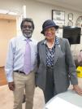
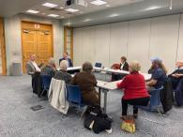
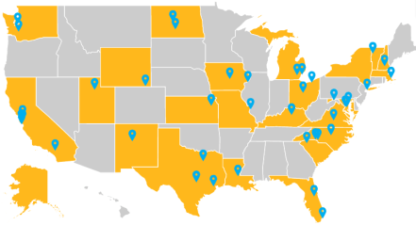
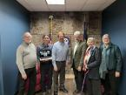
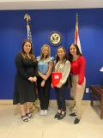
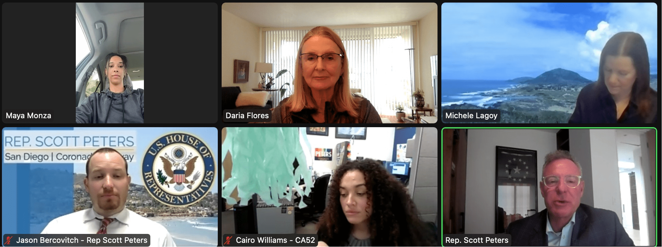
Set the Agenda Campaign
https://results.org/set-the-agenda
Advocacy Goal: Meet with 100 percent of congressional offices
we cover by end of March. Groups have had at least 40 meetings so far (with many more requests made)!

Slide 11
Set the Agenda lobbying resources
Set the Agenda resources: https://results.org/set-the-agenda. Find links to policy briefs, lobby leave-behinds, and laser talks.
Important! Please do not share background briefs with congressional offices. Only the Renter Tax Credit brief may be shared.
Submit meeting requests! Find sample meeting requests and other lobbying materials at: https://results.org/volunteers/lobbying.
Upcoming recesses: March 11-20 (House only); April 1-16 (House and Senate).
Set up your state lobby prep call to get ready for your lobby meetings. Contact Katie Fleischer (kfleischer@results.org) to schedule your prep call.

Slide 12
Let's practice our advocacy skills!
EPIC Laser Talk training!
Find all current Laser Talks at:
https://results.org/volunteers/laser-talks
Learn how to draft and deliver your own EPIC Laser Talk at:
https://results.org/resources/create-and-deliver-a-laser-talk

Slide 13
Breakouts
Let’s learn two of our laser talks.
For the laser talk on global TB appropriations, STAY WHERE YOU ARE.
For the laser talk on the Renter Tax Credit, GO TO THE BREAKOUT ROOM when promoted.
Find all out 2023 laser talks at: https://results.org/volunteers/laser-talks

Slide 14
U.S. Poverty Laser Talk Renter Tax Credit
Engage: The tax code provides billions in tax subsidies to homeowners, developers, businesses, and landlords, but almost nothing for the nearly 44 million Americans who rent.
Problem: Even employed households are having trouble keeping up with skyrocketing rents.
Inform: A Renter Tax Credit would help. The credit would be targeted to rent-burdened, low-income households and paid out on a monthly basis, essentially capping out-of-pocket rent and utilities costs at 30 percent of total income. This would allow low-income renters to afford a safe place to live without sacrificing other basic needs. It would broadly benefit households that existing housing and homelessness programs are unable to serve, resulting in fewer evictions and fewer people experiencing homelessness.
Call to Action: Stable housing is the foundation of financial security. Will you support using the tax code to target relief to renters with a Renter Tax Credit? May we follow up with you with more details on how to use the tax code in this way? What’s the best way to follow up with you?

Slide 15
Global Poverty Laser Talk Appropriations for global tuberculosis
Engage: Tuberculosis - an airborne bacteria - now kills more people each year than HIV and malaria combined.
Problem: COVID, conflict, and other crises have specifically taken a toll on the fight against tuberculosis. This disease drives and exacerbates global poverty, and it targets vulnerable populations. Alarmingly, TB cases increased in both 2020 and 2021. In 2021, 1.6 million people worldwide died from this often-curable disease.
Inform: The U.S. has been a leader in the fight against TB, and fiscal year 2024 decisions will soon be made in Congress by the committee that funds foreign aid.
Call to Action: Will you write and speak to the leadership of the State and Foreign Operations Subcommittee of Appropriations and ask that they include at least $1 billion for USAID bilateral tuberculosis funding in the FY24 spending bill? Will you also ask for at least $2 billion for the Global Fund to Fight AIDS, TB and Malaria?

Slide 16
Announcements

Slide 17
March Policy Forums
Thursday, March 16
8-8:45 pm ET: U.S. Poverty Policy Forum
Register today.
9-9:45 pm ET: Global Poverty Policy Forum
Register today.

Slide 18
2023 Anti-Oppression Work
Structural Racism – March 31, 12:00 pm ET
Oppression: The Missing Perspectives – April 28, 12:00 pm ET
Disrupting Biases on Poverty & Classism – May 11, 8:00 pm ET facilitated by RESULTS Experts on Poverty
Diversity & Inclusion 101 – May 23, 8:00 pm ET. Register at: https://results.zoom.us/meeting/register/tJMtc-mgqjsjGNHx51wSwXWrlNiujf3Ygt3y.
Notes:
Dr. Christina Gunther (3 mins)

Slide 19
Free Agents and New Advocate Orientations
U.S. Poverty Free Agents
March 21, 1:00 pm ET and 9:00 pm ET (your choice)
Contact Jos Linn at jlinn@results.org for information.
Global Poverty Free Agents
March 27, 7:00 pm ET
Contact Lisa Marchal at lmarchal@results.org for information.
2023 New Advocate Orientation sign-up page: https://tinyurl.com/NAdvOrientation23

Slide 20
Partner Organization Webinars
Together Women Rise partnership webinar
March 21, 8:30 pm ET
Join at https://tinyurl.com/TWRPFeb
Global Allies Program: Partners Ending Poverty
with Returned Peace Corps Volunteers
March 22, 8:30 pm ET
Register at https://tinyurl.com/GlobalAllies223

Slide 21
Learning and Sharing Opportunities
Action Network Managers Webinar
March 15
Click for the 8:00 pm ET session
No mid-day session this month.
No registration required.
Media Office Hour
March 22, 2:00 pm ET
Join via Zoom at https://results.zoom.us/j/93668005494
or (312) 626-6799, meeting ID 936 6800 5494.

Slide 22
U.S. and Global Poverty Policy Section

Slide 23
Our long-term goal: Economic Justice through the tax code
Child Tax Credit (CTC)
Address Our Housing Crisis

Slide 24
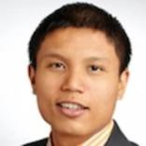
Cara Baldari First Focus on Children www.firstfocus.org
24
U.S. Poverty Policy
Guest Speakers
Stacy Pollard Family Promise
www.familypromise.org
Facilitated by Michael Santos
RESULTS U.S. Poverty Associate Director

Slide 25
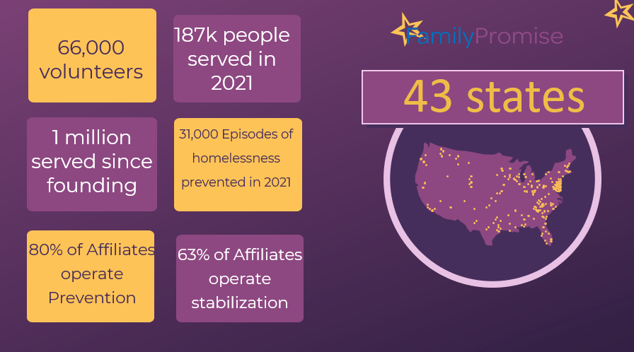
25

Slide 26
26

Slide 27
State of Play on the Hill
27
Bipartisanship still possible and key to getting something done in current Congress
Lobby meetings key to setting agenda, lay groundwork for possible tax legislation later this year.

Slide 28
State of U.S. Economy
28
Employment rose and joblessness is at an all-time low.
But Americans feel poorer because of lingering inflation: the average consumer good cost 6.4 percent more in January 2023 than in January 2022. Food costs rose 10 percent.
Lower-income Americans are struggling the most.
In the Gallup poll, 61 percent of low-income respondents said they are worse off than a year ago, compared to 43 percent of upper-income people.
Securing housing in the current market remains challenging for many.

Slide 29
Additional Resources
29
Set the Agenda Campaign Materials
Renter Tax Credit
Policy Brief
RTC Video
How to Effectively Talk to Your Lawmakers About the RTC
Hawaii State-Level Renter Tax Credit on the news!
Where Other States Are on Renter Tax Credits
RTC Leave Behind
Child Tax Credit
Policy Brief
Making the Conservative Case for CTC
CTC Leave Behind
Resources from today's speakers
FF Policy Brief on Child, Family and Youth Homelessness (2021)
FF Fact Sheet on Child Poverty (latest annual child poverty data)
It is way too early to declare victory over child poverty (blog)
Family Promise List of Affiliates

Slide 30
30
Take Action on Key U.S. Poverty Priorities
Child Tax Credit Tell your member to urge colleagues – especially on Senate Finance and House Ways and Means – and leadership to expand the Child Tax Credit (CTC) with monthly payments prioritizing the lowest-income families in any tax legislation this year.
Renter Tax Credit Urge your member and their staff to read the RESULTS Renter Tax Credit policy brief to get more information about how this works. In addition, urge them to do their own research on tax policies that help lower-income renters, and to meet directly with constituents struggling with rent costs to discuss policy solutions

Slide 31
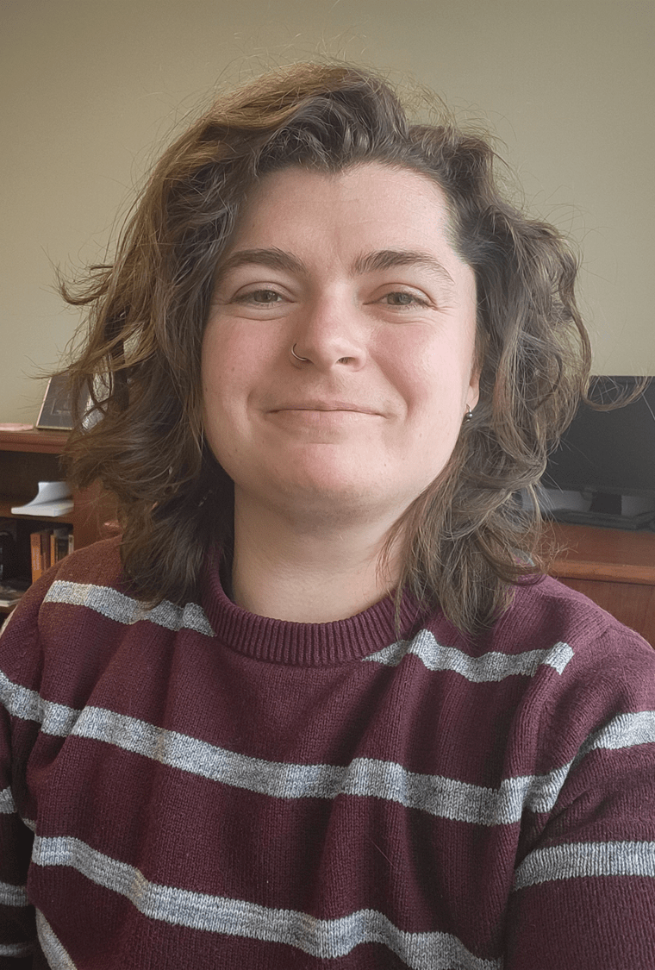
U.S. Poverty Policy Staff Announcement
Gabe Hafemann (they/them) Congressional Hunger Center
2023 RESULTS Bill Emerson National Hunger Fellow

Slide 32
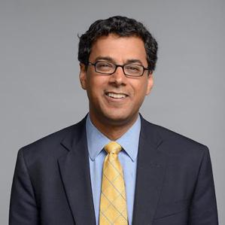
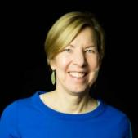
32
Global Poverty Policy
Guest Speaker
Atul Gawande Assistant Administrator for Global Health,
U.S. Agency for International Development (USAID)
Facilitated by Joanne Carter RESULTS Executive Director

Slide 33
33

Slide 34
FY24 Appropriations Requests
Account | FY21 | FY22 | FY23 | RESULTS’ FY24 Request
USAID Tuberculosis | $319 million | $371 million | $394.5 million | $1 billion
USAID Maternal and Child Health | $855 million | $890 million | $910 million | $1.15 billion
Of which, Gavi | $290 million | $290 million | $290 million | $340 million
USAID Nutrition | $150 million | $155 million | $160 million | $300 million
USAID International Basic Education | $950 million | $950 million | $970 million | $1.2 billion
Of which, Global partnership for Education | $125 million | $125 million | $130 million | $200 million
Global Fund to Fight AIDS, TB, and Malaria | $1.56 billion | $1.56 billion | $2 billion | $2 billion

Slide 35
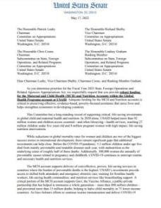
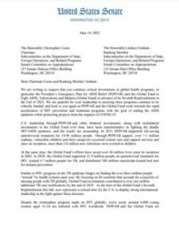
asking members of Congress to sign “Dear Colleague” letters on funding.
we influence appropriations by…
results.org/blog/fy24-appropriations-tell-congress-to-fund-the-fight-against-poverty

Slide 36
Appropriations Process
36
House Side Deadlines:
SFOPS Member Day – March 8th
SFOPS Committee deadline – March 24th
Most personal office deadlines are coming up soon!
Senate Side Deadlines:
SFOPS Committee deadline – April 12th
All personal office deadlines will be before that date.
Cheat sheets and leave-behinds:
results.org/resources/fy24-global-appropriations-memos

Slide 37
37
Join the next
RESULTS National Webinar
Saturday, April 1 at 1:00 pm ET
This webinar will focus on engaging people with the lived experience of poverty. It is hosted by the RESULTS Experts on Poverty.

