Slide 1
RESULTS National Webinar
December 3, 2022
Welcome!

Slide 2
Our Anti-Oppression Values
2
​RESULTS is a movement of passionate, committed everyday people. Together we use our voices to influence political decisions that will bring an end to poverty. Poverty cannot end as long as oppression exists. We commit to opposing all forms of oppression, including ableism, ageism, biphobia, classism, colonialism, homophobia, racism, religious discrimination, sexism, transphobia, white saviorism, and xenophobia.
At RESULTS we pledge to create space for all voices, including those of us who are currently experiencing poverty. We will address oppressive behavior in our interactions, families, communities, work, and world. Our strength is rooted in our diversity of experiences, not in our assumptions.
With unearned privilege comes the responsibility to act so the burden to educate and change doesn’t fall solely on those experiencing oppression. When we miss the mark on our values, we will acknowledge our mistake, seek forgiveness, learn, and work together as a community to pursue equity.
There are no saviors — only partners, advocates, and allies. We agree to help make the RESULTS movement a respectful, inclusive space.
Find all our anti-oppression resources at https://results.org/volunteers/anti-oppression/

Slide 3
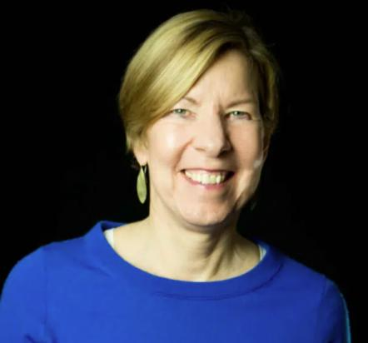
Joanne Carter Executive Director RESULTS/RESULTS Educational Fund
3

Slide 4
Guest Speaker Sen. Sherrod Brown D-OH
4

Slide 5
Legislative Update

Slide 6
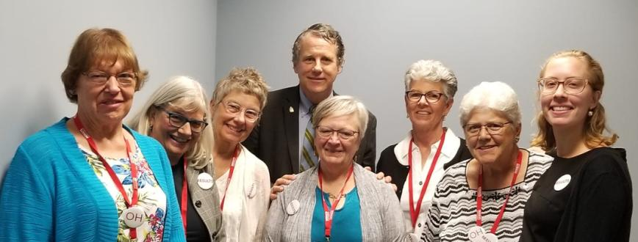
Grassroots Share
6
Liz Clerkin, RESULTS Cleveland (center)
with Sen. Sherrod Brown and fellow Ohio RESULTS volunteers
Notes:
MD revise before webinar, mention “year-end” = multiple approps bills, otherwise known as an omnibus. Key because that is the vehicle (vs a Continuing Resolution or CR) for any tax provisions – and Republican Senate Finance Committee staff if comes 9:25
Most of this presentation is now going to focus more on potential responses from more conservative audiences.
MD Dem strategy then
DP GOP strategy

Slide 7
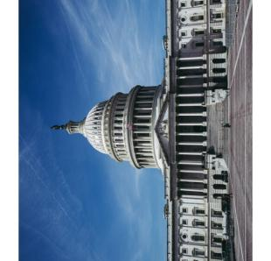
Latest from Capitol Hill
7
Some uncertainty on whether a larger year-end package will come together
Conversations between Republicans and Democrats are starting now on a potential year-end tax package
Republicans (and some Democrats) want to extend R&D and other corporate tax breaks
Goals: Build enough bipartisan support/willingness so CTC for lowest-income families can pass in a larger package
Notes:
MD revise before webinar, mention “year-end” = multiple approps bills, otherwise known as an omnibus. Key because that is the vehicle (vs a Continuing Resolution or CR) for any tax provisions – and Republican Senate Finance Committee staff if comes 9:25
Most of this presentation is now going to focus more on potential responses from more conservative audiences.
MD Dem strategy then
DP GOP strategy

Slide 8
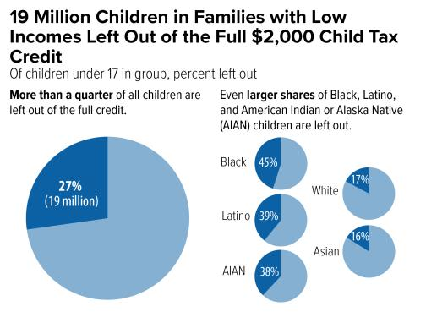
Notes:
MD 9:12 Many of you saw this new data on our November 17 webinar but I thought it would be helpful to go through it again – and to highlight that there are new state-specific numbers you can use in your advocacy the next few weeks.
As a reminder, last year was historic – we saw huge reductions in child poverty. For the first time, the CTC was fully available to the lowest income families. As a reminder, this is often called “full refundability”.
As of now, we are back at “current law” and this means that the policymakers have left millions of the lowest-income families out of receiving the full value of the CTC. New estimates from CBPP indicate that 19 million children in those lowest-income families are again left out from the Child Tax Credit under current law. Some families – those with the lowest incomes or no incomes, get no CTC at all while others only get a portion of the CTC that higher-income families can claim. State numbers from the new CBPP estimates are embedded in your leave behinds.
As I noted during our November 17 webinar: Here is a major policy designed to help with the costs of raising children that leaves out 19 million children whose families face challenges meeting basic expenses. This is a reminder of how skewed policymaking can be – and why people like you raising your voices is so important.
And, it is important to recognize the disparate impact of these policies. Because of the legacies of systemic and ongoing racism and other forms of oppression, Black families and other people of color are overrepresented in low-paid work. As you can see here, 45% of Black children and almost 40% of Latino and American Indian & Alaskan Native children are left out of the full CTC. It is critical that we pass policies that close these racial poverty gaps – and do more to achieve racial equity and counter forms of intersecting oppression.
In addition, 1/3 of children in rural areas https://www.cbpp.org/research/federal-tax/year-end-tax-policy-priority-expand-the-child-tax-credit-for-the-19-million#appendix-table-1 – higher percentage than in metropolitan. These percentages for your state are also in your leave behind.
Also 670,000 children in veteran households nationwide are left out of CTC for lack of sufficient income.
So, let’s pause for a moment and pair up to practice how we are going to make the case for why each of us thinks expanding the CTC is important. 9:15-9:20

Slide 9
Tell Congress to extend the expanded Child Tax Credit (CTC)
The CTC strengthened families and helped them weather tough times (and share your story!)
Urge Congress to prioritize expanding the CTC in year-end legislation
Share that you oppose more tax breaks for large corporations unless they include support for families
Notes:
Anything can happen – if it doesn’t not lack of trying. You are tip of the spear – playing critical role in this… don’t stop now.
Here’s how to get your whole group involved: 1. Point person reach out to Senate tax aide. 2. everyone (Action Network) call-in 12/7 call-in – we’ll send alert out on Wed, forward along and call yourselves. …
DP your story has power – for those that can, I urge you to share why you think the CTC should be expanded. 9:40

Slide 10
Engaging Senate Offices: Extend CTC
Can we count on Sen. ____________ to relay that expanding the CTC is a priority in the next few days with both Leadership and Senate Finance Committee members?
Can you let us know what actions your office is taking to support the CTC? We’d love to amplify what you all are doing.
How should we follow up?
Notes:
This is for those of you who are Senate point people. And, I’ve got more detailed
DP for some of you
So, let’s pause for a moment and pair up to practice how we’ll make the “ask” 9:45-9:50

Slide 11
December Action
11
Keep getting media published on the Child Tax Credit.
It’s working – you’ve gotten 45 CTC media pieces since November 1!
TAKE ACTION!
If you have two minutes… personalize the media templates on our website and hit send!
If you have twenty minutes… use our December Action Sheet to draft your letters to the editor and send them to your local newspaper.
If you need help with your letters, please contact Jos Linn for assistance.
Notes:
3. media… Jos draft. Don’t say permanent.

Slide 12
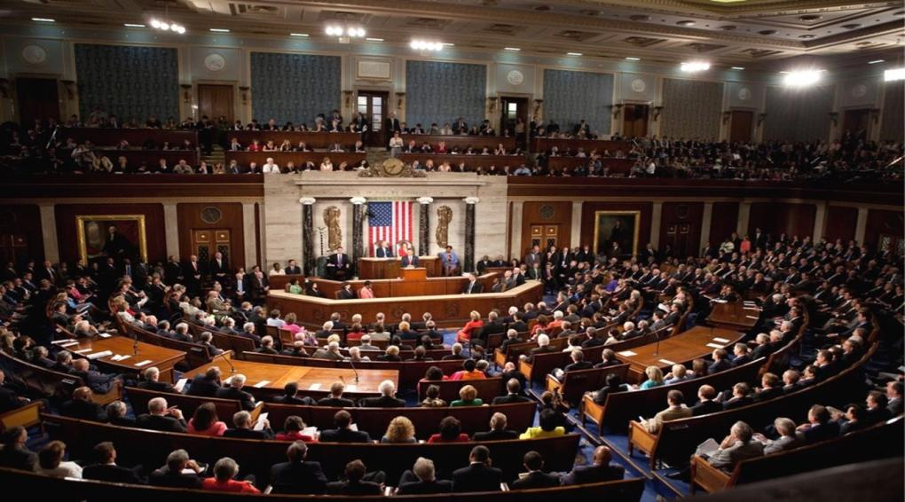
End of Year Opportunity
Congress is negotiating an omnibus bill that could include global health funding and the CTC. But some Republicans may want to extend the deadline with a continuing resolution (CR).
Take Action: Tell your members that we need an end of year omnibus with our policy priorities, NOT a continuing resolution!

Slide 13
RESULTS appropriations advocacy issues
13
OUR ISSUES
Ending the tuberculosis epidemic
Ending preventable maternal and child deaths
Ensuring access to quality education for
all children

Slide 14
Global Legislation Status
results.org/fall2022

Slide 15
SFRC Members
15
Majority Members
Menendez, Robert (NJ), Chairman
Cardin, Benjamin L. (MD)
Shaheen, Jeanne (NH)
Coons, Christopher A. (DE)
Murphy, Christopher (CT)
Kaine, Tim (VA)
Markey, Edward J. (MA)
Merkley, Jeff (OR)
Booker, Cory A. (NJ)
Schatz, Brian (HI)
Van Hollen, Chris (MD)
Minority Members
Risch, James E. (ID), Ranking Member
Rubio, Marco (FL)
Johnson, Ron (WI)
Romney, Mitt (UT)
Portman, Rob (OH)
Paul, Rand (KY)
Young, Todd (IN)
Barrasso, John (WY)
Cruz, Ted (TX)
Rounds, Mike (SD)
Hagerty, Bill (TN)

Slide 16
HFAC Members – Majority
16
Meeks, Gregory (NY), Chair
Malinowski, Tom (NJ), Vice Chair
Sherman, Brad (CA)
Sires, Albio (NJ)
Connolly, Gerry (VA)
Deutch, Ted (FL)
Bass, Karen (CA)
Keating, Bill (MA)
Cicilline, David (RI)
Bera, Ami (CA)
Castro, Joaquin (TX)
Titus, Dina (NV)
Lieu, Ted (CA)
Wild, Susan (PA)
Phillips, Dean (MN)
Omar, Ilhan (MN)
Allred, Colin (TX)
Levin, Andy (MI)
Spanberger, Abigail (VA)
Houlahan, Chrissy (PA)
Kim, Andy (NJ)
Jacobs, Sara (CA)
Manning, Kathy (NC)
Cherfilus-McCormick, Sheila (FL)
Costa, Jim (CA)
Vargas, Juan (CA)
Gonzalez, Vicente (TX)
Schneider, Brad (IL)

Slide 17
HFAC Members – Minority
17
McCaul, Michael (TX)
Ranking Member
Wagner, Ann (MO)
Vice Ranking Member
Smith, Chris (NJ)
Chabot, Steve (OH)
Wilson, Joe (SC)
Perry, Scott (PA)
Issa, Darrell (CA)
Kinzinger, Adam (IL)
Zeldin, Lee (NY)
Mast, Brian (FL)
Fitzpatrick, Brian (PA)
Buck, Ken (CO)
Burchett, Tim (TN)
Green, Mark (TN)
Barr, Andy (KY)
Steube, Greg (FL)
Meuser, Dan (PA)
Tenney, Claudia (NY)
Pfluger, August (TX)
Malliotakis, Nicole (NY)
Meijer, Peter (MI)
Jackson, Ronny (TX)
Kim, Young (CA)
Salazar, Maria (FL)

Slide 18
Grassroots Café

Slide 19
Thank you for joining us!
19
Who is joining you in the room today?
In the poll, please respond with the number of people in the room with you (including yourself).

Slide 20
YOU ARE FANTASTIC! 2022 Highlights by the Numbers (so far!)

Slide 21
Lobby meetings 401! (151 Senate, 246 House, 4 Candidates)

Slide 22
More Success!
Media Hits
422!
Outreach Efforts
33+

Slide 23
What RESULTS victory from 2022 are you celebrating?
23
Breakout Rooms
Photo by Bryan Lopez on Unsplash

Slide 24
We welcomed…
24
200+
new volunteers

Slide 25
Outreach & Partnerships Coordinators
25
Chloe Brown -Burlington, VT
Korban Christensen - Fort Wayne, IN
Molly Dreznick - Baton Rouge, LA
Stephanie Gonzalez - Kansas City, MO
Akia Guillotte – Gulfport, MS
Eliza Hardy – Tempe, AZ
Jennifer Quinlivan -Cheyenne, WY
Takoda Wheeler – Corvallis, OR

Slide 26
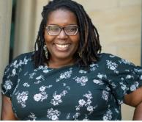
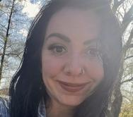
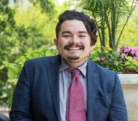
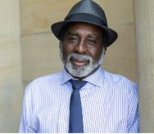
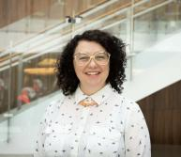
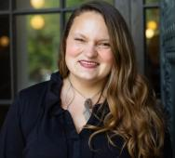
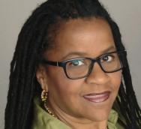
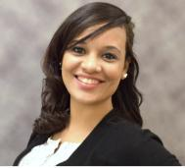
Celebrating our Experts on Poverty
26
Learn more at results.org/experts-on-poverty

Slide 27
Congratulations 2022 Fellows
27
results.org/fellowship

Slide 28
End Of Year Celebrations: Action Networks and their Managers!

Slide 29
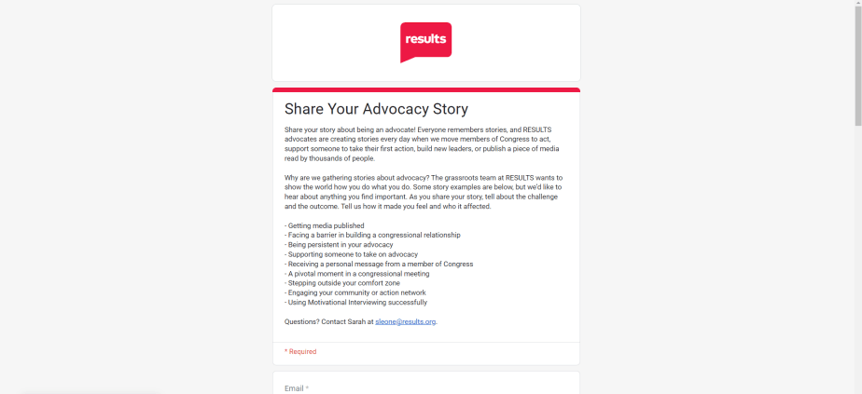
Share Your Advocacy Story!

Slide 30
Announcements

Slide 31
Let us know about your…
31
2022 successes. If you have unreported lobby meetings, media, outreach events, please let us know at: https://results.org/volunteers/reporting-your-advocacy-actions.
Thoughts on 2023 in-person events. Let us know how you feel about RESULTS doing in-person gatherings next year. Fill out our grassroots survey now at: https://docs.google.com/forms/d/e/1FAIpQLSfNT1TcVj1KMtGuc1-ea1cx_KfNLTVjEXcHrxBEmbXaKnly5g/viewform.
Deadline to complete the survey is this Monday, December 5.

Slide 32
Partner Org. Webinars
32
Global Allies Program: Partners Ending Poverty
with Returned Peace Corps Volunteers
December 8, 8:30 pm ET
Register: https://results.zoom.us/meeting/register/tJEld-Ggqz4vG9ObuUh2QzlbQnMK94FaCDVb
Together Women Rise partnership webinar
December 13, 8:30 pm ET
For more information:
https://togetherwomenrise.org/advocacy/results-parntership/

Slide 33
Learning and Sharing Opportunities
33
Action Network End of Year Celebration webinars! (your choice)
November 16
Register for 12:30 pm ET webinar: https://tinyurl.com/RANMW1230
Register for 8:00 pm ET webinar: https://tinyurl.com/RANMW9

Slide 34
Learning and Sharing Opportunities
34
Global Poverty Free Agents
December 12, 7:00 pm ET
Contact Lisa Marchal at lmarchal@results.org for information on how to join.
U.S. Poverty Free Agents
December 13, 1:00 pm ET and 9 pm ET (your choice)
Contact Jos Linn at jlinn@results.org for information on how to join.
Media Office Hour
December 14, 2:00 pm ET
Join via Zoom at https://results.zoom.us/j/93668005494
or (312) 626-6799, meeting ID 936 6800 5494.

Slide 35
Group Planning materials coming!
35
Group Planning will be a major focus in January. 2023 will be a pivotal year for all groups to do planning.
Materials will be available in mid-December for groups who want to do 2023 planning early.
Look for more info about planning in the Weekly Update and on January 2023 National Webinar.

Slide 36
36
See you next month!
Join the next
RESULTS National Webinar
Saturday, January 7 at 1:00 pm ET
Note: We will use a new National Webinar Zoom number in 2023. Everyone will need to register for the January webinar. Look for the registration link in the Weekly Update.

