Slide 1
U.S. Poverty – Policy Forum
October 20, 2022
Welcome!
Notes:
Welcome everyone! Happy October! My name is Michael Santos, Senior Policy Associate

Slide 2
RESULTS Anti-Oppression Values
​RESULTS is a movement of passionate, committed everyday people. Together
we use our voices to influence political decisions that will bring an end to poverty.
Poverty cannot end as long as oppression exists.
We commit to opposing all forms of oppression, including racism, classism, colonialism, white saviorism, sexism, homophobia, transphobia, ableism, xenophobia, and religious discrimination. ​
At RESULTS we pledge to create space for all voices, including those of us who are currently experiencing poverty. We will address oppressive behavior in our interactions, families, communities, work, and world. Our strength is rooted in our diversity of experiences, not in our assumptions. ​
With unearned privilege comes the responsibility to act so the burden to educate and change doesn’t fall solely on those experiencing oppression. When we miss the mark on our values, we will acknowledge our mistake, seek forgiveness, learn, and work together as a community to pursue equity.
There are no saviors — only partners, advocates, and allies. We agree to help make the RESULTS movement a respectful, inclusive space.​
Find all our anti-oppression resources at: https://results.org/volunteers/anti-oppression/

Slide 3
Renter’s Tax Credit &
Achieving Economic Justice
Notes:
We will learn how to engage with lawmakers and candidates on the Renter’s Tax Credit and our long-term goal of achieving economic justice using the tax code.
A renter's tax credit is a form of tax benefit that targets renters and goes through the tax code, particularly for the benefit low-income renters. There is currently no federal renter's tax credit, but some states do have them.
We have been getting information and feedback from gr, eops, and external stakeholders that has informed the campaign. And we will continue to do so in the coming weeks / months. We wanted to err on the side of inclusivity, making sure we include information for all levels
We will keep an eye on questions and will try to answer them as we go along. But if we run out of time, you can always email or call me.

Slide 4
State-Level Renter’s Tax Credits
23 states currently offer some type of renter’s tax credit or deduction
Deductions: IN, MA, NJ​
Non-Refundable Credits: AZ, CA, HI, MD, MI, MO, RI, UT​
Categorical Eligibility (only for elderly and/or disabled): AZ, CO, CT, IA, MO, MT, NM, ND, PA, RI, UT​
Others have refundable credits, but often they are not enough: CA: $60, HI: $50
Noteworthy states: MN, DC
Two states recently introduced legislation: KY, NE
Notes:
Evaluating state-level credits can give us an idea of how to target, determine eligibility for, and disburse credit. We looked at the elements of RTC earlier:
Categorical eligibility, income thresholds, credit amounts, formulas for calculation, necessary documents/proof, but there are other policy considerations
Marriage penalty
Benefits through rebate system (like CO) vs. Tax returns
Income / work requirements
Household size (MD accounts for size of household)
Credit calculations (limited legislative history + language)
We can use the structure, language, and qualifications to think about what a federal-level policy would look like
As a reminder, a deduction/nonrefundable/categorical eligibility is... See prior slides.
We have a list of state level renter’s tax credits that we will make available to you: state renters' tax credits.xlsx
Good examples: MN, DC
It should inspire you to look at potential communities for targeting outreach bc they benefit from credit; complementary of other benefits, like ssi, disability, etc. – thinking about the other work we’re doing – expanding our capacity and recruiting. As part of advocacy strategy – before you meet with lawmakers or candidates: what do others think about RTC? And you have an important role to play because you are not a special interest group asking for direct assistance.

Slide 5
Elements of RTC
Eligibility
Income requirements/caps
Age, (dis)ability, geographical area
Delivery
Landlord or tenant?
Periodic or annually?
Required Documents
Lease, rent receipts, proof of residency
Amount Calculation
Universal payment or relationship between income, rent payment, and/or local fair market rent
Notes:
Elements that we are not tied to, still determining with gr and stakeholders
Amount calculations: tying to FMR. The amount of credit will be the sticking point – it’s a DIFFICULT policy design (no one fix, no quick fix). But the amount would also help inform the structure, who gets it, how much helpful it can be to people. The amount can be structured based on your input, based on what we’re hearing on the Hill and how lawmakers want to structure it. We’re going to spend the next few months as we build up the campaign on determining the elements and design of RTC.
There will be constraints in determining amount (and the rest of the design), to be capped by costs. But we’re not going to be focused on the costs yet (estimated to be $76B). Before we talk about the costs, we want to generate the political will – hence the work ahead.

Slide 6
Why is renter's tax credit needed?
Unaffordable rents
Housing shortage
Notes:
Skyrocketing rents are affecting everyone. https://www.nytimes.com/2022/10/15/business/economy/rent-tenant-activism.html - NYT reported on how rent affordability crisis is affecting everyone
Inflation still high
A strong labor market - The combination of historically high job openings, steady consumer spending and federal stimulus gave workers leverage in the job market.
Housing shortage drives prices higher - A national shortage of affordable housing is putting pressure on American budgets and weighing heavily on inflation figures. The recovery from the COVID-19 recession has only made it worse.
While the Fed intends to slow activity in the housing sector by jacking up mortgage rates, the resulting slowdown in home sales has forced would-be homebuyers into a crowded rental market, where the number of affordable apartments and rental homes has long fallen short of demand.

Slide 7
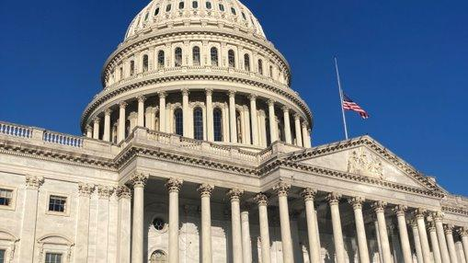
Notes:
Legislative landscape + opportunities ahead
Overview of the Campaign
Work on supply of affordable housing underway
Political pressures on addressing visible forms of poverty, criminalization

Slide 8
Bipartisanship
Seeing support for state-level renter’s tax credits from BOTH Democrats and Republicans
Bipartisan bills in state legislature to expand and increase credits in CA, MN, and MO
Republican support for programs that use categorical eligibility (CA, CT, MN, MT)
Main source of contention will likely be cost, work requirements
Notes:
Importance of exploring different options: we can play with elements to reduce costs, address issues that may cause contention
- https://sd07.senate.ca.gov/news/2022-01-12-40-legislators-call-increase-renters-tax-credit#:~:text=California%20has%20not%20increased%20the,hit%20hard%20during%20COVID%2D19.
- https://www.minnpost.com/state-government/2022/05/minnesota-lawmakers-say-they-have-a-deal-on-what-would-be-largest-tax-cut-in-state-history/
https://www.thecentersquare.com/missouri/bill-would-give-more-missouri-seniors-disabled-increased-property-tax-relief/article_f0f7262e-9350-11ec-a3fe-b381753e64e2.html
Bipartisanship will be key to get things done. And reading the political headwinds, bipartisanship will be the theme for the rest of this year and very likely next year – where it is predicted that Republicans will retake the majority in the House. It’s unlikely that one party will maintain control of the House, Senate, and the White House – the trifecta – next year (which is what we have now).

Slide 9
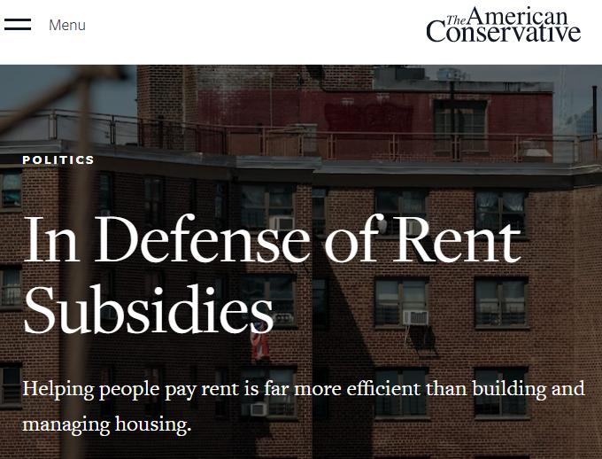
Notes:
https://www.theamericanconservative.com/in-defense-of-rent-subsidies/
The long-term answer to surging prices is to allow more housing. But when people find themselves stretched too thin, the best solution is fast cash subsidies for people in market-rate housing.
cash is the best way to deliver housing subsidies. Helping people pay rent is far more efficient than building and managing housing.
Makes the case for no work requirements: "But we shouldn't, out of principle, allow suffering simply to “build character.” Helping people with housing costs via subsidies might result in some abuse, but surely will not result in the erosion of people's character; massive tax-credit programs for building projects, by contrast, encourage blind money grubbing among already-wealthy organizations, non-profits, consultants, and lawyers."
Cash can subsidize work, not indolence, and allow people to save, pay down debt, and ultimately, lever themselves out of generational poverty.

Slide 10
Who needs RTC? How can it help?
Low-income tenants
Families with children
Students, young people
Employees
People with disabilities
Senior / Elderly
Landlords
Notes:
Talking about who needs RTC can also touch on some of the overarching principles and values that inform our long-term campaign... expanding the definition of poverty, changing the narrative (and not buying into comparing people's stories and traumas), how an ounce of prevention is worth a pound of cure (preventative vs. Reactive – preventing evictions, preventing homelessness), achieving racial justice / addressing the racial wealth gap through economic justice, economic security.
For families with children: https://www.washingtonpost.com/business/interactive/2022/cost-raising-child-calculator/?itid=hp_business_1

Slide 11
U.S. Poverty Guest Speaker Danielle Bautista Senior Policy Associate SaverLife
11
Notes:
Discussion questions:
Can you introduce yourself and your affiliation with RESULTS? Where are you from?
Can you tell us more about CA renter's tax credits? Where is it now?
You've done quite a bit of advocacy with RESULTS this year and our policy priorities both on housing and CTC. Can you talk about how these issues intersect with economic justice? How does this intersection show up in both your personal/professional life?
How do you communicate to members of Congress about these issues?
Are there any lessons learned from your advocacy (both within and outside of RESULTS) that you'd like to share with other grassroots?

Slide 14
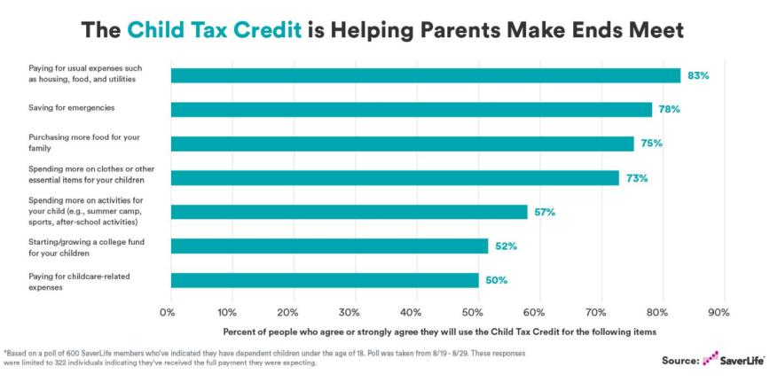

Slide 18
Notes:
In light of the information we just shared with you, what would be most helpful to hear about or learn from this topic as we approach the end of the year and the beginning of a new Congress?

Slide 19
Join our special, post-election
U.S. and Global Poverty Policy Forum
RESULTS Post-Election Webinar: What's next in the fight against poverty?
Thursday, November 17, 8:30-9:30 pm ET
This is a fantastic opportunity for new and current advocates to get informed, energized, and motivated to move our U.S. and global poverty agenda forward!
Register at: https://results.zoom.us/meeting/register/tJAufu6upj8sG9c2Hx6HFenFh3vC3lgsLcqO
Use this guide to invite people you know to attend

