Slide 1
US Poverty Policy Forum
September 21, 2022
Making the Conservative Case for the CTC

Slide 2
Welcome and Icebreaker
Thank You for Joining us Tonight!
Please share in the chat:
Your name
Where you are joining from tonight
One argument against expanding the CTC that you have heard

Slide 3
Our Anti-Oppression Values
​RESULTS is a movement of passionate, committed everyday people. Together we use our voices to influence political decisions that will bring an end to poverty. Poverty cannot end as long as oppression exists. We commit to opposing all forms of oppression, including ableism, ageism, biphobia, classism, colonialism, homophobia, racism, religious discrimination, sexism, transphobia, white saviorism, and xenophobia.
At RESULTS we pledge to create space for all voices, including those of us who are currently experiencing poverty. We will address oppressive behavior in our interactions, families, communities, work, and world. Our strength is rooted in our diversity of experiences, not in our assumptions.
With unearned privilege comes the responsibility to act so the burden to educate and change doesn’t fall solely on those experiencing oppression. When we miss the mark on our values, we will acknowledge our mistake, seek forgiveness, learn, and work together as a community to pursue equity.
There are no saviors — only partners, advocates, and allies. We agree to help make the RESULTS movement a respectful, inclusive space.
Find all our anti-oppression resources at https://results.org/volunteers/anti-oppression/

Slide 4
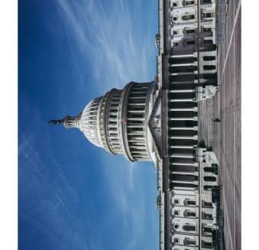
Latest from Capitol Hill
Expanded CTC was not included in reconciliation (Inflation Reduction Act)
Best chance for legislation expanding the CTC in 2022 will be in a bipartisan end of year tax package
Influence ongoing conversations now – will need broad bipartisan support for final negotiations
Strategy is to use corporate tax breaks (R&D etc) as leverage to get CTC
Notes:
Note that final negotiations after election, more intense.

Slide 5
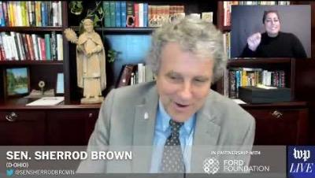
Congressional Champions in the News
5
Sens. Brown, Booker, Bennet and Reps. DelBene, DeLauro, and Torres release statement on heels of Census Poverty Data
“Today’s Census data confirms that the expanded Child Tax Credit worked: it allowed the hard work of tens of millions of parents to pay off and helped them keep up with the cost of living, dramatically reducing child poverty and hunger. We should have never allowed this critical program to lapse, and we should not extend corporate tax breaks at the end of this year without also extending the expanded Child Tax Credit.”
Sen. Sherrod Brown on Washington Post Live

Slide 6
Making the Conservative Case for the CTC
Three key things to do to connect with your Conservative MOC
Find shared sources
Find shared values
Find shared goals
Link to Blog: https://results.org/blog/making-the-conservative-case-for-the-ctc

Slide 7
Making the Conservative Case for the CTC
Finding Shared Sources
We need to have a shared set of facts to begin discussion
Some Conservative/Nonpartisan sources to consider:
Niskanen Center
American Enterprise Institute
National Bureau of Economic Research
Congressional Republican’s Statements
Government Data (Census, CBO)

Slide 8
Making the Conservative Case for the CTC
Finding Shared Values
Consider workshops on Motivational Interviewing where we have discussed finding shared values. Link to past Motivational Interviewing training
Some values you may share with conservatives:
Bipartisanship
Family Stability & Self-Sufficiency
Parental Freedom
Economic Growth (especially locally)

Slide 9
Making the Conservative Case for the CTC
Finding Shared Goals
This is the biggest challenge
Objective: align on shared goal to expand the CTC (even if it is “reluctant acceptance”)
Put it all together in one clear compelling case – tailored elevator speech
Must be ready for pushback

Slide 10
Making the Conservative Case for the CTC
Common Arguments against CTC Expansion from Lobby Reports
Costs too much/Increases Inflation
Disincentivizes work
Not the place of government to promote the general welfare of the people
Partisanship

Slide 11
Common Arguments against CTC Expansion
Costs too much/Increases Inflation
Corporate tax breaks also have high costs, if we can afford those, we can afford CTC
Janet Yellen told Sen. Brown inflation “has utterly nothing to do with the CTC”
Former Treasury Secretaries Robert Rubin and Jack Lew OpEd supporting CTC

Slide 12
Common Arguments against CTC Expansion
Disincentivizes work
Univ. of Chicago Study rebuttal by Niskanen Center
Real world evidence by Tax Policy Center and NBER
CTC helped people go to work i.e. childcare, transportation, stable housing
1.4 million left the workforce when CTC ended
New Twitter thread from CBPP showing no change in employment in 2021 from Census data
Make the ”moral argument” that the CTC is proven to reduce child poverty and should be expanded

Slide 13
Common Arguments against CTC Expansion
Not the place of government to promote the general welfare of the people
CTC improves parental freedom by utilizing direct payments
If government can provide corporate welfare, then it can provide for families as well
Make the ”moral argument” that the CTC is proven to reduce child poverty and should be expanded

Slide 14
Common Arguments against CTC Expansion
Partisanship
Reinforce that CTC has bipartisan support
Primarily an argument during reconciliation
Ask them to reach out to make bipartisan expansion a reality
Ask their thoughts on other conservative proposals – open-ended questions lead to discussion

Slide 15
Questions?

Slide 16
Let’s Practice
Breakout Room Options
Practice elevator speech
Practice response to common responses
When We Return
Share what you practiced/learned
Time for specific questions about your MOC

Slide 17
RESULTS U.S. Poverty Key Action
17
Tell Congress to extend the Child Tax Credit (CTC)
Remind lawmakers that families are struggling to makes ends meet and facing higher costs for rent, food, gas, etc
Highlight that the CTC strengthened families and helped them weather tough times
Urge them to prioritize expanding the CTC in year-end legislation, and that you oppose any more tax breaks for large corporations unless they include support for families. They should specifically voice that CTC is a priority to leadership.

Slide 18
RESULTS U.S. Poverty Key Action
18
Follow up with tax aides, and write letters to Congress about the CTC using the September U.S. Poverty Action.
Send feedback to dplasterer@results.org

Slide 19
Thank you for joining us tonight and for all you do to better our world!

