Slide 1
RESULTS National Webinar
August 6, 2022
Welcome!

Slide 2
Our Anti-Oppression Values
2
​RESULTS is a movement of passionate, committed everyday people. Together we use our voices to influence political decisions that will bring an end to poverty. Poverty cannot end as long as oppression exists. We commit to opposing all forms of oppression, including ableism, ageism, biphobia, classism, colonialism, homophobia, racism, religious discrimination, sexism, transphobia, white saviorism, and xenophobia.
At RESULTS we pledge to create space for all voices, including those of us who are currently experiencing poverty. We will address oppressive behavior in our interactions, families, communities, work, and world. Our strength is rooted in our diversity of experiences, not in our assumptions.
With unearned privilege comes the responsibility to act so the burden to educate and change doesn’t fall solely on those experiencing oppression. When we miss the mark on our values, we will acknowledge our mistake, seek forgiveness, learn, and work together as a community to pursue equity.
There are no saviors — only partners, advocates, and allies. We agree to help make the RESULTS movement a respectful, inclusive space.
Find all our anti-oppression resources at https://results.org/volunteers/anti-oppression/
Notes:
April is National Fair Housing Month. Housing advocates across the country are celebrating the 54th anniversary of the passage of the Fair Housing Act. Signed into law by President Lyndon B. Johnson on April 11, 1968, this landmark legislation prohibits discrimination in the sale, rental and financing of housing based on race, color, religion, national origin, sex, disability, and family status. Yet the federal law’s promise to promote a more equitable and integrated society remains largely unfulfilled. Shortly after the law passed, the federal government adopted policies meant to keep Black people and others out of white neighborhoods, which in turn perpetuated the segregated and unequal society we now see. Many were (and continue to be) left behind, unable to access and benefit from the opportunities only made available in white neighborhoods - read more here: https://results.org/blog/housing-justice-is-racial-justice/.

Slide 3
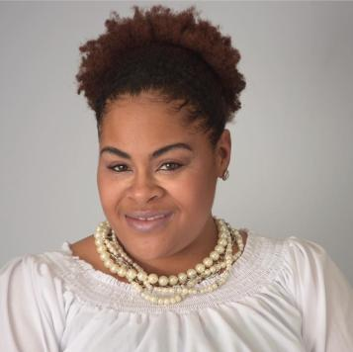
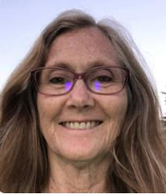
3
Congratulations to our newest Grassroots Board Member
Lynne Patalano!
And thank you to Maxine Thomas for her exceptional service on the Board

Slide 4
4
Equity & Impact in Global Anti-Poverty Programs
Goal: Three bills, signed into law, requiring equity & impact in the fight against global poverty
Tuberculosis
Nutrition
Education
Join the Global Poverty Policy Forum: August 18 at 9:00 pm ET for more details

Slide 5
Fall resources and tracker
5
results.org/fall2022

Slide 6
6
Achieving Economic Justice
through the Tax Code
Goals:
Expansion of the Child Tax Credit by end of year
Reduce poverty & housing instability with a Renter's Tax Credit in the next Congress
Join the US Poverty Policy Forum on August 18 at 8:00pm ET for more details

Slide 7
7
U.S. Poverty – Quick Policy Updates
Congress currently working on a reconciliation bill, but without RESULTS' domestic policy priorities.
Note that the bill does have important provisions to make health care more affordable and bring more equity to the tax code
Build on your prior advocacy on CTC and housing to seize an opportunity to advance our goals at an end-of-the-year tax bill.
The work continues to make the tax code more equitable at a time of high inflation.
Notes:
Quick policy updates to be posted on the chat:
“WE ARE GRATEFUL FOR ALL YOUR HARD WORK, which we plan to build upon in the coming months, as we bring more advocates to join us in our fight for ending poverty in Congress. Your advocacy already made a difference, even in this budget reconciliation bill that does not include our main priorities, because there are provisions in the bill that we consider as incremental steps towards achieving our goals, among them is more funding for the federal agency that implements and enforces the tax code, including the Child Tax Credit. We need more advocates to join us to keep pushing Congress for our priorities, particularly at a time of high inflation, skyrocketing rent prices, and higher costs of living. We will get into more details of what's ahead at the August policy forum, so please stay tuned.”

Slide 8
Building Power for Lasting Change

Slide 9
9
9
I know, but …
I’ve tried this before…
No one shows up…
It’s discouraging…
“Failing” feels bad…
I don’t wanna do it….
I must not be good at it…
It just doesn’t work…
Photo by Henrikke Due on Unsplash
Notes:
Want to ask – why are you here? And I don’t mean what’s your “why” for being an advocate or the values and goals that motivate you to be involved. But logistically .. Why are you here

Slide 10
Why are you here?
10
I was literally born an advocate..
I dreamt I was an advocate and when I woke up it was true…
Photo by kaushal mishra on Unsplash
Photo by Kate Stone Matheson on Unsplash
Notes:
Not your ‘why’ but logically .. Logistically ... Why are you an advocate? What happened in order to get you connected and in action

Slide 11
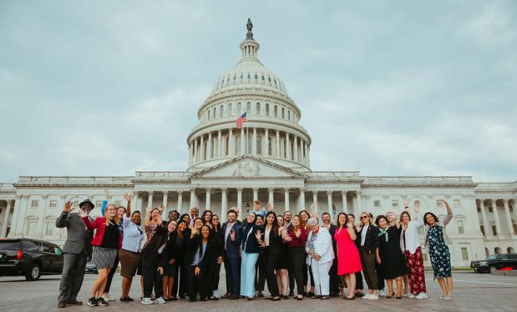
11
Why are you here?
I responded to an invitation to be an advocate
Notes:
You’re all proof that inviting others to be advocates works -- Whether you found us on volunteermatch, saw us on Google, attended a local action event, came through a partner org, were invited to be involved by friends/family .. Or any other way you found your way here – you responded to an invitation
Invitations come in all shapes and sizes – saw an ad online – met an advocate at a tabling event – friend or family spoke with you – saw something in the newspaper
All of those are invitations that were strategically put out in front of you to open a door and invite you to explore more

Slide 12
12
Steps to Take Today
Get inspired by Fall Outreach Opportunities to Maximize Advocacy Success
Set Your Goals for Fall Outreach and Advocacy Success
Prepare Your Group for New Advocates
Coming Soon: Outreach skills training & messaging

Slide 13
13
Fall Outreach & Organizing Timeline
August
Set Outreach Goals & Plans
September
Training & Resourcing
October
Outreach Actions
November
December
Convene New Advocates Post-Election
Celebrate & Recommit for 2023
Start Outreach Actions
Notes:
Staff Led vs Volunteer Led

Slide 14
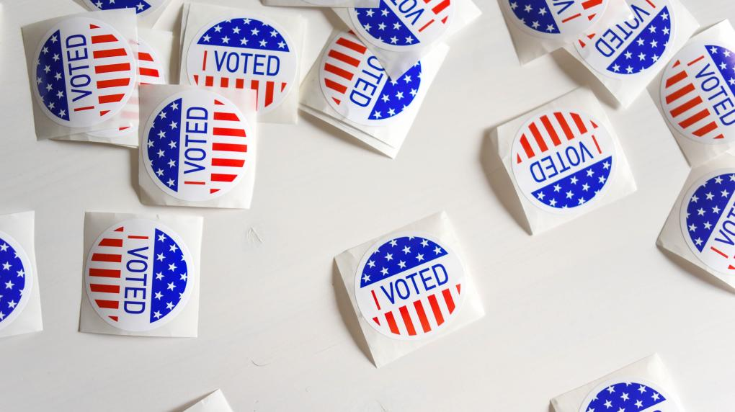
14
Fall 2022 Is a Big Opportunity!
(but not the only opportunity…)
Notes:
Our issues matter to your community …
There are more opportunities in your community to be out there and share in the Fall and especially in major election years…

Slide 15
15
Your Community NEEDS to Hear from You
Without an Invitation to Act
With an Invitation to Act
Hopelessness
Anxiety
Frustration
Apathy
Cynicism
Disengagement
“Doomism”
Hopeful
Engaged
In Action
Sense of Agency
Powerful
Supported
Connected
Notes:
As important discussions are happening in the community, your community needs to hear from you
Not only do candidates need to hear that issues like housing, economic security, global health, hunger & nutrition are things that people care about ..
Community members need to hear that there are people out there that feel the same way they do and are doing something – that there is a place that they belong, and there is hope to make a difference
The opposition wins when negative, hopeless feelings dominate. They beat us from the inside out. They don’t even need to try harder or develop new strategies – b/c there isno one pushing back. So not only does outreach / organizing give us more power by bringing more ppl together, but by not doing it we are making our chances of winning and being successful lower

Slide 16
16
You are the most effective messenger to make invitations in your community!
Notes:
You are the most effective messenger to offer an invitation in your community!
You’re local – you know your community and you know what’s going on (or can easily find the things)
You are trusted – your friends family and networks already know you and what you’re about – you don’t have to convince them you’re legit
You have personal reasons for being involved – deeply held values and beliefs – visions for what you want to see happen in your community and the world – and likely personal connections that share some of those things with you – and at the least, connections that share your community and shared experience
It matters that people hear from you

Slide 17
17
Share: Using My Passion to Connect My Community
Maxine Thomas
RESULTS Grassroots Board Member and Advocate
How I use my passion for change to mobilize the community

Slide 18
Outreach & Advocacy Goals
Defining (or redefining) Success

Slide 19
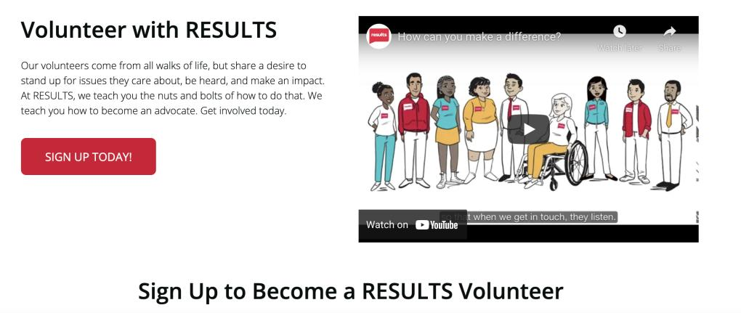
19
What Does Success Look Like?
Notes:
We often see success in outreach and recruitment as “did they become a volunteer – did they take on a position in the group – did they come to our monthly meetings regularly”
Ultimately – to build power and maintain success – we want our outreach and organizing to lead to that! But it’s only one part of ‘success’ – and when we don’t reach it, we feel like we’ve failed. And once we fail a few times .. We convince ourselves that we’re not good at this and shouldn’t try anymore

Slide 20
20
Commitment is a JOURNEY
(not a single action)

Slide 21
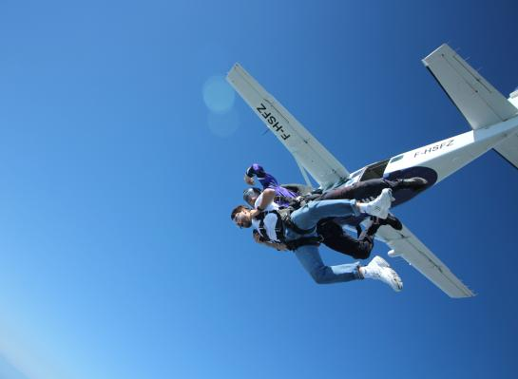
21
Redefining Success...
Sign up to volunteer!
Join our group!
Come to our next meeting / event!
Photo by Thanos Papazoglou on Unsplash
Notes:
We have to meet ppl where they are
This fall – I’d like to challenge you to redefine what success in your outreach looks like ---
Some asks that we think are small – like be a volunteer, come to a meeting or event – are actually pretty big leaps for many new people! And some of the hardest won successes from organizers. Some people will be ready for it so we need to be prepared to recognize and enlist and engage them early and often. But most people won’t be ready to make that commitment yet. Commitment is a journey, not a single action. And there are too many logistical and emotional needs and barriers along that journey that people deal with before committing. So we need to support them on a journey to commitment. Meet them where they are. Ask them to do something small and agitate them up a scale. What might that look like?

Slide 22
22
Community Outreach for Connection & Awareness
CREATE A FOLLOWING
Build community awareness.
Mobilize for Action
ENGAGE YOUR FOLLOWING
Support community to act.
Organize for Power
BUILD POWER
Connect community for long-term advocacy.
Nurture new relationships. Enlist new advocates. Develop new leaders.
Notes:
These are all important. These are all related. And growing in any or all of these areas is powerful and represents success. So let’s redefine ‘success’ from “joined RESULTS or didn’t” “became a leader or didn’t” to incorporate all the benefits that outreach, mobilizing, and organizing bring to our collective work

Slide 23
23
Get updates on Campaign
Take a quick or online action (1 action)
Join our Action Network
(regular action)
Become a leader
Attend an action event with our group
Join our team -Be a Volunteer
Small Steps → Big Results
Build Power
Mobilize your Following
Create a Following
Notes:
Commitment is a journey
You might be starting at the first step – or in the middle – you have to meet people where they are, get them on the journey
Even if you only get someone to sign up for updates on RESULTS website – we will send them a ‘welcome series’ to help them learn more about RESULTS and take them down the commitment journey

Slide 24
24
Advocacy Success
Awareness & Outreach
Mobilizing for Action
Organizing for Power
More people ..
Know about & trust RESULTS
Are aware of issues & solutions
Are in touch with their values
Have opportunities to be in action
MoCs hear from more people through increased..
Letters/emails generated
Media published
Calls to the office at important decision points
Community participation in MoC meetings and events
More members to sustain group
New leaders to drive change
Strong partnerships to demonstrate broad community support
Meet Advocacy Goals Through Outreach Activities
Notes:
While we want to get more members and advocates to sustain our groups and grow our list of local leads / following – those aren’t just organzing / outreach goals that exist on their own. All of our outreach & organizing activities also support our advocacy success both in the short term (immediate actions you’ll take this fall) but also in the long term (having a sustaining group with new leaders to carry on the long term work to make bigger change happen)
Success of our campaigns this year – and in the future – will depend on having more people taking action. By engaging in awareness, outreach we build those lists of immediate action takers but also future leaders. By mobilizing those people to take an action, like making a phone call when a vote on major tax legislation comes up later this year, or publishing media to thank MoCs for passing global nutrition bill and calling on them to support more, or following up on your Advocacy Month meetings later in the fall with new people for your MoCs to see at the table - we increase the power of our voice with members of Congress.
So this fall – we don’t’ want you to see the actions you’re doing to reach out and engage your community, recruit more action takers, and cultivate new advocates, as something separate from your advocacy. But really we want to help you connect HOW you can use outreach and mobilizing activities as part of your advocacy actions

Slide 25
25
What Could Success Look Like?
Build a Following
Mobilize for Action
Organize for Power
Have a 1:1 conversation with 5 people in my network
Add 30 new people to RESULTS email list
Connect with 3 possible new community partners
Show up vocally at 3 community / election / tabling events
Support 25 people to take an online / supportive action
Grow our local Action Network by 15 people
Invite 5 new people to election event or MoC meeting
Support 3 members to take on new leadership
Host 2 Group Action events with 10 potential new advocates
Welcome 4 new advocates to our team
Notes:
So instead of just saying success is enrolling new vols in our group – and having a pass/fail “did they join our group or not?” we can redefine what success looks like by setting small goals to build a following if you don’t have one – to mobilize that following as you act on our campaigns – and to organize your most active followers for future membership and leadership
What other ideas do you have for what success could look like in your local outreach and organizing?

Slide 26
Fall Outreach Activities to Build, Mobilize, and Organize a Following
Notes:
When we go through these – think about how these can be used to 1 – build a following 2– mobilize key actions and 3 – bring people together for relationship and collective action

Slide 27
27
RESULTS Fall Outreach & Organizing Campaign
August-December 2022
Online Recruitment (RESULTS Staff Led)
Word of Mouth Recruitment (Local Volunteer Led)
Relational Organizing
Digital Outreach
Candidate & Community Events
Partnership Development / Strengthening
Hosting Education & Action Events
Notes:
Staff Led vs Volunteer Led

Slide 28
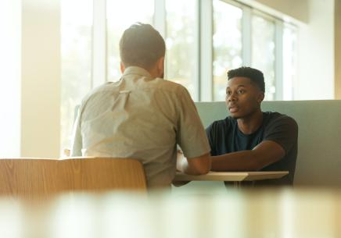
28
Relational Organizing
Mobilizing personal contacts within your network
This can be a…
Text
Call
Social media direct message
Friendly chat at work
Coffee date…
Photo by LinkedIn Sales Solutions on Unsplash
Upcoming Trainings (more details soon): RESULTS National Webinar, September 10;
Relational Organizing training, September 13
Notes:
To make progress in our communities the most impactful thing we can do is create meaningful conversations with the people who we are already connected with. Connection is at the heart of relational organizing
Wherever your people are – however your people are connecting – that’s where this stuff happens. So you don’t need to plan an event to bring people together or orchestrate an action – just show up as you normally would and have a conversation
The first conversations you have with someone probably won’t have the ‘join our group’ ask! But they might include you sharing your own values / concerns and how you use RESULTS advocacy to meet your needs. Your first ask here might just be to see if they’re open to hearing updates about what’s going on
This could look like..
Having coffee with a friend/family/colleague and talking about shared values and concerns
Following up and sharing updates on your advocacy that are connected to their values/concerns
Reaching out with key, timely action opportunities connected to their concerns/interests

Slide 29
29
Digital Outreach
This could look like…
Sharing your ‘why’ on social media, connected with a picture of you in action and invitation to ‘sign up for updates’
Sharing visuals/graphics RESULTS creates with invitations to take an online action
This could lead to…
Bigger following & Action Network to be mobilized
Anyone added to RESULTS emails will receive a “Welcome Series”
Notes:
If you’re thinking “wait- how will getting people to sign up for basic emails help us meet our outreach goals?’
Anyone added to our email lists will get a welcome series to help move them along the commitment journey

Slide 30
30
Candidate & Community Events
This could look like..
Candidate Events:
Advocacy: Showing up at a Town Hall / Candidate Events to ask a question
Outreach: While there, striking up conversations with other attendees & exchanging contact information
Upcoming Training: RESULTS and Right2Health “Birddogging” Training, Tuesday, August 9 at 8:30pm ET
Notes:
Staff Led vs Volunteer Led

Slide 31
31
Candidate & Community Events
This could also look like..
Community Events:
Outreach: Tabling at university fairs, community events, farmer’s markets, or other high traffic areas to advertise RESULTS opportunity.
Outreach: Attending other local orgs community events related to RESULTS values / issues and connecting with allies
Advocacy: Asking people to take a ‘quick action’ at your table to support RESULTS policy campaigns
Chat Box: What other opportunities exist in your community? Where do people gather?
Notes:
Staff Led vs Volunteer Led

Slide 32
32
Partnership Development & Strengthening
This could look like..
Connecting with your local Returned Peace Corps or Together Women Rise group to take a joint action
Identifying like-minded organizations at fairs / community events and setting up a one-one conversation
Notes:
Staff Led vs Volunteer Led

Slide 33
33
Tips for Making the Most of Outreach
Be present – show up!
Be aware – look for signs of interest in the crowd
Be ready – always have a way to collect contact info
Be active – bring Action Sheets for quick actions anytime
Remember: Commitment is a process.
Anyone who signs up for campaign updates or actions will receive a Welcome Series tailored to increase commitment
Notes:
Don’t be discouraged if your outreach doesn’t result in immediate volunteers – you’re building a following – commitment is a process

Slide 34
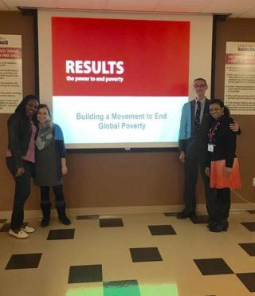
34
Education & Action Events
Use November & December group meetings to bring people together for collective action & relationship building
Notes:
Once you’ve connected with people – built a bigger following – mobilized small actions – after the election there’s a big opportunity to bring people together (organizing!) to talk about what’s possible moving forward and get commitment for sustained engagement

Slide 35
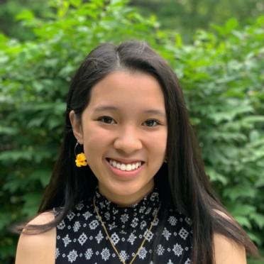
35
Share: Relational Organizing
Jennn Koo
RESULTS Grassroots Board Member and Advocate
Connecting my friends, family, and local network with advocacy opportunities

Slide 36
36
What are you excited to work towards this fall?
Build a Following
Mobilize for Action
Organize for Power
Have a 1:1 conversation with ___ personal contacts
Add __ new people to RESULTS email list
Show up vocally at __ community / election events
Connect with __ new community partners
Support __ people to take an online / quick action
Grow our Local Action Network by __ people
Invite ___ new people to election event or MoC meeting
Support __ members to take on new leadership
Host __ Group Education & Action events with __ potential new advocates
Welcome __ new advocates to our team
Notes:
We often see success in outreach and recruitment as “did they become a volunteer – did they take on a position in the group – did they come to our monthly meetings regularly”
Ultimately – to build power and maintain success – we want our outreach and organizing to lead to that! But it’s only one part of ‘success’ – and when we don’t reach it, we feel like we’ve failed. And once we fail a few times .. We convince ourselves that we’re not good at this and shouldn’t try anymore

Slide 37
Preparing For & Welcoming New Advocates

Slide 38
38
Preparing for New Advocates
Barriers to advocacy
General Best Practices
Meeting emotional needs
Meeting informational needs
Notes:
Staff Led vs Volunteer Led

Slide 39
39
Barriers for New Advocates
Sense of overwhelm
Not feeling connected to the group / Struggling to see how they fit in
Not feeling connected to all the issues
Lack of understanding of the impact of RESULTS actions
Not feeling like they are having impact
Feeling that this is "unbelievable"
Notes:
Overwhelm from not understanding all the issues and sense of overwhelm with not being able to navigate the website and find information of their own. Next few slides are things that can help

Slide 40
40
General Best Practices
Revisit the Group Guide to Welcoming & Supporting New Advocates
Be intentional
Create a plan beforehand for welcoming new advocates
Be prepared to be flexible. New member, new group.
Be "rigid" with the why, but flexible with the how
Notes:
Staff Led vs Volunteer Led

Slide 41
41
Meeting Emotional Needs of New Advocates
Create a sense of belonging
Take the time to do introductions
Create a sense of community
Do a group building activity that will help the group connect on a personal level
Utilize the Outreach and Partnerships Coordinator role
Grow your group through local outreach
Notes:
Staff Led vs Volunteer Led

Slide 42
42
Meeting Emotional Needs of New Advocates
Utilize the New Advocate Mentor role
Welcome new advocates and give them coaching and support
Understand that commitment is a journey
Redefine what commitment looks like
Notes:
Staff Led vs Volunteer Led

Slide 43
43
Meeting Informational Needs
Walk new advocates through resources and tools
Take the time to show and tell
Help new advocates become familiar with campaigns
Provide resources
Reiterate webinar and forum opportunities
Encourage new advocates to make the issues personal
Prepare beforehand to utilize shared leadership within your group
Group Leader, Outreach and Partnerships Coordinator, New Advocate Mentor, and Action Network Manager
Notes:
Staff Led vs Volunteer Led

Slide 44
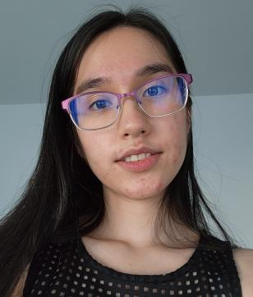
44
Share: New Advocate Support = Success
Molly Dreznick
Grassroots Advocate
Mentorship and clear communication empowered me to take powerful action as a new advocate

Slide 45
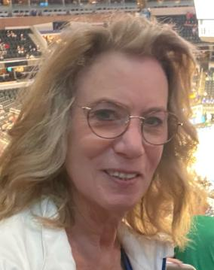
45
Share: New Advocate Support = Success
Rita Egan
Grassroots Advocate
Personal relationships and invitations to engage helped me to succeed as an advocate

Slide 46
46
Breakout Room Prompts
What outreach ideas are you most excited about trying and what would that success look like for you?
Despite past outreach challenges, what can you do now to reach new advocates in your community? This is an opportunity to be creative and think outside of the box.
Notes:
Staff Led vs Volunteer Led

Slide 47
Outreach: Preparing for Success
47
Set outreach goals and create a plan
Prepare to receive new advocates
Engage with candidates and community

Slide 48
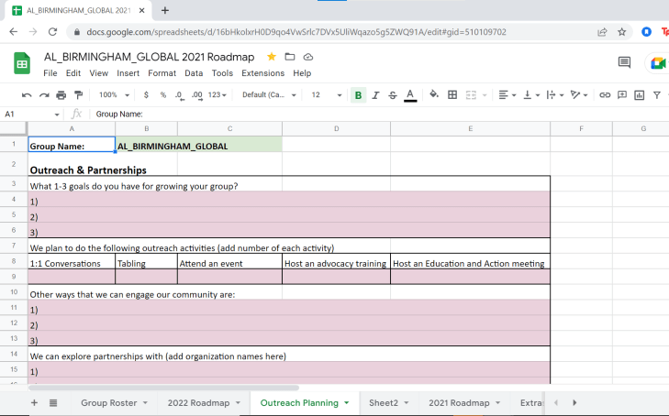
Outreach: Preparing for Success
48

Slide 49
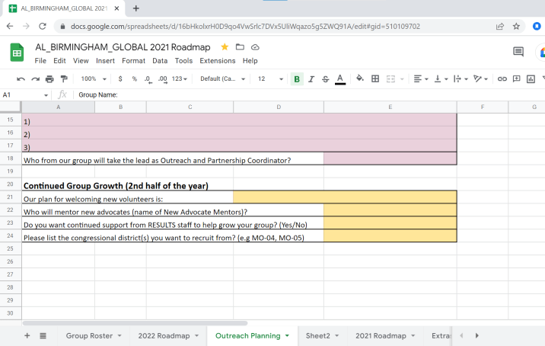
49
Outreach: Preparing for Success

Slide 50
Candidate Engagement Training
50
Join us on Tuesday!
August 9 @ 8:30 pm - 10:00 pm EDT
Learn tactics of “birddogging” candidates
Get ideas about engaging people in your community in transformational advocacy

Slide 51
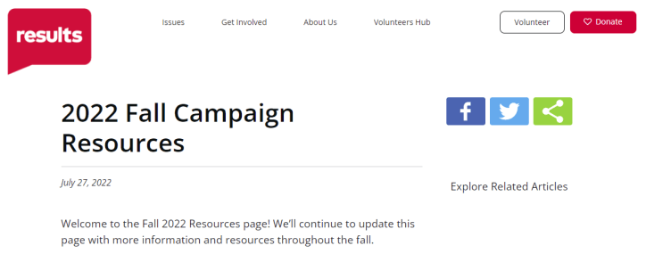
Fall 2022 Campaign Resources
51
Link: https://results.org/resources/2022-fall-campaign-resources/
Organizing Resources for working with congress, candidates and community
Global Policy Campaign Resources
U.S. Policy Campaign Resources

Slide 52
Important Reminder!
52
Please complete your lobby reports and your outreach reports!

Slide 53
Thank you for joining us!
53
Who is joining you in the room today?
In the poll, please respond with the number of people in the room with you (including yourself).
Notes:
Ken launches poll

Slide 54
54
Join the
August Policy Forums
Thursday, August 18
U.S. Poverty Policy Forum, 8:00 pm ET. Focus: Using the tax code to address America’s housing problem. Register here.
Global Poverty Policy Forum, 9:00 pm ET. Focus: Fall global campaigns overview. Register here.

Slide 55
2023 Fellowship application open!
55
results.org/fellowship

Slide 56
56
Upcoming Events
Tuesday, August 9: Candidate Engagement Training, 8:30 pm ET. Join using this Zoom link or dial 669-900-6833, meeting ID: 967 3380 6790, passcode: 764508.
Thursday, August 11: Global Allies Program (with Returned Peace Corps Volunteers), 8:30 pm ET. Register today!
Tuesday, August 16: U.S. Poverty Free Agents, 1:00 pm and 9:00 pm ET. If you are interested in joining, contact Jos Linn for more information.
Tuesday, August 16: Together Women Rise Advocacy Chapter with RESULTS, 8:30 pm ET. Check out more information.

Slide 57
57
Upcoming Events
Wednesday, August 17: Media office hour, 1:00 pm ET. Get your media questions answered. Join via Zoom at: https://results.zoom.us/j/93668005494 or (312) 626-6799, meeting ID: 936 6800 5494.
Monday, August 22: Global Poverty Free Agents Webinar, 7:00 pm ET. Contact Lisa Marchal at lmarchal@results.org for more information.
Tuesday, August 23: Diversity and Inclusion 101, 12:00 pm ET. Register here.
Saturday, August 27: Building Resilience in Challenging Times, 11:00 am ET. Read more and join here.

Slide 58
58
Upcoming Events
New Advocate Orientations are on-going! Register for an upcoming orientation at: www.results.org/volunteer.
See all events on the RESULTS Events Calendar: https://results.org/events/.
Join the
September National Webinar
Saturday, September 10 at 1:00 pm ET
(delayed a week due to Labor Day holiday)
Register at: https://results.zoom.us/meeting/register/tJ0pc-2spjkiY3WkF4QbtgAWikteQvMT2A

Slide 59
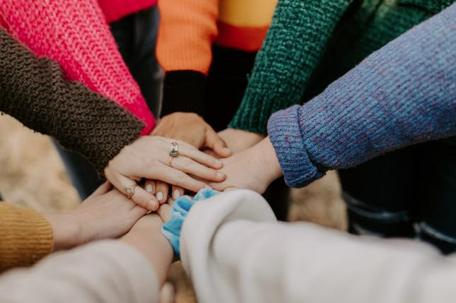
59
Let’s do this!
Photo by Hannah Busing on Unsplash
Notes:
Reflection - 1 min, share 2 mins

