Slide 1
The RESULTS National Webinar
July 10, 2021
Welcome!

Slide 2
Our Anti-Oppression Values
2
​RESULTS is a movement of passionate, committed everyday people. Together we use our voices to influence political decisions that will bring an end to poverty. Poverty cannot end as long as oppression exists. We commit to opposing all forms of oppression, including ableism, ageism, classism, colonialism, homophobia, racism, religious discrimination, sexism, transphobia, white saviorism, and xenophobia.
At RESULTS we pledge to create space for all voices, including those of us who are currently experiencing poverty. We will address oppressive behavior in our interactions, families, communities, work, and world. Our strength is rooted in our diversity of experiences, not in our assumptions.
With unearned privilege comes the responsibility to act so the burden to educate and change doesn’t fall solely on those experiencing oppression. When we miss the mark on our values, we will acknowledge our mistake, seek forgiveness, learn, and work together as a community to pursue equity.
There are no saviors — only partners, advocates, and allies. We agree to help make the RESULTS movement a respectful, inclusive space.
Find all our anti-oppression resources at: https://results.org/volunteers/anti-oppression/

Slide 3
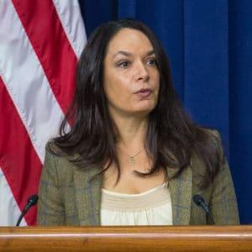
Guest Speaker: Ann Oliva
3
Senior Fellow with the Housing team at the Center on Budget and Policy Priorities (www.cbpp.org)
Former Senior Policy Advisor at the Corporation for Supportive Housing
From 2007 to 2017, official at HUD, most recently as Deputy Assistant Secretary for Special Needs Assistance Program (SNAP).
In 2015, Oliva was named one of the 50 Most Influential Leaders in HUD’s 50-year history and was honored with the True Colors Fund’s True Leader Award.

Slide 4
U.S. Poverty “Asks”
4
Follow up with housing and tax aides. Urge them to speak to leadership, urging them to focus on bold and long-term anti-poverty policies:
Making 2021 EITC/CTC provisions permanent
Rental assistance (likely via Housing Choice Vouchers) should be universal for all those who qualify – with multi-year guaranteed funding
Support efforts to address access to affordable housing + racial inequities
Notes:
Biden gave speech to joint session in Congress, talking about lifting children out of poverty, affordable housing, preventing evictions
Tax: Biden maybe only going to 2025 on EITC/CTC but MoCs pushing for permanence; RESULTS would push for permanence
Housing: Not expecting universal vouchers from Biden and Congress
RESULTS will continue to push for significant increase in housing assistance for low-income renters (via vouchers)

Slide 5
Now is the time to be bold.
5
Bipartisan Infrastructure + Budget Reconciliation
Opportunity to secure large-scale policies that:
Dramatically reduce child poverty
Address racial inequities
Why is it key for members of Congress to speak to leadership (our “Ask”)?
Conversations happening now about their recovery priorities – specifically what changes they want to include beyond the Administration’s proposal
As Congress moves large-scale legislation, key that Congressional leaders/negotiators their peers care about poverty and equity
Notes:
Michael reiterate our top ask and build on Zach’s section: we are pushing to get MoCs to speak to leadership

Slide 6
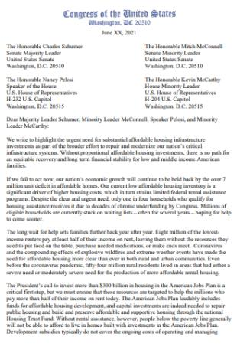
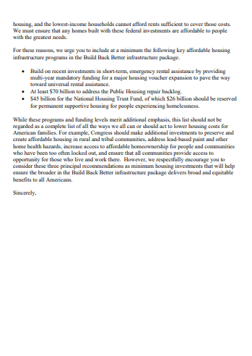
6
Housing Sign-on Letter
Deadline: Tuesday, July 13
For more information or to sign onto the letter, please contact matthew_traylor@merkley.senate.gov in Sen. Merkley’s office or christopher.jerrolds@mail.house.gov in Rep. Torres’s office.
Notes:
Dear Colleague Letter available here: https://results.org/wp-content/uploads/Housing-Choice-Voucher-Dear-Colleague-Letter.pdf
Tracker updates here: https://docs.google.com/spreadsheets/d/1Yh2WErLzjjKVSPqINqrX-oWGUS3vzJ9OPRCb7y146_4/edit?usp=sharing

Slide 7
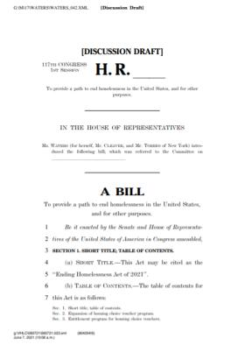
7
Bipartisan Support for Vouchers
Ending Homelessness Act, Rep. Maxine Waters (D-CA). Phased-in expansion of HCVs with guaranteed funding – TO BE INTRODUCED SOON!
The Family Stability and Opportunity Vouchers Act , Sens. Todd Young (R-IN) and Chris Van Hollen (D-MD)
Choice in Affordable Housing Act of 2021, Sens. Chris Coons (D-Del.) and Kevin Cramer (R-ND)
The Housing Choice Voucher Mobility Demonstration Act (H.R. 5793/S. 2945)
The Fostering Stable Housing Opportunities Act (H.R. 4300/S. 2803)
Veterans Health Care and Benefits Improvement Act (H.R. 7105/P.L. 116-315) and the Veteran HOUSE Act (H.R. 2398/incorporated into P.L. 116-283).
Notes:
Maxine Waters' Ending Homelessness Act to be introduced soon - https://financialservices.house.gov/uploadedfiles/bills-117pih-endinghomelessnessactof2021.pdf
Bipartisan support for vouchers:
The Family Stability and Opportunity Vouchers Act was re-introduced by Sens. Todd Young (R-IN) and Chris Van Hollen (D-MD) in 2019, to create 500,000 new Housing Choice Vouchers for families with young children experiencing homelessness or housing instability.
Choice in Affordable Housing Act of 2021 by Sens. Chris Coons (D-Del.) and Kevin Cramer (R-ND) would invest $500 million to increase the number of rental units that accept Housing Choice Vouchers in high-opportunity neighborhoods.
The Housing Choice Voucher Mobility Demonstration Act (H.R. 5793/S. 2945) was introduced in 2018 by Rep. Sean Duffy (R-WI) and Rep. Emmanuel Cleaver (D-MO). It proposed a limited demonstration program enabling public housing agencies to provide housing vouchers designed to encourage low-income families receiving such assistance to move to lower-poverty areas and access to areas of greater opportunity. Congress authorized and funded the demonstration with $50 million in both the fiscal year 2019 and 2020 appropriation bills.
The Fostering Stable Housing Opportunities Act (H.R. 4300/S. 2803) was introduced by Sens. Sherrod Brown (D-OH) and Chuck Grassley (R-IA) and Reps. Madeleine Dean (D-PA), Mike Turner (R-OH), Karen Bass (D-CA), and Steve Stivers (R-OH) to provide “on demand” vouchers to foster youth who are at risk of homelessness as they transition to adulthood. The legislation became law as part of the fiscal year 2021 appropriations bill that passed in December 2020 with additional COVID-19 relief.
HUD-VASH provides housing vouchers and case management services to veterans experiencing chronic homelessness. In recent years, Congress has provided sufficient funding to renew all HUD-VASH vouchers and advanced bipartisan legislation to improve the program and expand eligibility, passing the Johnny Isakson and David P. Roe, M.D., Veterans Health Care and Benefits Improvement Act (H.R. 7105/P.L. 116-315) and the Veteran HOUSE Act (H.R. 2398/incorporated into P.L. 116-283).

Slide 8
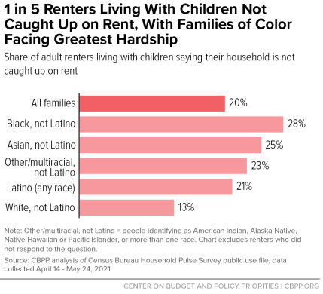
Housing Unaffordability + Instability Persist
8
CDC Eviction Moratorium Expires July 31!
In the 5 states and 27 cities, landlords have filed for 385,996 evictions during the pandemic.
6,250 evictions were filed two weeks ago.
Source: https://evictionlab.org/eviction-tracking/
Source: https://www.cbpp.org/1-in-5-renters-living-with-children-not-caught-up-on-rent-with-families-of-color-facing-greatest
Notes:
Source: https://www.cbpp.org/1-in-5-renters-living-with-children-not-caught-up-on-rent-with-families-of-color-facing-greatest
Source: https://evictionlab.org/eviction-tracking/
Note that CDC Eviction Moratorium expires July 31st.

Slide 9
9
Q& A with Ann Oliva

Slide 10
10
Rental Assistance and an Equitable Recovery
How State and Local Advocates Can Support Unprecedented Investments to Help People Struggling to Afford Housing
July 2021

Slide 11
Resources
CBPP’s dedicated page on voucher expansion: https://www.cbpp.org/research/resource-lists/expanding-housing-vouchers
One pager/infographic: https://www.cbpp.org/sites/default/files/5-3-21hous-infographic.pdf
Toolkit: Check out our NEW toolkit on housing vouchers with talking points, sample social media content, and ideas for action in your community.
https://drive.google.com/file/d/1dz6Uu5jB9hjBI_wGEYWbJGnRSNYwmGMA/view

Slide 12
Now Is the Time to Expand Federal Rental Assistance

Slide 13
Source: HUD Annual Homeless Assessment Report Part 1, 2020

Slide 14
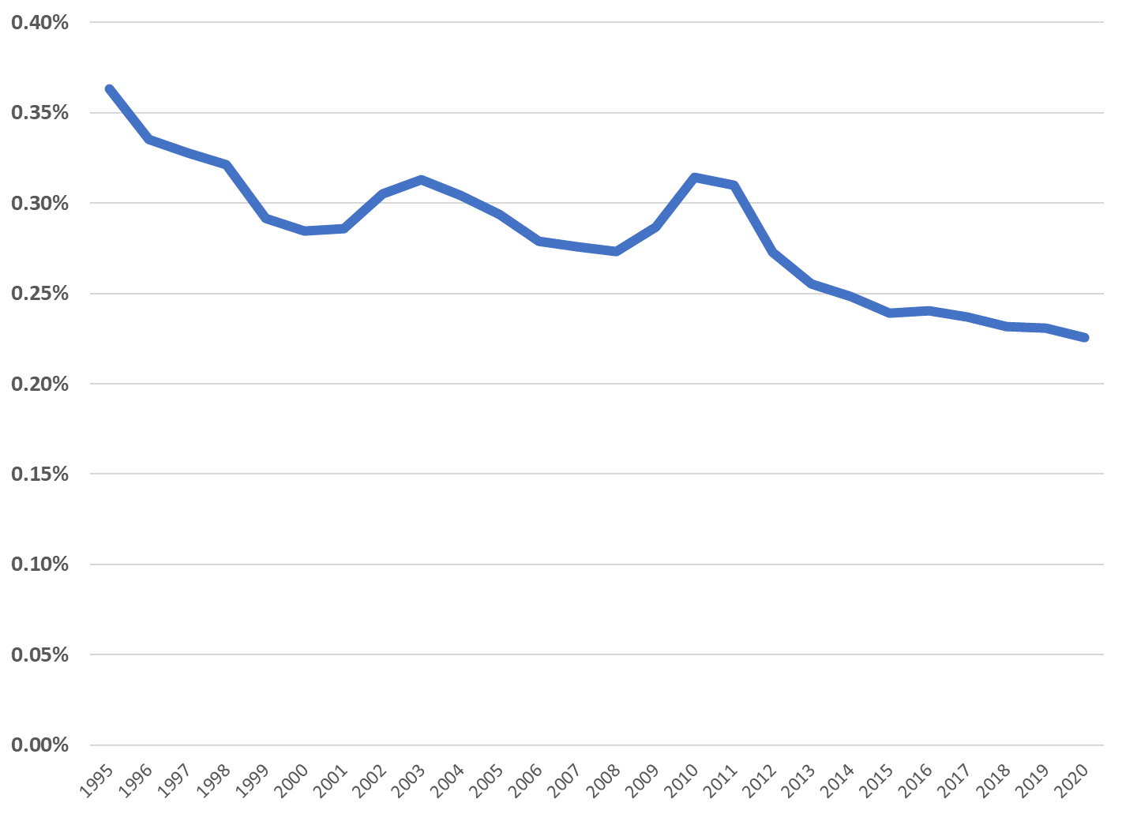
Discretionary Housing Assistance Spending Has Fallen to Historic Lows
Spending as a percent of gross domestic product
Source: President’s Fiscal Year 2021 Budget

Slide 15
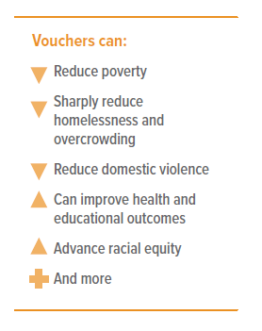
Why Housing Choice Vouchers?
Research shows that Housing Choice Vouchers:
Reduce the share of families living in shelters or on the street by three-fourths, the share living in overcrowded conditions by more than half, and the share of adults experiencing domestic violence by half.
Allow seniors to remain in their homes and allow people with disabilities to live independently.
Reduce how frequently children must change schools. This also benefits their classmates by helping their teachers better gauge and advance students’ learning.
Give low-income children better access to low-poverty, high-resource neighborhoods – particularly children of color, who disproportionately live in high-poverty areas due to a long history of discriminatory government policies.

Slide 16
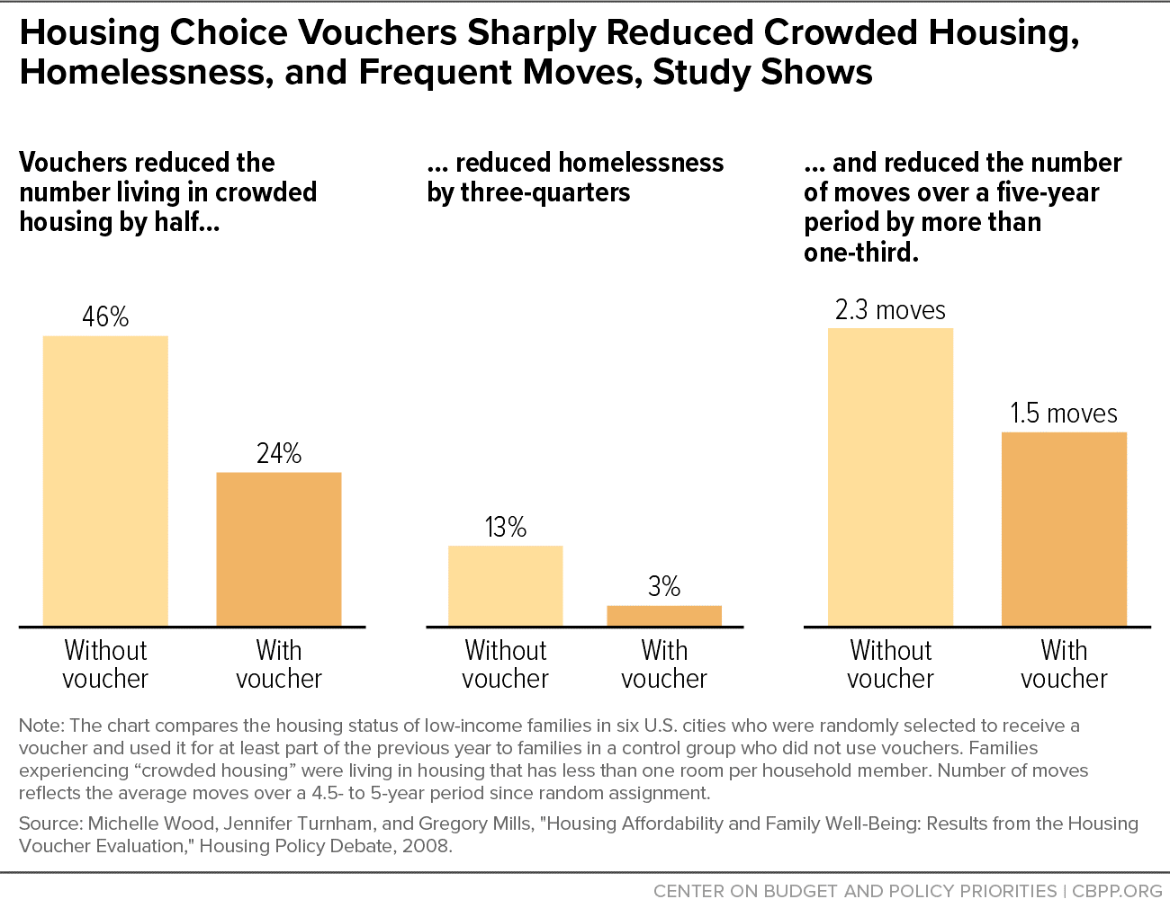

Slide 17
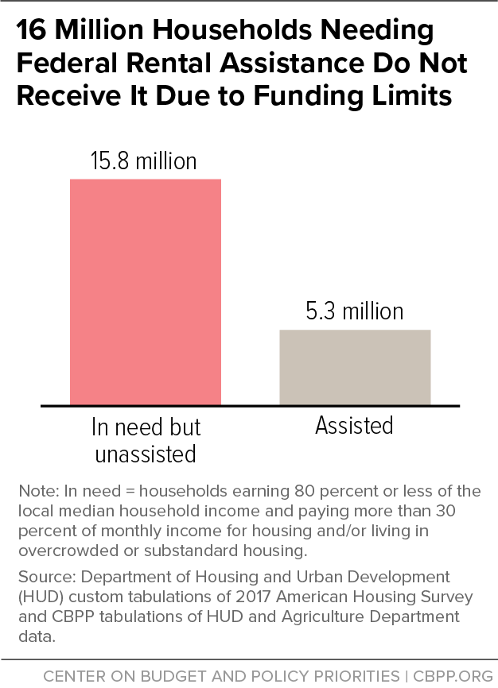
17

Slide 18
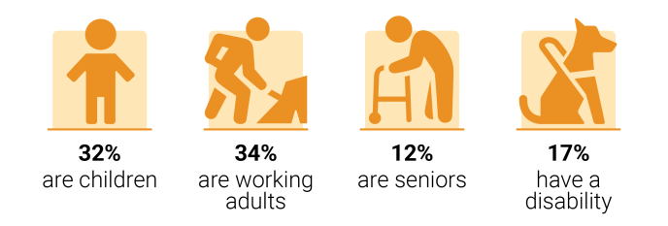
24 million people
live in low-income renter households that pay more than half their income for housing (rent and utilities)
Notes: Low income = household earns less than 80% of the local median income. Severely cost-burdened = household pays more than 50% of their monthly income on rent and utilities.
Source: CBPP analysis of 2014-2018 American Community Survey microdata and 2018 HUD area median income limits.

Slide 19
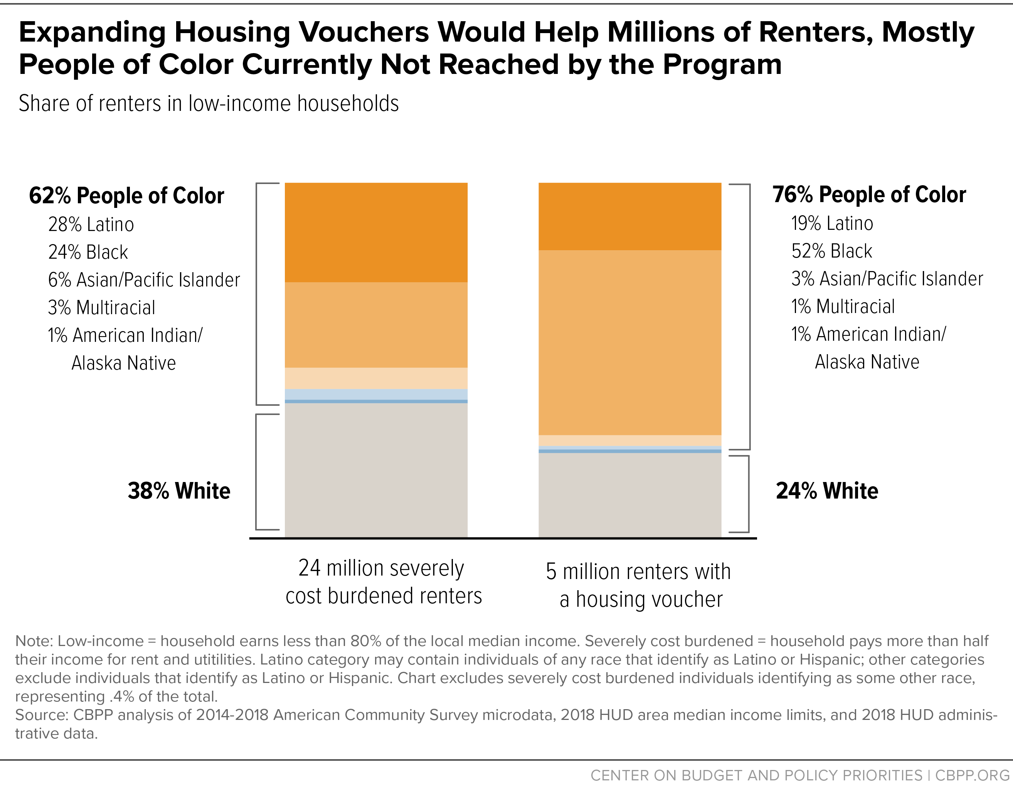

Slide 20
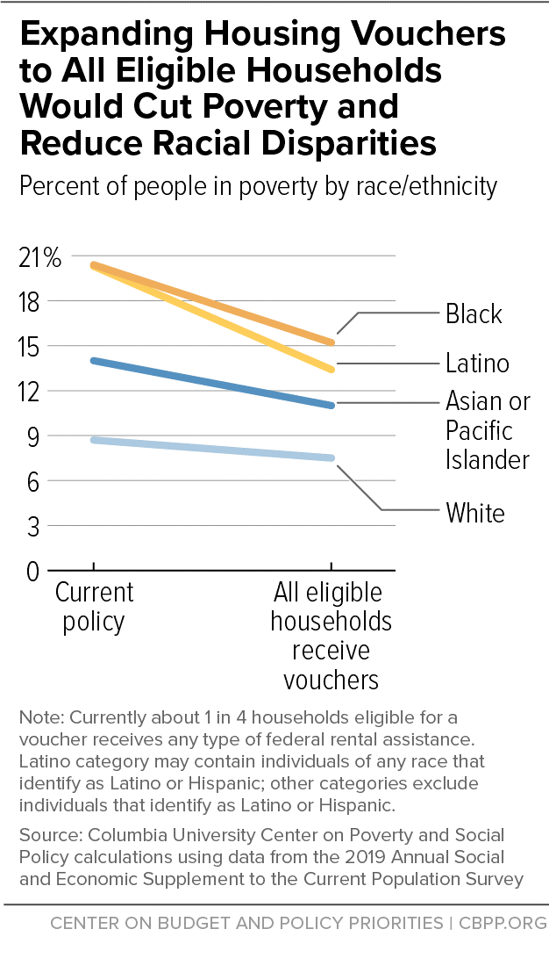

Slide 21
21
Ann Oliva
aoliva@cbpp.org

Slide 22
American Rescue Plan EITC and CTC changes
22
Expansion of EITC for workers without children
Increases maximum credit from around $500/yr to $1,500/yr
Expands eligible workers to 19 yrs + (previously 25-64 yrs old)
Expansion of CTC for families with children
All low-income families get the full credit, even if you have no income
Before 2021, max refund was $1,400 and families earning below $2,500/yr got nothing, while wealthy families got the full $2,000 credit
Credit increased from $2,000 per child to $3,000 per child 6-17 yrs old and $3,600 per child under 6

Slide 23
The improvements are game-changers!
23
CTC Expansion
EITC Expansion
Notes:
Source: https://www.cbpp.org/research/federal-tax/congress-should-adopt-american-families-plans-permanent-expansions-of-child

Slide 24
New Child Tax Credit payments
24
July 15: IRS starts monthly CTC payments to families
Most families will get $250-300 per child
Payment will go out each month through December
This will amount to ½ of their 2021 CTC; other half will be paid as a lump sum at tax time next year
Most will get payments automatically but if you have not filed taxes in last two years, you may need to sign up
Go to www.childtaxcredit.gov for more info
Notes:
To quickly touch base on tax policy, a reminder that 4/10 children who live in low-income families will not get the full value of the CTC in 2022 unless Congress makes the current CTC permanent – this chart shows a breakdown of what that looks like by race and ethnicity.
Source: Child Tax Credit Is a Critical Component of Recovery @iteptweets https://itep.org/child-tax-credit-is-critical-component-of-biden-administrations-recovery-package/
And, we’ll push to make the larger Child Tax Credit permanent beyond 2025, to maximize the impact on child poverty.

Slide 25
It is time for Congress to protect workers and children
25
The CTC expansions could cut child poverty by almost half
EITC expansion stops low-wage workers from being taxed into poverty
BUT… the changes only last one year (including the CTC monthly payment)
Tax credits for low-income workers and families should be made permanent this year.
Notes:
This past week, the Administration unveiled their full recovery proposal – you can read more about that here: https://results.org/blog/recovery-must-focus-on-reducing-poverty-and-systemic-inequities/
proposed to permanently increase the EITC for younger workers and others who are not raising children in their homes, along with making the CTC fully available to low-income families. While these steps are important, Congress should go further and make the full Child Tax Credit expansion permanent, as House Ways and Means Chairman Neal proposed this week. Ultimately, it is important for our members of Congress to hear from constituents that these policies should be permanent -- and for them to weigh in with Congressional leadership.
And a quick back story (only if time): a few weeks ago, RESULTS staff reached out to some of you who are Senate point people – and you did some amazing targeted work to get 41 senators on a letter that was sent to the Administration on March 26 urging them to prioritize making the Child Tax Credit and Earned Income Tax Credit permanent in their upcoming recovery proposal. There were only 17 senators on board at the start of the week and it was critical that 41 (of 50) Democratic senators signed this letter by the time it was sent four days later – and I *know* that many of you made the difference getting the vast majority of Senate Democrats on board in the last . This letter made a big difference and helped lay the groundwork for the permanent tax policies we just saw from the Administration.
The letter is here: https://www.brown.senate.gov/download/eitc-ctc-letter-march-2021__ along with this press release from Sen Brown: https://www.brown.senate.gov/newsroom/press/release/brown-lead-senate-democrats-tax-cuts-workers-families-permanent.

Slide 26
July U.S. Poverty Action
26
Submit your own letters to the editor this month:
Remind people about the new CTC monthly payments and urge Congress to make the EITC and CTC provisions permanent.
Call on Congress to commit to guaranteed, multi-year funding for the Housing Choice Voucher program so that all eligible renters can get help.
The July 2021 U.S. Poverty Action has template LTEs and other resources at: https://results.org/volunteers/monthly-actions/
Notes:
Start

Slide 27
July U.S. Poverty Action Resources
27
Main Resources
Monthly Action Sheets: https://results.org/volunteers/monthly-actions/
Lobby Resources: https://results.org/volunteers/lobbying/
Laser Talks: https://results.org/volunteers/laser-talks/
Lobby Report Form: www.tinyurl.com/RESLobbyReport
EITC and CTC stats by state: https://www.cbpp.org/research/federal-tax/congress-should-adopt-american-families-plans-permanent-expansions-of-child
State housing data https://nlihc.org/housing-needs-by-state
Columbia University poverty data on expanding CTC: www.tinyurl.com/ColumbiaCTC and expanding HCVs with CTC: www.tinyurl.com/ColumbiaHousingCTC
Notes:
Action: building on the really important conversations you all have had this year as part of the First 100 Days campaign, need to put public pressure – thus the media push that Ken will discuss more in a few minutes.
And media gives you a great excuse to follow up with staff to reiterate our priorities, ask them what their boss is doing re weighing in with leadership - key decisions being made on the hill
Overall, continued engagement with staff in the coming months will be key – if you are the point person with a Congressional housing or tax aide, this is a good time to connect with them to get their reaction to the Biden Administration’s recovery proposal and urge them to weigh in with leadership
Reach out if you need support – especially if you are meeting with a policymaker directly or scheduled with aides for a key committee leader, etc.
We are updating our State data but in the meantime, can put a few resources in the chat…
Census Household Pulse data https://www.census.gov/data-tools/demo/hhp/#/?measures=EXR
Housing https://nlihc.org/housing-needs-by-state and https://nlihc.org/coronavirus-and-housing-homelessness/eviction-update
Columbia on CTC: https://static1.squarespace.com/static/5743308460b5e922a25a6dc7/t/600f2123fdfa730101a4426a/1611604260458/Poverty-Reduction-Analysis-American-Family-Act-CPSP-2020.pdf

Slide 28
28
RESULTS Op-ed Workshop
Tuesday, July 20, 9:00 pm ET
Register at: https://results.zoom.us/meeting/register/tJAqd-6trzwtGd2fU8sONULOMASo-Yg57o62
Join us to start writing your own op-ed
Bring an idea or a draft first sentence of your op-ed to get started
Also, we recommend you listen to previous op-ed overview training beforehand. You can find the recording and slides at: https://results.org/resources/results-op-ed-101-training/.

Slide 29
Dr. Joanne Carter Executive Director
29

Slide 30
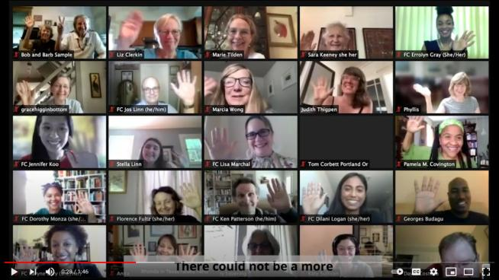
International Conference Wrap Up
30
Watch our new 2021 International Conference video at:
https://www.youtube.com/watch?v=SieVaUTFqBs

Slide 31
IC Advocacy Week Share
31
Amy Stern
Volunteer Advocate
RESULTS New York

Slide 32
IC Advocacy Week Share
32
Imtisal Imran
Volunteer Advocate
RESULTS Nova Southeastern University (NSU)

Slide 33
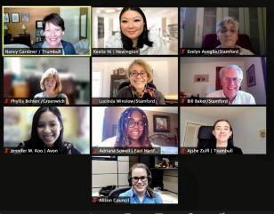
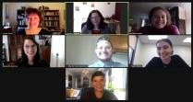
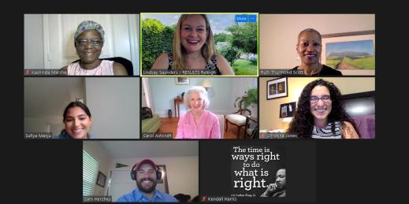
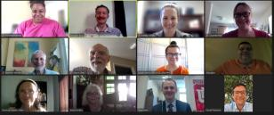
Open Shares IC Advocacy Week
33

Slide 34
Accomplishments since January 2021!
34
Recap of the First 100 Days Campaign!
Appropriations: House SFOPS
Media Progress: 245 pieces as of June 30th, 2021
Meeting Progress: 517 House and Senate meetings as of July 8th, 2021

Slide 35
Looking Ahead
35
July
Housing, tax, vaccine actions
Work with RCs to assess your group’s health, review roadmaps, regional conferences
July 22 policy forums: 8 pm ET US Poverty; 9 pm ET Global Poverty
August
Key actions
Slower pace: no National Webinar, no Policy Forums

Slide 36
Looking Ahead
36
September
Motivational Interviewing series starts
StrengthFinder leadership training offering
Regional Conference planning for fall
New advocates start being referred to groups by Expansion Team

Slide 37
Vote in Board Election
37
We have 3 outstanding candidates running for one of our four RESULTS Grassroots Board Member seats.
The deadline to vote is Saturday, July 17.
All active RESULTS volunteers are eligible to vote.
Go to https://results.org/blog/results-2021-grassroots-board-elections/ to learn about the candidates and vote today!

Slide 38
July Events
38
RESULTS Op-ed Workshop
Tuesday, July 20, 9:00 pm ET
Register at: https://results.zoom.us/meeting/register/tJAqd-6trzwtGd2fU8sONULOMASo-Yg57o62
Join us to start writing your own op-ed
Bring an idea or a draft first sentence of your op-ed to get started
Also, we recommend you listen to previous op-ed overview training beforehand. You can find the recording and slides at: https://results.org/resources/results-op-ed-101-training/.

Slide 39
39
July Events
July 22
8 pm ET – U.S. Poverty Policy Forum
9 pm ET – Global Poverty Policy Forum
Register for one or both at: www.results.org/events
New Advocate Orientations are on-going! Register for an upcoming orientation at: www.results.org/volunteer

Slide 40
July Events
40
U.S. Poverty Free Agents Webinars
Tuesday, July 20, 1:00 pm and 8:00 pm ET
Contact Jos Linn at jlinn@results.org for more information.
Global Poverty Free Agents Webinar
Monday, July 26, 7:00 pm ET
Contact Lisa Marchal at lmarchal@results.org for more information.
See more on the RESULTS Events Calendar: https://results.org/events/

Slide 41
U.S. Leadership to Address the Global Vaccine Access Crisis

Slide 42
As the first vaccines begin to be deployed, the promise of equitable access is at serious risk.​
I need to be blunt: the world is on the brink of a catastrophic moral failure – and the price of this failure will be paid with lives and livelihoods in the world’s poorest countries.​
Tedros Adhanom Ghebreyesus​
Director General
World Health Organization​
January 2021

Slide 43
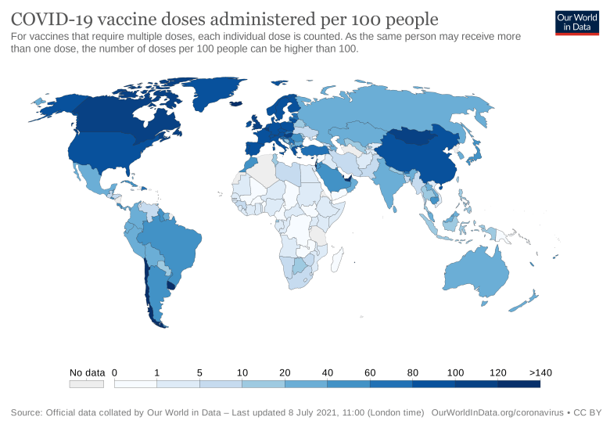

Slide 44
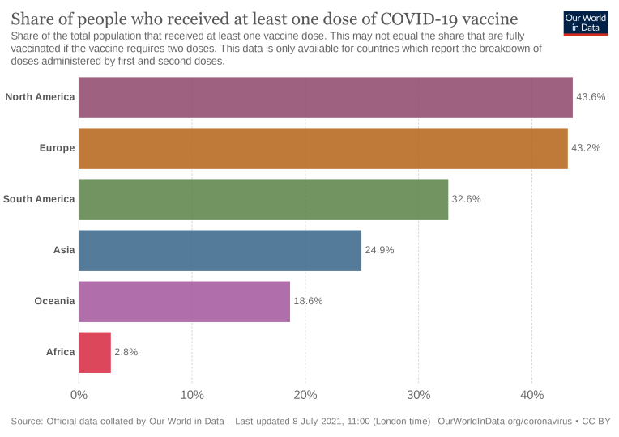

Slide 45
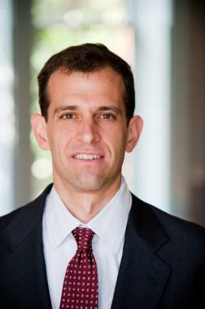
Guest Speaker: Robert Weissman
45
President of Public Citizen (https://www.citizen.org).
Worked as director of the corporate accountability organization Essential Action from 1995 to 2009.
From 1989 to 2009, editor of the Multinational Monitor magazine tracking multinational corporations.
Weissman helped make HIV drugs available to the developing world and has provided assistance to numerous governments on intellectual property and access to medicine issues.
Previously worked as a public interest attorney at the Center for Study of Responsive Law.
Earned a J.D. from Harvard Law School, graduated magna cum laude.

Slide 46
Take Action
Tell President Biden: the United States must lead the global effort to boost the supply of Covid-19 vaccines an end to the pandemic.
Tell Congress: The U.S. should allocate $25 billion to accelerate the production of vaccines and bring an end to the pandemic.

