Slide 1
The RESULTS U.S. Poverty Policy Forum
May 20, 2021
Welcome!
Notes:
MS welcome, quick agenda, this is mostly for Q&A so hoping you brought some/use chat

Slide 2
Our Anti-Oppression Values
2
​RESULTS is a movement of passionate, committed everyday people. Together we use our voices to influence political decisions that will bring an end to poverty. Poverty cannot end as long as oppression exists. We commit to opposing all forms of oppression, including ableism, ageism, classism, colonialism, homophobia, racism, religious discrimination, sexism, transphobia, white saviorism, and xenophobia.
At RESULTS we pledge to create space for all voices, including those of us who are currently experiencing poverty. We will address oppressive behavior in our interactions, families, communities, work, and world. Our strength is rooted in our diversity of experiences, not in our assumptions.
With unearned privilege comes the responsibility to act so the burden to educate and change doesn’t fall solely on those experiencing oppression. When we miss the mark on our values, we will acknowledge our mistake, seek forgiveness, learn, and work together as a community to pursue equity.
There are no saviors — only partners, advocates, and allies. We agree to help make the RESULTS movement a respectful, inclusive space.
Find all our anti-oppression resources at: https://results.org/volunteers/anti-oppression/

Slide 3
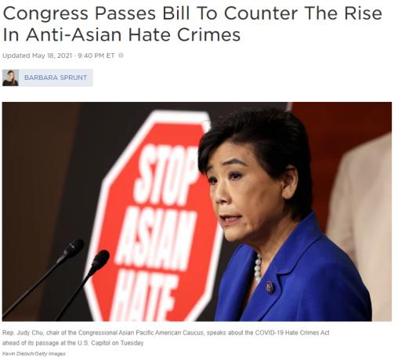
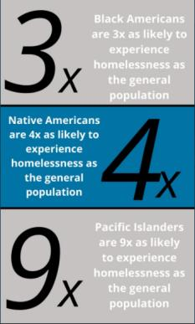
May is AAPI Heritage Month
3
Source: National Alliance to End Homelessness; https://endhomelessness.org/state-of-homelessness-a-look-at-race-and-ethnicity/
https://www.npr.org/2021/05/18/997847571/congress-passes-bill-to-counter-the-rise-in-anti-asian-hate-crimes
Notes:
The House of Representatives passed a bill Tuesday to address the increase in hate crimes and violence against Asian Americans during the coronavirus pandemic, clearing the legislation for President Biden to sign. The COVID–19 Hate Crimes Act passed by a 364-62 vote; all 62 votes against the bill were from Republicans. The Senate approved the legislation last month. The bill, which needed 60 votes for passage in the evenly divided Senate, was approved by a 94-1 vote. Only GOP Sen. Josh Hawley of Missouri voted no.
Source: https://www.npr.org/2021/05/18/997847571/congress-passes-bill-to-counter-the-rise-in-anti-asian-hate-crimes
But we still have a long way to go to end oppression. For example, Pacific Islanders are 9x as likely to experience homelessness as general population. Asians: Most Asian homelessness (76 percent) is found in five states and a territory—California, New York, Hawaii, Washington, Texas, and the Northern Mariana Islands. Pacific Islanders: Pacific Islander numbers exceed others in many of the above areas. As previously noted, it is the racial/ethnic group with the highest national-level rate of homelessness. Pacific Islanders are the only racial/ethnic group that has a higher rate (57 percent) of unsheltered individual homelessness than Native Americans. And it is the only group that has a higher representation of families (45 percent) than Black people.
Source: https://endhomelessness.org/wp-content/uploads/2020/05/EndHomelessness.org_Data-11-2.png; https://endhomelessness.org/state-of-homelessness-a-look-at-race-and-ethnicity/

Slide 4
U.S. Poverty “Asks”
Urge them to speak to leadership, urging them to focus on bold and long-term anti-poverty policies:
Making 2021 EITC/CTC provisions permanent
Rental assistance (likely via Housing Choice Vouchers) should be universal for all those who qualify – with multi-year guaranteed funding
Notes:
Biden gave speech to joint session in Congress, talking about lifting children out of poverty, affordable housing, preventing evictions
Tax: Biden only going to 2025 on EITC/CTC but RESULTS/many MoCs pushing for permanence
RESULTS will continue to push for significant increase in housing assistance for low-income renters (via vouchers)

Slide 5
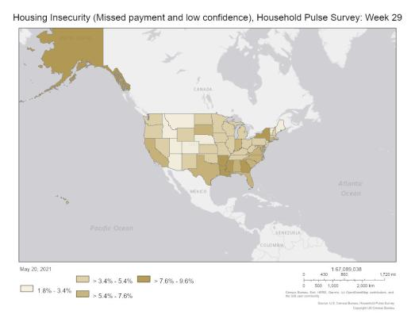
Housing Unaffordability + Instability Persist
33 - Percentage of adults living in households not current on rent or mortgage where eviction or foreclosure in the next two months is either very likely or somewhat likely
7.48 million - # of adults who are not current on rent or mortgage payments and who have slight or no confidence that their household can pay next month’s rent or mortgage on time
In the 5 states and 27 cities, landlords have filed for 342,289 evictions during the pandemic.
4,912 evictions were filed last week.
Source: US Census Bureau – Household Pulse Survey
Source: https://evictionlab.org/eviction-tracking/
Source: https://www.census.gov/data/experimental-data-products/household-pulse-survey.html
Notes:
Evictions are continuing, rental assistance percolating to state and local programs – so important advocacy is happening to make sure those resources are allocated in a racially equitable way that targets low-income renters most at risk of eviction. But ouf focus is now on long-term.
Source: US Census Bureau - Household Pulse Survey (note: survey only looks at impact of COVID-19 on households)
Source: https://evictionlab.org/eviction-tracking/

Slide 6
Rent Increases + Incomes Out-of-Sync
Sources: https://bit.ly/3hJHKut; https://www.jchs.harvard.edu/state-nations-housing-2020
Notes:
Sources: https://www.cbpp.org/blog/2019-income-rent-gap-underscores-need-for-rental-assistance-census-data-show

Slide 7
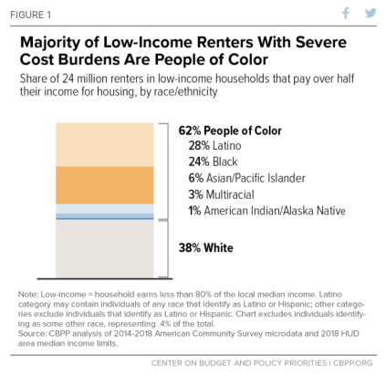
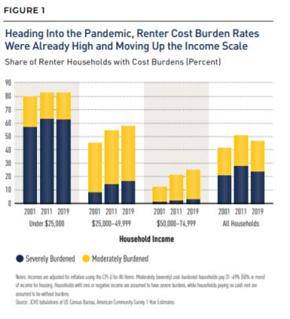
Rent Burdened Pre-Pandemic + Racial Disparities
Sources: https://bit.ly/3hJHKut; https://www.jchs.harvard.edu/state-nations-housing-2020; https://www.cbpp.org/research/housing/more-housing-vouchers-most-important-step-to-help-more-people-afford-stable-homes
Notes:
RESULTS supports efforts to address access to affordable housing + racial inequities, and there will be opportunities to pursue these efforts in the future. Current projection of a reconciliation bill limits what can advance through Congress in the next few months. We recognize the need for further legislative action, for example, to protect renters at risk of eviction and address discrimination in housing.
Sources: https://bit.ly/3hJHKut; https://www.jchs.harvard.edu/state-nations-housing-2020 ; https://www.cbpp.org/research/housing/more-housing-vouchers-most-important-step-to-help-more-people-afford-stable-homes

Slide 8
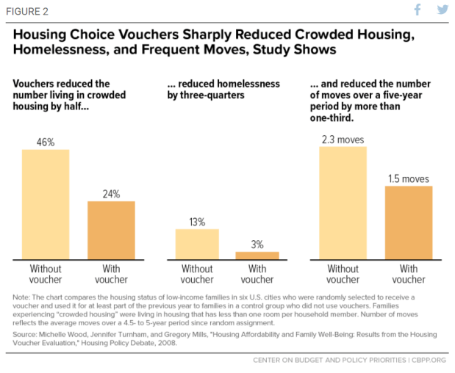
Source: https://www.cbpp.org/research/housing/more-housing-vouchers-most-important-step-to-help-more-people-afford-stable-homes
Notes:
Source: https://www.cbpp.org/research/housing/more-housing-vouchers-most-important-step-to-help-more-people-afford-stable-homes

Slide 9
Demand Congress To Expand Long-Term Rental Assistance
Biden's Presidential Campaign: Universal HCVs
Short-term rental assistance through American Rescue Plan Act
Currently, HCVs funded via annual appropriations. Biden's FY2022 budget proposal called for 200,000 more vouchers.
No additional expansion of rental assistance in Administration’s recovery proposals
Notes:
Biden gave speech to joint session in Congress, talking about lifting children out of poverty, affordable housing, preventing evictions
Tax: Biden maybe only going to 2025 on EITC/CTC but MoCs pushing for permanence; RESULTS would push for permanence
Housing: Not expecting universal vouchers from Biden and Congress
RESULTS will continue to push for significant increase in housing assistance for low-income renters (via vouchers)

Slide 10
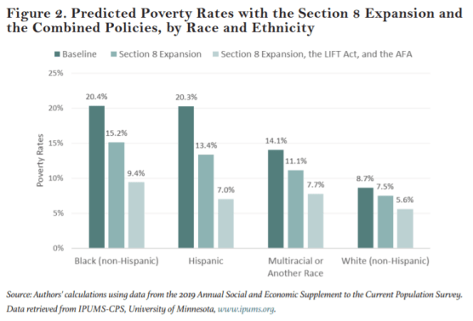
Expanding Rental Assistance Lifts Children Out of Poverty
HCV expansion = lift 9 million people out of poverty
Combined with EITC/CTC expansion = lift 20 million people out of poverty, cut poverty rate by half, cut child poverty rate by nearly 75 percent
Source: https://bit.ly/3f1dE3F (Center on Poverty and Social Policy, Columbia University)
Notes:
Source: https://bit.ly/3f1dE3F (Center on Poverty and Social Policy, Columbia University)
The Section 8 expansion could reduce the national poverty rate by nearly a
quarter, moving 9 million people in the United States out of poverty—exceeding
the current impact of the EITC. Combined with EITC/CTC expansion, would
yield greater cumulative impacts, cutting the national poverty rate by half and the child poverty rate by nearly 75 percent. This translates to moving a total of 20 million people in the United States out of poverty, 7.5 million of whom are children.

Slide 11
Tax credits for low-income workers and families should be expanded permanently.
COVID relief makes temporary changes, so key to make permanent in a recovery package
The Administration proposed to permanently increase the EITC for younger workers and others who are not raising children in their homes, along with making the CTC fully available to low-income families.
But Administration proposal does not make full CTC expansion permanent – we need to push Congress to do so!
We can pay for this by asking the wealthy and corporations to finally pay their fair share.
Notes:
Last month the Administration unveiled their full recovery proposal – you can read more about that here: https://results.org/blog/recovery-must-focus-on-reducing-poverty-and-systemic-inequities/
proposed to permanently increase the EITC for younger workers and others who are not raising children in their homes, along with making the CTC fully available to low-income families. While these steps are important, Congress should go further and make the full Child Tax Credit expansion permanent, as House Ways and Means Chairman Neal proposed. Ultimately, it is important for our members of Congress to hear from constituents that these policies should be permanent -- and for them to weigh in with Congressional leadership.
And a quick back story (only if time): a few weeks ago, RESULTS staff reached out to some of you who are Senate point people – and you did some amazing targeted work to get 41 senators on a letter that was sent to the Administration on March 26 urging them to prioritize making the Child Tax Credit and Earned Income Tax Credit permanent in their upcoming recovery proposal. There were only 17 senators on board at the start of the week and it was critical that 41 (of 50) Democratic senators signed this letter by the time it was sent four days later – and I *know* that many of you made the difference getting the vast majority of Senate Democrats on board in the last . This letter made a big difference and helped lay the groundwork for the permanent tax policies we just saw from the Administration.
The letter is here: https://www.brown.senate.gov/download/eitc-ctc-letter-march-2021__ along with this press release from Sen Brown: https://www.brown.senate.gov/newsroom/press/release/brown-lead-senate-democrats-tax-cuts-workers-families-permanent.

Slide 12
Anti-poverty potential of the American Families Plan
Projected 2022 poverty rates with and without the American Families Plan
The American Families Plan includes:
Expansion of subsidized childcare
An expansion of the CDCTC
A fully refundable Child Tax Credit ($3000/$3600)
An expanded Earned Income Tax Credit for childless workers
Expansion of Summer-EBT benefits
Expansion of the Pell Grant
23%
47%
Based on: Collyer, Curran, Hartley, Parolin, Wimer (2021)
Access all results at: https://www.povertycenter.columbia.edu/s/Poverty-Reduction-Analysis-American-Families-Plan-CPSP-2021.pdf
Notes:
MD flag new research/modeling from Columbia

Slide 13
Anti-poverty potential of American Families Plan: CHILDREN
Projected 2022 child poverty rates with and without the American Families Plan
*Note: projections are approximate; estimates of potential anti-poverty impact for children across racial and ethnic groups using pre-pandemic data also available – see Table A1. on pg. 6 of https://www.povertycenter.columbia.edu/s/Poverty-Reduction-Analysis-American-Families-Plan-CPSP-2021.pdf
Notes:
Worth noting huge racial gaps persist – the Black child poverty rate post Biden proposal is still substantially higher than the White poverty rate before AFP, for example.

Slide 14
For impacts of CTC expansion specifically (using pre-pandemic data), see our January 2021 American Family Act fact sheet
Poverty impacts by children’s age, family type, disability status, race/ethnicity at 50% SPM, 100% SPM, 200% SPM and across all states
Please reach out with data questions and potential requests for analysis: megan.curran@columbia.edu
***IMPORTANT NOTE***
Our poverty projections assume full take-up of the CTC; results represent what is possible if all who are eligible receive it.
To achieve these poverty reductions, access remains key!

Slide 15
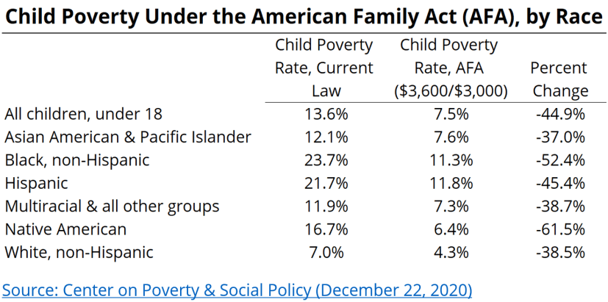
Impact of expanding CTC
Notes:
Reminder: bipartisan child allowance proposals. MD suggests framing our tax policy work like “we are very interested in policies that reduce child poverty… have you looked at Senator Romney’s child allowance proposal? Do you favor that approach versus the CTC expansions put forward by Senators Rubio and Lee?” And also ask "are there current GOP members of Congress following former Speaker Paul Ryan's lead in support of expanding the EITC so younger workers/others who don't claim dependents?". Would love to frame it like "which one of the GOP proposals do you like more?" vs "will you be on board with a Dem-only proposal" (which they won't). Might be worth sharing this video of a March 18 conservative think tank event with Sen Romney on Child Allowance: https://www.youtube.com/watch?v=rVtJ--1YccQ.
Plus open-end questions like “what are your priorities when it comes to addressing the affordable housing crisis?” etc. and then pivoting to why helping low-income renters is key.
Screenshot from a talk Sen Romney gave today [Live] Family Financial Security: Sen. Romney on the Fight to Support Our Most Important Institution - YouTube

Slide 16
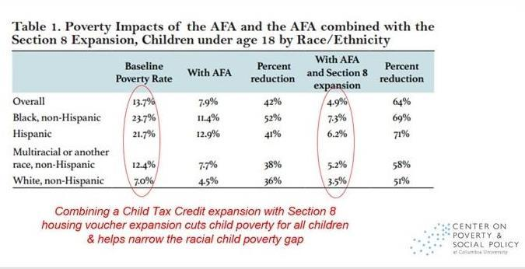
Now is the time to be bold.
Notes:
Going to back to the data we saw earlier… As we close out, a reminder that these housing and tax policies combined can reduce child poverty by almost 2/3 (see chart)– let’s make this happen and lay the groundwork for the a more equitable, poverty-free future! https://static1.squarespace.com/static/5743308460b5e922a25a6dc7/t/5f7dd00e12dfe51e169a7e83/1602080783936/Housing-Vouchers-Proposal-Poverty-Impacts-CPSP-2020.pdf?fbclid=IwAR07aysbP4Z81vVVOZ-ipzuKYAxoVUGvXSRsaxT_cUH0M7zcuUsFmXn1P_8

Slide 17
Now is the time to be bold.
Opportunity to secure large-scale policies that:
Dramatically reduce child poverty
Start to address racial inequities
Why is it key for members of Congress to speak to Leadership?
While primary negotiations are focused on bipartisan infrastructure legislation, conversations happening in next few weeks about their recovery priorities
As Congress moves large-scale legislation, key that Congressional leaders/negotiators their peers care about poverty and equity
Also key to build long-term bipartisan support for these policies
Notes:
MD we are pushing to get MoCs to speak to leadership (esp Dems, including Committee Chairs)
meeting with GOP offices: while less involved in negotiations right now on recovery package, will be key to secure support long-term to protect any policies passed this year.
STOP HERE FOR QUESTIONS

Slide 18
Action Resources
Main Resources
Monthly Action Sheets: https://results.org/volunteers/monthly-actions/
Lobby Resources: https://results.org/volunteers/lobbying/
Laser Talks: https://results.org/volunteers/laser-talks/
Lobby Report Form: www.tinyurl.com/RESLobbyReport
U.S. Poverty Resources
Census Household Pulse data https://www.census.gov/data-tools/demo/hhp/#/?measures=EXR
State housing data https://nlihc.org/housing-needs-by-state
Columbia University poverty data on expanding CTC: www.tinyurl.com/ColumbiaCTC and expanding HCVs with CTC: www.tinyurl.com/ColumbiaHousingCTC
Notes:
STOP HERE FOR QUESTIONS
Action: building on the really important conversations you all have had this year as part of the First 100 Days campaign, need to put public pressure – thus the media push that Ken will discuss more in a few minutes.
And media gives you a great excuse to follow up with staff to reiterate our priorities, ask them what their boss is doing re weighing in with leadership - key decisions being made on the hill
Overall, continued engagement with staff in the coming months will be key – if you are the point person with a Congressional housing or tax aide, this is a good time to connect with them to get their reaction to the Biden Administration’s recovery proposal and urge them to weigh in with leadership
Reach out if you need support – especially if you are meeting with a policymaker directly or scheduled with aides for a key committee leader, etc.
We are updating our State data but in the meantime, can put a few resources in the chat…
Census Household Pulse data https://www.census.gov/data-tools/demo/hhp/#/?measures=EXR
Housing https://nlihc.org/housing-needs-by-state and https://nlihc.org/coronavirus-and-housing-homelessness/eviction-update
Columbia on CTC: https://static1.squarespace.com/static/5743308460b5e922a25a6dc7/t/600f2123fdfa730101a4426a/1611604260458/Poverty-Reduction-Analysis-American-Family-Act-CPSP-2020.pdf

Slide 19
May U.S. Poverty Action
On the heels of your amazing lobbying during the First 100 Days, generate media in support of bold housing and tax policies as part of economic recovery.
Submit letters to the editor and op-eds urging Congress to expand rental assistance and to make the EITC and CTC provisions permanent.
The May 2021 U.S. Poverty Action has template LTEs and other resources at: https://results.org/volunteers/monthly-actions/
Notes:
Start

Slide 20
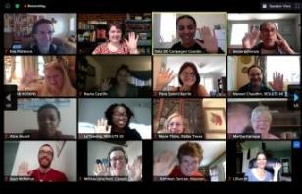
June 12-13, 2021
RESULTS International Conference
Interactive online event
Exciting speakers
Advocacy skill & issue workshops
Coordinated Advocacy Week, June 14-18
Register today! results.org/conference
Please register today if you plan to participate in
Advocacy Week

Slide 22
Suggested Housing Talking Points
Key data
Rents + Home Prices in your neighborhood
Rent Affordability / Rent/Mortgage Burdens
Importance of housing stability – including your own story!
Evictions
Homelessness
Notes:
Feel empowered to speak and voice your opinions, share stories, and concerns about affordable housing (or lack thereof), how much rents have gone up in your neighborhood (the more specific you are - about the cost of renting a 1BR, a studio, a 2BR, the better!), the importance of being able to afford and remain stably housed (tying it to important health outcomes, educational outcomes), how visible homelessness is in your community, what you're hearing about evictions in your respective communities. BUT MAKE SURE TO RETURN TO MAIN ASK: EXPAND RENTAL ASSISTANCE. Affordable housing prevents evictions + homelessness.

Slide 23
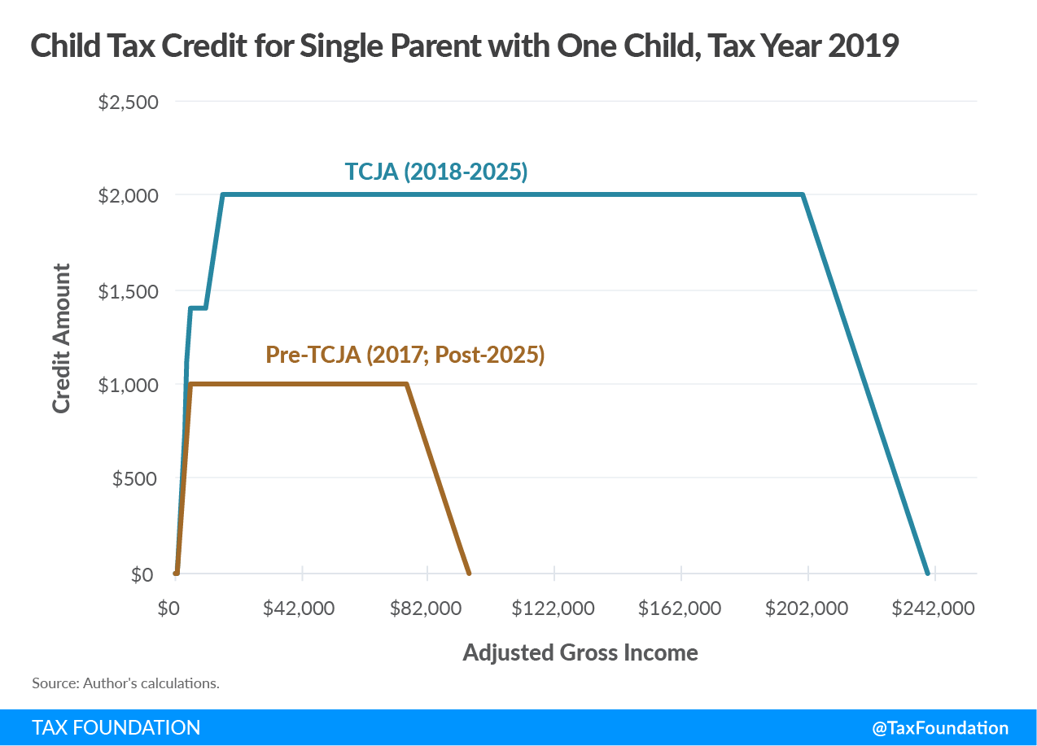
Visual: Previous CTC
TCJA = 2017 tax law (passed via budget reconciliation)
Flat here since families under $2,500 in income do not get any CTC
Notes:
Source: https://taxfoundation.org/tax-basics/child-tax-credit/

Slide 24
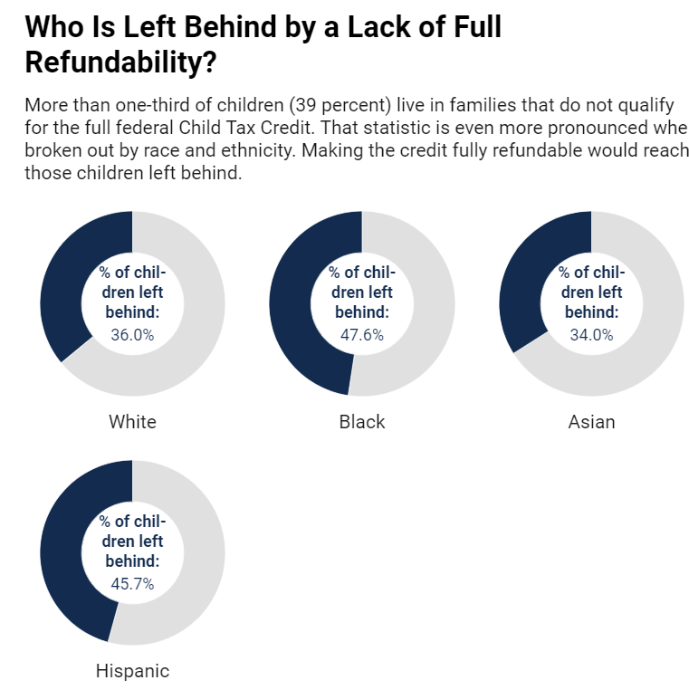
Child Tax Credit changes key
Notes:
To quickly touch base on tax policy, a reminder that 4/10 children who live in low-income families will not get the full value of the CTC in 2022 unless Congress makes the current CTC permanent – this chart shows a breakdown of what that looks like by race and ethnicity.
Source: Child Tax Credit Is a Critical Component of Recovery @iteptweets https://itep.org/child-tax-credit-is-critical-component-of-biden-administrations-recovery-package/
And, we’ll push to make the larger Child Tax Credit permanent beyond 2025, to maximize the impact on child poverty.

Slide 25
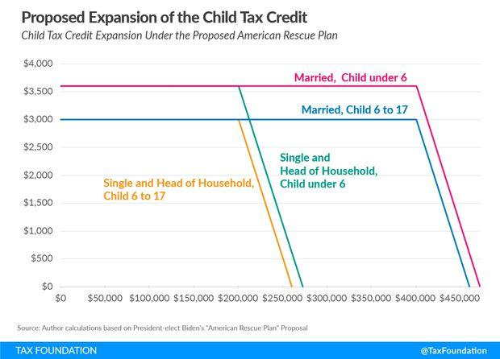
Visual: Expanding CTC
Notes:
https://taxfoundation.org/biden-stimulus-american-rescue-plan/

Slide 26
Visual: Expanding EITC
Notes:
And a reminder that the expansion of EITC for 17 million low-income workers – younger workers and others who don’t claim dependents – is also set to expire after 2021. We will push Congress to make this happen, reminding them that otherwise 5 million younger workers and others without children in the home are taxed into poverty each year because their EITC is too low.
Visual source: https://taxfoundation.org/biden-stimulus-american-rescue-plan/

Slide 27
Make Corporations Pay Their Fair Share
A Trump-era tax break reduced the top corporate tax rate from 35 percent to 21 percent.
This tax cut deprived the country of needed revenues— an estimated $200 billion annually
It benefited wealthy (mostly white & male) shareholders instead of low-income workers.
The American Jobs Plan proposed raising the corporate tax rate and closing other corporate tax loopholes.
Notes:
MD have these slides on hand re revenue ?s but wont review

Slide 28
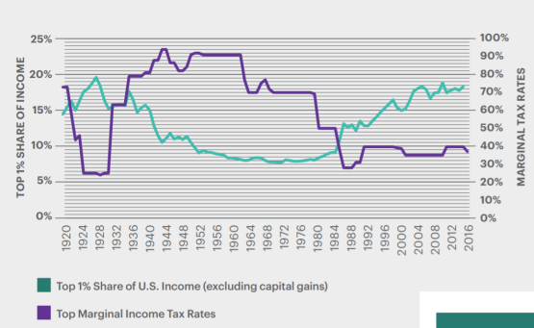
Make Wealthy Individuals Pay Their Fair Share
Trump-era tax cuts lowered the top tax rate from 39.6 percent to 37 percent
The top rate only applies to the very wealthiest people—who are disproportionately white and male.
As the top tax rate goes down, income inequality gets worse →
The American Families Plan proposes restoring this tax rate.

Slide 29
Tax Income From Wealth Like Income From Work
Wealthy people receive a significant amount of their income from their wealth—selling assets like boats, stocks, and businesses—not from working.
This income is taxed at a lower rate (20 percent at most).
Wealthy people can delay paying these taxes and sometimes avoid paying them entirely.
Women and people of color are more likely to receive income from working—and have less wealth--and so benefit from this tax break less.
The American Families Plan includes raising tax rates on capital gains on households making over $1 million & ending the "stepped up" basis loophole.

Slide 30
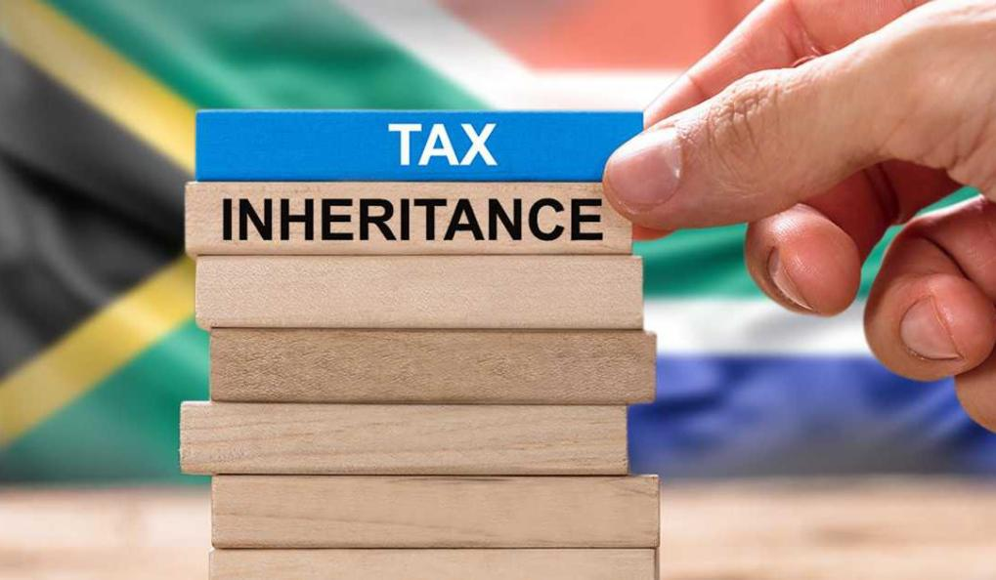
Tax Inheritance Meaningfully
Trump-era tax breaks made the estate tax much less effective—in 2018, only .06 percent of estates were taxed.
Inheritance plays a huge role in wealth disparities. It accounts for 40 percent of all wealth!
The estate tax is a powerful took for leveling the playing field between those who inherit wealth (disproportionately white families) and those who rely on income from labor (disproportionately people of color).

Slide 31
Enforce Tax Laws Against the Rich & Powerful
IRS funding has been slashed by a third in recent years, decreasing tax enforcement against corporations and the very rich.
Many wealthy individuals and corporations are able to avoid paying their taxes at all.
This causes (at least) a $600 billion loss in revenues a year—revenues that could have been invested in women & families.
The American Families Plan would increase IRS funding to boost enforcement against those with the highest incomes.

Slide 32
Questions?
Notes:
And a reminder that the expansion of EITC for 17 million low-income workers – younger workers and others who don’t claim dependents – is also set to expire after 2021. We will push Congress to make this happen, reminding them that otherwise 5 million younger workers and others without children in the home are taxed into poverty each year because their EITC is too low.
Visual source: https://taxfoundation.org/biden-stimulus-american-rescue-plan/

