Slide 1
The RESULTS National Webinar
March 6, 2021
Welcome!

Slide 2
RESULTS Anti-Oppression Values
​RESULTS is a movement of passionate, committed everyday people. Together
we use our voices to influence political decisions that will bring an end to poverty.
Poverty cannot end as long as oppression exists.
We commit to opposing all forms of oppression, including racism, classism, colonialism, white saviorism, sexism, homophobia, transphobia, ableism, xenophobia, and religious discrimination. ​
At RESULTS we pledge to create space for all voices, including those of us who are currently experiencing poverty. We will address oppressive behavior in our interactions, families, communities, work, and world. Our strength is rooted in our diversity of experiences, not in our assumptions. ​
With unearned privilege comes the responsibility to act so the burden to educate and change doesn’t fall solely on those experiencing oppression. When we miss the mark on our values, we will acknowledge our mistake, seek forgiveness, learn, and work together as a community to pursue equity.
There are no saviors — only partners, advocates, and allies. We agree to help make the RESULTS movement a respectful, inclusive space.​
Find all our anti-oppression resources at: https://results.org/volunteers/anti-oppression/

Slide 3
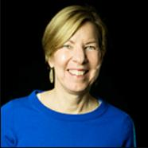
Dr. Joanne Carter Executive Director

Slide 4
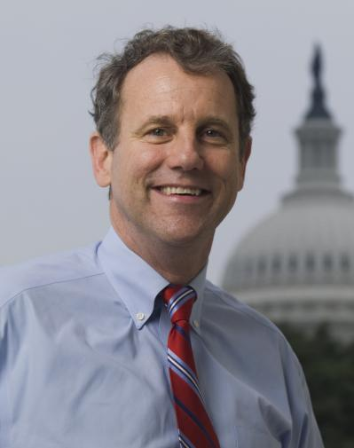
Sen. Sherrod Brown (D-OH)

Slide 5
1. Budget resolution adopted that includes reconciliation directives to individual committees
2A. Specific committees report legislation in response to reconciliation directives
2B. When applicable, Budget Committee packages responses together and reports bill to full chamber
3. The reconciliation bill is considered on chamber floor
4. Differences resolved between chambers (conference committee or amendment exchange)
5. The reconciliation bill is signed and enacted into law or vetoed by President
Budget reconciliation process
Notes:
Source: https://fas.org/sgp/crs/misc/R44058.pdf

Slide 6
Where things stand now
House and Senate passed $1.9 trillion package including
$11 billion for global response, including $3.5 billion for the Global Fund to Fight AIDS, TB, and Malaria
$25 billion for emergency rental assistance
Expands the EITC and Child Tax Credit
Another reconciliation package (for FY 2022) is possible later in the year
RESULTS shifting focus to long-term policy priorities

Slide 8
Fiscal year 2022 appropriations
Every member of Congress has an opportunity to weigh in on how funding is allocated – your voice matters!
Priority issues:
Global Tuberculosis
Global Partnership for Education
Global Nutrition

Slide 9
It’s possible to end the global tuberculosis epidemic once and for all.
COVID-19 pandemic is reversing decades of progress on TB
TB still the #1 infectious disease killer in low- and middle-income countries
Biggest obstacle to progress is lack of political will and funding.

Slide 10
All kids deserve the chance to learn equally, learn early, and learn well.
COVID-19 related school closures disrupted learning for 1.5 billion children
The Global Partnership is the only public-private partnership exclusively focused on quality education
Replenishment conference this year for next 5-year period

Slide 11
Adequate nutrition helps kids reach their full potential and saves lives.
Childhood malnutrition goes hand in hand with poverty
150 million additional people driven into extreme poverty in 2020
The first 1,000 days are a critical window of growth and development
Before COVID-19, nearly 1 in 5 children globally was stunted.

Slide 12
FY22 appropriations requests
Global Tuberculosis | $1 billion for tuberculosis within USAID Global Health
Global Partnership for Education (GPE) | $150 million for GPE within USAID Basic Education
Global Nutrition | $300 million for Nutrition within USAID Global Health
*USAID= United States Agency for International Development

Slide 13
Take action on appropriations
Lobby meetings with members of Congress (MoCs)
Use appropriations memos as leave behinds
Ask if office has an individual member appropriations request form (for support completing, email to dmonza@results.org)
Part of First 100 days (and beyond)!
Dear Colleague letters
FY22 versions coming soon

Slide 14
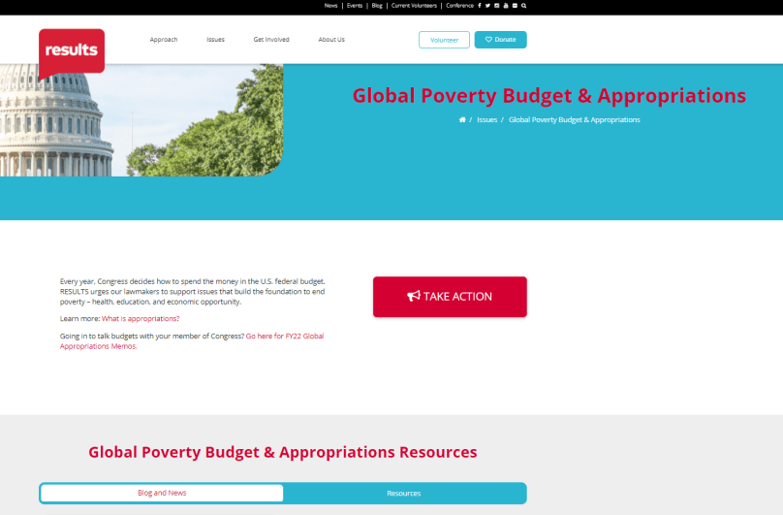
Resources on issues page and/or lobbying page!

Slide 15
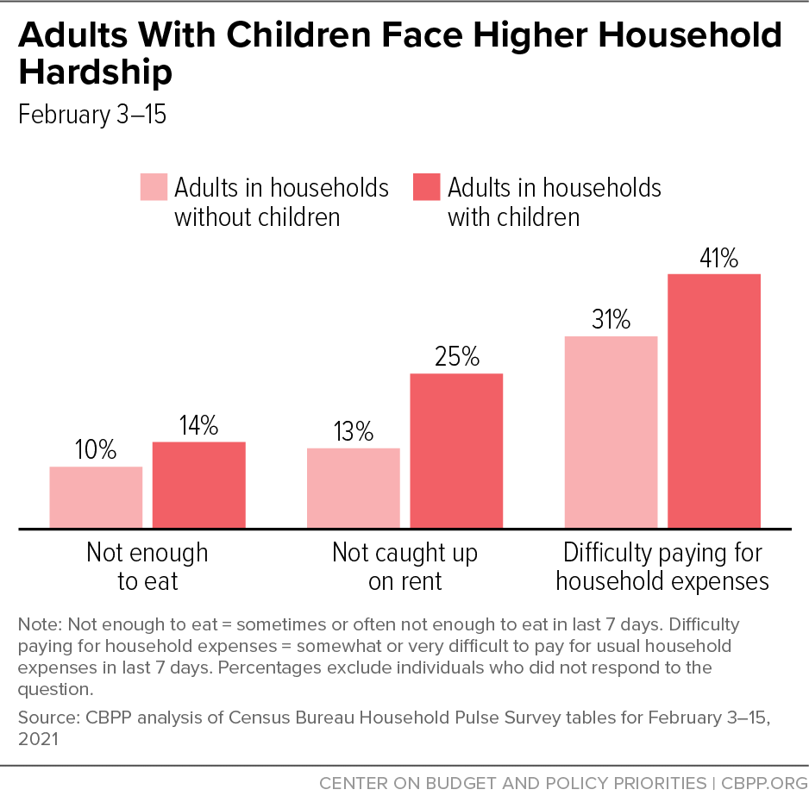
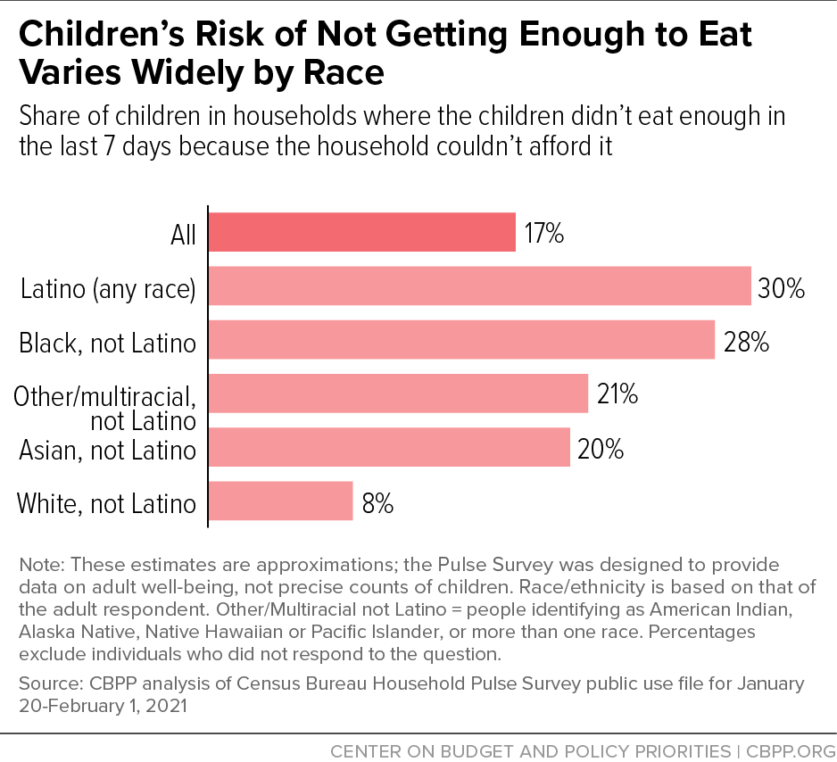
Hardship in the U.S. now
Notes:
Latest Census Household Pulse Survey data – visuals source: https://www.cbpp.org/research/poverty-and-inequality/bolstering-family-income-is-essential-to-helping-children-emerge
Families with children – and especially children of color – still face tremendous hardship. The COVID relief package will certainly help, but we need to prioritize recovery policies that can reduce child poverty, address our underlying housing crisis, and begin to reduce racial wealth inequality.

Slide 16
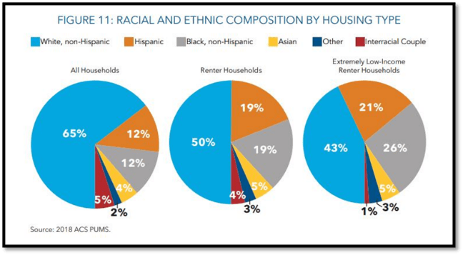
Notes:
Visual source: https://www.opportunityhome.org/resources/racial-equity-housing/ -- this visual helps describe housing by race and ethnicity before the pandemic.
Because of the legacy of segregation and racist housing policies, people of color are more likely than white households to be 1. renters and 2. extremely low-income renters and that people of color disproportionately struggle to pay rent compared to white households. BIPOC households own homes at a much lower rate than white households and they are more likely to be cost-burdened renters and at risk of eviction, which further strips wealth and opportunity.

Slide 17
We need to address the underlying housing crisis with bold long-term solutions.
Rental Assistance
Dramatically scale-up assistance for low-income renters
Housing supply
May work on increasing supply of affordable housing
Longer term
Look at policies to reduce racial wealth inequality, including home ownership
Make Housing Choice Vouchers universal – so all those eligible get federal housing assistance
Housing = infrastructure
Notes:
Housing: want to focus on the need/asks, and then circle back to what’s happening with Congress in a few min
expand housing assistance (Could break up into 2 slides?)
Provide Section 8 housing vouchers to every eligible family so that no one has to pay more than 30% of their income for rental housing.
MD flag shift/most likely possibility in 2021 = big expansion of HCVs, especially since infrastructure already exists. And later plenary will include new research from Columbia looking at the anti-poverty impact.
Long term, still support a renters credit),
acknowledge the importance of increasing the supply of affordable housing

Slide 18
Tax credits for low-income workers and families should be expanded permanently.
Expanding (and restructuring) the CTC could cut child poverty by almost half
FYI bipartisan CTC expansion proposals
Expand EITC for younger workers/others who don’t claim dependents
COVID relief makes temporary changes, then work to lock in permanent tax policies in a recovery package

Slide 19
Visual: Expanding EITC
Notes:
https://taxfoundation.org/biden-stimulus-american-rescue-plan/
Many of you know about the powerful anti-poverty impact of these refundable credits – together the EITC and CTC lifted 7.5 million people above the poverty line in 2019.
Problem: 5 million younger workers and others without children in the home are taxed into poverty each year because their EITC is too low.
Inform or Illustrate: President Biden has proposed long-overdue improvements to the EITC and CTC that would fix these problems. By increasing the EITC for workers without children and expanding it to younger workers, 17 million low-income workers would benefit.

Slide 20
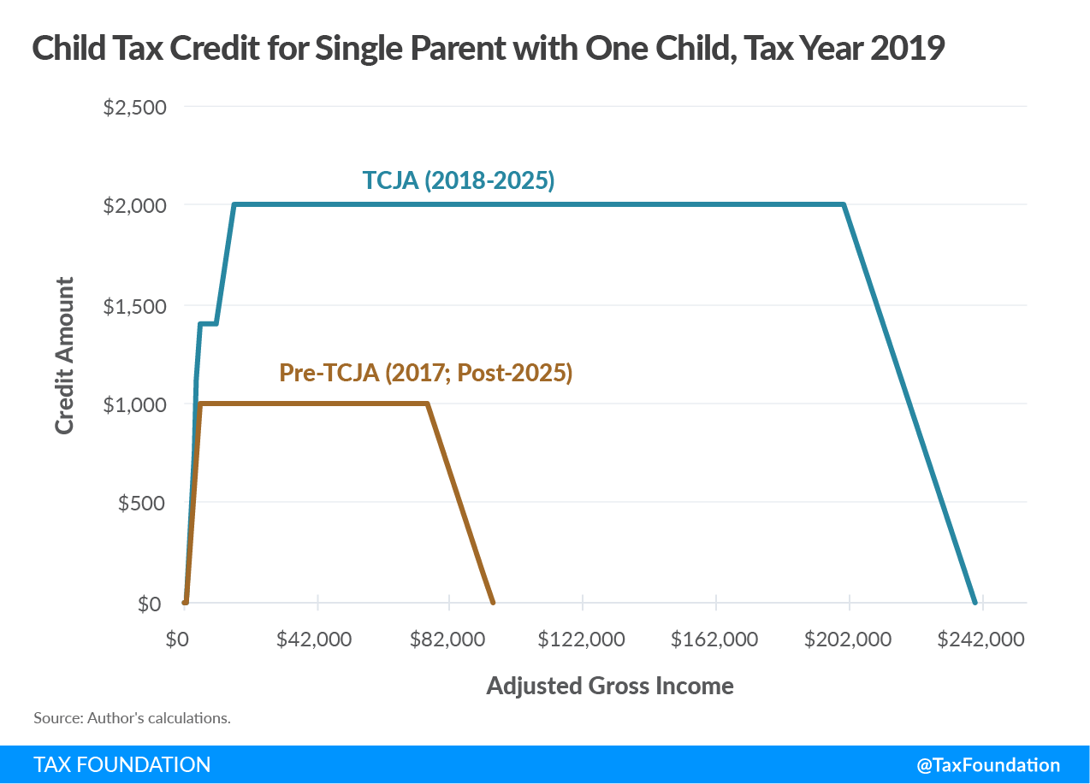
Visual: Current CTC
TCJA = 2017 tax law (passed via budget reconciliation)
Flat here since families under $2,500 in income do not get any CTC
Notes:
Source: https://taxfoundation.org/tax-basics/child-tax-credit/

Slide 21
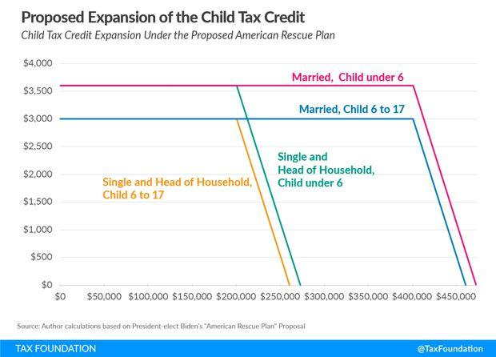
Visual: Expanding CTC
Notes:
https://taxfoundation.org/biden-stimulus-american-rescue-plan/
Could break up into 2 slides?

Slide 22
Now is the time to be bold.
Biden Harris Administration developing their recovery plans now – and members of Congress are communicating their priorities
Make sure your members of Congress hear from you!
Opportunity to secure large-scale policies that:
Dramatically reduce child poverty
Address the disproportionate impact of racist housing policies for Black renters and other communities of color

Slide 23
Now is the time to be bold.
Notes:
By making the HCV program universal to ensure housing assistance is available for all low-income renters along with a child allowance (modeled on the American Family Act, or AFA), Congress can reduce child poverty by almost 2/3 (see chart) https://static1.squarespace.com/static/5743308460b5e922a25a6dc7/t/5f7dd00e12dfe51e169a7e83/1602080783936/Housing-Vouchers-Proposal-Poverty-Impacts-CPSP-2020.pdf?fbclid=IwAR07aysbP4Z81vVVOZ-ipzuKYAxoVUGvXSRsaxT_cUH0M7zcuUsFmXn1P_8

Slide 24
Learn more!
Monthly Policy Forum: Housing and Taxes – Where to Next?
Thursday, March 18, 8:00 pm ET
Register:
https://results.zoom.us/meeting/register/tJEoc-CvrD4oGNLFmh30yEWDpdb0JypCRveT
Monthly Policy Forum: Global Tuberculosis
Thursday, March 18, 9:00 pm ET
Register: https://results.zoom.us/meeting/register/tJYpfuGqpz0iHtxA1hDWHIsuE0tiR22IhpOg
Notes:
First 100 Days asks sheet, lobby leave behinds, laser talks, and the 2021 lobby report form are on our website.
Reach out if you need support – especially if you are meeting with a policymaker directly or scheduled with aides for a key committee leader, etc.
We are updating our State data but in the meantime, can put a few resources in the chat…
Census Household Pulse data https://www.census.gov/data-tools/demo/hhp/#/?measures=EXR
Housing https://nlihc.org/housing-needs-by-state and https://nlihc.org/coronavirus-and-housing-homelessness/eviction-update
Columbia on CTC: https://static1.squarespace.com/static/5743308460b5e922a25a6dc7/t/600f2123fdfa730101a4426a/1611604260458/Poverty-Reduction-Analysis-American-Family-Act-CPSP-2020.pdf

Slide 25
March U.S. Poverty Action
Meet (again) with House and Senate offices and
follow up with housing and tax aides. Urge them to:
Address long-term solutions to poverty and housing by
making new EITC/CTC provisions permanent
making Housing Choice Vouchers universal
Increasing supply of affordable housing and addressing legacy of racism in housing (increase Black homeownership, reduce wealth inequality)

Slide 26
March Global Poverty Action
Meet (again) with House and Senate offices and
follow up with aides. Urge them to:
Include our appropriations requests on TB, nutrition, education in their submissions to leadership of State and Foreign Operations subcommittees (SFOPS). Ask if they have forms to complete and deadlines (RESULTS staff can help with forms).
Ask members and staff to attend TB briefing (details soon). Opportunity to educate new members and staff.

Slide 27
March Action Resources
Main Resources
Monthly Action Sheets: https://results.org/volunteers/monthly-actions/
Lobby Resources: https://results.org/volunteers/lobbying/
Laser Talks: https://results.org/volunteers/laser-talks/
Lobby Report Form: www.tinyurl.com/RESLobbyReport
U.S. Poverty Resources
Census Household Pulse data https://www.census.gov/data-tools/demo/hhp/#/?measures=EXR
State housing data https://nlihc.org/housing-needs-by-state
Columbia University poverty data on expanding CTC: www.tinyurl.com/ColumbiaCTC and expanding HCVs with CTC: www.tinyurl.com/ColumbiaHousingCTC
Global Poverty Resources
FY2022 Global Appropriations Memos: https://results.org/resources/fy22-global-appropriations-memos/
GPE Case for Investment: https://www.globalpartnership.org/financing-2025/case-for-investment
UNICEF 2020 Malnutrition Estimates: https://www.unicef.org/media/69816/file/Joint-malnutrition-estimates-2020.pdf

Slide 28
Celebrations!

Slide 29
Meet with all 100 Senate offices
Meet with 3/4 of House offices
Build a cadre of new RESULTS leaders with lived experiences of poverty

Slide 30
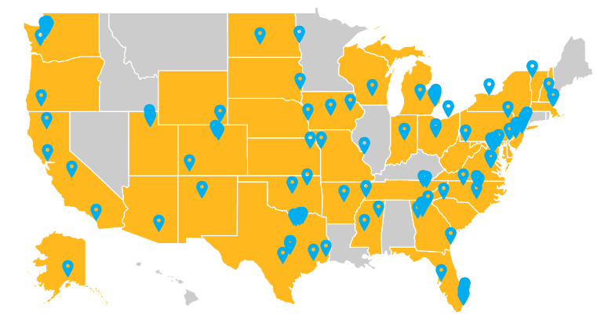
Total Meetings: 131
Updated on March 4

Slide 31
Total Meetings: 131
See full size images on social media by following #Voices4RESULTS

Slide 32
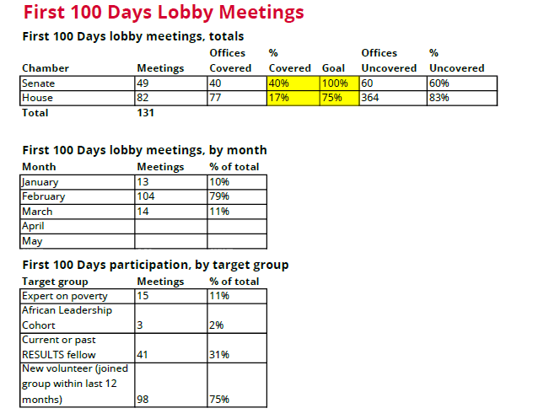
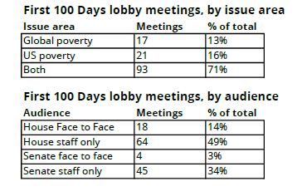
Updated on March 4

Slide 33
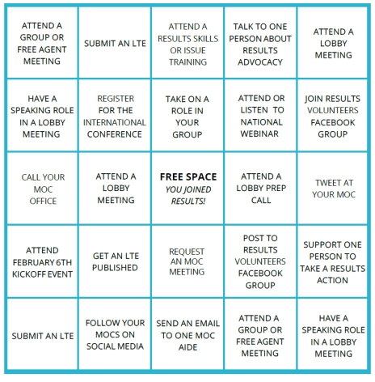
RESULTS Advocacy Bingo
X
Congratulations to new volunteers Courtney Cohen, Sarah Izabel, and Beth Prevo for already getting a BINGO this year!
If you’d like to play, find the game card and instructions here:
bit.ly/advocacy-bingo
X
X
X
X
Notes:
First 100 Days asks sheet, lobby leave behinds, laser talks, and the 2021 lobby report form are on our website.
Reach out if you need support – especially if you are meeting with a policymaker directly or scheduled with aides for a key committee leader, etc.
We are updating our State data but in the meantime, I will put a few resources in the chat…
Census Household Pulse data https://www.census.gov/data-tools/demo/hhp/#/?measures=EXR
Housing https://nlihc.org/housing-needs-by-state and https://nlihc.org/coronavirus-and-housing-homelessness/eviction-update
Columbia on CTC: https://static1.squarespace.com/static/5743308460b5e922a25a6dc7/t/600f2123fdfa730101a4426a/1611604260458/Poverty-Reduction-Analysis-American-Family-Act-CPSP-2020.pdf

Slide 34
Help fill up the map at results.org/First100Days!
To get on the map, complete this form for each meeting: www.tinyurl.com/RESLobbyReport.

Slide 35
Welcome RESULTS Advocates
Heidi Alkoutami - Chapel Hill, NC
Ann Alvarez - Salt Lake City, UT
Andrew Baca-Grant - Albuquerque, NM
Sarah Bargnesi - Buffalo, NY
Selena Bennett - Raleigh, NC
Jenna Bradshaw - Oswego, NY
Andrea Bustamente - Flower Mound, TX
Christian Curtis – Fort Worth, TX
Nisrine Elmouttaqi - San Jose, CA
Abby Feldman - Rochester, NY
Cole Fredricks - New City, NY
Marisa Langlois - Seattle, WA
Ben Leigh - St. Louis, MO
Michelle Lyons - Greenville, SC
Kim Mace - Lake Tapps, WA
Juwann Moss - Philadelphia, PA
Mia Nieves​ - San Jose, CA
Brynn O'Shaughnessy – Minneapolis, MN
Taylor Paraboschi​ - Westfield, NJ
Lisa Pedersen - Rancho Santa Margarita, CA
Scott Price - Rancho Cordava, CA
Rachel Richardson -​ Fort Lauderdale, FL
Zoha Rizvi​ - Carrollton, TX
Regina Robison​ - Chandler, AZ
Britta Seaberg​ - Madison, WI
Paschaline Uti​ - Kansas City, MO
Sara Windoloski​ - Charlottesville, VA
Megan Zawilinski ​ - Cleveland, OH
Notes:
2:01 (6 min)

Slide 36
Timea Renfrow
RESULTS Fellow
Virginia Advocate
First Lobby Meeting
Rep. Connolly (D-VA-11)

Slide 37
Open Shares
What exciting moments have you had during your lobby meetings?
Did you participate in a lobby meeting for the first time? What was that like?
Unmute (or *6 if you're on the phone).
Feel free to share in the chat, too!

Slide 38
Welcome Sarah Leone
Grassroots Impact Associate
Notes:
2:01 (6 min)

Slide 39
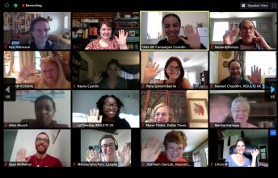
June 12-13, 2021
RESULTS International Conference
Interactive online event
Exciting speakers
Advocacy skill & issue workshops
Coordinated advocacy
Registration now open at results.org/conference

Slide 40
Upcoming Trainings
Supporting New Advocates to Grow
Thursday, March 11, 8:30 pm ET
Register: https://results.zoom.us/meeting/register/tJYlc-muqDojG93K3vrNo3DC5UgYFaNXYEc-
Monthly Policy Forum: Housing and Taxes – Where to Next? Thursday, March 18, 8:00 pm ET
Register: https://results.zoom.us/meeting/register/tJEoc-CvrD4oGNLFmh30yEWDpdb0JypCRveT
Monthly Policy Forum: Global Tuberculosis
Thursday, March 18, 9:00 pm ET
Register: https://results.zoom.us/meeting/register/tJYpfuGqpz0iHtxA1hDWHIsuE0tiR22IhpOg
How to Build Your Action Network 101
Wednesday, March 31 8:30 pm ET
Register: https://results.zoom.us/meeting/register/tJAsf-2tqDwpHN1ttCcQOHtzS4u7movyJfVU
Registration information also in the Weekly Update!
https://results.org/volunteers/weekly-updates/

Slide 41
Upcoming Events
New Advocate Orientations
Tuesday, March 9, 12:00 pm ET; Wednesday, March 24, 8:30 pm ET
Register to attend at: https://results.salsalabs.org/orientationcallrsvp/index.html?_ga=2.111757443.60245586.1607979731-2052042826.1602183780
U.S. Poverty Free Agents Webinars
Tuesday, March 16, 1:00 pm and 8:00 pm ET
Contact Jos Linn at jlinn@results.org for more information.
Global Poverty Free Agents Webinar
Monday, March 22, 8:00 pm ET
Contact Lisa Marchal at lmarchal@results.org for more information.

