Slide 1
The RESULTS National Webinar
January 2021
Welcome!

Slide 2
RESULTS Anti-Oppression Values
​

Slide 3
RESULTS Anti-Oppression Values
​RESULTS is a movement of passionate, committed everyday people. Together
we use our voices to influence political decisions that will bring an end to poverty.
Poverty cannot end as long as oppression exists.
We commit to opposing all forms of oppression, including racism, classism, colonialism, white saviorism, sexism, homophobia, transphobia, ableism, xenophobia, and religious discrimination. ​
At RESULTS we pledge to create space for all voices, including those of us who are currently experiencing poverty. We will address oppressive behavior in our interactions, families, communities, work, and world. Our strength is rooted in our diversity of experiences, not in our assumptions. ​
With unearned privilege comes the responsibility to act so the burden to educate and change doesn’t fall solely on those experiencing oppression. When we miss the mark on our values, we will acknowledge our mistake, seek forgiveness, learn, and work together as a community to pursue equity.
There are no saviors — only partners, advocates, and allies. We agree to help make the RESULTS movement a respectful, inclusive space.​
Find all our anti-oppression resources at: https://results.org/volunteers/anti-oppression/

Slide 4
Remarks from
Executive Director
Dr. Joanne Carter
Notes:
Longer than normal

Slide 5
COVID Deal
Bipartisan package includes:
$25 billion in emergency rental assistance with a priority for low-income renters most at risk of eviction (more on the housing specifics here)
Extends the national CDC eviction moratorium for one month (see revised CDC declaration form)
15 percent boost to SNAP for six months to help families put food on the table (more on food assistance here)
Key changes to boost the Earned Income Tax Credit (EITC) and Child Tax Credit (CTC) for low-income workers and families, which enables workers who have lost jobs or face reduced wages to use their 2019 income to get a larger refund
$4 billion for Gavi, the Vaccine Alliance, which will mean millions of people in low-income countries have access to a COVID vaccine
Notes:
Joanne https://results.org/blog/latest-from-capitol-hill-on-coronavirus-and-poverty/

Slide 6
We’ve done incredible advocacy in 2020!
700+ pieces of media published
(Second highest ever!)

Slide 7
We’ve done incredible advocacy in 2020!
500+ congressional meetings

Slide 8
We’ve done incredible advocacy in 2020!
We brought housing, SNAP, & global assistance to the forefront in COVID negotiations.
We protected anti-poverty programs & secured a Gavi pledge.

Slide 9
2021 Policy Priorities – U.S.
Housing
Tax
Nutrition

Slide 10
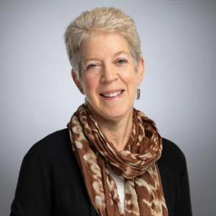
Guest Speaker: Ellen Nissenbaum
Senior Vice President for Government Affairs
for CBPP (www.cbpp.org)
Has directed CBPP’s work with federal
policymakers and national organizations
since 1984
Works on federal budget and tax issues
Medicaid and health care, nutrition programs,
and other critical policies
Regarded as one of the leading legislative
directors among non-profit organizations in
Washington
Assists national and state organizations and coalitions on key policy developments in Congress and the Executive Branch, strategic guidance, and communications planning
Regularly speaks at conferences, in briefings for policymakers, and with news outlets on federal budget issues.
Notes:
MD start with priorities: 1. housing 2. tax 3. nutrition – our guest speaker will give us context and opportunities shorter and longer-term. Create slide?
MD intro, Ellen talk 15 min followed by Q&A (3-5)
What the GA election means: incredible opportunity, things will move quickly, will still mean we need to be strategically balanced re pushing for bold anti-racist policies but recognize limits (slim margins) – make sure win broad support. Bold and grounded
Value of building bipartisan support: working with GOP also important, anything that isn’t done via reconciliation will need 60 Senate votes
COVID: Biden/Harris COVID package soon (mention but RESULTS grassroots wont play role), will set the stage for fast-paced process (Jan-Feb, maybe into March). Congress will build on Admin proposal, don’t have to wait to shape. Starts with current FY budget resolution for reconciliation for COVID but limited (extend SNAP, help immigrants, housing) – will work out ahead of time to know what is in there, and need to push for those policies targeted at low-income.
emphasize housing, SNAP, tax – and racial equity/immigrants.
Medium-term: another reconciliation package, still TBD (climate, health) with tax – but Moderate Dems may push back. Opportunity to make temporary measures permanent.

Slide 11
Questions?
Please share your questions in the chat.

Slide 12
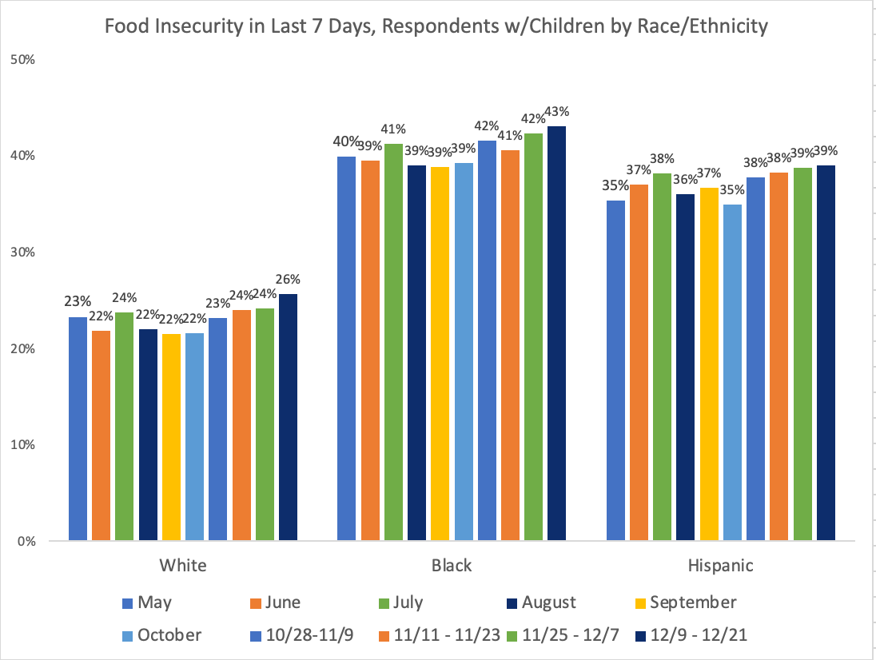
Census Household Pulse Survey
Meredith Dodson
mdodson@results.org
Notes:
MD latest data released Wed from Census Household Pulse Survey: (this visual)
New Household Pulse covering Dec 9 -21 just released, underscores how desperately relief is needed. Estimated #foodinsecurity at a pandemic high: 24% overall; 31% among those w/kids. 18.3% of those w/kids said they didn't have enough to eat. source: https://twitter.com/dwschanz/status/1334156063394967555 based on data from the Census Household Pulse Survey
To make it real, that means many of our neighbors – and in particular, Black families, are “standing outside in the cold in line for food donations in this holiday season and harsh winter conditions” If we want to help families, the kind of large-scale policies that respond like SNAP can addres this in a better/safer way.

Slide 13
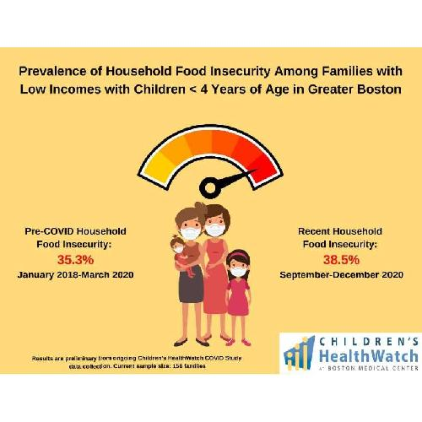
Snapshot: Families with Young Children
Notes:
MD on A First Look at Preliminary Children’s HealthWatch COVID-19 Survey Data https://childrenshealthwatch.org/a-first-look-at-preliminary-childrens-healthwatch-covid-19-survey-data/
high levels of household food insecurity have persisted among families in Boston, Massachusetts during the COVID-19 pandemic. These preliminary results highlight a persistent need – food insecurity rates remain high (38.5%) among families with young children and low incomes. These data underscore how the pandemic has worsened inequitable deprivation that already existed among households with children, immigrants and communities of color.
families struggled to put food on the table before the pandemic – with SNAP benefits often not lasting through the month. The 15% boost in SNAP is an important first step but we’ll continue to support food assistance to meet the need…
To make it real, that means many of our neighbors – and in particular, Black families, are “standing outside in the cold in line for food donations in this holiday season and harsh winter conditions” If we want to help families, the kind of large-scale policies that respond like SNAP can address this in a better/safer way.

Slide 14
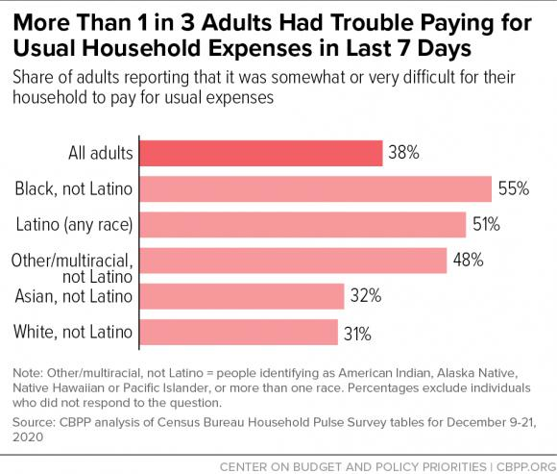
Hardship continues
Notes:
MD The latest Census Household Pulse Survey data shows millions of families are struggling to make ends meet – and we can see the legacy of racist policies in the struggles families are facing:
Adults in households with children were more likely to report difficulty paying for usual expenses: 45 percent, compared to 32 percent for households without children.
In addition, Black and Latino adults reported difficulty covering expenses at higher rates: 55 percent and 51 percent, respectively, compared to 32 percent for Asian adults and 31 percent for white adults. (See Figure 6.)
Although the survey does not provide data for other individual racial groups, 48 percent of American Indian, Alaska Native, Native Hawaiian, Pacific Islander, and multiracial adults taken together reported difficulty paying for usual expenses.
https://www.cbpp.org/research/poverty-and-inequality/tracking-the-covid-19-recessions-effects-on-food-housing-and based on data from the Census Household Pulse Survey

Slide 15
2021 housing policy priorities
Immediate need: keep renters stably housed – estimated need of $100 billion total in emergency rental assistance over 12 months
Plus eviction moratorium (push to get new President to enact ASAP)
Then, must address underlying housing crisis with bold long-term solutions
Dramatically scale up assistance for low-income renters
May work on increasing supply of affordable housing (infrastructure)
Longer term/next strategic plan: homeownership
Notes:
Housing: expand housing assistance (we still favor a renters credit), and acknowledge the importance of increasing the supply of affordable housing
President-elect Biden proposal’s housing plan – focuses on Housing Choice Vouchers https://www.vox.com/2020/7/9/21316912/joe-biden-housing-plan-section-8?utm_campaign=vox&utm_content=entry&utm_medium=social&utm_source=twitter and Biden housing proposal: https://joebiden.com/housing/#:
Provide Section 8 housing vouchers to every eligible family so that no one has to pay more than 30% of their income for rental housing. Roughly three in four households eligible for Section 8 rental assistance do not receive housing assistance because the program is underfunded. Biden’s approach is straightforward: the Section 8 rental housing assistance program should be fully funded so that everyone eligible gets the assistance they need to pay their rent for a safe home. Biden will devote resources to both voucher-based rental assistance and the project-based program. Over time, this approach will provide assistance to at least 17 million low-income families. And, as part of the Homeowner and Renter Bill of Rights, Biden will enact a law prohibiting landlords from discriminating against renters receiving federal housing benefits.
Create a new renter’s tax credit to help more low-income families. Biden will work with Congress to enact a new renter’s tax credit, designed to reduce rent and utilities to 30% of income for low-income individuals and families who may make too much money to qualify for a Section 8 voucher but still struggle to pay their rent. He will allocate $5 billion in federal funding for the tax credit every year.
Help families buy their first homes and build wealth by creating a new refundable, advanceable tax credit of up to $15,000. Biden’s new First Down Payment Tax Credit will help families offset the costs of homebuying and help millions of families lay down roots for the first time. Building off of a temporary tax credit expanded as part of the Recovery Act, this tax credit will be permanent and advanceable, meaning that homebuyers receive the tax credit when they make the purchase instead of waiting to receive the assistance when they file taxes the following year.
MD thinks since effect for low-income renters similar, renters credit would have similar impact (with more autonomy/opportunity for families if they get the credit, no income source discrimination)
And engage on zoning? Key to tie any big expansion of rental assistance (HCVs or renters credit) with zoning changes: “The need to legalize modest homes—to lift apartment bans, but also duplex and granny flat bans—becomes even more urgent if the federal government boosts rental assistance, for example, by making Section 8 vouchers available to all who qualify. As Binyamin Appelbaum explains in The New York Times, “Without a significant expansion in the supply of housing, adding vouchers would be like adding players to a game of musical chairs without increasing the number of chairs.” And the poorest households always lose that game…. momentum has been building for federal action on zoning laws that shut out poor people by banning modest, multi-dwelling homes. In May, the New York Times editorial board got right to the point: The government also should require communities that want federal funding for roads and other infrastructure to allow the development of denser, more affordable housing. Last year US lawmakers introduced four bills with schemes to connect federal funding to zoning reform. Two of those—the YIMBY Act, and the Build More Housing Near Transit Act—are still in play in Congress. The HOME Act mirrors proposals made by several presidential primary candidates. The boldest of the four bills by far—the Place to Prosper Act—hasn’t moved beyond its introduction.
AEI: Restrictive zoning laws that ban duplexes, triplexes, quadplexes, and other so-called “missing middle” homes have severely impacted the underproduction of homes in America, according to Edward J. Pinto, director of American Enterprise Institute’s Housing Center and Mike Kingsella, the executive director of Up for Growth. To explore the impact of restrictive zoning on the housing supply and cost of homes, AEI conducted a case study of towns in Bergen County, New Jersey with varying levels of restrictive zoning. One of the towns in the analysis with relatively open zoning laws saw an increase in its housing supply by 30 percent from 2000 to 2010 and increased population growth. In contrast, towns with more restrictive zoning regulations saw flatter population growth and higher property taxes. Pinto and Kingsella suggest that light touch density spreads the increasing cost of land across more units, creating new middle housing that provides more people with access to quality jobs, education, and other resources. Pinto and Kingsella also posit that revising strict zoning laws via light touch density helps to combat the racial inequities that persist in the housing market.
How Do We Change the Narrative Around Housing? https://shelterforce.org/2020/07/27/how-do-we-change-the-narrative-around-housing/
Tax policy
Donald Trump’s Bullet Point Tax Agenda: https://tpc.io/31pEOun via @TaxPolicyCenter
Biden CTC expansion proposal, would cut #ChildPoverty by 40% (and by 50% for the ~24% of Black kids currently living in poverty) Vox piece from Dylan Matthews, who is a big fan of a child allowance and includes a lot of the supporting research that he has cited before: https://www.vox.com/future-perfect/2020/9/18/21444103/child-tax-credit-2020-joe-bden.
Biden and Breathe Act include racial equity/tax: "A federal commission that proposes changes to tax policy, which will dramatically increase racial and economic equity" (Ellen CBPP reminder that EITC especially for younger workers key for equity reasons)
Prosperity Now revised July 2020: From Upside Down to Right-Side Up https://prosperitynow.org/resources/upside-down-right-side#.X3SW29tI0Ec.twitter
Racial Justice inc Reparations etc:
Truth, Racial Healing and Transformation resolution (H. Con. Res. 100), reached out to Sheila Jackson Lee as 1st supporter, see as complementary to HR 40 -- dialogue that can lead to reparations. Aggressively trying to engage GOP, see as nonpartisan. https://lee.house.gov/news/press-releases/in-the-wake-of-covid-19-and-murder-of-george-floyd-congresswoman-barbara-lee-calls-for-formation-of-truth-racial-healing-and-transformation-commission
RESULTS signed letter to pressure the US Congress to take up HR 40 -- live copy of the letter here with updated signatures.
Opinion piece on reparations: http://bostonreview.net/forum/basic-income-just-society/dorian-t-warren-reparations-and-basic-income
Racial equity = equal and optimal outcomes, not just in needs but in leadership
And don’t use “vulnerable”
Policy scorecard: https://www.bread.org/sites/default/files/downloads/racial-equity-scorecard-policies.pdf
Acknowledge disconnect between how we want to view ourselves as accountable for lived experience vs how much we are really accountable
Equity is about the process (who has role in shapng/lived experience) and outcomes
Okay to go into conversation just to expand understanding (not for reaching consensus/finding common ground)
Equity→justice→collective liberation
Truth and Redistribution https://www.colorlines.com/articles/truth-and-redistribution
Nikole Hanna Jones more optimistic about reparations than any time since Reconstruction, no longer a “fringe issue” https://www.facebook.com/lseps/videos/767561540749528
What Reparations for Slavery Might Look Like https://www.nytimes.com/2019/05/23/business/economy/reparations-slavery.html?smid=tw-share
The BREATHE Act: https://breatheact.org includes reparations not just for slavery, but War on Drugs etc.
Need articulation of demands so wont get co-opted
Century Foundation discussion with Representative Barbara Lee, The Root’s Danielle Belton, Dedrick Asante-Muhammad, and Asheville Councilmember Keith Young. At this moment of urgency and racial reckoning, we hope the conversation offered important insights and concrete steps to make amends for the legacy of slavery and oppression. If you missed the conversation, or want to revisit it, a recording is available.

Slide 16
2021 U.S. policy priorities
Tax: expand the EITC and Child Tax Credit (CTC)
Expanding (and restructuring) the CTC could child poverty by at least one-third
Can build on bipartisan CTC expansion proposals
Expand EITC for younger workers/others who don’t claim dependents
Once Dems control Senate: large scale tax legislation via reconciliation
Food assistance including SNAP boost beyond the 15 percent for six months included in the bipartisan package passed last month
Notes:
In addition to our work on food assistance, we know families struggle with basic expenses.
Biden CTC expansion proposal “would cut child poverty in the United States by at least a third, possibly more, and would give an average of $2,260 more to American families with children, per the Urban Institute’s Elaine Maag.”: https://www.vox.com/future-perfect/2020/9/18/21444103/child-tax-credit-2020-joe-bden
MD mention: also broadly working to apply a Racial Equity lens: this means not just understanding our legacy of racist policy choices and the disproportionate impact of poverty and the pandemic, but also a focus on racially equitable outcomes with policy change
In 2019, when the latest version of the AFA was released, a team of researchers at Columbia University’s Center on Poverty and Social Policy — Christopher Wimer, Sophie Collyer, Robert Paul Hartley, and Sara Kimberlin — estimated how the plan would affect the child poverty rate (measured using the Census Bureau’s Supplemental Poverty Measure, or SPM). The results were remarkable.
Poverty among children would fall from 14.8 percent to 9.5 percent, meaning 4 million kids would escape poverty. Deep poverty — the share of kids living on half the poverty line or less — would fall almost by half, from 4.6 percent to 2.4 percent. The effects might be larger in 2020, when baseline poverty is likely to be higher in the absence of additional government relief measures to combat the recession.
would cut #ChildPoverty by 40% (and by 50% for the ~24% of Black kids currently living in poverty) Vox piece from Dylan Matthews, who is a big fan of a child allowance and includes a lot of the supporting research that he has cited before: https://www.vox.com/future-perfect/2020/9/18/21444103/child-tax-credit-2020-joe-bden.
Biden and Breathe Act include racial equity/tax: "A federal commission that proposes changes to tax policy, which will dramatically increase racial and economic equity" (Ellen CBPP reminder that EITC especially for younger workers key for equity reasons)
Prosperity Now revised July 2020: From Upside Down to Right-Side Up https://prosperitynow.org/resources/upside-down-right-side#.X3SW29tI0Ec.twitter
Racial Justice inc Reparations etc:
Truth, Racial Healing and Transformation resolution (H. Con. Res. 100), reached out to Sheila Jackson Lee as 1st supporter, see as complementary to HR 40 -- dialogue that can lead to reparations. Aggressively trying to engage GOP, see as nonpartisan. https://lee.house.gov/news/press-releases/in-the-wake-of-covid-19-and-murder-of-george-floyd-congresswoman-barbara-lee-calls-for-formation-of-truth-racial-healing-and-transformation-commission
RESULTS signed letter to pressure the US Congress to take up HR 40 -- live copy of the letter here with updated signatures.
Opinion piece on reparations: http://bostonreview.net/forum/basic-income-just-society/dorian-t-warren-reparations-and-basic-income
Racial equity = equal and optimal outcomes, not just in needs but in leadership
And don’t use “vulnerable”
Policy scorecard: https://www.bread.org/sites/default/files/downloads/racial-equity-scorecard-policies.pdf
Acknowledge disconnect between how we want to view ourselves as accountable for lived experience vs how much we are really accountable
Equity is about the process (who has role in shapng/lived experience) and outcomes
Okay to go into conversation just to expand understanding (not for reaching consensus/finding common ground)
Equity→justice→collective liberation
Truth and Redistribution https://www.colorlines.com/articles/truth-and-redistribution
Nikole Hanna Jones more optimistic about reparations than any time since Reconstruction, no longer a “fringe issue” https://www.facebook.com/lseps/videos/767561540749528
What Reparations for Slavery Might Look Like https://www.nytimes.com/2019/05/23/business/economy/reparations-slavery.html?smid=tw-share
The BREATHE Act: https://breatheact.org includes reparations not just for slavery, but War on Drugs etc.
Need articulation of demands so wont get co-opted
Century Foundation discussion with Representative Barbara Lee, The Root’s Danielle Belton, Dedrick Asante-Muhammad, and Asheville Councilmember Keith Young. At this moment of urgency and racial reckoning, we hope the conversation offered important insights and concrete steps to make amends for the legacy of slavery and oppression. If you missed the conversation, or want to revisit it, a recording is available.

Slide 17
Take Action
Put in your virtual lobby meeting requests now. Ask for face-to-face meetings with both senators and all the reps your group covers.
Find lobbying resources, including an editable request letter, at: https://results.org/volunteers/lobbying/
Get letters to the editor published urging Congress to pass additional COVID relief as soon as possible.
Use our online LTE alert to take action today: https://results.org/volunteers/action-center/
Notes:
MD say, Jos create

Slide 18
Grassroots Inspiration and Action
jlinn@results.org
lmarchal@results.org
kpatterson@results.org

Slide 20
Looking Ahead: First 100 Days Goals
Meet with all 100 Senate offices by May 1
Meet with 3/4 of the House offices by May 1
Build a cadre of new RESULTS leaders across all groups that amplifies the voices of people with lived experiences of poverty

Slide 21
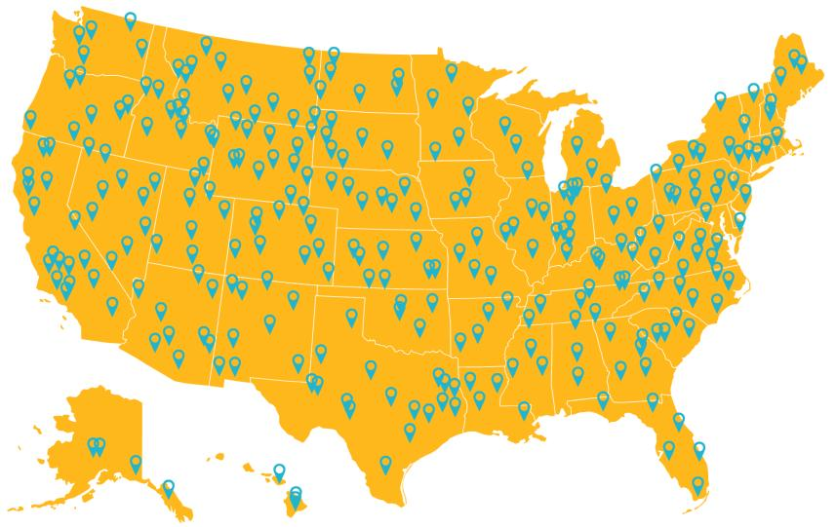
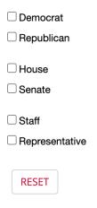
Total Meetings: 301

Slide 22
2021 Group Roadmaps
Put those Roadmaps into action!
Start with lobby meeting requests
Find Group Roadmap resources at: https://results.org/volunteers/outreach-planning/ (under “My group wants to make our plans”)
If you haven’t already, please complete your Roadmaps.
If you have questions, please contact Jos Linn at jlinn@results.org or 202.783.4800, x. 203.

Slide 23
JOIN US! First 100 Days Kickoff Virtual Event
Saturday, February 6
1:00 pm ET – 5:00pm ET
Register today at:
results.org/first100days

Slide 24
Welcome RESULTS Advocates
Sheah Ableman – Kingston, NH
Shiza Ashraf – Sacramento, CA
Posa Aswani - Minneapolis, MN
Jeanette Augustine – Philadelphia, PA
Yuliza Avelar – North Brunswick, NJ
Patience Babcock – Schertz, TX
Thanh Bach - San Jose, CA
Daniel Becirevic - Garland, TX
Liam Becker – Triangle, NC
Lindsay Behen – Pittsburg, PA
Stephen Benchik – Denver, CO
Bayley Borowy - Clinton Township, MI
Georges Buhamba Hamba – Detroit, MI
Carmen Carias – Houston, TX
Marcelina Ceniceros - Iowa City, IA
Brenda De Ramus - Tacoma, WA
Sam Doiron – Schertz, TX
Briana Dorsey - Fort Worth, TX
Ellie Gresser – Portland, ME
Deborah Grieser – Washington DC
Gina Gylys – Asheville, NC
Brenna Harmless-Lentner – Tucson, AZ
Sereion Humphrey – Raleigh, NC
Alain Kwizera - Grand Prairie, TX
Jackie Jacob - Palm Springs, CA
Koryn Johnson – Corona, CA
Tameica Jones – Greenville, NC
Darrell Juan - Tucson, AZ
Yonata Kidana – Dallas, TX
Ro-Anne Galleta – Silicon Valley, CA
Niaz Hussain – Cary, NC
Meghan Leineweber - Kitsap County, WA
Matt Lok – Brighton, MA
Utkarsh Mehta - Pullman, WA
Sam Murray – Flemington, NJ
Aram Nejad – Phoenix, AZ
Kevin Peters - Fairless Hills, PA
Salina Pressimone - River Edge, NJ
Beth Prevo - Lakewood, WA
Ella Regan – Hampton, VA
Ivy Rob – Dallas, TX
Samantha Saechao – Oakland, CA
Jeff Sarazin – Birmingham, MI
Puneet Singhal - Pittsburgh, PA
Steven Tracy – Rochester, NY
Alaina Velarde - North Salt Lake, UT
Mike Villeneuve – Raleigh, NC
Greg Wagner - Glendive, MT
Nisha Wattanayuth – Madison, WI
Kristal West – Boise, ID
Hailli Wickens – Pearland, TX
Victoria Wilscam – Minneapolis, MN
Katy Wirissa - Black Diamond, WA
Ji Su Yoo Glendale, CA
Notes:
2:01 (6 min)

Slide 25
Welcome RESULTS Fellows
Peter Augustin
Sam Armstrong
Rashenda Aziz Mohona
Hunter Beetham
Taelyr Blehm
Cristina Bolanos
Jamaica Brickhouse
Rayna Castillo
Maggie Cech
Paloma Chumacero
Cindy Collazo Zapata
Cesia Cotache Condor
Tiffany Chiem
Jibrell Crump
Leah Daniels
Marcos Delgado
Ishaan Desai
Lindsey Earl
Saba Fathima
Alice Feng
Heather Fischer
Gabriela Galindo
Indiana Hammel
Deanna Jacobs
Brian Jan
Abhinav Janappareddi
Olivera Jankovska
Erika Jarmon
Andrea Vasquez Johnson
Monet Jones
Emily Kauffman
Ivan Khvatik
Anuroop Kumar
Skylee Lawton
Brittany Lee
Hwa Young Lee
Rania Lewis
Annika List
Dilani Logan
Samantha Magbulos
Michaela Mishoe
Lizzett Mora
Chelsea Morgan
Alexie Nilo
Valielza O'Keefe
Drew Orlan
Michael Orlando
Chandrasimha Penthala
Jasmine Phillips
O'nisha Philpot
Alicia Polak
Kazmyn Ramos
Danielle Radford
Mayisah Rahman
Yassah Reed
Timea Renfrow
Steffani Ritter
Makai Roberts
Alec Rodriguez
Meri Hayden Rushing
Annum Sadana
Alexandra Saulenas
Allen Setzer
Sandhya Shankar
Kavita Shah
Alexandria Smith
Hunter Smith
Jazmine Smith​
Elizabeth Staffeldt​
Ellie Storer​
J. Haley Swindle​
Edward Syth​
Dianne Techwei​
Barune Thapa​
Natalia Tovar​
Aaron Tucker​
Sarah Vizzeswarapu​
Antigone Washington​
Leena Yumeen​
Ajshe Zulfi​
​
Notes:
2:01 (6 min)

Slide 26
New Advocate Lobbying Success
Crystal Sexton
Hampton, New Hampshire
RESULTS Free Agent
Joined RESULTS in November 2020
Notes:
2:01 (6 min)

Slide 27
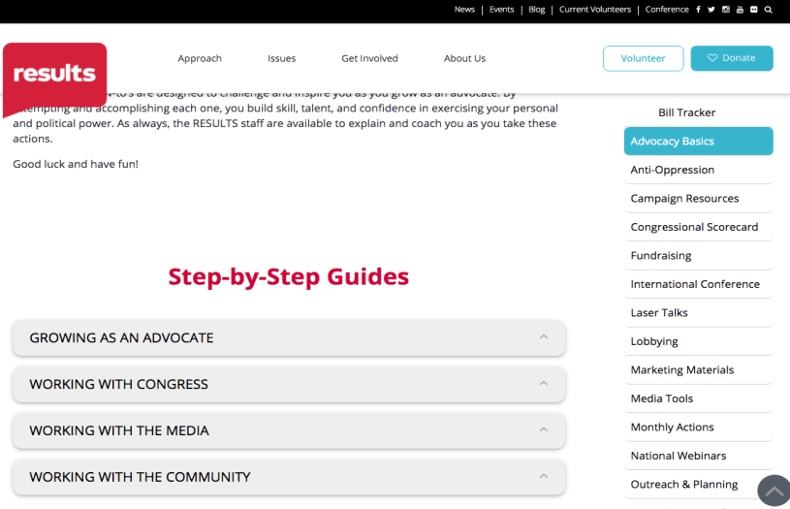
Resources for Working with Congress
Notes:
2:01 (6 min)

Slide 28
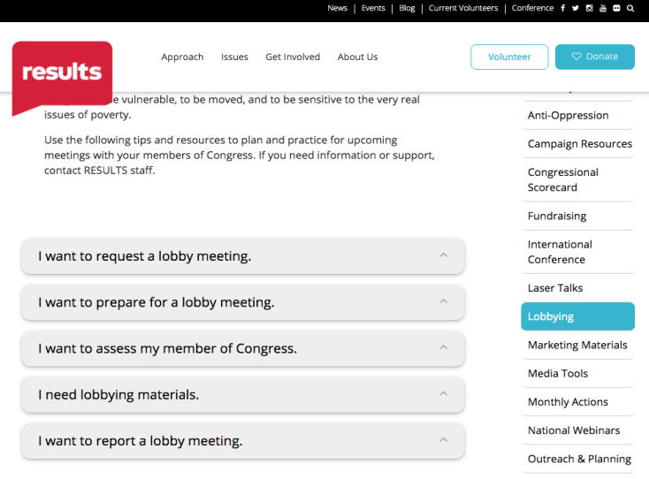
Lobbying Resources
Laser talks to request meetings & speak about our campaigns
Sample letter to request meeting
Leave behinds
Notes:
2:01 (6 min)

Slide 29
Setting Up a Meeting
Contact scheduler for your member of Congress, make a verbal request (use our laser talk)
Follow with a written request (use our sample letter)
Follow up with the scheduler via email & phone
Develop relationships with DC aides covering our issues and staff in local offices. Ask them to help you secure a meeting with the Rep. or Senator
Notes:
2:01 (6 min)

Slide 30
BREAKOUT ROOM DISCUSSION
We recognize that we’re in a challenging political environment.
What has worked in securing meetings/establishing relationships with members of Congress (MoCs) in such an environment?
Let’s break out into smaller rooms and talk about it.

Slide 31
BREAKOUT ROOM DISCUSSION Debrief What did you learn? What inspired you?

Slide 32
2021 International Conference
June 12-13
with Advocacy Week following
Virtual Format

Slide 33
Upcoming Trainings
Basics of Zoom Training
Wednesday, January 13, 8:30 pm ET
Register: https://results.zoom.us/meeting/register/tJYlc-muqDojG93K3vrNo3DC5UgYFaNXYEc-
How Do I Meet with My Congressional Office?
Thursday, January 21, 8:30 pm ET
Register: https://results.zoom.us/meeting/register/tJMsdOqoqj8uHtYJQGIixuUgBKzOXOtPy1Md
Researching Your Members of Congress
Thursday, January 28, 8:30 pm ET
Register: https://results.zoom.us/meeting/register/tJYvduyopjMqGNT_bXzBLzblYn9223MwmoaN
Registration information also in the Weekly Update!
https://results.org/volunteers/weekly-updates/

Slide 35
Upcoming Events
New Advocate Orientation
Tuesday, January 12, 12:00 pm ET
Register to attend at: https://results.salsalabs.org/orientationcallrsvp/index.html?_ga=2.111757443.60245586.1607979731-2052042826.1602183780
U.S. Poverty Free Agents Webinars
Tuesday, January 19 , 1:00 pm and 8:00 pm ET
Contact Jos Linn at jlinn@results.org for more information
Global Poverty Free Agents Webinar
Monday, January 25, 8:00 pm ET
Contact Lisa Marchal at lmarchal@results.org for more information

Slide 37
Don’t Forget! First 100 Days Kickoff Virtual Event
Saturday, February 6
1:00 pm ET – 5:00pm ET
Register today at:
results.org/first100days

Slide 39
Questions?
Please share your questions in the chat.

Slide 40
2021 Policy Priorities – Global
Pandemic response
Education
Nutrition
Tuberculosis

Slide 41
2021 Global policy priorities
Responding to the global pandemic
U.S. leadership for the Global Partnership for Education
Increase support for underfunded priorities
Nutrition
Tuberculosis

Slide 42
2021 Global policy priorities
Responding to the global pandemic
U.S. leadership for the Global Partnership for Education
Increase support for underfunded priorities
Nutrition
Tuberculosis

Slide 43
The pandemic could drive an additional 150 million people into extreme poverty.

Slide 44
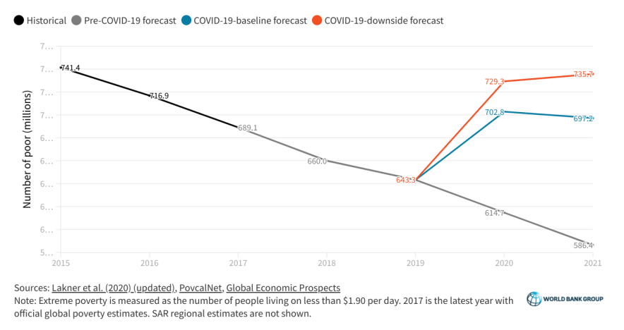

Slide 45
Not just more extreme poverty – more extreme inequality. Poor households are hit harder and recover slower than wealthier households.

Slide 46
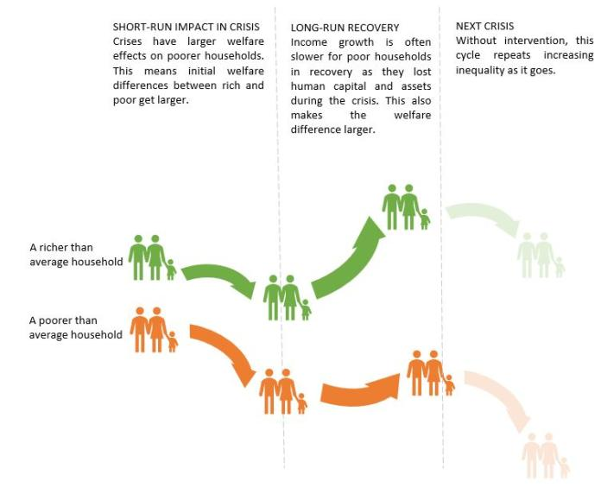

Slide 47
By 2022 an additional: - 9.3 million children with wasting - 2.3 million children stunted - 168,000 child deaths from undernutrition
Notes:
https://www.researchsquare.com/article/rs-123716/v1

Slide 48
An additional $1.2 billion per year in nutrition funding could mitigate the worst impacts.
Notes:
https://www.researchsquare.com/article/rs-123716/v1

Slide 49
Up to two thirds of AIDS, TB and malaria programs report service disruptions. The Global Fund has exhausted its funding to support country responses.

Slide 50
“The second wave is here.” Dr. John N. Nkengasong Director Africa Centers for Disease Control and Prevention

Slide 51
Percent of U.S. Covid-19 emergency funding for global aspects of the pandemic.
0.2
Notes:
https://www.researchsquare.com/article/rs-123716/v1

Slide 52
Congress should provide at least $20 billion in emergency Covid-19 funding for the global pandemic, including $4 billion for the Global Fund to Fight AIDS, Tuberculosis, and Malaria.

Slide 53
The pandemic could drive an additional 150 million people into extreme poverty.

Slide 54
2021 Global policy priorities
Responding to the global pandemic
U.S. leadership for the Global Partnership for Education
Increase support for underfunded priorities
Nutrition
Tuberculosis

Slide 59
At least 1.5 billion students were out of school at the peak of the pandemic.

Slide 61
The U.S. should pledge $1 billion over 5 years (2021-2025) at the Global Partnership for Education replenishment conference in July.

Slide 62
2021 Global policy priorities
Responding to the global pandemic
U.S. leadership for the Global Partnership for Education
Increase support for underfunded priorities
Nutrition
Tuberculosis

Slide 63
Notes:
https://thousanddays.org/wp-content/uploads/1000-Days_Severe-Malnutrition_Power-4-Standalone_PDF_MMS-update.pdf

Slide 64
The U.S. accelerate investment in high impact health and nutrition interventions, including: - $1 billion for USAID TB programs - Increased funding and new legislation to strengthen nutrition programs.

Slide 65
Please report your advocacy actions! https://results.org/volunteers/reporting-your-advocacy-actions/
Let us know how many were in your room at your location today (or how many joined from your city, if you know).
Put the city and number in the chat box
or send to lmarchal@results.org

