Slide 1
Advocacy Week Prep

Slide 2
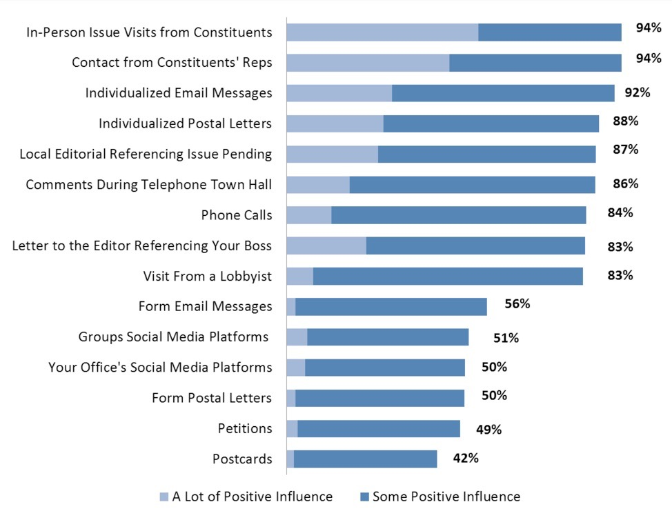
Actions that
Make a Difference
Source: Congressional Management Foundation

Slide 3
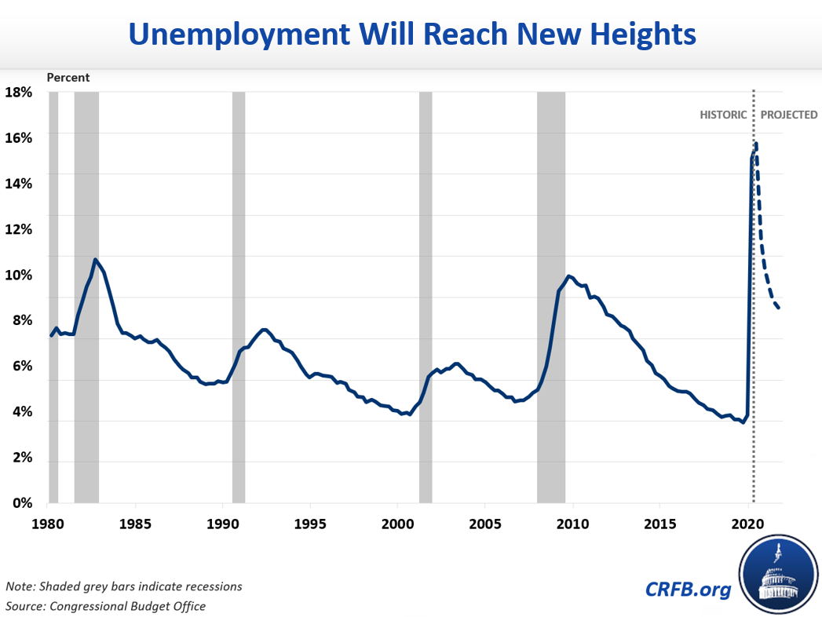
Notes:
As I flagged yesterday, I think one of the challenges some of us will encounter is that policymakers do not understand the scale of the need – we need to inject a sense of urgency, especially with Senate Republicans. Obviously we will push for specific and important policies that help families keep a roof over their heads, put food on the table, and meet other basic needs within that context.
Yesterday, I shared an a visual that showed unemployment data predictions from the non-partisan Congressional Budget Office, but I thought it might be helpful to see those predictions in a larger context – if unemployment remains at or above 9% in 2021, as the CBO projected, worth noting that is roughly the same as the peak of the Great Recession and other economic downturns of the last 40 years. It is hard to get our heads around how unprecedented this economic crisis is.
Image source: http://www.crfb.org/blogs/cbo-releases-interim-economic-projections, based on CBO May report: https://www.cbo.gov/publication/56368
Jerome Powell’s Tone Is Grim But He Forecasts The Economy Recovers In 20 Months (Forbes)
Suzy TaherianContributor
CFO Network
I write about topics that concern CEOs, CFOs, and boards.
Federal Reserve Chairman Jerome Powell spoke last week predicting a “long road” to economic recovery. Powell’s speech came shortly after U.S. Bureau of Labor Statistics released unemployment data for May indicating civilian unemployment dropped from a peak of 14.7% at end of April to 13.3% at end of May. Powell acknowledged the improvement in the unemployment rate but foreshadowed that the GDP would shrink by 6.5% in 2020. Along with Powell’s speech, the Federal Reserve published an economic forecast for 2020 to 2022. While the outlook for 2020 was grim, the forecast for 2021 suggests this will be one of the fastest recoveries in memory.
Washington Post: A recent Fed survey showed that among households with an annual income of $40,000 or less, nearly 40 percent of workers in February lost jobs in March or early April, compared with 20 percent of the overall population... (but differing from CBO) Still, Powell has emphasized that the recovery will take time and that more aid will be needed from Congress as millions of Americans risk losing their jobs permanently. Last week, the Fed predicted that the unemployment rate will fall only to 9.3 percent by the end of this year and to 6.5 percent by the end of 2021. https://www.washingtonpost.com/business/2020/06/16/powell-economy-senate/
The Congressional Budget Office (CBO) forecasts that the unemployment rate will average 10.1 percent in 2021, or nearly three times its pre-crisis level, and still be at 9.5 percent at the end of the year. There is substantial risk that the poverty rate — and the hardship that goes with it — will rise dramatically. https://www.cbpp.org/research/federal-tax/temporarily-expanding-child-tax-credit-and-earned-income-tax-credit-would
Federal policymakers should enact stronger policies now to avoid a steep poverty spike, help people meet basic needs, and boost the economy. Alongside strengthened state fiscal relief, nutrition assistance, unemployment insurance, and Medicaid funding, the next fiscal stimulus package should include specific expansions of the Child Tax Credit and Earned Income Tax Credit (EITC) that would deliver well-timed, high “bang-for-the-buck” economic stimulus to millions of low-income households when they file their taxes in early 2021.

Slide 4
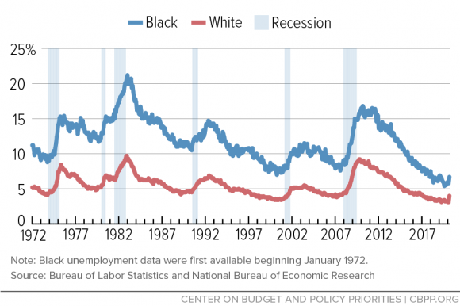
Economic Downturns Not Felt Equally
Notes:
Decided to swap this slide into this presentation via Peggy Bailey at CBPP from the housing panel since it shows how much higher unemployment rates for Black workers are historically – and this is true now. From the May CBO report on unemployment: https://www.cbo.gov/publication/56368, verbatim: “Although employment between February and April declined by 16 percent overall, it decreased by 31 percent for people ages 16 to 24, by 18 percent for women regardless of age, by 19 percent for people age 25 or older without a bachelor’s degree, and by 21 percent for Hispanic workers regardless of age. Among black workers, employment declined by 18 percent. Also, black and Hispanic people constitute a disproportionate share of workers in certain industries in which many jobs involve elevated risks of exposure to COVID-19.^{4”}
Jerome Powell’s Tone Is Grim But He Forecasts The Economy Recovers In 20 Months (Forbes)
Suzy Taherian Contributor
CFO Network
I write about topics that concern CEOs, CFOs, and boards.
Federal Reserve Chairman Jerome Powell spoke last week predicting a “long road” to economic recovery. Powell’s speech came shortly after U.S. Bureau of Labor Statistics released unemployment data for May indicating civilian unemployment dropped from a peak of 14.7% at end of April to 13.3% at end of May. Powell acknowledged the improvement in the unemployment rate but foreshadowed that the GDP would shrink by 6.5% in 2020. Along with Powell’s speech, the Federal Reserve published an economic forecast for 2020 to 2022. While the outlook for 2020 was grim, the forecast for 2021 suggests this will be one of the fastest recoveries in memory.
Washington Post: A recent Fed survey showed that among households with an annual income of $40,000 or less, nearly 40 percent of workers in February lost jobs in March or early April, compared with 20 percent of the overall population... (but differing from CBO) Still, Powell has emphasized that the recovery will take time and that more aid will be needed from Congress as millions of Americans risk losing their jobs permanently. Last week, the Fed predicted that the unemployment rate will fall only to 9.3 percent by the end of this year and to 6.5 percent by the end of 2021. https://www.washingtonpost.com/business/2020/06/16/powell-economy-senate/
The Congressional Budget Office (CBO) forecasts that the unemployment rate will average 10.1 percent in 2021, or nearly three times its pre-crisis level, and still be at 9.5 percent at the end of the year. There is substantial risk that the poverty rate — and the hardship that goes with it — will rise dramatically. https://www.cbpp.org/research/federal-tax/temporarily-expanding-child-tax-credit-and-earned-income-tax-credit-would
Federal policymakers should enact stronger policies now to avoid a steep poverty spike, help people meet basic needs, and boost the economy. Alongside strengthened state fiscal relief, nutrition assistance, unemployment insurance, and Medicaid funding, the next fiscal stimulus package should include specific expansions of the Child Tax Credit and Earned Income Tax Credit (EITC) that would deliver well-timed, high “bang-for-the-buck” economic stimulus to millions of low-income households when they file their taxes in early 2021.

Slide 5
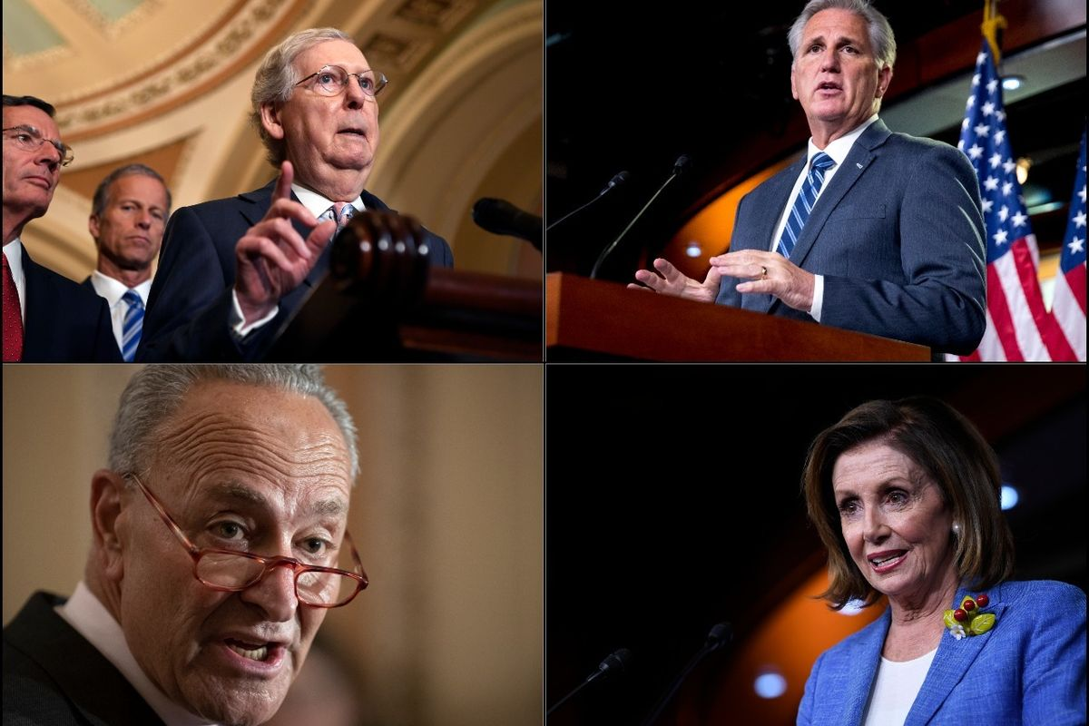
Getting to Leadership Matters
Four Corners
+ the White House
= Needed for any
next emergency response bill
Notes:
While Senate Majority Leader Mitch McConnell has made it clear that the Senate will not take up emergency response legislation until the 2nd half of July, your conversations this week are well-timed as policymakers discuss their overall priorities for the next package.
And since the final legislative package will be negotiated primarily by these Congressional leaders and the White House, that is why our requests focus on getting members of Congress to weigh in with those who will be in those negotiations.

Slide 6
U.S. Poverty HOUSE Requests:
As you reach out to House Leadership (speak personally to Speaker Pelosi and/or Minority Leader McCarthy), urge them to prioritize the following in emergency response legislation:
$100 billion in emergency rental assistance and a national eviction moratorium in the next emergency response legislation
Boost the maximum SNAP benefits by 15 percent
Expand the EITC and CTC for low-income workers and families
And, if time/appropriate: will you speak out publicly in support of a refundable renters’ tax credit to help families access affordable housing longer-term?
Notes:
The House-passed HEROES Act includes $100 billion in emergency rental assistance,15% SNAP boost, and EITC/CTC expansion.
Why key for House leadership to hear? Can’t take it for granted that these issues will be a priority – lot of pressure to pass a smaller package. And many competing priorities, so need these to be top tier. To be frank, we can’t take it for granted that House leadership has emergency rental assistance as a top tier priority despite broad support amongst a variety of House Democrats – even if they tell you they supported $100 bil in emergency rental assistance already, ask them to weigh in again. And this housing crisis is hitting every Congressional district – need to educate House Republicans about the needs of low-income renters and urge them to support bipartisan efforts to keep renters stably housed.
SNAP: generally not targeting since Speaker Pelosi does have this a top tier priority already, but can remind Agriculture Committee members.
Who are we targeting for EITC/CTC? Generally, good for House members to hear broadly that people care about tax policy, especially since we anticipate larger conversations on tax policy priorities in 2021 and beyond. And in particular, good to educate Ways and Means Committee members since they have jurisdiction. And new policymakers since they might not be as familiar with EITC/CTC.
and SNAP, see briefs/presentation/lobby prep calls for more

Slide 7
U.S. Poverty SENATE Requests:
As you reach out to Senate Leadership (speak personally to Leader McConnell and/or Minority Leader Schumer), urge them to prioritize the following in emergency response legislation:
$100 billion in emergency rental assistance and a national eviction moratorium in the next emergency response legislation
Boost the maximum SNAP benefits by 15 percent
Expand the EITC and CTC for low-income workers and families
And, if time/appropriate: will you speak out publicly in support of a refundable renters’ tax credit to help families access affordable housing longer-term?
Notes:
Senate leaders are moving slowly to enact additional COVID legislation. Also includes 15% SNAP boost and EITC/CTC expansion.
Why key for Senate leadership to hear? Lot of pressure to pass a smaller package, “wait and see how what we’ve done so far has made a difference”. And many competing priorities, so need these to be top tier. Need bipartisan support – though McConnell has prohibited his caucus from much bipartisan conversation. Reinforce engagement of Portman and Young, MD maybe mention Sen Brown bill?
SNAP: Agriculture Committee members, moderate Senate Republicans, those in states with high food insecurity rates. Worth mentioning that Sen Grassley and Gardner have publicly stated they support a SNAP boost.
Who are we targeting for EITC/CTC? Again, good for them to hear broadly that people care about tax policy, especially since we anticipate larger conversations on tax policy priorities in 2021 and beyond. Certain body of Senate GOP are particularly key – see your scorecard for those who supported Senator Rubio’s amendment, and there are a number of “new guard” GOP leaders that are engaged/interested. And in particular, good to reinforce that tax policies for low-income workers and families should be a key priority for Senate Finance members since they have jurisdiction.

Slide 8
Background Documents:
EVERY OFFICE:
Leave Behind: Congress Must Prioritize Housing Measures in Recovery Legislation (PDF)
Leave Behind: Boost Food Security by Increasing SNAP (PDF)
Leave Behind: Prioritize Tax Credits for Low-Wage Workers and Families (PDF)
U.S. Poverty Data by State

Slide 9
Review: Housing Laser Talk
Engage: The COVID-19 pandemic has made America’s housing crisis far worse. This is hitting families in our community, especially low-income Black renters, along with Indigenous families and other people of color, hard.
Notes:
We will spend the next few minutes reviewing key talking points – focused on our top request for emergency rental assistance. You can use the US Poverty Laser Talk Worksheets – Housing, SNAP, EITC/CTC (PDF) (Word Version) to craft your own laser talk – use this as a template, but embed your own story, local or state data (see U.S. Poverty Data by State).
This is crafted using the “EPIC” format, see Create and deliver a "laser talk“ under Advocacy Basics in the Current Volunteers section of our website for more on this tool.

Slide 10
Review: Housing Laser Talk
Problem: Millions of low-income renters face a “housing cliff” when eviction moratoria and other relief measures end for unemployed workers unless Congress acts soon.
Notes:
Quick note: some of you might have seen media coverage about the eviction protections for renters in federally-backed housing extended: https://www.cnn.com/2020/06/17/success/fha-eviction-and-foreclosure-moratorium-extended/index.html?utm_content=2020-06-18T02%3A01%3A03&utm_source=twbusiness&utm_medium=social&utm_term=link, but again this just covers 1/4 renters and only puts off the “cliff” – unemployed renters still do not have the resources to make up hundreds or thousands in back rent.

Slide 11
Review: Housing Laser Talk
Illustrate or Inform: One in five of all renters, including one in three Black renters, had low confidence in their ability to pay July rent when surveyed by the Census Bureau in early June. Keeping low-income renters in their homes is key [and then include your own experience and/or why you care].
Notes:
I know many of you have heard me say this before, but remember what an illustrator does – paints the picture. Talk about how this impacts you, your family, your community – if you cannot speak firsthand, share why access to housing is important to you. You can also use local media coverage of families, since they have already given permission for their story to be public.
If you are looking for support in crafting your story, please join RESULTS Experts on Poverty during tomorrow’s Open Office Hours – you can get 1:1 coaching or a chance to practice with some of our amazing storytellers.

Slide 12
Review: Housing Laser Talk
Call to Action: Will you tell leadership to prioritize $100 billion in emergency rental assistance and a national eviction moratorium in the next emergency response legislation?

Slide 13
Global Pandemic Demands a
Global Response
Notes:
2:01 (6 min)
HI Yall! If I’m just meeting you – I’m Crickett Nicovich –RESULTS’ Associate Director for Policy and Government Affairs
So grateful to be with you beautiful people this afternoon/morning.
Going back to what Meredith said – that Sense of Urgency needs to be impressed on our Members of Congress. Your voices here are going to matter.

Slide 14
The World Bank estimates that the COVID-19 pandemic could drive over 70 million people into extreme poverty in 2020.
Notes:
2:01 (6 min)
Massive health system and economic disruption due to lock-downs.
Millions of children missing basics – from immunizations – growth monitoring as folks are fearful of going into health clinics to get care, or are prevented from going in due to strict shelter at home orders... That also means an increase of women laboring at home.
And economic conditions world wide still unfolding – of global unemployment estimates now have projections growing to almost 50 percent of working age people – who would be employed – could be without a job.
With increased hunger and food insecurity - Wasting – acute malnutrition - is expected to be the leading cause of death in under-five children. Killing about 6,000 per day.

Slide 15
These are not predictions.
They are projections of what will happen if we don't act.
Notes:
2:01 (6 min)
AGAIN - thank goodness for yall.!!

Slide 16
Where we are now
About $1 billion in foreign aid in bipartisan CARES Act
That’s less than tenth of one percent.
ZERO foreign aid in Heroes Act
Notes:
Back in MARCH... The bipartisan Cares Act did include a small allocation of funding for global work – to support the global CDC efforts and some emergency aid to bring Peace Corps volunteers back to the U.S. and such issues. the entirety of the Emergency response was about 1 tenth of 1 percent of the Cares package. About a billion - we annually spend well over $40 billion annually on foreign aid – so again - the initial response was quite small.
In the House – Democrat led Heros ACT
PROBLEM IS – in this pandemic is having a global impact and spread in 100 years

Slide 17
Again – Speaking to Leadership Matters
Four Corners
+ the White House
= Needed for any
next emergency response bill
Notes:
These four corners – and other in leadership will be the ones making the decision on any negotiated bill.
We have to have members of congress reaching out to McConnell, Shumer, Pelosi and McCarthy DIRECTLY

Slide 18
SENATE Global Request:
Will you urge Senate Leadership (Speak personally to Leader McConnell and/or Minority Leader Schumer) to address the global pandemic by including $12-20 billion in foreign aid in any next emergency response legislation?
• As you reach out to leadership, will you support at least:
o $4 billion over 2 years for the Global Fund
o Increase in our support for Gavi’s immunization efforts
o $2 billion to address hunger/ famine-relief, with at least $500 million to address the crisis of malnutrition and wasting.

Slide 19
https://results.org/resources/2020-international-conference-resources/
Notes:
2:01 (6 min)

Slide 20
HOUSE Global Request:
As you reach out to House Leadership (Speak personally to Speaker Pelosi and/or Minority Leader McCarthy), will you support at least $12- $20 billion in foreign aid – that includes:
o $4 billion over 2 years for the Global Fund
o Increase in our support for Gavi’s immunization efforts
o $2 billion to address hunger/ famine-relief, with at least $500 million to address the crisis of malnutrition and wasting.
Will you join Reps. Lois Frankel (D-FL)/Francis Rooney (R-FL) letter to urge House Leadership to address the global pandemic by including foreign aid in any next emergency response legislation?
Notes:
The House-passed HEROES Act includes $100 billion in emergency rental assistance – though Senate leaders are moving slowly to enact additional COVID legislation.
Mention that we’ll also do some advocacy on EITC/CTC and SNAP, see briefs/presentation/lobby prep calls for more

Slide 21
QUESTIONS?
Notes:
2:01 (6 min)

Slide 22
Background Documents:
EVERY OFFICE HOUSE or SENATE:
“Global Response Needed for Global Pandemic”
HOUSE:
Reps. Frankel/Rooney Letter to Leadership on Global Emergency Response
FOR REPUBLICAN SENATE:
Sens. Rubio/Cardin Letter to Leadership on Global COVID-19 efforts – if you need a copy, please email cnicovich@results.org .

Slide 23
Review: Global Laser Talk
Engage: The impact of the COVID-19 global pandemic is still unfolding, but the global economy is suffering, while strict lockdown measures are forcing millions of people around the world to stay at home.
Notes:
2:01 (6 min)

Slide 24
Review: Global Laser Talk
Problem: Although the virus has caused near universal disruption, it’s countries and communities facing poverty that face the greatest risks. A new World Bank estimate suggests that COVID-19 could drive over 70 million people into extreme poverty in 2020.
Notes:
2:01 (6 min)

Slide 25
Review: Global Laser Talk
Illustrate or Inform: Since COVID-19 restrictions were put in place – tens of millions of infants are missing the health basics – such as immunization and growth monitoring. We are seeing outbreaks of diphtheria, measles, and cholera. The World Food Program has modelled a doubling of world hunger. Wasting, an acute form of malnutrition, now threatens the lives of over 1 million children. And, without additional resources, over 1.4 million additional people are at risk of dying of tuberculosis.
Notes:
2:01 (6 min)

Slide 26
Review: Global Laser Talk
Call to Action: The country- and community-level response will be critical, but Congress should require a global response be included in any emergency response bill. Will you speak to Leadership to address the global pandemic by including at least $12-20 billion for foreign aid in any next legislation?
As you reach out to leadership, will you support at least:
$4 billion over 2 years for the Global Fund to Fight AIDS, TB, and Malaria
Increase support for Gavi, the Vaccine Alliance’s immunization efforts
$2 billion to address hunger/famine-relief, with at least $500 million to address the crisis of child malnutrition and wasting.
Notes:
2:01 (6 min)

Slide 27
QUESTIONS?
Notes:
2:01 (6 min)

Slide 28
Resources
IC resources: https://results.org/resources/2020-international-conference-resources/
Planning a Virtual Lobby meeting training: https://results.org/resources/planning-virtual-lobby-meetings-with-members-of-congress/
How to use Zoom for online meetings training: https://results.org/resources/how-to-organize-remote-meetings-with-zoom-and-phone/

Slide 29
Staff office hours
Monday, June 22
10am-12pm ET
2-4pm ET
7-9pm ET
Link: https://results.zoom.us/j/97487242006 Meeting ID: 974 8724 2006 (Password in your email inbox. Make sure to check your spam folder.)

Slide 30
Thank you!

Slide 31
UP NEXT!
3:15-3:30pm ET: Break
3:30-4:00pm ET: Workshop Block
Media Lab: Letters to the Editor 101
Wanted: Talent Scouts & Coaches to Grow the Movement to End Poverty
Open Office Hours for Advocates
Find login numbers in the Conference agenda: https://results.org/conference/agenda/

