Slide 1
Election Candidate Engagement:
Set the Agenda for the Future

Slide 2
Our Anti-Oppression Values
2
​RESULTS is a movement of passionate, committed everyday people. Together
we use our voices to influence political decisions that will bring an end to poverty.
Poverty cannot end as long as oppression exists.
We commit to opposing all forms of oppression, including racism, classism, colonialism, white saviorism, sexism, homophobia, transphobia, ableism, xenophobia, and religious discrimination. ​
At RESULTS we pledge to create space for all voices, including those of us who are currently experiencing poverty. We will address oppressive behavior in our interactions, families, communities, work, and world. Our strength is rooted in our diversity of experiences, not in our assumptions. ​
With unearned privilege comes the responsibility to act so the burden to educate and change doesn’t fall solely on those experiencing oppression. When we miss the mark on our values, we will acknowledge our mistake, seek forgiveness, learn, and work together as a community to pursue equity.
There are no saviors — only partners, advocates, and allies. We agree to help make the RESULTS movement a respectful, inclusive space.​
Find all our anti-oppression resources at: https://results.org/volunteers/anti-oppression/

Slide 3
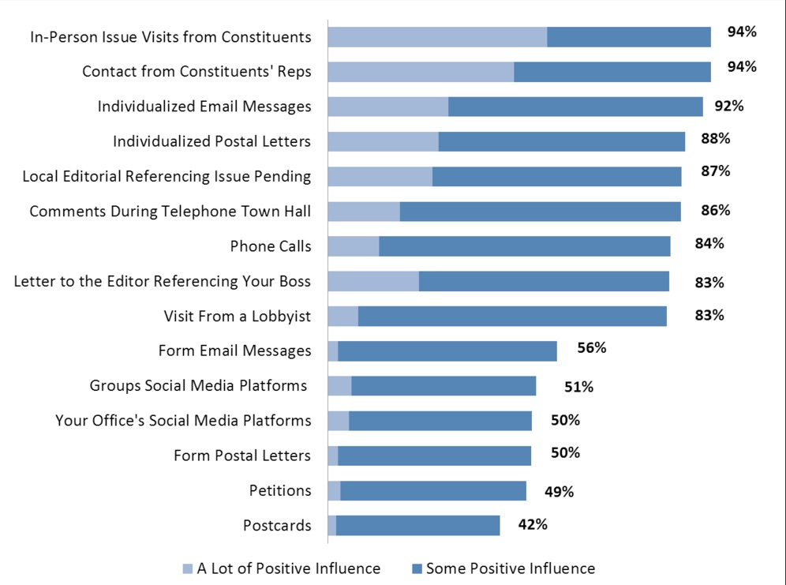
Advocacy Works!
3
If your member of Congress has not already come to a decision on an issue, how much influence do the following advocacy strategies have:
Source: Congressional Management Foundation, 2017

Slide 4
4
Why advocate around the election?
Establish early relationships
Inform/educate candidates
Educate the public
Set the agenda for next Congress
Talk to them when they are interested
Notes:
Examples
Met with candidate who was elected—led to starting a new group
Talk to them at a time when they really want/need to connect with constituents
January is chaotic, especially for newly elected members—hard to even find them
Staff are often carried over to the new offices—you’ll know them already

Slide 5
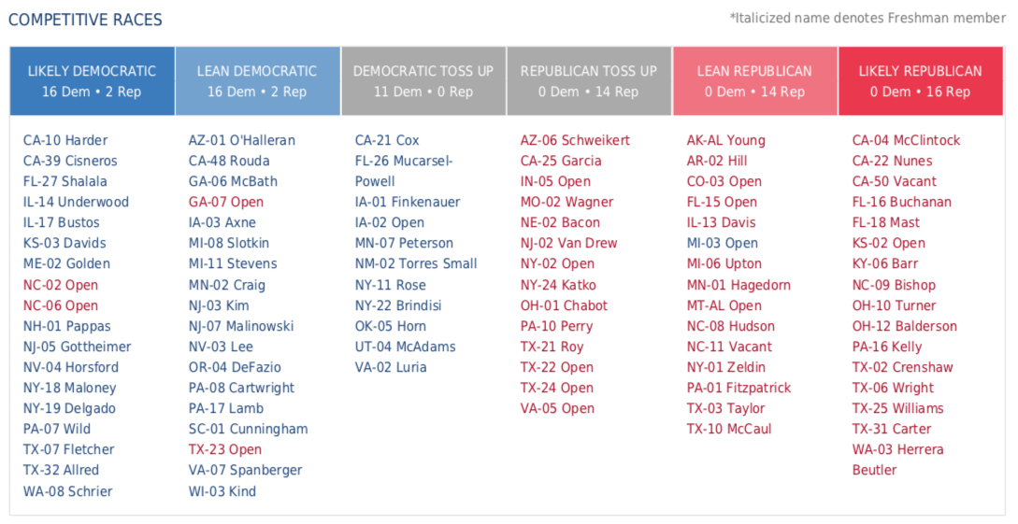
5
Why advocate around the election?
Notes:
Examples
Met with candidate who was elected—led to starting a new group
Talk to them at a time when they really want/need to connect with constituents
January is chaotic, especially for newly elected members—hard to even find them
Staff are often carried over to the new offices—you’ll know them already

Slide 6
6
Ways to Engage
Direct Advocacy
Media

Slide 7
7
Direct Advocacy: Public events, group meetings, one-on-one interactions
Set up a meeting with your group
Town halls (virtual or in-person)
Meet and greets and fundraisers
Working for the campaign
Candidate calls to voters

Slide 8
Creating Direct Advocacy Opportunities: Find Events, Set Up a Meeting
8
Check website & contact campaign office or party headquarters for a meeting and/or ask when you can hear candidates speak.
Sign up for campaign updates on their campaign page. Campaign pages are separate from official government websites.
Follow candidates and local political parties on Twitter and Facebook
Donate to a campaign
Visit www.townhallproject.com (mainly current members of Congress)
Research their positions on the issues.

Slide 9
Preparing to Engage – What to say
9
Identify the issue(s) you want to highlight
Research candidate positions on the issues
Campaign website, public statements, third-party ex. League of Women Voters
Draft your question(s) – keep brief; use EPIC format
ENGAGE the listener in your conversation
Identify the PROBLEM you want solved
INFORM them of the solution (tell a story)
Provide a detailed CALL TO ACTION (Yes/No question)
Coordinate with others to participate
Increases chances of personal encounter with candidate
Practice, practice, practice

Slide 10
Prepare to Ask Questions & Listen: Town Hall or Meet & Greet
10
Let them know who you are and who you represent in your community. The RESULTS laser talk is a good start.
Prepare a laser talk and question related to US or global poverty. You’ll likely only do 1, but prepare 2.
Listen. Offer to provide information on our issues.
Ask for a meeting with your group.
Notes:
Depending on how long you have to speak, prepare to talk about RESULTS successes and history.

Slide 11
Online Town Hall & Meet and Greet Tips
11
Recruit others to participate and coordinate on questions you’ll ask
Arrive early to online event so you don’t miss any instructions.
Listen carefully to for how to ask questions.
If they are taking live questions, get in the queue as early as possible
If they are only taking written questions, submit them early.
If using video, don’t wear anything political
When called on, ask your question in a succinct, informative way
Follow-up with campaign staff
Provide more details of issue and any materials
If you don’t get a question asked, ask staffer to speak to candidate and then follow-up about the response

Slide 12
Prepare to Ask Questions & Listen: Group Meeting
12
Similar to a meeting with a MoC.
Engage other organizations if it helps set the meeting
Let them know who you are, who you represent in the community, history of the group, recent successes
Prepare laser talks and questions related to RESULTS issues
Listen and offer to provide more information on our issues
Let them know you want to work with them in the future
Take photo
Notes:
Depending on how long you have to speak, prepare to talk about RESULTS successes and history.

Slide 13
Sample EPIC Laser Talk: US Housing
13
Engage: There was already an affordable housing crisis in America, and the COVID-19 pandemic has made it far worse. This is hitting families in our community, especially low-income Black renters and other people of color, hard.​
Problem: While the recent national eviction moratorium helps, without funds to help renters get current on their rent, America will face a wave evictions when the moratorium ends in January.​
Illustrate or Inform: Keeping low-income renters in their homes must be a national priority in the short-term, but we also need long-term solutions.​ [Share more about your story and/or why you care]
Call to Action: What are your thoughts on the current affordable housing crisis and how might we address it if you are elected? Will you support emergency rental assistance and long-term solutions, like a refundable renters credit?
Notes:
Depending on how long you have to speak, prepare to talk about RESULTS successes and history.

Slide 14
Sample EPIC Laser Talk: Global Poverty
14
Engage: A recent poll by the ONE Campaign confirms my sentiments that the US must also have a global response to this global pandemic. According to the poll, “nearly all voters say it is important for the U.S. to lead the world in responding (85%), preventing (86%), and detecting (85%) global infectious diseases.”
Problem: Projections are that, because of COVID-19, hard fought global health progress could be set back 10-20 years and millions of children and adults could die from lack of healthcare, malnutrition, and disease without additional resources.
Inform: But sustaining and increasing U.S. support to existing global health programs like Gavi, the Global Fund, and PEPFAR, as well as investing in food aid and nutrition, will make a difference now and in the longer-term.
Call to Action: US leadership has contributed to major advances on global health and poverty over the years. What role do you think the US should play in addressing global poverty and global health? And what will you do about these issues once elected?
Notes:
Depending on how long you have to speak, prepare to talk about RESULTS successes and history.

Slide 15
Working for Campaign or Candidate Calls
15
Always have your question(s) ready to go
Take advantage of your opportunities when they come
Be polite and friendly
Make sure you have a specific ask (could be policy position)
Plan to follow up as needed
Check in on request, provide additional info, materials,
Talk to others about the issues you care about
Good way to get others interested in your issues

Slide 16
Direct Advocacy
16
Questions?

Slide 17
Election Advocacy using Media
17

Slide 18
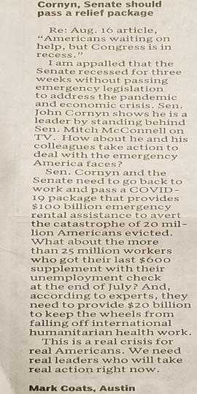
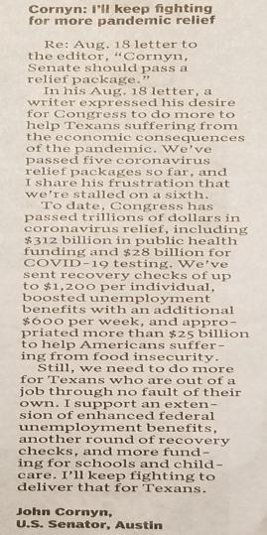
Influence of Letters to the Editor

Slide 19
What does the media landscape feel like these days?
19

Slide 20
20

Slide 21
21
Opinion Media Madlibs
_____________ should _____________.
(person) (action)

Slide 22
22
New
Unusual
Local
Personal
Important

Slide 23
Letters to the Editor
Structure
Typically 150-200 words – the shorter, the better
How it appears
Local & timely hook
Why it matters
Call to action
How you write it
Call to action
Why it matters
Local & timely hook

Slide 24
Letters to the Editor
Structure
How it appears
Local & timely hook
Why it matters
Call to action
How you write it
CALL TO ACTION
Why it matters
Local & timely hook

Slide 25
Letters to the Editor
Structure
A good CALL TO ACTION is:
Brief
Specific
Mentions people by name

Slide 26
Letters to the Editor
Structure
How it appears
Local & timely hook
Why it matters
Call to action
How you write it
Call to action
WHY IT MATTERS
Local & timely hook

Slide 27
Why it matters
Why do I care about this issue?
What makes this issue compelling now?
Why does my member of Congress need to know about it?

Slide 28
Letters to the Editor
Structure
How it appears
Local & timely hook
Why it matters
Call to action
How you write it
Call to action
Why it matters
LOCAL & TIMELY HOOK

Slide 29
Local and timely hook
Easiest hook – responding to an article or opinion piece in the paper
Racism
2020 election coverage
Coronavirus
Local election
Poverty and homelessness
Unemployment
Public health
Evictions
Pop culture
Health care workers
Candidate endorsement
Gridlock in DC
Local or national budget cuts
Student housing
Health disparities
Charity drives

Slide 30
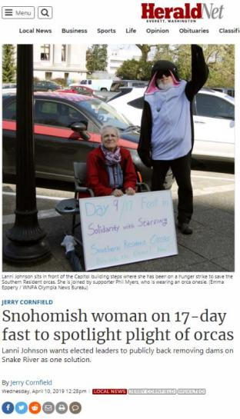
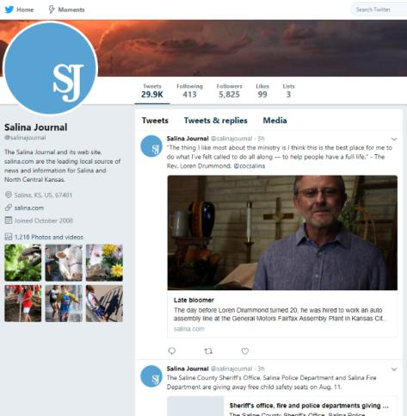
30

Slide 31
SEND IT!
100 percent of unsent letters never get published!
Submitting your LTE:
E-mail it directly to the paper (e.g. letters@kcstar.com - look on paper’s website for address)
Submit it through your paper’s website
Submit it through the RESULTS website (https://results.org/volunteers/action-center/)
Mailing a hard copy to your local paper (takes longer)
Important! Most papers require you to include your name and contact info to be published. If you are a new writer, they will sometimes contact you to verify authorship.

Slide 32
Leverage your Media
Maximize the impact of your media by:
Send copies to the candidate if you have contact info
Tag candidates on social media with your published letters
Share your media with allies urging people to write letters in response
Plan to deliver all your recent media in upcoming lobby meetings
Share your knowledge and experience – show someone new how to write and submit their own LTE
Leveraging Your Media info sheet: https://results.org/wp-content/uploads/Leveraging-Media-Chart.pdf

Slide 33
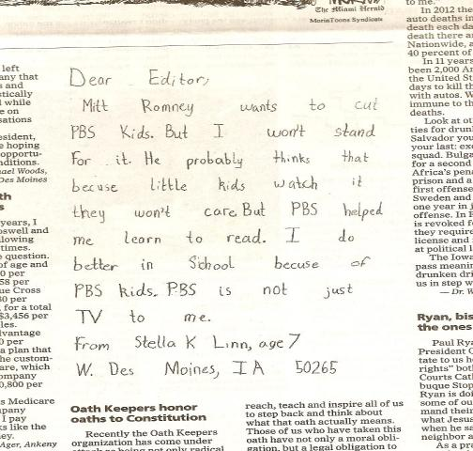
33
The Des Moines Register, October 9, 2012

Slide 34
34
Share your skills with others
Meeting candidates and getting published can be empowering and fun
Invite others to write letters with you
Attend an event with you
Work on drafting questions for a candidate
Call a friend and ask him/her to write an LTE (support)
Collaborate on writing an op-ed
Hold an online training (use this PPT – it’s easy!)
Make it a game – who can get published first?
Always follow up after to celebrate success/try again

Slide 35
Resources
35
RESULTS Media Tools: https://results.org/volunteers/media-tools/
RESULTS Online Media Actions: https://results.org/volunteers/action-center/
Leveraging Media: https://results.org/wp-content/uploads/Leveraging-Media-Chart.pdf
RESULTS Media Report Form: www.tinyurl.com/RESULTSMedia
RESULTS Advocacy Basics: https://results.org/volunteers/advocacy-basics/
Staff Media Support: Jos Linn, jlinn@results.org
RESULTS Training Resources: https://results.org/volunteers/training-webinars/

Slide 36
36
Questions?

Slide 38
Town Hall Tips (in person)
38
Arrive early.
Ask for extra campaign paraphernalia at the door like stickers. Try to look like a HUGE fan of the candidate.
Split up if in a big group.
Sit by an aisle towards the front. Think about where it is easy for a candidate to see you and for an aide to hand you a microphone.
Wear bright colors that could be easily described by a candidate who is calling on you without knowing your name.
Cheer loudly during speech - especially during parts that don’t often get applause. Candidates are more likely to call on friendly, smiling, cheering faces – because they are hoping for positive interactions!

Slide 39
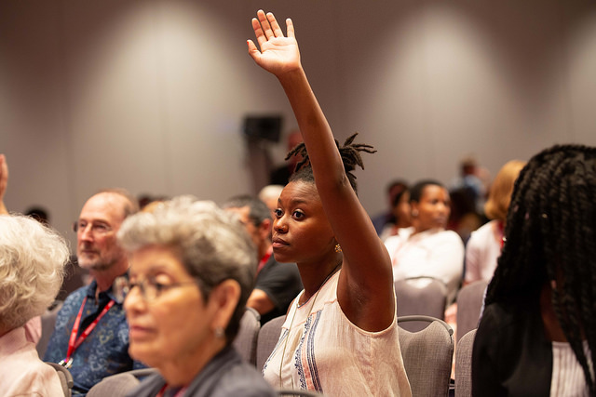
Raise your Hand First, Fast and High!
39

Slide 40
40
Town Hall Tips (in person)
If called on make sure you say who you are, why you care and ask a yes or no question. Keep it very brief (think 30 seconds) and be sure to mention what organization your represent (if appropriate)!
If you don’t get called on head for the handshake line! Hold the candidate’s hand firmly but politely. Tell them who you are and ask a shortened version of your question.

Slide 41
Meet and Greets (in person)
41
Meet and greets are informal events where candidates take pictures and chat with potential voters.
These can happen at campaign volunteer events or popular local destinations like farmers markets and diners.
Use the same strategies you would in a rope line at the Town Hall for a Meet and Greet!
Approach the Candidate (you may need to wait in line).
Shake their hand and ask a question – don’t let go until you’ve finished talking and they’ve answered.
Keep it quick, and make sure you say your name and that you’re a RESULTS Volunteer.

