Slide 1
RESULTS U.S. Poverty Data Webinar
September 15, 2020
Welcome!

Slide 2
Our Anti-Oppression Values
​RESULTS is a movement of passionate, committed everyday people. Together
we use our voices to influence political decisions that will bring an end to poverty.
Poverty cannot end as long as oppression exists.
We commit to opposing all forms of oppression, including racism, classism, colonialism, white saviorism, sexism, homophobia, transphobia, ableism, xenophobia, and religious discrimination. ​
At RESULTS we pledge to create space for all voices, including those of us who are currently experiencing poverty. We will address oppressive behavior in our interactions, families, communities, work, and world. Our strength is rooted in our diversity of experiences, not in our assumptions. ​
With unearned privilege comes the responsibility to act so the burden to educate and change doesn’t fall solely on those experiencing oppression. When we miss the mark on our values, we will acknowledge our mistake, seek forgiveness, learn, and work together as a community to pursue equity.
There are no saviors — only partners, advocates, and allies. We agree to help make the RESULTS movement a respectful, inclusive space.​
Find all our anti-oppression resources at: https://results.org/volunteers/anti-oppression/

Slide 3
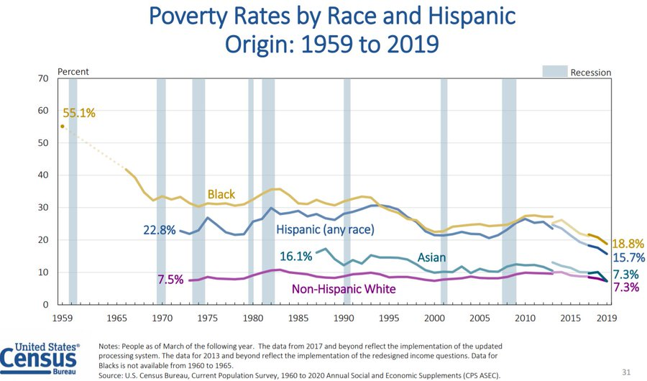
2019 Poverty Data
Notes:
https://www.census.gov/newsroom/press-kits/2020/income-poverty.html
These numbers bear little resemblance to today’s hardships – during the recession and pandemic. Households’ circumstances differ sharply now from those reflected in the 2019 data. I’ll get into it in more detail later.
Poverty also dropped in 2019, the last year before the current recession. But there were deep racial disparities, and these are unquestionably deepening further as a result of the recession.
Much more recent Census Bureau data show that as of late August 2020, more than 22 million adults were in households that lacked sufficient food the previous week and millions of renters had fallen behind on rent. 8/
FYI re data from Bob G CBPP: The income and poverty data, by contrast, come from the Current Population Survey (CPS), and their reliability is compromised because Census chiefly surveyed households for the CPS in March, as the pandemic was hitting. 4/
Necessary changes, including suspending in-person interviews, sharply reduced response rates in the survey — especially among lower-income households, which caused the results to overstate the rise in median income and the decline in poverty. 5/
We will see poverty and income data from the ACS on Thursday, which will be more reliable. 6/

Slide 4
2019 Poverty Data
Notes:
https://www.census.gov/newsroom/press-kits/2020/income-poverty.html
These numbers bear little resemblance to today’s hardships – during the recession and pandemic. Households’ circumstances differ sharply now from those reflected in the 2019 data. I’ll get into it in more detail later.
Much more recent Census Bureau data show that as of late August 2020, more than 22 million adults were in households that lacked sufficient food the previous week and millions of renters had fallen behind on rent. 8/
FYI re data from Bob G CBPP: The income and poverty data, by contrast, come from the Current Population Survey (CPS), and their reliability is compromised because Census chiefly surveyed households for the CPS in March, as the pandemic was hitting. 4/
Necessary changes, including suspending in-person interviews, sharply reduced response rates in the survey — especially among lower-income households, which caused the results to overstate the rise in median income and the decline in poverty. 5/
We will see poverty and income data from the ACS on Thursday, which will be more reliable. 6/

Slide 5
2019 Supplemental Poverty Data
Notes:
https://www.census.gov/newsroom/press-kits/2020/income-poverty.html

Slide 6
Economic woes
August data: 8.4 percent unemployment
More people remain unemployed than at the height of the Great Recession.
More than 1 in 10 Black women (12.0%) and Latinas (10.5%) are still unemployed, compared to only 6.9% of white men.
Notes:
Showed this on Saturday but to reiterate/bring us to today.
Latest data: 8.4 percent unemployment
Source: Bureau of Labor Statistics: https://www.bls.gov/charts/employment-situation/civilian-unemployment-rate.htm#
More people remain unemployed than at the height of the Great Recession.
More than 1 in 10 Black women (12.0%) and Latinas (10.5%) are still unemployed, compared to only 6.9% of white men.
The @BLS_gov August unemployment report in full context, despite the slow progress in improving since April, the unemployment rate is double last August's rate. For service occupations, it is more than triple, and for many occupations it is more than doubled.

Slide 7
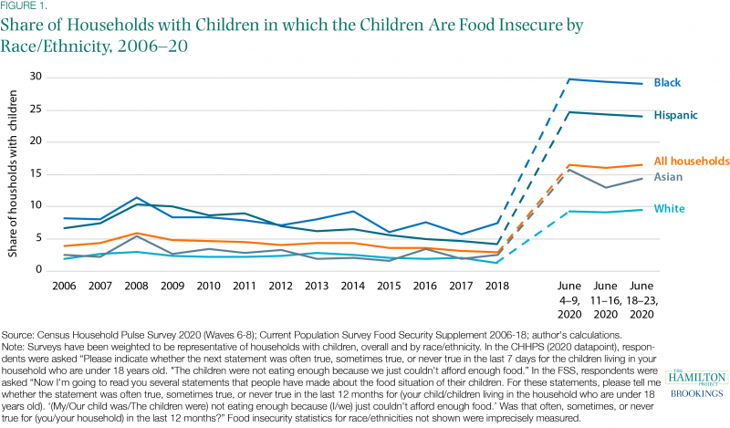
Struggles putting food on the table during a pandemic
Notes:
Hamilton Project https://www.hamiltonproject.org/blog/five_figures_highlighting_the_economic_impact_of_covid_19

Slide 8
Struggles putting food on the table during a pandemic
Notes:
New NWLC paper focusing on July Census data, with a focus on women of color: https://nwlc.org/resources/covid-19-is-making-womens-economic-situation-even-worse/

Slide 9
Food insufficiency for women of color
Notes:
New NWLC paper focusing on July Census data, with a focus on women of color: https://nwlc.org/resources/covid-19-is-making-womens-economic-situation-even-worse/
Between April 23, 2020 and July 21, 2020, the U.S. Census Bureau collected 12 weeks’ worth of data measuring the social and economic impact of COVID-19 on households. Our analysis of this data shows that women – and Black women and Latinas in particular – are too often going without adequate food and are facing housing insecurity at alarming rates. Key findings include:
More than half of Black, non-Hispanic women (54.5%), Asian, non-Hispanic women (56.3%), and Latinas (63.7%) reported a loss of income since March, compared to 45.1% of white, non-Hispanic men and 46.0% of white, non-Hispanic women.
More than 1 in 5 Black, non-Hispanic women (21.5%) and Latinas (21.1%) reported not having enough food in the past week, making them three times more likely than white, non-Hispanic men (7.0%) to report experiencing food scarcity.

Slide 10
Housing insecurity during a pandemic
Notes:
New NWLC paper focusing on July Census data, with a focus on women of color: https://nwlc.org/resources/covid-19-is-making-womens-economic-situation-even-worse/
Between April 23, 2020 and July 21, 2020, the U.S. Census Bureau collected 12 weeks’ worth of data measuring the social and economic impact of COVID-19 on households. Our analysis of this data shows that women – and Black women and Latinas in particular – are too often going without adequate food and are facing housing insecurity at alarming rates. Key findings include:
More than 2 in 5 Black, non-Hispanic women (40.8%) and Latinas (44.6%) reported facing housing insecurity, compared to 15.4% of white, non-Hispanic men.

Slide 11
Hardship during a pandemic
Notes:
New NWLC paper focusing on July Census data, with a focus on women of color: https://nwlc.org/resources/covid-19-is-making-womens-economic-situation-even-worse/

Slide 12
Latest Census Household Pulse Survey Data
Notes:
new data from the Census Household Pulse Survey
The Census Bureau released the first wave of results from Phase 2 of their Household Pulse Survey on September 9, and the responses reveal that many renters continue to struggle to afford their housing. The survey, conducted August 19 through August 31, indicates that 15% of renters are behind on paying their rent. Most of those who have fallen behind are low-income renters.
1/5 renter with incomes under $35k not caught up, now every 2 weeks, now asks if “caught up on rent”. 19% renters said didn’t pay July rent on time, now 15% say “not caught up”.

Slide 13
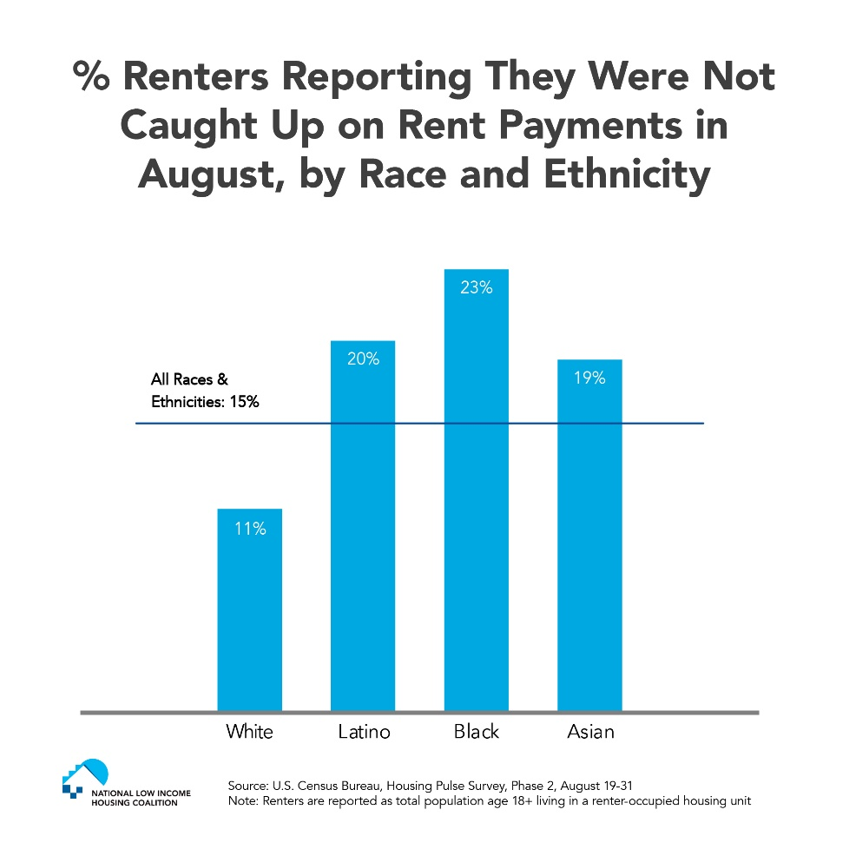
Latest Census Household Pulse Survey Data
Notes:
Visual source: pending NLIHC blogpost, used with permission, based on new data from the Census Household Pulse Survey
Due to the United State’s legacy of racist housing policies, Black families and other people of color are more likely to be renters. It is estimated that 59 percent of Black-occupied housing units are rented compared to only 28 percent of white-occupied housing units. Even before the pandemic, Black, Latino, and immigrant renters were struggling to afford housing in the United States and more likely to face evictions.
Renters of color are more likely to be struggling to catch up on rent payments. A greater share of Latino, Black, and Asian renters are behind on their rent (Figure 1). While 11% of white renters are behind, 19% of Asian renters, 20% of Latino renters, and 23% of Black renters are behind. Before the pandemic, people of color were already more likely than white people to be severely housing cost-burdened, paying more than half of their incomes on housing costs, and they were more likely to be extremely low-income renters.

Slide 14
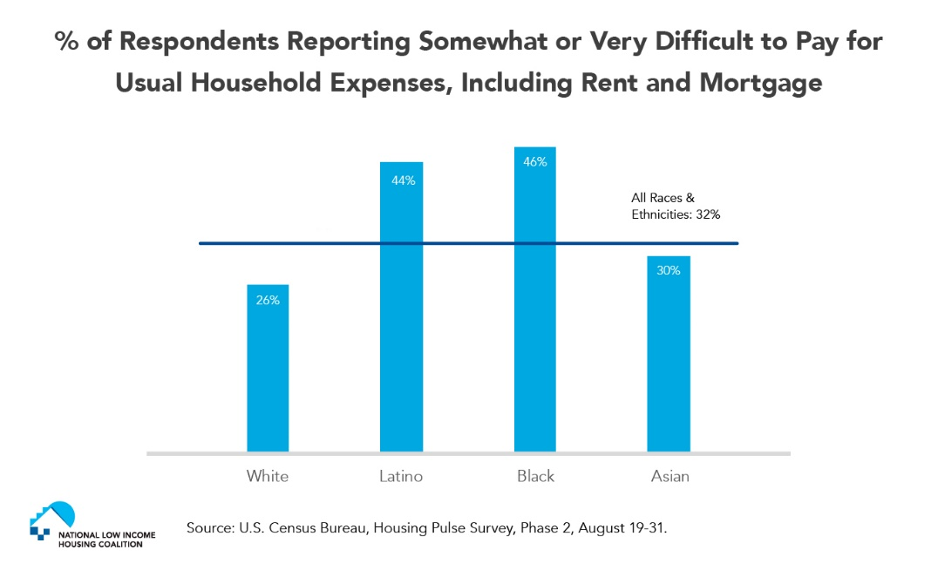
Notes:
Visual source: pending NLIHC blogpost, used with permission, based on new data from the Census Household Pulse Survey
Thirty-two percent of all respondents—including renters and homeowners—found it very or somewhat difficult to pay for their usual household expenses in the prior seven days. These usual expenses include food, rent and mortgage payments, car payments, medical expenses, and student loans, among other things. Over half (54%) of people with household incomes below $35,000 found it very or somewhat difficult to pay for these expenses. Twenty-six percent of white respondents, 30% of Asians, 44% of Latinos, and 46% of Blacks reported it was very or somewhat difficult (Figure 3). If “the rent eats first,” low-income renters who are currently paying their rent may be able to do so only because they are cutting back and struggling to pay for food, medical care, transportation, and other necessities.

Slide 15
Latest Census Household Pulse Survey Data
Notes:
new data from the Census Household Pulse Survey
34% of July renters said no confidence, now 27% little/no confidence and 39% of low-income renters = surprising improvements (but could be about responding rates… longer survey etc).

Slide 16
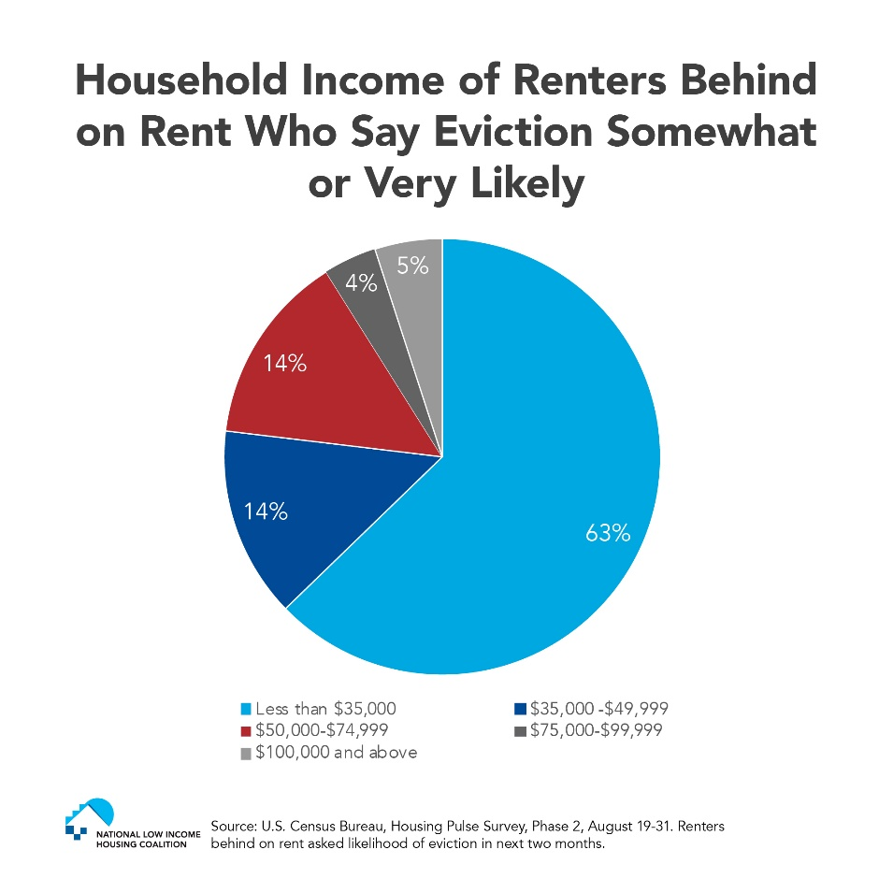
Latest Census Household Pulse Survey Data
Notes:
Visual source: pending NLIHC blogpost, used with permission.
A fifth of renters with household incomes below $35,000 are not caught up on rent. Among renters who have experienced loss of employment income, nearly 22% have already fallen behind. If renters experiencing loss of income have been paying the rent using dwindling savings or credit cards, that share may continue to rise. Among renters who reported they were not caught up on rent, 47% said it was very or somewhat likely they would be forced to leave their home in the next two months. A patchwork of local, state, and federal eviction moratoriums prevented this share from being even higher. Most of the renters who expected to be evicted had household incomes below $35,000 (Figure 2).

Slide 17
Reprieve for renters
Helpful: September 1 CDC national eviction moratorium.
But millions are still struggling to make ends meet, and this moratorium won’t pay the rent.
“Tenants already owe nearly $25 billion in back rent, which could reach $69.8 billion by the end of the year," according to conservative economist Mark Zandi of Moody’s analytics.
Notes:
September 1 CDC national eviction moratorium to prevent the spread of COVID-19 – an important step to keep renters housed short-term through the end of the year. As I noted Saturday, your work to build pressure on Congress – via 200 media pieces on housing, hundreds of lobby meetings with 41/50 Congressional delegations – helped make this happen.
The recent CDC eviction moratorium, in effect until the end of 2020, protects most, but not all, renters from eviction. It does not cover renters struggling to pay their rent before the pandemic who have not experienced a loss of income. For renters already behind on rent, many will not be able to pay their debts by October.
Renters must fill out this form and submit to their landlords (NLIHC has more resources for renters) in order to be protected. Even covered renters, however, will continue to accumulate back rent and late fees, absent sufficient rental assistance. Without this assistance, the nation will likely face a massive eviction crisis at the end of the moratorium. conservative economist Mark Zandi of Moody’s analytics: “Tenants already owe nearly $25 billion in back rent, which could reach $69.8 billion by the end of the year,"
Moratorium is a move in the right direction but not a panacea.

Slide 18
Rental assistance key to keep housing affordable
Notes:
Another important angle to keep in mind: Most landlords, especially smaller owners, can’t sustain a massive drop-off in rent payments. They could risk defaulting on their mortgages, missing insurance payments, or failing to pay city taxes, which could destabilize the broader community https://urbn.is/2K6xryy
and this article about the impact of the pandemic on landlords to further illustrate the dire need for rental assistance.
BTW, Eviction filings by big institutional landlords have surged following Trump's announced moratorium https://www.bloomberg.com/news/articles/2020-09-14/eviction-filings-by-big-landlords-surged-after-trump-issued-ban via @business. Big landlords increased the number of eviction cases they filed after President Donald Trump announced his recent moratorium, signaling the struggle tenants face getting protection from the federal order.
Institutional landlords filed more than 900 eviction cases across eight metropolitan areas from Sept. 2 to Sept. 8, according to data compiled by Private Equity Stakeholder Project, an activist group partly funded by organized labor. Landlords filed 165 cases in the same markets during the week of Aug. 3.

Slide 19
Where things stand now
House passed HEROES Act May 15
Senate voted on a “skinny” package
Bipartisan Problem Solvers Caucus proposal, includes:
15% SNAP boost
$25 billion in rental assistance
Next few days = all hands on deck!
Meredith Dodson
mdodson@results.org
Notes:
unless something dramatically changes, on track to see no COVID Relief until 2021. Urgency mostly about getting to vote for things (not getting stuff done): many House Dems pushed today to vote for something else (Pelosi reminded that has come down from HEROES... but pledge to walked back by Pelosi and Hoyer this afternoon), and see McConnell vote last week. https://www.politico.com/news/2020/09/15/nancy-pelosi-house-coronavirus-deal-415112
Problem Solvers proposal includes $25 bil for emergency rental assistance until Jan 2021 (= $84 bil for 12 months so close to $100 bil), good to have GOP on record. (above) this wont move forward but adds pressure on Congress. NYT: https://www.nytimes.com/2020/09/15/us/politics/bipartisan-stimulus-bill.html. No plan to bring any particular proposal to House floor, House Dem Chairs and Hoyer pushed back on Problem Solvers ($1.5 tril) – doesn’t go far enough, though better on fiscal relief/SNAP/rent than expected.
Meadows stuck at $1.3 while others like Mnuchin $1.5 tril. Failure not an option. Payroll tax Exec action is a disaster, Treasury can’t fix, if Trump wants a check with his name then he might push for a deal.

Slide 20
U.S. Poverty Requests
Will you personally speak to Senate/House Leadership urging them to pass a robust relief package, and prioritize:
$100 billion in emergency rental assistance
Included in House bill, but not in Senate GOP proposal
Boost the maximum SNAP benefits by 15 percent
Included in House bill but not Senate GOP proposal
There is bipartisan support for rental assistance and an increase in SNAP benefits, but we need Congress to pass a robust relief package to ensure we help families keep a roof over their heads and food on the table.
Notes:
It’s key that Congressional leadership hear from colleagues. this is an all hands-on deck moment. I know you’ve been working tirelessly to do just that over the last few months, but we feel we have to give it all we have (at least) one more time.
Keep up the pressure, urging Congress to pass a robust relief package, and prioritize:
$100 billion in emergency rental assistance and a national eviction moratorium
A boost to the maximum SNAP benefit level by 15 percent
We know here is bipartisan support for rental assistance and an increase in SNAP benefits – which you all have played a key role in creating -- but we need Congress to pass a robust relief package to ensure we help families keep a roof over their heads and food on the table.
TAKE ACTION:
forward our email alert to your Action Network today
Circle back to aides directly (especially Senate GOP)
mark your calendars for a National Call-In Day Wednesday.
AND leverage all your letters to the editor – later in this call we’ll dive into a training on how to get media published and hear from some RESULTSers.

Slide 21
U.S. Poverty Requests
Notes:
It’s key that Congressional leadership hear from colleagues. this is an all hands-on deck moment. I know you’ve been working tirelessly to do just that over the last few months, but we feel we have to give it all we have (at least) one more time.
Keep up the pressure, urging Congress to pass a robust relief package, and prioritize:
$100 billion in emergency rental assistance and a national eviction moratorium
A boost to the maximum SNAP benefit level by 15 percent
We know here is bipartisan support for rental assistance and an increase in SNAP benefits – which you all have played a key role in creating -- but we need Congress to pass a robust relief package to ensure we help families keep a roof over their heads and food on the table.
TAKE ACTION:
forward our email alert to your Action Network today
Circle back to aides directly (especially Senate GOP)
mark your calendars for a National Call-In Day Wednesday.
AND leverage all your letters to the editor – later in this call we’ll dive into a training on how to get media published and hear from some RESULTSers.

Slide 22
U.S. Poverty Action Resources
U.S. Poverty Action available online at: https://results.org/volunteers/monthly-actions/
Online Housing LTE: https://results.org/volunteers/action-center/?vvsrc=%2fcampaigns%2f72504%2frespond
Online SNAP LTE: https://results.org/volunteers/action-center/?vvsrc=%2fcampaigns%2f74353%2frespond
Partial information on evictions: https://nlihc.org/coronavirus-and-housing-homelessness/eviction-update
State data on renters at risk of eviction: https://nlihc.org/sites/default/files/The_Eviction_Crisis_080720.pdf
Report published media at: www.tinyurl.com/RESULTSMedia
Report meetings with Congressional offices at: www.tinyurl.com/RESLRF
Public pressure (media) and direct follow up (especially with Senate GOP) key
Notes:
Here are some of the resources that can help you take action – and please reach out to the RESULTS staff if you have any questions. Now we’ll move to Q&A

Slide 24
BE AN ADVOCATE
WHO WE ARE I WHAT WE DO I HOW WE DO IT I WHY IT MATTERS
Sign up to volunteer at www.results.org/volunteer

