Slide 1
December 2019 RESULTS U.S. Poverty National Webinar
Understanding Equity and the Tax Code
Login at: https://results.zoom.us/j/873308801 or dial (929) 436-2866 or (669) 900-6833, Meeting ID: 873 308 801.

Slide 2
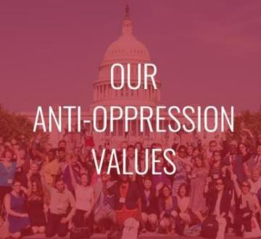
RESULTS is a movement of passionate, committed everyday people. Together we use our voices to influence political decisions that will bring an end to poverty. Poverty cannot end as long as oppression exists. We commit to opposing all forms of oppression, including racism, classism, colonialism, white saviorism, sexism, homophobia, transphobia, ableism, xenophobia, and religious discrimination.
At RESULTS we pledge to create space for all voices, including those of us who are currently experiencing poverty. We will address oppressive behavior in our interactions, families, communities, work, and world. Our strength is rooted in our diversity of experiences, not in our assumptions.
With unearned privilege comes the responsibility to act so the burden to educate and change doesn’t fall solely on those experiencing oppression. When we miss the mark on our values, we will acknowledge our mistake, seek forgiveness, learn, and work together as a community to pursue equity.
There are no saviors — only partners, advocates, and allies. We agree to help make the RESULTS movement a respectful, inclusive space.
Find all our anti-oppression resources at: https://results.org/volunteers/anti-oppression/
RESULTS U.S. Poverty National Webinar

Slide 3
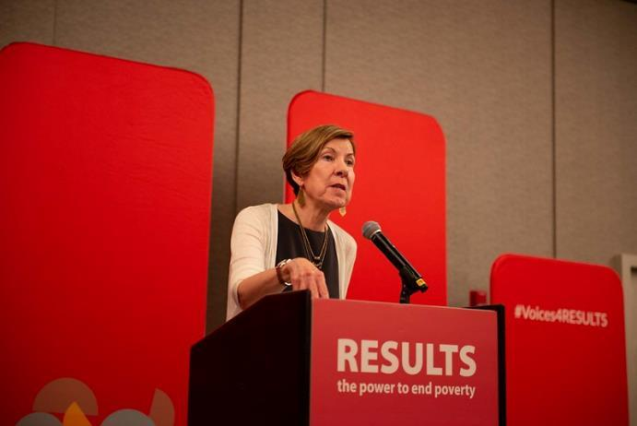
Welcome from Joanne Carter Executive Director, RESULTS
3
RESULTS U.S. Poverty National Webinar

Slide 4
Today for Giving Tuesday, a generous longtime supporter is matching all donations to RESULTS 2-to-1, up to $5,000! That’s TRIPLE the impact!
Here’s how you can get involved:
Donate on our website – results.org/donate
Donate through RESULTS’ Facebook page for a chance to unlock an additional match from Facebook
Start your own Facebook fundraiser and ask your friends to fight poverty on Giving Tuesday.

Slide 5
5
U.S. Poverty Campaigns Update
Congressional leaders have reached a deal on spending levels – and face a deadline to pass spending bills by December 20
Meredith Dodson
mdodson@results.org
Next 1.5 weeks will be make or break re whether we secure key expansions of the Earned Income Tax Credit (EITC) for younger workers and others who don’t claim dependents, and the Child Tax Credit (CTC) for the lowest-income families.
This is the biggest opportunity in this Congress to pass important policies for low-income families!
Call to Action: Will you/your boss tell congressional leaders that any final tax package this year must include expanding the EITC and CTC for low-income workers and families?
RESULTS U.S. Poverty National Webinar
Notes:
QUESTIONS AFTER QUICK REVIEW On House floor 12/11-12/13 with Senate floor the next week. Even if 2 year EITC/CTC still the biggest opportunity for low-income Americans in this Congress.
MD may mention (depending on Funke): State and local numbers on expanding EITC and CTC: https://www.cbpp.org/research/federal-tax/working-families-tax-relief-act-would-raise-incomes-of-46-million-households
While we don’t expect the full Working Families Tax Relief Act to be enacted this year, it is “foundational” legislation that sets the terms of the debate for how we should be focusing our efforts to rewrite the 2017 Trump tax law to promote policies that help millions of Americans struggling to make ends meet and would help address income inequality that has affected white, Black, and brown working-class households.
The recently introduced Kildee-Evans bill (the Working Families Tax Relief Act) would substantially expand both the EITC and the Child Tax Credit. Substantially expand both the EITC for families with children and the EITC for workers not raising a child at home. The expansions include broadening the age range of workers eligible for the credit from 25-64 today to 19-67, a provision that would support young workers, especially those who lack a college degree.
The bill would have large effects on poverty. It would:
Reduce the overall poverty rate (using the Supplemental Poverty Measure, which analysts favor) from 14 percent to 12 percent — a 15-percent reduction.
Reduce the Black poverty rate from 21 percent to 17 percent, an 18-percent reduction.
Reduce the Latino poverty rate from 22 percent to 18 percent, a 20-percent reduction.
Lower the overall child poverty rate from 15 percent to 11 percent, a 28-percent reduction.
And shrink the Latino child poverty rate from 24 percent to 18 percent, a 27-percent reduction.
And shrink the Black child poverty rate from 23 percent to 15 percent, a 33-percent reduction.

Slide 6
December Action Resources
6
Push Congress to expand the EITC and CTC
Action Sheet: https://results.org/wp-content/uploads/2019-12-U.S.-Poverty-Action-Final-Push-for-EITC-and-CTC-Expansions.pdf
RESULTS Lobbying page: https://results.org/volunteers/lobbying/
EITC/CTC Lobby Leave-Behind: https://results.org/wp-content/uploads/RESULTS-EITC-CTC-Congressional-Requests-Fall-2019-1.docx
CBPP State Fact Sheets on Working Families Tax Relief Act: https://www.cbpp.org/research/federal-tax/working-families-tax-relief-act-would-boost-incomes-improve-childrens-prospects
Contact info for congressional offices: https://results.org/volunteers/action-center/legislator-lookup/?vvsrc=%2fAddress
Online actions for EITC/CTC and Housing: https://results.org/volunteers/action-center/action-alerts/?vvsrc=%2fCampaigns
RESULTS U.S. Poverty National Webinar

Slide 7
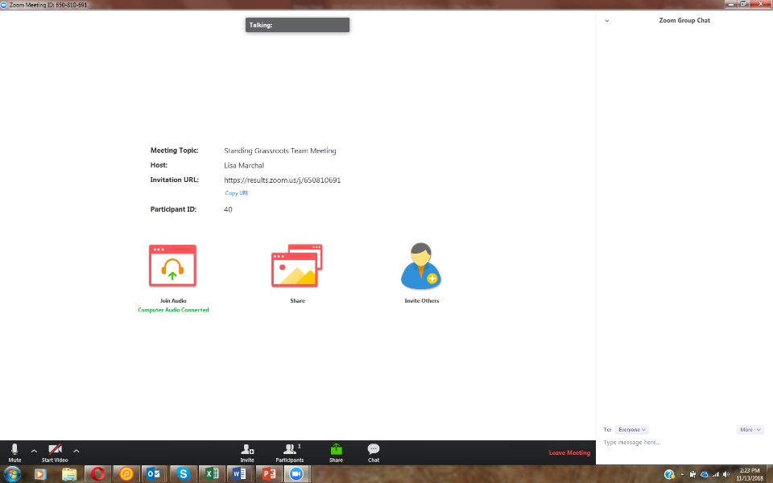
How to Ask a Question/Make a Comment on Zoom
3. See here
1. Click here
2. Type here
jlinn@results.org
RESULTS U.S. Poverty National Webinar

Slide 8
8
A TAX CODE FOR THE REST OF US:
A Framework & Recommendations for Advancing Racial Equity Through Tax Credits
RESULTS Educational Fund
U.S. Poverty National Webinar
Tuesday, December 3, 2019
Funke Aderonmu
Notes:
I’d like to thank
Meredith Dodson, Jos Lin and the rest of the RESULTS U.S. Poverty team for organizing this webinar
Co-authors of the report, Melissa Boteach and Amy Matsui (NWLC), Rachel Black (Jain Family Institute), and my colleagues Indi Dutta Gupta and Kali Grant at GCPI
Everyone listening in on the webinars & RESULTS volunteers for the crucial work you do advocating for working people and people in poverty
[Next slide] Today I’ll provide an overview of our recently published report, A Tax Code for the Rest of Us

Slide 9
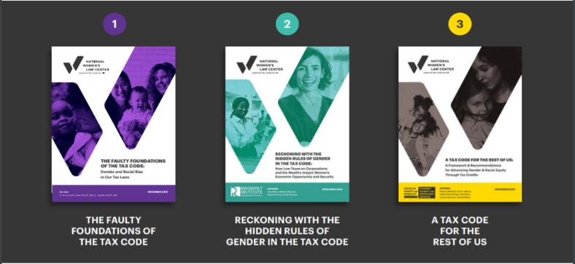
Tax Justice is Gender Justice
Advancing Gender and Racial Equity by Harnessing the Power of the U.S. Tax Code
9
1
Notes:
Today I’ll provide an overview of our recently published report, A Tax Code for the Rest of Us
Part of the “Tax Justice is Gender Justice” series: 3 interrelated reports that examine the federal tax code with a focus on racial & gender equity, & explore policies to make the tax code work better for all of us
Faulty Foundations looks at the inaccurate assumptions about race, gender, family structures, participation in the paid workforce, caregiving and wealth embedded in the tax code; then offers recommendations for better data & analysis that can enable policy makers, advocates, & the public to fully understand the impact of current tax code and tax proposals
Reckoning w/ the Hidden Rules, illuminates several ways low taxes on the wealthy & corporations fail to deliver for low-income families & women, while exacerbating economic inequality; then offers a set of reforms to better leverage the tax code to advance gender and racial equity
Finally the report we’ll be exploring today, A Tax Code for the Rest of Us, finds that low-income families, women, & people of color are underserved by both direct spending & tax subsidies, particularly in housing, caregiving, transportation & higher ed, largely due to insufficient funding & poorly designed tax provisions that privilege the wealthy; then explores the opportunities & challenges of refundable tax credits in addressing this gap & proposes a framework to help policymakers, advocates, and the public evaluate when and how refundable tax credits can help advance equity, economic mobility, and opportunity for all
[Next slide] In this overview, I will First: Tax Code & Direct Spending Programs Do Too Little to Advance Equity

Slide 10
Overview
10
Tax Code & Direct Spending Programs Do Too Little to Advance Equity
Opportunities & Challenges For Advancing Equity Through Refundable Tax Credits
A Policy Framework For Advancing Equity Through Refundable Tax Credits
Notes:
In this overview, I will:
First: Tax Code & Direct Spending Programs Do Too Little to Advance Equity
Then: Opportunities & Challenges For Advancing Equity Through Refundable Tax Credits
Lastly: A Policy Framework For Advancing Equity Through Refundable Tax Credits
[Next slide]The U.S. gov’t at all levels collects less tax revenue as a share of GDP…

Slide 11
Overview
11
Tax Code & Direct Spending Programs Do Too Little to Advance Equity
Opportunities & Challenges For Advancing Equity Through Refundable Tax Credits
A Policy Framework For Advancing Equity Through Refundable Tax Credits
Notes:
The U.S. gov’t at all levels collects less tax revenue as a share of GDP than most peer OECD countries, incl. Canada, UK & Australia
These lower revenues constricts the govt’s ability to fund direct-spending programs that reduce racial & gender equity
Further, the tax code fuels & perpetuates structural wealth & income inequality; these inequities are the legacy of historical discrimination (ex. Jim Crow segregation, legislation like Labor Standards Act, Social Security that left out people of color & women-dominated professions like domestic workers)
Tax policy has yet to reckon with these structural inequities & historical discrimination, which means that it continues to exacerbate racial & gender wealth inequality, while limited direct spending is unable to fully fund programs crucial to race & gender equity such as childcare & housing
[Next slide] While tax code is overall progressive, meaning high-income households pay a greater share…

Slide 12
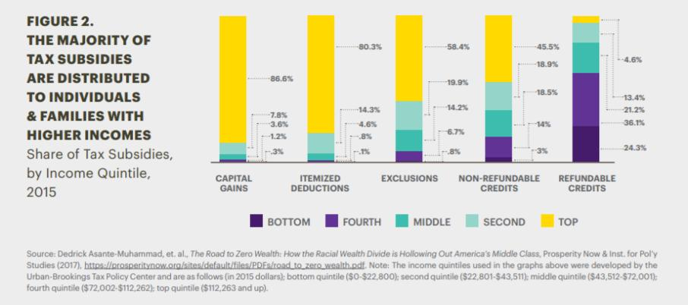
The Tax Code & Direct Spending Programs Do Too Little to Advance Equity
12
Figure 1. Share of Tax Subsidies, by Income Quintile, 2015
Notes:
While tax code is overall progressive, meaning high-income households pay a greater share of income in taxes relative to low-income households,
it includes a number of provisions such as nonrefundable credits, exemptions, deductions, & tax breaks on wealth that largely benefit high-income, predominantly white households with low levels of need, undermining some of the system’s overall progressivity
[Next slide] Because families of color and women are overrepresented in lower-income quintiles…

Slide 13
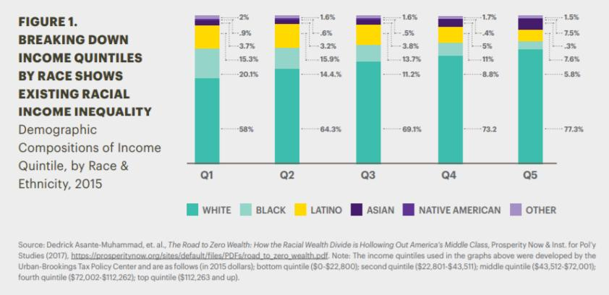
The Federal Tax Code is Not Race- or Gender- Neutral
13
Figure 2. Demographic Compositions of Income Quintile, by Race & Ethnicity, 2015
Notes:
Because families of color and women are overrepresented in lower-income quintiles, they are largely unable to reap the benefits of many tax subsidies aimed at wealthier households
White households are especially concentrated in the top three income quintiles where most tax subsidies are claimed, meaning the households with the most advantages receive the bulk of tax subsidies; this unequal distribution of subsidies undermines racial, gender equity, in addition to the progressivity of the tax code
The tax code’s unequal support across the income line in turn perpetuates gender & racial econ inequality b/c it undermines access & supports that are esp. vital for economic security & mobility for people of color & women with low-income, namely housing, childcare, transportation & higher education
[Next slide] Housing is critical to advancing not only economic security and access to opportunity, but also to equity

Slide 14
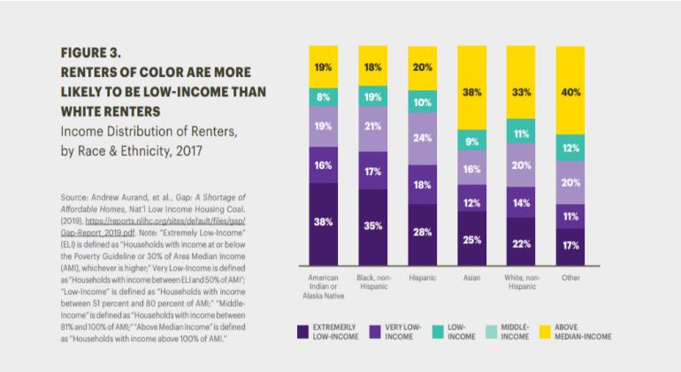
Gaps in Federal Housing Supports Undermine Economic Security & Equity Goals
Figure 3. Income Distribution of Renters, by Race & Ethnicity, 2017
Notes:
Housing is critical to advancing not only economic security and access to opportunity, but also to equity
As I learned during my time as a Hunger Fellow at RESULTS, a body of research links housing policy to economic & social mobility
Housing-related factors, like childhood neighborhood, often determine future earnings as an adult and the likelihood of escaping poverty, among other factors
Studies also highlight that these factors are more powerful determinants for Black people relative to white people, with the legacies of structural racism and housing segregation contributing to significant disparities between Black & white communities.
Further, homeownership remains a core pathway to wealth building in the U.S.
home equity represents 40 percent of the wealth of Black households and 42 percent of the wealth of Latinx households, compared to 25 percent for white households, as of 2017
Housing is also one of the biggest costs low-income families face
Renters of color are more likely to be low-income than white renters (as seen in figure above)
[Next slide] Women-headed households make up the majority of housing assistance recipients (figure above)

Slide 15
Gaps in Federal Housing Supports Undermine Economic Security & Equity Goals
15
Figure 4. Percentage of Female-Headed Households, by Housing Program, 2009
Notes:
Women-headed households make up the majority of housing assistance recipients (figure above); they are also much more likely to be housing-burdened, spending between 30 and 50 percent of their monthly income on housing costs than those headed by men
Yet the tax code does not provide adequate housing supports for low-income families, with implications for racial & gender equity
Tax provisions like the Mortgage Interest Deduction (MID) allows tax filers who itemize deductions to deduct mortgage interest on primary and secondary residences from their taxable income
Mainly due to decades of race and gender-based discrimination in housing and credit market, in line with a long history of systemic racial & gender discrimination in the U.S., lower-income families are:
Less likely to be homeowners, esp. if headed by women or families of color,
Less likely to itemize deductions, and instead take the standard deduction
As a result, this feature of the tax code rewards homeownership largely for higher-income households, to the tune of $66 billion in total tax subsidies in 2017, while failing to support homeownership & wealth-building for lower-income families, reinforcing racial & gender disparities
Direct spending programs that provide housing assistance, namely Section 8, public housing & project-based rental assistance (PBRA) have not kept pace with demand due to chronic underfunding & other structural issues
[Next slide] Access to affordable, quality child care can help adults better secure & maintain employment…

Slide 16
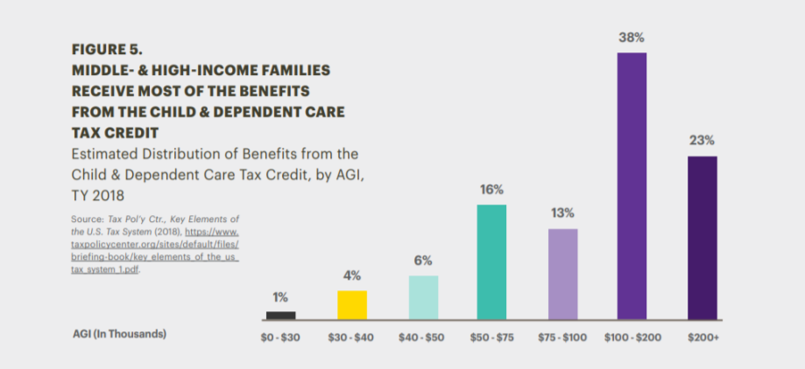
Gaps in Child Care Assistance Hurt Children & Families
16
Figure 5. Estimated Distribution of Benefits from the Child & Dependent Care Tax Credit, by AGI, TY 2018
Notes:
Access to affordable, quality child care can help adults better secure & maintain employment (or attend school or training) & sets children up for success in school & beyond
Yet child care costs are significantly costly for families ranging between $3K - $20K each year for full-time child care
Additionally, low-income families face non-cost related challenges to finding high-quality, affordable child care, like:
work hours that fall outside typical child care center hours,
unpredictable schedules that make child care coverage a constant, lastminute struggle and
limited child care options near where they live or work.
As a result, low-income parents often face difficult choices between having to quit or work fewer hours if they cannot access child care, or paying a premium for care that fits their needs
The primary tax credit for parents with child care needs is the Child Dependent Tax Credit (CDCTC), a nonrefundable credit that reduces taxes owed by a percentage, based on income, of taxpayers’ child or dependent care expenses, with a cap of $ $3,000 for one child or dependent and $6,000 for two or more; the percentage ranges from 20-35%
However, b/c the CDCTC is nonrefundable, many otherwise eligible families with low incomes do not have enough federal income tax liability against which to apply any CDCTC amounts
Families that rely on informal care networks such as family,friends or neighbors(FFN, are also less likely to qualify for CDCTC credit because they lack formal documentation/payments of child care; this impacts women of color and families or color who are more likely to rely on these forms of care, due to things like irregular work schedules
As a result, low-income families who are more burdened from out-of-pocket child care expenses rarely get the full benefit of CDCTC
A 2018 (Tax Policy Center) study found that only 1% of CDCTC benefits went to families w/ incomes below $30K, only 11% went to families w/ incomes below 50K, while 61% went to families with incomes $100K or above (as seen in figure 5)
On the direct spending front, the largest program for child care funding, the Child Care & Development Block Grant, also faces chronic underfunding, where just 1 in 6 children eligible for federal child care assistance received it in 2013; this particularly impacts children of color
[Next slide] Transportation needs can also place a large strain on budgets for low- & moderate-income families,...

Slide 17
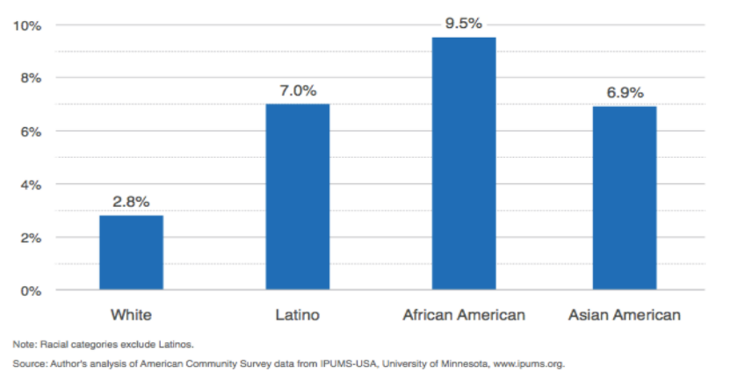
Unaddressed Transportation Needs Compound Families’ Challenges
17
Figure 6. Percentage of Workers Without a Vehicle at Home by Race & Latino Ethnicity, 2011-15
Notes:
Transportation needs can also place a large strain on budgets for low- & moderate-income families, in light of the decentralization of jobs from urban areas, and places where people live
Since 2000, 61 percent of communities with high poverty rates and 55 percent of “majority-minority” communities have seen a decline in the proximity of jobs, meaning workers in these communities need to travel further to get to their jobs
Inadequate transportation access can create barriers to employment, esp. For workers of color,
American Community Survey data show a greater share of Black, Latinx, and Asian workers lack access to a vehicle
Women face added barriers to transportation that preserves personal safety & works w/ child care arrangements
2018 study of transit experiences in New York City found that, on average, women paid an additional $26-50 per month relative to men to access safer forms of transportation
The tax code allows employers to offer workers the opportunity to use pre-tax income to defray their transportation costs, but this subsidy is largely inaccessible to low- & moderate income workers for 3 key reasons:
Employers must voluntarily offer the benefit; which results in only 6% of employees having this benefit; the passage of the 2017 TCJA reduces the likelihood employers will continue to offer the benefit, since employers can no longer deduct this benefit from their expenses
It requires workers to defer income that they may not be able to forgo
The benefit comes in the form of a tax subsidy which is less useful to low & moderate-income families than a refundable credit
There is no dedicated direct spending program for providing transportation assistance to low-income individuals & families; while TANF, a cash assistance program could be used to cover transportation costs, only 1 in 4 low-income families with children receive income assistance through TANF
[Next slide] Postsecondary education is central to accessing economic opportunity and mobility, with higher levels of education…

Slide 18
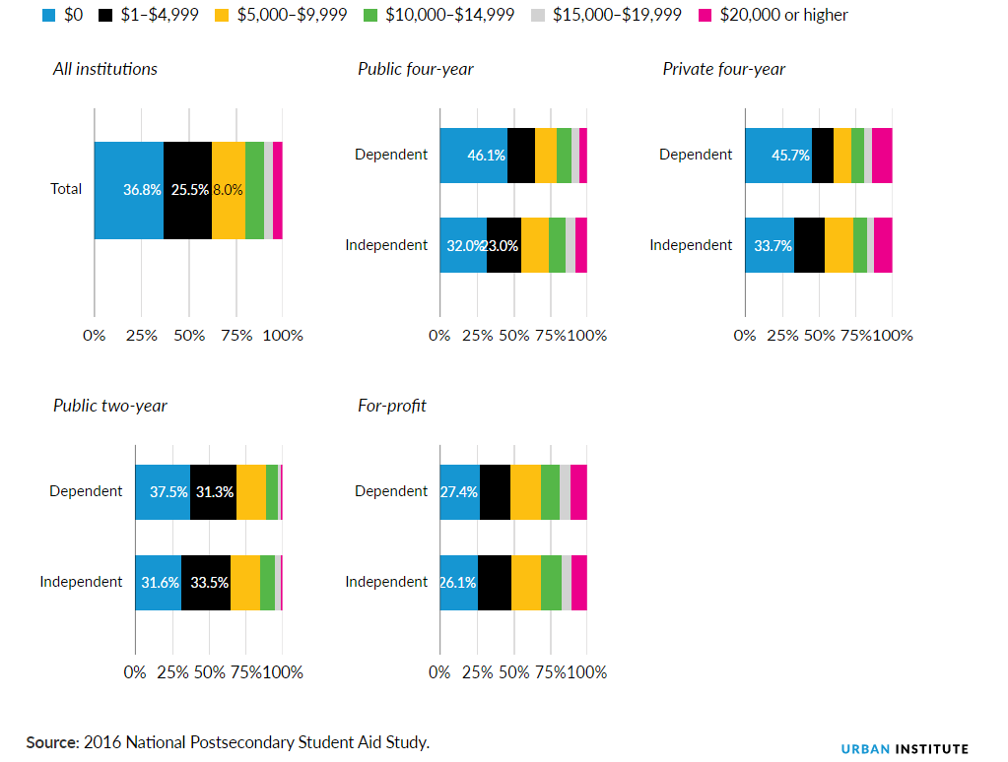
Current Postsecondary Education Assistance
Leaves Students With Unmet Needs
18
Figure 7. Distribution of Unmet Need by Dependency Status and Sector, 2015–16
Notes:
Postsecondary education is central to accessing economic opportunity and mobility, with higher levels of education linked to higher earnings & more stable employment
Rising higher ed costs have created obstacles to education for students from low- & moderate-income families, & esp. for non-traditional students (financially independent of a parent or guardian)
At 4-year public universities, 68% of independent students face unmet need relative to 54% of dependent students
According to most recent data, more than 90% of full-time independent college students w/ incomes below $28,356 had unmet financial need in 2011-2012
These unmet costs can undermine racial & gender equity, as students of color hold more debt than their white counterparts on average, with Black students having highest debt burden
The tax code provides support for higher ed for example through the American Opportunity Tax Credit (AOTC), formerly the Hope Scholarship, which provides a partially refundable credit (up to $1K out of $2.5K refundable) for higher ed expenses
While not w/out its challenges, the refundable feature of the AOTC has made it more equitable for low- & moderate income families relative to other provisions such as the “529” college savings plan which skews heavily towards higher income households
The Pell Grant, a major direct spending program for higher ed costs, provides direct federal grants to students w/ great financial need; however recent trends show that demand for Pell Grants is rising due to increased costs of higher ed. but funding has not kept up with need
In 2017, Pell covered only 29 percent of the average total costs for tuition, fees, and room and board at public four-year universities, the lowest in over 40 years
Further the complicated Pell Grant application process (via FAFSA) can deter students from pursuing possible financial assistance
[Next slide] As we’ve seen, neither tax subsidies nor direct spending programs adequately or equitably support low- and moderate-income families…

Slide 19
Overview
19
Tax Code & Direct Spending Programs Do Too Little to Advance Equity
Opportunities & Challenges For Advancing Equity Through Refundable Tax Credits
A Policy Framework For Advancing Equity Through Refundable Tax Credits
Notes:
As we’ve seen, neither tax subsidies nor direct spending programs adequately or equitably support low- and moderate-income families, women-headed families, and families of color
Given the gaps in support from the tax code & direct spending programs, we’ll now explore how refundable tax credits like the EITC & CTC promote economic security for millions of families and can serve as a tool for advancing, gender, racial & economic equity
[Next slide] Refundable tax credits like the EITC and the CTC are tax policies that increase economic equity

Slide 20
Opportunities & Challenges For Advancing Equity Through Refundable Tax Credits
20
Tax credits like the EITC & CTC increase economic equity, particularly for women, households of color, & women of color
Notes:
Refundable tax credits like the EITC and the CTC are tax policies that increase economic equity
CBPP estimates that the EITC and ACTC kept 7.9 million people out of poverty in 2018, including 4.2 million
These credits also help women, households of color & women of color
The EITC and ACTC benefit a larger proportion of households of color than white households,
The share of women of color (both women filing tax returns themselves and as spouses) benefiting from the CTC & ACTC outpaces the share of white women benefiting from these credits
[Next slide] Refundable tax credits can also be effective tools for advancing racial & gender equity for 3 key reasons

Slide 21
The Potential For Advancing Equity Through Refundable Tax Credits
21
Refundable Tax Credits:
Facilitate flexibility & purchasing power
Have a track record of reaching families
Are responsive to need
Notes:
Refundable tax credits can also be effective tools for advancing racial & gender equity for 3 key reasons
They have a track record of reaching families
The tax code already administers refundable tax credits w/ high participation rates
The federal tax return filing process households use to claim the credits can be expanded to contract workers, contingent workers & others under existing program rules
The VITA free tax prep service available to low- & moderate-income families has proven effective & can be expanded to reach more eligible families
They facilitate flexibility & purchasing power
EITC & CTC benefits are distributed annually in refunds that provide low-and moderate-income families with flexibility and buying power, allowing them the autonomy to decide how best to meet their family’s financial needs
They are responsive to need
In contrast to many direct spending programs which are not designed as federally guaranteed benefits & limited by capped funding, refundable credits have a higher likelihood of reaching eligible families b/c when these families meet eligibility criteria, they typically receive the claimed tax benefits
Indeed, EITC (and Medicaid) participation rates are higher than those for housing assistance and TANF – which, unlike refundable tax credits and Medicaid, do not serve all eligible claimants
[Next slide] However, refundable tax credits like the EITC & CTC do have some limitations that if addressed, could further boost their reach and impact

Slide 22
Challenges & Limitations of Refundable Tax Credits To Advance Equity
22
Requiring earned income has equity implications
Level of complexity can affect access
Timing of benefits should work with families’ economic realities
Notes:
However, refundable tax credits like the EITC & CTC do have some limitations that if addressed, could further boost their reach and impact
Requiring earned income has equity implications
Due to earned income requirement, the EITC and CTC exclude people not in the formal labor market (including many students, people with work-limiting disabilities, and caregivers), are unemployed, or have very low earnings
Program rules in the EITC & CTC also exclude childless adult workers, who consequently are taxed into poverty; and exclude or limit benefits for undocumented immigrants (many of whom are people of color), furhter exacerbted by the Trump Admin’s attacks on immigrant communities
Level of complexity can affect access
The complexity of the EITC app causes many families to resort to paid tax preparers which can reduce families’ tax refunds and, effectively, constitute de facto access fees
Families of color are particularly likely to bear these costs: over 70 percent of Latinx and Black low-income families report using paid tax preparers
Further, paid preparers does not guarantee compliance; the Treasury Depart found that unenrolled paid preparers (i.e., preparers “who are neither attorneys, certified public accountants, nor enrolled agents”) make errors at a higher rate than other types of preparers
Timing of benefits should work w/ families’ economic realities
The timing of the delivery of tax credits as a lump sum, can sometimes limit the extent to which refundable tax credits can (1) smooth income levels throughout the year for workers with fluctuating incomes & (2) help low & moderate-income families meet expenses as they arise throughout the year
[Next slide] Now that we’ve assessed the opportunities & challenges of refundable tax credits in advancing racial & gender equity…

Slide 23
Overview
23
Tax Code & Direct Spending Programs Do Too Little to Advance Equity
Opportunities & Challenges For Advancing Equity Through Refundable Tax Credits
A Policy Framework For Advancing Equity Through Refundable Tax Credits
Notes:
Now that we’ve assessed the opportunities & challenges of refundable tax credits in advancing racial & gender equity, we’ll unpack a policy framework that can help us better evaluate, design, & strengthen refundable tax credits to effectively & equitably advance economic security & opportunity, particularly for women & people of color
[Next slide] This framework was borne out of previous analyses, that laid important groundwork about considerations to effectively leverage the tax code…

Slide 24
A Policy Framework For Advancing Equity Through Refundable Tax Credits
24
What is the policy goal?
How would this proposed tax credit complement any direct spending programs that further this policy goal & target low- & moderate-income families?
Does the structure of the tax credit proposal meet the needs and/ or preferences of low- & moderate-income families?
Notes:
This framework was borne out of previous analyses, that laid important groundwork about considerations to effectively leverage the tax code to advance specific policy goals
Ex. Lily Batchelder & Eric Toder, “Government Spending Undercover: Spending Programs Administered by the IRS, (2010)”
When presented w/ a tax proposal, this framework can enable policymakers & advocates to assess whether the proposal would advance income, gender, racial, and/or other forms of equity based on our understanding of the following key questions:
What is the policy goal?
How would this proposed tax credit complement any direct spending programs that further this policy goal & target low- & moderate-income families?
Does the structure of the tax credit proposal meet the needs and/ or preferences of low- & moderate-income families?
[Next slide] We’ll now use this framework to analyze a recent tax credit proposal, the Working Families Tax Relief Act of 2019 (WFTRA)...

Slide 25
Working Families Tax Relief Act of 2019
25
Introduced by Sens. Brown (OH), Bennet (CO), Durbin (IL), Wyden (OR) & Reps. Kildee, Evans
Expands EITC amount for childless adult workers
Expands the age range for eligibility to 19-67
A $500 advance on EITC refund
Fully refundable CTC
Families can receive CTC in advance monthly installments
A $3,000 Young Child Tax Credit for families with children under age 6
Notes:
We’ll now use this framework to analyze a recent tax credit proposal, the Working Families Tax Relief Act of 2019 (WFTRA) (many of you might be familiar w/ this proposal from the Nov. RESULTS webinar)
Introduced by Sens. Brown (OH), Bennet (CO), Durbin (IL), Wyden (OR) & Reps. Kildee, Evans
Expand EITC amount for workers not claiming children,
Expand the age range for eligibility to 19-67 (instead of 25-64 as under current law);
Allow workers to choose a $500 advance on their EITC refund
Make the CTC fully refundable
Allow families to choose to receive their CTC in advance monthly installments
Create a new, $3,000 Young Child Tax Credit for families with children under age 6
[Next slide] Policy goal is to increase families’ incomes to address wage stagnation and the increasing costs of raising children

Slide 26
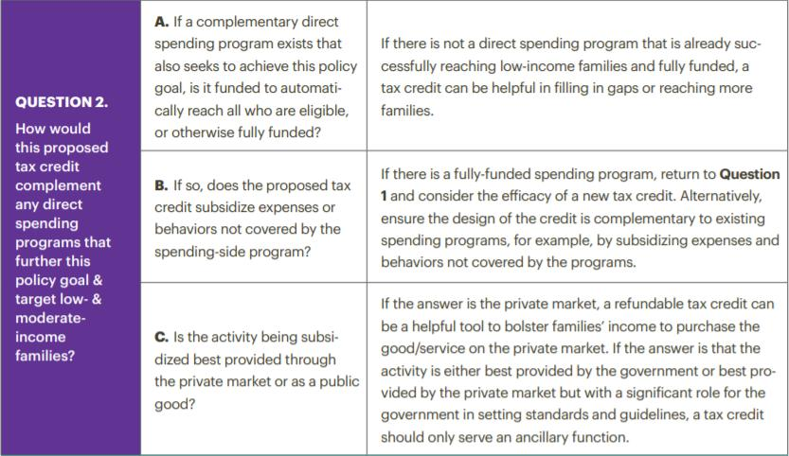
What is the Policy Goal of WFTRA?
26
Figure 8. A Framework For Advancing Equity Through Refundable Tax Credits
Notes:
Policy goal is to increase families’ incomes to address wage stagnation and the increasing costs of raising children
A. Is there any reason to not equitably reach low- and moderate-income people, women, people of color, LGBTQ people, people with disabilities, immigrant families, or other historically disadvantaged groups as part of this policy goal? No.
B. Is there an existing tax subsidy intended to further this policy goal that excludes low- and moderate-income people, women, people of color, and other historically disadvantaged groups? No.
C. Is there a direct spending program that also seeks to advance this policy goal? Not really, given the severe underfunding of TANF, although a robust minimum wage is a strong complement to the EITC.
[Next slide] A. If a complementary direct spending program exists that also seeks to achieve this policy goal, is it funded…

Slide 27
How Would WFTRA Complement Direct Spending Programs?
27
Figure 9. A Framework For Advancing Equity Through Refundable Tax Credits
Notes:
A. If a complementary direct spending program exists that also seeks to achieve this policy goal, is it funded to automatically reach all who are eligible, or otherwise fully funded? No.
B. If so, then does the proposed tax credit subsidize expenses or behaviors not covered by the spending-side program? N/A.
C. Is the activity being subsidized best provided through the private market or as a public good? The activities being subsidized are work & child care expenses; The private market (payment of wages).
[Next slide] A. Is the proposed tax subsidy in the form of a refundable tax credit? Yes.

Slide 28
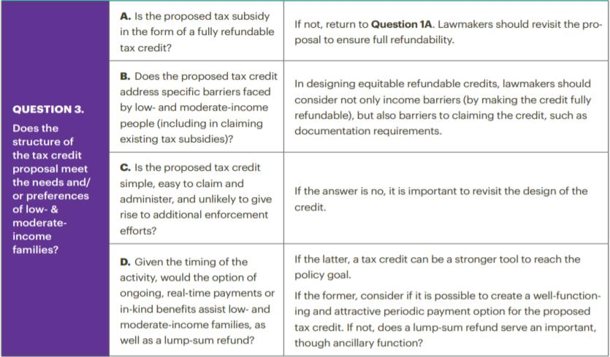
Does WFTRA Meet the Needs and/or Preferences of Low- & Moderate-Income Families?
28
Figure 10. A Framework For Advancing Equity Through Refundable Tax Credits
Notes:
A. Is the proposed tax subsidy in the form of a refundable tax credit? Yes.
B. Does the proposed tax credit address specific barriers faced by low- and moderate-income people (including in claiming existing tax subsidies)? Yes;
the EITC currently for childless workers is not large enough to keep the incomes of low-paid workers from being pushed below the poverty line by federal income taxes;
the refundable CTC (or ACTC) is limited to $1,400 of the $2,000 CTC amount & requires $2,500 in earned income to be claimed
The WFTRA would eliminate these limitations to both the EITC for workers not claiming children and the CTC. It would also address the higher cost of raising young children, which places a higher burden on families with lower incomes.
C. Is the proposed tax credit simple, easy to claim and administer, and unlikely to give rise to additional enforcement efforts? The proposal builds on the existing EITC and CTC infrastructures, with the exception of offering a new option of a $500 EITC advance payment and advance monthly installments of the CTC, which will likely require some administrative innovations.
D. Given the timing of the activity, would the option of ongoing, real-time payments or in-kind benefits assist low- and moderate-income families, as well as a lump-sum refund? There is no specific activity being subsidized.
i. If the former, is it possible to create a periodic payment option for the proposed tax credit? The bill proposes an advance of up to $500 of the EITC and advance monthly payments of the CTC to help with expenses as they arise throughout the year.
ii. If the former, does a lump-sum refund serve an important, though ancillary function? Yes.
Overall, the WFTRA would positively impact low- & moderate-income people, women, & people of color b/c its EITC and CTC expansions would increase the incomes of approximately “24 million white families, 9 million Latinx families, 8 million Black families, & 2 million Asian families”
If this legislation had been in effect in 2017, over 25 million working women would have benefitted—including almost 4.9 million Black women, nearly 4.8 million Latinx women, 1.3 million Asian women, and 280,000 Native American women
[Next slide] While not a silver bullet, refundable tax credits have the potential to fill gaps in assistance for low- and moderate-income families…

Slide 29
Conclusion
29
Refundable tax credits fill crucial gaps in assistance & direct spending programs
These credits can be leveraged to better advance race & gender equity
Framework provides guidance and structure for policy design of equitable tax credits and programs
Notes:
While not a silver bullet, refundable tax credits have the potential to fill gaps in assistance for low- and moderate-income families, women and people of color ill-served by the tax code and direct spending programs
Other policies like raising wages are also essential to increase incomes for most households. But tax credits can serve as an important complementary policy tool for equity, bolstering (rather than undercutting) efforts to increase investments in direct spending programs
Our framework helps policymakers & advocates thoughtfully design & leverage refundable tax credits to achieve the goals of advancing racial, gender, & economic equity
[Next slide] Thank you & I look forward to your questions

Slide 30
30
Thank You
Report
Boatech, Melissa, et al. “A Tax Code For The Rest Of Us: A Framework & Recommendations For Advancing Gender & Racial Equity Through Tax Credits.” November 2019. Available at https://nwlc.org/resources/a-tax-code-for-the-rest-of-us-a-framework-recommendations-for-advancing-gender-racial-equity-through-tax-credits/.
Presented by
Funke Aderonmu
Policy Assistant, Georgetown Center on Poverty & Inequality
fa519@georgetown.edu
@GCPIEconSec | @GtownLawPovCntr | www.georgetownpoverty.org
Notes:
Thank you & I look forward to your questions

Slide 31
How to Ask a Question/Make a Comment on Zoom
3. See here
1. Click here
2. Type here
jlinn@results.org
RESULTS U.S. Poverty National Webinar

Slide 32
Coming Changes to How We Support You
32
Background
Looking to streamline our support and training
Maintain your effectiveness while respecting your time
More groups and new volunteers interested in being “glomestic” – work on both U.S. and global poverty issues
We wanted your active participation in the decision making
National Webinar Survey
74 responses: 38 percent global, 32 percent U.S., and 30 percent glomestic
How do you listen? U.S. volunteers typically listen individually; most global volunteers listen live with group
Convenience biggest factor in those who do not attend
What do you want to get out of the monthly webinars?
The info you need to take action
You also like inspiration, skill building, and org updates
Jos Linn
jlinn@results.org
RESULTS U.S. Poverty National Webinar

Slide 33
Coming Changes to How We Support You
33
RESULTS U.S. Poverty National Webinar

Slide 34
Coming Changes to How We Support You
34
RESULTS U.S. Poverty National Webinar

Slide 35
Coming Changes to How We Support You
35
RESULTS U.S. Poverty National Webinar

Slide 36
Coming Changes to How We Support You
36
So what do we do to balance these competing preferences?
January webinar: Normal joint webinar, Saturday, January 11 at 1:00pm ET (60 minutes)
New webinar format debuts on Saturday, February 1 at 1:00pm ET
Most survey respondents wanted a Saturday webinar
Moving to the first Saturday of each month at 1:00pm ET
More time to take actions; less likely to be on holiday weekend
90-minute webinar in three parts
1:00-1:30pm ET
U.S. Poverty Policy
1:30-2:00pm ET
Joint Grassroots Section
2:00-2:30pm ET
Global Poverty Policy
Glomestic groups
U.S. Poverty groups
Global Poverty groups
RESULTS U.S. Poverty National Webinar

Slide 37
Coming Changes to How We Support You
37
90-minute format helps both single-focus and dual-focused groups
If your group focuses on just one issue, you can attend the first hour or second hour based on your issue area
If your group focuses on both, you can get it all on one, 90-minute webinar each month
Changes also coming to the Weekly Update
Desire to reduce the number of e-mails you receive and give you everything you need in one place
Starting in January, you will receive one joint U.S./global weekly update e-mail
E-mail includes the top action from each issue area and brief organizational updates
E-mail links to an extended online version with additional actions and updates for you
RESULTS U.S. Poverty National Webinar

Slide 38
38
Stay tuned for more exciting changes in 2020!
Please let us know what you like and don’t like as we move forward with these exciting changes.
Help us name the new monthly webinar!
The winner gets a free registration to the 2020 RESULTS International Conference. E-mail your suggestion by January 8 to grassroots@results.org.
We’ll announce the winner on the January national webinar.
RESULTS U.S. Poverty National Webinar

Slide 39
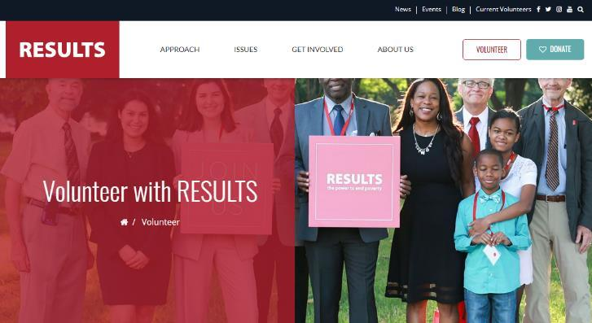
New to RESULTS?
39
Thank you for joining us this evening. If you’d like more information about RESULTS and how to get involved, go to www.results.org and click “Volunteer”.
Click here
RESULTS U.S. Poverty National Webinar

Slide 40
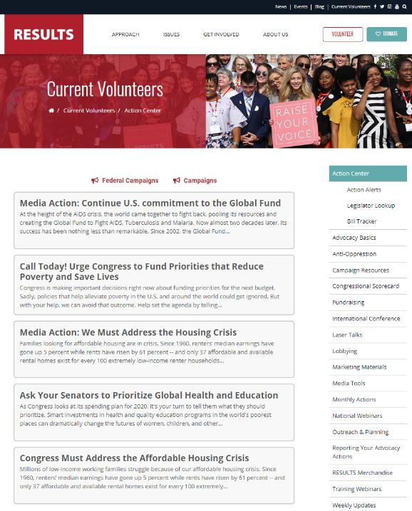
Find All Your Need on the “Current Volunteers” page
40
Click here
Find action alerts, lobbying resources, monthly actions, weekly updates, national webinars, and more!

Slide 41
41
RESULTS U.S. Poverty National Webinar

Slide 42
Announcements
42
Wednesday, December 4: RESULTS Action Network Community of Practice webinar, 8:30pm ET. To join, log in: https://results.zoom.us/j/427674133 or dial in: 669-900-6833, Meeting ID: 427 674 133. You can also join our Facebook and e-mail groups.
Tuesday, December 17: U.S. Poverty Free Agents Calls, 1:00pm and 8:00pm ET. Join at: https://results.zoom.us/j/324294681 or dial by phone at (929) 436-2866 or (669) 900-6833, Meeting ID: 324 294 681.
Wednesday, December 25-Wednesday, January 1: RESULTS holiday break. All RESULTS offices closed.
We apologize that our online calendar will be unavailable until late January. In the meantime, see the Weekly Updates for calendar items.
RESULTS U.S. Poverty National Webinar

Slide 43
43
FINAL ACTION: Give to RESULTS Tonight!
Today for Giving Tuesday, a generous longtime supporter is matching all donations to RESULTS 2-to-1, up to $5,000! That’s TRIPLE the impact!
Here’s how you can get involved:
Donate on our website – results.org/donate
Donate through RESULTS’ Facebook page for a chance to unlock an additional match from Facebook
Start your own Facebook fundraiser and ask your friends to fight poverty on Giving Tuesday.

Slide 44
44
Thank you for being on tonight’s webinar!
We’ll link to the recording and audio transcript of the webinar on our National Webinars page tomorrow.
The next National Webinar (Joint) is on Saturday, January 11 at 1:00pm ET.
Happy
Holidays!
RESULTS U.S. Poverty National Webinar

