Slide 1
RESULTS August 2019 Joint U.S./Global National Webinar
Build on the Success of the International Conference
Join at https://results.zoom.us/j/510407386. Or by phone at (669) 900-6833 or (929) 436-2866, meeting ID 510-407-386
Closed captioning: http://west.typewell.com/faelapgb

Slide 2
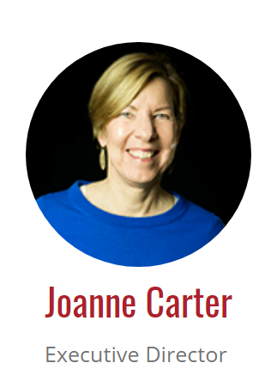
Welcome!

Slide 3
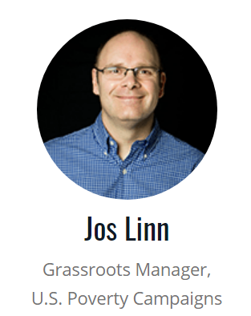
Celebrating the RESULTS International Conference
3

Slide 4
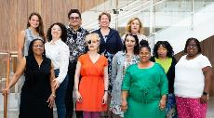
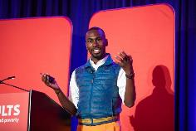
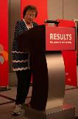
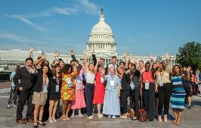
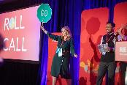
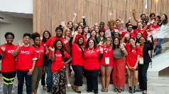
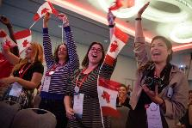
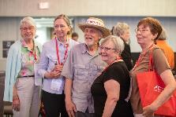
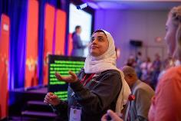
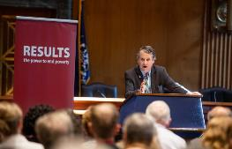
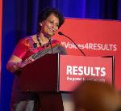
2019 RESULTS International Conference
375 attendees
Nearly all 50 states
25+ countries
More than 240 lobby meetings
62 face-to-face meetings (36 House, 26 Senate)

Slide 5
Shares and Open Phones
5
What breakthrough did you experience in meetings with your members of Congress?
What has your 2019 Conference experience inspired you to do back home?
On the webinar? Unmute by clicking the microphone.
On by phone? Unmute by hitting *6.
If you are not speaking, please stay muted.

Slide 6
Complete Your Conference Experience
Fill out a separate lobby report for each meeting you had at: www.tinyurl.com/RMoCReport.
Follow up with the aides you met with:
Thank them
Reiterate your request with leave-behinds attached (IC Resources)
Send any needed follow-up info
Ask about status of request
Request face-to-face meetings during the August recess (now through September 6)

Slide 7
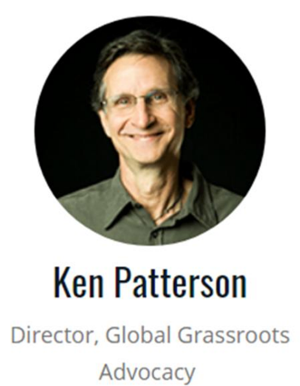
Campaigns Overview

Slide 8
Grassroots Support Campaign
Aug. – Dec. 2019: Organizing to Grow Our Groups
Goal: Support groups to add new advocates using the “organizing” approach covered on the June U.S. Poverty webinar with Hahrie Han and the “Transformational Organizing” workshop at the IC.
Plan:
Groups decide how many new group members they want to add by the end of the year (1, 2, 3, 4?)
Grassroots staff and RCs will support groups to achieve their goals using an organizing approach around current campaign goals.

Slide 9
Global Poverty Campaign Update
Appropriations Update
House numbers for FY2020 are strong, maintaining or increasing funding for all programs we advocate for.
In the House, got critical increase to $1.56 billion for the Global Fund to Fight AIDS, TB, and Malaria, plus language supporting three years of funding at this level.
We need the Senate to follow suit on House funding levels and the Global Fund increase.
Request: Ask your senators to speak to Senators Graham & Leahy in support of the House funding levels except, ask for an increase in global nutrition to $250 million.

Slide 10
Global Poverty Campaign Update
Global Fund Goals Through October 10
Goal: Generate overwhelming support for the Global Fund replenishment in Congress and in the media. Specifically:
Get Senate to include $1.56 billion for the Global Fund in SFOPS.
Get 2/3 of the House to cosponsor House Resolution 517.
Get over half the Senate to cosponsor the Global Fund resolution.
Generate media in support of the Global Fund in all 50 states!
Plan:
Follow up on IC requests and use August recess meetings.
Use August Action Sheet to generate letters to Congress
Use May Action Sheet and online action to generate media. Work with ONE, and other community partners.

Slide 11
Global Fund Media Map
Let's get all 50 states!

Slide 12
Global Poverty Campaign Update
After October 10
Take action to build US support for two 2020 global health pledging moments:
Gavi, The Vaccine Alliance replenishment in the UK, mid-2020
The Nutrition for Growth Summit in Tokyo during the Summer Olympics (sometime between July 24– Aug. 9)

Slide 13
U.S. Poverty Campaign Update
Expand Access to Affordable Housing
Building support for bold policies to address affordable housing, with a focus on Renters’ Credit
In conjunction with other policies that increase the supply of affordable housing and ultimately support homeownership and reduce racial wealth inequality
Last month = 100s of conversations on Capitol Hill, our first lobby day on housing
Bipartisan interest in addressing housing crisis
This is a marathon, not a sprint – use conversations with Congress, candidates, in the media to build additional momentum for change over the next few years

Slide 14
U.S. Poverty Campaign Update
Expand Tax Credits for Working Families
Learned at IC that EITC/CTC is in play for this year
GREAT opportunity in “tax extenders bill” (same as 2015)
Make CTC fully refundable: 1/3 kids (26 mil) impacted
Expand EITC for “childless” workers: 16 mil young workers and others without dependents, including 5 million currently taxed into poverty would benefit
VITAL to this effort is August recess conversations AND follow up with DC tax aides key
Then 9/10 Census poverty data release = media opportunity

Slide 15
U.S. Poverty Campaign Update
August Action: Talk to members of Congress during the August recess in meetings and town halls
Housing: Urge members to support a renters’ tax credit for low-income families
Tax:
House: Co-sponsor H.R. 3157
Senate: Follow the precedent from 2015 – no extension of business tax credits without including expansion of EITC and CTC
See August Action for more details and contact Jos Linn (jlinn@results.org) for coaching and questions
September preview: Generate media around the 2018 Census poverty day release. September webinar will be Tuesday September 10 at 8:00pm ET, the day the data is released.

Slide 16
Get those meetings in August!
Congress is on recess until Sept. 6. It's called a "work period".
Schedule meetings and attend town halls to discuss our issues.
Follow up with DC aides afterward.
Find resources on our Monthly Actions and Lobbying pages under "Current Volunteers".

Slide 17
Let’s take the congressional recess quiz!

Slide 18
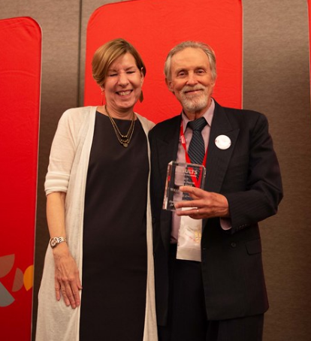
Willie Dickerson
2019 Cameron Duncan Media Award Winner
RESULTS Snohomish, WA

Slide 19
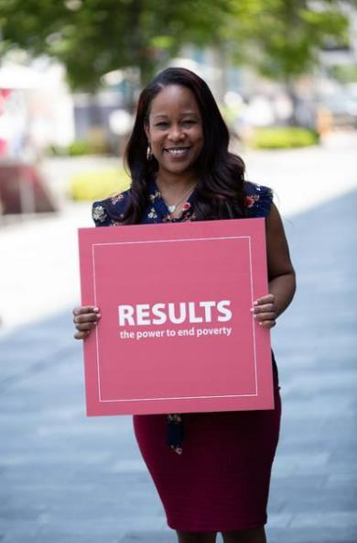
Special Announcement from
Qiana Torregano
RESULTS Grassroots Board Member, RESULTS New Orleans

Slide 20
Important Dates
Aug. 21, 8:30 pm ET: Webinar: "Wow, I got published!": Making Media a Transformational Experience.
Sept.19 at 8:30 pm ET. Webinar: "Wow I got published" repeated.
September National Webinars:
US: Tuesday, September 10 at 8pm ET
Global: Saturday, September 14 at 2pm ET
Nov. 2019: Virtual Thanksgiving Feast fundraising

Slide 21
Let us know how many joined you today
directly in the chat box or send to
Lisa Marchal
lmarchal@results.org

Slide 22
22
RESULTS is a movement of passionate, committed everyday people. Together we use our voices to influence political decisions that will bring an end to poverty. Poverty cannot end as long as oppression exists. We commit to opposing all forms of oppression, including racism, classism, colonialism, white saviorism, sexism, homophobia, transphobia, ableism, xenophobia, and religious discrimination.
At RESULTS we pledge to create space for all voices, including those of us who are currently experiencing poverty. We will address oppressive behavior in our interactions, families, communities, work, and world. Our strength is rooted in our diversity of experiences, not in our assumptions.
With unearned privilege comes the responsibility to act so the burden to educate and change doesn’t fall solely on those experiencing oppression. When we miss the mark on our values, we will acknowledge our mistake, seek forgiveness, learn, and work together as a community to pursue equity.
There are no saviors — only partners, advocates, and allies. We agree to help make the RESULTS movement a respectful, inclusive space.
Find all our anti-oppression resources at: https://results.org/volunteers/anti-oppression/

Slide 23
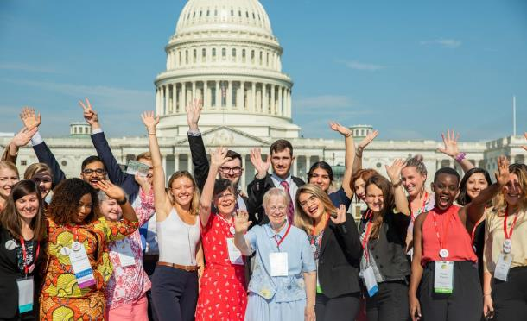
Thank you for being so persistent, consistent, and effective!

