Slide 1
“Wow, I got published!” Making Media a Transformational Experience

Slide 2
Welcome!
Tell us why you’re here and what you hope to get out of this webinar

Slide 3
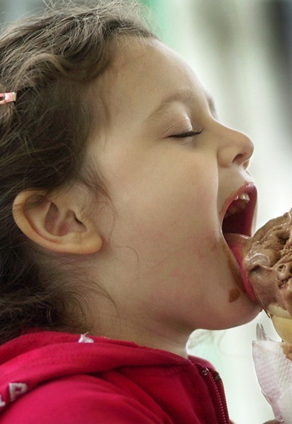
Not Transformational
“Let me explain to you what this ice cream tastes like…”
Notes:
Sometimes this is our approach—we take the lead and ask people to watch us while we have an amazing experience. Anyone relate to this? Why do we do this? Fear of giving up our power and experience—might not do it right. Will people stick around?

Slide 4
Better
“This ice cream is awesome—please try it.”
Notes:
What are some examples of this?

Slide 5
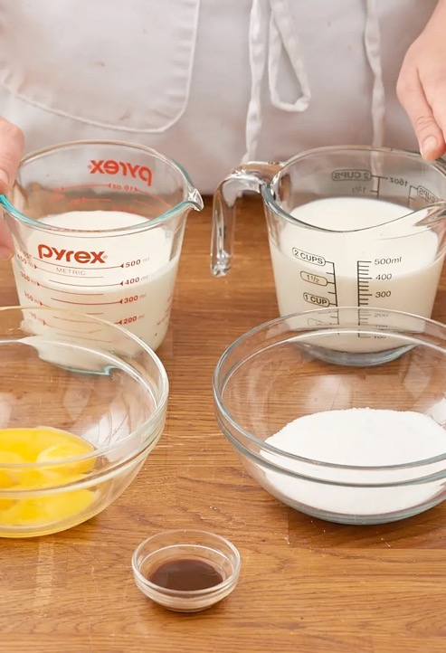
Even Better
“You love ice cream. Here’s how you make it.”
Notes:
But to really build a movement what we really need is more ice cream makers giving away ice cream and teach others to make ice cream

Slide 6
Mobilizing and Organizing
Notes:
Hahrie Han in her book, How organizations develop new activists looks at the issue of developing activist as a research question. In the research she lands on two modes of engaging activists: mobilizing and organizing. Organizations that are good at developing activists do both—so they can develop depth in their leadership and breadth in their numbers. But many organizations rely heavily on one mode—mobilizing, which is not on its own, effective, in building activists.

Slide 7
Organizing vs Mobilizing
Organizing | Mobilizing
Transformational: assign outcomes | Transactional: assign tasks
Organizing Organizers | Organizing Events
Personalized Communications (1:1s) | Mass Communications
Relationship Based | Not Relationship Based
High value for time | Low value for time
Notes:
Transformational: Support people to do things they would not do on their own. Challenge people to go outside their comfort zones. Really feel that are delivering on their passion to make a difference.
Transactional: Take the action you feel comfortable taking. Not pushing or supporting people to become something else. Take this action…
Best example is what staff and RCs do with groups

Slide 8
Organizing Characteristics
Relationship. Give advocates work that brings them in contact with others
Autonomy. Provide autonomy and independence on how the work is done so they own it.
Purpose. Show advocates how their work fits into the bigger picture—the campaign, the change they are creating in the world

Slide 9
Organizing Characteristics
Regular reflection to create meaning and excitement from experiences.
”Did you ever think you could do that?”
”What did it feel like to do that?”
”What did you learn from that experience?”
“What does it feel like to make a difference in this way?”
Notes:
This is how you help people see the transformational nature of what they’ve done. Thinking about thinking—like Sarah Wolman talked about.

Slide 10
Purpose of Outreach
Organizing | Mobilizing
Build a list of people that can be mobilized to demonstrate a broad base of community support with decision makers | Build a list of people that can be mobilized to demonstrate a broad base of community support with decision makers
Build a list of people from which you can identify new leaders that can be trained and supported to mobilize others to build greater power
Notes:
Organizers mobilize to identify downstream potential leaders.

Slide 11
What do editors want?
New
Unusual
Local
Personal
Important

Slide 12
Letters to the Editor
150 – 200 words (check website)
3 key pieces:
Local or timely hook (best to respond to a story)
Why it matters
Call to action

Slide 13
Letters to the Editor
Structure
What it looks like
Local & timely hook
Why it matters
Call to action
How you write it
Call to action
Why it matters
Local & timely hook

Slide 14
Call to Action
Make it short
Make it specific
Mention members of Congress by name
Global Poverty Example
Representatives McCaul and Engel have introduced House Resolution 517, in support of the Global Fund replenishment. I urge Rep. McHenry to please cosponsor the Global Fund Resolution?
U.S. Poverty Example
I urge Sens. Blunt and Hawley, and Representative Cleaver, to uphold the principle that no business tax breaks should be extended or expanded without also expanding the EITC and CTC in the same bill.

Slide 15
Letters to the Editor
Structure
What it looks like
Local & timely hook
Why it matters
Call to action
How you write it
Call to action
Why it matters
Local & timely hook

Slide 16
Why it matters
These policies aren’t just decisions made in Washington. They affect the lives of people all over the country/world.
____________________________________________________________________________________________________________________________________________________________________________________________________________________________________________________________________________________________________________________________________________________________________________________________________________.

Slide 17
Why it matters
Global Poverty Example
Since 2002, the Global Fund to Fight AIDS, Tuberculosis and Malaria helped save 27 million lives. Without U.S. leadership in providing one-third of the financial resources for the Global Fund, many of those lives would have been lost. The Global Fund needs at least $14 billion to save 16 million lives by 2022 and put us on a path to finally ending these diseases.
U.S. Poverty Example
Congress should prioritize tax policies for working people and families. The Earned Income Tax Credit (EITC) and Child Tax Credit (CTC) are pro-work, pro-family financial lifelines for people working in low-wage jobs. Together, they lift over 8 million Americans above the poverty line. Congress may consider yet another tax bill with lots of benefits for businesses, and they must not ignore working families again. Expanding the EITC and CTC would ensure our tax code supports workers and families struggling to make ends meet.

Slide 18
Letters to the Editor
Structure
What it looks like
Local & timely hook
Why it matters
Call to action
How you write it
Call to action
Why it matters
Local & timely hook

Slide 20
Local and timely hook
Make it local
Easiest way is to reference a recent story in the paper
Local event is also a good hook
Respond to another LTE
Make it timely
Something that matters now
Release of a new report and introduction of a new piece of legislation
Make it relevant
You can link almost any topic to your issue

Slide 21
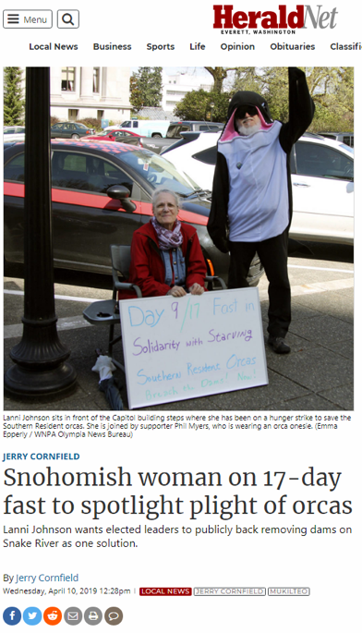
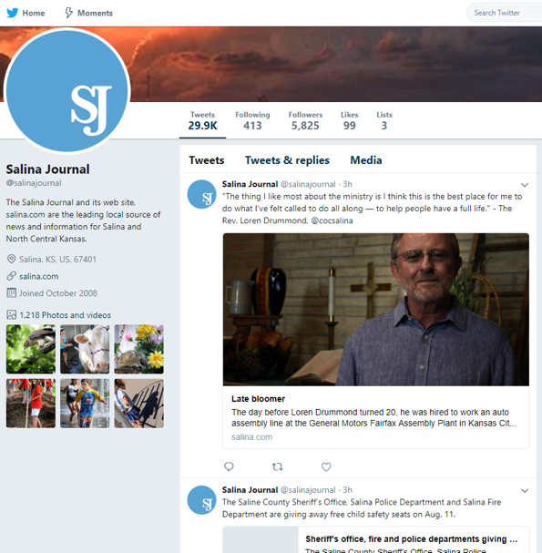

Slide 22
Local and timely hook
Global Poverty Example
In reference to Asheville Medicare-for-All proclamation, I am glad to see the mayor supporting the idea of universal health care. Access to medical care and treatment is literally the difference between life and death, both here in the U.S. and around the world.
U.S. Poverty Example
I am writing in response to your article about recession fears among economists. To ward off this fears, President Trump is talking about enacting another tax cut. In 2017, Congress passed a massive tax cut for wealthy Americans and big corporations. Meanwhile, the federal tax code taxes more than 5 million low-wage workers not raising children at home into - or deeper into - poverty.

Slide 23
Resources
Sample Laser Talks: https://results.org/volunteers/laser-talks/
Media actions: https://results.org/volunteers/action-center/action-alerts/?vvsrc=%2fCampaigns
Advocacy Basics: Working with the Media: https://results.org/volunteers/advocacy-basics/

Slide 24
Writing & Organizing
Relationship. Offer to write with them or bring a small group together to write and share with each other.
Autonomy. Help them brainstorm hooks, ask them why they care, encourage them to write in their voice.
Purpose. Share what is at stake and how much their action matters in achieving our bigger goals. Let them know they are part of a national effort.

Slide 25
Organizing Asks for Advocates
“Would you be willing to take on getting published in at least one of our local publications It would be great for our Rep. and Senators to hear from a new voice like yours. I can provide you with coaching on how to scan for hooks and draft and submit your letter the first go around. After that it will be easy.”

Slide 26
Organizing Asks for Advocates
“We’re working to get our Rep. and Senators to take action. We know media, like letters to the editor, can have a great impact. Would you be willing to bring together a group of your friends, colleagues, or club members for a letter to the editor writing workshop? I’ll train folks in writing letters and submitting them. Someone typically gets published from these kinds of activities. There is a lot at stake now—this would make a big difference.”

Slide 27
Organizing Asks for Advocates
What might an organizing ask be for someone who has already gotten published?

Slide 28
Organizing Asks for Advocates
What might an organizing ask be for someone who has already gotten published?

Slide 29
Organizing Asks for Advocates
“We need to generate overwhelming support around the Global Fund or EITC/CTC, would you be willing to take on getting published in another publication in our area to help influence our Reps. and Senators on our issue—they don’t know much about it yet?”

Slide 30
Organizing Asks for Advocates
“Would you be willing to hunt for hooks in our local media outlets and feed them to our RESULTS group and support us in getting 10 letters submitted over the next month? Some of those letters would likely get published—this will help us move our Reps. and Senators into action.”

Slide 31
Organizing Asks for Advocates
“Would you be willing to get published in at least 2 other places across the state by scanning papers for hooks and writing and submitting letters? It will help us influence more Reps. and let our Senators know there is support across the state.”

Slide 32
Organizing Asks for Advocates
“Would you be willing to bring together a group of your friends, colleagues, or club members for a LTE writing workshop? It would be great to have you lead it—would you be up for that? If you don’t feel ready yet, I’m also happy to help lead, or model running a workshop this first go around. You remember how exciting it was to get published. Would it be great to share that experience with others.”

Slide 33
Organizing Asks for Advocates
“Would you be willing to bring together a group of your friends, colleagues, or club members for a LTE writing workshop? It would be great to have you lead it—would you be up for that? If you don’t feel ready yet, I’m also happy to help lead, or model running a workshop this first go around. You remember how exciting it was to get published. Would it be great to share that experience with others.”

Slide 34
Organizing Asks for Advocates
“Would you be willing to take some leadership in using your letter and other published media to influence our Rep. and Senators? Here are some of the ways you can do that—which ones would you like to start with?”

Slide 35
Next Steps
What goals do you want to set for yourself in using media to create transformational experiences?
What do you need from RESULTS to be successful?

Slide 36
Remember: Relationship = Success
Celebrate success along the way
Check to see if they got published and support them to do the same (for their letters and letters from others they contacted)
Take time to reflect with them
How did doing this action make you feel?
What did you like about it? What was scary?
Do you feel different now that you’ve done it? If so, how?
Would you be interested in taking another action?

Slide 37
Thank you!
We will repeat this webinar on
Thursday, September 19 at 8:30pm ET.
Invite others to join us.
Questions?
Contact Ken Patterson (kpatterson@results.org) or
Jos Linn (jlinn@results.org)

