Slide 1
February 2019 RESULTS U.S. Poverty National Webinar
Set the Agenda on Affordable Housing
Login at: https://results.zoom.us/j/873308801 or dial (929) 436-2866 or (669) 900-6833, Meeting ID: 873 308 801.

Slide 2
Welcome from Qiana Torregano RESULTS Grassroots Board Member and Expert on Poverty
2
RESULTS U.S. Poverty National Webinar

Slide 3
Qiana’s Remarks
3
Welcome to the RESULTS U.S. Poverty National Webinar. We are so glad you could be with us this evening. My name is Qiana Torregano and I am a RESULTS volunteer from New Orleans, Louisiana, Grassroots Board member elected last summer, and one of the Experts on Poverty. On tonight’s webinar, we are excited to have Tralonne Shorter as our guest speaker, who will share some incredible information about Network Lobby, the NETWORK’s “Mind the Gap” campaign and how housing policy intersects with that. After that, Jos Linn will lead us through a discussion and grassroots shares about our new campaign to Set the Agenda with the new Congress, by: meeting with congressional offices this month and inviting new people to join you. We’ll then close the webinar with some brief announcements and final action. Before we get to our guest speaker, I’d like to share a few thoughts with you all on new work RESULTS has going on around housing. For 2019 RESULTS will push to support bipartisan efforts to ban housing discrimination based on income source, urge policy makers to prioritize low-income working families and communities of color in economic policies, especially related to housing and tax issues, as well writing letters to support affordable rental housing. I will start with quotes directly from RESULTS literature.
Millions of low-income working families struggle because of our affordable housing crisis: 71 percent of extremely low-income renters spend more than half their income on housing. The rising cost of housing forces many Americans to struggle to make ends meet. A worker earning the federal minimum wage ($7.25 per hour) cannot afford a two-bedroom apartment anywhere in America, and, nationwide there are only 35 affordable rental homes available for every 100 extremely low-income renter households. Meanwhile, two-thirds of families who participate in federal housing programs can face discrimination from landlords simply for getting assistance, creating yet more barriers to economic security. We must urge Congress to invest in increasing access to affordable housing. Sadly, U.S. housing policy is upside down – we subsidize homeownership through tax breaks that often benefit the wealthy, while only one in four eligible low-income households receives federal housing assistance. As House and Senate leaders negotiate budget bills this year, urge your members of Congress to tell congressional leaders that they must support a large boost in federal rental assistance.
RESULTS U.S. Poverty National Webinar

Slide 4
Qiana’s Remarks (cont’d)
4
I work in the schools, I see the impact of inequitable school placement, cross city bussing, and disconnected school communities because the funds that follow the student does not impact neighborhoods only systems. In fact, I firmly believe that as a direct result of the Housing and Education crisis, there are no more neighborhoods only city blocks people live in. Where I am from, a high percentage of houses in these blocks are blighted, and the newly renovated properties are more than 3 times the minimum wage, and the properties poor people can afford are minimal and deplorable. I have students who travel an hour in the morning on the bus to get to our school that is low performing only to pass at least 8 schools along the way, many right in their own block. The homeless population continues to spiral out of control, meanwhile there are properties and unused land sitting for years and years with no action. My mom is 63 and on social security, she receives 653 a month, I can't find her a decent affordable home, partly because most 1 bedroom homes start at 700-800 dollars and those I did find between 550 - 600 require the renters income three times the rent and immediately rejects social security or section 8 recipients.
As we push forward into this new year with new and pressing actions, let us also keep in mind the practices we use as advocates. We are building a team without the key players, the most affected by poverty and protected by anti poverty systems. We must charge ourselves to help build their capacity to fight with us but ultimately for themselves. That is how we truly end poverty. Our Anti-Oppression pledge as RESULTS advocates is that there are no saviors — only partners, advocates, and allies. We agree to help make the RESULTS movement a respectful, inclusive space. Together we use our voices to influence political decisions that will bring an end to poverty. Poverty cannot end as long as oppression exists. We commit to opposing all forms of oppression. This is what makes the Experts on Poverty so important to our team, the EOPs are experiencing poverty and utilizing the tools and strategies from RESULTS and taking this power right to the people. If we all execute this concept by partnering with EOPs as the necessary liaisons to make deeper connections with our neighbors in impoverished communities, we increase opportunities for new membership, fundraising, while ensuring progressive and sustainable organizational efficacy.
RESULTS U.S. Poverty National Webinar

Slide 5
RESULTS is a movement of passionate, committed everyday people. Together we use our voices to influence political decisions that will bring an end to poverty. Poverty cannot end as long as oppression exists. We commit to opposing all forms of oppression, including racism, classism, colonialism, white saviorism, sexism, homophobia, transphobia, ableism, xenophobia, and religious discrimination.
At RESULTS we pledge to create space for all voices, including those of us who are currently experiencing poverty. We will address oppressive behavior in our interactions, families, communities, work, and world. Our strength is rooted in our diversity of experiences, not in our assumptions.
With unearned privilege comes the responsibility to act so the burden to educate and change doesn’t fall solely on those experiencing oppression. When we miss the mark on our values, we will acknowledge our mistake, seek forgiveness, learn, and work together as a community to pursue equity.
There are no saviors — only partners, advocates, and allies. We agree to help make the RESULTS movement a respectful, inclusive space.
RESULTS U.S. Poverty National Webinar

Slide 6
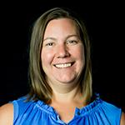
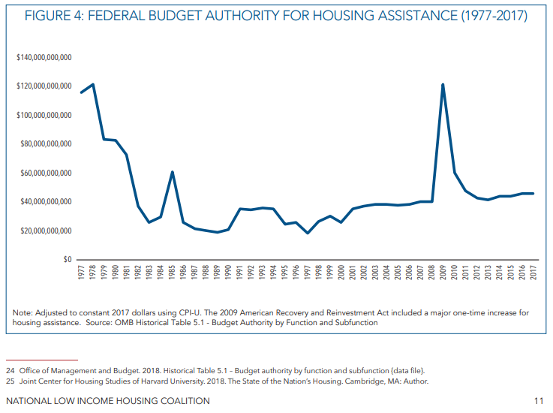
RESULTS Focus for Early 2019
6
Meredith Dodson
Director of U.S. Poverty Campaigns (mdodson@results.org)
RESULTS short-term priority: increase federal rental assistance while supporting bipartisan efforts to ban discrimination against people who get housing assistance
RESULTS U.S. Poverty National Webinar
Notes:
https://nlihc.org/sites/default/files/NLIHC_New-Congress-Memo_2019.pdf

Slide 7
Building Momentum to Address the Crisis
7
RESULTS longer-term priorities:
Shift tax priorities to increase support for low- and moderate-income renters via a “Renters Credit” and target homeownership policies to reduce racial wealth inequality
Address other barriers to affordable housing and racial equity including inclusive zoning, credit scores, and application fees
Support emergency stabilization funds for families facing eviction
RESULTS U.S. Poverty National Webinar
Notes:
https://www.opportunityhome.org/resources/withinreach/

Slide 8
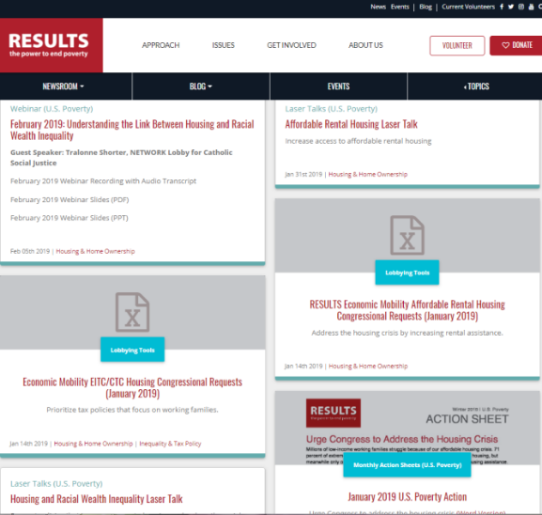
Housing and Racial Wealth Inequality Resources
8
Lots on our website→
NETWORK’s 2020 Vision: Mend the Gaps https://networklobby.org/2020vision/
Local housing data: https://www.cbpp.org/research/housing/national-and-state-housing-fact-sheets-data
CBPP data on housing vouchers by race/ethnicity: https://www.cbpp.org/research/housing/where-families-with-children-use-housing-vouchers
RESULTS U.S. Poverty National Webinar

Slide 9
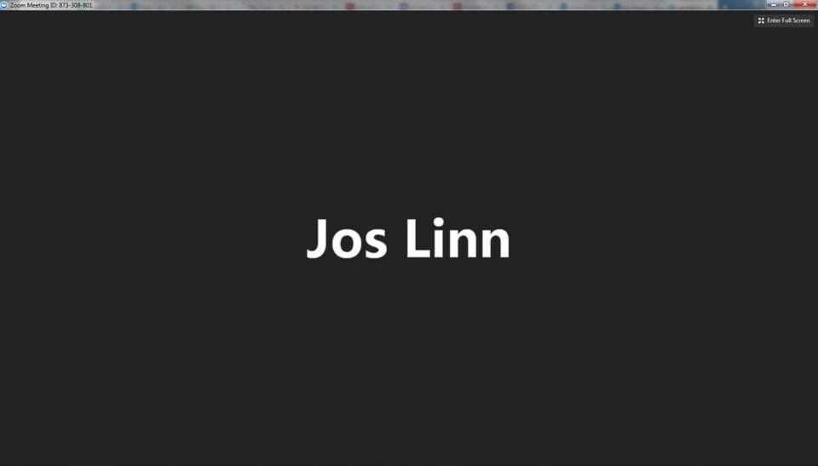
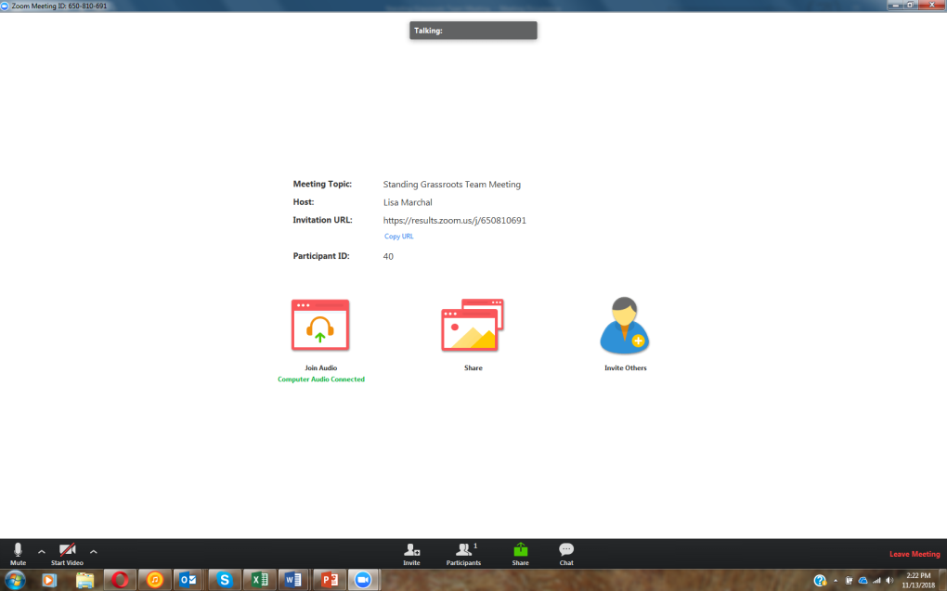
How to Chat on Zoom
1. Click here
jlinn@results.org
RESULTS U.S. Poverty National Webinar

Slide 10
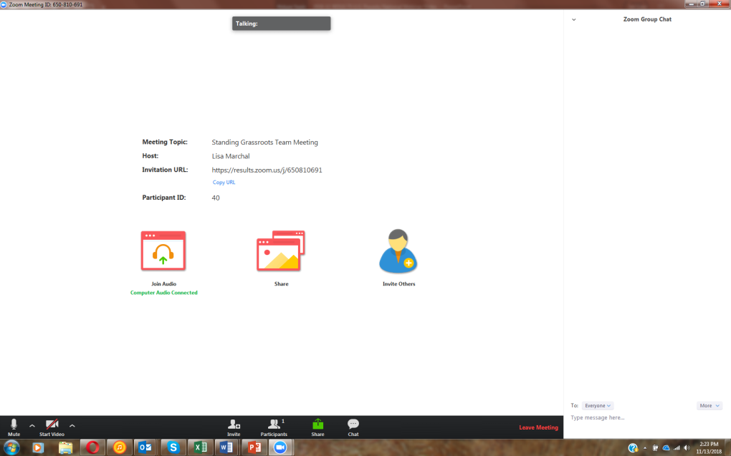
How to Chat on Zoom
3. See here
2. Type here
jlinn@results.org
RESULTS U.S. Poverty National Webinar

Slide 11
Guest Speaker: Tralonne Shorter Network Lobby
11
Senior Government Relations Advocate
Leads NETWORK’s lobby efforts championing a faithful budget, family-friendly workplace policies, and safe, affordable housing
20 years of public policy and appropriations and advocacy expertise
Served as an advisor to various federal and state elected officials, including the late Senator Frank Lautenberg (D-NJ)
Prior to NETWORK Lobby, she was the Director of Public Policy and Government Affairs at the United Negro College Fund
Holds a bachelor’s degree in Political Science from Howard University
RESULTS U.S. Poverty National Webinar

Slide 12
Resources
12
More info on NETWORK's policy agenda NETWORK’s 2020 Vision: Mend the Gaps at: https://networklobby.org/2020vision/
NETWORK’s four principles for federal housing policy at: https://networklobby.org/issues/housing/
Quick shutdown update:
The partial federal shutdown already threatened many low-income families with children, seniors, and people with disabilities because Project Based Rental Assistance contracts with private landlords expired.
A prolonged government shutdown would put housing vouchers and food assistance via SNAP and school meal programs at risk for millions.
Urge Congress and the administration to work immediately to pass full year FY19 spending bills and stop putting people struggling to put a roof over their heads and food on the table at further risk: https://results.org/volunteers/action-center/?vvsrc=%2fcampaigns%2f62575%2frespond
RESULTS U.S. Poverty National Webinar

Slide 13
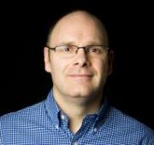
13
Jos Linn
Grassroots Manager for U.S. Poverty Campaigns (jlinn@results.org)
Every group/free agent meets with each
congressional office they cover.
Every group/free agents has at least one
face-to-face meeting with a member of Congress
Every group/free agents makes an invitation to a new person to join in a congressional meeting.
Check out ongoing resources for this effort online on our "Set the Agenda" resource page
RESULTS U.S. Poverty National Webinar

Slide 14
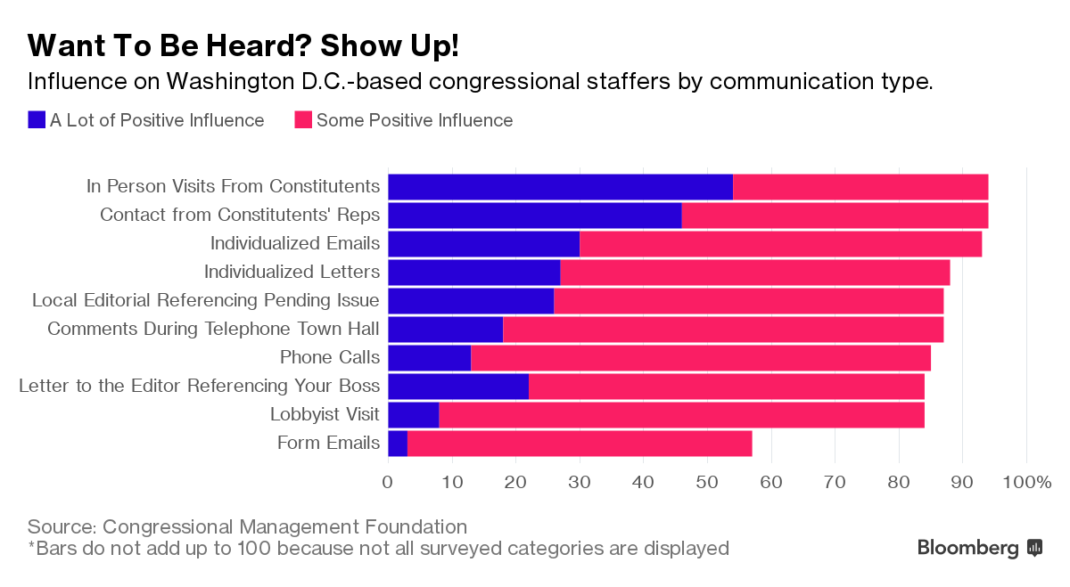
Set the Agenda: Get Meetings with Congress
RESULTS U.S. Poverty National Webinar
Notes:
TAKE ACTION: Reach out to new and returning members of Congress. For new members, visit their campaign pages for contact information and leverage contacts you know from their campaign. For returning members, use the same procedure you’ve used previously get meetings. Personalize our updated meeting request (online or Word doc) to ask for meetings (if you need help, please contact Jos Linn). Once you get a meeting, contact Meredith Dodson for targeted coaching and requests.

Slide 15
Meet with Members of Congress
15
Upcoming recesses: Feb. 18-22, March 18-22, April 15-26
Follow up on recent requests or use our meeting request templates to request a meeting today (online or Word doc)
Look for other public appearances both during and in-between recesses
Be creative
RESULTS U.S. Poverty National Webinar

Slide 16
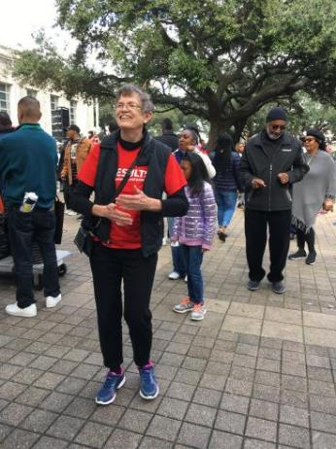
Grassroots Share
16
Kathleen Duncan, RESULTS Houston
Kathleen dancing at the 2019 MLK Day event in downtown Houston
RESULTS U.S. Poverty National Webinar

Slide 17
Kathleen’s Remarks
17
Houston has three new House Reps, RESULTS Houston is pursuing meetings with all three. We have either heard nothing from those offices or have heard receipt of meeting request email notices. Like many of you with new House Reps, we got our requests in before the Reps had been sworn into office. Then as the offices were set up, our original contact gave us the name of the new-hired Schedulers.
As sometimes happens when a group is working toward a goal, luck intervenes, one of us heard on the local NPR radio that two of those Reps were going to be interviewed on a locally-produced show a week apart. Days ahead, in gathering interest for the show, listeners are invited to either call in, TWEET, or email questions during the show.
I’m going to switch to first person here – I didn’t get in gear until after the one-hour show had begun on Mon, Jan 28. I quick re-read the December Action sheet where it offers the wording for the meeting requests, picked out one sentence, wrote down that one sentence, began dialing in only to hear a busy signal, tried three times. The 15 min interview with the Rep had begun. Forget dialing in, quickly went to the website of the local NPR station, picked up the email address for the show, threw in that one sentence, inserted the congressional district number, clicked send and waited. Sure enough, the show host picked up the email request and read our request:
What are your priorities addressing poverty and expanding economic opportunity in the 2nd CD, including access to affordable housing and other strategies to reduce wealth inequality?
I wrote up the Rep’s responses, 1) put the Rep’s remarks in a Lobby Report form, 2) sent remarks to one of the 2018 Houston REAL Changers, Connor Bowering, who is pursuing the face meeting with this Rep but because of his school schedule, could not listen in to the show.
A week later, which was yesterday, Feb 4, the next new Houston House Rep was on, we were way more prepared, Becky Hopson is the constituent, and put the same question in an email and sent it into the show, I drove to Becky’s house, we sat and waited – the question, our question was NOT picked up. We looked at each other, shrugged our shoulders, ya win some, ya lose some. We will continue to follow up on our meeting requests. So fun.
RESULTS U.S. Poverty National Webinar

Slide 18
Invite New People to Lobby Meetings
18
People are still hungry to get involved
191 people signed up for the RESULTS New Activist Orientation after the election
71 people have signed up in 2019
We need them!
Lobby meetings are a great way to inspire new people
RESULTS U.S. Poverty National Webinar

Slide 19
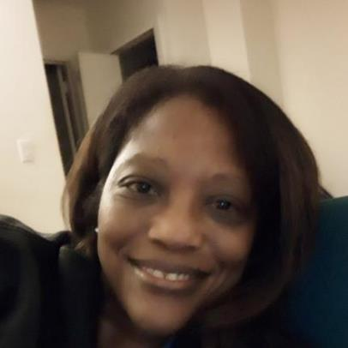
Grassroots Share
19
Elaine Campbell, RESULTS Richardson, TX
RESULTS U.S. Poverty National Webinar

Slide 20
Elaine’s Remarks
20
After being actively involved in the campaign of a few local candidates in the mid terms, I was looking for a non-profit organization to support that focused on working with our political reps to make sure they continue to hear from us after being elected. I found RESULTS by searching on the internet and saw the mission “Ending Poverty” which peaked my interest because I thought ‘wow, is that even possible??”. By joining the New Advocate Orientation for RESULTS, I realized that this was a match for me because of how many issues are addressed when focused on ending poverty and I love how RESULTS focus’ on specific Bill’s and provides detailed data and training that makes it pretty easy to get educated and Lobby our Reps.
Noticing that we have a Global Chapter but not a Domestic Chapter to focus on US Poverty in Dallas where I live, I decided to be the lead and start one. With Jos’ help, we had our first initiation Jan 24, and will have our first training session with the group of 4 next week on the 13th which is pretty exciting.
Our Dallas Global Chapter has been in place for 10 years so I have been meeting with them and they have been amazing help.
So I could see lobbying in action, the Global Chapter included me in a meeting with my Rep Congressman Colin Allred and it went quite well. We mentioned that I am starting a Domestic Chapter and Congressman Allred suggested that we get in touch with Eddie Bernice Johnson, which we have, so hopefully we will get to meet with her soon.
This morning, we I attended another meeting with the Dallas global group to Senator Ted’s Cruz’s office and I actually completed my first official “ask” for the Domestic Dallas Domestic Chapter.
That is where we are now and I am really looking forward to developing the Dallas Domestic Chapter.
RESULTS U.S. Poverty National Webinar

Slide 21
Other Ways to Engage People
21
Write Letters to Hand-Deliver in Lobby Meetings. Ask people to write letters to Congress about increasing funding for rental housing. Use our Action Sheet for guidance. Give letters to REAL Change Fellows to hand-deliver in their lobby meetings on February 12 in Washington, DC or hand-deliver them in your local lobby meetings this month.
Engage Your Action Network with E-mails. Send a message to your local Action Network urging them to contact their members of Congress about increasing funding for affordable housing. Send them our online e-mail alert and urge them to take action today.
Call-in Day Next Tuesday. RESULTS will do a call-in day next Tuesday, February 12 on housing issues while REAL Change Fellows are on Capitol Hill. We will send an alert that morning with the number to call and message to leave. Call and then forward the alert to your networks for them to call as well.
RESULTS U.S. Poverty National Webinar

Slide 22
Coming Up in Open Shares
22
What are your plans to get new people involved in your local group in 2019?
What are you looking forward to doing with RESULTS in 2019?
RESULTS U.S. Poverty National Webinar

Slide 23
2019 Leadership and Goals Planning
23
How has your planning gone?
Thank you to everyone who has submitted plans so far this year
Your plans are key to making the Set the Agenda campaign a success
Submit them online at: https://results.org/volunteers/action-center/?vvsrc=%2fSurveys%2f4929%2fRespond
RESULTS U.S. Poverty National Webinar

Slide 24
Resources
24
Set the Agenda page: https://results.org/issues/set-the-agenda/
Lobbying Resources page: https://results.org/volunteers/lobbying/
Outreach and Planning page: https://results.org/volunteers/outreach-planning/ (look under “My group wants to make our plans”)
2019 Planning Guide: https://results.org/wp-content/uploads/RESULTS-2019-Planning-Guide-1.docx
2019 Plan Summary Form (online): https://results.org/volunteers/action-center/?vvsrc=%2fSurveys%2f4929%2fRespond
Please submit your plan ASAP
RESULTS U.S. Poverty National Webinar

Slide 25
Open Shares Questions
25
What are your plans to get new people involved in your local group in 2019?
What are you looking forward to doing with RESULTS in 2019?
RESULTS U.S. Poverty National Webinar

Slide 26
26
We want to see YOU at the…
Registration is now open at www.resultsconference.org!
RESULTS U.S. Poverty National Webinar

Slide 27
Announcements
27
Celebrate Black History Month. Pursuant to our values, RESULTS advocates to immerse ourselves in learning, discussion, and making community connections during Black History Month, such as:
Join Black History Month activities in your community.
Read our Black History Month resource list – pick out a movie, video, article, or book to use in discussion with your RESULTS group and/or community.
Join RESULTS Regional Coordinator Rachel Azanleko-Akouete for a discussion centered on three short videos: What does my headscarf mean to you?, Place Matters, and The danger of a single story. The webinar is Tuesday, February 26 at 1:00 pm ET. Join via Zoom: https://results.zoom.us/j/398056270 or dial either (669) 900-6833 or (929) 436-2866, ID:398 056 270.
Join RESULTS Director of U.S. Poverty Campaigns Meredith Dodson for a discussion of the book, Between the World and Me by Ta-Nehisi Coates on Thursday, February 28 at 2:00 pm ET. Join via Zoom: https://results.zoom.us/j/398056270 or dial either (669) 900-6833 or (929) 436-2866, ID:398 056 270.
RESULTS U.S. Poverty National Webinar

Slide 28
Announcements
28
RESULTS New Advocate Orientation February 7 (8:30pm ET), February 12 (12:00pm ET), February 20 (8:30pm ET), and March 7 (8:30pm ET). Get started at: https://results.salsalabs.org/volunteer/index.html.
RESULTS Action Network Community of Practice webinar, Wednesday, February 6 at 8:00pm ET. To join, log in: https://results.zoom.us/j/427674133 or dial in: 669-900-6833, Meeting ID: 427 674 133.
U.S. Poverty Free Agents Calls, Tuesday, February 19 at 1:00 pm and 8:00 pm ET. Join at: https://results.zoom.us/j/324294681 or dial by phone at (929) 436-2866 or (669) 900-6833, Meeting ID: 324 294 681.
Thursday, February 21: Quiet Leadership Book Club, 9:00 pm ET. To join, go to https://results.zoom.us/j/482992263. You can also join by phone at (929) 436-2866 or (669) 900-6833, meeting ID 482 992 263.
RESULTS International Conference, July 13-16, 2019. Learn more at www.resultsconference.org.
Find these and other events on our Event Calendar.
RESULTS U.S. Poverty National Webinar

Slide 29
29
Thank you for being on tonight’s webinar!
The next U.S. Poverty National Webinar is
Tuesday, March 5 at 8:00pm ET.
All RESULTS offices will be closed
Monday, February 18 for the Presidents’ Day holiday.
RESULTS U.S. Poverty National Webinar

Slide 30
30
FINAL ACTION
Tell Congress to Expand Affordable Housing
Send an e-mail to your members of Congress tonight telling them to increase funding for low-income Americans needing rental housing. Use our online action alert to send your message tonight!
https://results.org/volunteers/action-center/?vvsrc=%2fcampaigns%2f62575%2frespond
RESULTS U.S. Poverty National Webinar

Slide 31
31
Happy Valentine’s Day!
RESULTS U.S. Poverty National Webinar

