Slide 1
January 2019 RESULTS U.S. Poverty National Webinar
Making a Difference in 2019
Login at: https://results.zoom.us/j/873308801 or dial (929) 436-2866 or (669) 900-6833, Meeting ID: 873 308 801.
Post-webinar: Link to webinar recording and audio transcript

Slide 2
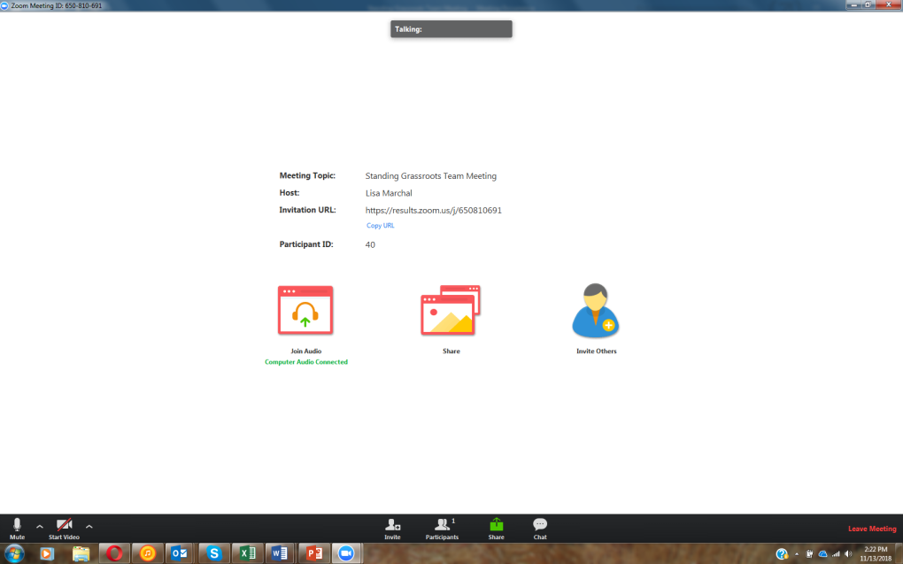
How to Chat on Zoom
1. Click here
jlinn@results.org
RESULTS U.S. Poverty National Webinar

Slide 3
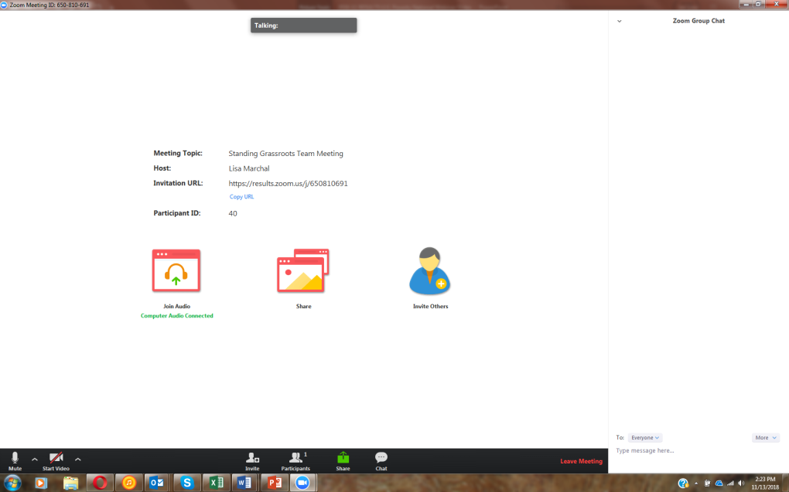
How to Chat on Zoom
3. See here
2. Type here
jlinn@results.org
RESULTS U.S. Poverty National Webinar

Slide 4
Welcome from Joanne Carter Executive Director, RESULTS
4
RESULTS U.S. Poverty National Webinar

Slide 5
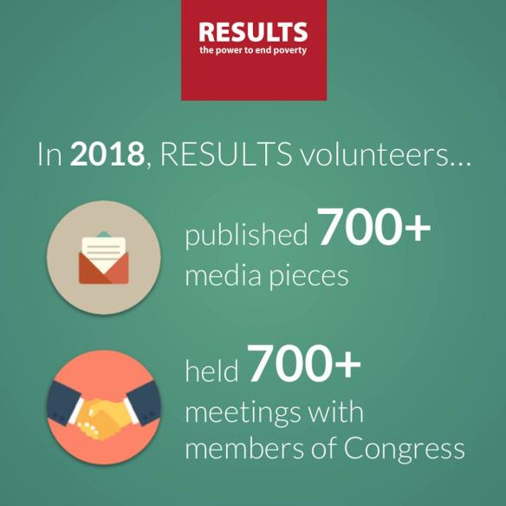
Congratulations on an amazing 2018!
5
RESULTS U.S. Poverty National Webinar

Slide 6
You Made a Difference!
6
SNAP cuts in the 2018 Farm Bill
RESULTS advocates spent much of 2018 pushing back against proposed harmful cuts to SNAP (formerly known as food stamps). Volunteers made calls, wrote letters, and published more than 260 pieces of media. Their hard work paid off: in December 2018, Congress passed a bipartisan farm bill that protects SNAP.
RESULTS U.S. Poverty National Webinar

Slide 7
RESULTS Values Statement
RESULTS is a movement of passionate, committed everyday people. Together we use our voices to influence political decisions that will bring an end to poverty. Poverty cannot end as long as oppression exists. We commit to opposing all forms of oppression, including racism, classism, colonialism, white saviorism, sexism, homophobia, transphobia, ableism, xenophobia, and religious discrimination.
At RESULTS we pledge to create space for all voices, including those of us who are currently experiencing poverty. We will address oppressive behavior in our interactions, families, communities, work, and world. Our strength is rooted in our diversity of experiences, not in our assumptions.
With unearned privilege comes the responsibility to act so the burden to educate and change doesn’t fall solely on those experiencing oppression. When we miss the mark on our values, we will acknowledge our mistake, seek forgiveness, learn, and work together as a community to pursue equity.
There are no saviors — only partners, advocates, and allies. I agree to help make the RESULTS movement a respectful, inclusive space.
RESULTS U.S. Poverty National Webinar
Notes:
What beliefs and values would you want your group to consider taking on to strengthen your group’s culture, and avoid creating a Dominant Culture Club?
What norms would strengthen culture?
Initiate a conversation with your group about its beliefs, values, culture? Think about how you’d do it, and then let’s hear what some of you would say.
How about assessing the group and designing next steps?
Note: if Struggling: Perhaps think of this in terms of some of the challenges you explored in the Group Health session: look at your worksheet for the areas that weren’t so strong.
Idea: Maybe think of this in terms of some of the challenges you explored in the Group Attributes worksheet—what beliefs and values would strengthen weaker areas?
Use the assessment tool?

Slide 8
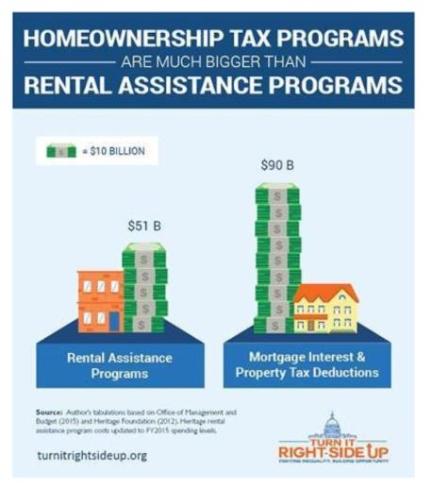
2019 U.S. Poverty Campaign Priorities
8
GOAL: Ensure the new Congress (and political candidates) center the needs of low-income families, with a focus on communities of color, in economic policies focused on creating opportunity and ending poverty.
2019 housing priority ask: increase access to affordable rental housing while ensuring that families have opportunities via bipartisan proposals to ban income discrimination
.
Meredith Dodson
Director of U.S. Poverty Campaigns (mdodson@results.org)
RESULTS U.S. Poverty National Webinar
Notes:
Goal: ensure new Congress (and political candidates) center the needs of low-income families, with a focus on communities of color, in economic policies focused on creating opportunity and ending poverty.
2019 housing priority ask: increase access to affordable rental housing.
On last month’s national webinar we learned more about the housing crisis – and excited to deepen our knowledge this evening.
Ultimately, government policy, especially our tax code, does a lot to support housing and homeownership – but not in an effective way that meets the needs of millions of low-income families.
Right now: shutdown threatens housing assistance (we’ll learn more in a moment…)
Key opportunity to immediately address part of the affordable rental housing crisis with an immediate bump in rental assistance via large increase in housing vouchers in spending deal this spring
While ensuring that families have opportunities/choice via bipartisan proposals to ban income discrimination
Longer term: shift tax priorities in order to increase support for low- and moderate-income renters via a “Renters Credit” and support homeownership policies that will reduce racial wealth inequality, support proposals for emergency stabilization funds to avoid evictions, and address other barriers to affordable housing and racial equity including inclusive zoning, credit scores, and application fees

Slide 9
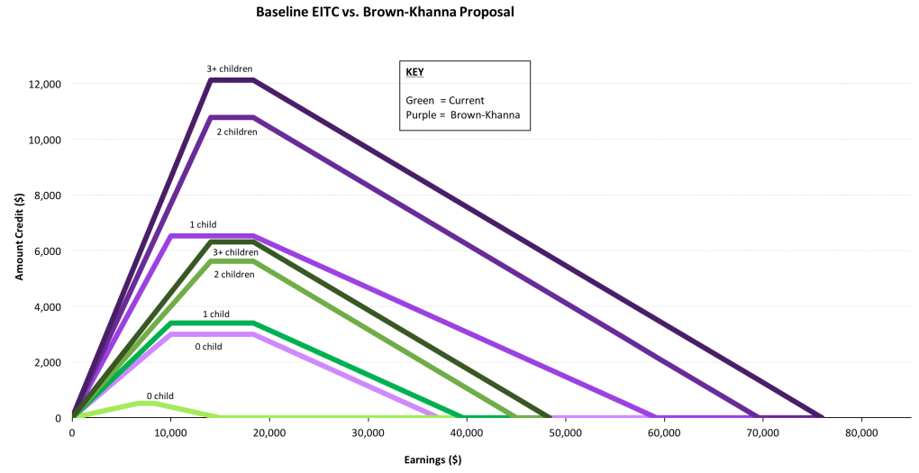
2019 U.S. Poverty Campaign Priorities
2019 tax priority ask: address wage stagnation with robust expansions of the Earned Income Tax Credit and the Child Tax Credit
RESULTS U.S. Poverty National Webinar
Notes:
2019 tax priority ask: address wage stagnation by making robust expansions of the Earned Income Tax Credit and the Child Tax Credit for low-income families a key priority in tax legislation
Will look for opportunities to push for EITC and CTC expansions in this Congress will building momentum to the longer-term goal of a tax code that prioritizes low-income working families
An example: https://khanna.house.gov/media/press-releases/release-sen-sherrod-brown-and-rep-ro-khanna-introduce-landmark-legislation
Lay the groundwork by building momentum for bills along the lines of:
Child Tax Credit Improvement Act -- expands Child Tax Credit for young children | 115th Congress (2017-2018)
Earned Income Tax Credit Improvement and Simplification Act -- expands the EITC | 115th Congress (2017-2018)
Working Families Tax Relief Act of 2017 -- expands EITC and the Child Tax Credit | 115th Congress (2017-2018)

Slide 10
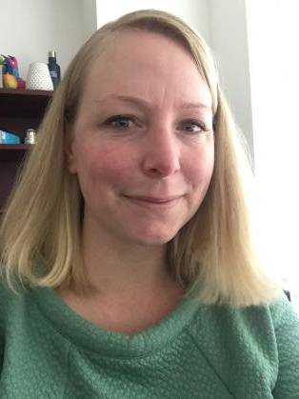
Guest Speaker: Alison Bell Center on Budget and Policy Priorities
10
Senior Policy Analyst in the Housing Policy Division, focusing on housing voucher policy and funding, including housing mobility initiatives
Former Executive Director of the Baltimore Regional Housing Partnership (BRHP).
Prior to BRHP, held numerous positions working with public housing authorities and the U.S. Department of Housing and Urban Development.
Bachelor’s degree from the University of Alabama and a Master of Public Policy from Johns Hopkins University.
RESULTS U.S. Poverty National Webinar

Slide 11
Results Webinar January 8, 2019: Overview of Federal Housing Programs and 2019 Outlook Alison Bell Senior Policy Analyst

Slide 12
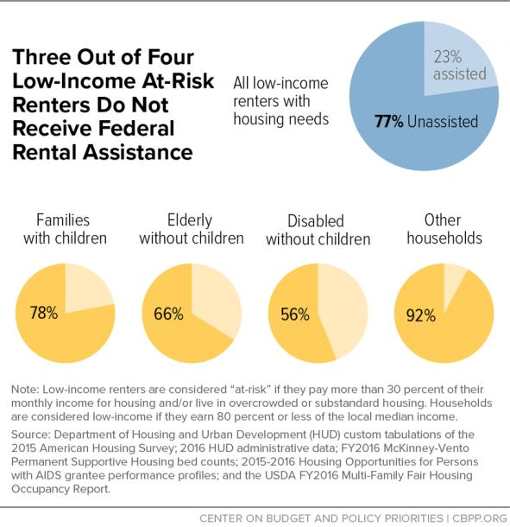
The Need for Rental Assistance

Slide 13
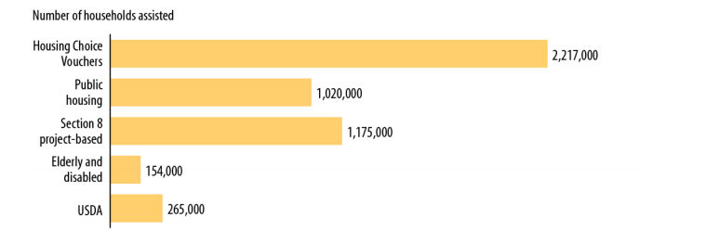
Major Federal Rental Assistance Programs

Slide 14
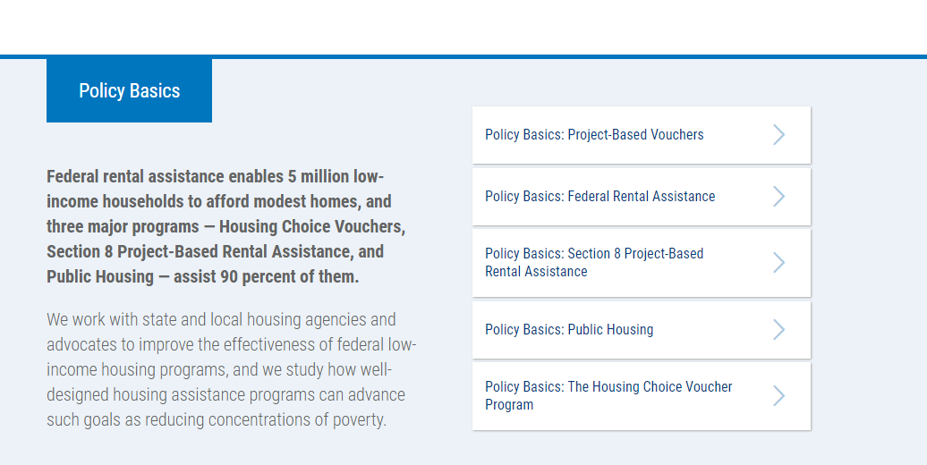
CBPP Policy Basics and Fact Sheets

Slide 15
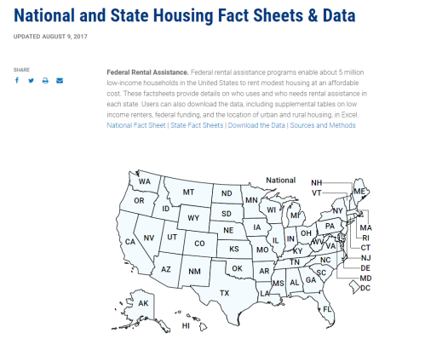
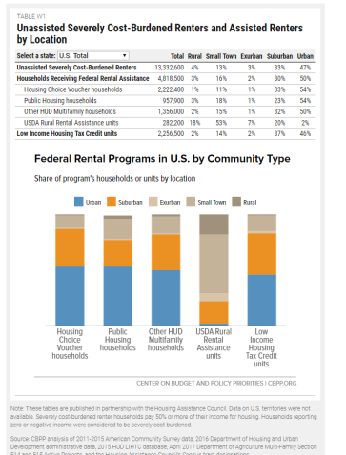
CBPP Policy Basics and Fact Sheets

Slide 16
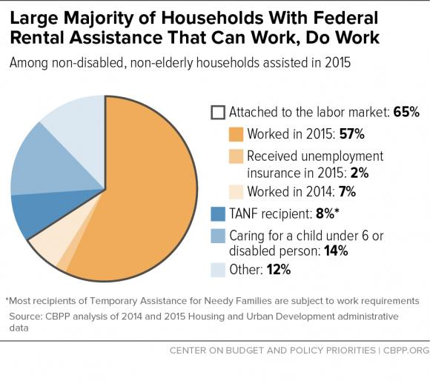
Major Federal Rental Assistance Programs

Slide 17
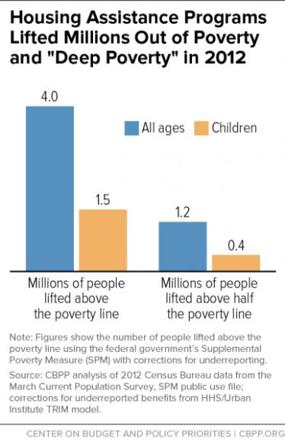
Major Federal Rental Assistance Programs

Slide 18
Housing Choice Voucher Program
Largest federal rental assistance program
Serves over 5 million people in over 2.2 million households
Families rent units in the private rental market using a voucher
Federal law does not prevent landlords from rejecting all housing vouchers
Some exceptions, such as Low-Income Housing Tax Credit
Notes:
Alison

Slide 19
Two New CBPP Reports
Where Families With Children Use Housing Vouchers
Alicia Mazzara and Brian Knudsden, Jan 2019
Prohibiting Discrimination Against Renters Using Housing Vouchers Improves Results
Alison Bell, Barbara Sard, and Becky Koepnick, December 2018

Slide 20
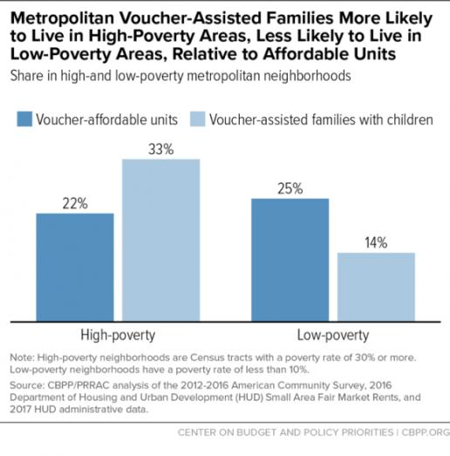
Where Families With Children Use Housing Vouchers in Top 50 Metros

Slide 21
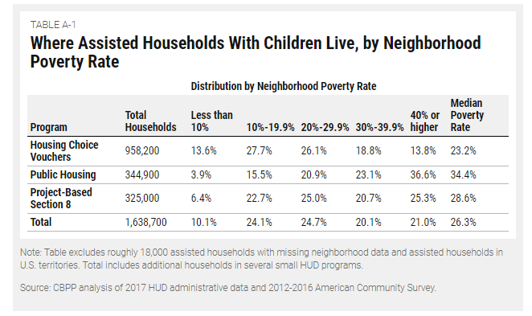
Major Rental Assistance Programs Neighborhood Poverty

Slide 22
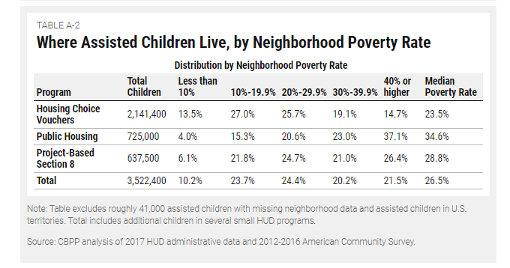
Major Rental Assistance Programs Neighborhood Poverty

Slide 23
Neighborhoods Influence Children’s Well-Being and Long-Term Success
Where families live largely determines
Quality of children’s schools
Safety of streets and playgrounds
Access to jobs
Transportation costs to work
Access to fresh and reasonably priced food, goods and services
A compelling, and growing, body of research shows that growing up in low-poverty neighborhood with good schools improves children’s academic achievement and long-term chances for success

Slide 24
Why Housing Mobility?
HCV program intended as an alternative to place-based programs, provide choice to families
Research supports housing mobility initiatives
Families want opportunities to use their voucher to move
Successful programs running to serve as models
Housing choice voucher program works, but needs to do more to successfully help families move
Pre-and post-move services
Financial coaching and removing barriers
Landlord outreach
Market rents
Efficient program administration
Remove jurisdictional barriers – housing markets are regional
Increase housing options overall for low-income families

Slide 25
Housing Mobility Legislative and Policy Resources
https://cbpp.org/housing-mobility

Slide 26
Source of Income Laws
Some states and local jurisdictions have adopted “source of income” laws
Often prohibit discrimination based on
Alimony
Disability benefits
Frequently, but not always, housing vouchers
Variation in how laws are written
Notes:
Alison

Slide 27
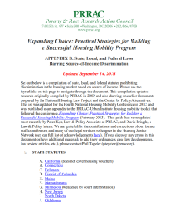
State and Local Adoption of Voucher Non-discrimination Laws
New CBPP report
Analysis of where laws have been adopted and how many voucher families covered
Interviews with local, state and national experts
Leading strategies, lessons learned, and advocacy ideas on adopting new laws and strengthening existing laws
Notes:
ALISON

Slide 28
Voucher Non-discrimination Laws Improve Program’s Effectiveness
A recent large-scale, multi-site HUD study looked at landlord acceptance rates of vouchers as a way to measure differential treatment of renters who use vouchers
Appears to show a lower rate of voucher denial in jurisdictions with voucher non-discrimination protections
Notes:
Phil

Slide 29
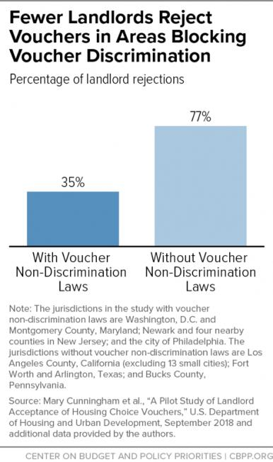
Notes:
Phil

Slide 30
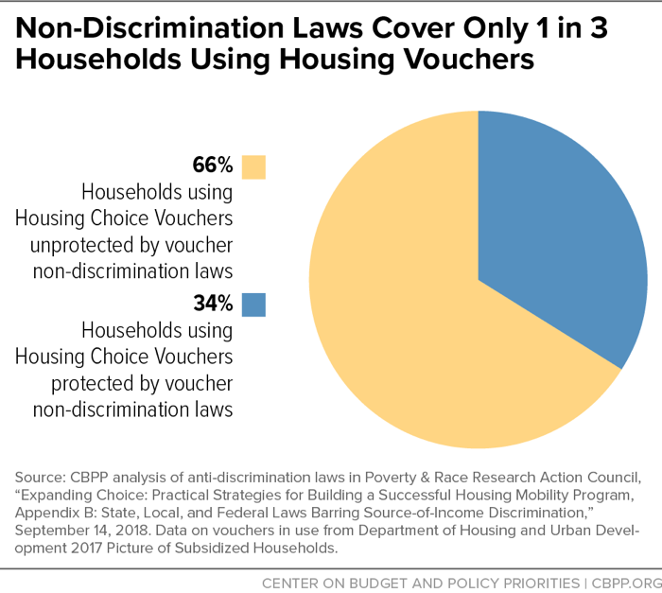
Notes:
Phil

Slide 31
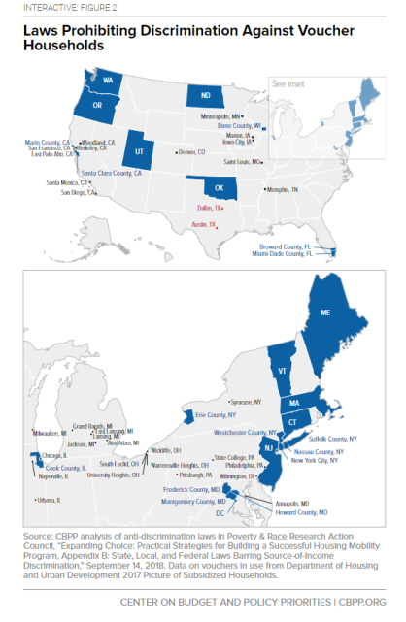
https://www.cbpp.org/research/housing/prohibiting-discrimination-against-renters-using-housing-vouchers-improves-results#hous9-12-18
Notes:
Alison

Slide 32
Resources on Voucher Non-discrimination
Prohibiting Discrimination Against Renters Using Housing Vouchers Improves Results, CBPP, 2018 https://www.cbpp.org/research/housing/low-income-housing-tax-credit-could-do-more-to-expand-opportunity-for-poor-families.
Poverty & Race Research Action Council Appendix B,2018 https://www.prrac.org/pdf/AppendixB.pdf
A Pilot Study of Landlord Acceptance of Housing Choice Vouchers, HUD and Urban Institute, 2018, https://www.huduser.gov/portal/pilot-study-landlord-acceptance-hcv.html
Landlord Participation in the HCV Program Webcast, 2018, https://www.huduser.gov/portal/event/Landlord-Participation-HCV-Program.html
Notes:
Alison

Slide 33
2019 Outlook
Shutdown status update
Legislative efforts
Expand rental assistance
Reduce discrimination against voucher holders
Action at state and local level
Helps build momentum for federal policy changes
Federal proposals
Promote housing choices and mobility
Notes:
For more on the impact of the shutdown: https://nlihc.org/article/government-shutdown-now-third-week-impacts-housing-programs-and-tenants

Slide 34
Additional Resources from Webinar (added 1/9/19)
Resources from CBPP on housing https://www.cbpp.org/topics/housing and link to the state data: https://www.cbpp.org/research/national-and-state-housing-data-fact-sheets
Statement by Bob Greenstein, head of CBPP, on the shutdown https://www.cbpp.org/press/statements/greenstein-policymakers-must-end-government-shutdown-as-harmful-effects-grow
Report from the @CenterOnBudget and @PRRAC_DC that explores how housing vouchers affect where low-income families with children in metropolitan areas. http://bit.ly/2F74SQc
Report on housing discrimination: https://www.cbpp.org/research/housing/prohibiting-discrimination-against-renters-using-housing-vouchers-improves-results
More on Nov 2018 Senate housing discrimination bill:
https://www.housingwire.com/articles/47416-prominent-senators-begin-bipartisan-push-to-expand-fair-housing-act
https://www.kaine.senate.gov/press-releases/kaine-hatch-introduce-bipartisan-bill-to-protect-veterans-and-low-income-families-from-housing-discrimination
RESULTS U.S. Poverty National Webinar
Notes:
TAKE ACTION: Reach out to new and returning members of Congress. For new members, visit their campaign pages for contact information and leverage contacts you know from their campaign. For returning members, use the same procedure you’ve used previously get meetings. Personalize our updated meeting request (online or Word doc) to ask for meetings (if you need help, please contact Jos Linn). Once you get a meeting, contact Meredith Dodson for targeted coaching and requests.

Slide 35
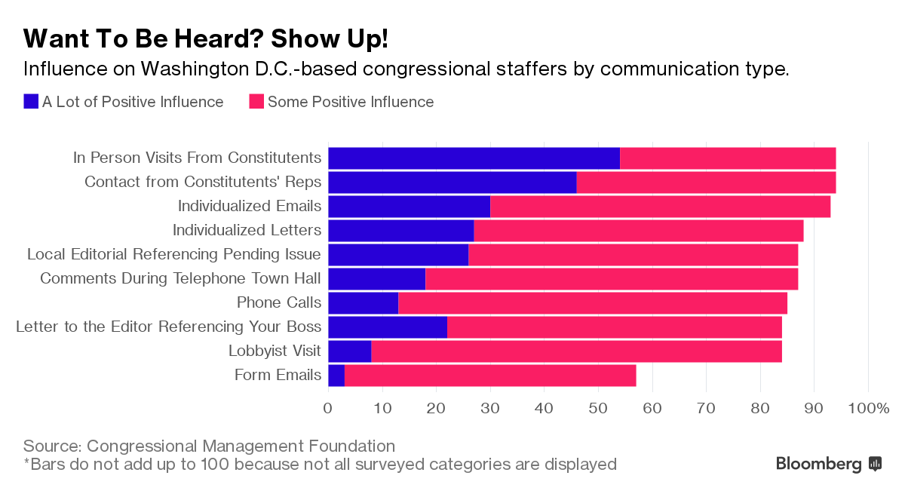
Set the Agenda: Get Meetings with Congress
Resources: https://results.org/issues/set-the-agenda.
Reminder: this is a great way to get new people engaged! All those folks looking for how to engage post-election and shape the priorities are eager to “set the agenda”
RESULTS U.S. Poverty National Webinar
Notes:
TAKE ACTION: Reach out to new and returning members of Congress. For new members, visit their campaign pages for contact information and leverage contacts you know from their campaign. For returning members, use the same procedure you’ve used previously get meetings. Personalize our updated meeting request (online or Word doc) to ask for meetings (if you need help, please contact Jos Linn). Once you get a meeting, contact Meredith Dodson for targeted coaching and requests.

Slide 36
2019 Leadership and Planning
36
2019 brings exciting new opportunities
Be ready by setting your intentions now
January is time to dedicate yourselves to
planning
“A goal without a plan is just a wish”
Your success is built on the goals and strategies you come up with now
New approach this year to make planning easier now and more fulfilling when you look back at the end of the year
Jos Linn
Grassroots Manager for U.S. Poverty Campaigns (jlinn@results.org)
RESULTS U.S. Poverty National Webinar

Slide 37
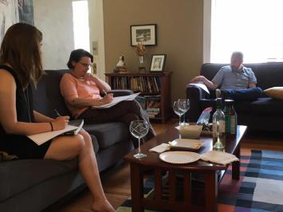
2019 Leadership and Planning
37
Focus on Roles
Group Leader or Co-Leader
Congressional Point People
Outreach Coordinator
Media Point Person
Action Network Manager
Plan for four months
Set the Agenda campaign
Submit your plans online
New online form
RESULTS U.S. Poverty National Webinar

Slide 38
Set the Agenda
38
Let's try for the following goals now through April so we can get our voices and our issues heard in the halls of Congress!
Every group/free agent meets with each congressional office they cover.
Every group/free agents has at least one face-to-face meeting with a member of Congress
Every group/free agents makes an invitation to a new person to join in a congressional meeting.
Check out ongoing resources for this effort online on our "Set the Agenda" resource page
RESULTS U.S. Poverty National Webinar

Slide 39
2019 Leadership and Planning Resources
39
All Planning Resources are on our new Outreach and Planning page: https://results.org/volunteers/outreach-planning/
Look under “My group wants to make our plans”
2019 Planning Guide: https://results.org/wp-content/uploads/RESULTS-2019-Planning-Guide-1.docx
2019 Plan Summary Form (online): https://results.org/volunteers/action-center/?vvsrc=%2fSurveys%2f4929%2fRespond
Please submit your plan no later than January 31
2019 Individual Planning Form: https://results.org/wp-content/uploads/RESULTS-2019-Individual-Planning-Form.doc
RESULTS Grassroots Roles Guide: https://results.org/wp-content/uploads/RESULTS_Grassroots_Roles_2017.doc
RESULTS U.S. Poverty National Webinar

Slide 40
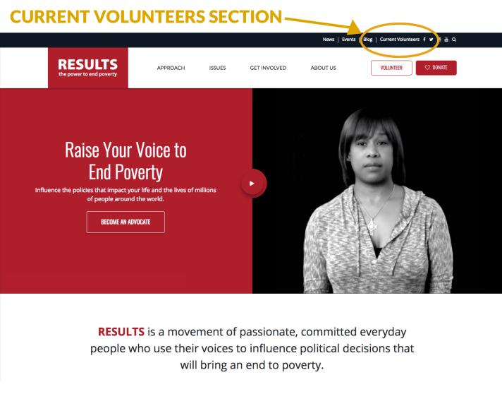
Check out our new website!
40
RESULTS U.S. Poverty National Webinar

Slide 41
Announcements
41
Set up face-to-face meetings. Use our updated meeting request (online or Word doc) you can personalize and submit today.
RESULTS New Advocate Orientation, January 10, 16 and 29 at 1:00pm and 8:30 pm ET. Get started at: https://results.salsalabs.org/volunteer/index.html.
RESULTS Action Network Community of Practice webinar, Wednesday, January 9 at 8:00pm ET. To join, log in: https://results.zoom.us/j/427674133 or dial in: 669-900-6833, Meeting ID: 427 674 133.
U.S. Poverty Free Agents Calls, Tuesday, January 15 at 1:00 pm and 8:00 pm ET. Join at: https://results.zoom.us/j/324294681 or dial by phone at (929) 436-2866 or (669) 900-6833, Meeting ID: 324 294 681.
RESULTS U.S. Poverty National Webinar

Slide 42
Announcements
42
Researching Your Member of Congress webinar, Thursday, January 24 at 9:00pm ET. Join at https://results.zoom.us/j/136610114 or call (669) 900-6833 or (929) 436-2866, meeting ID 136610114.
RESULTS International Conference, July 13-16, 2019. Learn more at www.resultsconference.org.
Find these and other events on our Event Calendar.
RESULTS U.S. Poverty National Webinar

Slide 43
43
Thank you for being on tonight’s webinar!
The next U.S. Poverty National Webinar is
Tuesday, February 5 at 8:00pm ET.
All RESULTS offices will be closed
Monday, January 21 for the Martin Luther King, Jr. holiday.
RESULTS U.S. Poverty National Webinar

Slide 44
44
FINAL ACTION
Set Your Leadership and Planning Meeting
Send an e-mail to your group members TONIGHT about when you will gather this month to do your 2019 leadership and planning meeting.
Urge each person to think about what role they want to play in your group this year and be prepared to discuss and assign roles at the meeting.
Find all the planning resources at: https://results.org/volunteers/outreach-planning/ and contact Jos Linn with questions.
RESULTS U.S. Poverty National Webinar

Slide 45
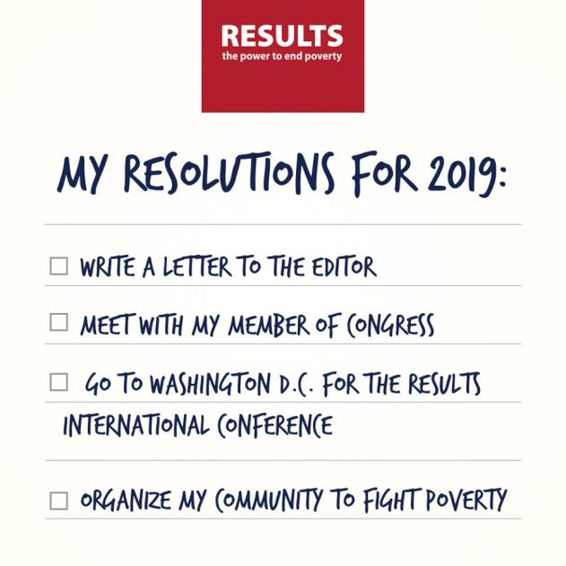
45
Happy New Year!
RESULTS U.S. Poverty National Webinar

