Slide 1
December 2018 RESULTS U.S. Poverty National Webinar
Looking Back and Looking Forward in the Movement to End Poverty
Login at: https://results.zoom.us/j/873308801 or dial (929) 436-2866 or (669) 900-6833, Meeting ID: 873 308 801.
Post-webinar: Link to webinar recording and audio transcript

Slide 2
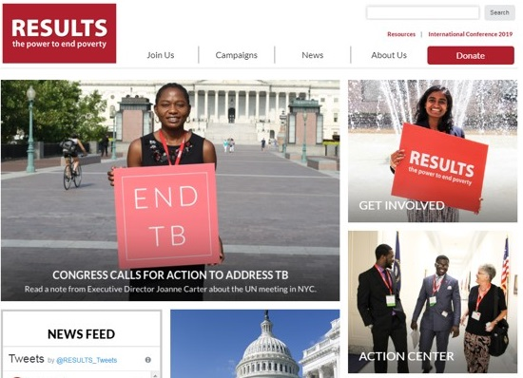
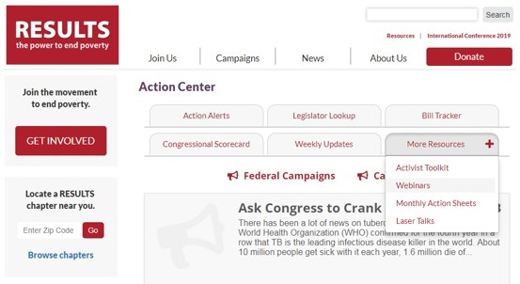
Find the slides on the National Webinars page
Click on Action Center from the RESULTS Homepage (www.results.org)
1.
2.
On the Action Center page, click on More Resources
Click on Webinars
3.
RESULTS U.S. Poverty National Webinar

Slide 3
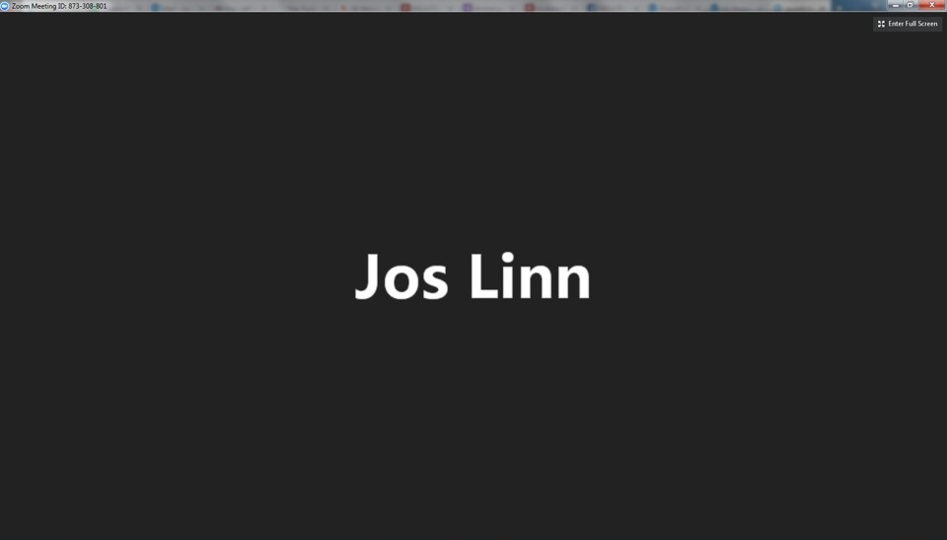
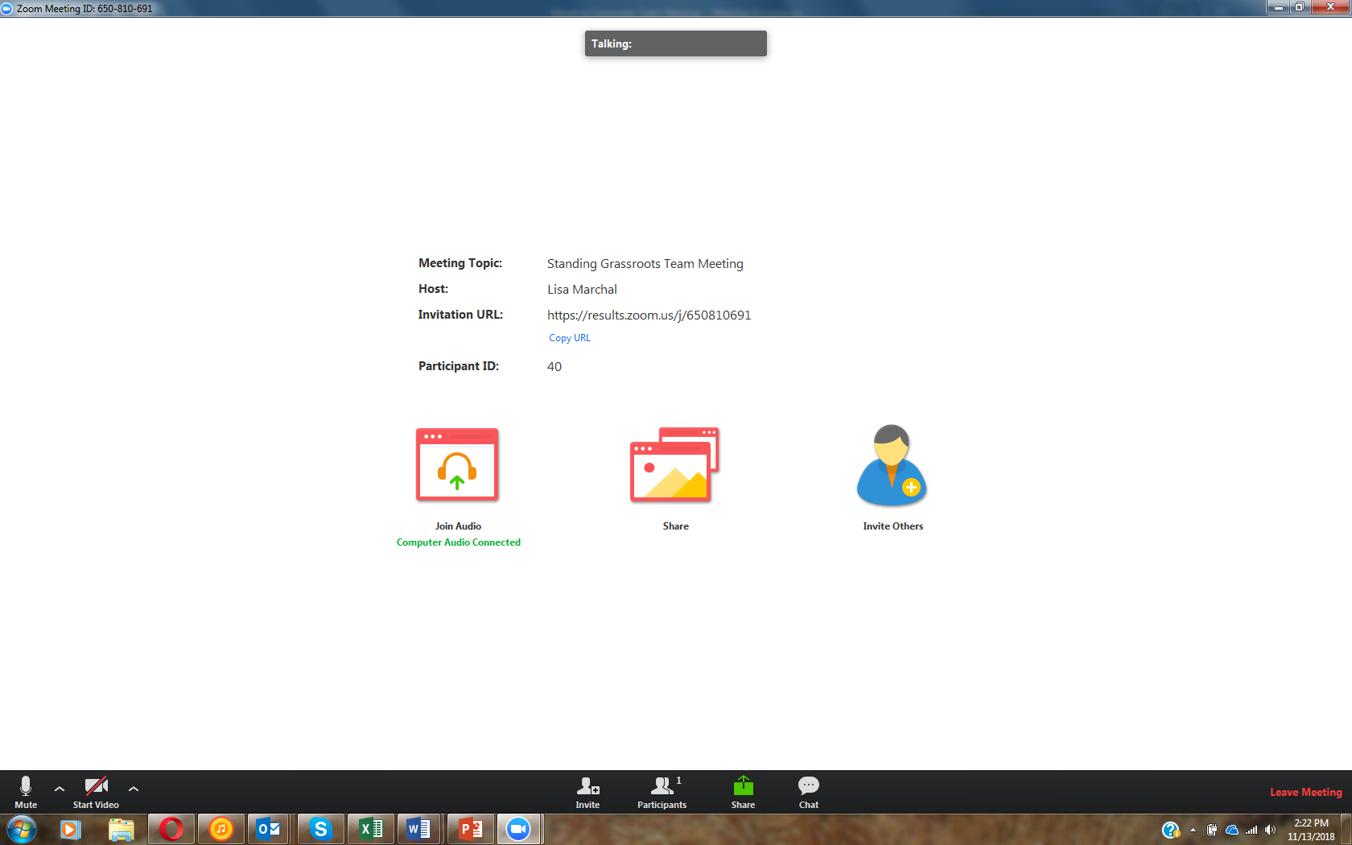

How to Chat on Zoom
1. Click here
jlinn@results.org
RESULTS U.S. Poverty National Webinar

Slide 4
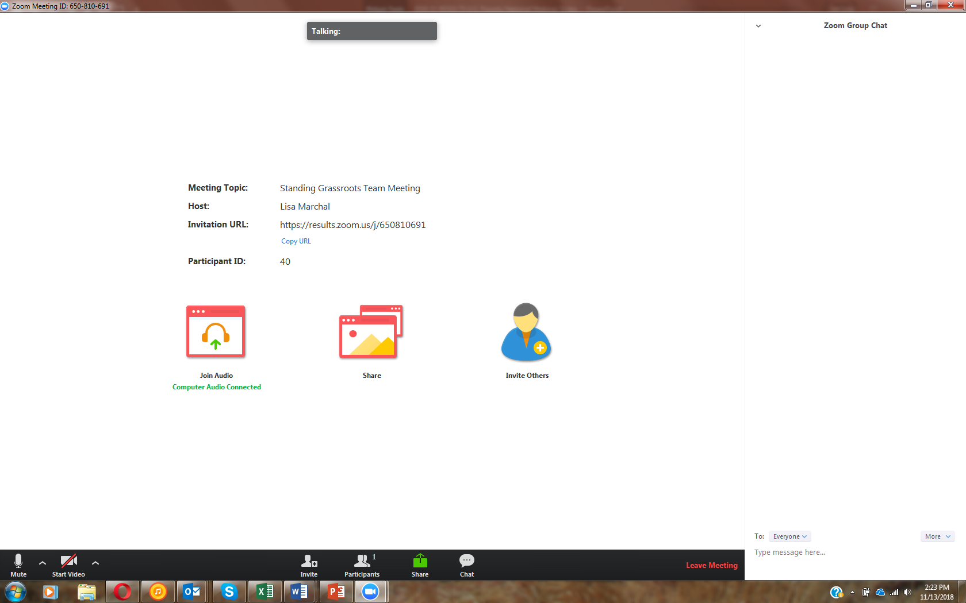
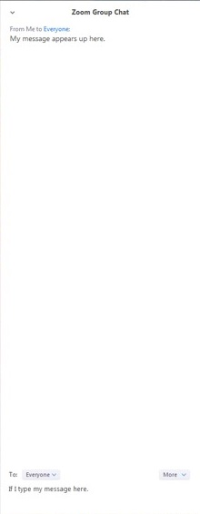
How to Chat on Zoom
3. See here
2. Type here
jlinn@results.org
RESULTS U.S. Poverty National Webinar

Slide 5


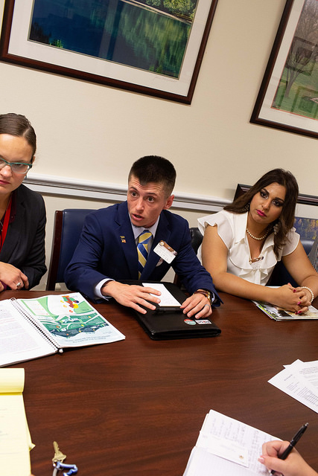












Another Amazing Year from You!
5
  Generating Media
  309 pieces (to date)
  (256 LTEs, 40 op-eds, 11 articles/TV/radio, 2 editorials)
    Meeting with Lawmakers
    38 Senators (28 different)
    92 Reps (80 different)
2018 was your second most productive year ever!
RESULTS U.S. Poverty National Webinar

Slide 6
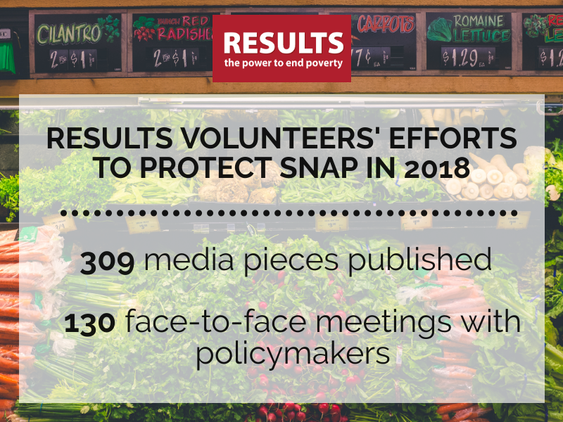
You Make a Difference!
6
  Also, your mobilization (including 46 letters to the editor) has helped generate over 100,000 public comments opposing the new public charge rule
  So what are you proud of this year? Share in CHAT box
RESULTS U.S. Poverty National Webinar

Slide 7
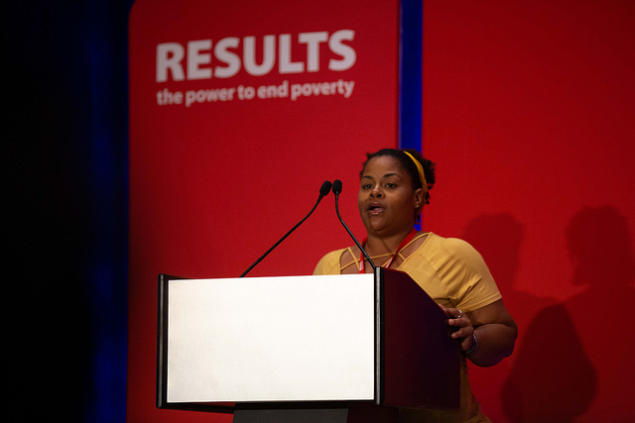
Maxine Thomas
RESULTS Grassroots Board member and Expert on Poverty
7
RESULTS U.S. Poverty National Webinar

Slide 8
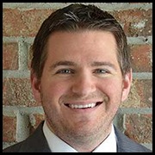

Guest Speakers:
Mike Koprowski and Chantelle Wilkinson
Opportunity Starts at Home Campaign
8
Opportunity Starts at Home is a multi-sector housing campaign to meet the rental housing needs of the nation’s lowest income people
National Campaign Director
Housing Campaign Coordinator
Was Executive Director of Opportunity Dallas
Served as the chief of transformation and innovation in the Dallas school system
Served in the U.S. Air Force
Degrees from the University of Notre Dame, Duke University, and Harvard University
Was a budget analyst for NY state legislature (housing and transportation policy)
In 2016, she worked on the Breathing Lights Campaign
Received BA and MA from the Rockefeller College of Public Affairs and Policy at the University at Albany
RESULTS U.S. Poverty National Webinar

Slide 9


@OppStartsatHome
#OpportunityStartsatHome
www.opportunityhome.org

Slide 10




America’s Affordable Housing Crisis
Has Reached Historic Heights
There’s a shortage of more than 7.2 million rental homes affordable and available to extremely low income renter households.
The nation has 11.2 million extremely low-income renter households.

Slide 11
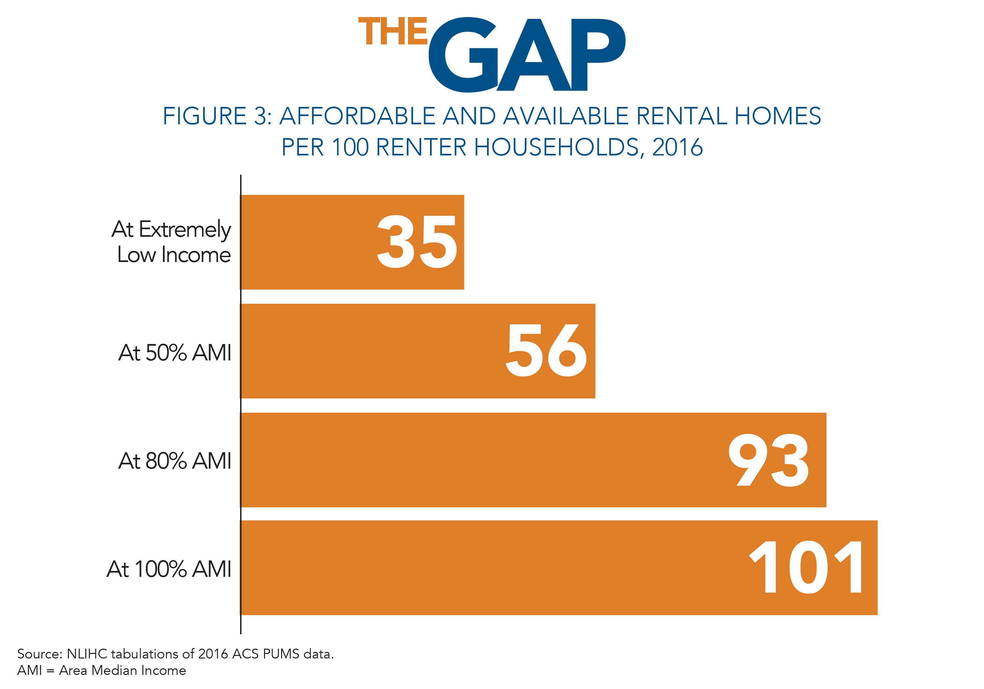
America’s Affordable Housing Crisis
Has Reached Historic Heights
There’s only 35 affordable and available units for every 100 extremely low-income renter household

Slide 12
America’s Affordable Housing Crisis
Has Reached Historic Heights

Slide 13
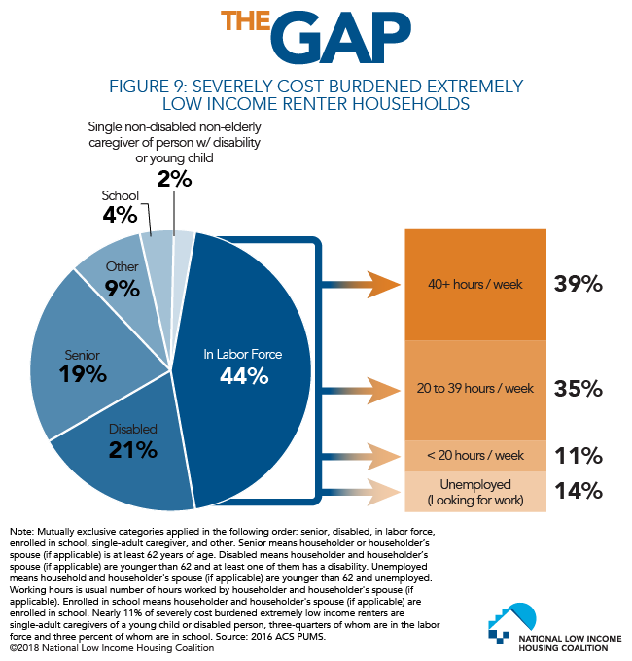
America’s Affordable Housing Crisis
Has Reached Historic Heights
71% of extremely
low-income renters are severely cost burdened, meaning they spend more than half their income on housing.

Slide 14
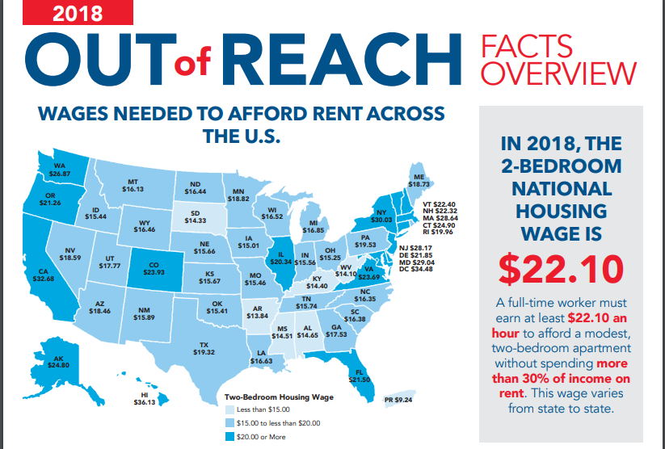

America’s Affordable Housing Crisis
Has Reached Historic Heights
Only
eligible low-income households receives federal housing assistance

Slide 15
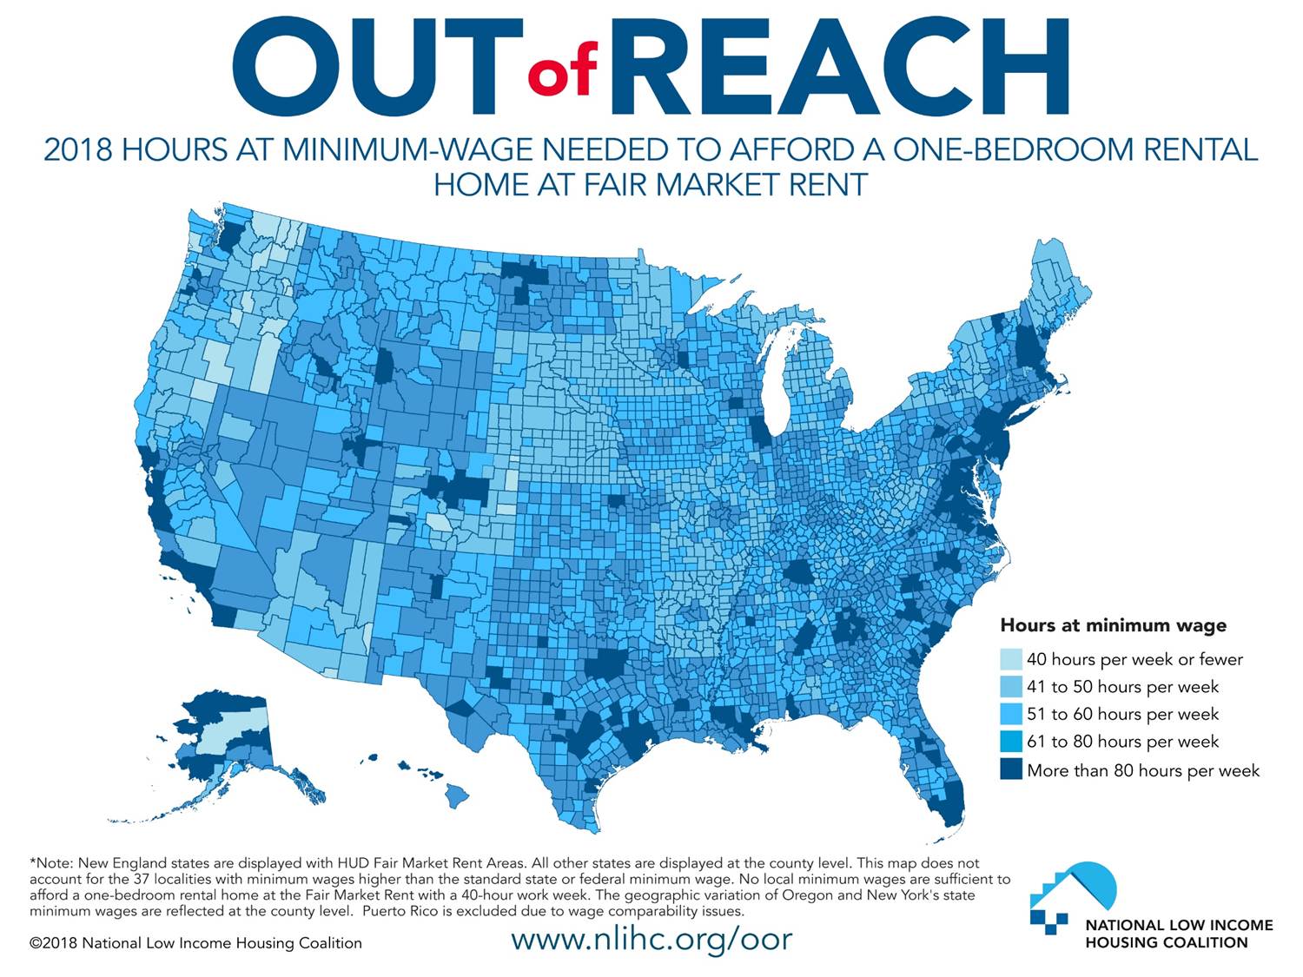
America’s Affordable Housing Crisis
Has Reached Historic Heights

Slide 16
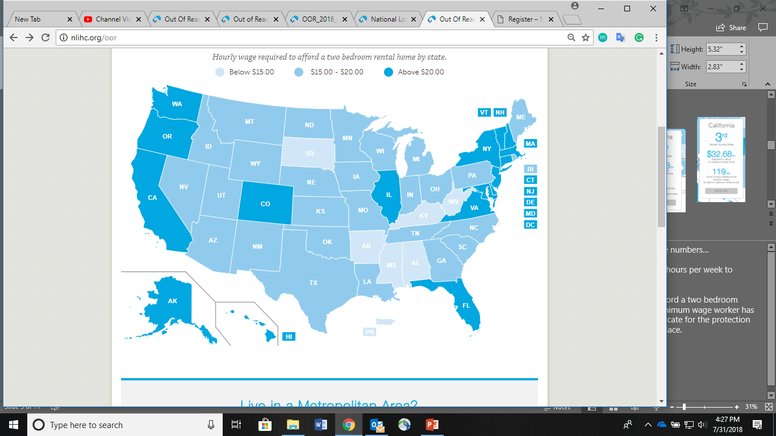
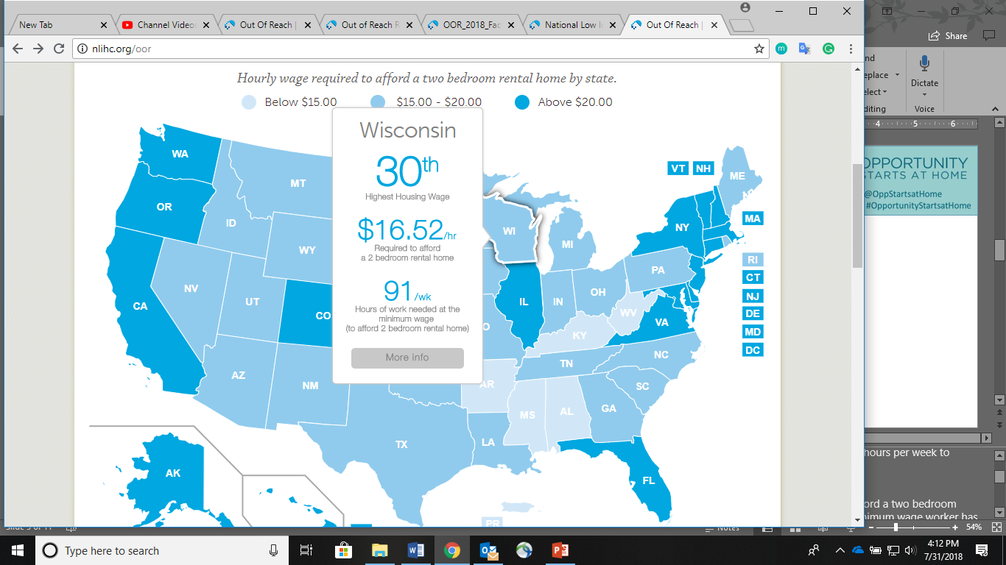
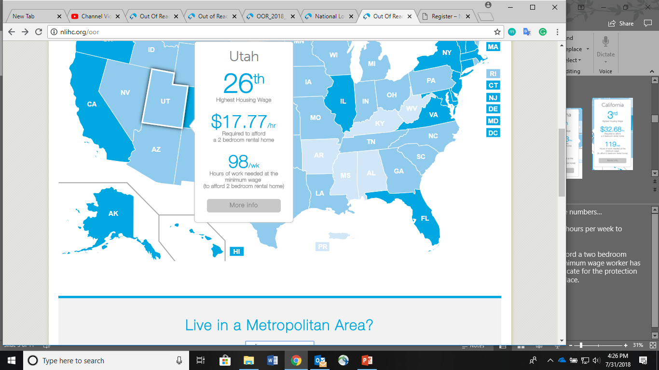
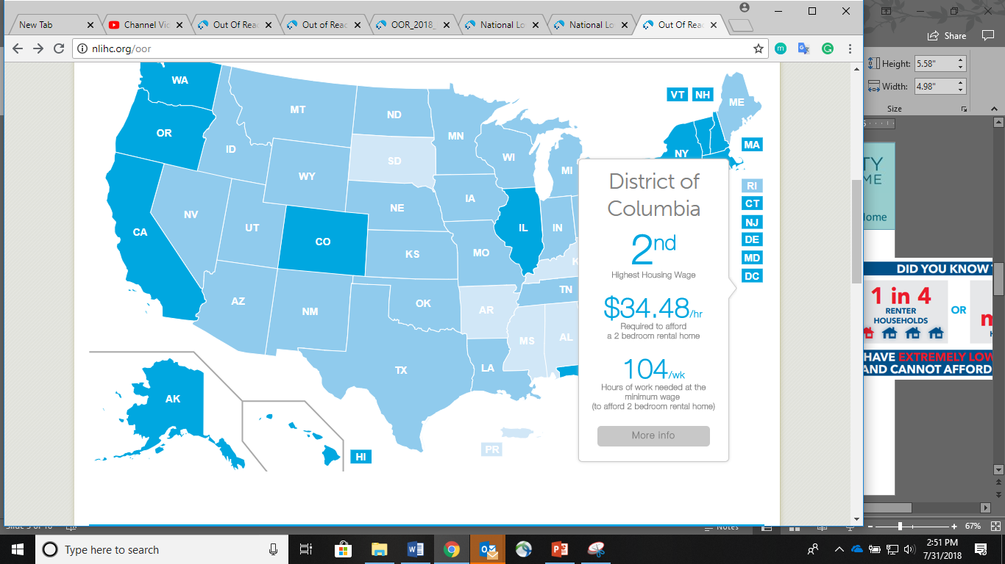
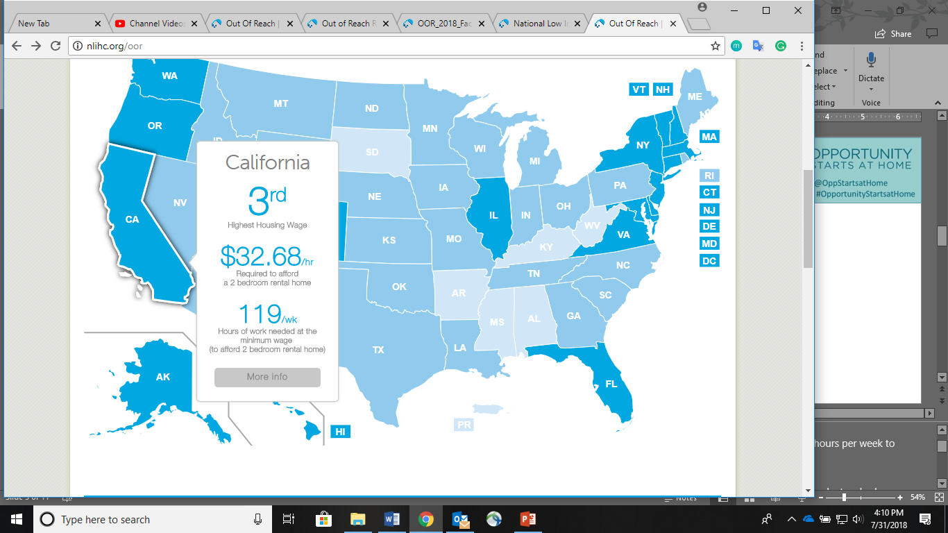
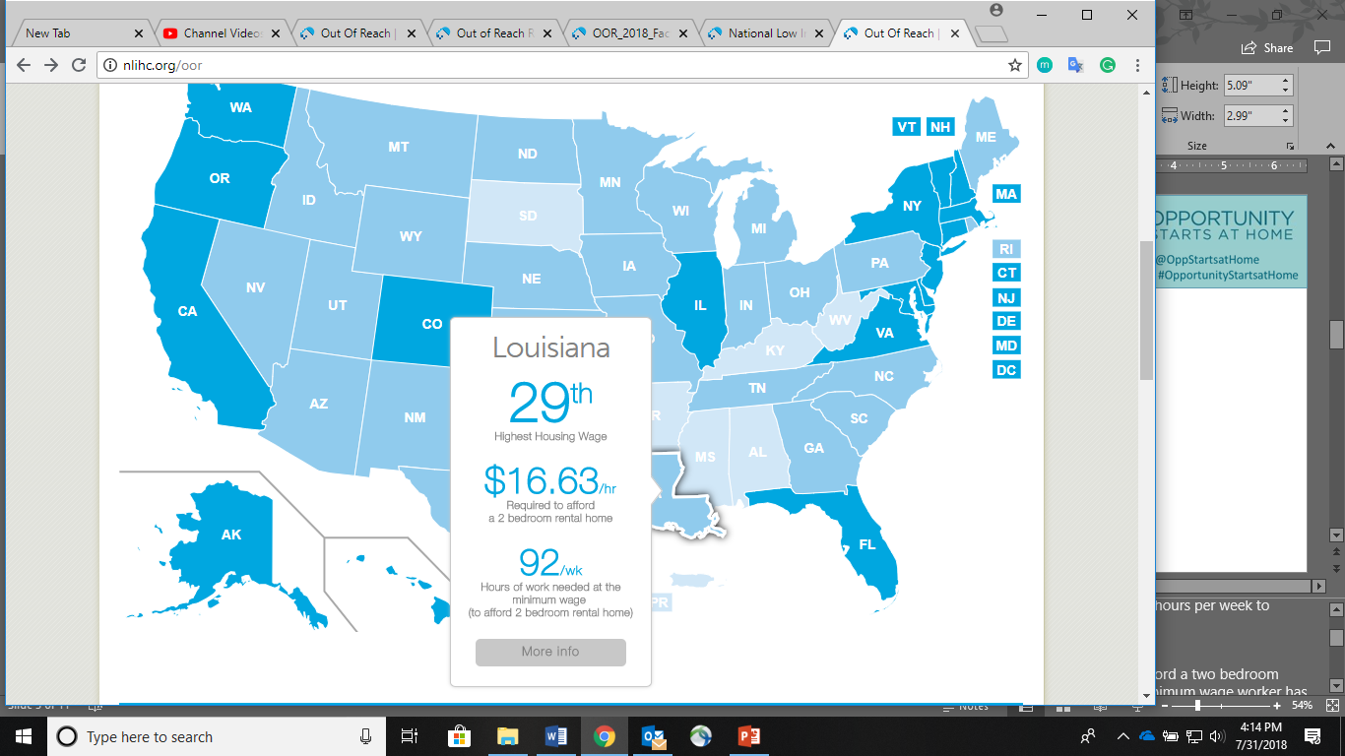
America’s Affordable Housing Crisis
Has Reached Historic Heights
www.opportunityhome.org
To afford a two-bedroom rental home, a full time worker must work
A full time worker earning $7.25 needs to work approximately 122 hours per week, for all 52 weeks of the year, to afford a two-bedroom rental home at the national average fair market rent.

Slide 17


America’s Affordable Housing Crisis
Has Reached Historic Heights
www.opportunityhome.org

Slide 18
About Us
@OppStartsatHome
#OpportunityStartsatHome
www.opportunityhome.org
Opportunity Starts at Home is a dynamic, long term, multi-sector housing campaign to address the housing affordability crisis for low income renters.
Various sectors are recognizing that affordable homes are inextricably linked to their own priorities and concerns, and housing advocates are realizing that they cannot do this work alone.
Campaign Vision
“America’s low-income households have access to safe, decent, and stable affordable housing in neighborhoods where everyone has equitable opportunities to thrive.”
Campaign Mission
“To build a national multi-sector movement which generates widespread support for federal policies that protect and expand affordable housing for low-income people.”

Slide 19

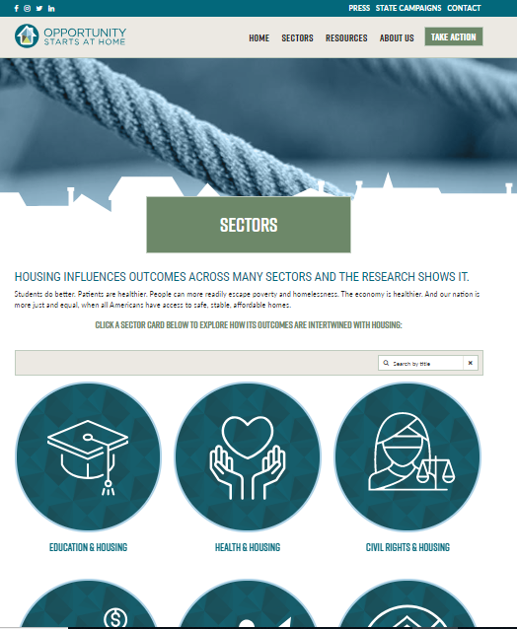
Housing Touches Every Aspect of Life
@OppStartsatHome
#OpportunityStartsatHome
www.opportunityhome.org

Slide 20















Steering Committee
@OppStartsatHome
#OpportunityStartsatHome
www.opportunityhome.org

Slide 21
Roundtable Participants
AARP
Alliance for Housing Solutions
American Academy of Pediatrics
American Heart Association
American Psychological Association
American Public Human Services Association
America's Health Insurance Plans
Anthem
Association of University Centers on Disability
Autism Society of America
Autism Speaks
Autistic Self Advocacy Network
B'nai B'rith
Catholic Health Association of the United States
Center for American Progress
Children’s Leadership Council
CLASP
Coalition on Human Needs
Community of Hope
Community Solutions
Community Stabilization Project
Council of Large Public Housing Authorities
CSH
Dignity Health
Enterprise Community Partners
Evangelical Lutheran Church in America
Family Promise
First Focus
Friends Committee on National Legislation
Georgetown Center on Poverty and Inequality
Good Shepherd Housing
Grounded Solutions
Habitat for Humanity International
Healthcare Anchor Network
Healthy Schools Campaign
Heartland Alliance
Housing Choice Partners
Housing on Merit
Housing Partnership Network
Human Rights Campaign
Just Homes
Justice in Aging
Leadership Conference on Civil and Human Rights
Legal Action Center
Low Income Investment Fund
Meals on Wheels America
National AIDS Housing Coalition
National Association of Social Workers
National Association of State Directors of Special
Education
National Coalition for Homeless Veterans
National Coalition for the Homeless
National Council of State Housing Agencies
National Fair Housing Alliance
National Health Care for the Homeless Council
National Housing Conference
National Housing Law Project
National Housing Trust
National Law Center on Homelessness and Poverty
National League of Cities
National Women's Law Center
NETWORK Lobby for Catholic Social Justice
Next Step
Poverty & Race Research Action Council
Prosperity Now
RESULTS
Stewards of Affordable Housing for the Future
StriveTogether
The Arc
True Colors Fund
Unity Health Care
Urban Institute
Washington Legal Clinic for the Homeless
YWCA
Zero Eight Three

Slide 22
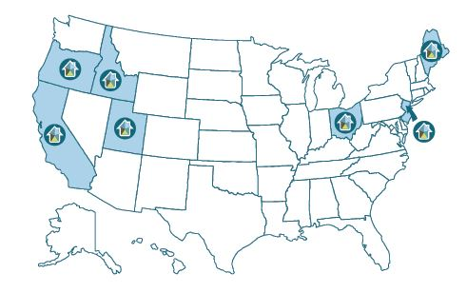
State Campaigns
@OppStartsatHome
#OpportunityStartsatHome
www.opportunityhome.org
Housing California
Idaho Asset Building Network
Maine Affordable Housing Coalition
Housing and Community Development Network of New Jersey
Coalition of Homelessness and Housing in Ohio
Neighborhood Partnerships Oregon Housing Alliance
Utah Housing Coalition

Slide 23
Long-Term Goal & Policy Strategies
@OppStartsatHome
#OpportunityStartsatHome
www.opportunityhome.org
LONG-TERM GOAL: Through more robust and equitable federal housing policies, we will end homelessness and ensure that the most vulnerable low-income households can afford the rent
BRIDGE THE GAP BETWEEN RENTS AND INCOME THROUGH RENTAL ASSISTANCE
Rental assistance subsidies are needed at scale to ensure units are affordable for low-income renters
EXPAND THE STOCK OF DEEPLY AFFORDABLE HOUSING
Increasing the supply of deeply affordable housing is necessary in markets where existing vacancies are scarce
STABILIZE HOUSEHOLDS
BY PROVIDING EMERGENCY ASSISTANCE TO AVERT HOUSING INSTABILITY & HOMELESSNESS
Temporary assistance can stabilize households experiencing major economic shocks that could otherwise lead to situations which require more prolonged and extensive housing assistance

Slide 24
Year One and Beyond
@OppStartsatHome
#OpportunityStartsatHome
www.opportunityhome.org
Year 1: Building the Infrastructure
Hire staff
Operationalize Steering Committee
Build website and multi-sector content (i.e., infographics, blogs, videos, etc.)
Action Items: (i.e., newsletter sign-on; Letters to Congress; recruit new voices; share your story)
Support the creation and capacity-building of multi-sector state campaigns
Building a social media network
Establish an “Opportunity Roundtable”
Identify incremental policy advocacy next steps in line with the campaign policy objectives
Create public visible actions and events around affordable housing
Engage national policymakers about the campaign
Out-Years: Build Visibility and Commitment
Advancing the policy agenda through robust advocacy
Continuing to expand the network at national and state levels
Major galvanizing event

Slide 25
Contact Us
@OppStartsatHome
#OpportunityStartsatHome
www.opportunityhome.org
Mike Koprowski, Campaign Director
mkoprowski@nlihc.org
@Mike_Koprowski
Chantelle Wilkinson, Campaign Coordinator
cwilkinson@nlihc.org
@cewilkinson11

Slide 26
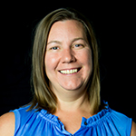
2019 Preview: Get to Your New Congress
26
GOAL: Ensure the new Congress (and political candidates) center
The needs of low-income families, with a focus on communities
of color, in economic policies focused on creating opportunity
and ending poverty.
Here are some of the policy ideas that you might raise in lobby
meetings:
Addressing wage stagnation by making robust expansions of the Earned Income Tax Credit and the Child Tax Credit for low-income families a key priority in tax legislation
Using the tax code to support low-income renters (Renters Credit), perhaps along with other direct support to renters via housing choice vouchers (Section 8)
Emergency stabilization funds to avoid evictions
First-time homebuyer tax credits targeted to reduce the impacts of segregation and racial wealth inequality
Addressing other barriers to affordable housing including credit scores, application fees, and discrimination against those using housing assistance
Meredith Dodson
Director of U.S. Poverty Campaigns (mdodson@results.org)
RESULTS U.S. Poverty National Webinar

Slide 27
2019 Preview: Learn More on our
Upcoming Webinars
27
Join one of our webinar discussions to learn more about and weigh in on RESULTS’ 2019 U.S. Poverty Campaigns strategies.
Thursday, December 13 at 7:30 pm ET
Monday, December 17 at 2:30 pm ET
To participate, join at https://results.zoom.us/j/584823247 or dial (929) 436-2866, Meeting ID: 584823247.
RESULTS U.S. Poverty National Webinar

Slide 28
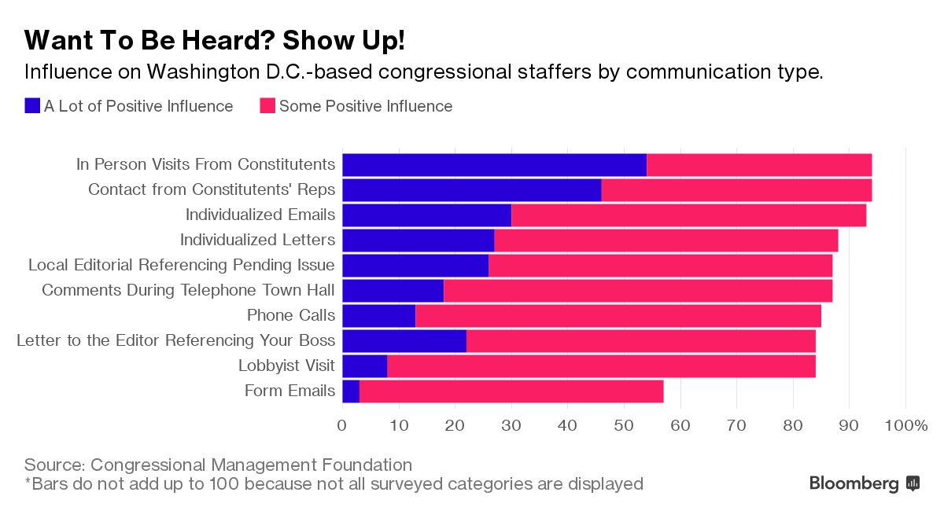
Monthly Action: Get Meetings with New Members of Congress
28
And invite new people – lobby meetings are a great way to get new advocates inspired!
RESULTS U.S. Poverty National Webinar
Notes:
TAKE ACTION: Reach out to new and returning members of Congress to see if you can meet with them before they get sworn in on January 3. For new members, visit their campaign pages for contact information and leverage contacts you know from their campaign. For returning members, use the same procedure you’ve used previously get meetings. Personalize our updated meeting request (online or Word doc) to ask for meetings (if you need help, please contact Jos Linn). Once you get a meeting, contact Meredith Dodson for targeted coaching and requests.

Slide 29
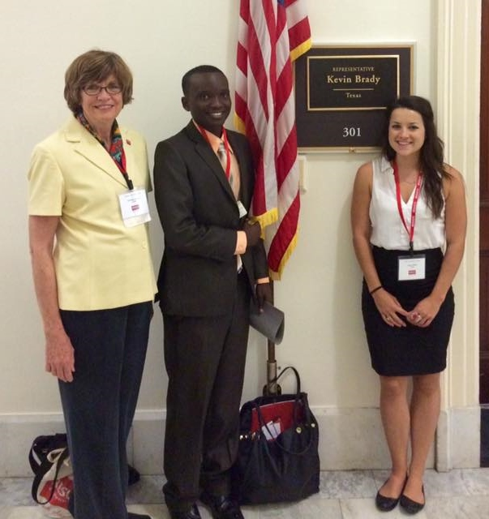
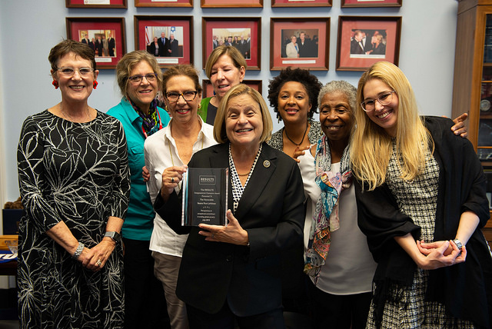
Grassroots Shares
29
Betsy Skipp of RESULTS Miami (third from left) with fellow volunteers and Rep. Ileana Ros-Lehtinen (R-FL-27)
Kathleen Duncan of RESULTS Houston (far left) with fellow volunteers at the RESULTS International Conference
RESULTS U.S. Poverty National Webinar

Slide 30
Webinar Notes
30
Share from Kathleen Duncan: Houston has three new House representatives, cooperating with the Houston Global group we are pursuing December meetings with them. I took Sylvia Garcia, as a group we strategized I should contact the campaign office. There were staff still working at the campaign headquarters who suggested I contact her state legislative office in Austin, the state capitol. After hearing me state the purpose of RESULTS - creating the political will to end hunger and the worst aspects of poverty - the state staffer remarked " ..... Bless You" I was told the new Rep would be bringing her Texas state Chief of Staff with her to Wash D.C. in fact they were both in D.C. for new member training. I was given the email address of the Chief of Staff. The staffer on the phone said if any problems to contact him and gave his email address.
RESULTS U.S. Poverty National Webinar

Slide 31
Election 2018 Action Resources
31
Post-Election Action: https://www.results.org/take_action/2018_post_election_u.s._poverty_action
Lobby Meeting Request Letter:
Online version: http://www.results.org/take-action/action-center?vvsrc=%2fcampaigns%2f54043%2frespond
Word version: http://www.results.org/uploads/files/2018_RESULTS_U.S._Poverty_Lobby_Meeting_Request_(Post-Election).doc
RESULTS Staff:
Once you get a meeting scheduled, please contact Meredith Dodson (mdodson@results.org) ASAP to set up a prep call to get you ready!
RESULTS U.S. Poverty National Webinar

Slide 32
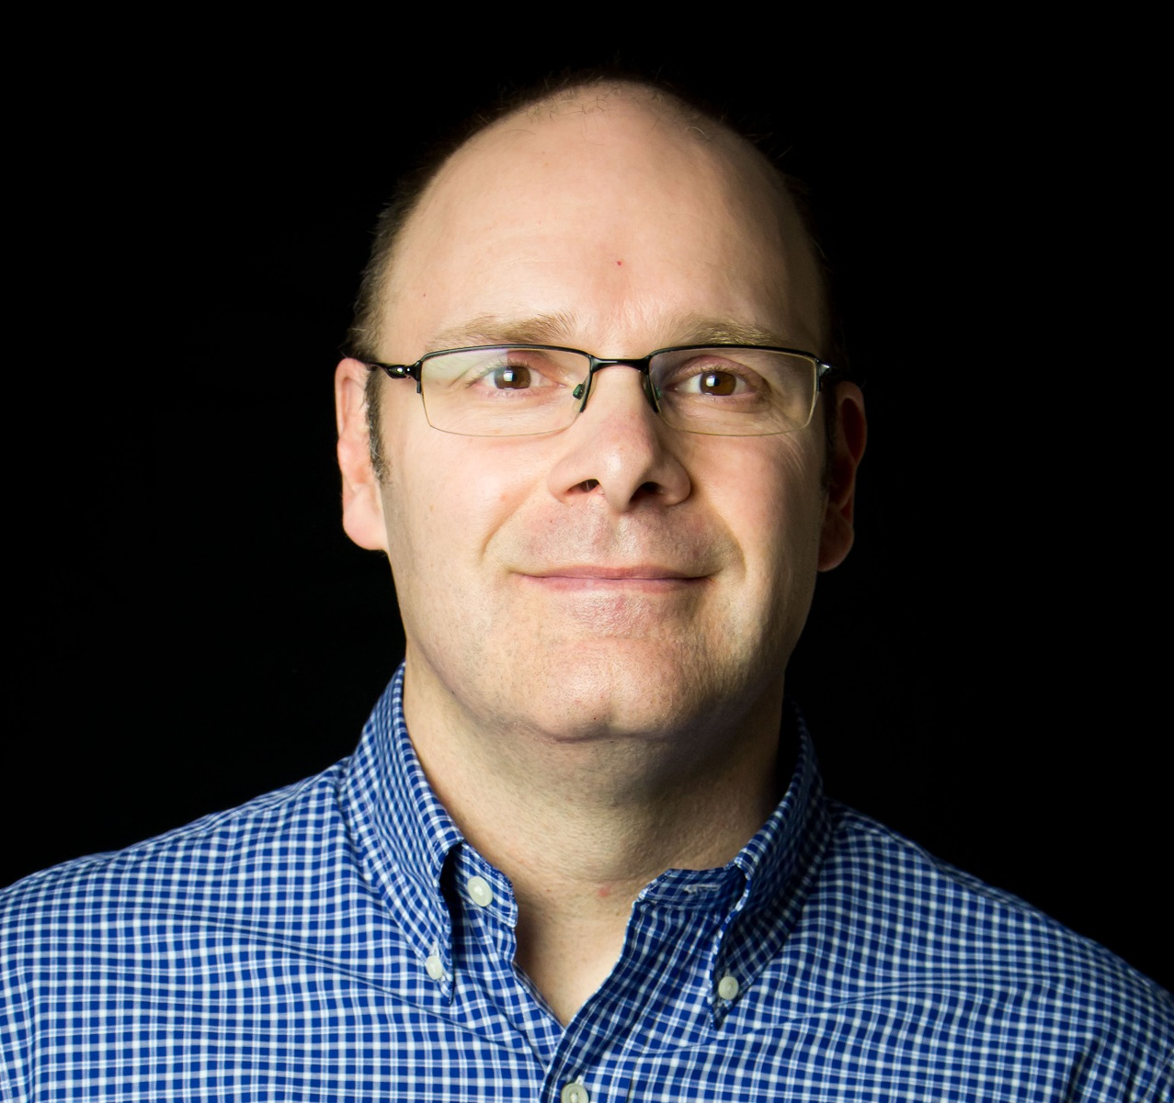
Use Election Energy to Engage New People
32
    Help others discover their inner advocate
    RESULTS volunteers know how to mobilize
    In 2018, U.S. poverty volunteers have:
      Done at least 56 outreach events (meetings, trainings, tabling, one-on-one conversations)
      Introduced RESULTS to over 1,000 people
    And let’s not forget fundraising
      100 RESULTS volunteers have fundraised for RESULTS, (10 in-person events, 3 Facebook fundraisers, our Spring FFC, November VTF)
      Raised $184,301 for RESULTS
Jos Linn
Grassroots Manager for U.S. Poverty Campaigns (jlinn@results.org)
RESULTS U.S. Poverty National Webinar

Slide 33

Volunteer Match Grassroots Share
33
    VolunteerMatch campaign = success!
    Over 250 people from all over the country responded
    Record numbers signing up Orientation calls
    Be ready in case you hear from us!
Jana Julian of RESULTS Honolulu
RESULTS U.S. Poverty National Webinar

Slide 34
Holiday Season Creates Opportunities
34
    Conversations turn to what you’re up to
    If you’re proud of your work with RESULTS, SHARE IT!
    It’s about being relational, not transactional
    People are interested to hear what you’re doing
    Think of 3 opportunities this month to share about your RESULTS work (holiday parties, family gatherings, faith community events, year-end newsletter)
      Write them down
      Use them to share why your 2018 RESULTS work was important to you
    Let’s hear your ideas in the Chat box
RESULTS U.S. Poverty National Webinar

Slide 35
Election 2018 Action Resources
35
2018 Post-Election Action: https://www.results.org/take_action/2018_post_election_u.s._poverty_action
”You Voted. What’s Next?” video: https://www.facebook.com/RESULTSEdFund/videos/1564022247031139/
Election 2018 Laser Talk: https://www.results.org/take_action/election_2018_laser_talk
VolunteerMatch Outreach Guide: http://www.results.org/uploads/files/2018_Post-Election_VolunteerMatch_Campaign.docx
Welcome Series sign-up: https://www.results.org/about/raise_your_voice
RESULTS Staff:
Jos Linn, jlinn@results.org
RESULTS U.S. Poverty National Webinar

Slide 36
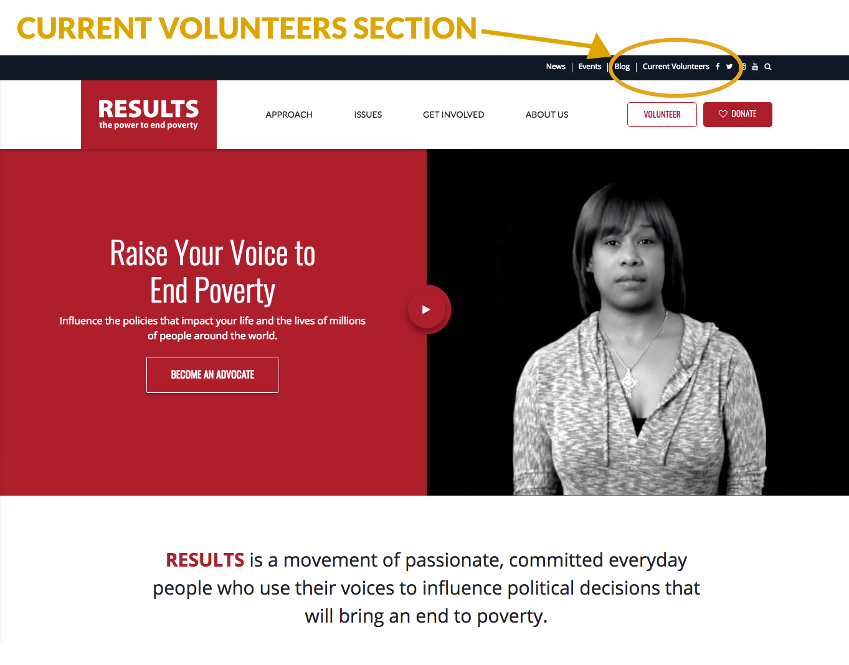
New RESULTS website coming!
36
RESULTS U.S. Poverty National Webinar

Slide 37
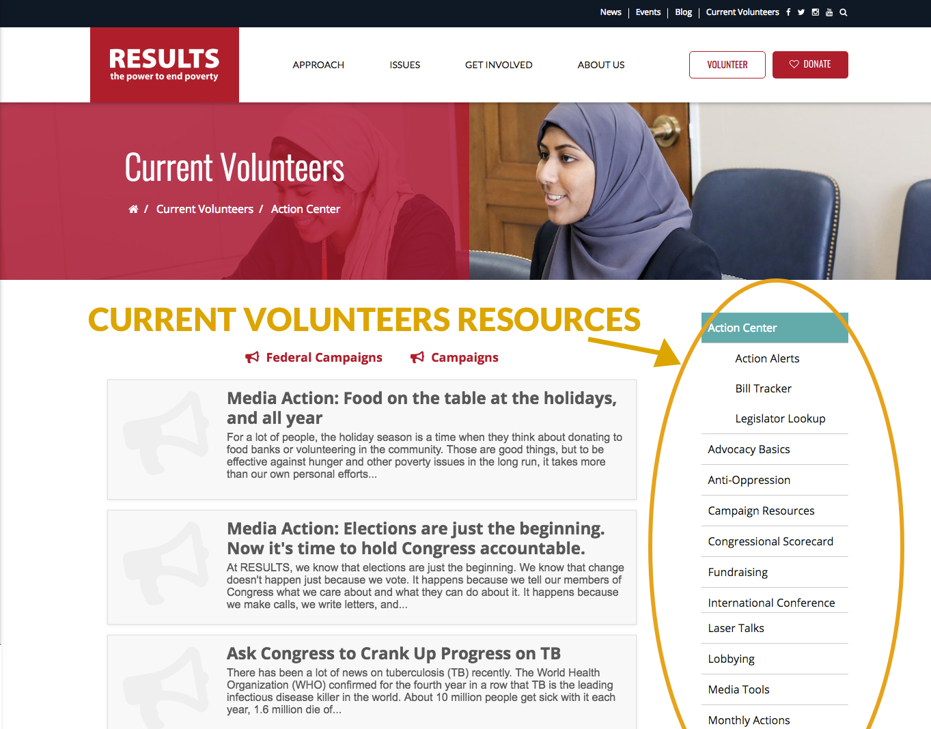
Planning to launch in mid-December
37
RESULTS U.S. Poverty National Webinar

Slide 38
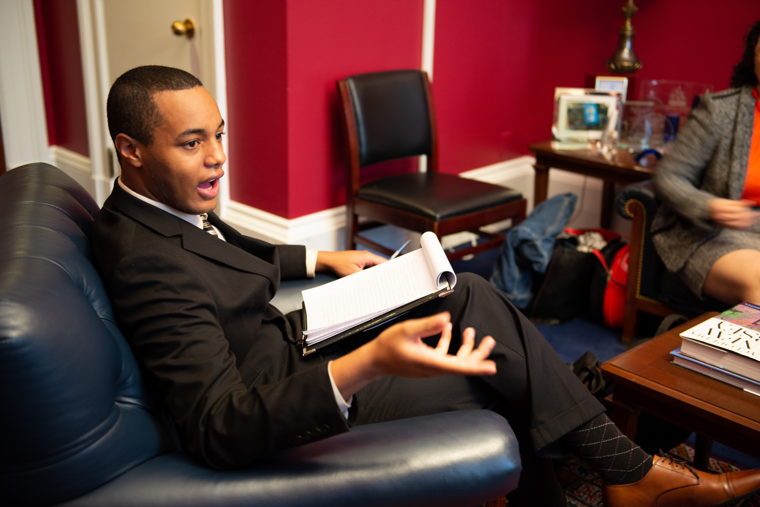
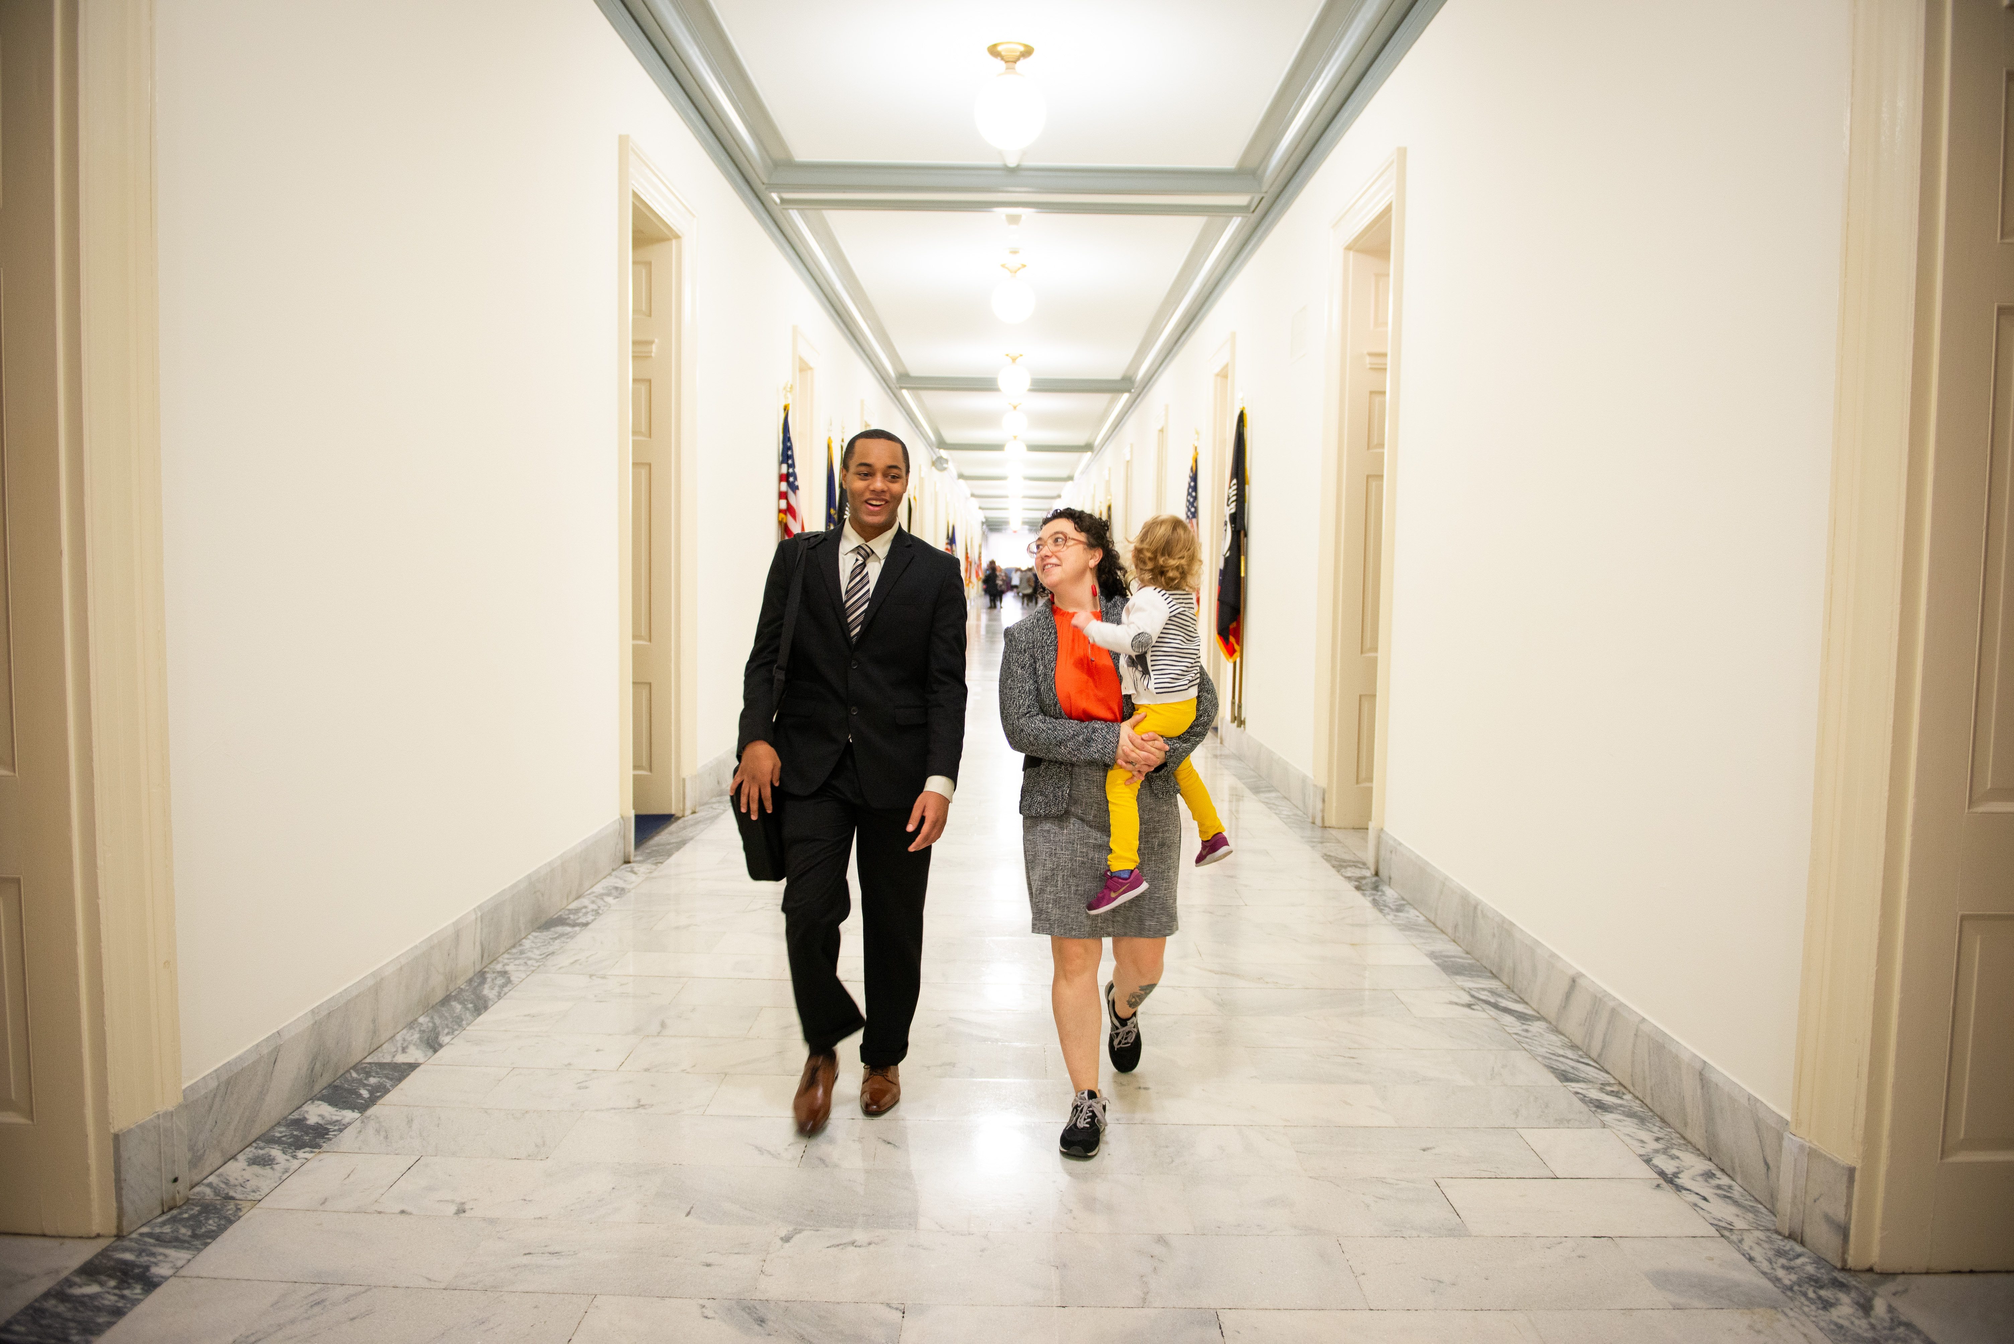
Thank you, Charles!
38
Charles Palmer
RESULTS U.S. Poverty Intern (Fall 2018)

Slide 39

39

Slide 40

Thank you for making this year’s Giving Tuesday our best ever!
40
Note: On the live webinar, we made a mistake in reporting the amount raised on Giving Tuesday. The actual amount raised was $70,000.

Slide 41
Announcements
41
RESULTS Action Network Community of Practice webinar, Wednesday, December 5 at 8:00pm ET. To join, log in: https://results.zoom.us/j/427674133 or dial in: 669-900-6833, Meeting ID: 427 674 133.
U.S. Poverty Free Agents Calls, Tuesday, December 11 at 1:00 pm and 8:00 pm ET. Join at: https://results.zoom.us/j/324294681 or dial by phone at (929) 436-2866 or (669) 900-6833, Meeting ID: 324 294 681.
RESULTS New Advocate Orientation, Thursday, December 13 at 8:30 pm ET. Get started at: https://results.salsalabs.org/volunteer/index.html.
RESULTS International Conference, July 13-16, 2019. Learn more at www.resultsconference.org. Submit your speaker and session ideas in our suggestion form.
Find these and other events on our Event Calendar.
RESULTS U.S. Poverty National Webinar

Slide 42
42
Thank you for being on tonight’s webinar!
The next U.S. Poverty National Webinar is
Tuesday, January 8 at 8:00pm ET.
  All RESULTS offices will be closed
  December 25-January 1 for the holidays.
RESULTS U.S. Poverty National Webinar

Slide 43
43
FINAL ACTION
Make One Last Push on Public Charge
Deadline to submit public charge comments is this Monday, December 10.
If you haven’t commented, go to www.protectingimmigrantfamilies.org to submit it and urge others to comment also.
Educate your community about this issue by submitting a letter to the editor TONIGHT at:
https://www.results.org/take-action/action-center?vvsrc=%2fcampaigns%2f61559%2frespond.
RESULTS U.S. Poverty National Webinar

Slide 44
44
Happy
Holidays!
RESULTS U.S. Poverty National Webinar

