Slide 1
Overview: Economic Mobility, Building Ladders out of Poverty
2015 U.S Poverty Campaigns

Slide 2
2015 U.S. Poverty Campaigns
Main Campaign: Creating Economic Mobility – Building Ladders out of Poverty
Protect and expand the Earned Income Tax Credit and Child Tax Credit
Build awareness and support strategies to eliminate the racial wealth gap
Targeted Campaign: Protecting Federal Nutrition Programs
Protect Supplemental Nutrition Assistance Program (SNAP)
Protect Child Nutrition programs (WIC, National School Lunch, School Breakfast, Fresh Fruit and Vegetable, Summer Food Service, Child and Adult Care Food Program)

Slide 3
Poverty in the U.S. Official Poverty Measure vs. the Supplemental Poverty Measure
In 2013, the official poverty rate was 14.5 percent of the total population, or more than 45.8 million people.
The Supplemental Poverty Measure (SPM), a more accurate measure accounting for taxes and government benefits, reported that 15.5 percent, or 48.7 million people, lived in poverty in 2013.
Source: https://www.census.gov/content/dam/Census/library/publications/2014/demo/p60-251.pdf

Slide 4
Poverty in the U.S. Keeping Households out of Poverty
The Supplemental Poverty Measure further accounts for critical anti-poverty programs that have kept many people out of poverty including tax credits (the EITC and CTC), and in-kind assistance programs such as SNAP, school lunch program and WIC.
Source: http://www.census.gov/newsroom/press-releases/2014/cb14-188.html
Notes:
Add citation

Slide 5
“‘Labor and capital have to share in the rewards of a productive economy, and for the last 25 years labor has gotten the short end of the stick,’ said Bill Gross, the founder of the investment firm PIMCO, in a recent interview with Yahoo. ‘Eventually,’ he said, ‘it will be destabilizing.’”
- New York Times Article: “Billionaires to Barricades”
Source: http://www.nytimes.com/2014/06/20/opinion/timothy-egan-walmart-starbucks-and-the-fight-against-inequality.html?smid=fb-share&_r=0
Notes:
And he’s not the only one! Other folks like George Oros, Warren Buffett, real estate moguls, and private equity investors all have recognized that while the economy and policy has been extremely beneficial for them, that prosperity is most certainly not equally shared across the population. Special kudos to Georgia on finding amazing articles on the wealthiest few realizing the…

Slide 6
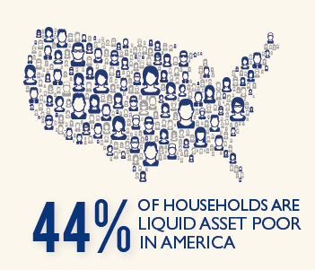
Asset Poverty: Beyond Income
Liquid asset-poverty: insufficient amount of readily accessible assets to live at the poverty level for three months without income.
These households are vulnerable to falling into poverty after a job loss, medical emergency, or any other unanticipated financial crisis.
Source: http://scorecard.assetsandopportunity.org/2013/measure/liquid-asset-poverty-rate
Notes:
This is also in the state fact sheets.

Slide 7
Wealth Inequality in America
America has an amazingly skewed distribution of wealth.
In 2013, the top 1 percent owned 40 percent of the nation’s wealth and the bottom 40 percent owned almost nothing.
Source: https://www.financialsocialwork.com/blog/video-wealth-inequality-in-america

Slide 8
Asset Poverty and Wealth Inequality
Households of Color are far more likely to be affected by asset poverty.
The racial disparities in asset-building opportunities and wealth have been created by racially-motivated public policy and generations of racial discrimination.
Source: http://assetsandopportunity.org/scorecard/about/main_findings/
Notes:
The racial wealth gap has continued to marginalize communities of color.

Slide 9
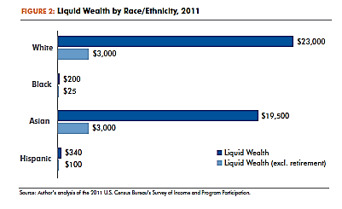
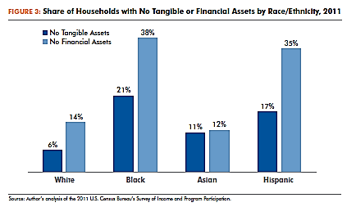
The Racial Wealth Gap
Communities of color are disproportionately affected by America’s wealth inequality and asset poverty.
Source: http://globalpolicysolutions.org/wp-content/uploads/2014/04/Beyond_Broke_FINAL.pdf
Notes:
Data inequities for Asian and Native American demographics but here’s what we know: Less than 6/10 Native Americans in 2007 and in 2011 Asians own a home compared to 68% of Whites.

Slide 10
Racial Wealth Gap Quiz
1. In 2011, how much wealth did Black and Latino households own for every $1 dollar White households owned?
A Black family held 30 cents and a Latino family held 20 cents.
A Black family held 6 cents and a Latino family held 7 cents.
A Black family held 4 cents and a Latino family held 3 cents.
A Black family held 50 cents and a Latino family held 63 cents.

Slide 11
Racial Wealth Gap Quiz
1. In 2011, how much wealth did Black and Latino households own for every $1 dollar White households owned?
B. A Black family held 6 cents and a Hispanic family held 7 cents.
Source: http://globalpolicysolutions.org/wp-content/uploads/2014/04/Beyond_Broke_FINAL.pdf

Slide 12
Racial Wealth Gap Quiz
2. As of 2013, what is the ratio of White wealth to Black wealth?
A. 15:2
B. 13:1
C. 10:1
D. 19:1

Slide 13
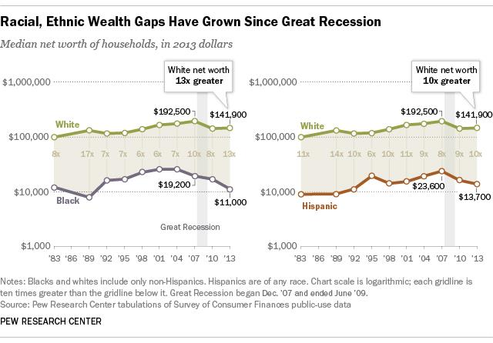
Racial Wealth Gap Quiz
2. As of 2013, what is the ratio of White wealth to Black wealth?
B. 13:1
Source: http://www.pewresearch.org/fact-tank/2014/12/12/racial-wealth-gaps-great-recession/
Notes:
This ratio has actually grown since the Great Recession. Pew Research Center points out that financial assets (stocks and investments), which White families are much more likely to own, recovered quicker than housing assets.

Slide 14
Racial Wealth Gap Quiz
3. Who has the most wealth?
A. A Black college graduate
B. A Latino college graduate
C. A White high school dropout
D. A Black or Latino high school graduate
.

Slide 15
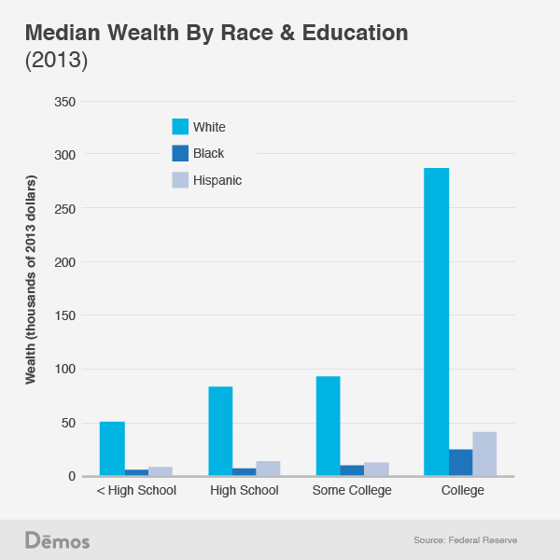
Racial Wealth Gap Quiz
3. Who has the most wealth?
C. A White high school dropout
A Black college graduate or
a Latino college graduate,
on average, owns less
wealth than a White high
school dropout.
Source: http://www.demos.org/blog/9/23/14/white-high-school-dropouts-have-more-wealth-black-and-hispanic-college-graduates

Slide 16
Racial Wealth Gap Quiz
4. What is the single largest driver of the racial wealth gap?
A. Inequities in college education
B. Inequities in homeownership
C. Inequities in income
D. Inequities in family inheritances

Slide 17
Racial Wealth Gap Quiz
4. What is the single largest driver of the racial wealth gap?
B. Inequities in homeownership

Slide 18
Homeownership and
the Racial Wealth Gap
Source: http://iasp.brandeis.edu/pdfs/2015/RWA.pdf

Slide 19
Racial Wealth Gap Quiz
5. Which of the following is considered the most significant cause of the racial wealth gap?
A. Lack of educational attainment.
B. Racially-motivated/discriminatory public policies.
C. The housing bust of 2007.
D. Natural occurrences given such a diverse country like USA.

Slide 20
Racial Wealth Gap Quiz
5. Which of the following is considered the most significant cause of the racial wealth gap?
B. Racially-motivated/discriminatory public policies.
It is easy to assume that this wealth gap is because people just do not attain enough education, or earn enough, or that it just happened. But history shows that policies at the federal, state, and local levels (especially housing policies) explicitly or implicitly denied communities of color access to wealth building opportunities that were available to White Americans.
Source: http://www.epi.org/publication/modern-segregation/

Slide 21
Creating and Sustaining the Racial Wealth Gap with Policy
1) The founding of America
Land-grabbing and slavery as forms of wealth
2) Home-ownership
Redlining and restrictive covenants as examples of racial discrimination
3) Predatory lending
The Great Recession
4) The consequences are still felt today
To learn more! : Ta-Nehisi Coates: http://www.theatlantic.com/features/archive/2014/05/the-case-for-reparations/361631/, http://www.theatlantic.com/business/archive/2014/10/the-racist-housing-policies-that-built-ferguson/381595/ racial wealth gap historical timeline: http://www.tiki-toki.com/timeline/embed/184899/9116693987/#vars!date=1951-11-09_05:55:48!
Notes:
Racial wealth gap was created by public policy which leaves the conversation open to understanding government’s role in the issue rather than ascribing this to private, individual relationships. These patterns of racial segregation, discrimination, and exclusion occurred everywhere! The government created segregated public housing projects, as policy. It subsidized the development of suburban communities on the condition that they exclude black residents. It barred blacks from receiving government-backed mortgages, enforced neighborhood covenants barring black homeowners, and advised against integrating neighborhoods lest white property values fall. And it tacitly supported industry practices where real estate agents risking losing their licenses for selling homes to black families in white neighborhoods.
Local zoning regulations, meanwhile, hemmed in black communities with the industrial development no one wanted. It permitted liquor stores, bars and polluting businesses in black neighborhoods but not white ones. Then when all these unwanted neighbors devalued the property of the blacks who lived in these communities, they were systematically denied mortgage insurance. Local governments, on top of this, increasingly ignored these communities with trash collection, street maintance and policing, devaluing them even more.
"Even if there was no discrimination, even if everybody behaved perfectly, neutrally, with regard to race, we haven’t addressed the permanent structures that were set up by state-sponsored segregation in the past," Rothstein says. "They don’t disappear by themselves."

Slide 22
Racial Wealth Gap Quiz
6. What percentage of Black workers weren’t included in the original Social Security Act created by Franklin D. Roosevelt?
A. 65 percent
B. 50 percent
C. 25 percent
D. 80 percent

Slide 23
Racial Wealth Gap Quiz
6. What percentage of Black workers weren’t included in the original Social Security Act created by FDR?
A. 65 percent
Resource: http://www.washingtonpost.com/blogs/wonkblog/wp/2013/06/03/a-second-look-at-social-securitys-racist-origins/
Notes:
Farmworkers and maids were excluded at the onset of the act resulting in 65% of African American workers (and 27% of white workers) being excluded from benefits accessing benefits.
Fair Labor Standards Act of 1938- gave min wage, overtime, etc but excluded farmworkers which disproportionately affected Mexican migrant workers in later decades and farm workers weren’t included until 1978

Slide 24
Racial Wealth Gap Quiz
7. What is redlining?
A practice that denies or charges premium prices for mortgages and other services in certain neighborhoods, specifically those of color.
A federal tax program that only helps upper middle income Americans buy a home.
A secret agreement between realtors and White homeowners that prohibited the purchase of property by Blacks.
White individuals driving people of color away from living in primarily White neighborhoods.

Slide 25
Racial Wealth Gap Quiz
7. What is redlining?
A practice that denies or charges premium prices for mortgages and other services in certain neighborhoods, specifically those of color.
Both private banks AND the federal government practiced this discriminatory method.
Resources to learn more! http://www.encyclopedia.chicagohistory.org/pages/1050.html; http://www.washingtonpost.com/blogs/wonkblog/wp/2015/05/28/evidence-that-banks-still-deny-black-borrowers-just-as-they-did-50-years-ago/
Notes:
FDR’s New Deal created the Federal Home Loan Bank Board and the Home Owners’ Loan Corporation (HOLC) which worked to refinance home mortgages and avoid foreclosures for individuals. Redlining refers to actual red lines drawn on 239 city maps created by HOLC outlining neighborhoods of color where assets and services were to be denied. These maps, called “residential security maps” were adopted by other sectors including health care, banking, retail / supermarkets, and insurance providers which systematically lead to barring neighborhoods of color from accessing vital assets available to other neighborhoods.

Slide 26
Racial Wealth Gap Quiz
8. How can we begin to close the racial wealth gap?
A. Equalizing homeownership rates.
B. Fair tax policies.
C. We can’t close it.
D. A & B.

Slide 27
Racial Wealth Gap Quiz
8. How can we begin to close the racial wealth gap?
D. A & B!
It will take intentional public policies- both within the housing and tax spheres- to be able to begin decreasing the gap.
But it can happen. Luckily we have you to help make it happen!
Source: http://www.newrepublic.com/article/118425/closing-racial-wealth-gap

Slide 28
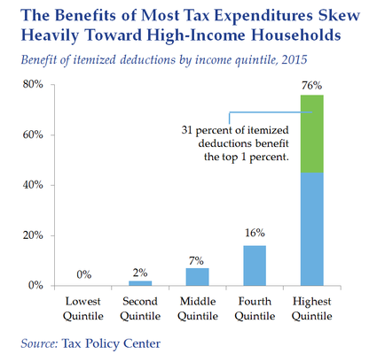
Tax Inequity in the U.S. An Unbalanced Tax System
Tax Expenditures: Spending in the Tax Code
Expenditures consist of exclusions, deductions, preferential tax rates, and tax credits.
These reduce the amount of taxes a household owes.
Over half of these benefits go to the richest 20 percent of Americans.
Source: http://www.budget.senate.gov/democratic/public/index.cfm/fixing-a-broken-and-unfair-tax-system
Notes:
Mention how tax expenditures are federal spending by another name as the Corporation for Enterprise Development says. The U.S. spends over $540 billion a year through the tax code on asset-building programs and incentives. However, these tax expenditures go mostly towards the highest quintile- leaving an upside down feeling as CFED says: the families that need the most receive the least and the families that need it the least receive the most. Source: CFED

Slide 29
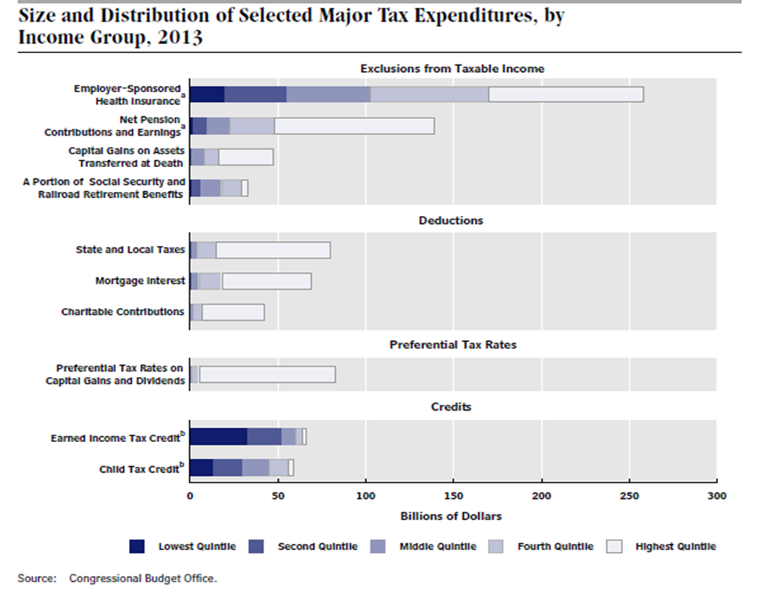
Tax Inequity in the U.S. An Unbalanced Tax System
Tax credits, particularly refundable tax credits (e.g. the EITC and CTC), are the only type of tax expenditure that favors low-income taxpayers.
Source: http://www.cbo.gov/sites/default/files/43768_DistributionTaxExpenditures.pdf

Slide 30
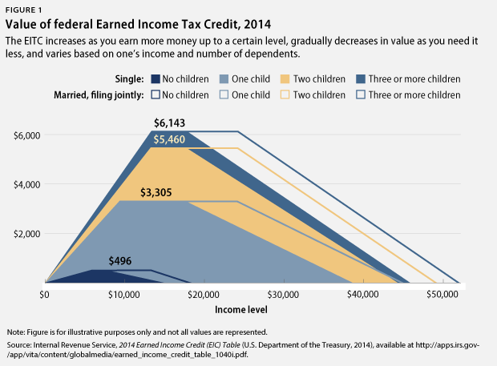
Earned Income Tax Credit
The Earned Income Tax Credit (EITC):
Designed to “make work pay”
Fully refundable federal tax credit targeted to low-income families
Increases as earnings increase up to a certain income level, then gradually decreases
Source: http://www.cbpp.org/research/policy-basics-the-earned-income-tax-credit
Notes:
amount is determined by family size and composition

Slide 31
Why the EITC Works
The EITC, together with the CTC, is the most effective federal anti-poverty program excluding Social Security. In 2013, the EITC lifted about 6.2 million people out of poverty, including about 3.2 million children.
The EITC promotes work, especially among single mothers. The EITC expansions of the 1990s helped more than a half a million families move from cash welfare assistance to work.
EITC children do better in school. Elementary and middle-school students earn higher test scores when their families receive larger refundable tax credits.
Source: http://www.cbpp.org/research/policy-basics-the-earned-income-tax-credit
Notes:
Here mention about poverty and brain development.

Slide 32
Why the EITC Works
Infant health is positively correlated with increases in EITC. Higher EITCs correspond with healthier birth weights and fewer premature births.
The EITC strengthens local economies – it is estimated to generate $1.50 - $2.00 in economic activity for every $1 spent.
About 2 million military and veteran families earn the EITC and/or CTC, which together keep about 100,000 veteran and military households from falling below the poverty line and lessen the severity of poverty for another 470,000 such families.
Source: http://www.cbpp.org/research/policy-basics-the-earned-income-tax-credit
http://www.cbpp.org/research/federal-tax/pro-work-tax-credits-help-2-million-veteran-and-military-households

Slide 33
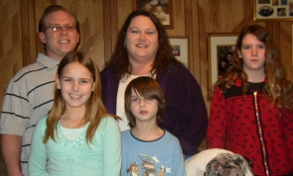
Tax Credits Support Small Businesses
Desarae Mace-Runyon runs a childcare service in Newark, Delaware.
The EITC and CTC provides the opportunity for annual business upgrades.
Desarae: "By filing my taxes, I've been able to invest in my business like never before."
Notes:
Most people dread filing their taxes, but not Desarae Mace-Runyon.
Now her refund is significant enough that she and her husband plan a business-related house upgrade each year. They have installed new carpet, a new water heater and a play set for the yard. Next, she plans to build a separate daycare entrance and a half-bath.
"I'm able to do so much more to the house and the business. It's a huge help."

Slide 34
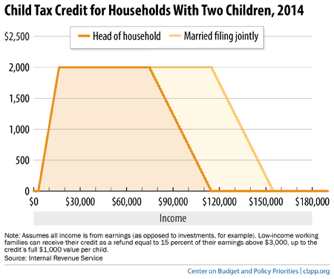
The Child Tax Credit
The Child Tax Credit (CTC):
Partially refundable federal tax credit designed to offset cost of raising children.
Requires a $3,000 income minimum.
Largest tax provision benefitting families with children.
Protected approximately 3.1 million people from poverty in 2013, including about 1.7 million children, and reduced the severity of poverty for another 13.7 million people, including 6.8 million children.
Source: http://www.cbpp.org/research/policy-basics-the-child-tax-credit
Notes:
has a $1000 per child (under age 17) maximum

Slide 35
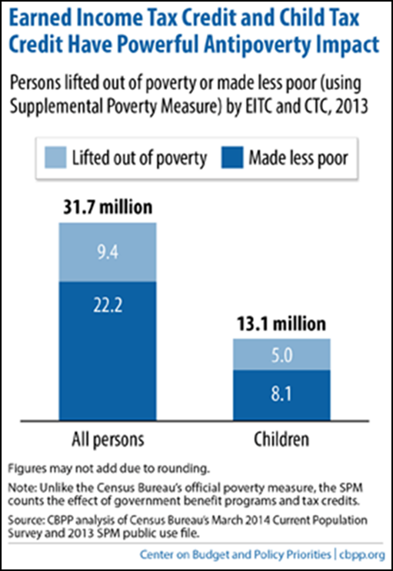
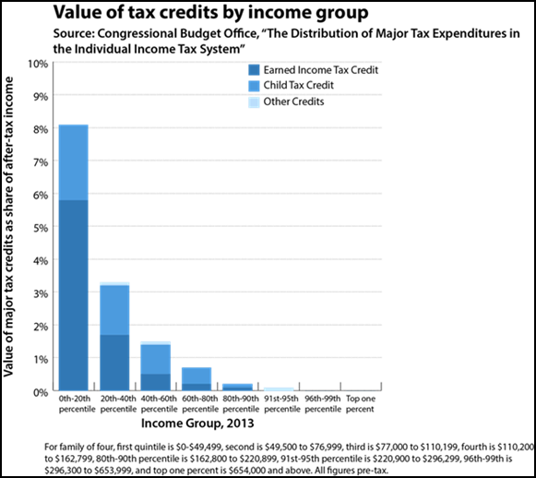
The Nation’s Strongest Tools to Promote Work
The EITC and CTC are our best defense against a tax system that favors the wealthy.
These credits have time and again proven their effective-ness, together lifting 9.4 million people out of poverty in 2013.
Source: http://www.cbpp.org/research/federal-tax/chart-book-the-earned-income-tax-credit-and-child-tax-credit; http://www.cbo.gov/sites/default/files/43768_DistributionTaxExpenditures.pdf
Notes:
Being best anti-poverty program with historically bipartisan support.

Slide 36
EITC and CTC Encourages Savings
Stephanie is a teacher’s assistant and single mom.
Tax refunds she receives are critical to her family’s continued success.
Stephanie: "My tax refund makes all the difference for me and my family."
Source: www.cfed.org
Notes:
More details on her story here: Stephanie has a lot on her plate, but tax time helps her to make it financially manageable.
"Because of tax credits like the Earned Income Tax Credit, I've been able to pay off my debt and save. I was without a care for a year. After I paid for repairs, I was able to build an emergency savings account to help me the next time something like that happens.”

Slide 37
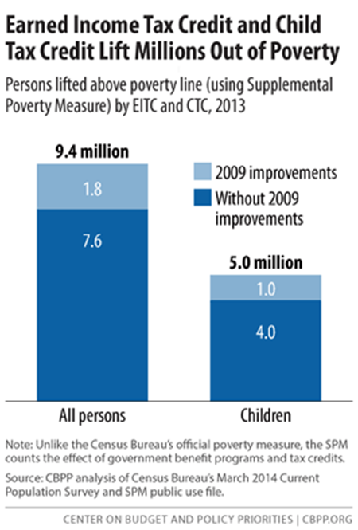
Critical EITC and CTC Expansions
In 2009, the American Recovery and Reinvestment Act (ARRA) made key improvements to the EITC and CTC.
EITC:
Reduced the “marriage penalty” by allowing married couple to earn more before phase-out begins
Increased credit for families with 3 or more children
CTC:
Reduced income eligibility threshold from $12,000 to $3,000
Source: http://www.cbpp.org/research/policy-basics-the-earned-income-tax-credit?fa=view&id=2505
http://www.cbpp.org/research/policy-basics-the-child-tax-credit?fa=view&id=2989
Notes:
In notes: need to include history?
In 2013, these expansions to the EITC lifted nearly 600,000 people out of poverty and reduced the severity of poverty for another 10 million people. This change to the CTC lifted 1.1 million people above the poverty line.

Slide 38
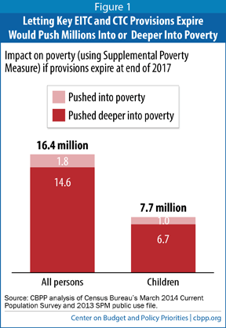
Save the EITC and CTC Expansions!
The critical provisions made in 2009 are SET TO EXPIRE in 2017 if Congress fails to extend them or make them permanent.
If these key provisions are allowed to expire, 16.4 million people could fall into or deeper into poverty, including 7.7 million children.
Meanwhile, Congress is considering extending tax breaks to benefit large corporations that will cost about $700 billion dollars in federal revenue over ten years.
Source: http://www.cbpp.org/research/letting-key-provisions-of-working-family-tax-credits-expire-would-push-16-million-people
https://www.nationalpriorities.org/blog/2014/04/07/congress-extend-corporate-tax-breaks-not-unemployment-benefits/

Slide 39
The Racial Wealth Gap and Tax Fairness
Tax policy is a critical tool in the toolbox of policies to eliminate racial disparities.
If the provisions of EITC and CTC are not saved:
2.8 million Blacks, including 1.5 million children, will fall into or deeper into poverty.
7.4 million Latinos, including 3.6 million children, will fall into or deeper into poverty.
Notes:
African Americans make up 12 percent of the population but 19 percent of the working poor. Latino/as make up about 17 percent of the working population but 28 percent of the working poor.

Slide 40
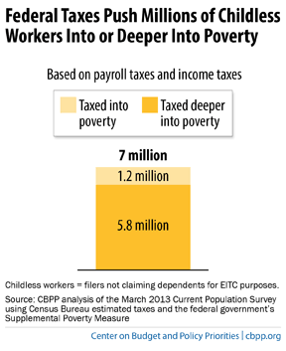
Fix the Glaring Gap Expanding EITC to Include Childless Workers
Currently, childless workers (including non-custodial parents) are the only group that is taxed into poverty; federal taxes pushed 7 million childless workers below or further below the poverty line in 2012.
Childless workers are eligible for a very small EITC compared to families (about $500 maximum).
Childless workers under age 25 are not eligible for a credit at all.
Source: http://www.cbpp.org/research/federal-tax/chart-book-the-earned-income-tax-credit-and-child-tax-credit
Notes:
“It’s not enough to just protect existing provisions but expand program to include other populations”

Slide 41
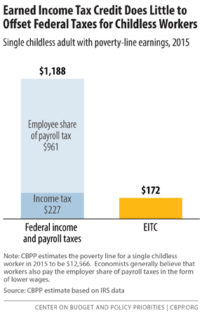
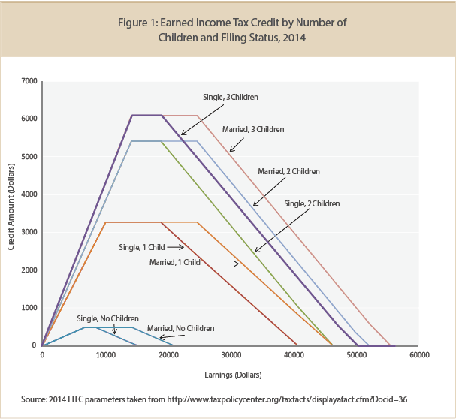
Fix the Glaring Gap Expanding EITC to Include Childless Workers
EITC for childless workers
Source: http://www.cbpp.org/research/strengthening-the-eitc-for-childless-workers-would-promote-work-and-reduce-poverty
http://www.taxpolicycenter.org/briefing-book/key-elements/family/eitc.cfm

Slide 42
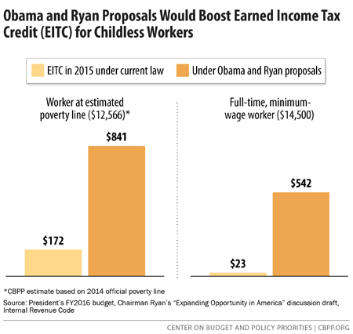
Fix the Glaring Gap Expanding EITC to Include Childless Workers
President Obama, Rep. Paul Ryan (R-WI), and others have proposed to close the gap in EITC benefits for childless workers by:
Doubling the maximum credit amount
Increasing the maximum income allowed before credit is lost
Making the credit available to childless workers starting at age 21
It is estimated that these proposals would lift about half a million people out of poverty and reduce the depth of poverty for another 10.1 million.
Source: http://www.cbpp.org/research/strengthening-the-eitc-for-childless-workers-would-promote-work-and-reduce-poverty
http://www.cbpp.org/research/strengthening-the-eitc-for-childless-workers-would-promote-work-and-reduce-poverty

Slide 43
Economic Mobility Resources
RESULTS www.results.org
Center for Global Policy Solutions www.globalpolicysolutions.org
Corporation for Enterprise Development www.cfed.org
Center on Budget and Policy Priorities www.cbpp.org
Americans for Tax Fairness www.americansfortaxfairness.org
Center for Tax Justice www.ctj.org
Tax Credits for Working Families www.taxcreditsforworkingfamilies.org
Tax Policy Center www.taxpolicycenter.org
Coalition on Human Needs www.chn.org
Half in Ten www.halfinten.org

Slide 44
“Overcoming poverty is not a task of charity, it is an act of justice. Like Slavery and Apartheid, poverty is not natural. It is man-made and it can be overcome and eradicated by the actions of human beings. Sometimes it falls on a generation to be great. YOU can be that great generation. Let your greatness blossom.” – Nelson Mandela

